Slide 1
Getting started with Node.js
Notes:
Add instructor notes here.

Slide 2
1.1: JavaScript Essentials How JavaScript works
JavaScript is Single Threaded.
A JavaScript engine exists in a single OS process and consumes a single thread.
When the application is running, CPU execution is never performed in parallel, since the JavaScript engine uses this method, it is impossible for users to get the Deadlocks and Race Conditions which actually makes Multi Threaded applications so complex.
Notes:
If an application is built to be Multi Threaded, it will make use of several of your CPU cores simultaneously. This means it can do number of tasks in different places at the same time and we refer to this as Concurrency.
An application built in this manner can be a single process within the Operating System. The Operating System itself usually gets to choose which cores an application will run on (even which core a single threaded application will run on).
At present we have more CPU cores at the computer. In order to truly scale and use the hardware to its fullest, one needs to build applications which make use of all CPU cores.
Even though Multi threaded programming concurrently perform the execution in parallel we have some issues particularly Deadlocks and Race Condition.
One such example of these kinds of issues is that if an application is running on two separate threads, both threads reads a variable from memory at the same time, and both attempt to update the value by adding 2 to it. If the existing value is 10, and thread A adds 2, it does so by writing 12 to the memory location. If thread B also wants to add 2, it still thinks the value is 10, and writes 12. The programmer would expect it to be 14 and ends up with 12, and there are no errors. This type of bug can be very hard to track down, and the worst part is that it will happen in an unpredictable way.
JavaScript is a single threaded programming language, single threaded Runtime, it has a single call stack. And it can do one thing at a time, that's what a single thread means, the program can run one piece of code at a time.
Add instructor notes here.

Slide 3
1.1: JavaScript Essentials Event loop
An event loop is a construct that mainly performs two functions in a continuous loop
Event detection : In any run of the loop, it has to detect which events just happened.
Event handler triggering : When an event happens, the event loop must determine the event callback and invoke it.
Event loop is just one thread running inside one process, which means that, when an event happens, the event handler can run without interruption
There is at most one event handler running at any given time
Any event handler will run to completion without being interrupted
This allows the programmer to relax the synchronization requirements and not have to worry about concurrent threads of execution changing the shared memory state.
Notes:
One of the key concepts "Node" brings from the browser to "JavaScript" on the server is the "Event Loop". In the browser, the "Event Loop" is constantly listening for DOM events, so just key presses or mouse clicks. Similarly, Node's "Event Loop" is constantly listening for events on the server side. These events can be externally generated, such as incoming HTTP requests or TCP connections, or they can be timers and other internal events generated by your "Node" application
Add instructor notes here.

Slide 4
1.1: JavaScript Essentials Stack, Heap and Queue
Different browsers have different JavaScript engines (e.g. Chrome has V8, Firefox has OdinMonkey and IE has Chakra)
JavaScript engine has three important features. They are Stack, Heap and Queue
Each browser will implement these features differently, but all does the same.
Stack
Currently running functions gets added to the stack(frame). Pops out from the once it completes its execution.
Heap
Memory allocation happened here. It is a bunch of memory where object’s live in a unordered manner.
Queue
function calls are queued up which gets added to the stack once it is empty.
Notes:
Heap: This is a bunch of memory where your objects live (e.g. variables and functions and all those things you instantiate). It is referred as Chaotic, only because the order doesn’t really matter and there’s no guarantee with how they will live. In this heap, different browsers will perform different optimizations, e.g., if an object is duplicated many times, it may only exist in memory once, until a change needs to happen, at which point the object is copied.
Stack: This is where the currently running functions get added. If function A() runs function B(), well you’re two levels deep in the stack. Each time one of these functions is added to the stack, it is called a frame. These frames contain pointers to the functions in the heap, as well as the objects available to the function depending on its current scope, and of course the arguments to the function itself. Different JavaScript engines likely have different maximum stack sizes, and unless you have a runaway recursive function, you’ve probably never hit this limit. Once a function call is complete, it gets removed from the stack. Once the stack is empty, we’re ready for the next item in the Queue.
Queue: This is where function calls which are queued up for the future go. If you perform a setTimeout(function() { console.log('hi'); }, 10);, that anonymous function is living in the next available queue slot. No items in the queue will be run until the current stack is complete. So, if you have some work that might be slow that you want to run after you get your data, try a setTimeout() with a delay of zero milliseconds.
Garbage Collection: JavaScript will keep an eye on the current stack and the items in the Queue, and see what objects in the Heap are being pointed to. If an object no longer has pointers to it, it is safe to assume that object can be thrown away.
Add instructor notes here.

Slide 5
1.1: JavaScript Essentials Stack, Heap and Queue
WebAPIs
heap
stack
DOM(document)
Fn2()
ajax(XMLHttpRequest)
variable
Fn1()
setTimeOut
event loop
callback queue
callbackFunction01
callbackFunction02
…
Notes:
In the stack when we step into a function, we put something on to the stack, if we return from a function, we pop off the top of the stack.
DOM, Ajax, timeout are the APIs provided to us by the browser, it doesn't live in the V8 source. Web API can't just start modifying your code, it can't chuck stuff onto the stack when it's ready. If it did, it would appear randomly in the middle of your code so this is where the task queue or callback queue kicks in. Web APIs pushes the callback on to the task queue when it's done.
The event loops job is to look at the stack and look at the task queue. If the stack is empty it takes the first thing on the queue and pushes it on to the stack which effectively run it.
Add instructor notes here.

Slide 6
Demo
EventLoop
Notes:
Add the notes here.
Add instructor notes here.

Slide 7
1.2: Node.js Fundamentals Introduction to Node.js
In 2009 Ryan Dahl created Node.js or Node, a framework primarily used to create highly scalable servers for web applications. It is written in C++ and JavaScript.
Node.js is a platform built on Chrome’s JavaScript runtime(v8 JavaScript Engine) for easily building fast, scalable network applications.
It’s a highly scalable system that uses asynchronous, non-blocking I/O model (input/output), rather than threads or separate processes
It is not a framework like jQuery nor a programming language like C# or JAVA . It's a new kind of web server like has a lot in common with other popular web servers, like Microsoft’s Internet Information Services (IIS) or Apache
IIS / Apache processes only HTTP requests, leaving application logic to be implemented in a language such as PHP or Java or ASP.NET. Node removes a layer of complexity by combining server and application logic in one place.
Notes:
Node.js is ideal for web applications that are frequently accessed but computationally simple

Slide 8
1.2: Node.js Fundamentals Why Node.js?
JavaScript everywhere i.e. Server-side and Client-side applications in JavaScript.
Node is very easy to set up and configure.
Vibrant Community
Small core but large community so far we have 60,000 + packages on npm
Real-time/ high concurrency apps (I/O bound)
API tier for single-page apps and rich clients(iOS, Android)
Service orchestration
Top corporate sponsors like Microsoft, Joyent, PayPal etc..
Working with NOSQL(MongoDB) Databases

Slide 9
1.2: Node.js Fundamentals Traditional Programming Limitations
In traditional programming I/O (database, network, file or inter-process communication) is performed in the same way as it does local function calls. i.e. Processing cannot continue until the operation is completed.
When the operation like executing a query against database is being executed, the whole process/thread idles, waiting for the response. This is termed as “Blocking”
Due to this blocking behavior we cannot perform another I/O operation, the call stack becomes frozen waiting for the response.
We can overcome this issue by creating more call stacks or by using event callbacks.

Slide 10
1.2: Node.js Fundamentals Creating more call stacks
To handle more concurrent I/O, we need to have more concurrent call stacks.
Multi-threading is one alternative to this programming model.
Makes use of separate CPU Cores as “Threads”
Uses a single process within the Operating System
Ran out of Ghz, hardware adds more cores
If the application relies heavily on a shared state between threads accessing and modifying shared state increase the complexity of the code and It can be very difficult to configure, understand and debug.
Notes:
A thread is a kind of lightweight process that shares memory with every other thread within the same process. Threads were created as an ad hoc extension of the previous model to accommodate several concurrent threads of execution. When one thread is waiting for an I/O operation, another thread can take over the CPU. When the I/O operation finishes, that thread can wake up, which means the thread that was running can be interrupted and eventually be resumed later. Furthermore, some systems allow threads to execute in parallel in different CPU cores

Slide 11
1.2: Node.js Fundamentals Event-driven Programming
Event-driven programming or Asynchronous programming is a programming style where the flow of execution is determined by events.
Events are handled by event handlers or event callbacks
An event callback is a function that is invoked when something significant happens like when the user clicks on a button or when the result of a database query is available.
Now instead of simply returning the result, the query will invoke the query_finished function once it is completed.
Node.js supports Event-driven programming and all I/O in Node are non-blocking
query_finished = function(result) {
do_something_with(result);
}
query('SELECT Id,Name FROM employees', query_finished);

Slide 12
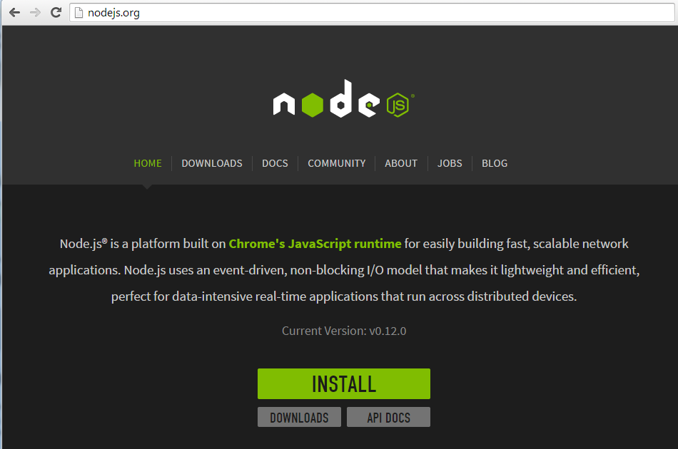
1.2: Node.js Fundamentals nodejs.org – Node.js official Website

Slide 13
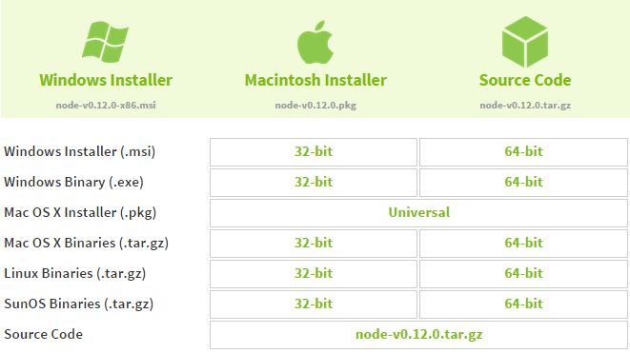
1.2: Node.js Fundamentals Downloading Node.js

Slide 14
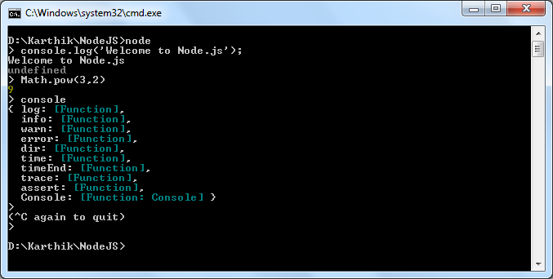
1.2: Node.js Fundamentals Node.js CLI
Notes:
Environment Variables
NODE_PATH : C:\Users\<username>\AppData\Roaming\npm\node_modules
PATH : C:\Users\<username>\AppData\Roaming\npm

Slide 15
1.2: Node.js Fundamentals Node.js Globals
global
Any variables or members attached to global are available anywhere in our application. GLOBAL is an alias for global
global.companyName = ‘Capgemini'
global['companyName'] // We can directly access the members attached to global.
process
The process object is a global object which is used to Inquire the current process to know the PID, environment variables, platform, memory usage etc.
process.platform
process.exit( )
console
It provides two primary functions for developers testing web pages and applications
console.log(‘Capgemini')

Slide 16
1.3: Working with modules Module Introduction
A module is the overall container which is used to structure and organize code.
It supports private data and we can explicitly defined public methods and variables (by just adding/removing the properties in return statement) which lead to increased readability.
JavaScript doesn’t have special syntax for package / namespace, using module we can create self-contained decoupled pieces of code.
It avoids collision of the methods/variables with other global APIs.

Slide 17
1.3: Working with modules Modules in Node.js
In Node, modules are referenced either by file path or by name.
Node’s core modules expose some Node core functions(like global, require, module, process, console) to the programmer, and they are preloaded when a Node process starts.
To use a module of any type, we have to use the require function. The require function returns an object that represents the JavaScript API exposed by the module.
var module = require('module_name');

Slide 18
1.3: Working with modules Loading a module
Modules can be referenced depending on which kind of module it is.
Loading a core module
Node has several modules compiled into its binary distribution. These are called the core modules. It is referred solely by the module name, not by the path and are preferentially loaded even if a third-party module exists with the same name.
var http = require('http');
Loading a file module (User defined module)
We can load non-core modules by providing the absolute path / relative path. Node will automatically adding the .js extension to the module referred.
var myModule = require('d:/karthik/nodejs/module'); // Absolute path for module.js
var myModule = require('../module'); // Relative path for module.js (one folder up level)
var myModule = require('./module'); // Relative path for module.js (Exists in current directory)

Slide 19
1.3: Working with modules Loading a module
Loading a folder module (User defined module)
We can use the path for a folder to load a module.
var myModule = require('./myModuleDir');
Node will presume the given folder as a package and look for a package definition file inside the folder. Package definition file name should be named as pagkage.json
Node will try to parse package.json and look for and use the main attribute as a relative path for the entry point.
We need to use npm init command to create package.json.
Creating Package.json using npm init command
D:\Karthik\NodeJs\modules> npm init
{ "name": "Karthik_Modules", "version": "1.0.0", "description": "Karthik Modules for Demo", "main": "index.js", "scripts": { "test": "echo \"Error: no test specified\" && exit 1" }, "author": "Karthik M <karthik.muthukrishnan@igate.com>", "license": "ISC"}
var myModule = require('d:/Karthik/NodeJS/modules'); // refer index.js placed in modules folder

Slide 20
1.3: Working with modules package.json usage
package.json is a configuration file from where the npm can recognize dependencies between packages and installs modules accordingly.
It must be located in project’s root directory.
The JSON data in package.json is expected to adhere to a certain schema. The following fields are used to build the schema for package.json file
name and version : package.json must be specified at least with a name and version for package. Without these fields, npm cannot process the package.
description and keywords : description field is used to provide a textual description of package. Keywords field is used to provide an array of keywords to further describe the package. Keywords and a description help people discover the package because they are searched by the npm search command
author : The primary author of a project is specified in the author field.
main : Instruct Node to identify its main entry point.

Slide 21
1.3: Working with modules package.json usage
dependencies : Package dependencies are specified in the dependencies field.
devdependencies : Many packages have dependencies that are used only for testing and development. These packages should not be included in the dependencies field. Instead, place them in the separate devdependencies field.
scripts : The scripts field, when present, contains a mapping of npm commands to script commands. The script commands, which can be any executable commands, are run in an external shell process. Two of the most common commands are start and test. The start command launches your application, and test runs one or more of your application’s test scripts.

Slide 22
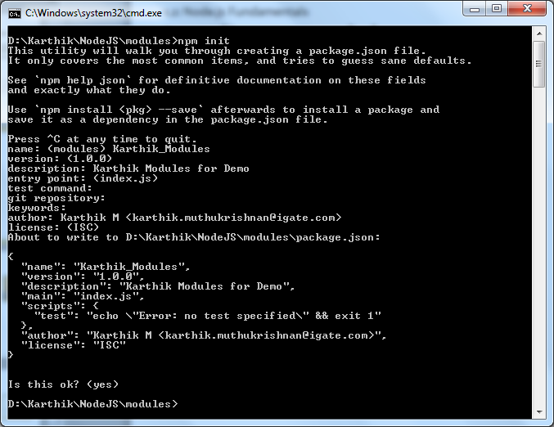
1.3: Working with modules Creating package.json

Slide 23
1.3: Working with modules Node Package Manager
Loading a module(Third party) installed via NPM (Node Package Manager)
Apart from writing our own modules and core modules, we will frequently use the modules written by other people in the Node community and published on the Internet (npmjs.com).
We can install those third party modules using the Node Package Manager which is installed by default with the node installation.
To install modules via npm use the npm install command.
npm installs module packages to the node_modules folder.
To update an installed package to a newer version use the npm update command.
If the module name is not relative and is not a core module, Node will try to find it inside the node_modules folder in the current directory.
var jade = require('jade');
Here jade is not a core module and not available as a user defined module found in relative path, it will look into the node_modules/jade/package.json and refer the file/ folder mentioned in main attribute.
Notes:
Installing a package using NPM
$ npm install <Package Unique Name>
Installing a module globally
$ npm install –g <Package Unique Name>
To remove an installed package
npm uninstall < Package Unique Name>
To remove a global package
npm uninstall –g < Package Unique Name>
To update a package to its latest version
npm update < Package Unique Name>
To update a global package
npm update –g < Package Unique Name>

Slide 24
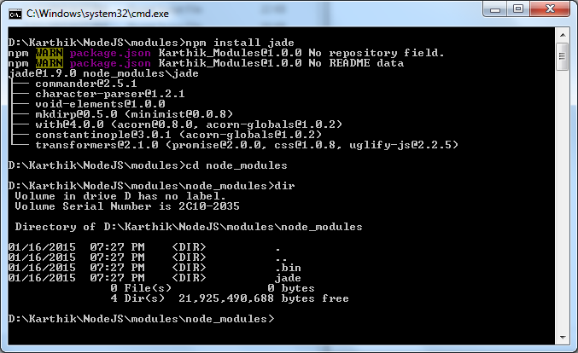
1.3: Working with modules Loading a third party module (installed via NPM)

Slide 25
1.3: Working with modules Creating and exporting a module
Creating a module that exposes / exports a function called helloWorld
exports object is a special object created by the Node module system which is returned as the value of the require function when you include that module.
Consuming the function on the exports object created in myModule.js
We can replace exports with module.exports
exports = module.exports = { }
// Save it as myModule.js
exports.helloWorld = function () {
console.log("Hello World");
}
// Save it as moduleTest.js
var module = require('./myModule'); module.helloWorld();
Notes:
module is just a plain JavaScript object with an exports property. exports is a plain JavaScript variable that happens to be set to module.exports.
At the end of the module will basically 'return' module.exports to the require function.
// greetings.js
// var exports = module.exports = {};
exports.sayHelloInEnglish = function() {
return "HELLO";
};
exports.sayHelloInSpanish = function() {
return "Hola";
};
/* following line re-assigns module.exports */
module.exports = "Bonjour";

Slide 26
1.4: Working with Buffers Buffers in Node
JavaScript doesn’t have a byte type. It just has strings.
Node is based on JavaScript with just using string type it is very difficult to perform the operations like communicate with HTTP protocol, working with databases, manipulate images and handle file uploads.
Node includes a binary buffer implementation, which is exposed as a JavaScript API under the Buffer pseudo-class.
Using buffers we can manipulate, encode, and decode binary data in Node. In node each buffer corresponds to some raw memory allocated outside V8.
A buffer acts like an array of integers, but cannot be resized

Slide 27
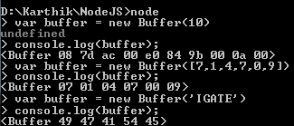
1.4: Working with Buffers Creating Buffers in Node
new Buffer(n) is used to create a new buffer of 'n' octets. One octet can be used to represent decimal values ranging from 0 to 255.
There are several ways to create new buffers.
new Buffer(n) : To create a new buffer of 'n' octets
var buffer = new Buffer(10);
new Buffer(arr) : To create a new buffer, using an array of octets.
var buffer = new Buffer([7,1,4,7,0,9]);
new Buffer(str,[encoding]) : To create a new buffer, using string and encoding.
var buffer = new Buffer("IGATE","utf-8"); // utf-8 is the default encoding in Node.

Slide 28
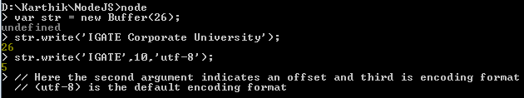
1.4: Working with Buffers Writing to Buffer
Writing to Buffer
buf.write(str, [offset], [length], [encoding]) method is used to write a string to the buffer.
buf.write() returns the number of octets written. If there is not enough space in the buffer to fit the entire string, it will write a part of the string.
An offset or the index of the buffer to start writing at. Default value is 0.

Slide 29
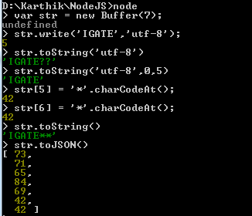
1.4: Working with Buffers Reading from Buffer
Reading from buffers
buf.toString([encoding], [start], [end]) method decodes and returns a string from buffer data.
buf.toString() returns method reads the entire buffer and returns as a string.
buf.toJSON() method is used to get the JSON-representation of the Buffer instance, which is identical to the output for JSON Arrays.

Slide 30
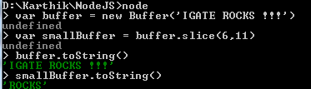
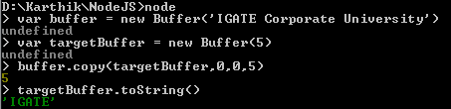
1.4: Working with Buffers Slicing and copying a buffer
Slicing a buffer
buffer.slice([start],[end]) : We can slice a buffer and extract a portion from it, to create another smaller buffer by specifying the starting and ending positions.
Copying a buffer
buffer.copy(targetBuffer, [targetStart], [sourceStart], [sourceEnd]) : It is used to copy the contents of one buffer onto another

Slide 31
1.5: Event Handling Event Handling in Node
In node there are two event handling techniques. They are called callbacks and EventEmitter.
Callbacks are for the async equivalent of a function. Any async function in node accepts a callback as it's last parameter
var myCallback = function(data) {
console.log('got data: '+data);
};
var fn = function(callback) {
callback('Data from Callback');
};
fn(myCallback);

Slide 32
1.5: Event Handling EventEmitter
In node.js an event can be described simply as a string with a corresponding callback and it can be emitted.
The on or addListener method allows us to subscribe the callback to the event.
The emit method "emits" event, which causes the callbacks registered to the event to trigger.
var events = require('events');
var eventEmitter = new events.EventEmitter();
var myCallback = function(data) {
console.log('Got data: '+data);
};
eventEmitter.on('karthikEvent', myCallback);
var fn = function() {
eventEmitter.emit('karthikEvent','Data from Emitter');
};
fn();
Notes:
Event Emitter is a nice way of enforcing the decoupling of interfaces, which improves the independence from specific interfaces, making your code more flexible

Slide 33
1.5: Event Handling EventEmitter Methods
All objects which emit events in node are instances of events.EventEmitter which is available inside Event module.
We can access the Event module using require("events")
addListener(event, listener) / on(event, listener)
Adds a listener to the end of the listeners array for the specified event. Where listener is a function which needs to be executed when an event is emitted.
once(event, listener)
Adds a one time listener for the event. This listener is invoked only the next time the event is fired, after which it is removed.
removeListener(event, listener)
Remove a listener from the listener array for the specified event
removeAllListeners([event])
Removes all listeners, or those of the specified event
Notes:
It's not a good idea to remove listeners that were added elsewhere in the code

Slide 34
1.5: Event Handling Creating an EventEmitter
We can create Event Emitter pattern by creating a constructor function / pseudo-class and inheriting from the EventEmitter.
var EventEmitter = require('events').EventEmitter,
util = require('util');
var Foo = function(){ }
util.inherits(Foo, EventEmitter);
Foo.prototype.someMethod = function() {
this.emit('customEvent', 'Data from Some Method');
}
var fooObj = new Foo();
fooObj.on('customEvent',function(arg){
console.log('Custom Event Occurred : '+arg);
});
fooObj.someMethod();

Slide 35
1.6: Working with File System & Streams File System Module
By default Node.js installations come with the file system module.
This module provides a wrapper for the standard file I/O operations.
We can access the file system module using require("fs")
All the methods in this module has asynchronous and synchronous forms.
synchronous methods in this module ends with 'Sync'. For instance renameSync is the synchronous method for rename asynchronous method.
The asynchronous form always take a completion callback as its last argument. The arguments passed to the completion callback depend on the method, but the first argument is always reserved for an exception. If the operation was completed successfully, then the first argument will be null or undefined.
When using the synchronous form any exceptions are immediately thrown. You can use try/catch to handle exceptions or allow them to bubble up.

Slide 36
1.6: Working with File System & Streams File I/O methods
fs.stat(path, callback)
Used to retrieve meta-info on a file or directory.
fs.readFile(filename, [options], callback)
Asynchronously reads the entire contents of a file.
fs.writeFile(filename, data, [options], callback)
Asynchronously writes data to a file, replacing the file if it already exists. Data can be a string or a buffer.
fs.unlink(path, callback)
Asynchronously deletes a file.
fs.watchFile(filename, [options], listener)
Watch for changes on filename. The callback listener will be called each time the file is accessed. Second argument is optional by default it is { persistent: true, interval: 5007 }. The listener gets two arguments the current stat object and the previous stat object.

Slide 37
1.6: Working with File System & Streams File I/O methods
fs.exists(path, callback)
Test whether or not the given path exists by checking with the file system. The callback argument assigned with either true or false based on the existence.
fs.rmdir(path, callback)
Asynchronously removes the directory.
fs.mkdir(path, [mode], callback)
Asynchronously created the directory.
fs.open(path, flags, [mode], callback)
Asynchronously open the file.
fs.close(fd, callback)
Asynchronously closes the file.
fs.read(fd, buffer, offset, length, position, callback)
Read data from the file specified by fd.

Slide 38
1.6: Working with File System & Streams Stream
A stream is an abstract interface implemented by various objects in Node. They represent inbound (ReadStream) or outbound (WriteStream) flow of data.
Streams are readable, writable, or both (Duplex).
All streams are instances of EventEmitter.
Stream base classes can be loaded using require('stream')
ReadStream is like an outlet of data, once it is created we can wait for the data, pause it, resume it and indicates when it is actually end.
WriteStream is an abstraction on where we can send data to. It can be a file or a network connection or even an object that outputs data that was transformed(when zipping a file)

Slide 39
1.6: Working with File System & Streams Readable Stream
ReadStream is like an outlet of data, which is an abstraction for a source of data that you are reading from
A Readable stream will not start emitting data until you indicate that you are ready to receive it.
Readable streams have two "modes": a flowing mode and a non-flowing mode.
In flowing mode, data is read from the underlying system and provided to your program as fast as possible.
In non-flowing mode, you must explicitly call stream.read() to get chunks of data out.
Readable streams can emit the following events
'readable' : This event is fired when a chunk of data can be read from the stream.
'data' : This event is fired when the data is available. It will switch the stream to flowing mode when it is attached. It is the best way to get the data from stream as soon as possible.

Slide 40
1.6: Working with File System & Streams Readable Stream
'end' : This event is fired when there will be no more data to read.
'close' : Emitted when the underlying resource (for example, the backing file descriptor) has been closed. Not all streams will emit this.
'error' : Emitted if there was an error receiving data.
Readable streams has the following methods
readable.read([size]) : Pulls data out of the internal buffer and returns it. If there is no data available, then it will return null.
readable.setEncoding(encoding) : Sets the encoding to use.
readable.resume() : This method will cause the readable stream to resume emitting data events.
readable.pause() : This method will cause a stream in flowing-mode to stop emitting data events. Any data that becomes available will remain in the internal buffer.
readable.pipe(destination, [options]) : Pulls all the data out of a readable stream and writes it to the supplied destination, automatically managing the flow.

Slide 41
1.6: Working with File System & Streams Writable Stream
Writable stream interface is an abstraction for a destination that you are writing data to.
Writable streams has the following methods
writable.write(chunk, [encoding], [callback]) : This method writes some data to the underlying system and calls the supplied callback once the data has been fully handled. Here chunk is a String / Buffer data to write
writable.end([chunk], [encoding], [callback]) : Call this method when no more data will be written to the stream. Here chunk String / Buffer optional data to write
Writable streams can emit the following events
'drain' : If a writable.write(chunk) call returns false, then the drain event will indicate when it is appropriate to begin writing more data to the stream.
'finish' : When the end() method has been called, and all data has been flushed to the underlying system, this event is emitted

Slide 42
1.6: Working with File System & Streams Writable Stream
'pipe' : This is emitted whenever the pipe() method is called on a readable stream, adding this writable to its set of destinations.
'unpipe' : This is emitted whenever the unpipe() method is called on a readable stream, removing this writable from its set of destinations.
'error' : Emitted if there was an error when writing or piping data.

