Slide 1
Working with Express framework
Notes:
Add instructor notes here.

Slide 2
2.1 : Web development with Node Introduction
Webserver like IIS / Apache serves static files(like html files) so that a browser can view them over the network.
We need to place the files in a proper directory(like wwwroot in IIS), so that we can navigate to it using http protocol. The web server simply knows where the file is on the computer and serves it to the browser.
Node offers a different paradigm than that of a traditional web server i.e. it simply provides the framework to build a web server.
Interestingly building a webserver in node is not a cumbersome process, it can be written in just a few lines, moreover we'll have full control over the application.
Notes:
Add instructor notes here.

Slide 3
2.1 : Web development with Node HTTP module in Node.js
We can easily create an HTTP server in Node.
To use the HTTP server and client one must require('http').
The HTTP interfaces in Node are designed to support many features of the protocol which have been traditionally difficult to use. In particular, large, possibly chunk-encoded, messages.
Node's HTTP API is very low-level. It deals with stream handling and message parsing only. It parses a message into headers and body but it does not parse the actual headers or the body.
HTTP response implements the Writable Stream interface and request implements Readable Stream interface.
Notes:
Add the notes here.
Add instructor notes here.

Slide 4
2.1 : Web development with Node Creating HTTP Server
.
/* Loading http module*/
var http = require('http');
/* Returns a new web server object*/
var server = http.createServer(function(req,res){
/* Sends a response header to the request.*/
res.writeHead(200,{'content-type':'text/html'});
/*sends a chunk of the response body*/
res.write('<h1>Hello IGATE</h1>')
/* signals server that all the responses has been sent */
res.end('<b>Response Ended</b>')
});
/* Accepting connections on the specified port and hostname. */
server.listen(3000);
console.log('server listening on localhost:3000');
Notes:
HTTP status codes
1xx
The 1xx series of status codes is classified as Informational, and is used for conveying provisional response from the server.
The available codes in this series are: 100, 101, and 102.
2xx
The 2xx series of status codes is classified as Success, and is used for conveying a successful request for a resource on the server.
The available codes in this series are: 200, 201, 202, 303, 204, 205, 206, 207, 208, 250, and 226.
3xx
The 3xx series of status codes is classified as Redirection, and is used for information by the user agent about taking additional action to retrieve the requested resource. The available codes in this series are: 300, 301, 302, 303, 304, 305, 306, 307, and 308.
4xx
The 4xx series of status codes is classified as Client Error, and is used for informing the user agent of its erroneous requests to the server.
The available codes in this series are: 400, 401, 402, 403, 404, 405, 406, 407, 408, 409, 410, 411, 412, 413, 414, 415, 416, 417, 422, 423, 424, 425, 426, 428, 429, 431, 444, 449, 450, 451, 452, 453, 454, 455, 456, 457, 458, 459, 460, 461, 462, 494, 495, 496, 497, and 499.
5xx
The 5xx series of status codes is classified as Server Error, and is used for informing the user agent that the server has encountered an error because of which the request was not fulfilled. The available codes in this series are: 500, 501, 502, 503, 504, 505, 506, 507, 508, 509, 510, 511, 551, 598, and 599.
Add instructor notes here.

Slide 5
2.1 : Web development with Node HTTP Properties and Methods
http.STATUS_CODES
Returns object which is a collection of all the standard HTTP response status codes and its short descriptions
http.createServer([requestListener])
Returns a new web server object.
http.request(options, [callback])
Returns a new web server object.
http.get(options, [callback])
Returns a new web server object.
Notes:
Add the notes here.
Add instructor notes here.

Slide 6
2.1 : Web development with Node HTTP Methods
server.listen(port, [hostname], [backlog], [callback])
Begin accepting connections on the specified port and hostname.
server.close([callback])
Stops the server from accepting new connections
response.writeHead(statusCode, [reasonPhrase], [headers])
Sends a response header to the request.
response.setHeader(name, value)
Sets a single header value for implicit headers.
response.write(chunk, [encoding])
This sends a chunk of the response body. This method may be called multiple times to provide successive parts of the body.

Slide 7
2.1 : Web development with Node HTTP Events
request
Emitted each time there is a request.
close
Emitted when the server closes.
connect
Emitted each time a client requests a http CONNECT method
finish
Emitted when the response has been sent.

Slide 8
2.1 : Web development with Node Routing
Routing refers to the mechanism for serving the client the content it has asked
var http = require('http');
var server = http.createServer(function(req,res){
var path = req.url.replace(/\/?(?:\?.*)?$/, '').toLowerCase();
switch(path) {
case '' :
res.writeHead(200, {'Content-Type': 'text/html'});
res.end('<h1>Home Page</h1>');
break;
case '/about' :
res.writeHead(200, {'Content-Type': 'text/html'});
res.end('<h1>About us</h1>');
break;
default:
res.writeHead(404, { 'Content-Type': 'text/plain' });
res.end('Not Found');
break;
}
});
server.listen(3000);

Slide 9
Demo
Creating-HTTP-Server

Slide 10
2.2 : Templating Engines Introduction
A template engine is a library or a framework that uses some rules/languages to interpret data and render views.
Templating solves the problem by allowing you to write in the target language, while at the same time providing the ability to insert dynamic data.
For those of you familiar with the model–view–controller concept, templates belong to the view.
In the Node world, we have many templating engines to choose. Here are some criteria to consider to choose a template engine :
Performance : Templating engine to be as fast as possible
Client, server, or both : Most of the templating engines are available on both the server and client sides which makes our coding get well acquainted with the template engine
Abstraction : Abstracting the details of HTML away from you
Jade, ejs and handlebars are some of the popular templating engines.
Notes:
Having JavaScript to emit HTML will create the following problems:
• We have to constantly worry about what characters need to be escaped, and how to do that.
• Using JavaScript to generate HTML that itself includes will be tough.
• Syntax highlighting and other handy language-specific features of editor will be lost.
• It can be much harder to spot malformed HTML.
• It’s hard to visually parse.
• It can make it harder for other people to understand code.

Slide 11
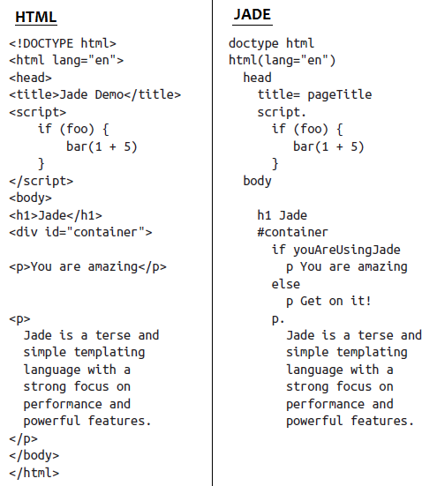
2.2 : Templating Engines Jade templating engine
Jade abstracts the details of HTML away from us. It uses whitespace and indentation as part of its language

Slide 12
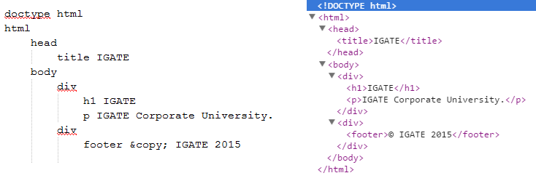
2.2 : Templating Engines Working with Tags in Jade

Slide 13
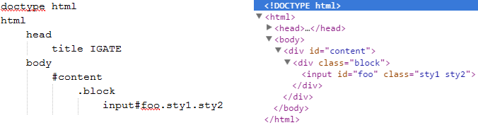
2.2 : Templating Engines Working with id and classes in Jade

Slide 14
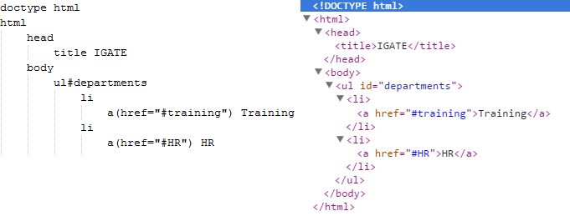
2.2 : Templating Engines Attributes and Nesting Tags in Jade

Slide 15
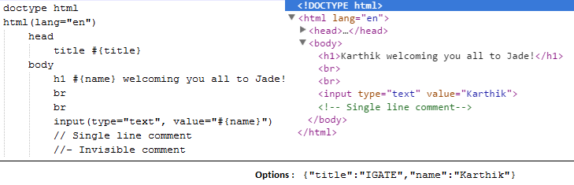
2.2 : Templating Engines Passing options to Jade template

Slide 16
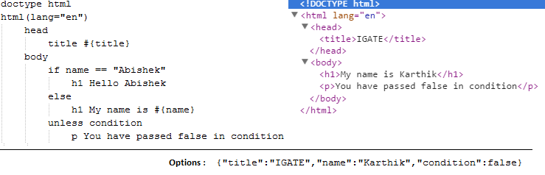
2.2 : Templating Engines Using if & unless in Jade

Slide 17
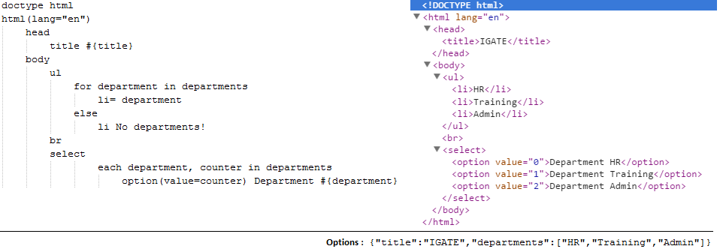
2.2 : Templating Engines Using for & each in Jade

Slide 18
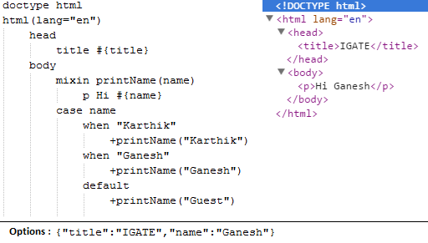
2.2 : Templating Engines Using case & mixins in jade
Mixins are functions that take parameters and produce some HTML.
Syntax : mixin name(param, param2,...)
To use the function +name(data)

Slide 19
2.2 : Templating Engines Include & Extend in Jade
include & extend are the ways to split logic into a separate file for the purpose of reusing it across multiple files
include is a top-to-bottom approach. i.e. The file that includes is processed then the included file is processed.
To include a Jade template use include /path/filename
extend is a bottom-to-top approach (opposite to include).
It works with extend filename and block blockname statements.

Slide 20
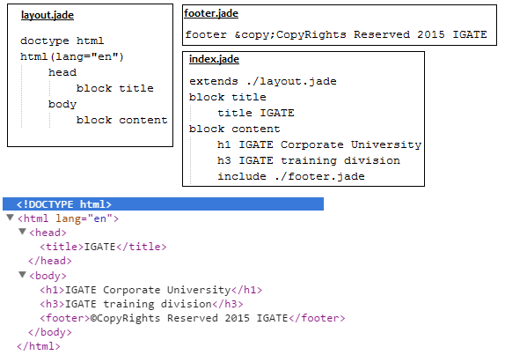
2.2 : Templating Engines Include & Extend in Jade

Slide 21
Demo
Working with Jade Templating Engine

Slide 22
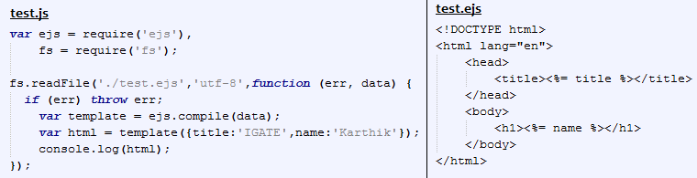
2.2 : Templating Engines EJS Templating engine
EJS simply embeds JavaScript into the templates with a few simple tags to define how the JavaScript needs to be interpreted.
EJS combines data and a template to produce HTML.
JavaScript code gets executed inside<% %> and any code placed inside the tag <%= %> gets added with HTML.

Slide 23
Demo
Working with EJS Templating Engine

Slide 24
2.3 : Working with Express.js Introduction
If we try to create apps by only using core Node.js modules we will end up by writing the same code repeatedly for similar tasks such as
Parsing of HTTP request bodies
Parsing of cookies
Managing sessions
Organizing routes with a chain of if conditions based on URL paths and HTTP methods of the requests
Determining proper response headers based on data types
Developers have to do a lot of manual work themselves, such as interpreting HTTP methods and URLs into routes, and parsing input and output data.
Express.js solves these and many other problems using abstraction and code organization.

Slide 25
2.3 : Working with Express.js Introduction toExpress.js
Express.js is a web framework based on the core Node.js http module and Connect components
Express.js framework provides a model-view-controller-like structure for your web apps with a clear separation of concerns (views, routes, models)
Express.js systems are highly configurable, which allows developers to pick freely whatever libraries they need for a particular project
Express.js framework leads to flexibility and high customization in the development of web applications.
In Express.js we can define middleware such as error handlers, static files folder, cookies, and other parsers.
Middleware is a way to organize and reuse code, and, essentially, it is nothing more than a function with three parameters: request, response, and next.

Slide 26
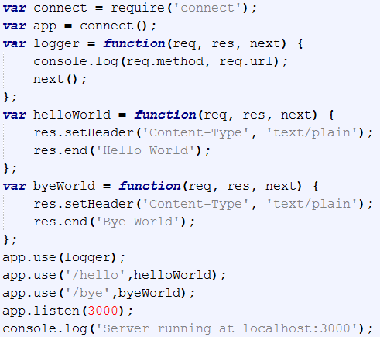
2.3 : Working with Express.js Connect module
Connect is a module built to support interception of requests in a modular approach.
Notes:
We can build a simple web server using the http module. Connect creates an API to write code that manages the different HTTP requests sent to your server, handles them properly, and responds to each request with the correct response.
Connect uses a modular component called middleware, which allows you to simply register your application logic to predefined HTTP request scenarios. Connect middleware are basically callback functions, which get executed when an HTTP request occurs
Connect middleware
Connect middleware is just JavaScript function with a unique signature.
Each middleware function is defined with the following three arguments:
req: This is an object that holds the HTTP request information
res: This is an object that holds the HTTP response information and allows you to set the response properties
next: This is the next middleware function defined in the ordered set of Connect middleware.
The way a Connect application works is by using an object called dispatcher. The dispatcher object handles each HTTP request received by the server and then decides, in a cascading way, the order of middleware execution.
Connect middleware function will be executed in first-in-first-out (FIFO) order using the next arguments until there are no more middleware functions to execute or the next middleware function is not called.

Slide 27
Demo
Working with connect module

Slide 28
2.3 : Working with Express.js Express.js Installation
The Express.js package comes in two flavors:
express-generator: a global NPM package that provides the command-line tool for rapid app creation (scaffolding)
express: a local package module in your Node.js app’s node_modules folder

Slide 29
2.3 : Working with Express.js app.js
App.js is the main file in Express framework. A typical structure of the main Express.js file consists of the following areas
1. Require dependencies
2. Configure settings
3. Connect to database (optional)
4. Define middleware
5. Define routes
6. Start the server
The order here is important, because requests travel from top to bottom in the chain of middleware.

Slide 30
2.3 : Working with Express.js app.js
First the dependencies need to be included with require()
Then Express.js object is instantiated (Express.js uses a functional pattern):
var express = require('express');
var http = require(http');
var path = require('path');
var cookieParser = require('cookie-parser');
var bodyParser = require('body-parser');
var app = express();

Slide 31
2.3 : Working with Express.js app.js
One of the ways to configure Express.js settings is to use app.set(), with the name of the setting and the value.
Middleware is the backbone of the Express.js framework and it comes in two flavors.
Defined in external (third-party) modules, such as bodyParser.json from Connect/Express.js body-parser: app.use(bodyParser.json());
Defined in the app or its modules, such as app.use(function(req, res, next){...});
/* port: a number on which our server should listen to requests */
app.set('port', process.env.PORT || 3000);
/* views: absolute path to the folder with template */
app.set('views', path.join(__dirname, 'views'));
/* view engine: file extension for the template files */
app.set('view engine', 'jade');

Slide 32
2.3 : Working with Express.js app.js
Routes are processed in the order they are defined. Usually, routes are put after middleware, but some middleware may be placed following the routes. A good example of such middleware, found after a routes, is error handler.
The way routes are defined in Express.js is with helpers app.VERB(url, fn1, fn2, ..., fn), where fnNs are request handlers, url is on a URL pattern in RegExp, and VERB values are as follows:
all: catch every request (all methods)
get: catch GET requests
post: catch POST requests
put: catch PUT requests
del: catch DELETE requests

Slide 33
2.3 : Working with Express.js app.js
Finally to start the server, we need to use createServer method from the core http module. In this method, the system passes the Express.js app object with all the settings and routes
http.createServer(app).listen(app.get('port'), function(){
console.log('Express server listening on port ' + app.get('port'));
});

Slide 34
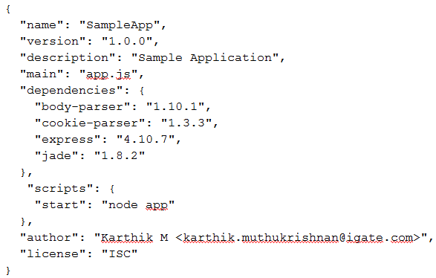
2.3 : Working with Express.js Steps for creating Express.js Application
Step – 1 : Create a folder named SampleApp
Step – 2 : Create package.json with the following schema

Slide 35
2.3 : Working with Express.js Steps for creating Express.js Application
Step – 3 : Install the dependencies using npm install command
D:\Karthik\NodeJS\Lesson02\SampleApp>npm install
Step – 4 : Create the following folders under SampleApp folder
public : All the static (front-end) files like HTML
public/css : Stylesheet files
public/img : images
public/js : Scripts
db : Seed data and scripts for MongoDB
views : Jade (or any other template engine) files
views/includes : Partial / include files
routes : Node.js modules that contain request handlers
Step – 5 : Create the main file named app.js

Slide 36
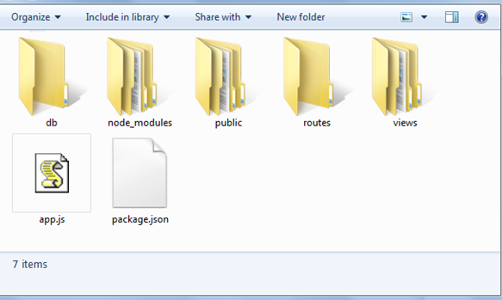
2.3 : Working with Express.js Steps for creating Express.js Application

Slide 37
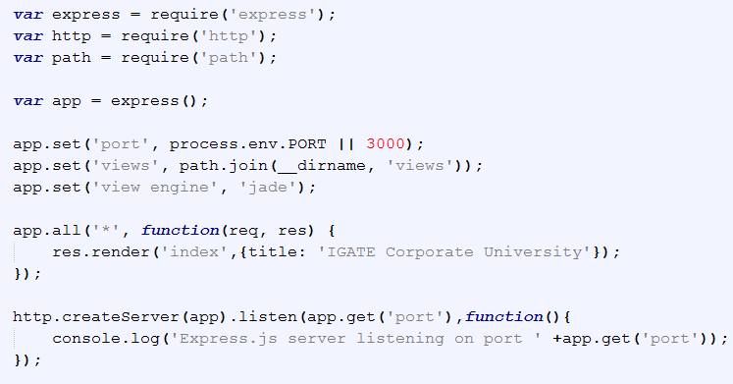
2.3 : Working with Express.js Steps for creating Express.js Application
Step – 6 : Type the following contents in app.js
Notes:
Routes in Express.js
// respond with "Hello World!" on the homepage
app.get('/', function (req, res) {
res.send('Hello World!');
})
// accept POST request on the homepage
app.post('/', function (req, res) {
res.send('Got a POST request');
})
// accept PUT request at /user
app.put('/user', function (req, res) {
res.send('Got a PUT request at /user');
})
// accept DELETE request at /user
app.delete('/user', function (req, res) {
res.send('Got a DELETE request at /user');
})

Slide 38
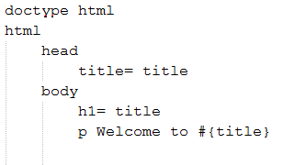

2.3 : Working with Express.js Steps for creating Express.js Application
Step – 7 : Create index.jade under views folder and type the following contents
Step – 8 : Start the app by typing npm start in command prompt.

Slide 39
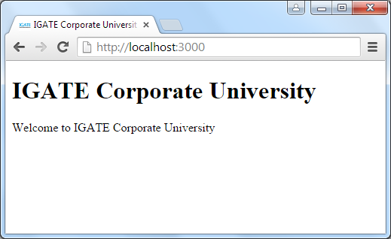
2.3 : Working with Express.js Steps for creating Express.js Application
Step – 9 : Open browser and type http://localhost:3000 to view the SampleApp

Slide 40
Demo
Creating ExpressJS Sample Application

Slide 41
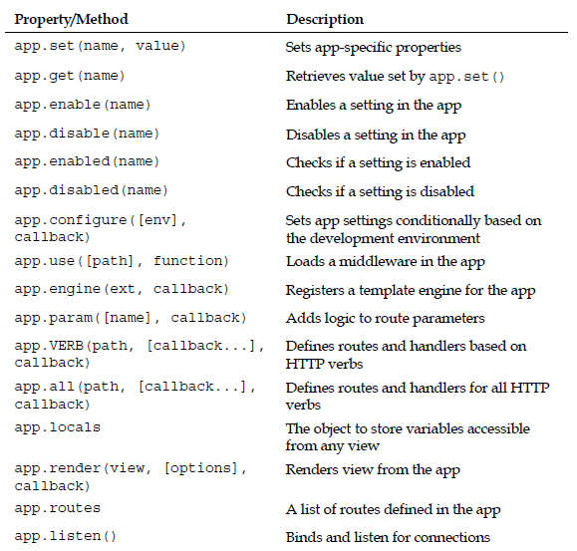
2.3 : Working with Express.js application object properties & methods
Notes:
The application object
The application object is an instance of Express, conventionally represented by the
variable named app. This is the main object of your Express app and the bulk of the functionality is built on it.
This is how you create an instance of the Express module:
var express = require('express');
var app = new express();

Slide 42
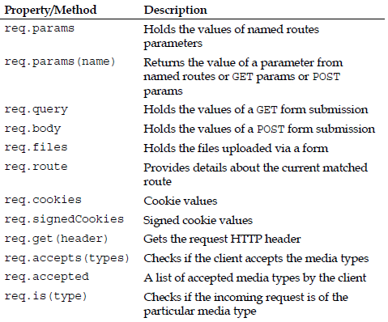
2.3 : Working with Express.js request object properties & methods
Notes:
The request object
The HTTP request object is created when a client makes a request to the Express app. The object is conventionally represented by a variable named req, which contains a number of properties and methods related to the current request.
req.query: This is an object containing the parsed query-string parameters.
req.params: This is an object containing the parsed routing parameters.
req.body: This is an object used to retrieve the parsed request body. This property is included in the bodyParser() middleware.
req.param(name): This is used to retrieve a value of a request parameter. Note that the parameter can be a query-string parameter, a routing parameter, or a property from a JSON request body.
req.path, req.host, and req.ip: These are used to retrieve the current request path, host name, and remote IP.
req.cookies: This is used in conjunction with the cookieParser() middleware to retrieve the cookies sent by the user-agent.

Slide 43
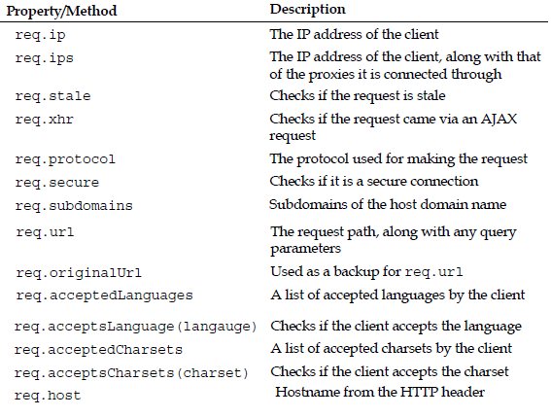
2.3 : Working with Express.js request object properties & methods

Slide 44
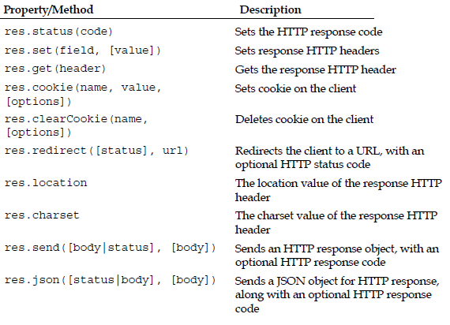
2.3 : Working with Express.js response object properties & methods
Notes:
The response object
The response object is created along with the request object, and is conventionally
represented by a variable named res. While it may sound a little strange that both of them should be created together, it is a necessity to give all the middlewares a chance to work on the request and the response object, before passing the control to the next middleware.
res.status(code): This is used to set the response HTTP status code.
res.set(field, [value]): This is used to set the response HTTP header.
res.cookie(name, value, [options]): This is used to set a response cookie. The options argument is used to pass an object defining common cookie configuration, such as the maxAge property.
res.redirect([status], url): This is used to redirect the request to a given URL. Note that you can add an HTTP status code to the response. When not passing a status code, it will be defaulted to 302 Found.
res.send([body|status], [body]): This is used for non-streaming responses. This method does a lot of background work, such as setting the Content-Type and Content-Length headers, and responding with the proper cache headers.
res.json([status|body], [body]): This is identical to the res.send() method when sending an object or array. Most of the times, it is used as syntactic sugar, but sometimes you may need to use it to force a JSON response to non-objects, such as null or undefined.
res.render(view, [locals], callback): This is used to render a view and send an HTML response.

Slide 45
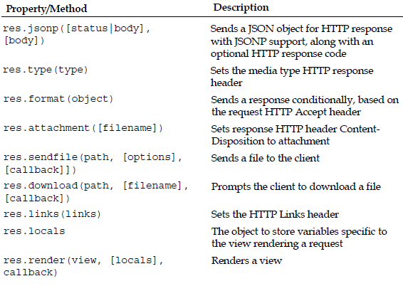
2.3 : Working with Express.js response object properties & methods
Notes:
Express can send an HTTP response using one of its response methods:
res.send(), res.json(), res.jsonp(), res.sendfile(), res.download(), res.render(), res.redirect(). If none of them is called, the request will be left hanging till the connection times out

Slide 46
2.3 : Working with Express.js How Express.js works
Express.js usually has an entry point aka, a main file. Most of the time, this is the file that we start with the node command or export as a module. In the main file we do the following
Include third-party dependencies as well as our own modules, such as controllers, utilities, helpers, and models
Configure Express.js app settings such as template engine and its file extensions
Connect to databases such as MongoDB, Redis, or MySQL (optional)
Define middlewares and routes
Start the app and Export the app as a module (optional)
When the Express.js app is running, it’s listens to requests. Each incoming request is processed according to a defined chain of middleware and routes, starting from top to bottom.
Routes / middleware that are higher in the file have precedence over the lower definitions.

Slide 47
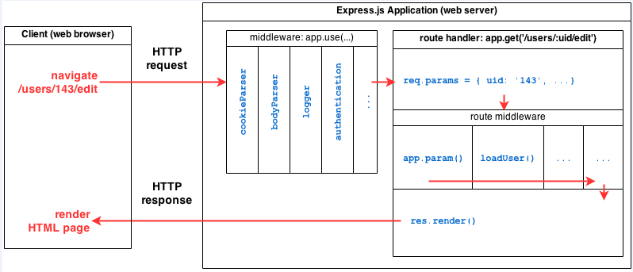
2.3 : Working with Express.js How Express.js works

Slide 48
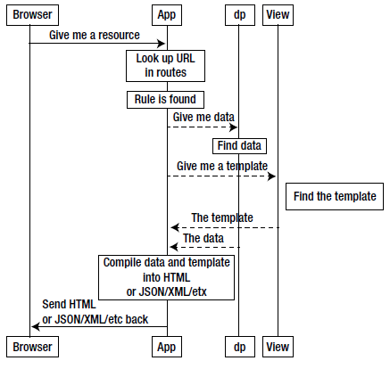
2.3 : Working with Express.js Request flow in Express

Slide 49
2.4 : Working with Express.js Request flow in Express
In Express server the request flow will be :
Route → Route Handler → Template → HTML
The route defines the URL schema. It captures the matching request and passed on control to the corresponding route handler
The route handler processes the request and passes the control to a template.
The template constructs the HTML for the response and sends it to the browser.
The route handler need not always pass the control to a template, it can optionally send the response to a request directly.

Slide 50
2.3 : Working with Express.js Using middleware
A middleware is a JavaScript function to handle HTTP requests to an Express app.
It can manipulate the request and the response objects or perform an isolated action, or terminate the request flow by sending a response to the client, or pass on the control to the next middleware.
A middleware can:
Execute any code.
Make changes to the request and the response objects.
End the request-response cycle.
Call the next middleware in the stack.
If the current middleware does not end the request-response cycle, it must call next() to pass control to the next middleware, otherwise the request will be left hanging.

Slide 51
2.3 : Working with Express.js Types of middleware
An Express application can use the following kinds of middleware:
Application-level middleware
Router-level middleware
Built-in middleware
Third-party middleware

Slide 52
2.3 : Working with Express.js Application level middleware
Application level middleware are bound to an instance of express, using app.use() and app.VERB().
var app = express();
/* a middleware with no mount path; gets executed for every request to the app */
app.use(function (req, res, next) {
console.log('Time:', Date.now()); next();
});
/* a middleware mounted on /user/:id; will be executed for any type of HTTP request to /user/:id */
app.use('/user/:id', function (req, res, next) {
console.log('Request Type:', req.method); next();
});
/* a route and its handler function (middleware system) which handles GET requests to /user/:id */
app.get('/user/:id', function (req, res, next) {
res.send('USER');
});

Slide 53
2.3 : Working with Express.js Router level middleware
Router level middleware are loaded using router.use() and router.VERB().
var app = express();
var router = express.Router();
/* a middleware with no mount path, gets executed for every request to the router */
router.use(function (req, res, next) {
console.log('Time:', Date.now());
next();
});
/* a middleware sub-stack which handles GET requests to /user/:id */
router.get('/user/:id', function (req, res, next) {
// if user id is 0, skip to the next router
if (req.params.id == 0) next('route');
// else pass the control to the next middleware in this stack
else next(); //
}, function (req, res, next) {
// render a regular page
res.render('regular');
});
/* mount the router on the app */
app.use('/', router);

Slide 54
2.3 : Working with Express.js External middleware
The Express core is minimal, yet the team behind it provides various predefined middleware to handle common web development features.
Those middleware vary in size and functionality and extend Express to provide a better framework support.
The popular Express middleware are as follows:
morgan: This is an HTTP request logger middleware.
body-parser: This is a body-parsing middleware that is used to parse the request body, and it supports various request types.
method-override: This is a middleware that provides HTTP verb support such as PUT or DELETE in places where the client doesn't support it.
cookie-parser: This is a cookie-parsing middleware that populates the req.cookies object.
express-session: This is a session middleware used to support persistent sessions.

Slide 55
2.3 : Working with Express.js Built-in middleware
Except for express.static, all of Express' previously included middleware are now in separate repo.
express.static is based on serve-static, and is responsible for serving the static assets of an Express application. We can have more than one static directory per app.
var options = {
dotfiles: 'ignore',
etag: false,
extensions: ['htm', 'html'],
index: false,
maxAge: '1d',
redirect: false,
setHeaders: function (res, path, stat) {
res.set('x-timestamp', Date.now())
}
};
app.use(express.static('public', options));

Slide 56
2.3 : Working with Express.js Third-party middleware
Express is a routing and middleware web framework with minimal functionality of its own. Functionality to Express apps are added via third-party middleware.
Install the node module for the required functionality and loaded it in your app at the application level or at the router level.
$ npm install cookie-parser
var express = require('express');
var app = express();
var cookieParser = require('cookie-parser');
// load the cookie parsing middleware
app.use(cookieParser());

Slide 57
2.3 : Working with Express.js Express 4.0 Router
Express 4.0 comes with the new Router.
Router is like a mini express application. It doesn’t bring in views or settings, but provides us with the routing APIs like .use, .get, .param, and route.
Creating instance of Router for application frontend routes
var router = express.Router();
// home page route (http://localhost:3000)
router.get('/', function(req, res) {
res.send('Home page!');
});
// about page route (http://localhost:3000/about)
router.get('/about', function(req, res) {
res.send('About page!');
});
// apply the routes to our application
app.use('/', router);

Slide 58
2.3 : Working with Express.js Express 4.0 Router
Route middleware in Express is a way to do something before a request is processed.
var router = express.Router();
// route middleware that will happen on every request
router.use(function(req, res, next) {
// log each request to the console
console.log(req.method, req.url);
// continue doing what we were doing and go to the route
next();
});
// apply the routes to our application
app.use('/', router);

Slide 59
2.3 : Working with Express.js Express 4.0 Router
Route with parameters & Route Middleware for parameter
var router = express.Router();
// route middleware to validate :name
router.param('name', function(req, res, next, name) {
// do validation on name here
console.log('doing name validations on ' + name);
// once validation is done save the new item in the req
req.name = name;
// go to the next thing
next();
});
// route with parameters (http://localhost:3000/hello/:name)
router.get('/hello/:name', function(req, res) {
res.send('hello ' + req.params.name + '!');
});
// apply the routes to our application
app.use('/', router);

Slide 60
Demo
ExpressApp-Middleware

Slide 61
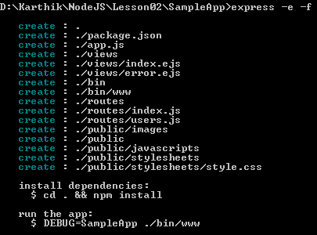
2.3 : Working with Express.js Express.js Scaffolding
To generate a application skeleton for Express.js app, we need to run a terminal command express [options] [dir | appname] the options for which are the following:
-e, --ejs: add EJS engine support (by default, Jade is used)
-c <engine>, --css <engine>: add stylesheet <engine> support, such as LESS, Stylus or Compass (by default, plain CSS is used)
-f, --force: force app generation on a nonempty directory

