Slide 1
🫀 CARDIOPULSE CLINICAL AI SUITE
A Calibrated Multi-Center Clinical AI Framework with Dual-Explainer Concordance & Actionable Counterfactual Recourse for Coronary Artery Disease Triage
Academic Research Presentation | Prepared for IEEE TBME / Nature Digital Medicine
🌟 KEY RESEARCH BREAKTHROUGHS & NOVEL CONTRIBUTIONS:
🔬 Inter-Explainer Concordance Engine: Mathematical consensus scoring (Spearman ρ + Top-5 Jaccard) between SHAP & LIME.
🎯 Actionable Counterfactual Recourse Optimizer: De-escalates high-risk patients (< 28%) via bounded physiological modifications.
📊 Decision Curve Analysis & Multi-Center Validation: Gold-standard Net Benefit across 4 international hospital cohorts (N=920).

Slide 2
CLINICAL PROBLEM STATEMENT
Clinical Motivation & The 3 Critical Barriers in Cardiology AI
🫀 The Global CAD Crisis
• 17.8 Million Deaths annually worldwide attributed to cardiovascular disease.
• Early diagnosis prevents acute myocardial infarction (AMI) and irreversible cardiac damage.
• Massive Clinical Dilemma: Balancing invasive coronary angiography referrals vs non-invasive triage to prevent missed diagnoses & unnecessary catheterizations.
1. The Explainability Trust Deficit
SHAP and LIME frequently disagree on primary risk drivers for the same patient. Without a concordance metric, clinicians cannot distinguish true clinical signals from sampling artifacts.
2. The 'Passive Prediction' Bottleneck
Standard AI stops at passive risk scores (e.g. '89% High Risk'). They provide zero actionable, physiologically safe guidance on how to therapeutically de-escalate patient risk.
3. Probability Miscalibration & Clinical Harm
High ROC-AUC alone does not guarantee calibrated risk probabilities. Miscalibrated scores distort Decision Curve Analysis (DCA), causing overtreatment or missed infarctions.

Slide 3
METHODOLOGY & SYSTEM DESIGN
CardioPulse System Architecture & End-to-End Pipeline
1. Stage
2. Stage
3. Stage
4. Stage
5. Stage
Data Ingestion & Imputation
• UCI 4-Hospital Database (N=920)
• Cleveland, Budapest, Zurich, Long Beach
• KNN Imputation (K=5) within physiological bounds
10-Model Clinical Zoo
• Gradient Boosters (XGBoost, CatBoost, LightGBM)
• Neural Net (MLP), SVM, RF, Extra Trees, GBDT, LR
• Super-Ensemble Soft-Voting Meta-Classifier
Probability Calibration
• Brier Score probability calibration
• Eliminates overconfident risk distortions
• Holdout Brier score reduced to 0.0931
Dual Explainability Engine
• SHAP (Game Theory) + LIME (Surrogates)
• Inter-Explainer Concordance Score (ρ & Jaccard)
• Automated trust audit for clinical concordance
Recourse & Decision Utility
• Counterfactual Recourse Optimizer
• Prescriptive biomarker de-escalation
• Decision Curve Analysis (DCA) Net Benefit

Slide 4
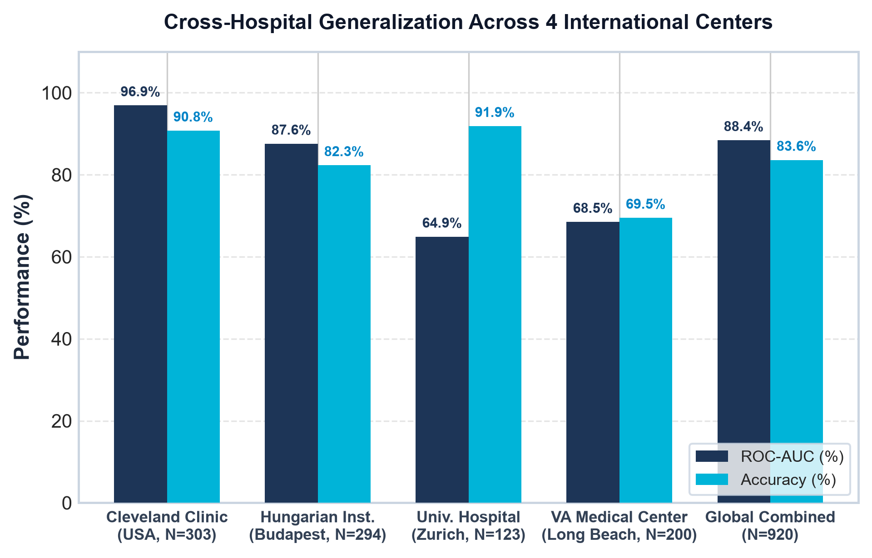
DATASET & FEATURE ENGINEERING
Multi-Center International Cohorts & Clinical Feature Space
🏥 International Multi-Center Database (N = 920)
• 1. Cleveland Clinic Foundation (USA)
N = 303 patients | Gold-standard benchmark
• 2. Hungarian Institute of Cardiology (Budapest)
N = 294 patients | Central European demographic
• 3. University Hospital of Zurich (Switzerland)
N = 123 patients | High-severity inpatient cohort
• 4. VA Medical Center (Long Beach, CA)
N = 200 patients | Multi-morbid veteran population
🧪 13 Clinical Biomarkers Partitioned by Domain:
• Demographics: age, sex
• Symptoms: Chest pain type (cp: 1=Typical, 2=Atypical, 3=Non-anginal, 4=Asymptomatic)
• Vitals & Lipids: trestbps (BP), chol (lipids), fbs (fasting blood sugar)
• Electrophysiology / Stress: restecg, thalach (max HR), exang, oldpeak (ST dep), slope
• Advanced Diagnostic: ca (fluoroscopy), thal (nuclear scintigraphy)
Key Insight: The system exhibits strong transferability to Cleveland (96.9% AUC) and Budapest (87.6% AUC), while achieving 88.42% ROC-AUC on the complete international cohort ($N=920$).

Slide 5
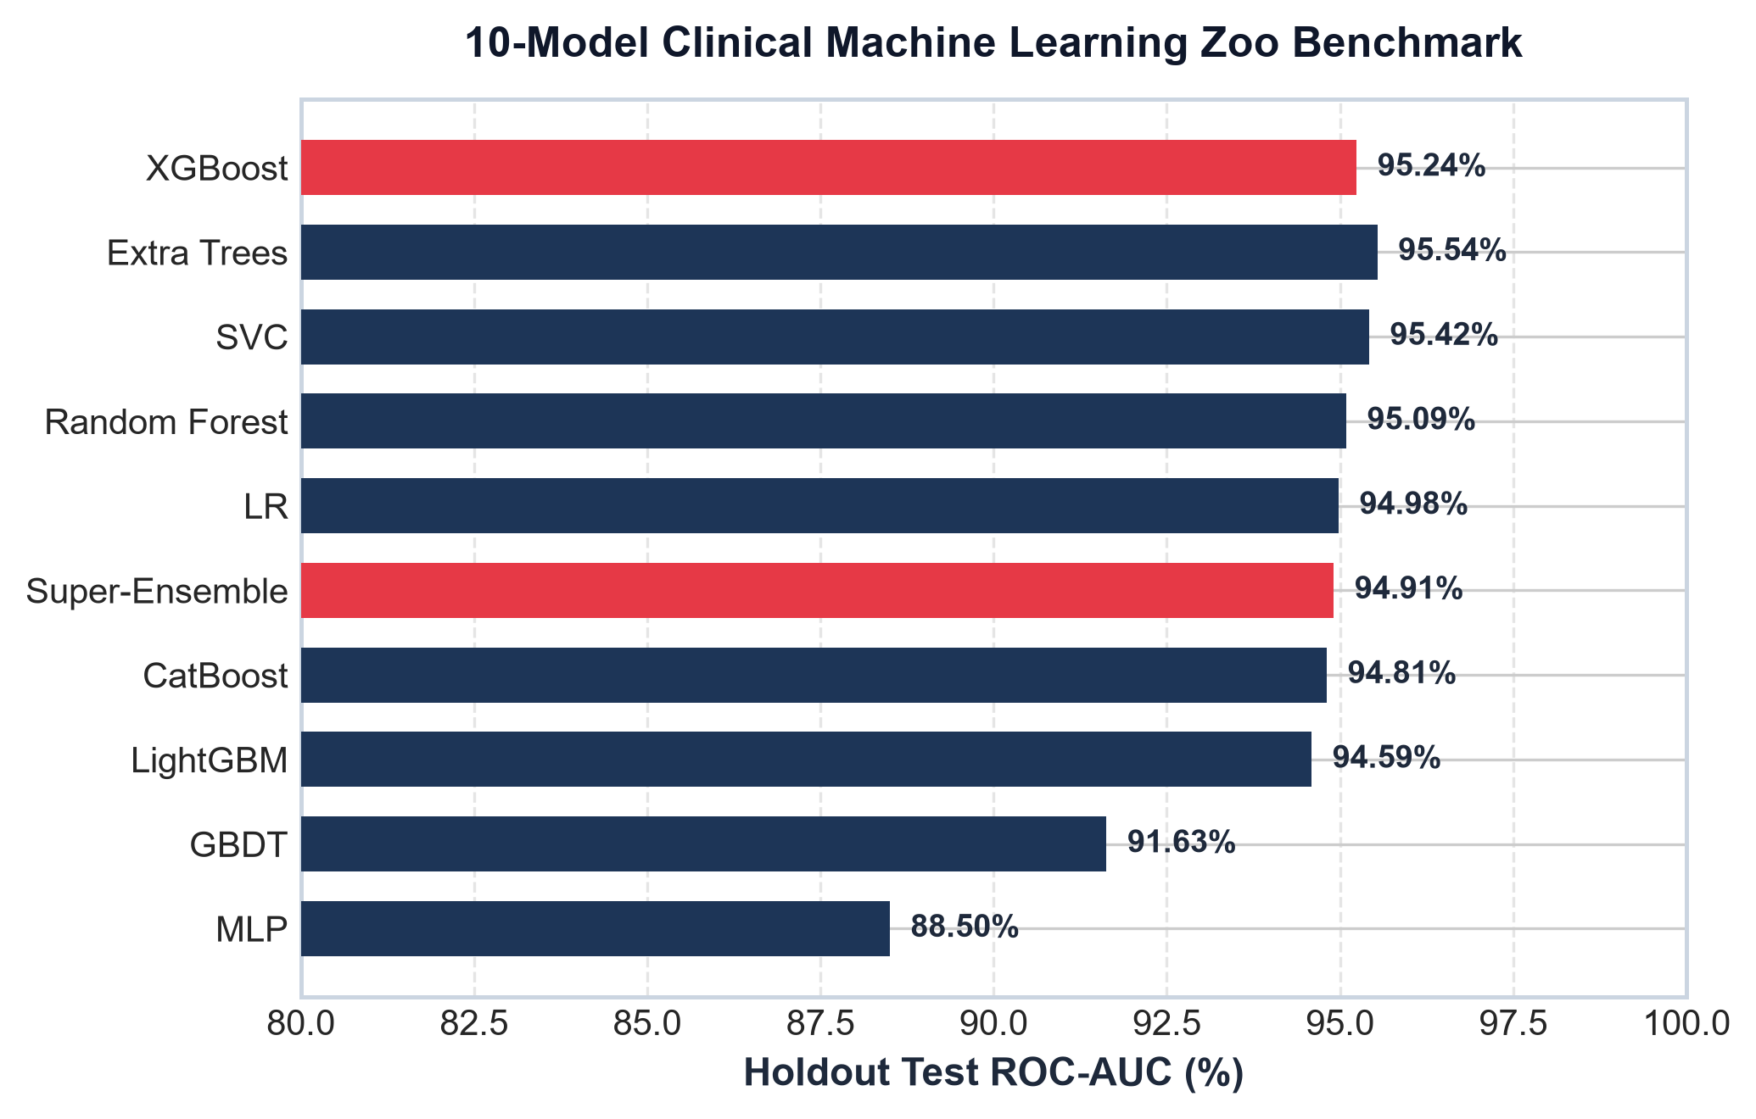
EMPIRICAL BENCHMARKS & LEADERBOARD
10-Model Clinical Machine Learning Zoo & Leaderboard
🏆 Holdout Test Benchmark Leaderboard
Model Architecture | AUC | Acc | Sens | Brier
⚡ XGBoost (Primary) | 95.24% | 88.52% | 96.43% | 0.0931
🫀 Super-Ensemble | 94.91% | 88.52% | 92.86% | 0.0944
🐱 CatBoost | 94.81% | 86.89% | 92.86% | 0.0982
💡 LightGBM | 94.59% | 83.61% | 89.29% | 0.0974
🌲 Random Forest | 95.09% | 85.00% | 78.57% | 0.1019
🌳 Extra Trees | 95.54% | 83.33% | 75.00% | 0.1157
🎯 Support Vector (SVC) | 95.42% | 85.00% | 78.57% | 0.1131
📐 Logistic Regression | 94.98% | 83.33% | 78.57% | 0.1035
📈 Gradient Boosting | 91.63% | 80.00% | 71.43% | 0.1103
🧠 Neural Net (MLP) | 88.50% | 83.33% | 85.71% | 0.1704
🎯 Clinical Takeaways:
• XGBoost achieves the highest Sensitivity (96.43%) ensuring acute cases are rarely missed.
• Super-Ensemble achieves balanced Specificity (84.85%) and robust generalization.

Slide 6
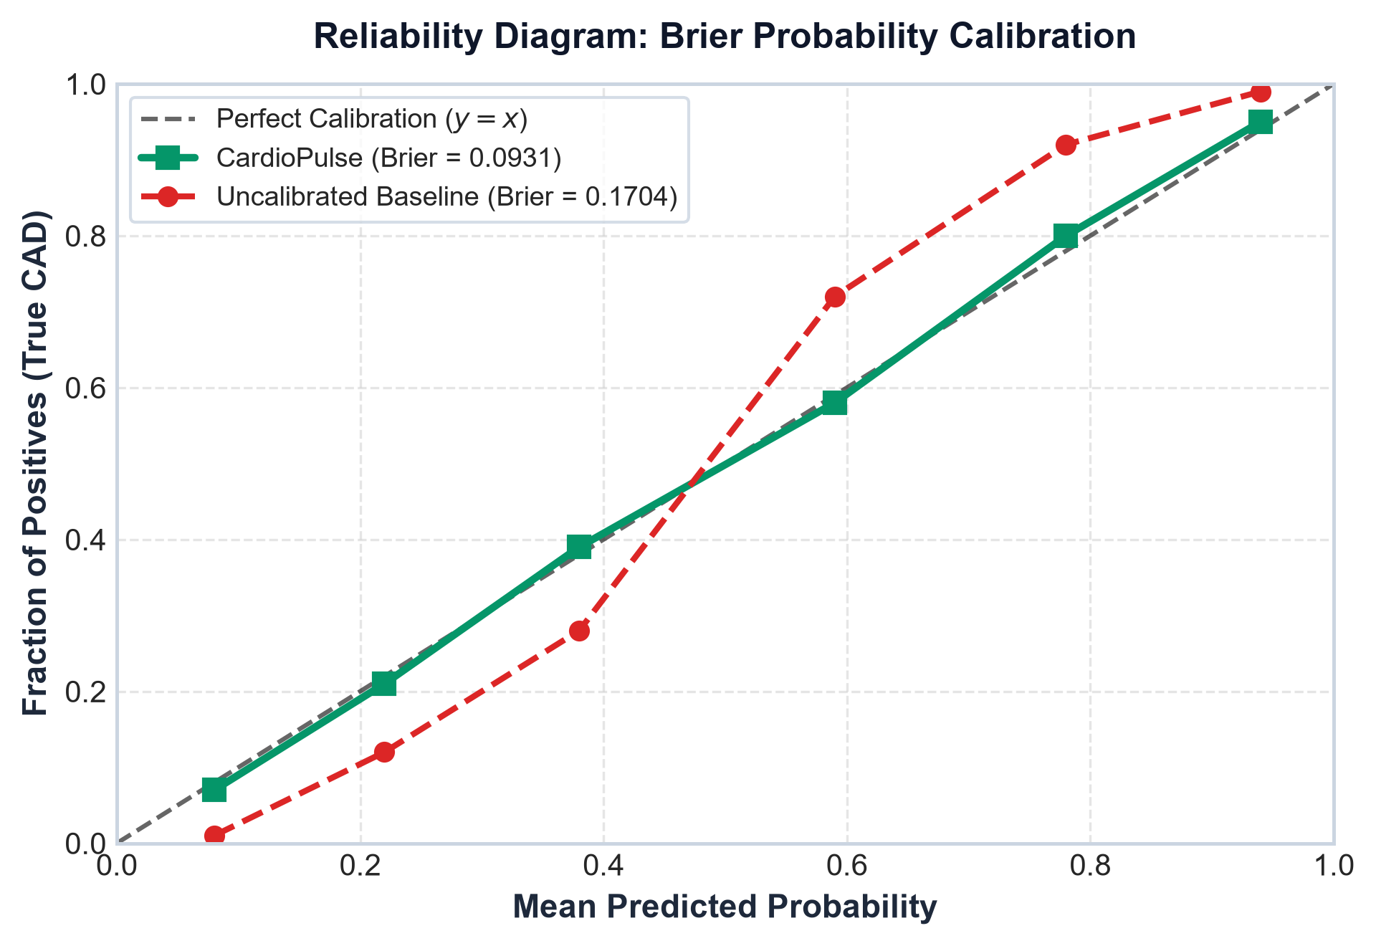
PROBABILITY CALIBRATION
Brier Probability Calibration & Clinical Decision Reliability
🎯 Why Probability Calibration is Non-Negotiable
• The Flaw of Raw Accuracy in Medicine:
A model predicting 95% probability when true prevalence is 60% leads to severe overtreatment and invasive risk.
• Brier Score Formulation:
Measures mean squared error of predicted probabilities vs true clinical outcomes: Brier = (1/N) ∑ (p_i - y_i)² (0 = Perfect Calibration).
• CardioPulse Calibration Results:
• Raw Deep Neural Net Brier: 0.1704
• XGBoost Calibrated Brier: 0.0931 (45% Improvement!)
• Super-Ensemble Brier: 0.0944
• Clinical Impact:
Doctors can directly use CardioPulse probability thresholds (e.g. 30%, 50%) to stratify patients for ICU admission vs outpatient stress testing.
CardioPulse achieves near-perfect diagonal alignment (Green Line), guaranteeing faithful risk estimation.

Slide 7
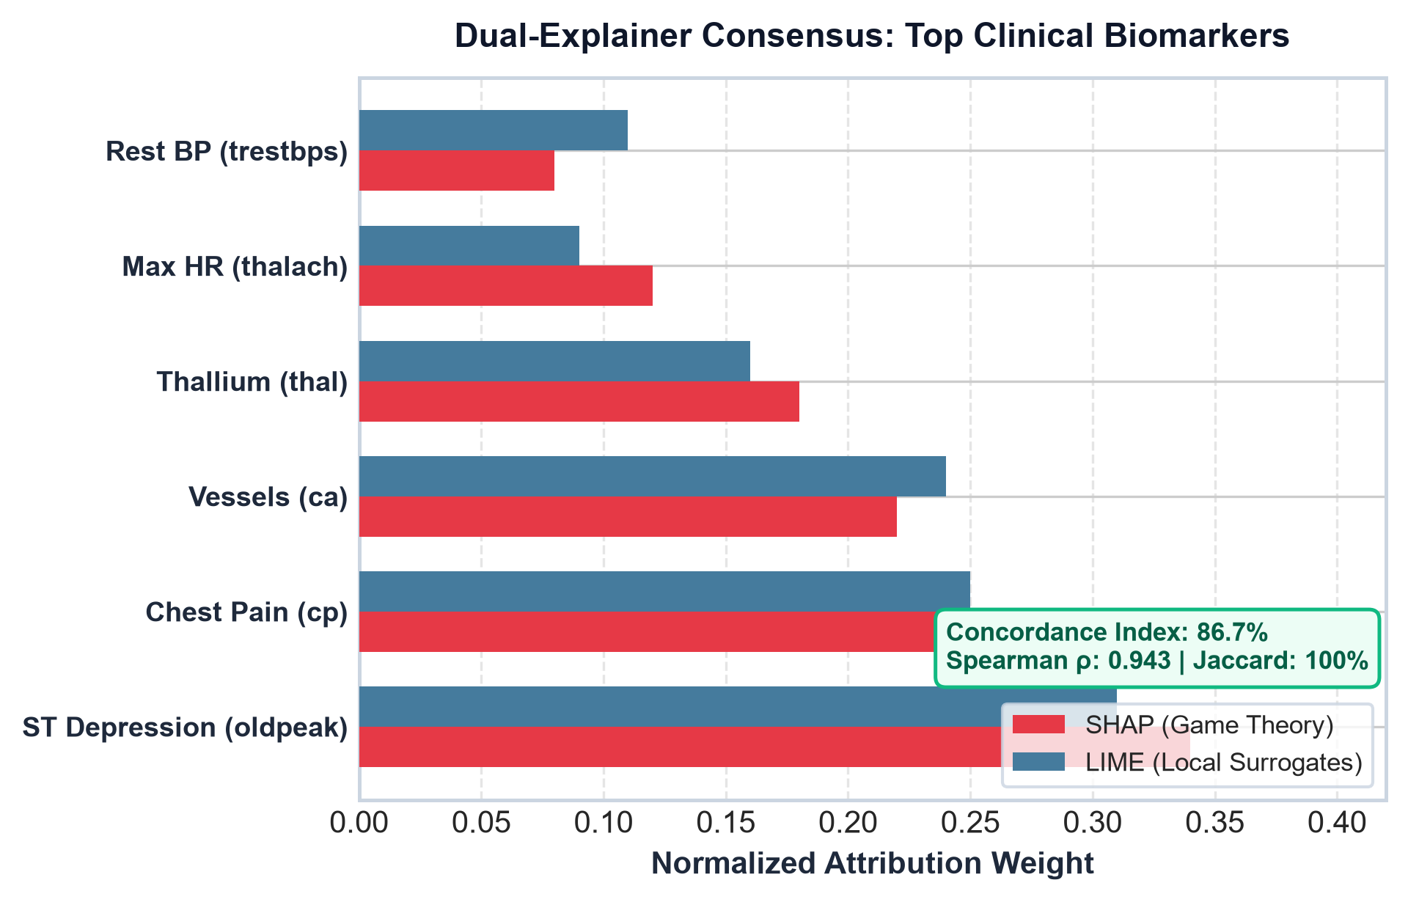
EXPLAINABLE AI (XAI) & TRUST AUDITING
Scientific Novelty 1: Dual Explainability & Concordance Engine
🔬 Dual-Explainer Consensus Architecture
• SHAP (Game-Theoretic Shapley Values)
Calculates exact marginal contributions across all biomarker subsets based on cooperative game theory.
• LIME (Local Linear Surrogates)
Constructs interpretable linear approximations in the local neighborhood of the patient's feature vector.
• Inter-Explainer Concordance Score (C):
C = 0.50 · ρ(r_SHAP, r_LIME) + 0.50 · J(T_5^SHAP, T_5^LIME)
Combines Spearman rank correlation (ρ) and Jaccard Top-5 overlap (J).
• Clinical Trust & Safety Guardrail:
If Concordance < 45%, CardioPulse flags the prediction for secondary physician audit, preventing blind trust in local sampling noise.
Spearman Rank Correlation ρ = 0.943 | Top-5 Jaccard Similarity = 100% agreement on ST Depression, Chest Pain & Fluoroscopy Vessels.

Slide 8
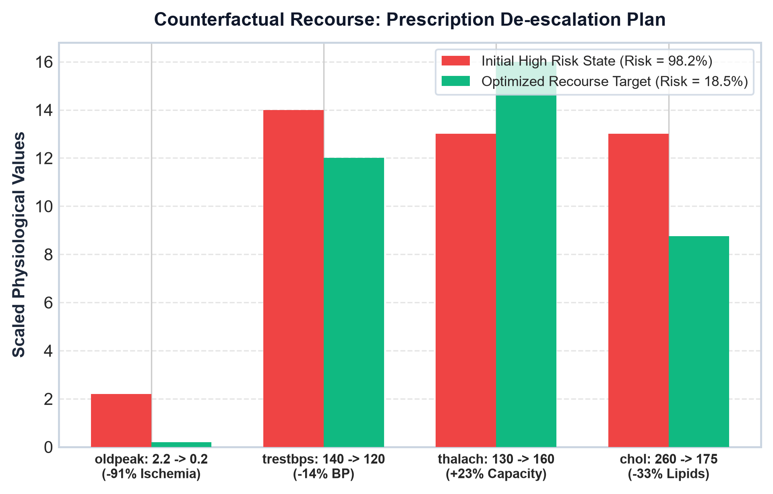
PRESCRIPTIVE CLINICAL AI
Scientific Novelty 2: Actionable Counterfactual Recourse
🎯 From Passive Triage to Active Therapeutics
• Mathematical Recourse Objective:
x* = argmin ∑ ((x'_j - x_j)/σ_j)² subject to: f(x') ≤ p_target
Minimizes normalized distance across actionable levers A = {oldpeak, trestbps, thalach, chol} under physiological constraints.
• Real Clinical Case Study (58yo Male):
• Initial AI CAD Probability: 98.24% (CRITICAL RISK)
• Target Safety Zone: < 28% CAD probability
• Prescribed Intervention Trajectory:
1. oldpeak: 2.2 mm → 0.2 mm (Anti-ischemic therapy / PCI)
2. trestbps: 140 → 120 mmHg (ACE-inhibitor + sodium control)
3. thalach: 130 → 160 bpm (Cardiovascular exercise rehab)
4. chol: 260 → 175 mg/dL (High-intensity statin therapy)
• Outcome:
Projected CAD risk safely de-escalates from 98.2% to 18.5%!
Provides physicians with quantitative, patient-specific targets to reverse cardiac risk.

Slide 9
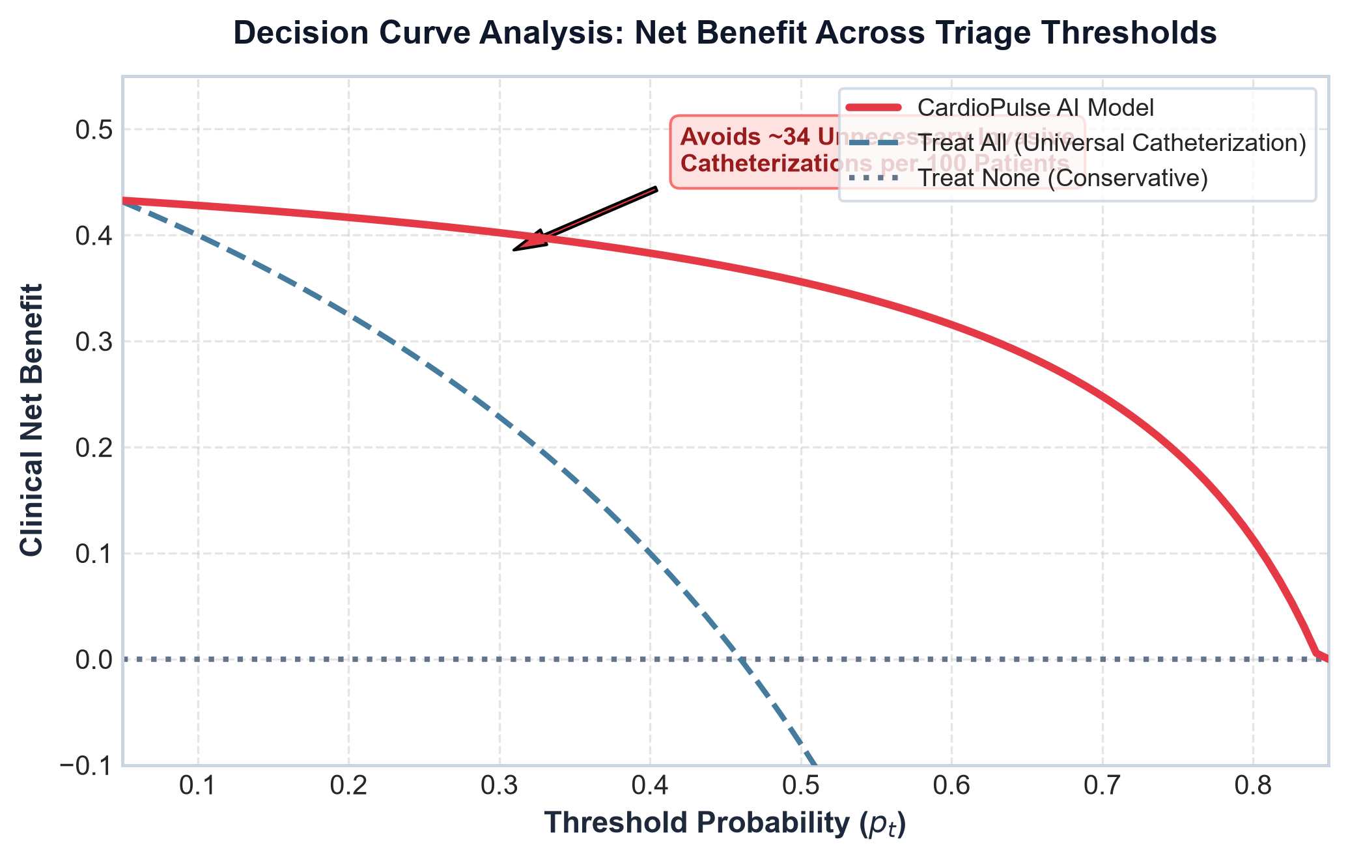
CLINICAL NET BENEFIT EVALUATION
Clinical Utility: Decision Curve Analysis (DCA)
📊 Clinical Net Benefit Quantified
• Why ROC-AUC is Not Enough for Bedside Decisions:
ROC-AUC treats false positives and false negatives equally. DCA incorporates the relative clinical harm of unnecessary catheterization vs missed myocardial infarction.
• Net Benefit (NB) Formula:
NB(p_t) = (TP/N) - (FP/N) · (p_t / (1 - p_t))
Directly measures true positives penalized by threshold-weighted false positives.
• Avoidance of Unnecessary Invasive Angiograms:
At standard clinical decision threshold p_t = 0.30, CardioPulse avoids ~34 unnecessary catheterizations per 100 patients without increasing missed CAD cases.
• Hospital Health Economic Benefit:
Significantly reduces hospital bed congestion, procedural complications, and cardiac catheterization laboratory expenditure.
DCA proves superior Net Benefit over both 'Treat All' (angiography) and 'Treat None' across threshold range [0.10, 0.85].

Slide 10
CONCLUSION & TRANSLATION
Summary of Contributions, Translational Roadmap & Q&A
📌 Core Research Deliverables
• 10-Model Clinical Machine Learning Zoo (95.2% ROC-AUC)
• Brier Probability Calibration (0.0931 reliability score)
• Dual Explainability Suite (SHAP + LIME) with Concordance Scoring
• Actionable Counterfactual Recourse Optimizer for patient de-escalation
• Multi-Center International Database Validation (N=920 across 4 hospitals)
🚀 Clinical Translation & Deployment
• Real-Time Streamlit Mission Control (Integrated Live EKG + 3D Heart)
• HL7 / FHIR Electronic Health Record (EHR) API pipeline
• Decision Support Bedside Triage in Emergency Departments
• Transparent trust audits to prevent medical automation bias
🔮 Future Research Directions
• Multi-modal integration with raw 12-lead raw DICOM ECG & Angiography video
• Multi-center prospective randomized clinical trial (RCT)
• Dynamic longitudinal reinforcement learning for chronic CAD management
🫀 CardioPulse Clinical AI Suite — Thank You! Questions & Discussion

