Slide 1
Introduction to Full Stack Development
Technologies :- [MERN]
MongoDB ExpressJS React NodeJS
Instructor
Raghavendra M J

Slide 2
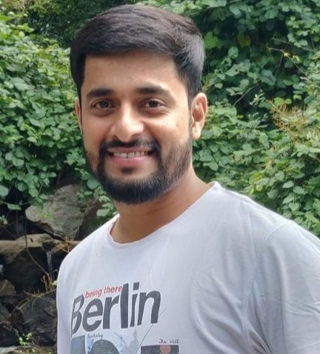
About Me
Raghavendra M J – Full Stack Developer
Have more than ten of experience in IT Industry in full stack development.
Working as Staff Software Engineer in fortune 100 companies.
Have conducted multiple training sessions on various Edtech platforms like upGrad, Great Learning, Simplilearn, NewtonSchool, HeroVired, Skill India etc on various topics on full stack development

Slide 3
Agenda
What is Software Development?
Skill sets required for this domain.
How’s the Job Market.
What it takes to be a software engineer?
What is Full Stack Development?

Slide 4
In demand skills?
Strong Computer Science Fundamentals • Full Stack, Frontend Backend , Mobile Application developers
Cyber Security
Data Science (Machine Learning and AI)
Cloud Computing ( AWS, GCP, Azure) • Distributed system Experts • Scalable Data systems (Database Engineers) • Solution Architecture
DevOps Engineers

Slide 5
Software Engineer Market Outlook – 2023 and beyond!
In 2023, global talent shortage of ~ 40M skilled workers worldwide.
By 2030, global talent shortage is predicted to reach 85.2M workers
Сompanies worldwide risk losing $8.4T in revenue because of the lack of skilled talent.
Worldwide market and technology trends are the main factors affecting the rising global talent shortage.
According to Forbes & U.S. Bureau of Labour Statistics, the demand for software engineers with the right skill set continues to skyrocket and is expected to grow 22 percent from 2019 to 2029.
Demand for Highly Skilled Software Engineers only Continuous to Grow.

Slide 6
Path to Success!
Strong Computer Science Fundamentals • Data Structures, Algorithms
Creative Problem-Solving Skills and Programming skills • Python, Java, JavaScript, Kotlin
System Design • Core Software engineering principles • Problem statement break down – manageable and scalable independent components • Object Oriented System Design • Distributed Systems Concepts, Scalable Databases
Notes:
First non repeating character?
Raghavendra -> ghvend -> 1st non repeating character!

Slide 7
Why Data Structures and Algorithms are “Must Have” for Developers?
Data Structures and Algorithms are the identity of a good Software Developer.
Data Structures and Algorithms improve the problem-solving ability of a candidate to a great extent.
Great Tech companies are more interested in seeing problem solving ability of the candidates ands how they use these tools to solve a problem.
Just like a car mechanic needs the right tool to fix a car and make it run properly, a programmer needs the right tool (algorithm and data structure) to make the software run properly.
Knowledge of data structures like Stacks, Queues, Hash Tables, Trees, Graphs, and various algorithm helps in solving real life problems efficiently
Under the hood all your SQL and Linux commands are algorithms and data structures

Slide 8
Real Life Examples
Data Structures:
Facebook and LinkedIn – Graphs
Forward and Back buttons in your favorite Browser – Doubly link List
Your compiler’s Syntax Parsing and expression evaluation – Stack
Customer Care Call management – Queues / Priority Queues
Multiplayer game – keeping Track of next player – Circular Linked List
Autocompletion in Google Search – Tries
Algorithm
Searching in a Dictionary – Binary Search
Shortest Path algorithm – Network Routing, Google Maps, Shipment Routing, Robot Path Planning
Breadth First Search - Getting Friends of friend in Facebook, Web Crawling in Google, Peer to Peer Network – Bit Torrents
Topological Sorting – Scheduling several tasks with Dependencies

Slide 9
Class Timings
Tuesday -> 9PM to 11PM
Thursday -> 9PM to 11PM
Saturday -> 9PM to 11PM
Sunday -> 9PM to 11PM

Slide 10
Topics Covered
FrontEnd
HTML
CSS
JavaScript
Framework:- React
BackEnd
NodeJS
ExpressJS
MongoDB
Project
2 to 3 Projects

Slide 11
DSA Course
MAANG → 1- to 15 questions
Arrays
Stacks
Queues
Heaps
Recursion
Dynamic Programming
Trees
Binary Trees
BST
Graphs

