Slide 1

Generative AI | Google Flash | LLAMA 3-8b | Langchain
Dr. HeAlify
(An AI-powered Doctor)
NAME : KARTAVYA MASTER

Slide 2
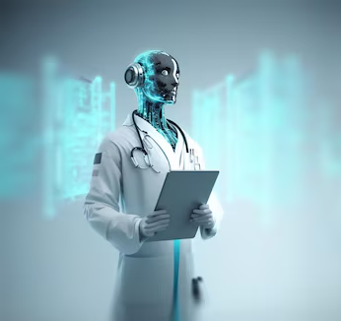
Objective
The primary objective of the Dr. HeAlify project is to develop an AI-powered healthcare- assistant that enhances the healthcare experience for users.
By providing an intuitive platform for medical report summarization and an AI-powered chatbot for real-time assistance
Medical Report Summarization : Understand key findings, diagnoses, and recommendations in medical reports and provides personalized health advice,
AI-powered Chatbot: Ask health questions, receive medical advice, and get health guidance from Dr. HeAlify Bot. By leveraging advanced AI technologies, The project aims to enhance the healthcare experience, user-friendly interface that improves patient engagement and understanding.

Slide 3
Prototype
The Dr. HeAlify prototype includes:
Medical Report Summarization:
Users can upload their medical reports in PDF format.
The AI model processes the reports and generates summaries highlighting key findings, diagnoses, treatments, and recommendations.
AI-powered Chatbot (Dr. HeAlify Bot):
Users can interact with the chatbot to get real-time medical advice and assistance.
The chatbot answers queries, provides health tips, and guides users on their healthcare journey.
User Interface:
A user-friendly interface built with Flask and Streamlit for easy navigation.
Features include a sidebar menu with options for home, medical report summarization, and chatbot interaction.

Slide 4
Working of the Model
Medical Report Summarization:
File Upload: Users upload a PDF medical report via the application.
AI Processing: The report is processed using advanced AI models (e.g., ChatGroq with Llama3).
Summarization: The AI extracts key findings, diagnoses, treatments, and recommendations, generating a concise summary.
Presentation: The summary is displayed in an easy-to-understand format, highlighting significant medical details
Dr. HeAlify Bot:
User Interaction: Users interact with the chatbot by typing their queries.
AI Response: The chatbot uses a generative AI model (e.g., Google Flash) to understand and respond to user queries.
Advice and Assistance: The bot provides detailed health advice, potential diagnoses, and treatment suggestions.
Continuous Learning: The AI model continuously improves its responses through user interactions, ensuring better assistance over time.

Slide 5
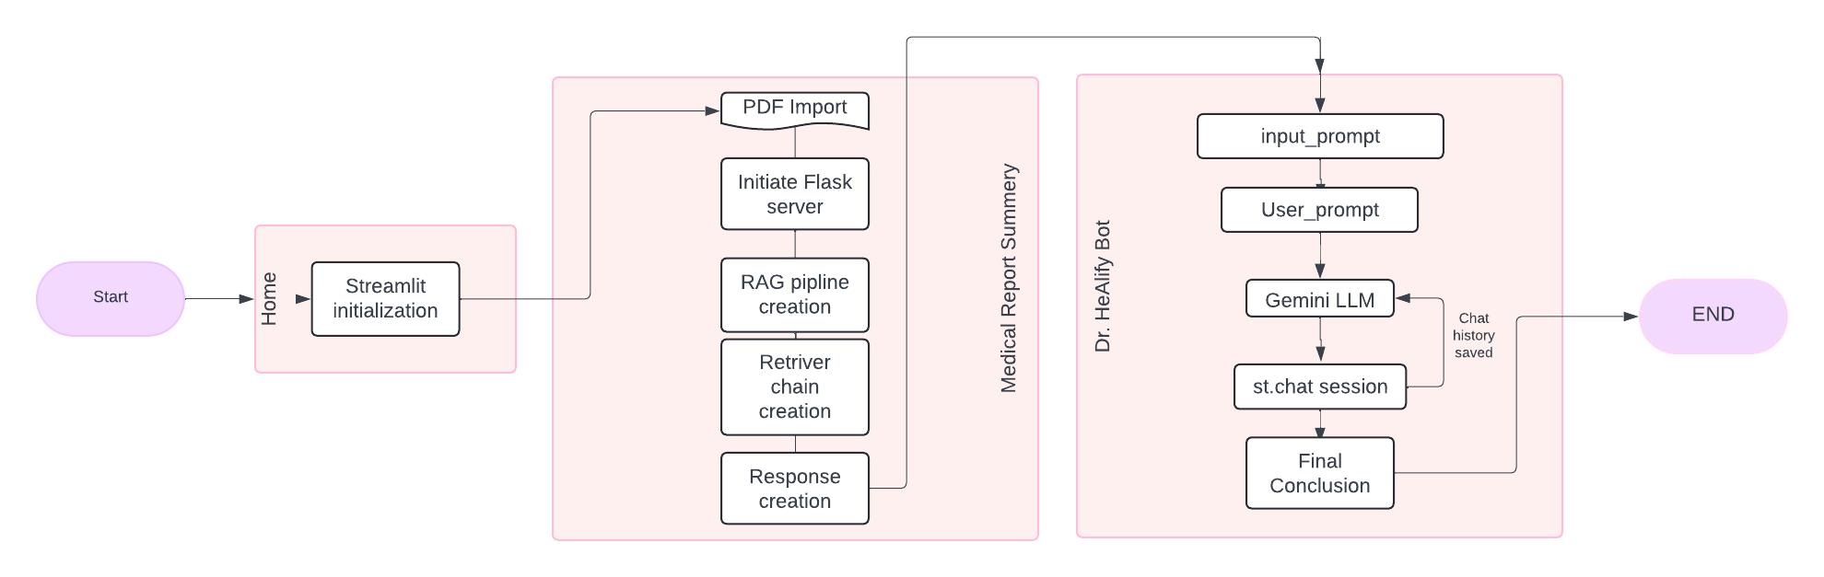
Work Flow (Flow-Chart)

Slide 6
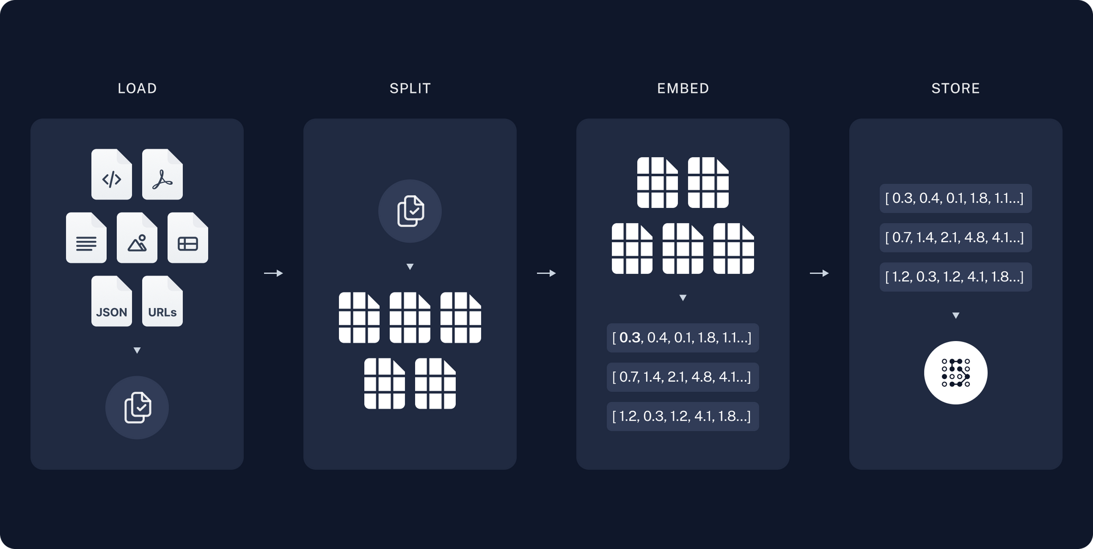
RAG Architecture

Slide 7
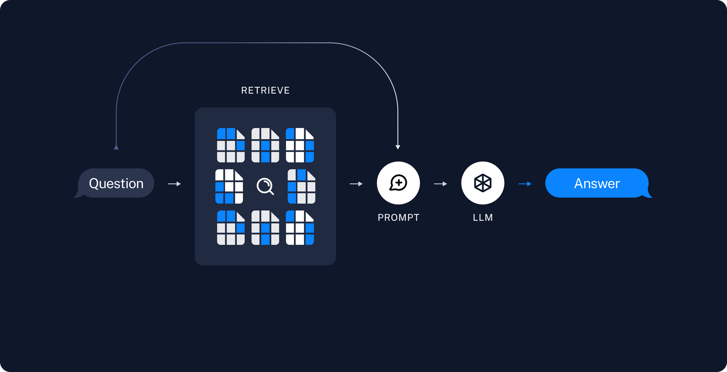
Retrieval and Response Generation

Slide 8
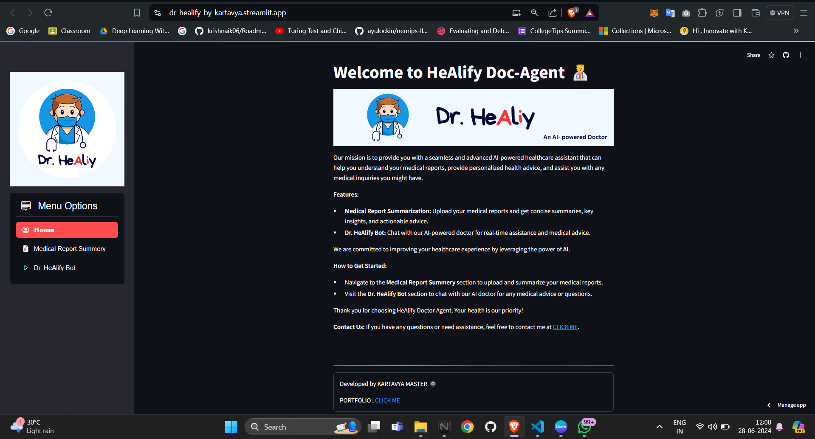
Working of the model (Home page)

Slide 9
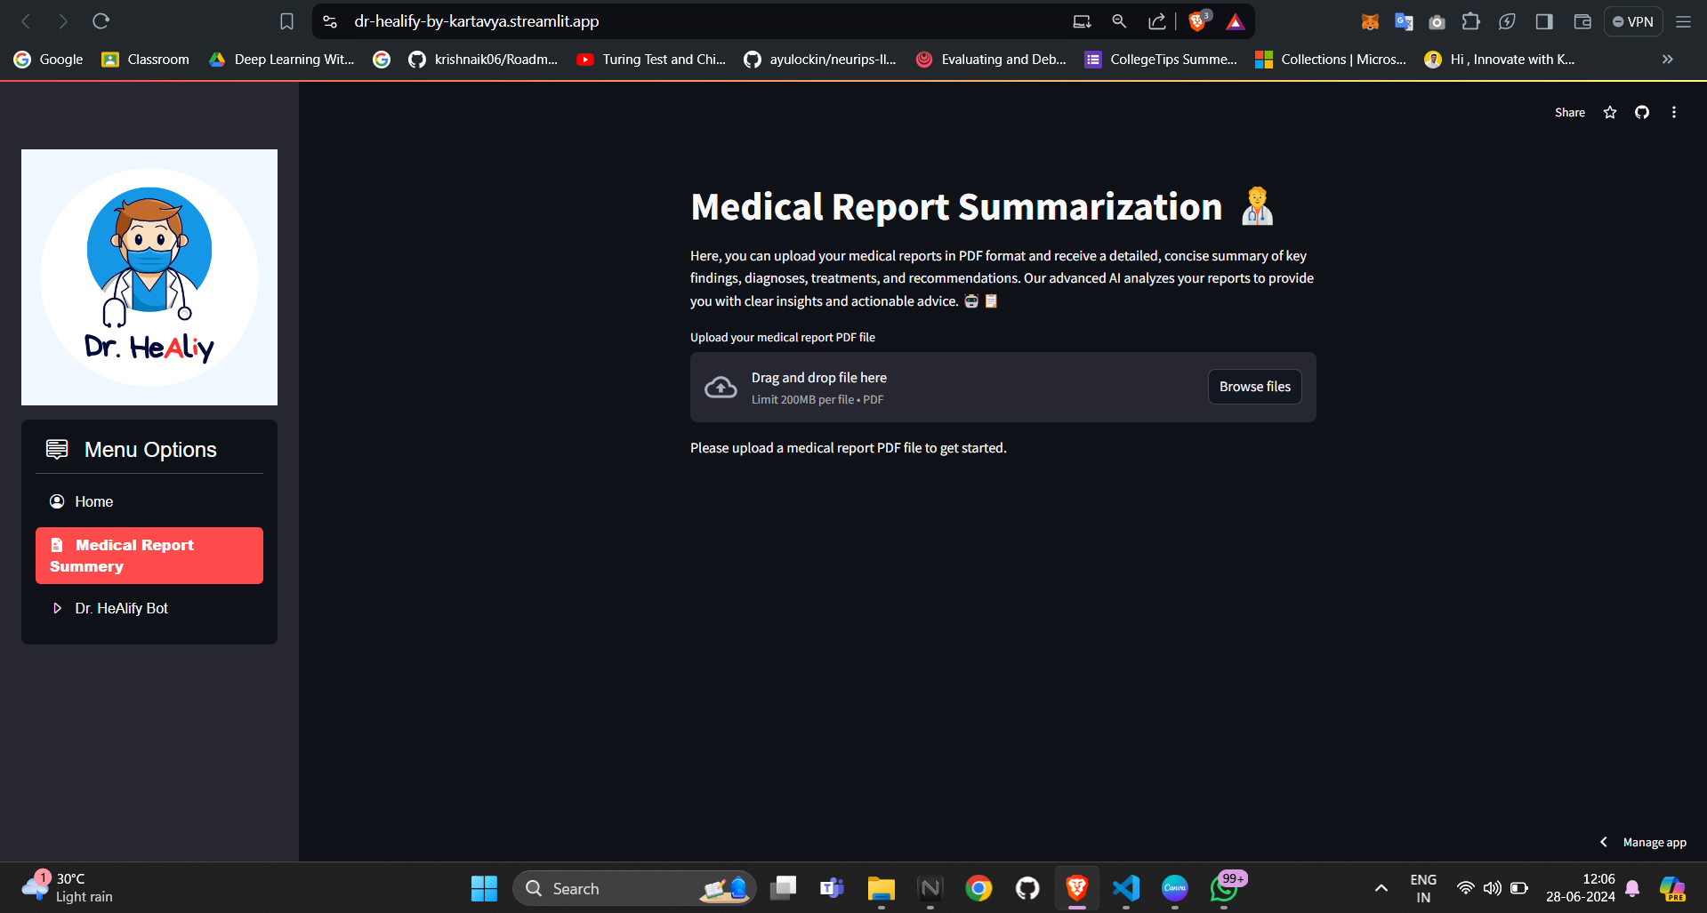
Working of the model (Medical Report Summery)

Slide 10
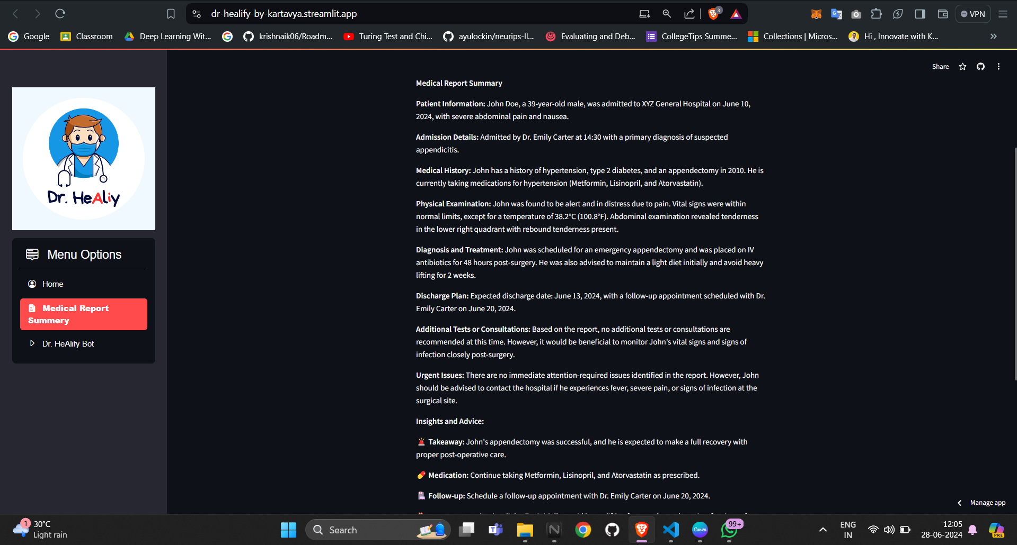
Working of the model (Medical Report Summery)

Slide 11
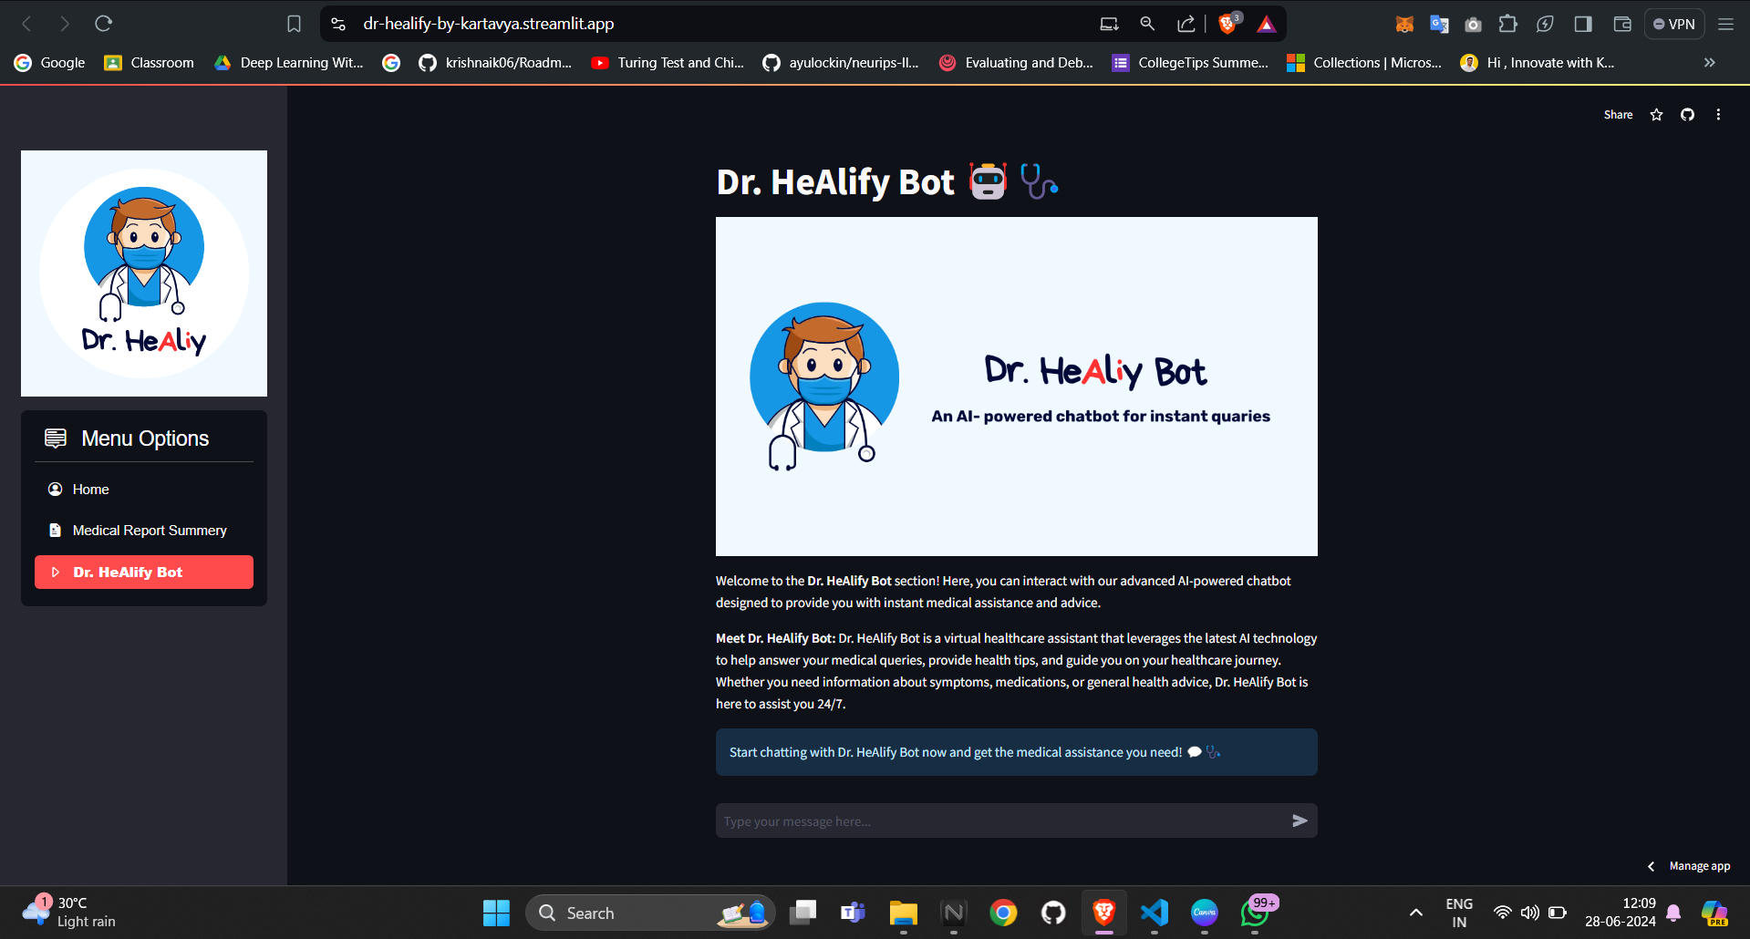
Working of the model (Dr. HeAlify Bot)

Slide 12
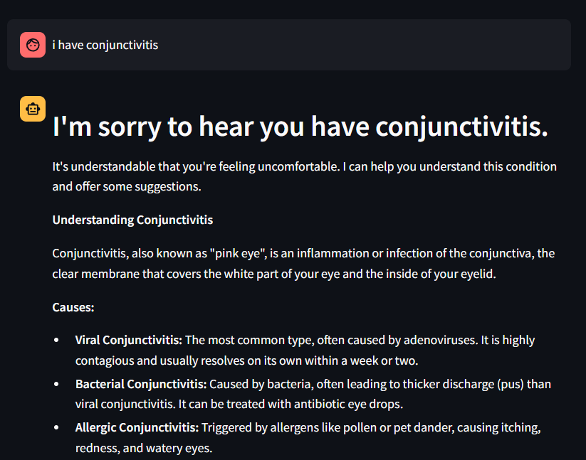
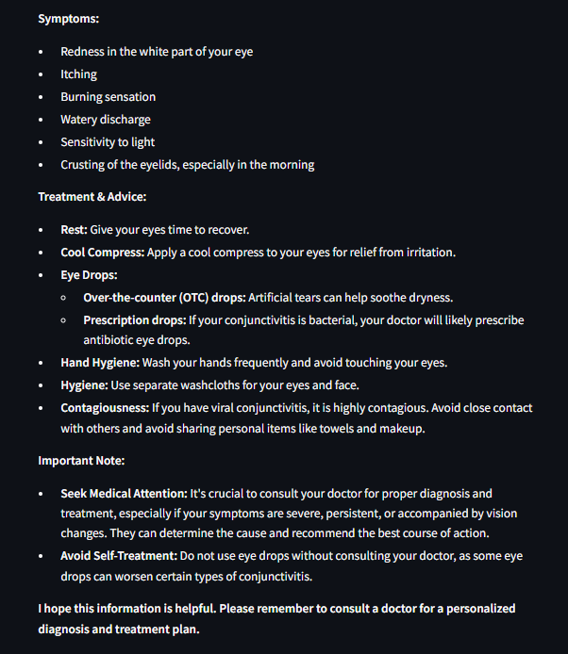
Working of the model (Dr. HeAlify Bot)

Slide 13


LINKS
Github
Streamlit
Dr. HeAliy

Slide 14
Scope of the Project
Immediate Benefits:
Enhanced Patient Understanding: By summarizing medical reports, users can better understand their health conditions and treatments.
Quick Access to Medical Advice: The chatbot provides instant responses to medical queries, improving accessibility to health information.
Improved Patient Engagement: Users are more engaged in their healthcare journey, leading to better health outcomes.
Future Enhancements:
Integration with Electronic Health Records (EHR) Systems: Seamless integration with EHR systems for comprehensive medical data access.
Language and Regional Expansion: Expanding the application to support multiple languages and regional medical practices.
Mobile Application Development: Creating a mobile app for broader accessibility and convenience.

Slide 15
Reference
Google Gemini Documentation
Krish Naik (Youtube)
Conclusion
Dr. HeAlify represents a significant advancement in the application of AI in healthcare. By providing an intuitive platform for medical report summarization and an AI-powered chatbot for real-time assistance, Dr. HeAlify aims to improve patient outcomes and satisfaction. The project demonstrates the potential of AI to transform the healthcare industry by making medical information more accessible and understandable for everyone. Dr. HeAlify is poised to become a valuable tool in the healthcare ecosystem, bridging the gap between complex medical data and patient comprehension.

Slide 16


