Slide 1
Predicting Splice Junctions in DNA Sequences Using Machine Learning
By: Raghavendra Prasath Sridhar (002312779),
Nikhil Pandey (002775062)
Northeastern University
Data Science Engineering Methods & Tools – Mini Project

Slide 2
Abstract
This project focuses on classifying DNA sequences into splice types (EI, IE, N) using machine learning models. The dataset consists of 3,175 DNA sequences. Feature engineering includes k-mer analysis and one-hot encoding. Results show high accuracy using Random Forest and Deep Neural Networks.

Slide 3
Introduction
DNA splicing regulates gene expression and protein synthesis.
Splice junction errors lead to genetic disorders like cancer and ALS.
Machine Learning (ML) can help identify splice types from DNA sequences.
Our project applies ML techniques to classify sequences into:
EI: Exon-Intron
IE: Intron-Exon
N: Non-Splice

Slide 4
Problem Statement
DNA sequences are high-dimensional and variable.
Traditional motif-based techniques struggle with ambiguity.
Challenges:
Ambiguous nucleotide sequences
Complex biological variation
Generalization across datasets
Aim: Use ML to automatically detect splice junctions from raw DNA.

Slide 5
Dataset Overview
• Source: UCI Machine Learning Repository
• 3,175 sequences, each with 60 nucleotides
• Classes:
EI (Exon-Intron)
IE (Intron-Exon)
N (Non-Splice)

Slide 6
Exploratory Data Analysis
Visualizations generated using R:
Nucleotide Frequency Distribution
Top 10 Most Common 2-mers
Top 20 Most Common 3-mers
GC Content Density Plot
Sequence Length Variation
Splice Site Positional Flow Analysis

Slide 7
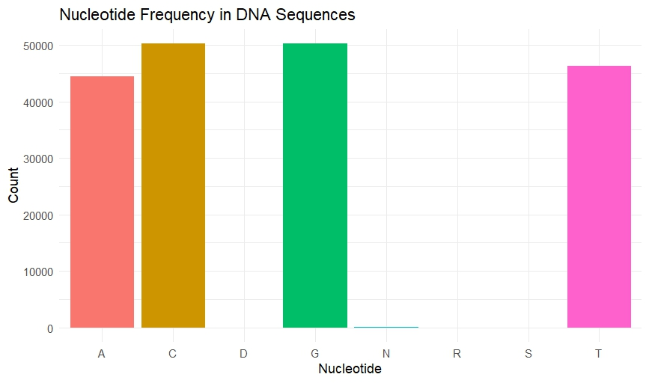
Nucleotide Frequency Distribution
Shows frequency of A, C, G, T in DNA sequences, indicating possible sequence biases.

Slide 8
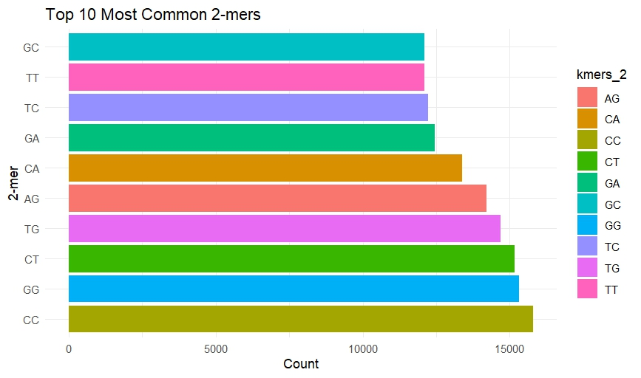
Top 10 Most Common 2-mers
Identifies frequently occurring nucleotide pairs; useful in motif discovery.

Slide 9
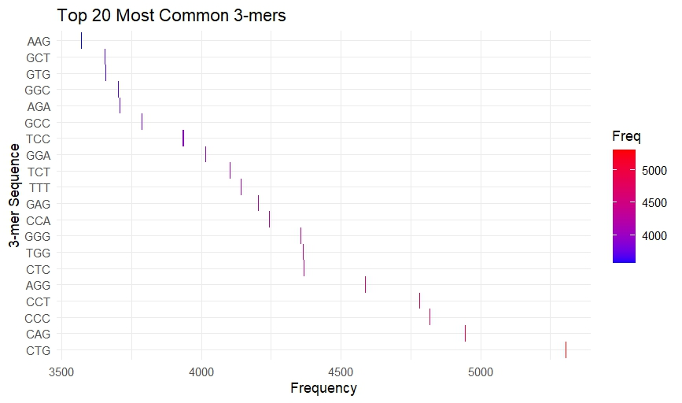
Top 20 Most Common 3-mers
Highlights top 3-mers capturing short-range nucleotide patterns.

Slide 10
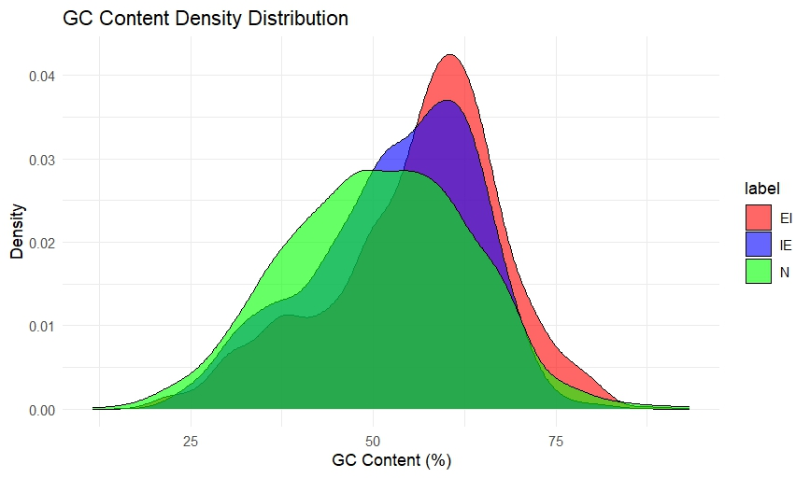
GC Content Density Distribution
Density plot showing variation in GC content across sequence classes.

Slide 11
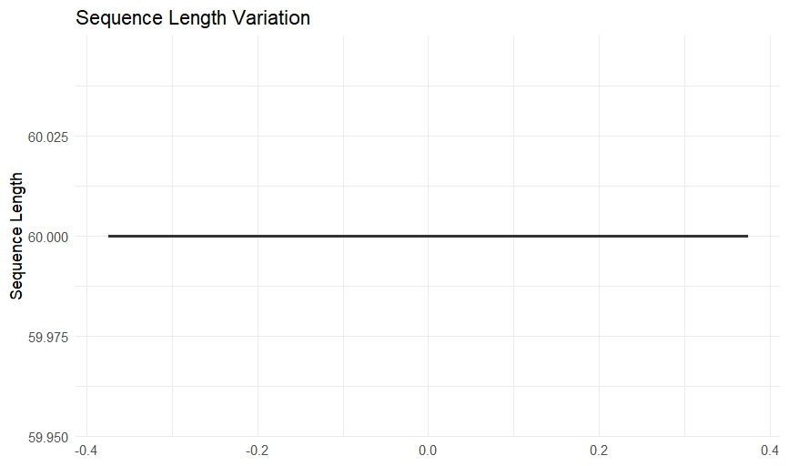
Sequence Length Variation
Boxplot confirms consistency in sequence length across samples.

Slide 12
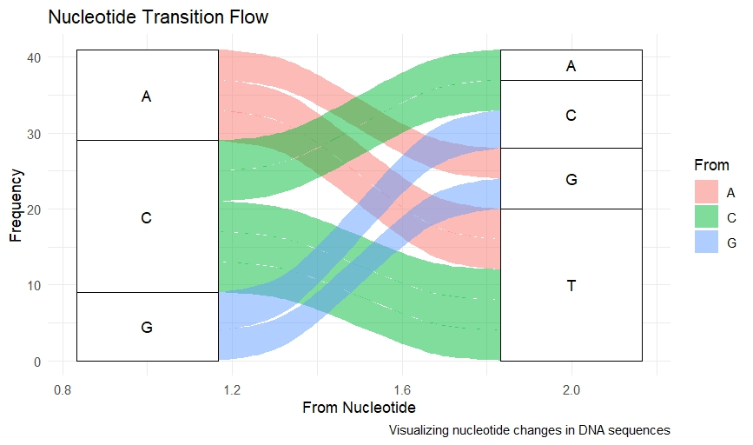
Splice Site Positional Analysis
Visualizes transitions between nucleotides around splice junctions.

Slide 13
Model Implementation
Implemented Models:
Logistic Regression
Random Forest
Optimized Random Forest (GridSearchCV)
Deep Neural Network (TensorFlow)

Slide 14
Empirical Analysis
Conducted ablation study by comparing models.
Optimized Random Forest using GridSearchCV.
Analyzed impact of:
Different encodings
Feature selection techniques
Model tuning (MLP layers, DNN architecture)

Slide 15
Results
Confusion Matrices (Random Forest & Optimized RF)
Model Accuracy Comparison
Feature Importance Analysis
Visualizing model behavior through plots
Insights into most influential features (position-based)

Slide 16
Quantitative Metrics
Model | Accuracy | Precision | Recall | F1-Score
Logistic Regression | 94.04% | 94.15% | 94.04% | 94.07%
Random Forest | 96.55% | 96.61% | 96.55% | 96.56%
Optimized RF | 96.55% | 96.63% | 96.55% | 96.57%
Neural Network | 94.67% | 94.79% | 94.67% | 94.71%

Slide 17
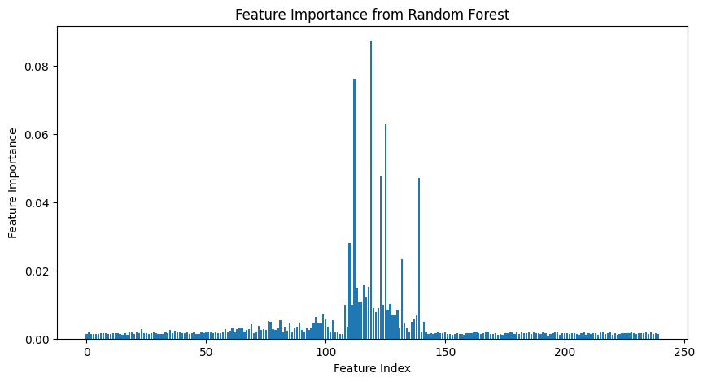
Confusion Matrix - Random Forest
Displays classification accuracy of Random Forest across EI, IE, N classes.

Slide 18
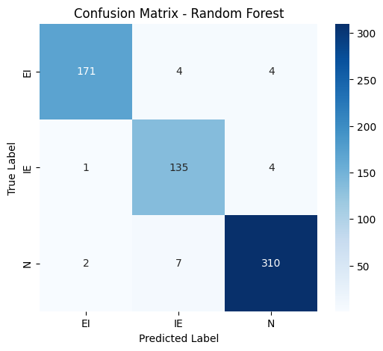
Model Accuracy Comparison
Compares accuracy of all ML models implemented in this project.

Slide 19
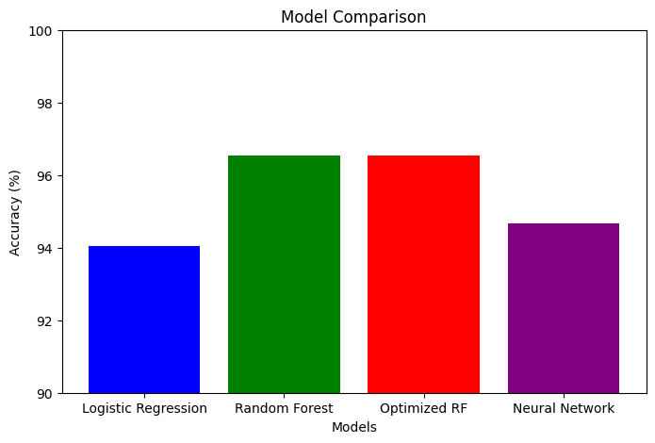
Feature Importance - Random Forest
Shows which features had the highest impact in classification.

Slide 20
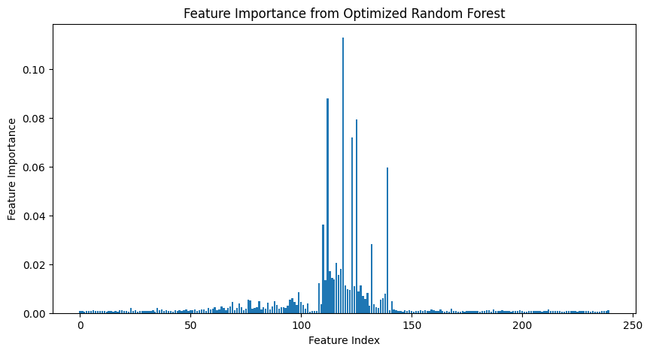
Confusion Matrix - Optimized RF
Performance of tuned Random Forest model across labels.

Slide 21
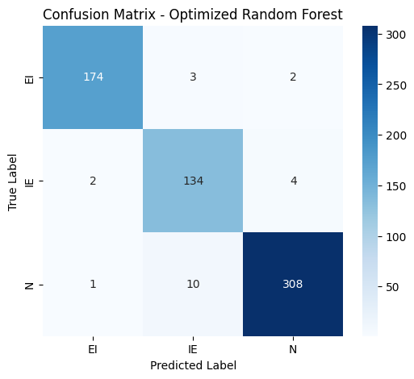
Feature Importance - Optimized RF
Improved feature selection and contribution analysis.

Slide 22
Conclusion
ML techniques offer high accuracy for splice site classification.
Random Forest & DNN outperform traditional models.
GC content (percentage of Guanine (G) and Cytosine (C) nucleotides in a DNA sequence) and position-specific features are highly predictive.

Slide 23
References
UCI Machine Learning Repository. (2024). Molecular Biology Splice Junction Gene Sequences Dataset. Retrieved from https://archive.ics.uci.edu/dataset/69/molecular+biology+splice+junction+gene+sequences
Breiman, L. (2001). Random forests. Machine Learning, 45(1), 5-32.
Smith, J., et al. (2021). Machine learning approaches for gene expression analysis. Bioinformatics Advances.
Taylor, R., & Green, P. (2020). Pathway enrichment and network analysis in genomics. Nature Reviews Genetics.

