Slide 1
ZENASTRA INDUSTRIES
Grow revenue from
₹10 crore to ₹100 crore.
Reduce avoidable cost from ₹100 to ₹10.
We help companies save lakhs to crores by building private AI operating systems for finance, growth and everyday execution.
One-time setup from ₹20 lakh+
A small fraction of the value we help unlock.
For companies and individuals • NDA-first • local control • continuous guidance
Raghav Agarwal • https://in.linkedin.com/in/raghav-agarwal-86854521b
Notes:
We create operating leverage: better control, lower leakage, faster decisions and scalable growth.

Slide 2
Three AI operating systems. One transformation partner.
Start with the highest-value problem. Expand into a company-wide operating layer.
01
AI ACCOUNTANT
02
COMPANY OPERATING SYSTEM
03
PERSONAL OPERATING SYSTEM
Reports • GST • filing • analysis • Tally data entry
Voice AI • sales • outreach • marketing • dashboards
Owner’s AI chief-of-staff
Reduce recurring accounting cost from thousands to lakhs monthly; identify leakage and improve decisions.
Automate workflows, talk to customers on WhatsApp, coordinate teams and report to leadership.
Hire, manage, follow up, automate Gmail/CRM and turn employee updates into action.
TALLY SILVER/GOLD + LOCAL COMPUTER
AI AGENTS + VOICE + WHATSAPP
PRIVATE OWNER CONTROL

Slide 3




Our customers
Selected brands we have supported across finance, growth and customer reach.
Cotton Jersey
Financial review, GST setup and reported savings opportunity.
The Love Band
Global customer reach and marketing growth support.
Labels by Preeti Anand
Instagram growth and international customer reach.
Ikris Pharma Network
Financial cost reduction and global outreach support.

Slide 4
Use case 1 — AI Accountant.
A private finance intelligence layer connected to your local Tally data.
WHAT YOU NEED
WHAT IT DOES
• TallyPrime Silver or Gold
• Your local computer
• Your company’s authorised approval
• AI provider credits paid directly by you, where applicable
1
All major financial reports and analysis
2
Receivables, payables, inventory and cash visibility
3
GST filing support, checks and structured data
Your data stays under your control. The system profiles the open company’s ledgers, groups, voucher types and items before writing.
4
Bill understanding → matching → draft → approval → Tally entry
5
Answers from your phone, using your own local data
Potential opportunity: lakhs to crores
from cost reduction and better control.
Outcome: replace repetitive manual work, catch leakage earlier and create a path from ₹10 crore to ₹100 crore.

Slide 5
Use cases 2 & 3 — automate the company and the owner.
COMPANY OPERATING SYSTEM
PERSONAL OPERATING SYSTEM
1
Voice AI that talks to teams and leadership
1
Owner’s AI chief-of-staff on phone or computer
2
Sales, outreach and social marketing agents
2
Hiring support for HR, sales and management roles
3
WhatsApp automation for customer conversations 24/7
3
Follow-ups, reminders, meeting and task execution
4
Gmail, CRM, dashboards and employee updates
4
Private operating dashboard for what is and is not getting done
5
Workflow automation across the organisation
5
Turn scattered information into decisions and action
Automate the work. Keep the company moving.
Give the owner leverage without adding headcount.

Slide 6
Perks, protection and the implementation promise.
WHAT YOU GET FOR ₹20 LAKH+
HOW WE START
1
One-time implementation, not a permanent Zenastra software fee
1
Sign NDA + agreement
2
NDA and business agreement before work begins
2
Show the Accountant Agent and results
3
AI Accountant proof-of-value demonstration first
4
Private local-host deployment and owner control
3
Confirm opportunity and scope
5
Employee training and rollout guidance
4
Receive implementation payment
6
WhatsApp, reporting and workflow automation roadmap
7
Ongoing support and help when you need it
5
Install, configure, train and support
8
AI provider credit costs paid directly by your company
We charge a fraction of the value we aim to create—not the value of your problem.

Slide 7

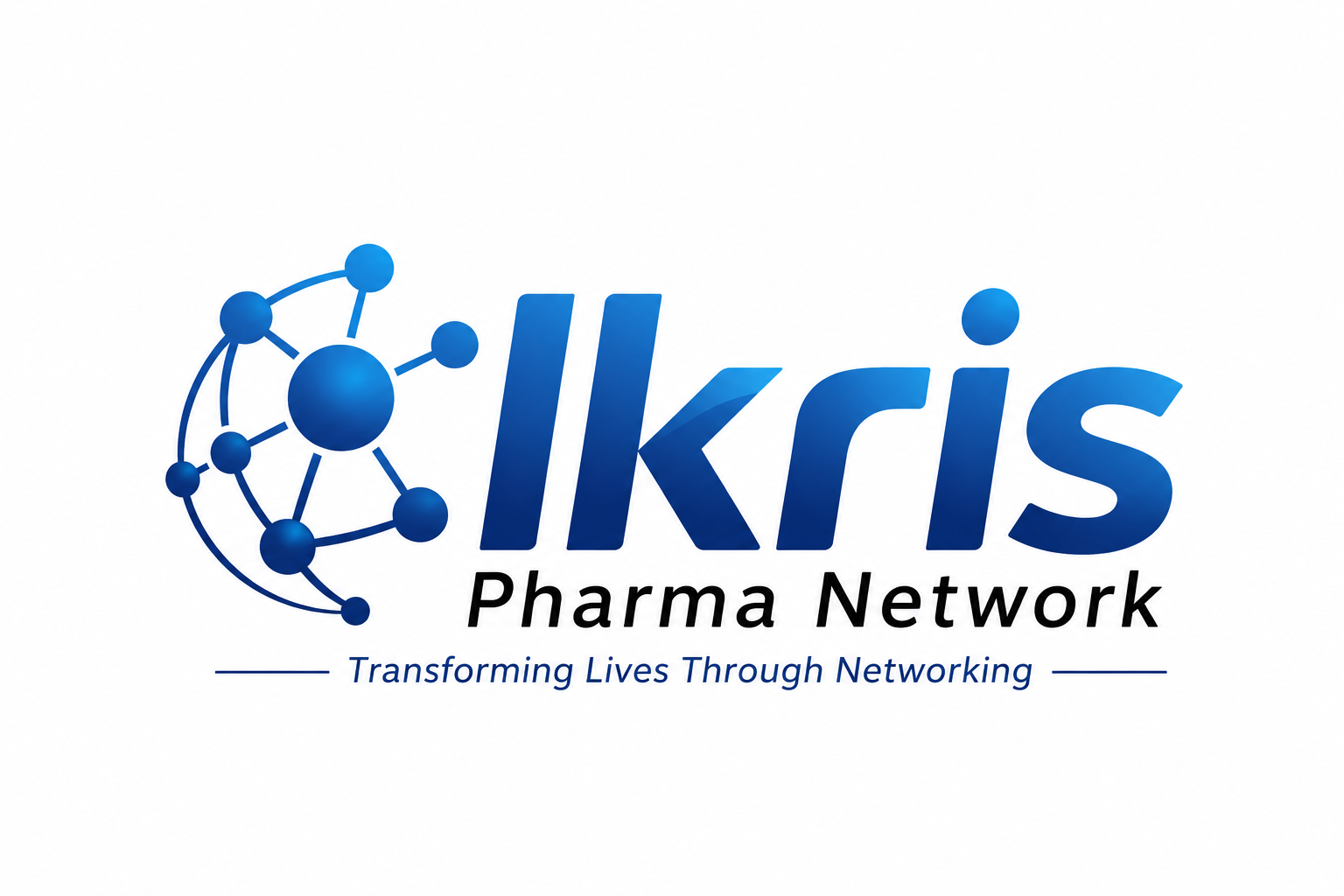

Trust, verification and evidence.
Built for confidential conversations with founders, CFOs and leadership teams.
CERTIFICATIONS & REGISTRATION
REPORTED CLIENT OUTCOMES
CIN
U62090WB2025PTC280868
Cotton Jersey
Financial review, GST setup and a reported savings opportunity of approximately ₹80 lakh.
GSTIN
19AACCZ6798B1ZT
The Love Band
Global customer reach and marketing growth support.
DPIIT
DIPP213909
Labels by Preeti Anand
Instagram growth from approximately 200 to 1,000+ followers and customers in the USA and Canada.
DATA
DPDP-aligned local-control approach
We will provide supporting certificates and verification documents during the NDA and diligence process.
Ikris Pharma
Financial cost reduction and global customer outreach support.
Let’s discuss your first measurable opportunity.
Raghav Agarwal • https://in.linkedin.com/in/raghav-agarwal-86854521b
contact@zenastraindustries.com • raghav22062003ss@gmail.com
zenastraindustries.com • WhatsApp: +91 93308 60396

