Slide 1

Introduction : This project aims to evaluate the Country Info SOAP (Simple Object Access Protocol) web service using the SOAP UI tool. The web service offers multiple operations to retrieve information about countries, including their name, capital city, languages, region, country code, currency code, phone code, and flag details. The service is accessible through the provided reference link.
Scope : The scope of this project involves testing the various operations supported by this web service and conducting a sanity test using multiple test cases. These test cases will demonstrate the use of various assertions and Groovy script validations, ensuring the API is robust and adheres to ACID properties (Atomicity, Consistency, Isolation, Durability).
Prerequisite : SOAP UI tool installed in Windows or Mac system.
Created By | Raghav Agnihotri
 | raghavhsp@gmail.com
 | https://www.linkedin.com/in/raghavhsp/
 | https://github.com/raghavhsp/
 | +91-8800519888

Slide 2
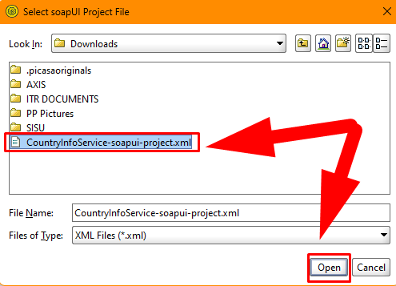
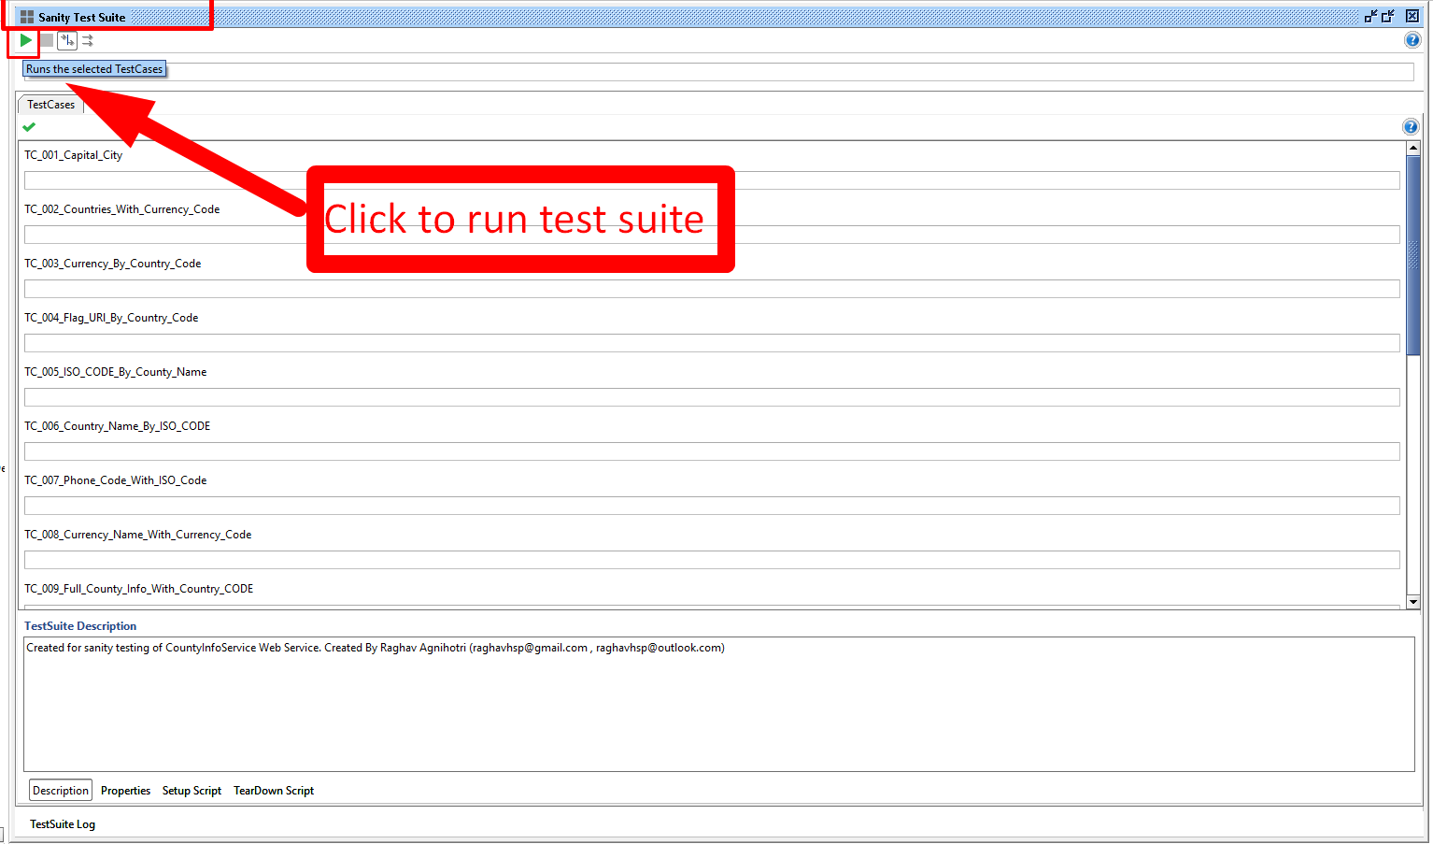
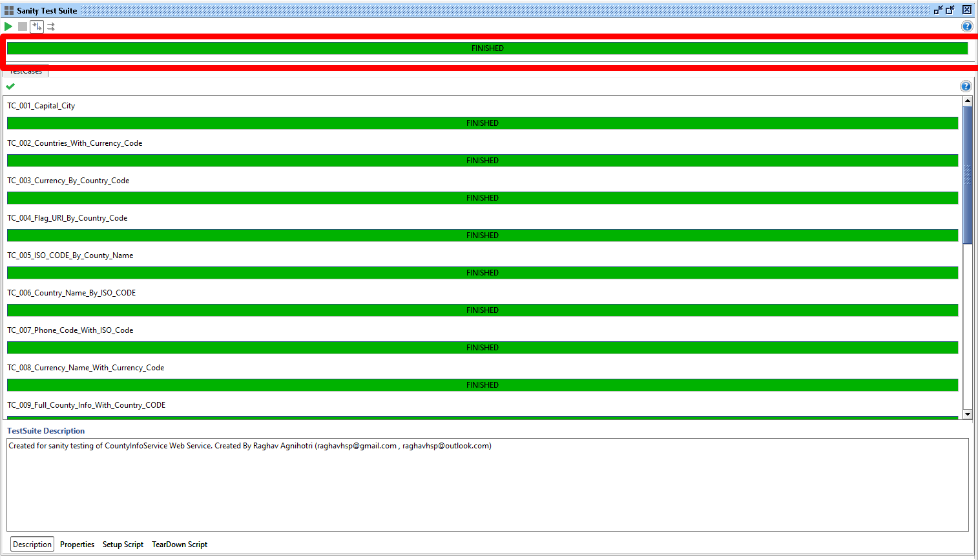
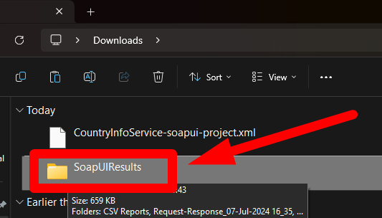
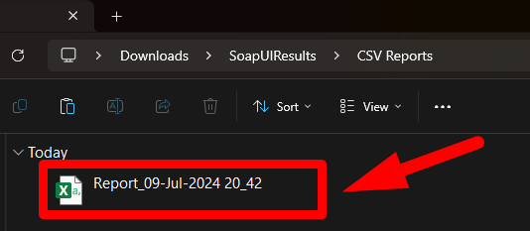
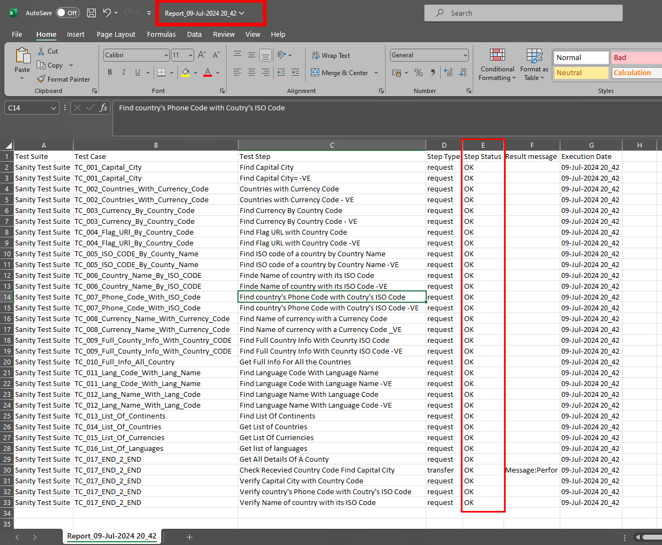
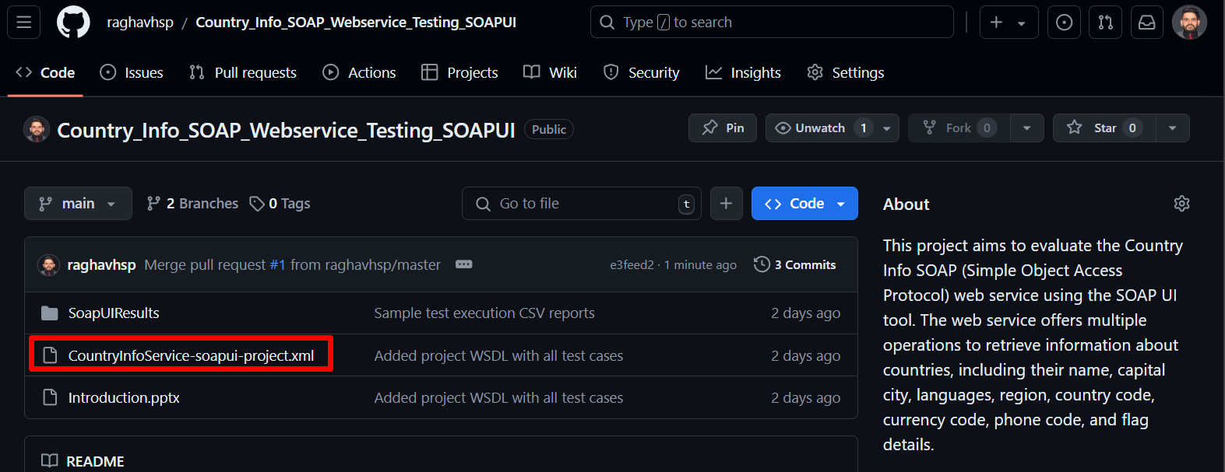
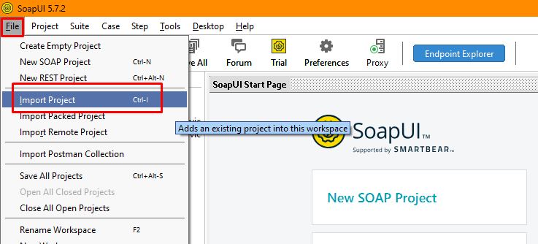
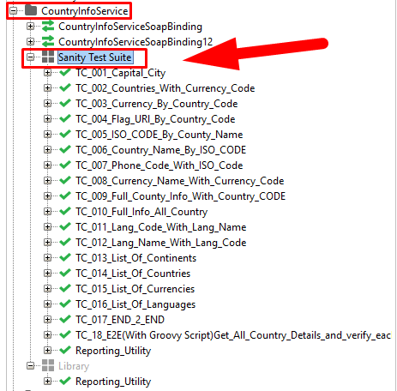
Step by step guide to setup and use this project.

Slide 3
Step 1: Download the project WSDL file from github.

Slide 4
Step 2: Download and install the SoapUI tool (open source) and import the downloaded WSDL into SoapUI after installation.

Slide 5
Step 3: After importing the downloaded WSDL file a SOAP project should be created in Soap Ui with all the operation of Country Info API and the associated test suite for sanity testing of features of this SOAP webservice. Double click on the test suite indicated to open test suite and see the details of test cases in the test suite.

Slide 6
Step 4: In test suite window click on Run icon to run all the tests cases present in test suite.

Slide 7
Step 5: Validate the results in SoapUI after completion of test execution as shown below.

Slide 8
Step 6: For result posting a CSV result file will be created in a new folder in the root directory of the WSDL file.

Slide 9
Step 7: Open the CSV file to check details of test execution.

Slide 10

Step 8: Reach me out for more details if needed.
Created By | Raghav Agnihotri
 | raghavhsp@gmail.com
 | https://www.linkedin.com/in/raghavhsp/
 | https://github.com/raghavhsp/
 | +91-8800519888

