Slide 1
KPI Analysis Report
Data Source: Kaggle: julialy900/marketing-campaign-analysis
Generated: September 25, 2025

Slide 2
Executive Summary
Dataset Overview: 1,116 rows, 8 columns
• Data quality: Good (0.0% missing values) • High variability detected in: CTR, Clicks • Action_Type: ...
• Data quality: Good (0.0% missing values) • High variability detected in: CTR, Clicks • Action_Type: ...
• Data quality: Good (0.0% missing values) • High variability detected in: CTR, Clicks • Action_Type: ...
• Data quality: Good (0.0% missing values) • High variability detected in: CTR, Clicks • Action_Type: ...

Slide 3
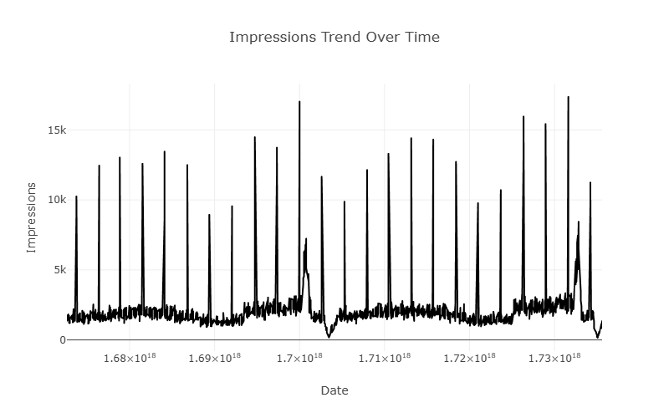
Impressions Trend Over Time
Insight: Data quality: Good (0.0% missing values) • High variability detected in: CTR, Clicks • Action_Type: Dominated by 'Instagram Post' category

Slide 4
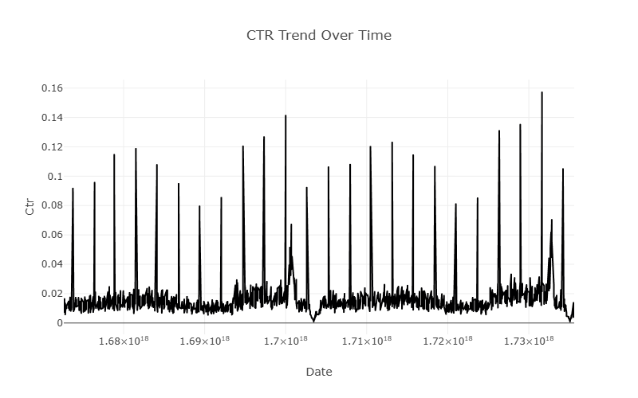
CTR Trend Over Time
Insight: Data quality: Good (0.0% missing values) • High variability detected in: CTR, Clicks • Action_Type: Dominated by 'Instagram Post' category

Slide 5
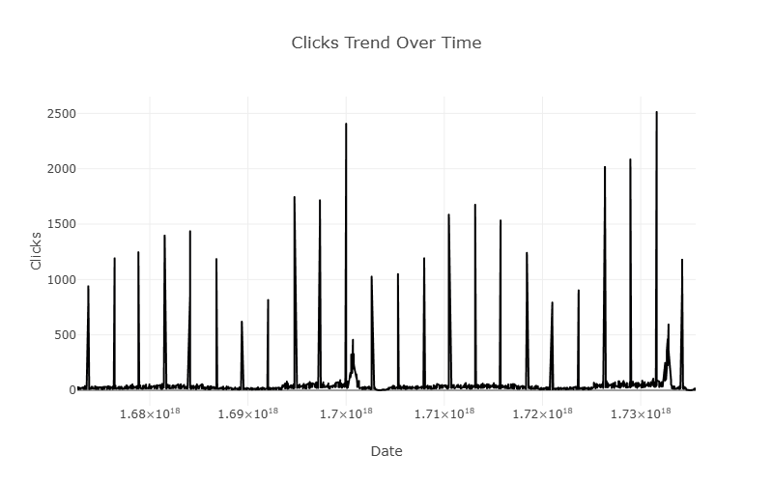
Clicks Trend Over Time
Insight: Data quality: Good (0.0% missing values) • High variability detected in: CTR, Clicks • Action_Type: Dominated by 'Instagram Post' category

Slide 6
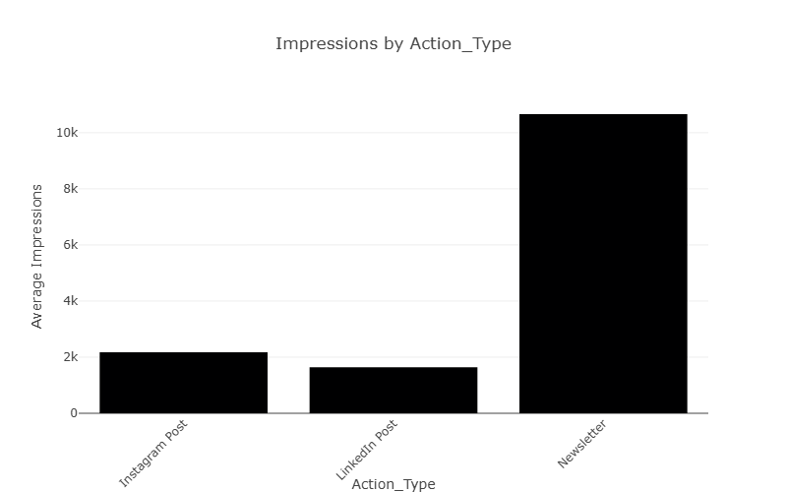
Impressions by Action_Type
Insight: Data quality: Good (0.0% missing values) • High variability detected in: CTR, Clicks • Action_Type: Dominated by 'Instagram Post' category

Slide 7
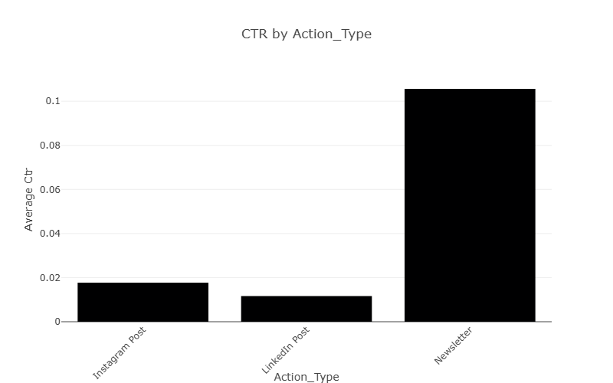
CTR by Action_Type
Insight: Data quality: Good (0.0% missing values) • High variability detected in: CTR, Clicks • Action_Type: Dominated by 'Instagram Post' category

Slide 8
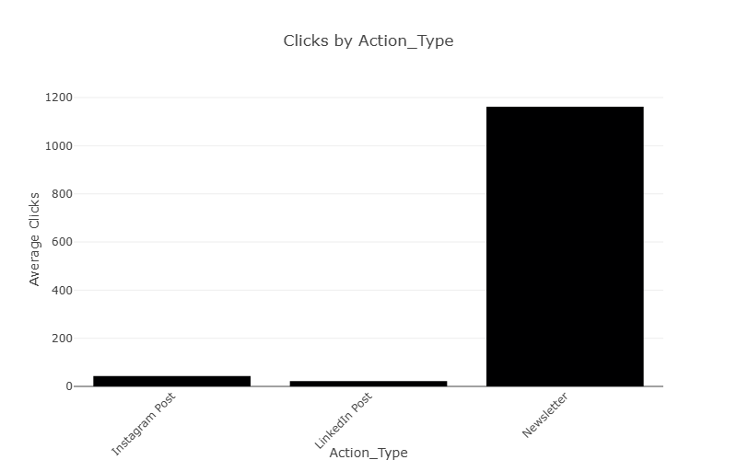
Clicks by Action_Type
Insight: Data quality: Good (0.0% missing values) • High variability detected in: CTR, Clicks • Action_Type: Dominated by 'Instagram Post' category

