Slide 1
KPI Analysis Report
Data Source: Kaggle: julialy900/marketing-campaign-analysis
Generated: September 25, 2025

Slide 2
Executive Summary
Dataset Overview: 1,116 rows, 8 columns
• Impressions remains relatively stable over time, suggesting consistent performance without major vol...
• Impressions remains relatively stable over time, suggesting consistent performance without major vol...
• Impressions remains relatively stable over time, suggesting consistent performance without major vol...
• 2024-09-15 leads in Impressions performance, outperforming 2023-12-25 by 7658%. This suggests succes...

Slide 3
Impressions Trend Over Time
Chart: Impressions Trend Over Time
Note: Chart image could not be embedded.
Error: Error 525: Failed to execute 'getPointAtLength' on 'SVGGeometryElement': The element's path is empty.

Slide 4
CTR Trend Over Time
Chart: CTR Trend Over Time
Note: Chart image could not be embedded.
Error: Error 525: Failed to execute 'getPointAtLength' on 'SVGGeometryElement': The element's path is empty.

Slide 5
Clicks Trend Over Time
Chart: Clicks Trend Over Time
Note: Chart image could not be embedded.
Error: Error 525: Failed to execute 'getPointAtLength' on 'SVGGeometryElement': The element's path is empty.

Slide 6
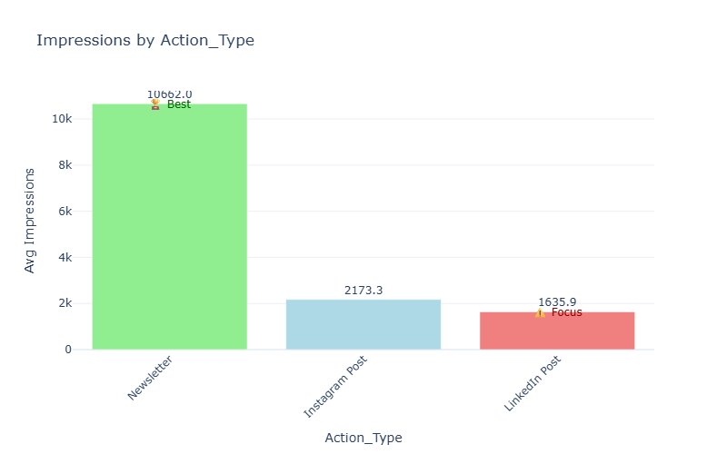
Impressions by Action_Type
Insight: 2024-09-15 leads in Impressions performance, outperforming 2023-12-25 by 7658%. This suggests successful strategies in 2024-09-15 that could be replicated elsewhere. There's significant variation in Impressions across different Date categories, indicating potential optimization opportunities.

Slide 7
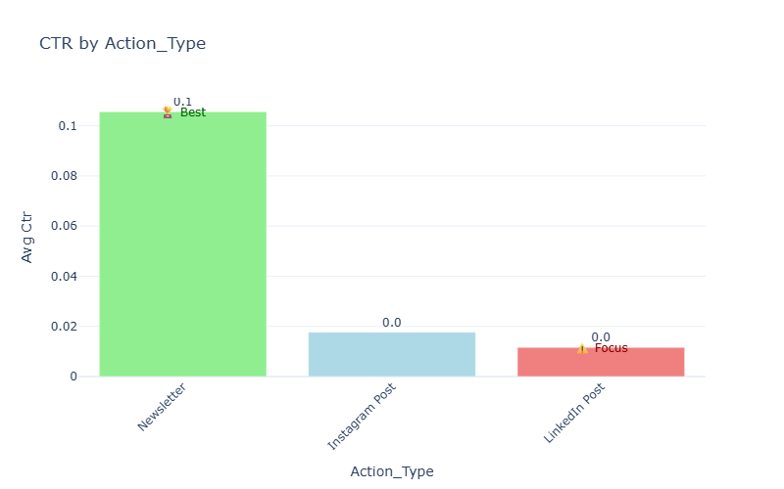
CTR by Action_Type
Insight: 2024-09-15 leads in Impressions performance, outperforming 2023-12-25 by 7658%. This suggests successful strategies in 2024-09-15 that could be replicated elsewhere. There's significant variation in Impressions across different Date categories, indicating potential optimization opportunities.

Slide 8
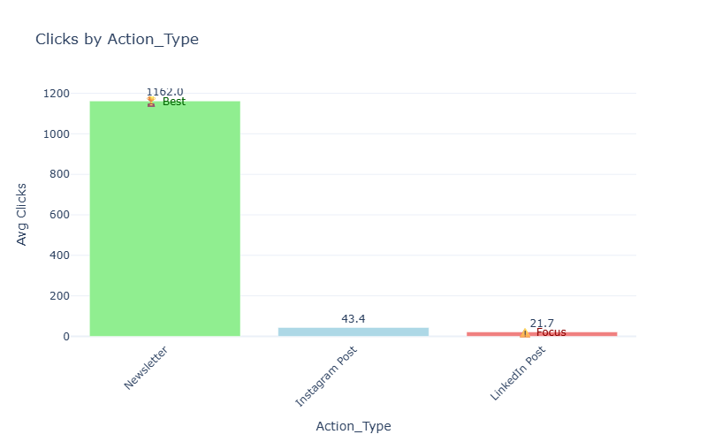
Clicks by Action_Type
Insight: 2024-09-15 leads in Impressions performance, outperforming 2023-12-25 by 7658%. This suggests successful strategies in 2024-09-15 that could be replicated elsewhere. There's significant variation in Impressions across different Date categories, indicating potential optimization opportunities.

Slide 9
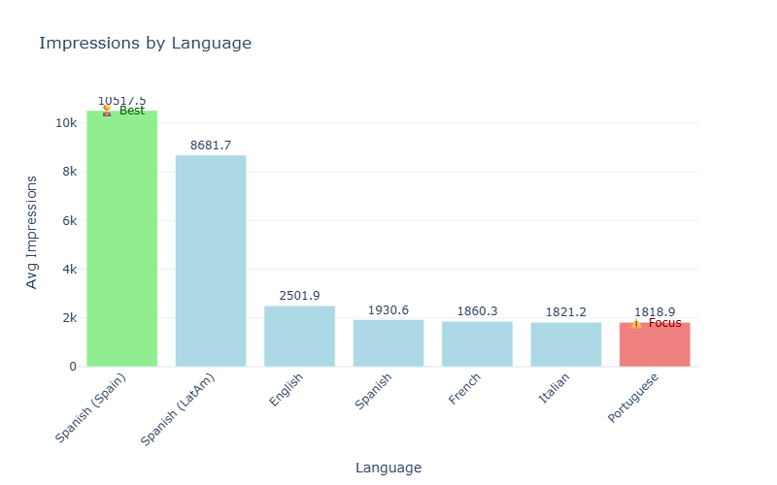
Impressions by Language
Insight: 2024-09-15 leads in Impressions performance, outperforming 2023-12-25 by 7658%. This suggests successful strategies in 2024-09-15 that could be replicated elsewhere. There's significant variation in Impressions across different Date categories, indicating potential optimization opportunities.

Slide 10
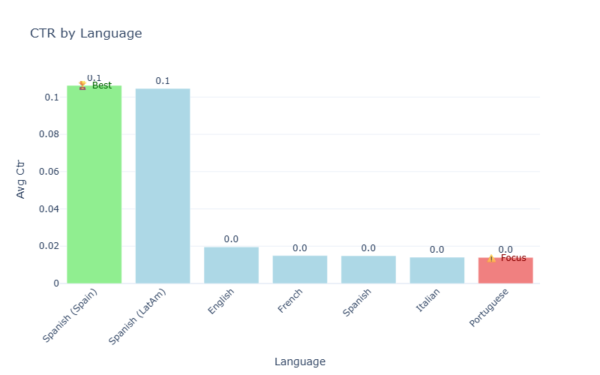
CTR by Language
Insight: 2024-09-15 leads in Impressions performance, outperforming 2023-12-25 by 7658%. This suggests successful strategies in 2024-09-15 that could be replicated elsewhere. There's significant variation in Impressions across different Date categories, indicating potential optimization opportunities.

Slide 11
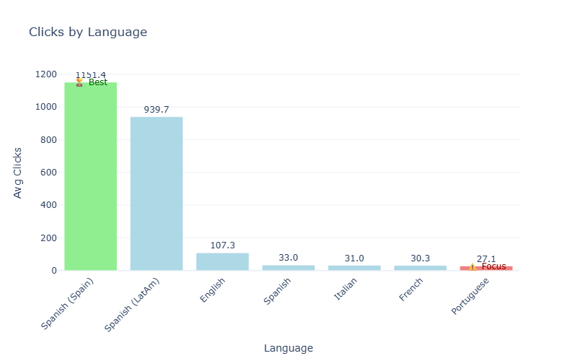
Clicks by Language
Insight: 2024-09-15 leads in Impressions performance, outperforming 2023-12-25 by 7658%. This suggests successful strategies in 2024-09-15 that could be replicated elsewhere. There's significant variation in Impressions across different Date categories, indicating potential optimization opportunities.

Slide 12
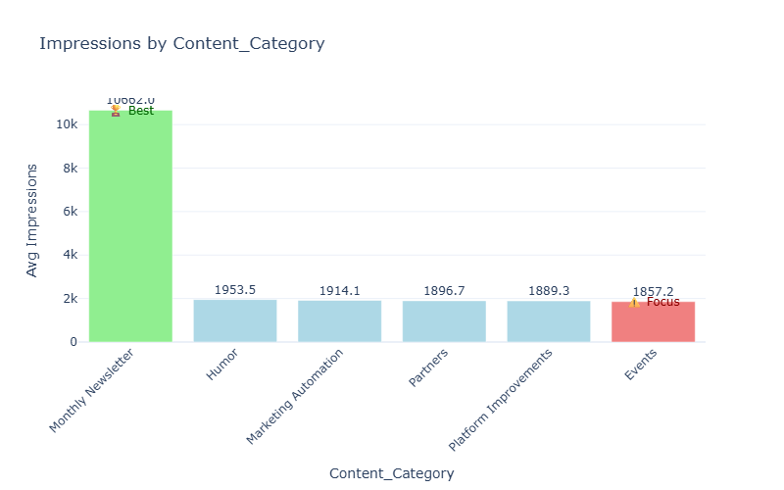
Impressions by Content_Category
Insight: 2024-09-15 leads in Impressions performance, outperforming 2023-12-25 by 7658%. This suggests successful strategies in 2024-09-15 that could be replicated elsewhere. There's significant variation in Impressions across different Date categories, indicating potential optimization opportunities.

Slide 13
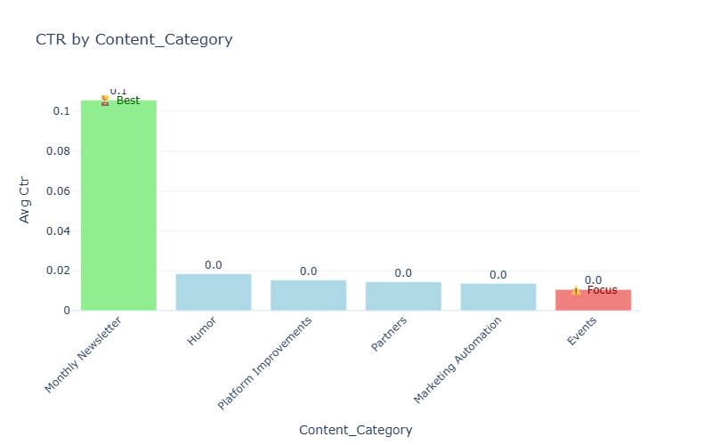
CTR by Content_Category
Insight: 2024-09-15 leads in Impressions performance, outperforming 2023-12-25 by 7658%. This suggests successful strategies in 2024-09-15 that could be replicated elsewhere. There's significant variation in Impressions across different Date categories, indicating potential optimization opportunities.

Slide 14
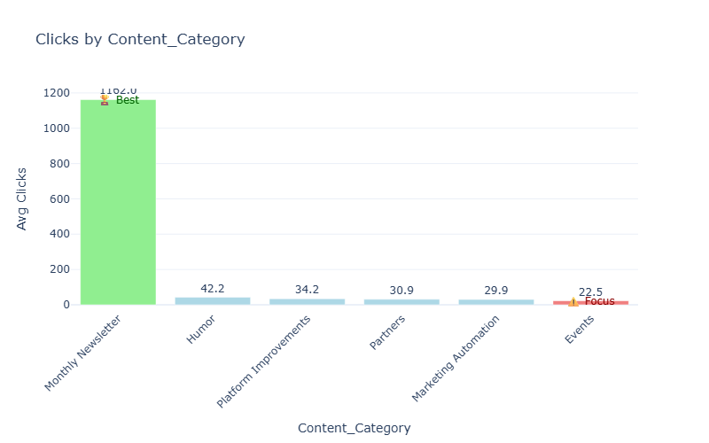
Clicks by Content_Category
Insight: 2024-09-15 leads in Impressions performance, outperforming 2023-12-25 by 7658%. This suggests successful strategies in 2024-09-15 that could be replicated elsewhere. There's significant variation in Impressions across different Date categories, indicating potential optimization opportunities.

Slide 15
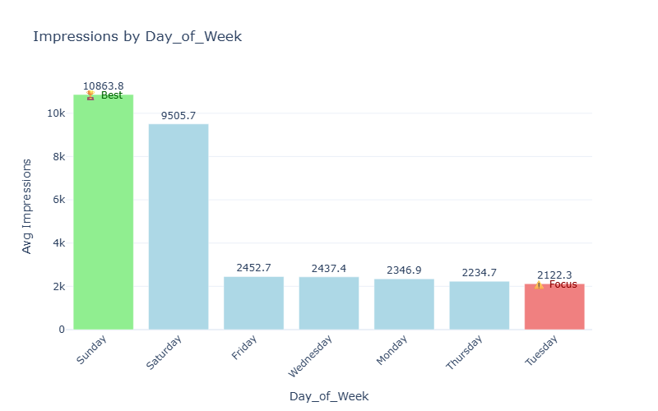
Impressions by Day_of_Week
Insight: 2024-09-15 leads in Impressions performance, outperforming 2023-12-25 by 7658%. This suggests successful strategies in 2024-09-15 that could be replicated elsewhere. There's significant variation in Impressions across different Date categories, indicating potential optimization opportunities.

Slide 16
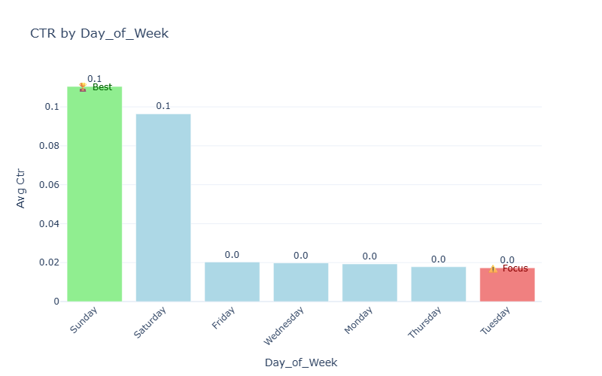
CTR by Day_of_Week
Insight: 2024-09-15 leads in Impressions performance, outperforming 2023-12-25 by 7658%. This suggests successful strategies in 2024-09-15 that could be replicated elsewhere. There's significant variation in Impressions across different Date categories, indicating potential optimization opportunities.

Slide 17
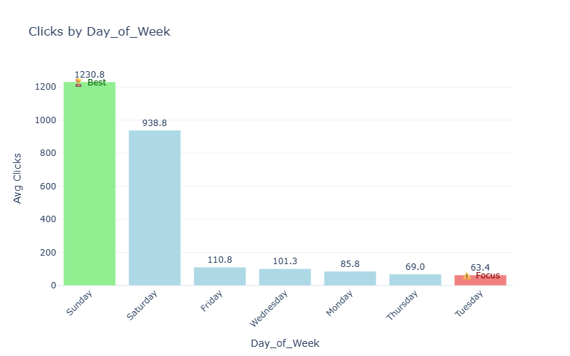
Clicks by Day_of_Week
Insight: 2024-09-15 leads in Impressions performance, outperforming 2023-12-25 by 7658%. This suggests successful strategies in 2024-09-15 that could be replicated elsewhere. There's significant variation in Impressions across different Date categories, indicating potential optimization opportunities.

Slide 18
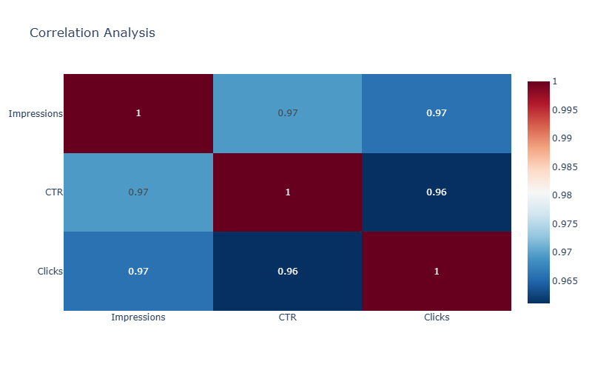
Correlation Analysis
Insight: Key finding: Impressions and CTR show a strongly positive relationship. This suggests these metrics move together and could be leveraged for predictive planning. These findings warrant further investigation to identify specific action items and optimization opportunities.

