Slide 1
📊 KPI Analysis Report
Data Source: Kaggle: julialy900/marketing-campaign-analysis
Generated: September 26, 2025
Professional Data Insights Dashboard

Slide 2
📋 Executive Summary
Dataset Overview: 10,000 rows, 10 columns
• What stands out to me is your daily time spent on site has been pretty steady over time. Sometimes boring is good - it m...
• I found something worth mentioning: your daily time spent on site has been pretty steady over time. Sometimes boring is ...
• Here's what caught my eye: your different metrics seem to dance to their own beat - they're not strongly connected to ea...

Slide 3
How Daily Time Spent On Site Changed Over Time
Chart: How Daily Time Spent On Site Changed Over Time
Chart visualization not available in PowerPoint.
View interactive version in the dashboard.
Technical note: Error 525: Failed to execute 'getPointAtLength' on 'SVGGeometryElement': The element's path is empty

Slide 4
Your Age Journey
Chart: Your Age Journey
Chart visualization not available in PowerPoint.
View interactive version in the dashboard.
Technical note: Error 525: Failed to execute 'getPointAtLength' on 'SVGGeometryElement': The element's path is empty

Slide 5
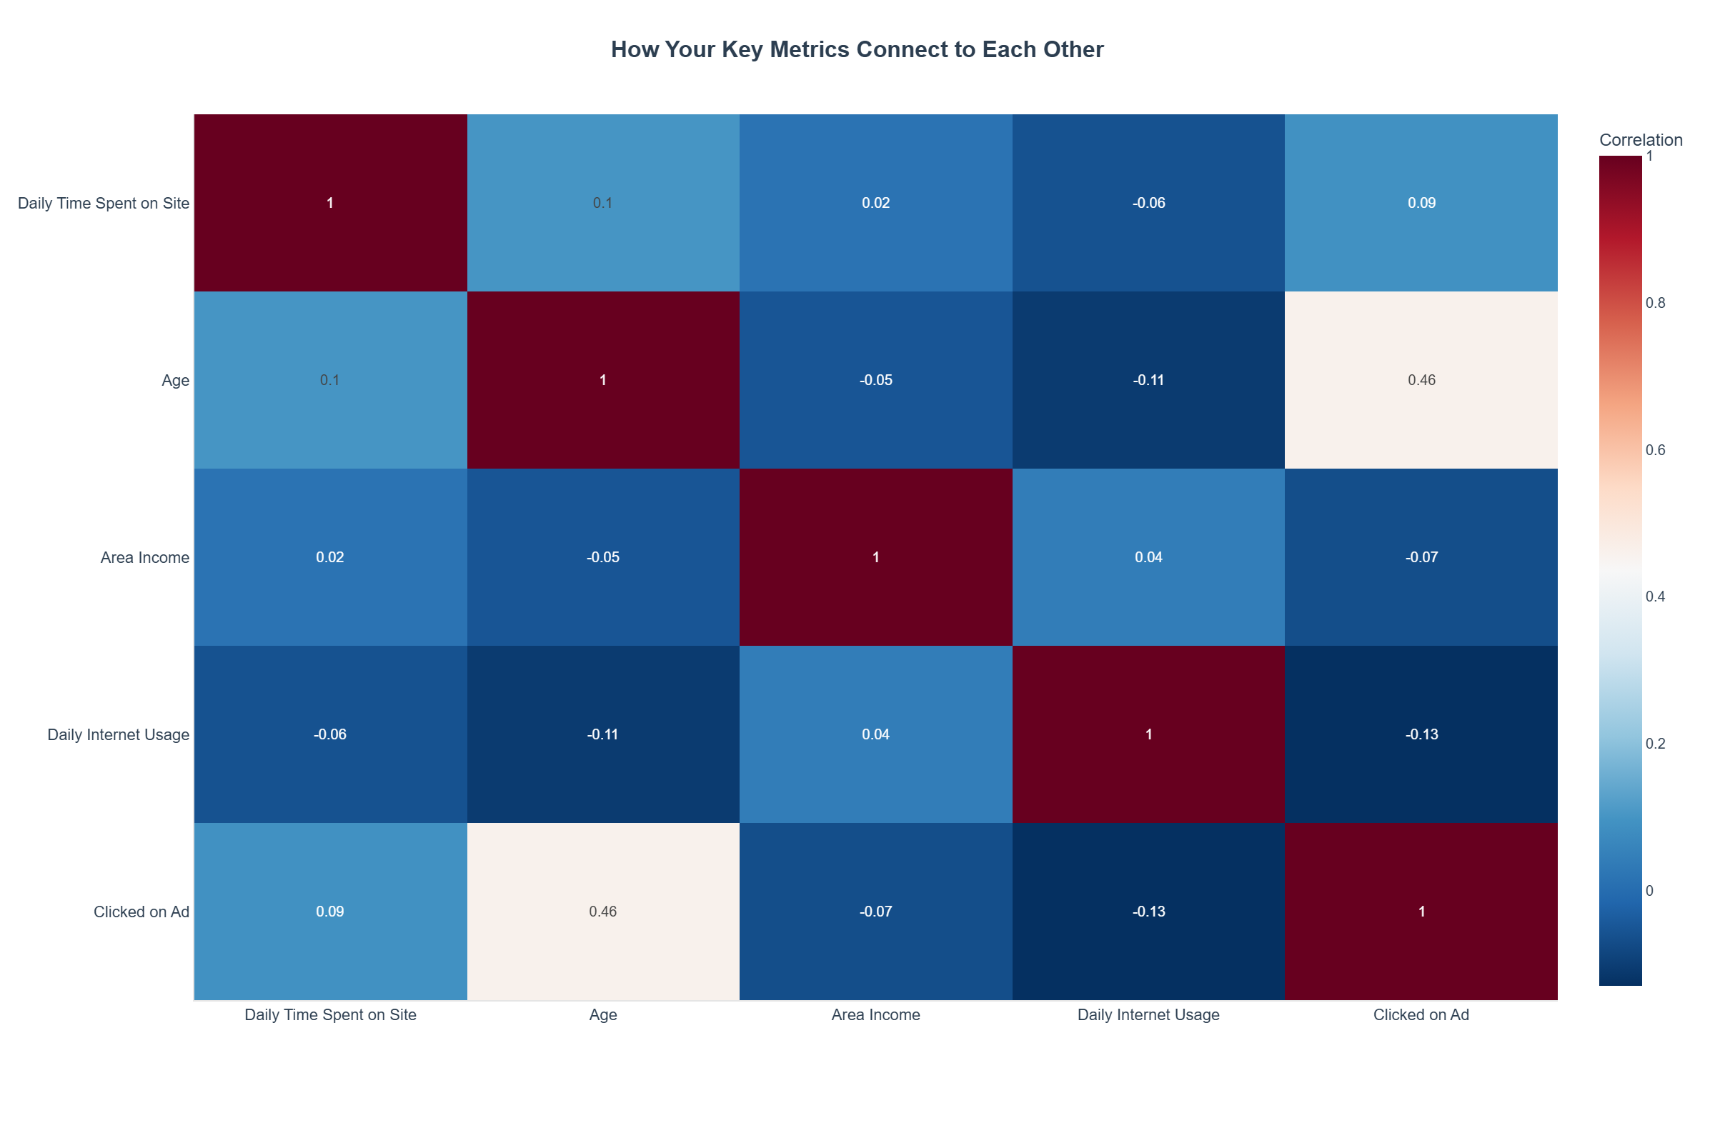
How Your Key Metrics Connect to Each Other
💡 Key Insight: Here's what caught my eye: your different metrics seem to dance to their own beat - they're not strongly connected to each other. That means each one is probably measuring something unique and valuable. This gives you a good foundation, but I'd be curious to see what you discover when you dig deeper into specific areas.

