Slide 1


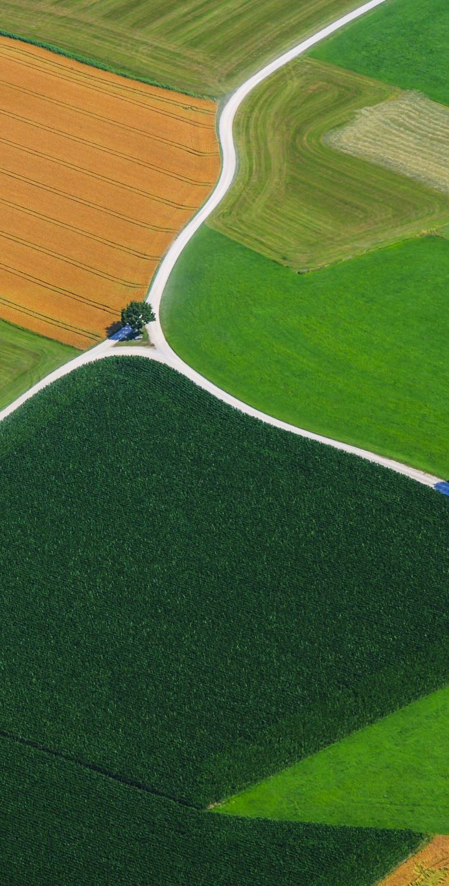
Intelligent Classification of Rural Infrastructure Projects
CAPSTONE PROJECT
Presented By:
Raghav Kumar Jha
K.R. Mangalam University – CSE (Core)

Slide 2
Outline
• Problem Statement
• Proposed Solution
• System Development Approach (Technology Used)
• Algorithm & Deployment
• Result
• Conclusion
• Future Scope
• References

Slide 3
Problem Statement
Manual classification of rural road/bridge projects into PMGSY scheme types (PMGSY-I, PMGSY-II, RCPLWEA, etc.) is time-consuming, error-prone, and not scalable.
With thousands of infrastructure projects across India, there's a critical need to automate this classification process based on physical and financial project attributes.

Slide 4
Proposed Solution
We propose a machine learning-based classification system to predict the PMGSY scheme type for any given project.
Using attributes like road length, cost, expenditure, and region, the system will learn patterns to auto-classify new projects.
It will improve decision-making, transparency, and reduce manual workload.

Slide 5
System Development Approach
• Dataset from AI Kosh & Dataful: project-level cost, length, and scheme type
• Tools: Python, Pandas, scikit-learn, IBM Watson Studio
• IBM Cloud Lite: model development and hosting
• Preprocessing: missing value handling, label encoding
• Feature Selection: cost, length, location, etc.

Slide 6
Algorithm & Deployment
• ML Model: Random Forest Classifier
• Input: project attributes (cost, length, district/state)
• Output: predicted PMGSY scheme type
• Evaluation: accuracy, confusion matrix, classification report
• Deployment: IBM Watson Studio or Flask app on Render

Slide 7
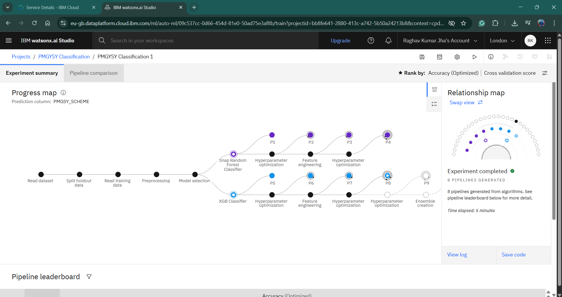
Result

Slide 8
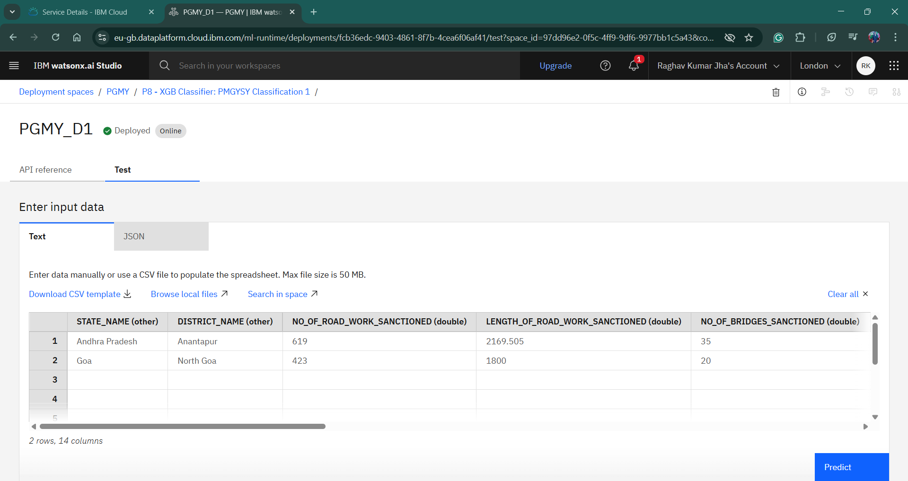
Result

Slide 9
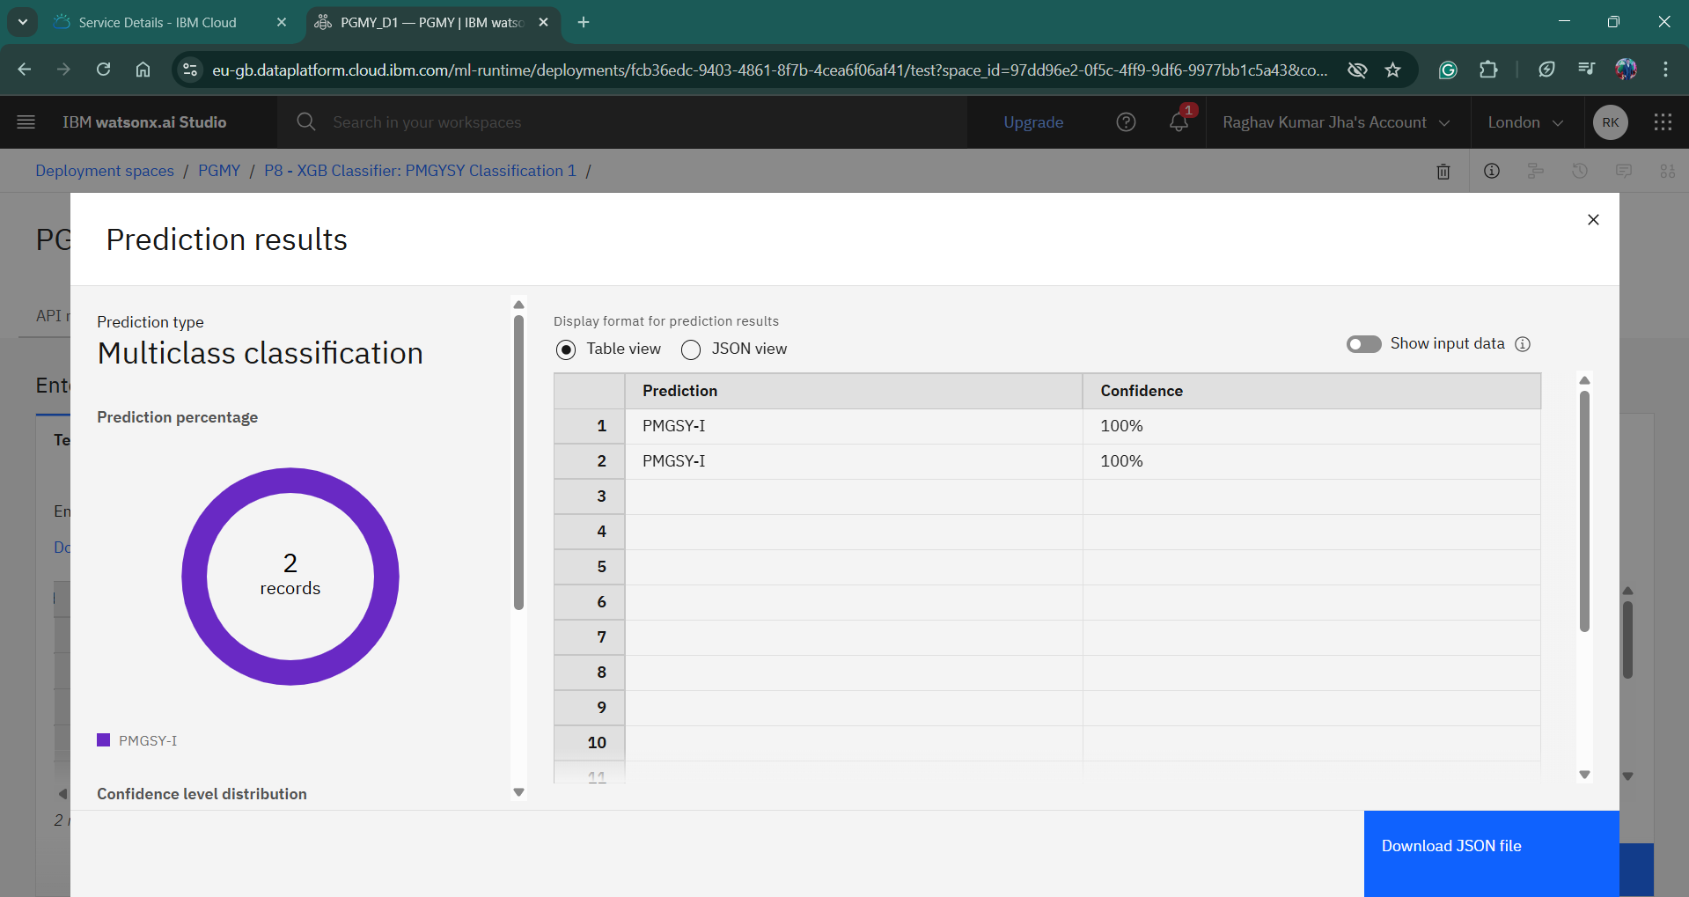
Result

Slide 10
Conclusion
The proposed ML model accurately predicts PMGSY scheme types using real project data.
It reduces manual efforts, enhances transparency, and improves decision support for rural infrastructure planning.

Slide 11
Future Scope
Add
Add more project attributes (terrain, weather, etc.)
Improve
Improve accuracy using Deep Learning models
Build
Build user-friendly interface for government departments
Integrate
Integrate with real-time project dashboards

Slide 12
References
• https://aikosh.indiaai.gov.in/
• https://cloud.ibm.com
• scikit-learn documentation
• Dataful PMGSY datasets

Slide 13
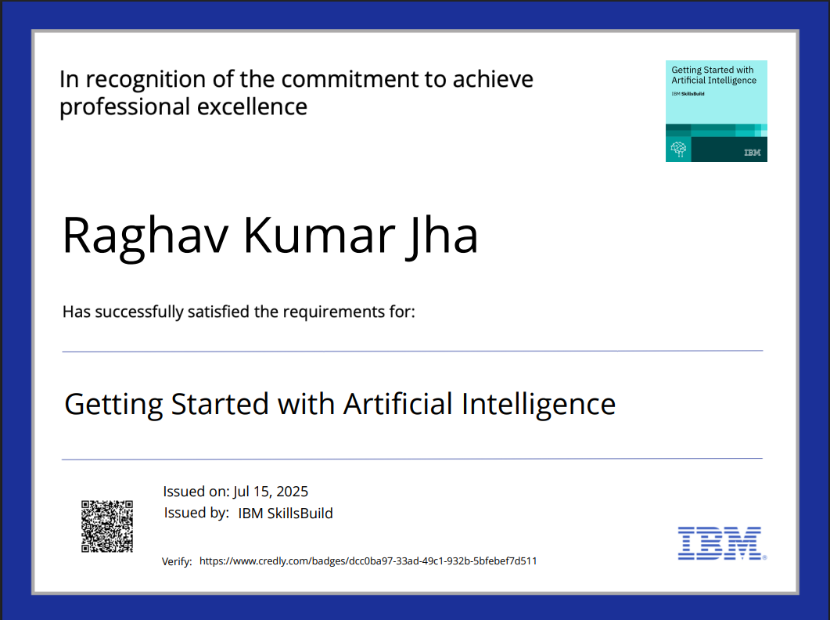
IBM Certifications

Slide 14
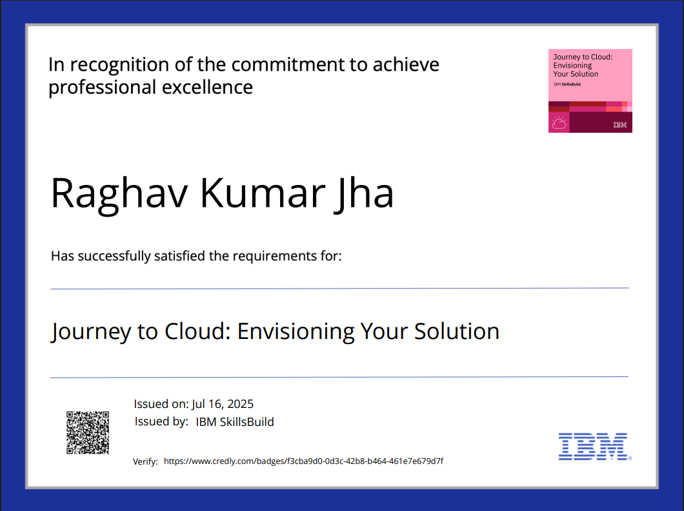
IBM Certifications

Slide 15
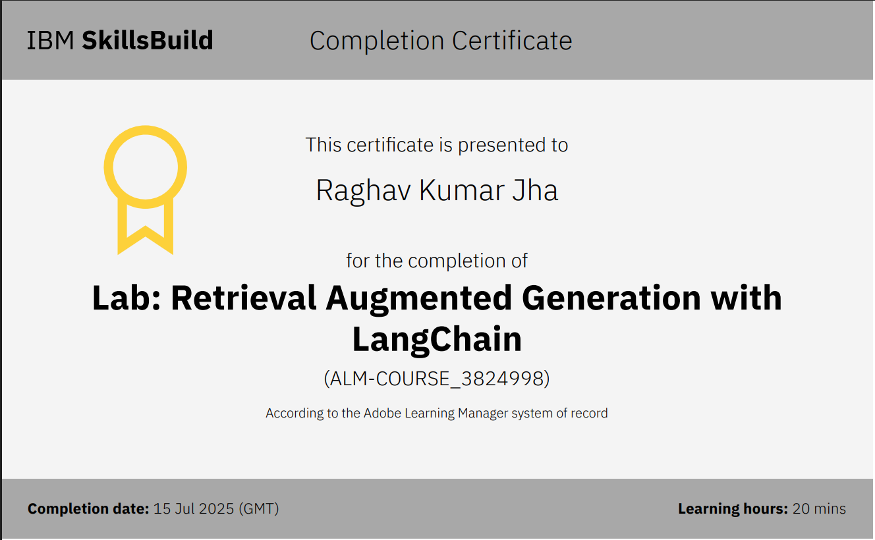
IBM Certifications

Slide 16

THANK YOU

