Slide 1


Smart Car Accident Prevention
DCoders
Raghav Khera,
Ankush Kamboj,
Shubham Sardana,
Deepak Dhanda,
Gaurav Raheja.

Slide 2
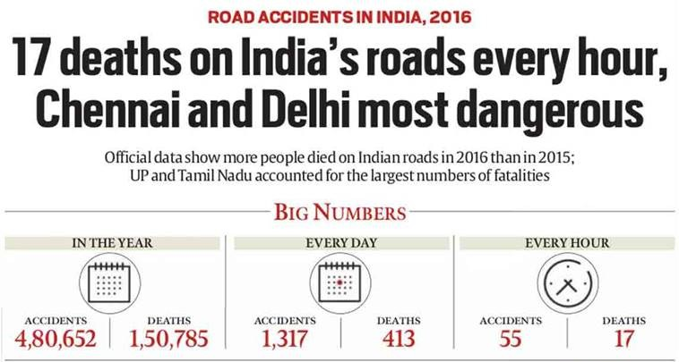
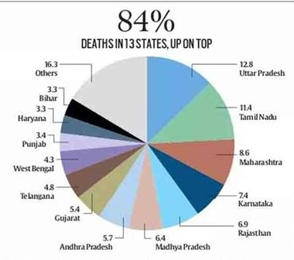
Problem Statement
Cost effective Smart accident alert and Prevention Device and brake failure notification generator .
Road Crash Statistics Nearly 1.3 million people die in road crashes each year.
There are 5.6 million car crashes in America every year, so brake failure accounts for about about 300,000 crashes per year.
Largest no of road accidents in India occurs in
Chennai over 7,486 .
The most Deaths occurs in Delhi over 1591 due to
Unsafe Lane Changes & Reckless Driving.

Slide 3
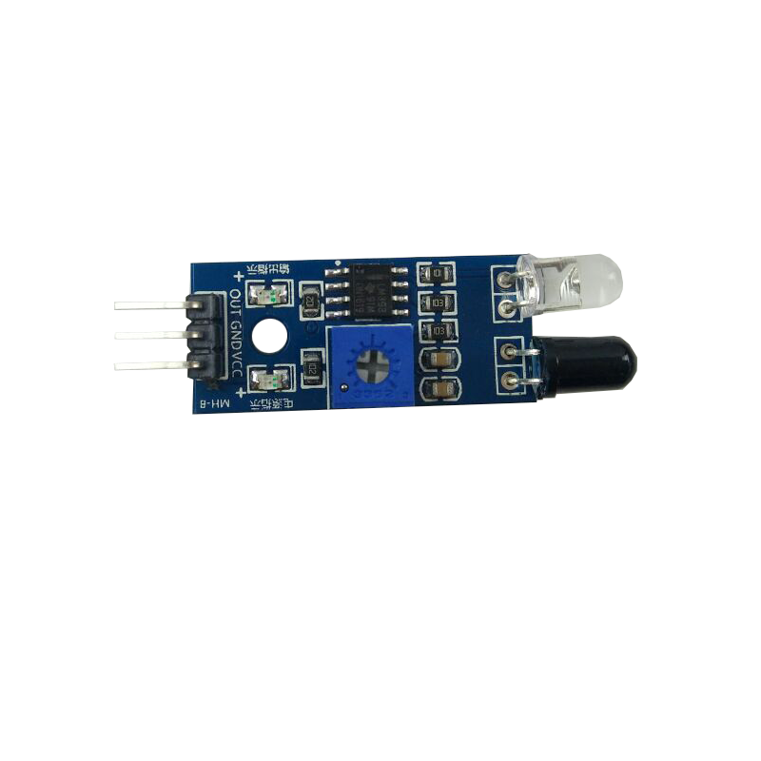
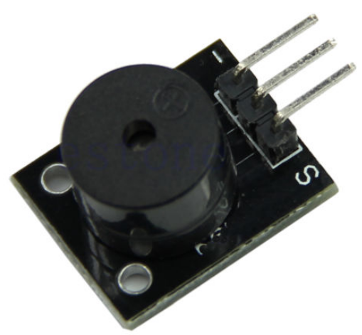
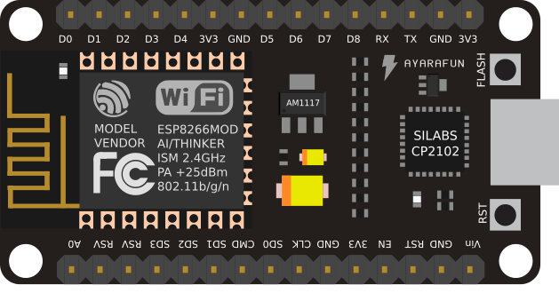

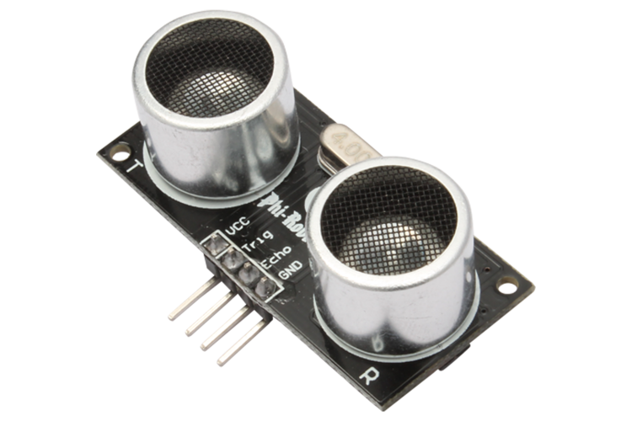

Block Diagram
Buzzer To Warn the Driver
3 IR Sensor to detect vehicle from sideways and Back
LED To warn about status of Brake
Notification to User About Brake Failure
HC05 To Detect vehicle aproarching from the front.

Slide 4
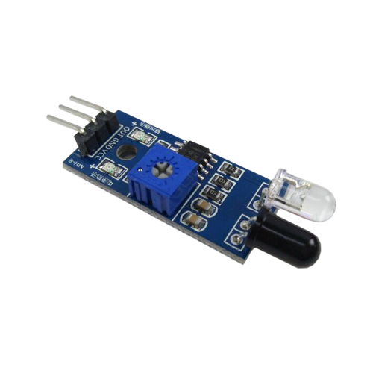

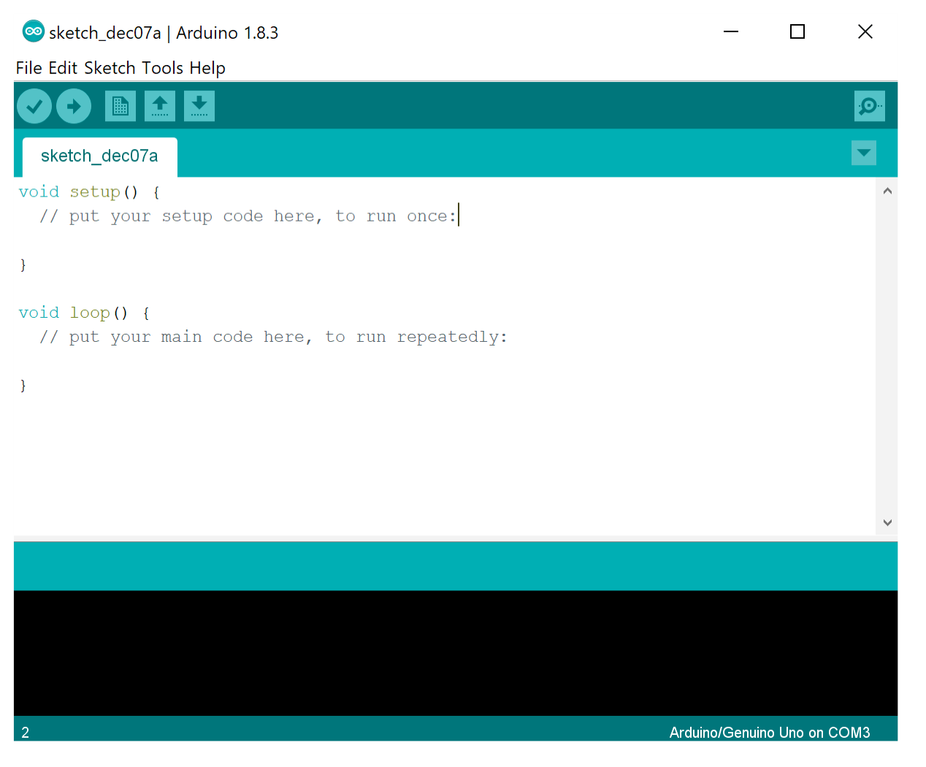
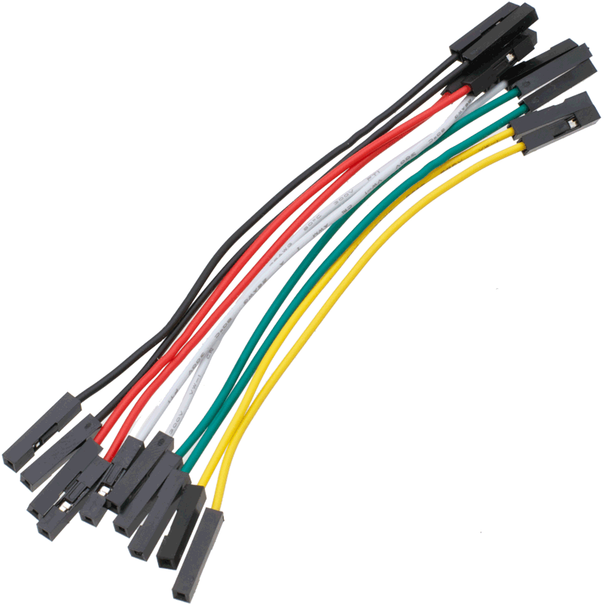
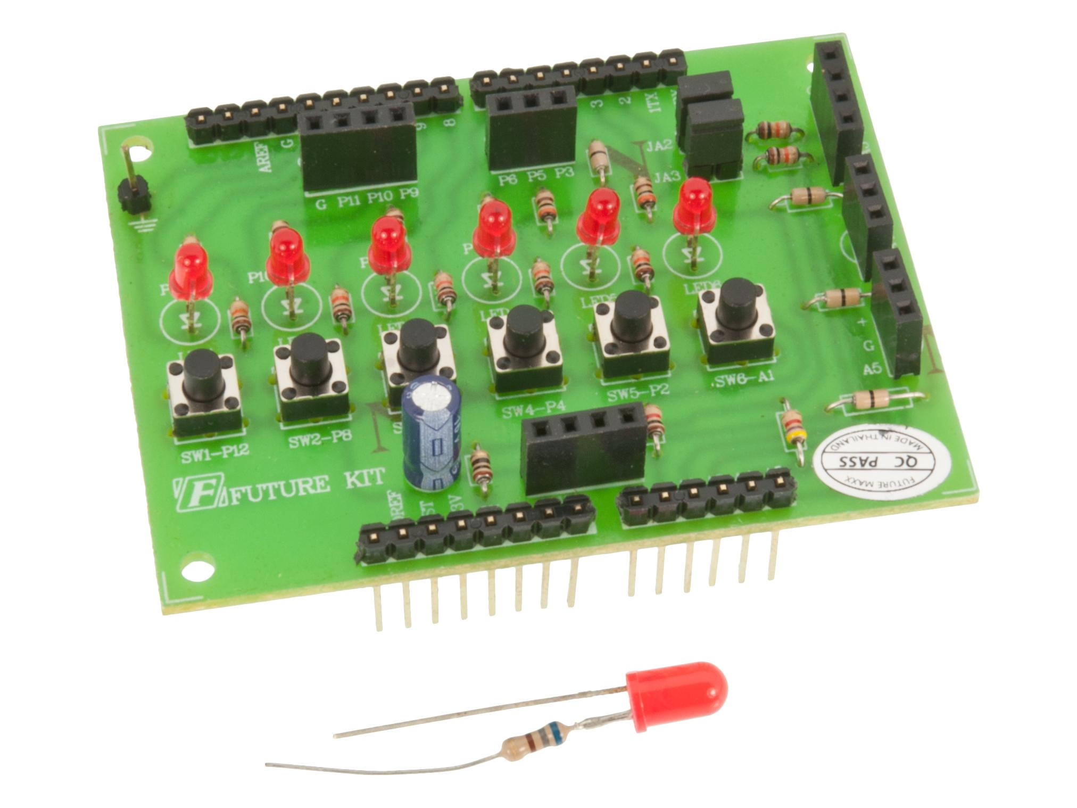
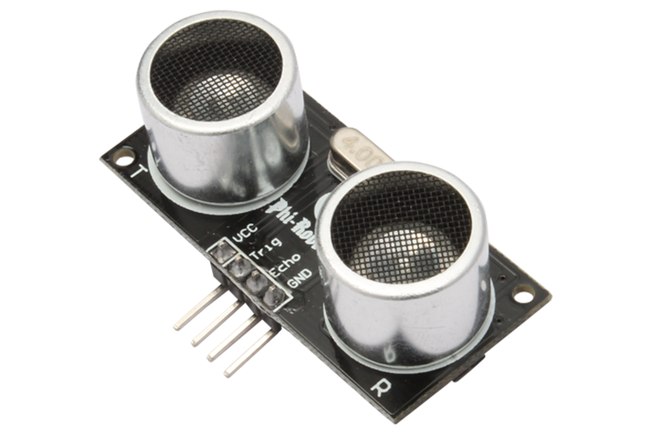
Hardware & Software
Hardware:
Node MCU, Ultrasonic Sensor, Buzzer, Jumper Wires, Basic Shield, 3 IR Sensor
Software:
Arduino IDE

Slide 5

Advantages & Disadvantages
Advantages
Our main motive to make this project is to reduce road accidents and save life not only the mankind but also the stray animals which accidentally come on the way.
This will also reduce the accidents in bad environmental conditions like fog, smog.
Alerts will be helping in gaining the drivers attention back on the road
Medical and other helps can reach the spot better

Slide 6
Advantages & Disadvantages
Disadvantages
Drivers may show negligence while driving by over relying on the sensors
Sudden brakes may lead to internal injuries.
Failure of sensors may lead to accidents

Slide 7
DCoders are thankful for your valuable time

