Slide 1



Smart Car Accident Prevention (S.C.A.P)
Raghav Khera
Ankush Kamboj
Shubham Sardana
Deepak Dhanda
Gaurav Raheja

Slide 2
Introduction
This project is about making cars more intelligent which will notify or resist user under unacceptable conditions, they may provide critical information of real time situations to rescue owner himself. In this paper, we describe a real-time online safety prototype that prevents the starting of the engine in the case of brake failure and warn the user through SMS and buzzer or LED. The main components of the system consist of number of real time sensors like Ultra-Sonic Sensors that can work in any harsh Conditions.

Slide 3
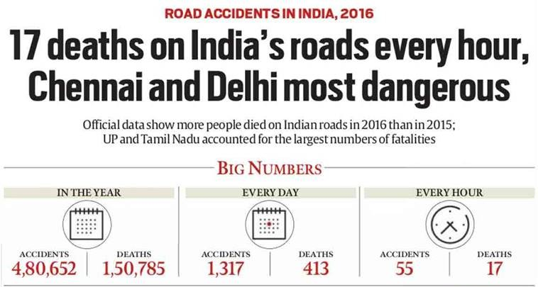
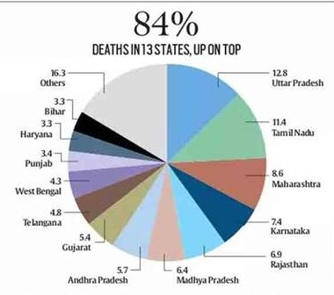
Problem Statement
Cost effective Smart accident alert and Prevention Device and brake failure notification generator .
Road Crash Statistics Nearly 1.3 million people die in road crashes each year.
There are 5.6 million car crashes in America every year, so brake failure accounts for about about 300,000 crashes per year.
Largest no of road accidents in India occurs in Chennai over 7,486 .
The most Deaths occurs in Delhi over 1591 due to Unsafe Lane Changes & Reckless Driving.

Slide 4
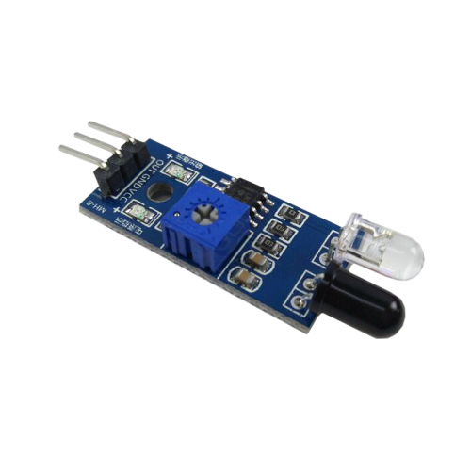
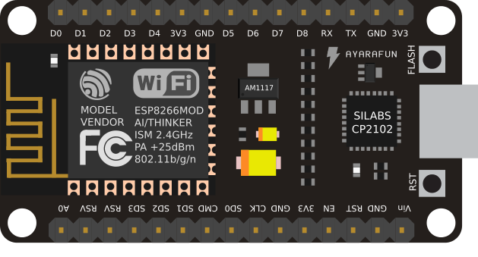

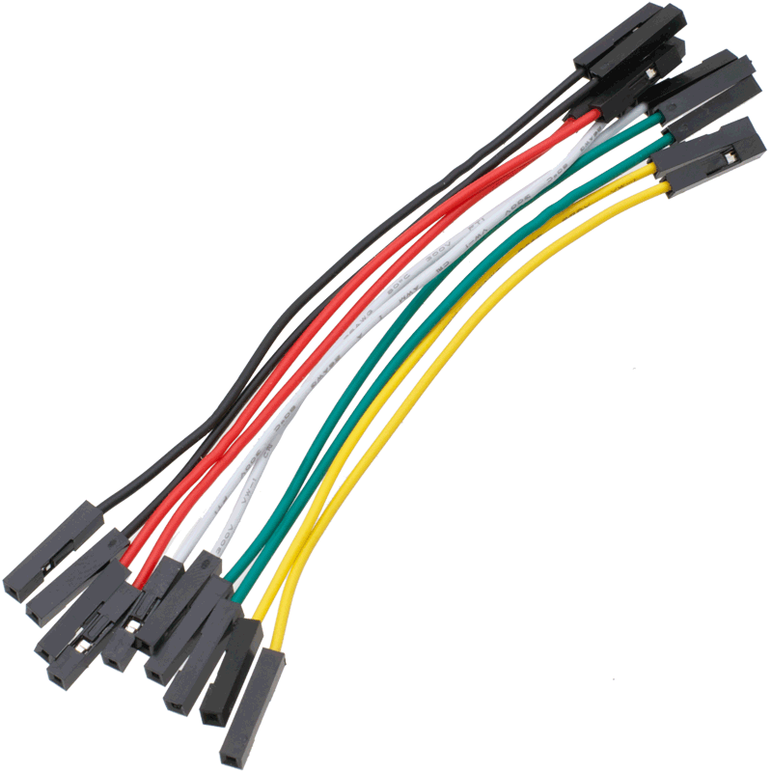
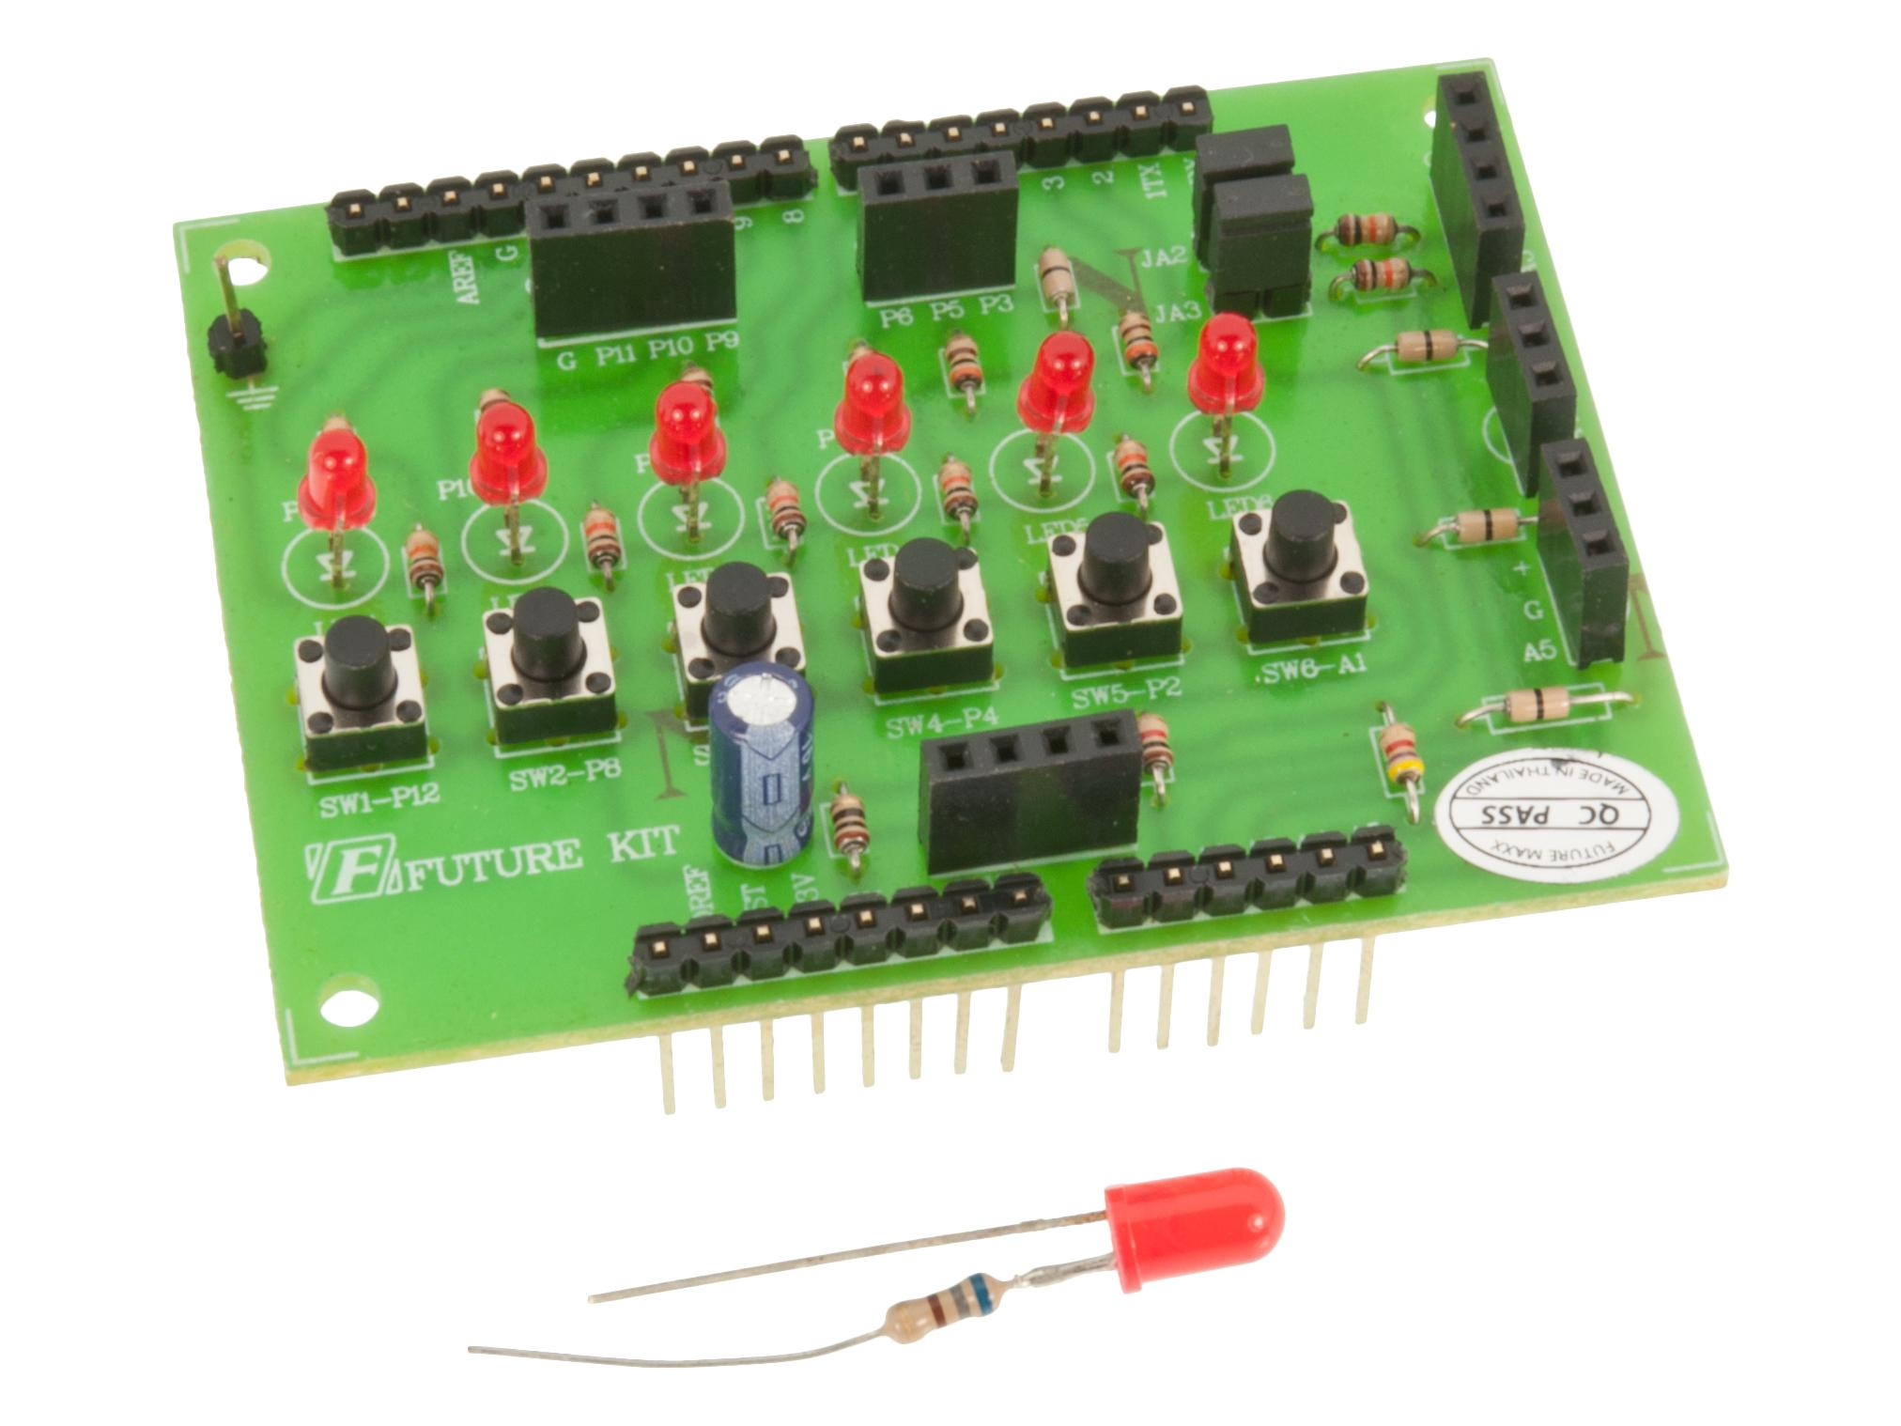
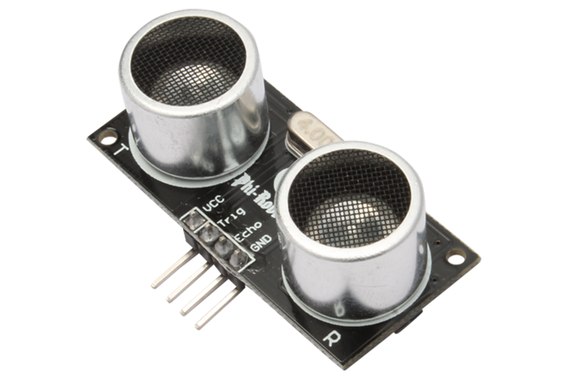
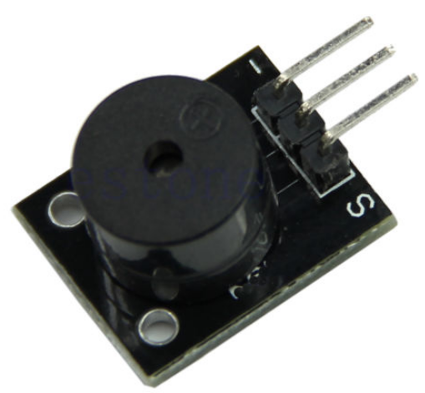
Hardware & Software
Hardware:
Node MCU, Ultrasonic Sensor, Buzzer, Jumper Wires, Basic Shield, 3 IR Sensor
Software:
Arduino IDE

Slide 5
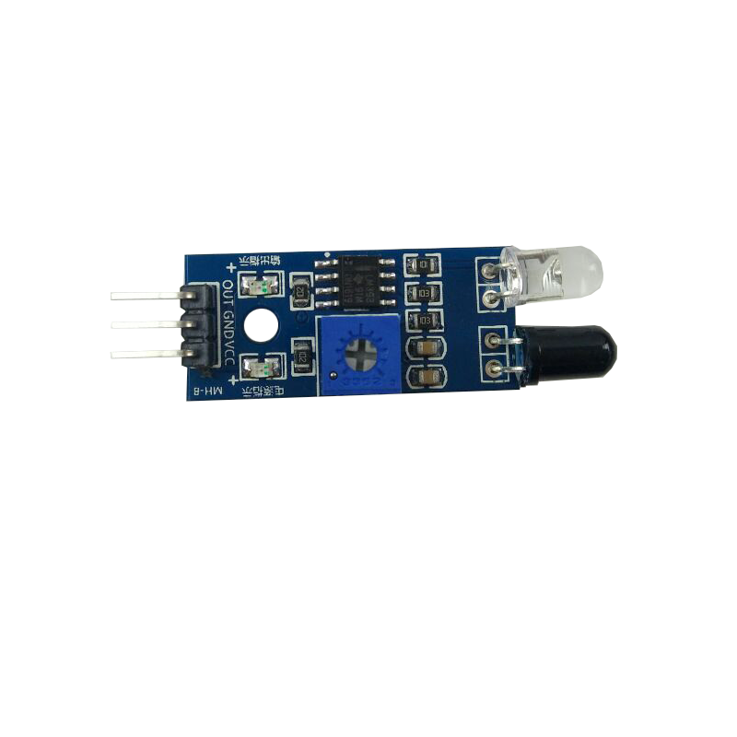


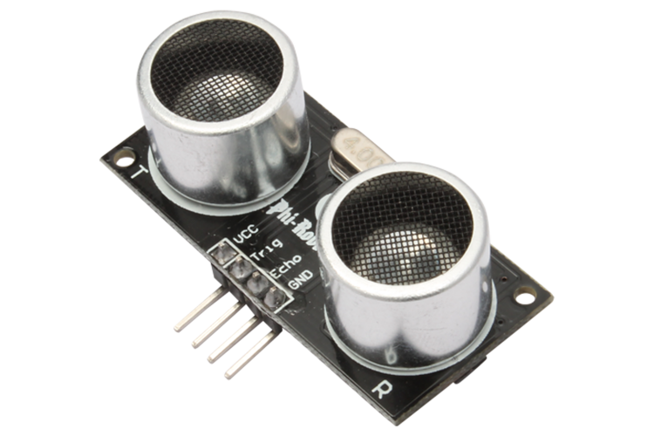

Proposed Circuit Diagram
Buzzer To Warn the Driver
3 IR Sensor to detect vehicle from sideways and Back
LED To warn about status of Brake
Notification to User About Brake Failure
HC05 To Detect vehicle aproarching from the front.

Slide 6
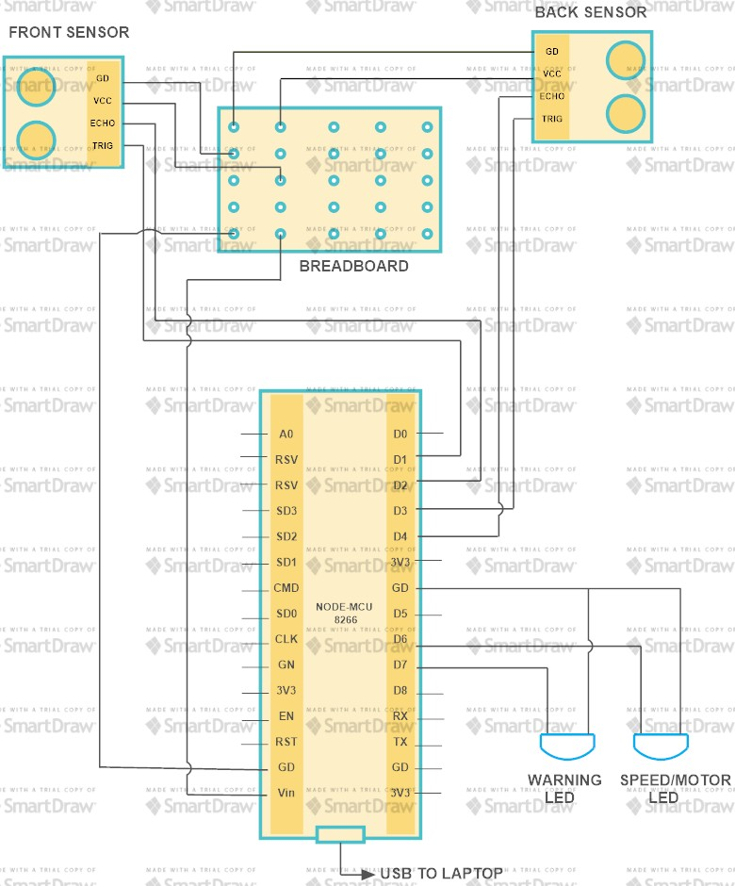
Block Diagram

Slide 7
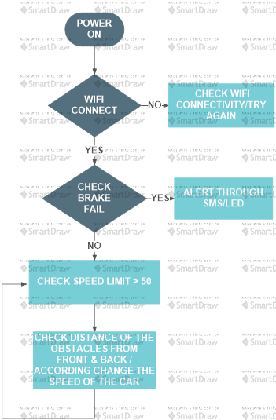
Flow Diagram

Slide 8
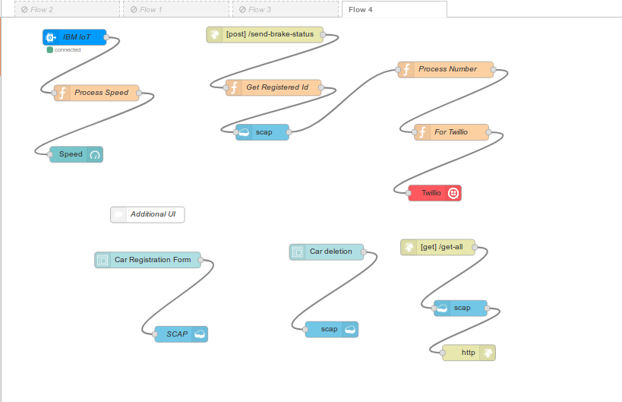
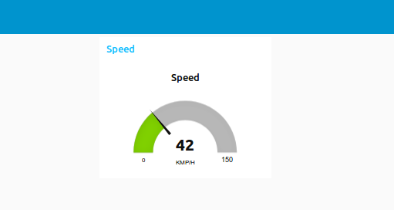
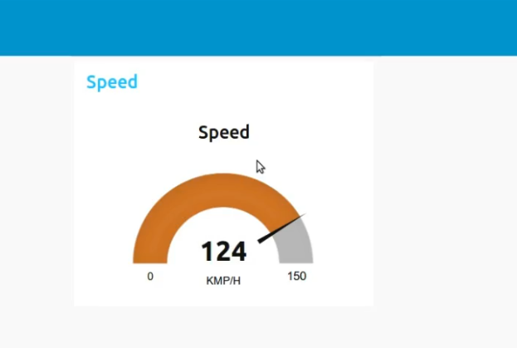

Results

Slide 9
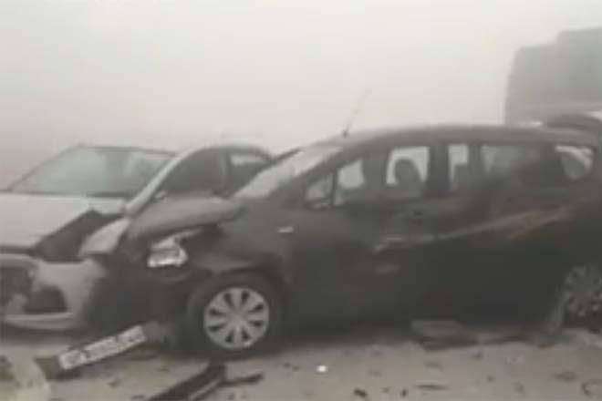
Advantages & Disadvantages
Advantages
Our main motive to make this project is to reduce road accidents and save life not only the mankind but also the stray animals which accidentally come on the way.
This will also reduce the accidents in bad environmental conditions like fog, smog.
Alerts will be helping in gaining the drivers attention back on the road
Medical and other helps can reach the spot better

Slide 10
Advantages & Disadvantages
Disadvantages
Drivers may show negligence while driving by over relying on the sensors
Sudden brakes may lead to internal injuries.
Failure of sensors may lead to accidents

Slide 11

Any Queries??

Slide 12
DCoders are thankful for your valuable time

