Slide 1

FULL-STACK PROJECT PRESENTATION
TripWise
Discover places.
Build a trip worth taking.
React · Express · PostgreSQL · Geoapify
Single-service deployment plan for Render

Slide 2
THE PRODUCT
One place to go from discovery to itinerary
TripWise combines real place search with a persistent, shared travel shortlist.
01
02
03
Search real places
Refine the results
Keep the good ones
Geocode a city and retrieve nearby destinations from Geoapify.
Choose a category, sort by name, or narrow the list with text search.
Open a destination, save it to My Trip, and remove it when plans change.
Designed for a fast demo: search → inspect → save → revisit.
The deployed MVP has no accounts; the itinerary is shared by all visitors to the same service.
TRIPWISE / SMART TRAVEL PLANNER
02

Slide 3
EXPLORE
Live destinations, useful controls
Search results come from Geoapify; category and sort state remain in sync.
City search
Resolve a place name, then fetch nearby destinations.
Category filters
Attractions, sights, restaurants, entertainment, and hotels.
Find and sort
Filter the visible list and sort names ascending or descending.
EXPLORE: DESTINATION SEARCH AND RESULTS
TRIPWISE / SMART TRAVEL PLANNER
03

Slide 4
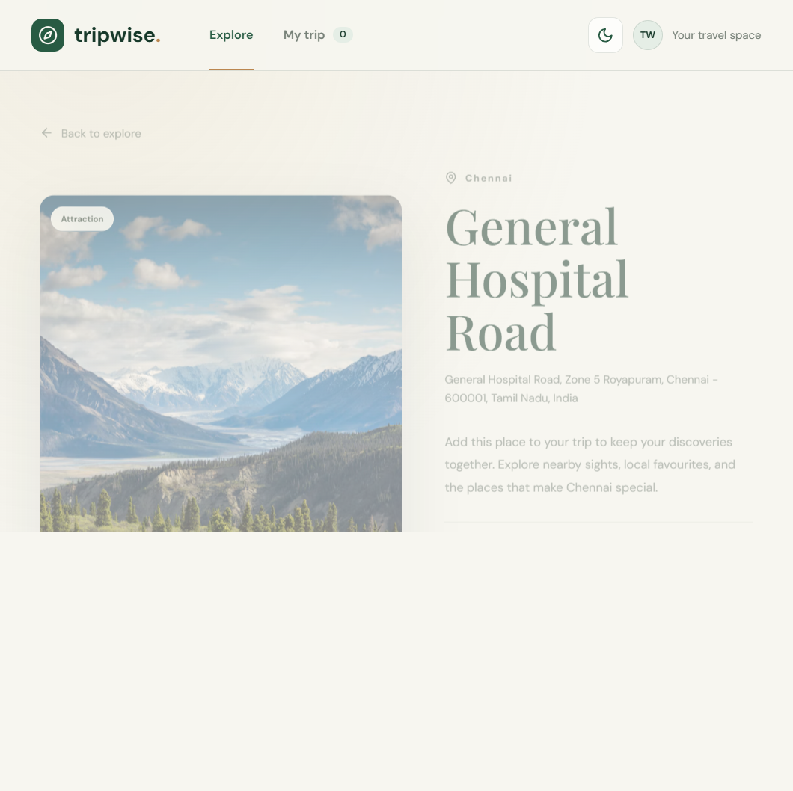
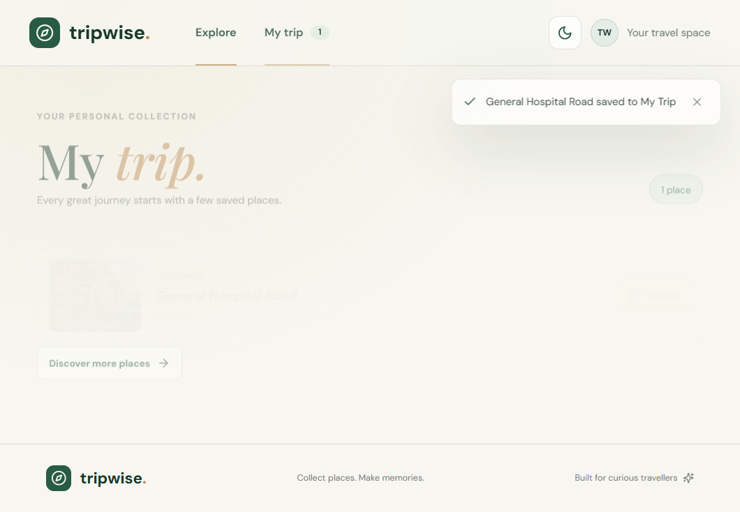
PLAN
A small, complete planning loop
Destination details lead directly into a database-backed itinerary.
DESTINATION DETAILS
MY TRIP: SAVED DESTINATION
Remove confirmation protects against accidental deletes; a reload confirms persistence.
TRIPWISE / SMART TRAVEL PLANNER
04

Slide 5
ARCHITECTURE
One Node service, one origin
The Express server serves both the JSON API and Vite's production build.
React + Vite
Express
Geoapify
PostgreSQL
→
→
→
UI and same-origin fetch
API, static assets, health
Geocode + nearby places
Trips + itinerary items
Render Web Service · npm run build → npm start · /api/health
Secrets stay in Render environment settings: DATABASE_URL and GEOAPIFY_API_KEY. No Vercel or client API key.
TRIPWISE / SMART TRAVEL PLANNER
05

Slide 6
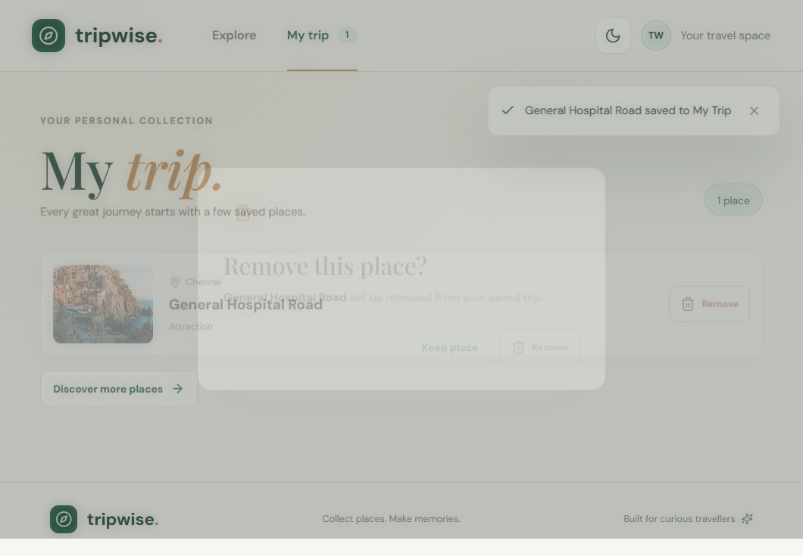
DATA FLOW
Search outside; persist the user's shortlist
Provider credentials stay server-side; itinerary writes are parameterized SQL.
1. Resolve the city
Server calls Geoapify geocoding and uses the returned coordinates.
2. Fetch nearby places
Category, radius, result limit, and requested ordering shape results.
3. Save or remove
Express validates inputs; PostgreSQL enforces one saved place per trip/place ID.
Health check reports DB state, uptime, and application version.
REMOVE CONFIRMATION
TRIPWISE / SMART TRAVEL PLANNER
06

Slide 7
VERIFIED LOCALLY
Release checks that were actually run
Production-style server served the built frontend and API from the same origin.
✓
Build
Root Render build completed successfully.
✓
Search
Live Geoapify search returned 30 places for tested cities/categories.
✓
Persistence
Add, read-back, reload, remove, and reload were verified in PostgreSQL.
✓
Runtime
Health returned connected DB + version; static assets and favicon returned 200.
✓
UX
Theme persistence, category/sort, confirmation, and 390px no-overflow checks passed.
Scope note: no automated test suite is currently included; manual integration checks used live services.
TRIPWISE / SMART TRAVEL PLANNER
07

Slide 8
DEPLOYMENT
Ready for Render. Not yet publicly deployed.
01
02
03
Push to GitHub
Create Render service
Set secrets + deploy
Use the TripWise repository root only.
Use render.yaml Blueprint or manual Web Service.
DATABASE_URL, GEOAPIFY_API_KEY; Render sets PORT.
Thank you
TripWise · Discover places. Keep the ones that matter.
08

