Slide 1
Real-time summarization of customer care conversation
Raghuveer Thirukovalluru
Ragunathan Mariappan

Slide 2



Context

Slide 3
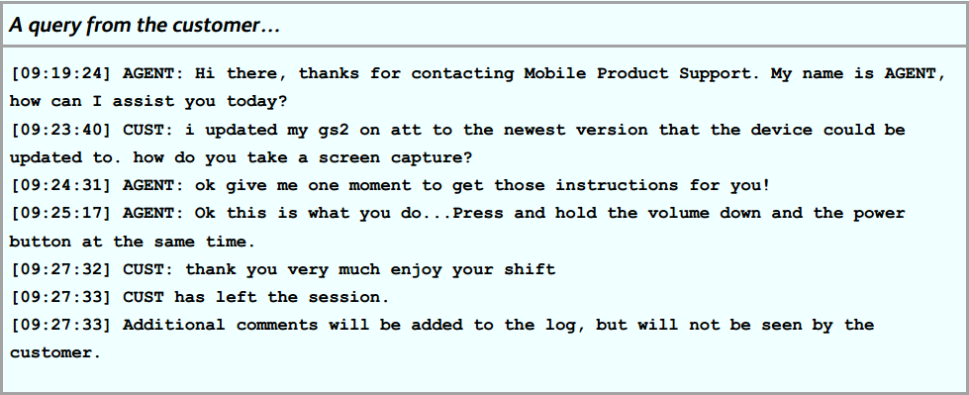
Customer care helpdesk agents interacts with customers to address their queries, requests, and complaints over different communication channels such as Phone, SMS, Chat, Social Networks and Email. These helpdesks offer customer support for various verticals such as Technology, Banking, Transport, etc. Generally, the customer care agent interactions with customers are recorded for quality analysis. Following are some examples of Mobile Product Support sessions offered via the chat channel. .

Slide 4



Motivation

Slide 5
In such customer care conversations 'hand-off' (i.e. change of agent in an ongoing support session) could happen for many reasons, particularly when the agent handling the session is unable to provide good customer experience. For example, agent unable to solve the problem, agent's supervisor would like to take-over the conversation, customer asking for a different agent whom e/she has already talked to, etc. Following is an example of such a hand-off scenario.
It can also be used for administration of ongoing chats in real time by the supervisor.
Following is an example of a customer care hand-off
.

Slide 6
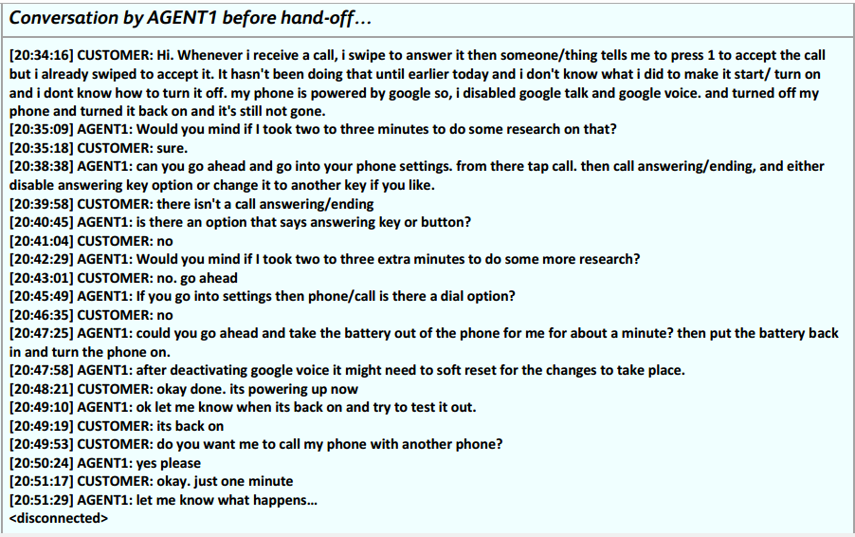
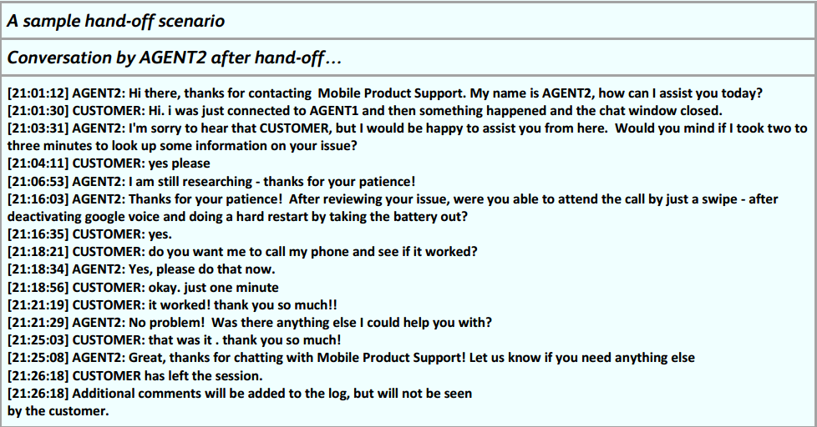

Slide 7
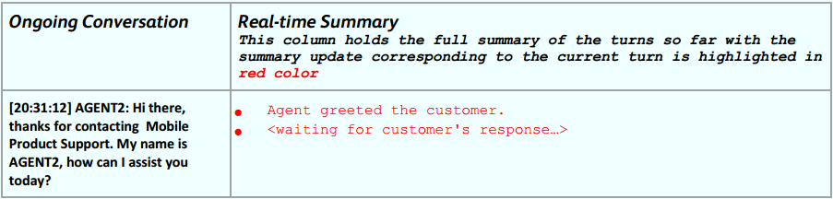
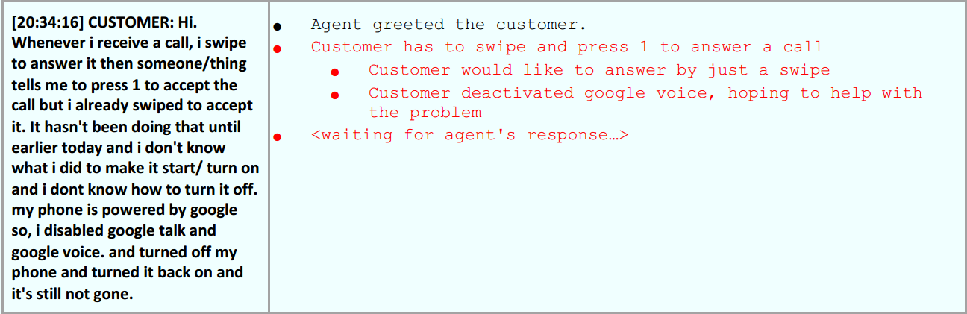
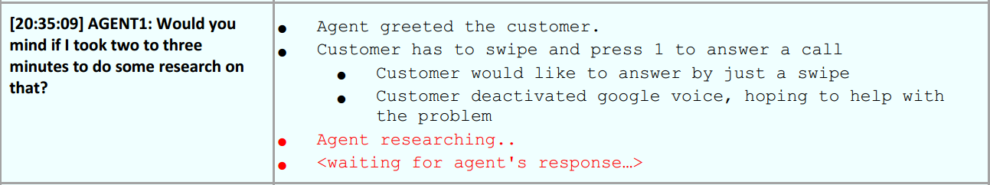
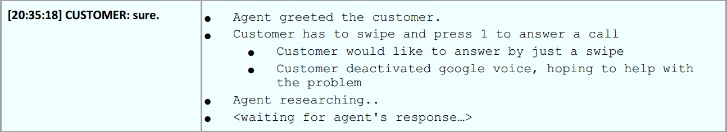
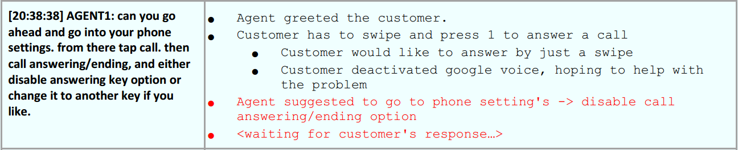

Slide 8
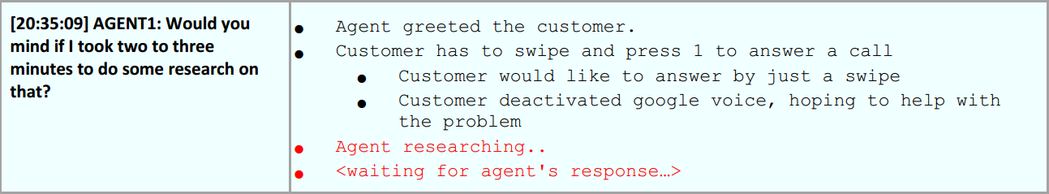
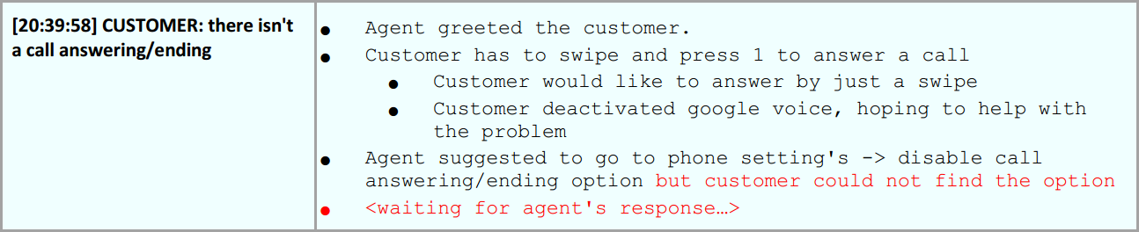

Some picks from the illustrated summary
- we here aim to build a mix of abstractive summary
- the summary would be dynamically updating at every turn(turn triggered)
- current status line gives update on present status of agent/customer Ex:
- turn summaries joined by different conjunctions Ex: #

Slide 9

Formal Problem Statement
To develop techniques to automatically generate a "real-time" summary of customer care conversation i.e. as the conversation progresses the summary is updated.
Research challenges: .
- Devising an effective summary template - based on the historical data
- Developing techniques to fill in the summary template in real-time
- Objectively validating the summary for usefulness in this problem context

Slide 10
Summarization??
Extractive summaries (extracts) are produced by concatenating several sentences taken exactly as they appear in the materials being summarized.
Abstractive summaries (abstracts) reuse phrases or clauses from it, but the summaries are overall expressed in the words of the summary author.

Slide 11
Single document summarization - systems produced a summary of one document
Multi-document summarization – summary of multiple documents brief digest of many documents on the same topic or the same event.
Indicative Summary - enables reader to determine about-ness of the document.
Informative Summary - can be read in place of the document.
Keyword Summary – which consists of a set of indicative words or phrases mentioned in the input
Headline summarization – document is summarised by a single sentence
Generic Summarization - importance of information is determined only with respect to the content of the input alone
Query focused Summarization - the goal is to summarize only the information in the input document(s) that is relevant to a specific user query
Update summarization - sensitive to time, convey the important development of an event beyond what the user has already seen.

Slide 12
Our problem statement corresponds to generating a single document, informative and an update summary

Slide 13
Available info as the chat progresses
Agent Performance – Info on language mistakes, brand non-adherence.
Customer Experience/Behaviour – Info on sentiment, emotion at every turn
Anomalous Conversation – Some anomalities in delays and turn time
Content – Info on use of prohibited words, trending topics, etc.
Conversation Structure – Segment info etc
CHAT CONTENT – content of the chat, metadata.

Slide 14
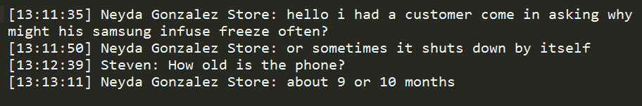
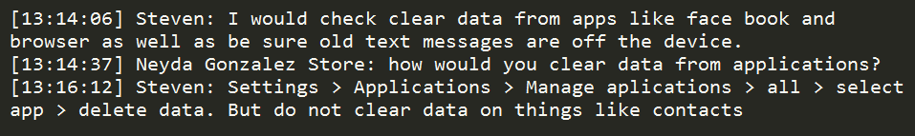
Structure of chats
Most chats follow a certain structure as they progress…
1)Introduction – agent and customer introduce themselves.
2)Problem Description – customer describes the problem
3)Problem Resolution – Agent proposes a solution and the customer tries the troubleshoot.
4)Closure – marks the thanking and end the chat

Slide 15
Templetes…

Slide 16
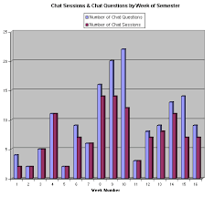




The Data

Slide 17
Scoping down the dataset we address two problems – Display and Specification requests.
Our dataset consists of 100 chats from display problems and 100 from Specification requests.
Metadata details of chats in each category follow.

Slide 18
Freezing problems
Problem types : Application, Platform Service.
Prblm_Resltn_Type : Walkthrough
Dev Capabilities
Factory reset
Soft reset
Closure : Issue resolved
Action_Type : Chat Store
Multiple PST.

Slide 19
Specification Requests
Problem_Type : Customer service
Problem_sub_type : Specification request
Problem_resltn_type : DevCap, Walkthrough
Action_Type : Chat Store
Closure_type : Issue Resolved.

Slide 20
Problems with the data
Data labelled by different chat center agents, there is lot of variance in ground truth.
An agent may name a chat as belonging to one category, some other agent has a different opinion.
Different categories are non - exclusive i.e. they have overlapps. Ex : A freezing chat may have factory reset as the final solution but is categorized under walkthrough because the agent walked the customer though the resetting procedure.

Slide 21
Our Solution

Slide 22
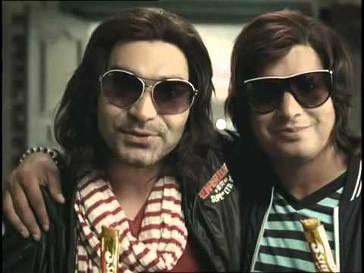
Our Solution Approach
The approach has an Extractive + Abstractive summary.
Abstractive = f( text input, Additional info );
Extractive = f( text_input ) ;
Extractive summary consists of supporting statements to the Abstractive summary generated.
Abstractive
Extractive

Slide 23

why this approach ??
This approach of showing both abstractive and supporting extractive summary is very task centered – very much useful in a supervision scenario.

Slide 24
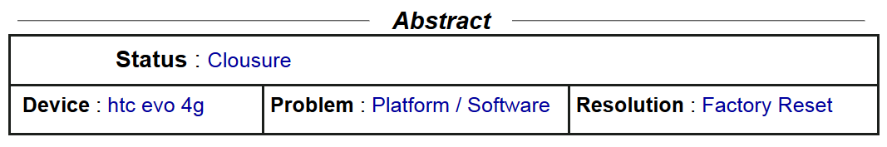
Abstractive Summary
Status here is the current status of the chat. Presently this is only a function od Segment. Ideally status has to be a function of segment and also chat text content
Three other details of device, problem, and problem resolution are also found.

Slide 25
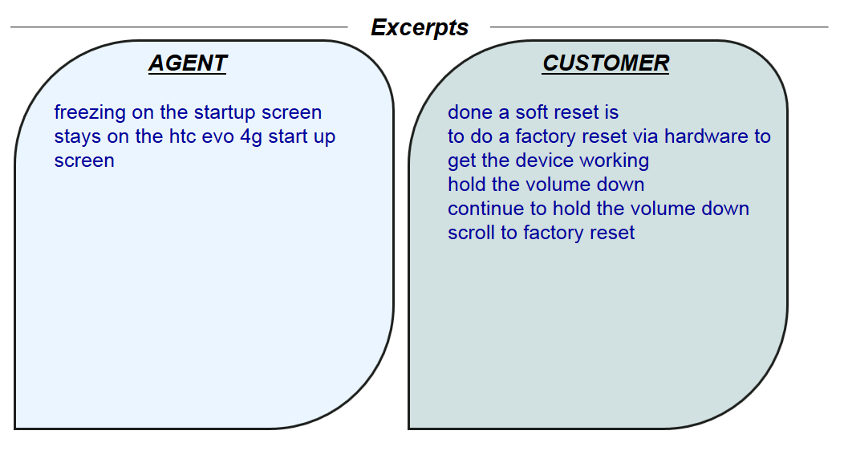
Extractive summary
Here in extractive summary, some excerpts by agent and customer are extracted and shown

Slide 26
Subparts of the solution
The proposed solution consists of a combination of classifiers, entity extractor and instrumenter.
Abstractive summary:
Device extractor, PT_classifier, PRT_classifier.
Extractive summary:
Instrumenter, Annotated learner.

Slide 27
Extractive
Phrase Instrumenter
Annotated learner
Abstractive
Device extracter
PT, PRT classifier

Slide 28
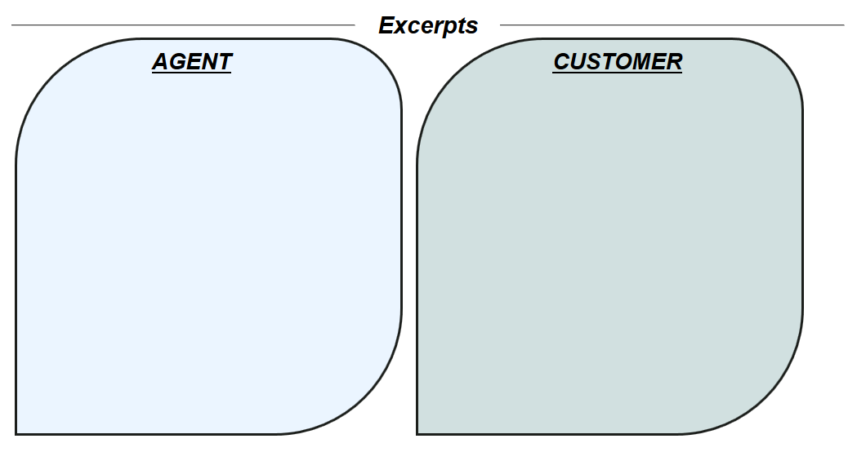
Phrase extraction
INSTRUMENTOR
TRAINING CHATS
SOME SPECIFIC POS PATTERNS PICKED
MANUALLY ANNOTATE THE PHARSES
CSV OF ALL PHRASES
EXTACT FEATURES AND LEARN A MODEL
START WITH A RAW CHAT
INSTRUMENTOR
ANNO_LEARNER

Slide 29
Instrumentor
Multiple chats were analysed and some important patterns were determined
A rule based extracter
Examples of the patterns
NP: {<JJ|NN.*>*<IN>?<JJ|NN.*>*<NN.*>} VP: {<VB.*><IN>*<DT><NP>*}
IP: {<NN.*|PR.*>+<VB.*>} IP: {<VB.*><NN.*|PR.*>+}
IP: {<VBZ><VB.*>} IP: {<NP><RB>*<IP|VP|VB.*>}
IP: {<JJ.><IN>*<DT>*<NP>} IP: {<CD><NP|NN.*>}
IP: {<NP><TO>+} IP: {<TO>+<VP|VB.*>}
IP: {<VP><IN>*} IP: {<IP><IP>}
IP: {<IP><NP>} IP: {<NP><IP>}
IP: {<VP><IP>} IP: {<IP><VP>}
IP: {<IP><VB.*>} IP: {<IP><PR.*><IP>}

Slide 30
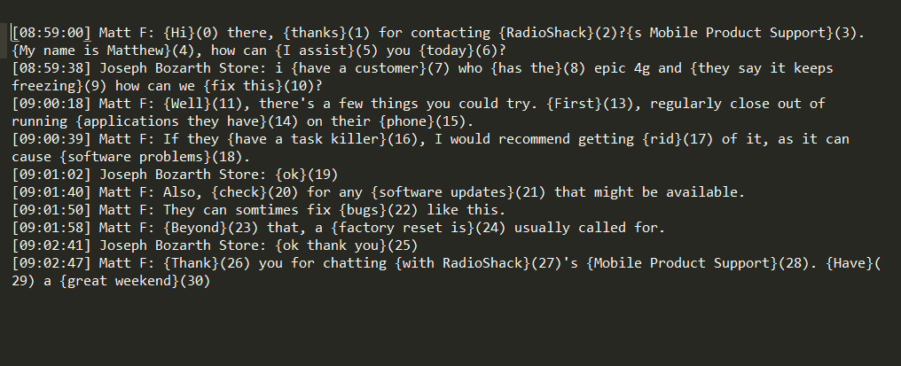
Example of an instrumented chat which is to be annotated

Slide 31
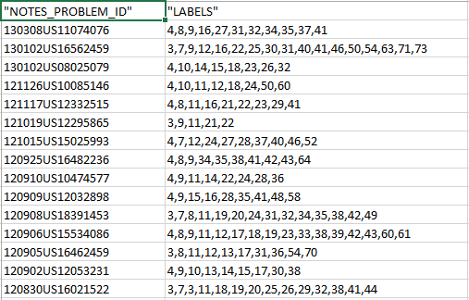
Example of Annotations

Slide 32
Features
For pupose of building the pipeline, basic bag of words features have been used. Words were stemmed before building the model.
Some other context features – length of the turn, length of phrase used.
Some conversational features – index of turn, time from the beginning, isQ, iscanned were also used

Slide 33
Some notable points
The features were very much categorical and hence random forests were working well.
Retrieving a learned model from its dump file was taking a long time and hence model parameters were found during training using a grid search CV and these parameters used to train the model on the go.

Slide 34
Accuracies
The instrument learner was found to give >90% cv accuracy on training data and >80% accuracy on test data.
Training data here is 10 annotated chats. Test data is 5 annotated chats.

Slide 35
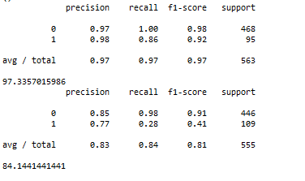

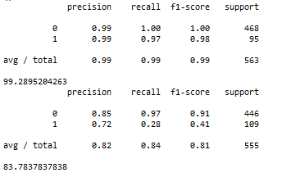

BOW
BOW + context_f

Slide 36
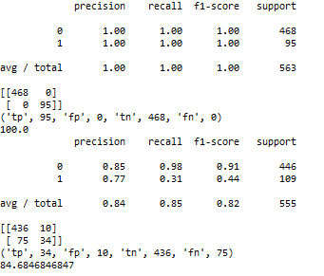
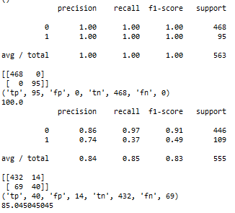
BOW + context_f+conv_f
BOW + context_f+conv_f+stemming

Slide 37
Device extracter
Extracts the device name from the chat.
The device name is generally comes up in segment two.
This is a rule based extractor. Uses the default library of 65000 chats to build a unigram dictionary and tries to find a match.

Slide 38
Csv of Chats
Devices Extracted
Unigram dictionary found
Top min 5 values of TN/(TFIDF+1)
picked
TF, IDF of each word in the unigram dictionary found over the 100 chats
Ordering of the selected words among the five found using a rule mechanism
Device output

Slide 39
Accuracy
Accuracy of this rule based system was found >72%
Resons for low accuracy:
Innapropriate ground truths
Many device short forms used which were not interpreted by the system Ex: galaxy S 4 as gs4,glxy s4
Insufficient info
Spelling mistakes – infuse for infuse etc

Slide 40
PT & PRT Classifiers
Problem type found in segment 2
Problem resolution type found in segment 3
Our system uses bag of words to extract features.
We first train the system for the best set of parameters over the 100 input chats.
We then use the parameters of the model and the vectoriser to train the input data on go during testing and predict the output of the classifier.

Slide 41
Accuracies
Accuracies of PT_classifier >70%
Accuracy of PRT_classifier >60%
Reasons for low accuracies:
Basic BOW no bloating/stemming done
The segment_my_turn library gives varied results in different trials. Sometimes gives varied segments for turns—still under dev.
PRT has 4 different classes

Slide 42
Structure of Summariser
The prediction code is very cleanly structures to bring in any variation with minimal effort.
Essentially consists of different modules for abstractive and extractive summerisers.
The abstractive and extractive summarisers again have different modules returning summaries for different segments
Here Extractive summary has been triggered at the end of every turn and abstractive has been triggered at end of segment.

Slide 43
EX_1
EX_2
Phrase picker
Extrctve_S
EX_3
Annotated learner
EX_4
SUMMARISER
AB_1
Problem Type
AB_2
Abstrctv_S
Device
AB_3
P_Resltn Type
AB_4

Slide 44
Summariser : appropriately triggers Abtractive at EOS and extractive at EOT. Has functions to re-initialize the summarizer and end() the chats.
Extrctve_S, Abstrtv_S are director codes which appropriately direct the summary to the segments. These modules would be essentially useful in generating a dynamically updating summary. Herein we can combine different summaries in required form. Summary of a segment can also be input to other segment to generate a dependent summary…
EX_1 generates the extractive summary of the intro, EX_2 generates the extractive summary of the PD, EX_3 generates the extractive summary of the PR, EX_4 generates the extractive summary of the CL. Having different modules for different segments enables the future use of different classifiers for different segments.

Slide 45
Phrase picker – this is a test form of the trainer that was initially discussed. Takes a single turn input and returns instrumented phrases.
Anno_learner - Learns the model from the stored vectors and vectoriser. Gives a decision on the instrumented phrases.
Device : A rule based device name extractor triggered at eo second segment.
PT – execution similar to annotated learner.
PRT – similar to annotated learner and PT.

Slide 46
Server simulator system
A system has been built which simulates a chat server generates summary at every turn and outputs it to a client UI using a socket connection

Slide 47
Server side simulator
Client side code
Summariser
Chat_Server
Summary requested
over a chat
Summary requested
over a chat
Client

Slide 48
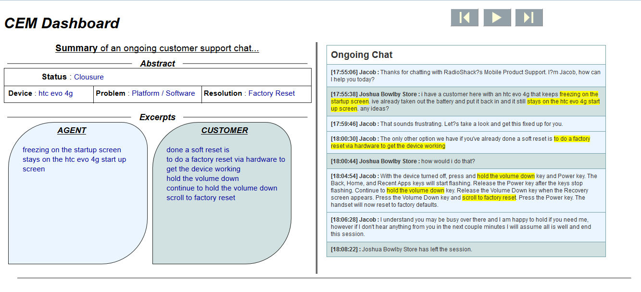
CLIENT
On the right is the ongoing chat with summary highlighted
On the left is the generated summary – Abstract and Excerpts

Slide 49
DEMO

Slide 50

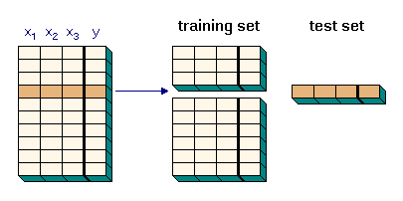
Data Preprocessing
Count
Count_1
Count_2
…
Count_10

Slide 51

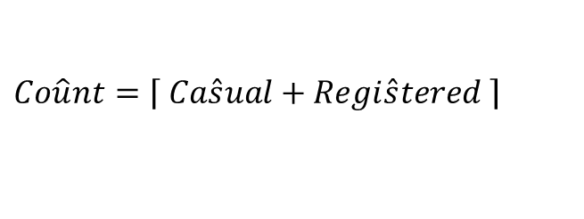


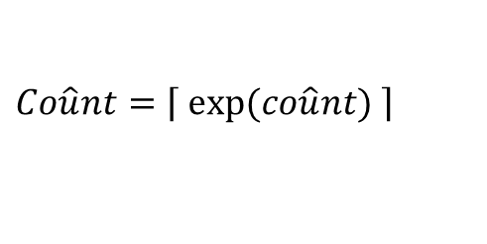

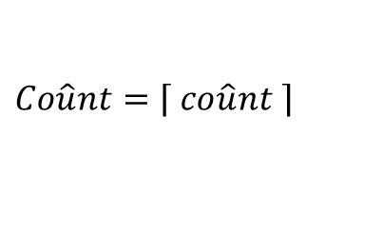
Data Interpretation
Model-1:
Model-2:
Model-3:

Slide 52
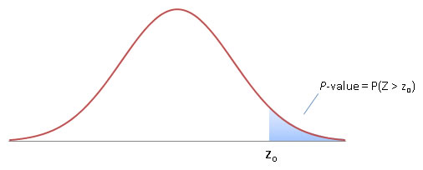
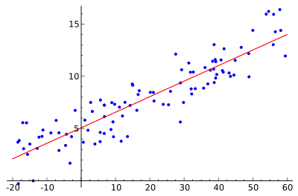
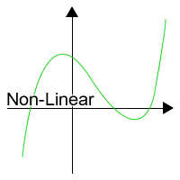
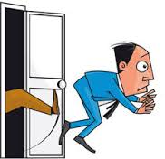

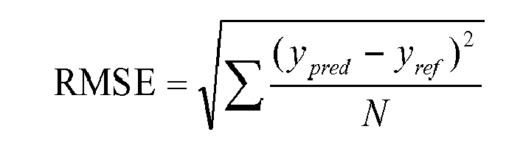
Linear Regression

Slide 53
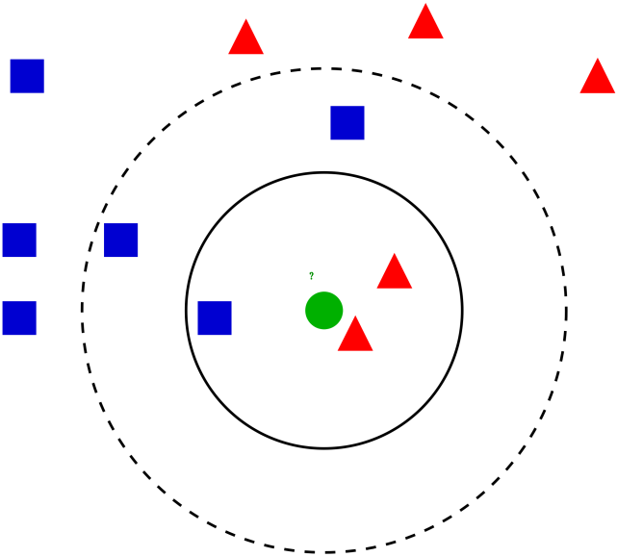
K-Nearest Neighbour

Slide 54
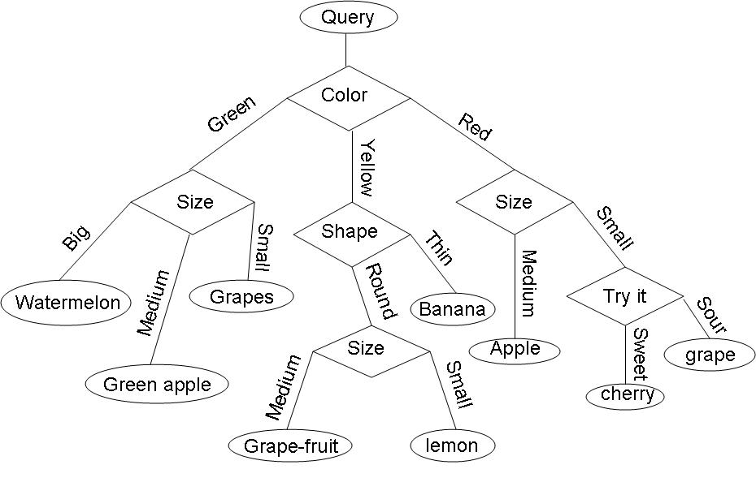
Decision Trees

Slide 55
Ensemble Regression

Slide 56
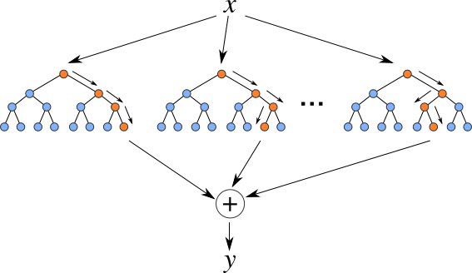

Random Forest

Slide 57
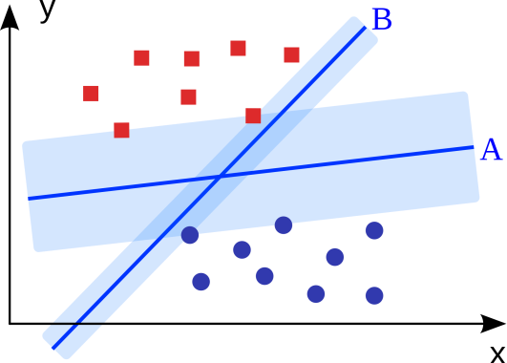
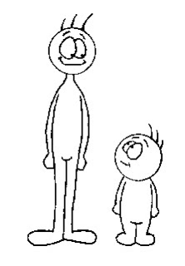
Support Vector Machine
SVM
Linear Regression, Ensemble regression

Slide 58
Ensemble SVMs

Slide 59
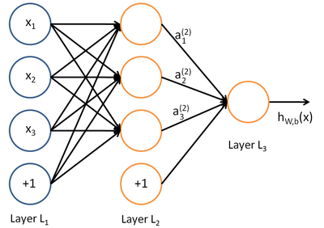

Neural Networks
Neural Network
SVM

Slide 60
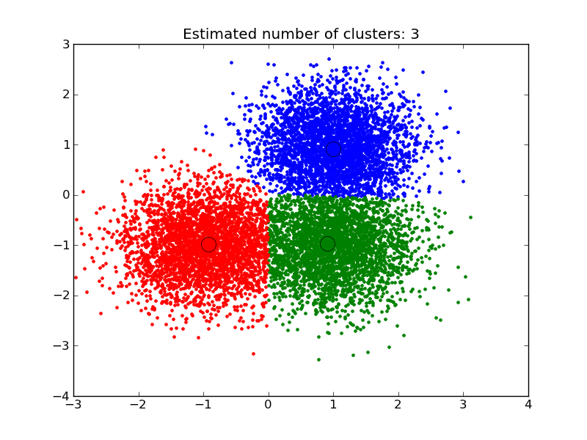

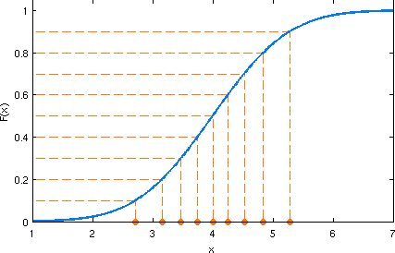
Classification Models
Regression Inside Them
Quantiles based on “count”

Slide 61
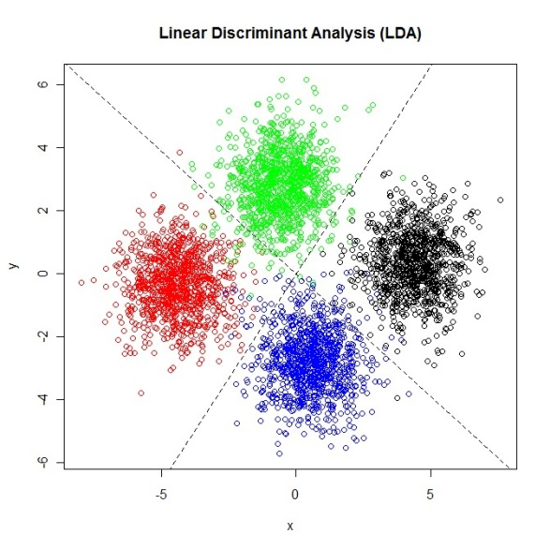
LDA + Random Forest
Linear Regression, Ensemble regression, SVM, Ensemble SVMs
LDA

Slide 62
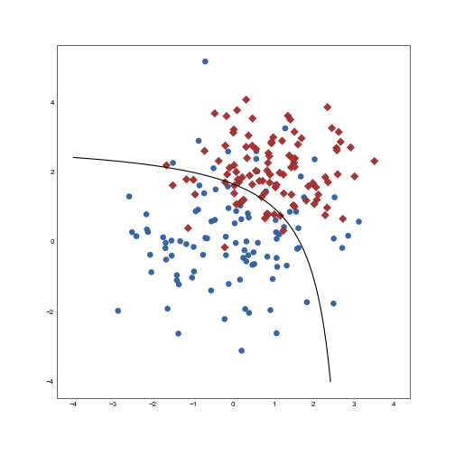
QDA + Random Forest
Linear Regression, Ensemble regression, SVM, Ensemble SVMs, even DTs
QDA

Slide 63
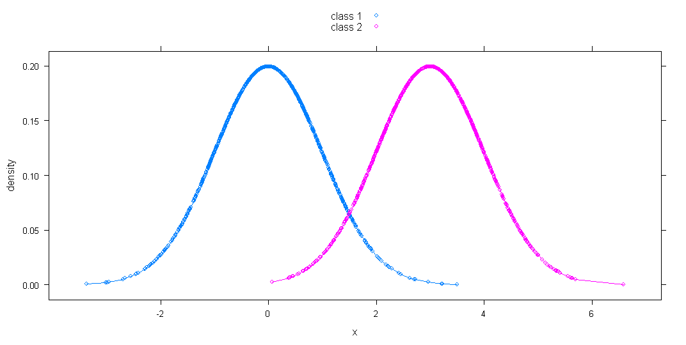
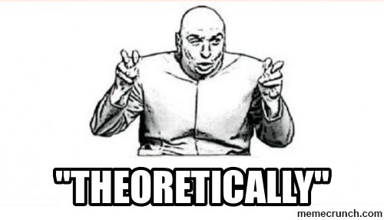


Bayes Discriminant Rule + RF
Practically

Slide 64
Time Series Analysis

Slide 65
Summary of Results
Techniques | RMSE | Kaggle Score
Linear Regression
K-NN Regression
Decision Tree
Ensemble Regression
Random Forest
Weighted Avg (RF + Ens. Reg.)
SVM
Ensemble SVMs
Weighted Avg (RF + Ens. SVMs)
Neural Network
LDA + RF
QDA + RF
Bayes Rule + RF
ARIMA (Time Series Analysis)

Slide 66
Conclusions
This paper deals with the problem of forecasting demand of bikes for a bike sharing system.
We used 14 ML techniques namely; Decision Tree, k-Nearest Neighbours, Linear Discriminant Analysis, Quadratic Discriminant Analysis, Linear Regression, Time Series Analysis, Neural Networks, Ensemble Regression, Random Forest, Weighted Average of Random Forest and Ensemble Regression, SVM, Ensemble SVM, Weighted Average of Ensemble SVM and Random Forest, and Bayes Discriminant Analysis.
Some of the classification models (+ regression model) performed better than some of the famous techniques.
The models which can capture non linearity performed better.
Random Forest gave the best results with the RMSE value of 74.1342 over the test data.

Slide 67
Future Work
In this report, we have focussed more on the techniques of Machine Learning that we can use along with their comparison.
There is a lot of scope of improvement regarding feature engineering.
Although we have done preprocessing needed to apply those techniques, but as discussed in the class, mean shifting, decorrelation of the attributes and variance normalization can be done to improve the results.
the impact of "casual" and "registered" can be dealt in detail so as to produce better results.

Slide 68
References
[1] Unger, D.A., Dool, H.V.D, Lenic, E., and Collins, D. (2009). Ensemble Regression. American Meteorological Society
[2] Espinola, R., Nogales, F.J., Conejo, A.J. (2003).
ARIMA models to predict next-day electricity prices. IEEE
[3] Smits, G.F., Dow Chem. Co., Jordaan, E.M. (2002).
Improved SVM regression using mixtures of kernels. IEEE
[4] Specht, Donald F. (1991).
A general regression neural network. IEEE

Slide 69
THANK YOU ☺

