Slide 1


CapSpense – Expense tracker
Raghav Mantri

Slide 2
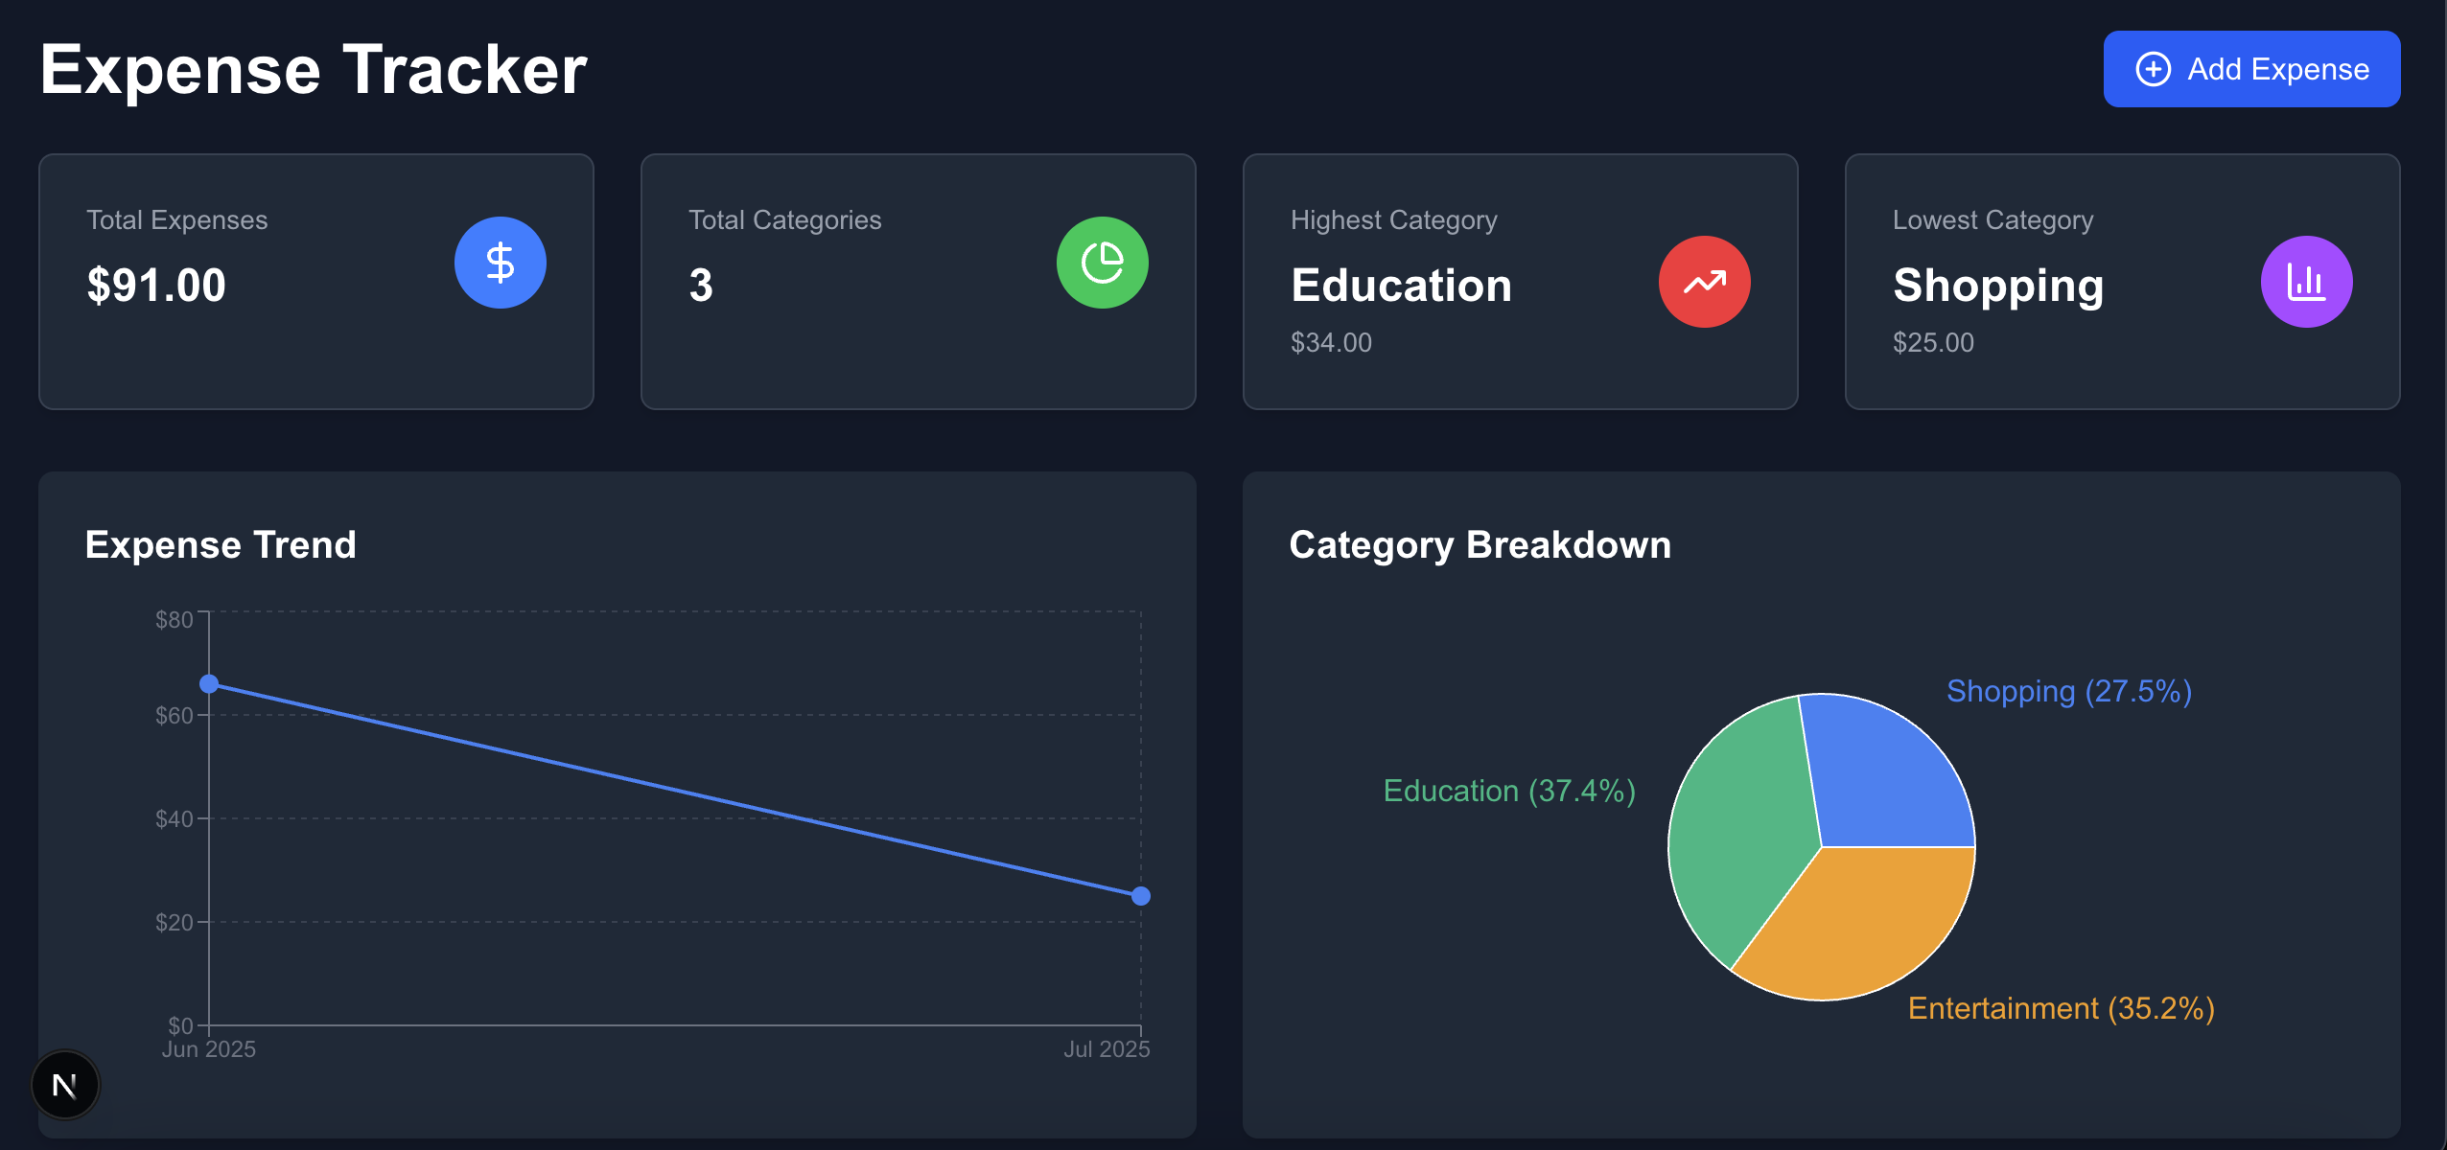
Table of contents
Overview
Approach
Architecture and Design
Key files and folders
Setup and demo
Future improvements

Slide 3
Overview
A full-stack expense tracking application built with Flask (python) backend and Next (typescript) frontend, featuring object-oriented design principles
Functional requirements –
The app should provide total expense
Total expense by category
Expense trend
Highest and lowest spend category

Slide 4
Approach
First step - gather requirements and design the backend architecture
Backend: Flask REST API
- object-oriented expense management
- for better scalability – demonstrates Object Relational Mapping, can be ported to SQL DBs
- Category and Expense classes with proper encapsulation
For this project, file-based JSON storage is used for simplicity (ready for database migration)

Slide 5
Approach - backend
Category class for rich category management
Expense class with validation and business logic
ExpenseTracker class for expense operations
Input validation for amounts, dates, and categories
Custom exceptions for better error handling
Type hints throughout for better code maintainability

Slide 6
Approach - frontend
Second step – Build frontend UI for ease of access for users
Next.js with TypeScript, modern React components
Utilized Tailwind CSS for styling
Utilized tools like Copilot for enhancing UI and adding popular charting packages for better visualization and quick prototyping

Slide 7
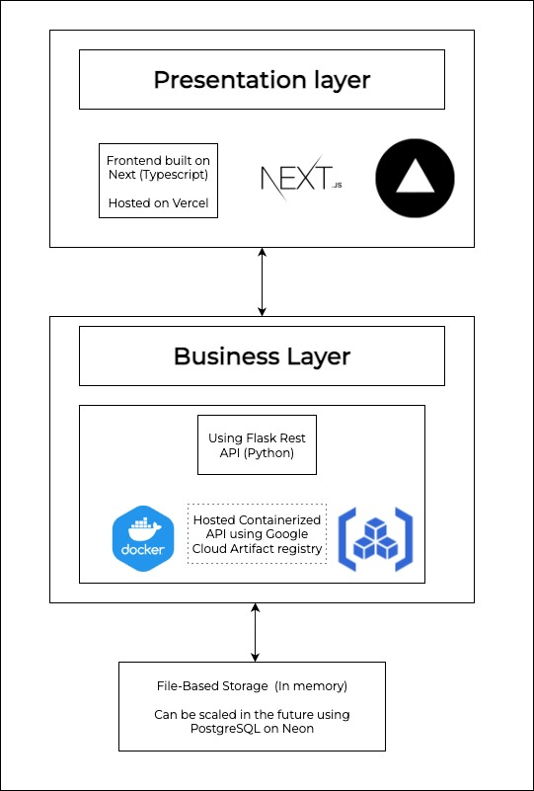
Architecture and Design
Fully hosted backend and frontend
Backend containerized and hosted on Artifact Registry in Google Cloud Platform (GCP)
Frontend hosted on Vercel
Using GitHub Actions for CI/CD and fast deployments

Slide 8
Key files and folders
File | Purpose | Key Components
expenses.py | Business Logic | Category, Expense, ExpenseTracker classes
app.py | REST API | API endpoints, CORS, error handling
main.py | Demo CLI | Sample usage, testing
requirements.txt | Dependencies | Flask, Flask-CORS, gunicorn
expenses.json | Data Storage | JSON file persistence
dockerfile | Deployment | GCP Cloud Run ready

Slide 9
Key files and folders
📁 cap-frontend/
├── 📁 src/
│ ├── 📁 app/ Next.js App Router
│ ├── 📁 components/ Components
│ └── 📁 services/ API Layer
├── 📦 package.json Dependencies
└── ⚙️ next.config.ts Next.js Config

Slide 10
Key files and folders
File | Purpose | Key Components
ExpenseTracker.tsx | Main App Container | State management, API calls, layout
ExpenseForm.tsx | Add Expense Form | Custom categories, validation
ExpenseList.tsx | Expense Display | List rendering, delete actions
ExpenseChart.tsx | Trend Visualization | Line chart, date sorting
CategoryBreakdown.tsx | Category Pie Chart | Recharts integration
DashboardCard.tsx | Stats Cards | Reusable metric display
api.ts | API Service Layer | HTTP client, error handling

Slide 11
Setup and demo
Hosted app ready for testing - https://capg-expense.vercel.app/
Instructions for setup are in the README –
https://github.com/raghavm1/capg-expense?tab=readme-ov-file#getting-started

Slide 12
Future improvements
The object-oriented architecture enables easy extension:
- Category hierarchies and subcategories
Budget tracking and alerts
Multi-currency support
Database integration (PostgreSQL/Neon)
Advanced analytics and reporting

