Slide 1

Quaternion-Based Reaction Wheel Attitude Control for Satellites
Control Systems BMEE330L | Team REGEL
Raghav Mahajan (23BME0456) • Vedant Singh (23BME0456) • Pranav Subhash (23BME0481)

Slide 2
Problem Statement
Satellites require precise orientation control to maintain proper alignment for communication, Earth observation, and scientific measurements. Without active control, external disturbances cause uncontrolled rotation.
Gravity Gradient
Solar Radiation
Atmospheric Drag
Residual drag at low altitudes
Non-uniform gravitational field from Earth
Pressure acting on satellite surfaces
Research Foundation
01
02
03
Research Foundation
Proven Technology
Advanced Mathematics
Project concept derived from spacecraft control literature and IEEE papers on quaternion-based control systems for small satellites.
Reaction wheels selected as primary actuators due to reliability, precision, and widespread use in CubeSats and larger spacecraft.
Quaternion representation chosen over Euler angles to avoid singularities and enable efficient attitude computation.

Slide 3




System Overview
The attitude control system operates through a closed-loop feedback mechanism that continuously adjusts satellite orientation using reaction wheel momentum.
Desired Orientation
Quaternion Error
Reference attitude input
Calculate attitude deviation
PD Controller
Reaction Wheel Torque
Generate control torque
Apply corrective forces

Slide 4
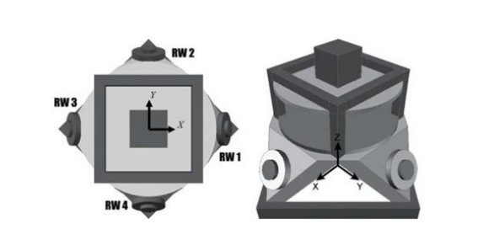
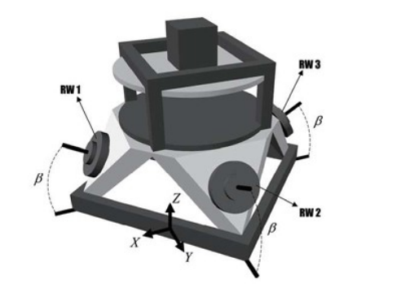
Pyramidal Four-Wheel Architecture
The system employs four reaction wheels arranged in a pyramid configuration with one wheel along each axis and a fourth wheel at an angle, providing redundancy and three-axis control capability.
Single Wheel Failure Tolerance
Improved Torque Distribution
Maintains partial functionality
Enhanced momentum management
Enhanced Control Authority
Balanced Mass Distribution
Across all rotational axes
Reduces structural vibrations

Slide 5



Mathematical Model
1
2
3
Quaternion Kinematics
Rotational Dynamics
Momentum Exchange
Rigid body dynamics governed by moment of inertia and applied control torque.
Reaction wheel angular momentum produces equal and opposite satellite torque.
Quaternion representation avoids gimbal lock and enables smooth rotation interpolation.

Slide 6


Control Algorithm
The PD controller computes control torque based on attitude error and angular velocity feedback, providing stable and responsive attitude correction.
Proportional Term
Quaternion Error
Total Torque
Derivative Term
Proportional gain k_p determines stiffness and response speed. Derivative gain k_d provides damping and stability. Values tuned through simulation and eigenvalue analysis.

Slide 7
Stability Properties
PD controller guarantees asymptotic stability for attitude regulation. Lyapunov analysis confirms bounded error convergence to zero equilibrium point.
Asymptotic Stability
Bounded Error
Zero Equilibrium
Guaranteed convergence to desired attitude
Lyapunov analysis confirms stability
Error converges to equilibrium point

Slide 8
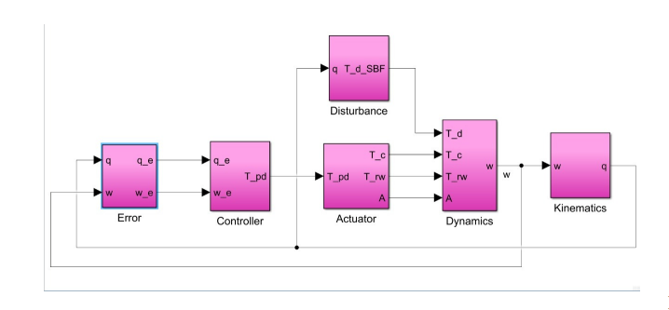
Code Implementation
Python implementation demonstrates quaternion error calculation, control torque generation, and reaction wheel distribution logic.
# Quaternion error calculation
def calculate_error(q_desired, q_current):
q_conj = np.array([q_current[0], -q_current[1],
-q_current[2], -q_current[3]])
q_error = quaternion_multiply(q_desired, q_conj)
return q_error
# PD controller implementation
def pd_controller(q_error, omega, kp, kd):
torque_p = -kp * q_error[1:4] # Proportional term
torque_d = -kd * omega # Derivative term
total_torque = torque_p + torque_d
return total_torque
# Reaction wheel distribution
def distribute_torque(T, B):
omega_dot = np.linalg.pinv(B) @ T
return omega_dot
Control Architecture
Key functions include quaternion multiplication with proper normalization, error vector extraction from scalar-vector form, matrix pseudoinverse for torque distribution, and saturation limits preventing wheel overspeed.

Slide 9
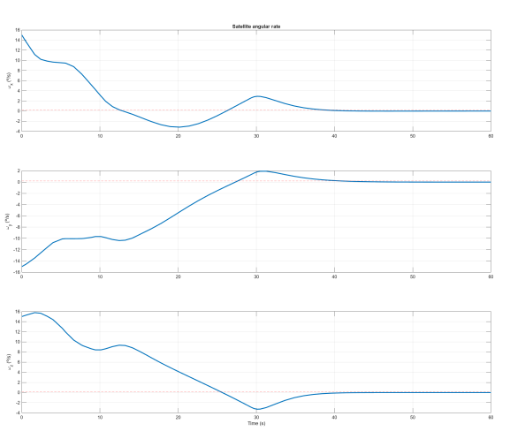
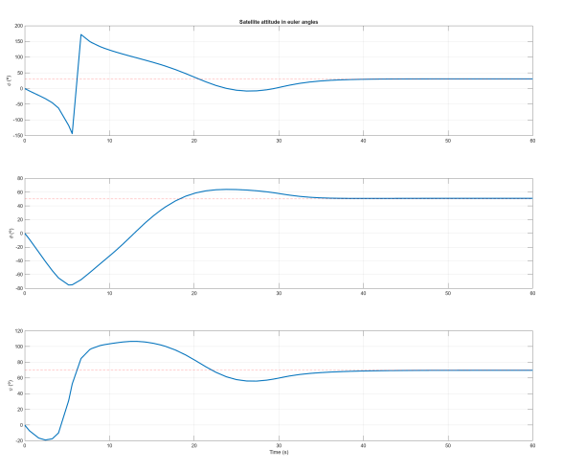
Results and Future Work
Current Results
Software-in-loop simulation validated control law performance. Attitude error reduced to <0.5° with ±5° initial perturbations.
Future Work
Hardware implementation on CubeSat platform with flight-rated reaction wheels. Integration with ADCS sensors including magnetometers and sun sensors for autonomous operation.
Enhancements
Adaptive gain scheduling for varying inertia conditions. Momentum dumping using magnetic torquers during eclipse periods. Fault detection and isolation for wheel failures.

Slide 10
References
Research Paper | Impact Factor
https://doi.org/10.1016/j.asr.2024.08.056 | 2.8
https://doi.org/10.1016/j.rineng.2022.100717 | 7.9
https://doi.org/10.3390/app12105273 | 2.5
https://doi.org/10.1016/j.actaastro.2014.05.018 | 3.4
https://doi.org/10.1016/j.conengprac.2007.02.004 | 4
https://doi.org/10.1016/j.actaastro.2008.01.007 | 3.4
https://doi.org/10.1016/j.actaastro.2015.05.013 | 3.5
https://doi.org/10.1016/j.actaastro.2014.03.004 | 3.4
https://doi.org/10.1016/j.actaastro.2010.01.018 | 3.4

Slide 11
THANK YOU

