Slide 1
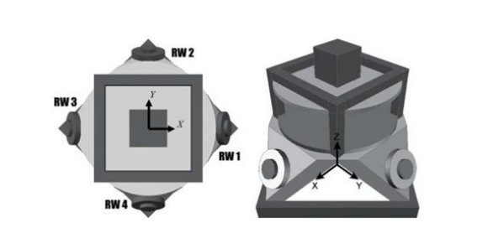
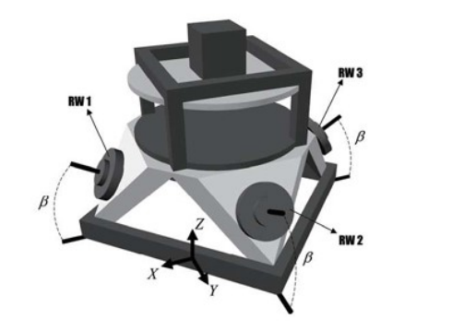
Quaternion-Based Reaction Wheel Attitude Control for Satellites
Review-2 Technical Presentation
Team Name - REGEL
Raghav Mahajan 23BME0456, Vedant Singh 23BME0456, Pranav Subhash 23BME0481
Control Systems BMEE330L

Slide 2
Why Attitude Control is Critical
Satellites require precise orientation control to maintain proper alignment for communication, Earth observation, and scientific measurements. Without active control, external disturbances cause uncontrolled rotation.
Problem Statement
Common Disturbances
Gravity gradient torque from Earth's non-uniform gravitational field
Solar radiation pressure acting on satellite surfaces
Magnetic torques from interaction with Earth's magnetic field
Residual atmospheric drag at low altitudes

Slide 3
Motivation and Idea Source
Research Foundation
Proven Technology
Project concept derived from spacecraft control literature and IEEE papers on quaternion-based control systems for small satellites.
Reaction wheels selected as primary actuators due to reliability, precision, and widespread use in CubeSats and larger spacecraft.
Advanced Mathematics
Quaternion representation chosen over Euler angles to avoid singularities and enable efficient attitude computation.

Slide 4


System Overview
The attitude control system operates through a closed-loop feedback mechanism that continuously adjusts satellite orientation using reaction wheel momentum.
Desired Orientation
Quaternion Error
PD Controller
Reaction Wheel Torque

Slide 5
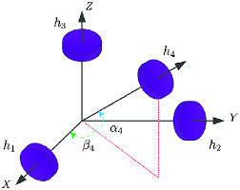
Reaction Wheel Configuration
Pyramidal Four-Wheel Architecture
The system employs four reaction wheels arranged in a pyramid configuration with one wheel along each axis and a fourth wheel at an angle, providing redundancy and three-axis control capability.
Advantages of Redundancy
Single wheel failure tolerance maintains partial functionality
Improved torque distribution and momentum management
Enhanced control authority across all rotational axes
Balanced mass distribution reduces structural vibrations

Slide 6
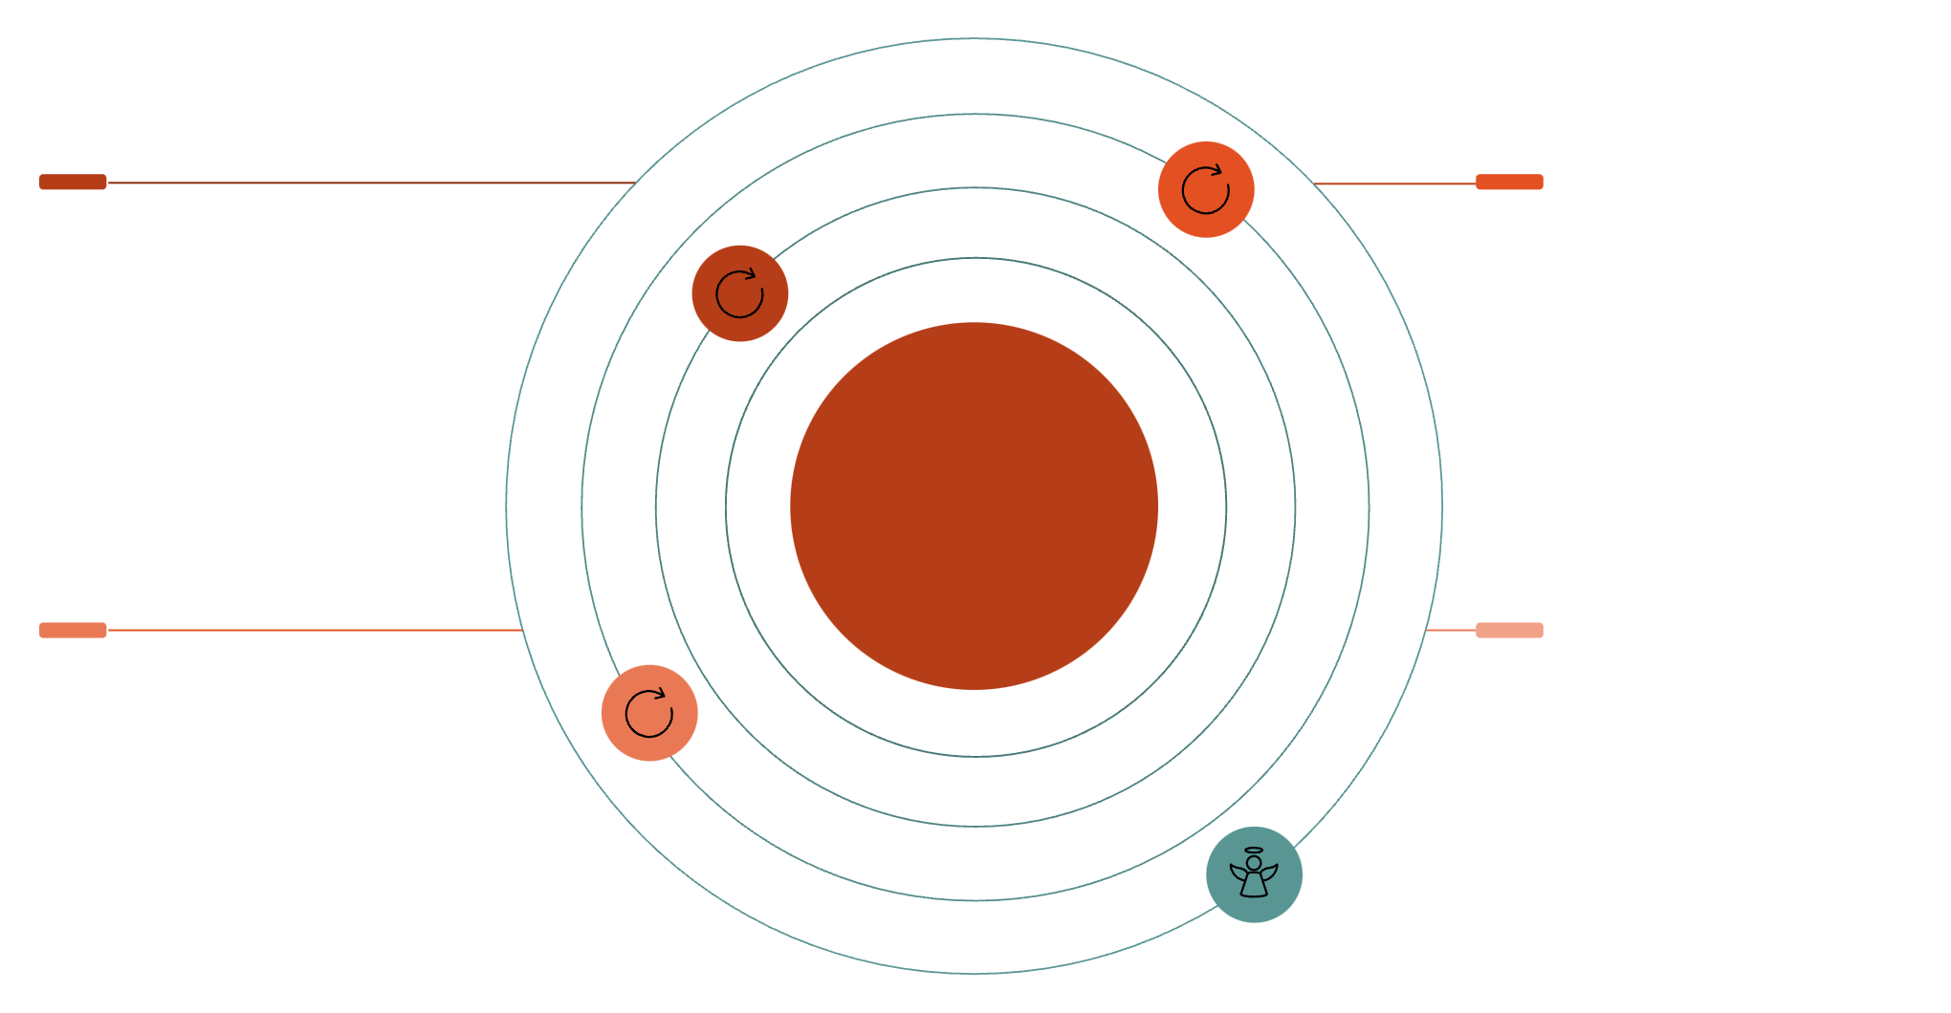
X-Axis Wheel
Y-Axis Wheel
Primary roll control wheel
Primary pitch control wheel
Pyramidal Four-Wheel Reaction System
Z-Axis Wheel
54.7° Offset Wheel
Primary yaw control wheel
Diagonal wheel for redundancy

Slide 7



Mathematical Model
1
2
3
Quaternion Kinematics
Rotational Dynamics
Momentum Exchange
Rigid body dynamics governed by moment of inertia and applied control torque
Reaction wheel angular momentum produces equal and opposite satellite torque
Quaternion representation avoids gimbal lock and enables smooth rotation interpolation

Slide 8


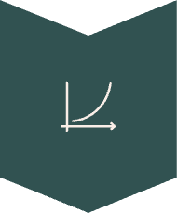

Control Algorithm
Quaternion Proportional-Derivative Controller
The PD controller computes control torque based on attitude error and angular velocity feedback, providing stable and responsive attitude correction.
Quaternion Error
Calculate qe​=qd​⊗q−1
Proportional Term
Tp​=−kp​qe,vec​
Derivative Term
Td​=−kd​ω
Total Torque
T=Tp​+Td​
Gain Selection
Stability Properties
Proportional gain k_p determines stiffness and response speed. Derivative gain k_d provides damping and stability. Values tuned through simulation and eigenvalue analysis.
PD controller guarantees asymptotic stability for attitude regulation. Lyapunov analysis confirms bounded error convergence to zero equilibrium point.

Slide 9

System Block Diagram
Satellite dynamics
Desired quaternion
Orientation changes feed sensors
Reference attitude input
Satellite Attitude Control
Measured quaternion
Reaction wheels
Four wheels distribute torque
Sensor-derived current attitude
PD controller
Quaternion error
Generates torque commands
Desired minus measured

Slide 10
Code Implementation
Python implementation demonstrates quaternion error calculation, control torque generation, and reaction wheel distribution logic.
# Quaternion error calculation
def calculate_error(q_desired, q_current):
q_conj = np.array([q_current[0], -q_current[1], -q_current[2], -q_current[3]])
q_error = quaternion_multiply(q_desired, q_conj)
return q_error
# PD controller implementation
def pd_controller(q_error, omega, kp, kd):
torque_p = -kp * q_error[1:4] # Proportional term
torque_d = -kd * omega # Derivative term
total_torque = torque_p + torque_d
return total_torque
# Reaction wheel distribution
def distribute_torque(T, B):
# B is wheel configuration matrix
omega_dot = np.linalg.pinv(B) @ T
return omega_dot
Key Functions
Implementation Notes
Quaternion multiplication with proper normalization
Error vector extraction from scalar-vector form
Matrix pseudoinverse for torque distribution
Saturation limits preventing wheel overspeed
Code includes numerical integration for quaternion propagation and checks for singular configurations. Wheel speeds limited to maximum rated RPM with momentum dumping logic.

Slide 11

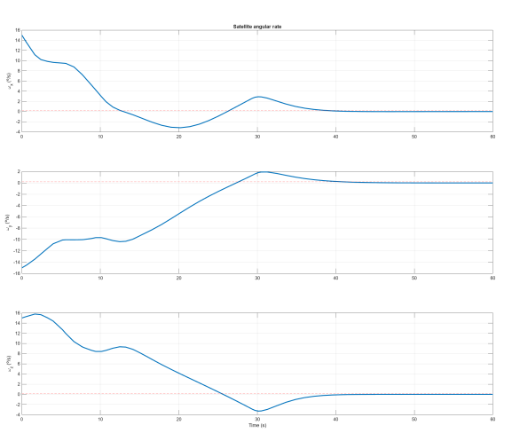
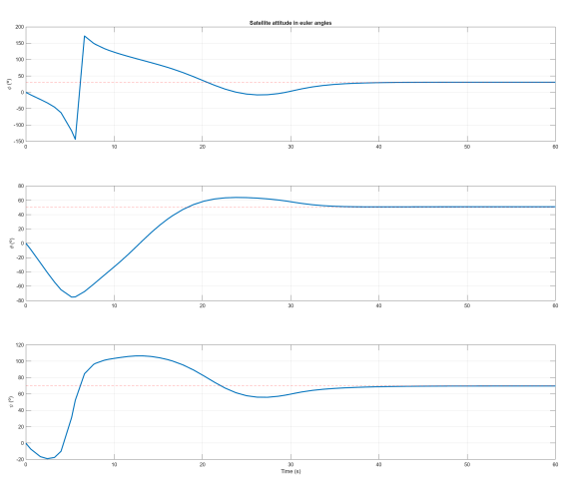
Simulation Results and Future Work
Euler Angle Response
Wheel Momentum
Simulation shows convergence from initial attitude error to desired orientation within 30 seconds. Oscillations dampened by derivative control term.
Individual reaction wheels demonstrate smooth torque application without saturation. Redundancy allows load sharing during large maneuvers.
Current Results
Software-in-loop simulation validated control law performance. Attitude error reduced to <0.5° steady-state with ±5° initial perturbations.
Future Work
Hardware implementation on CubeSat platform with flight-rated reaction wheels. Integration with ADCS sensors including magnetometers and sun sensors for autonomous operation.
Enhancements
Adaptive gain scheduling for varying inertia conditions. Momentum dumping using magnetic torquers during eclipse periods. Fault detection and isolation for wheel failures.

Slide 12
Research Paper | Impact Factor
https://doi.org/10.1016/j.asr.2024.08.056 | 2.8
https://doi.org/10.1016/j.rineng.2022.100717 | 7.9
https://doi.org/10.3390/app12105273 | 2.5
https://doi.org/10.1016/j.actaastro.2014.05.018 | 3.4
https://doi.org/10.1016/j.conengprac.2007.02.004 | 4
https://doi.org/10.1016/j.actaastro.2008.01.007 | 3.4
https://doi.org/10.1016/j.actaastro.2015.05.013 | 3.5
https://doi.org/10.1016/j.actaastro.2014.03.004 | 3.4
https://doi.org/10.1016/j.actaastro.2014.03.004 | 3.4
https://doi.org/10.1016/j.actaastro.2010.01.018 | 3.4
https://doi.org/10.1016/j.actaastro.2010.01.018 | 3.4
References

Slide 13
THANK YOU

