Slide 1

SOEN 6441 Advanced Programming Practices
RISK
Presented by:
Team W13
Rohit 40268994
Raghav 40276920
Ishaan 40262194
Sumit 40254093
Kevin 27035047
Bhavya 40270772

Slide 2
Table Of Contents
Features of Build 1
Architecture Overview and Diagram
Functional Description
Game snapshots
Tools used
Coding Convention followed

Slide 3
Features of Build 1
The main features of build 1 include implementation of mainly 2 phases:
Edit Map Phase
Startup Phase

Slide 4
1. Edit Map Phase
The game begins with the selection of map. The player can either:
Load the existing map
Edit the map
Create a new map
Save the map and
Validate the map

Slide 5
2. Startup Phase
This is the phase where main game begins.
The territories are allocated randomly among players.
Reinforcements are assigned
Issue order
Execute order

Slide 6
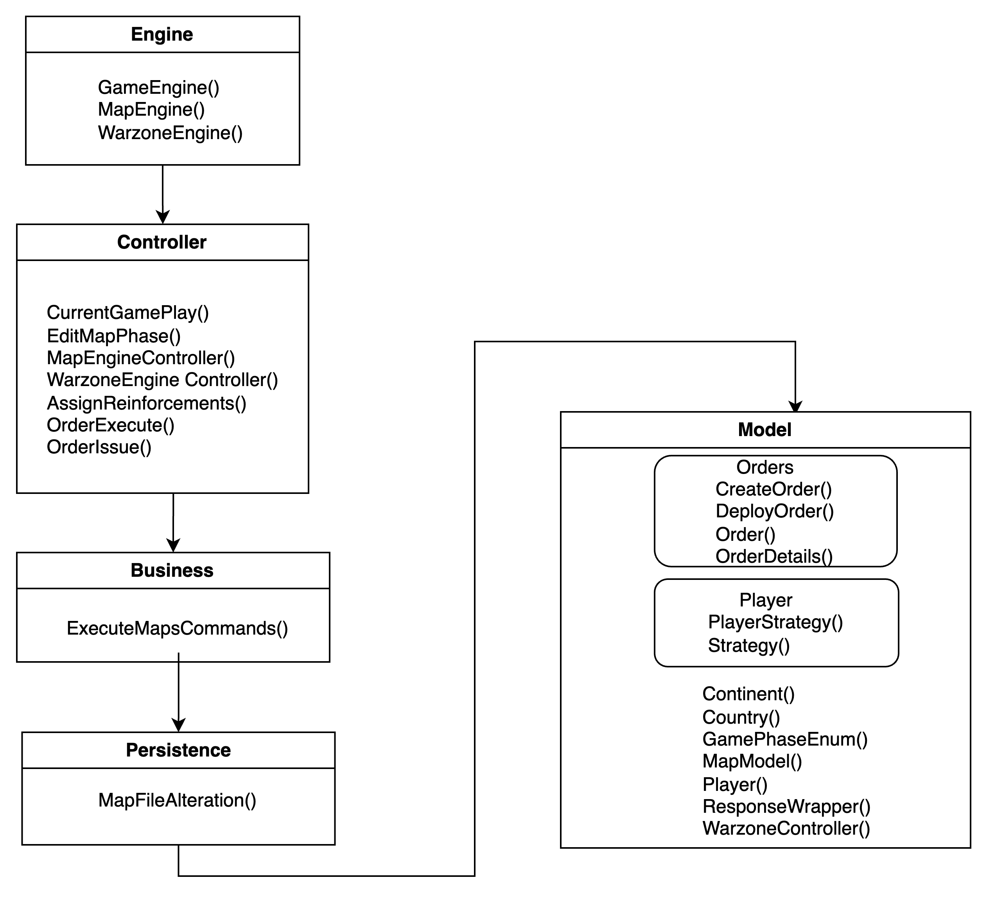
Architecture Overview

Slide 7
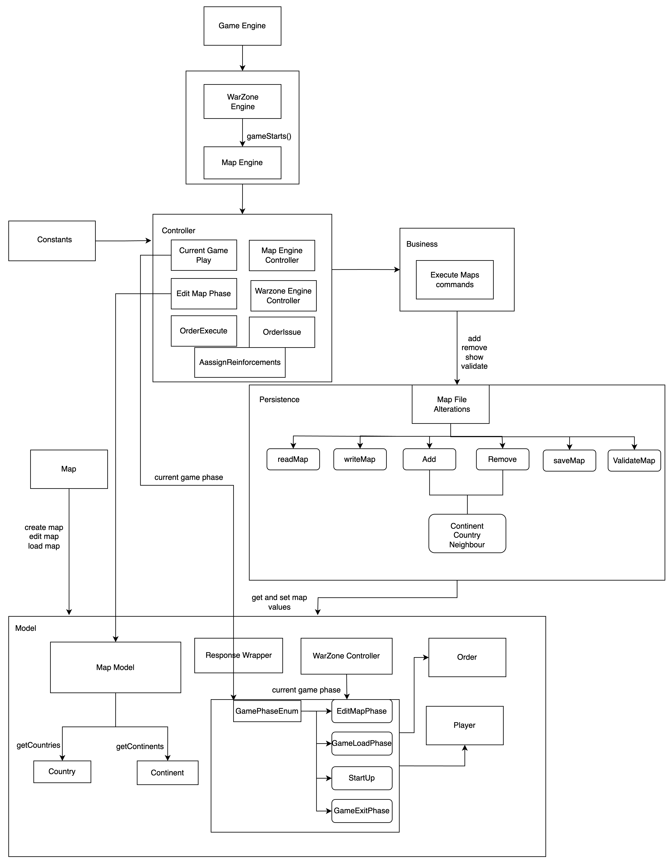
Architectural Diagram

Slide 8
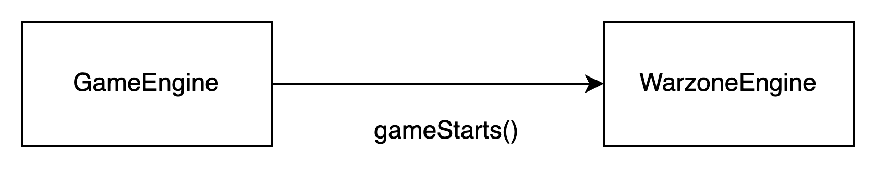
Functional Description
GameEngine
The purpose of this class is to initialize and start a game engine.

Slide 9
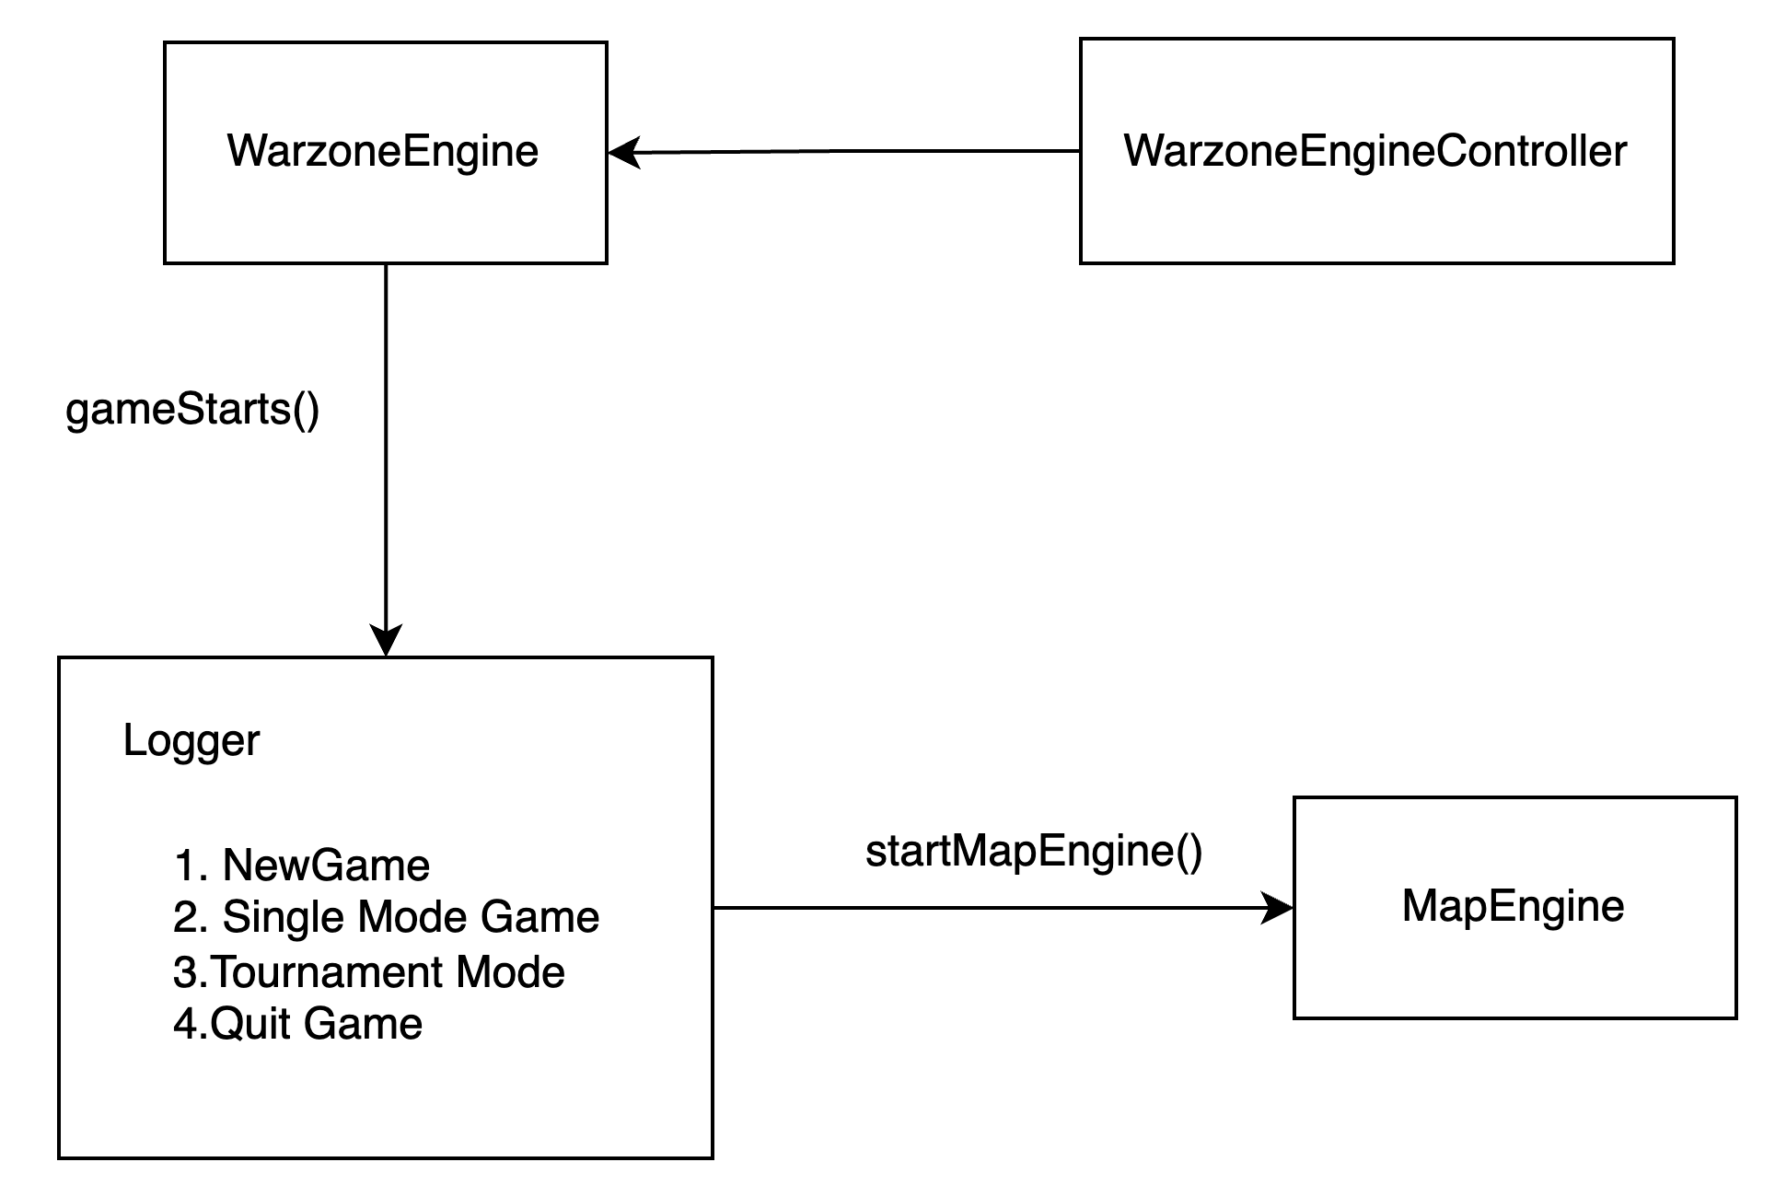
Warzone Engine
The entry point for a game, initializing game components, managing user input, and controlling game state transitions, including interactions with the map engine.

Slide 10
MapEngine and MapEngineController
They manage the map-related commands.
Create New Map
Edit Existing Map by adding or removing
Continents
Countries
Neighbours
Show Map
Validate Map
They follow a loop-based structure to receive and process map-related commands from users.

Slide 11
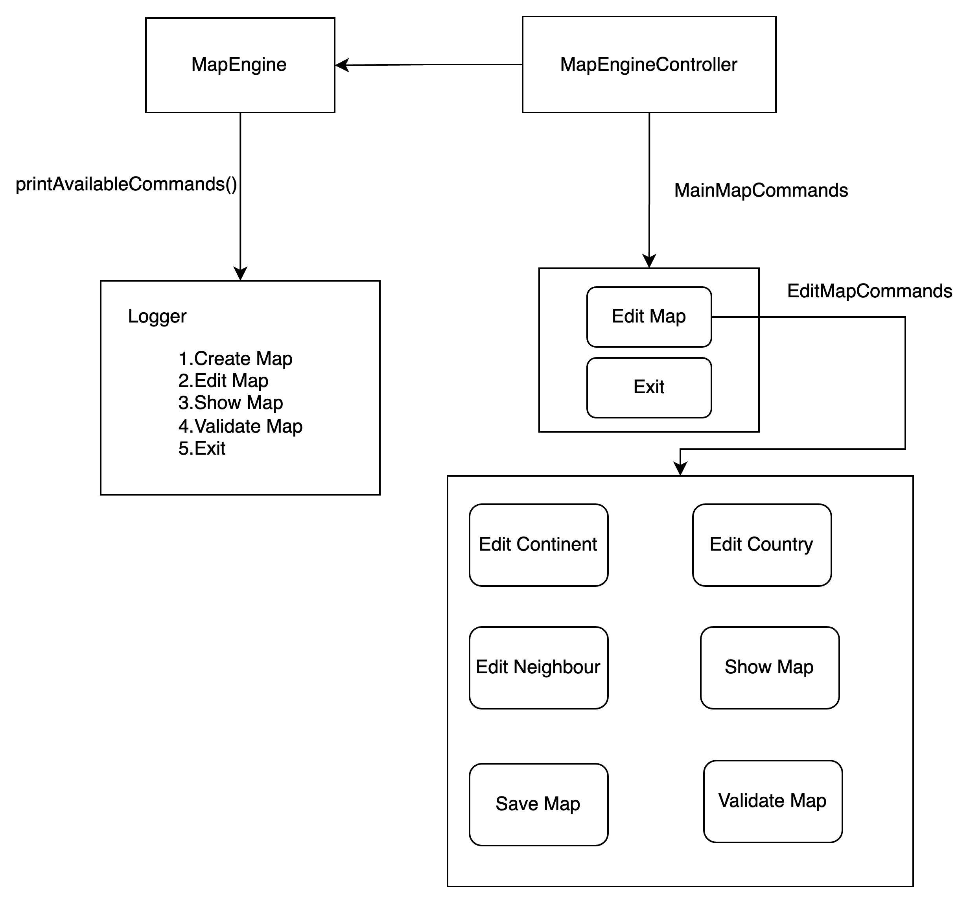
MapEngine and MapEngineController

Slide 12
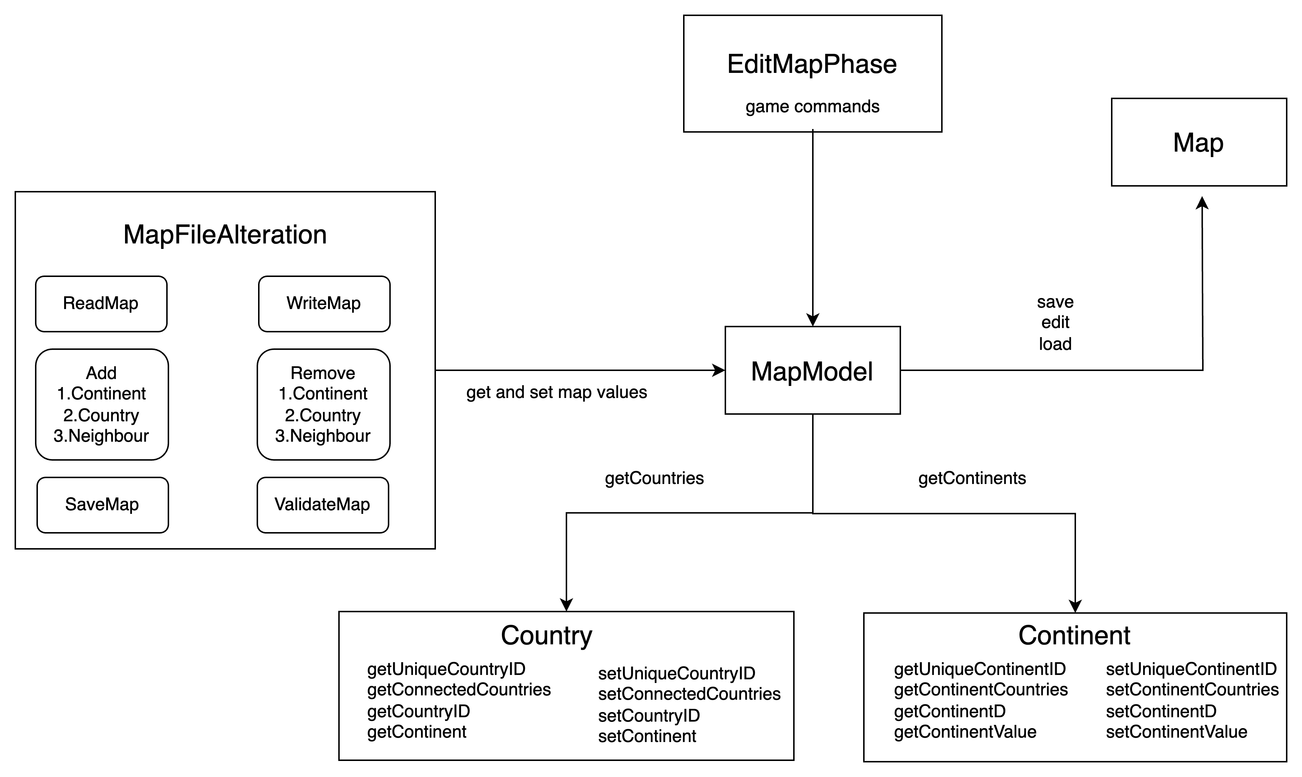
MapModel

Slide 13
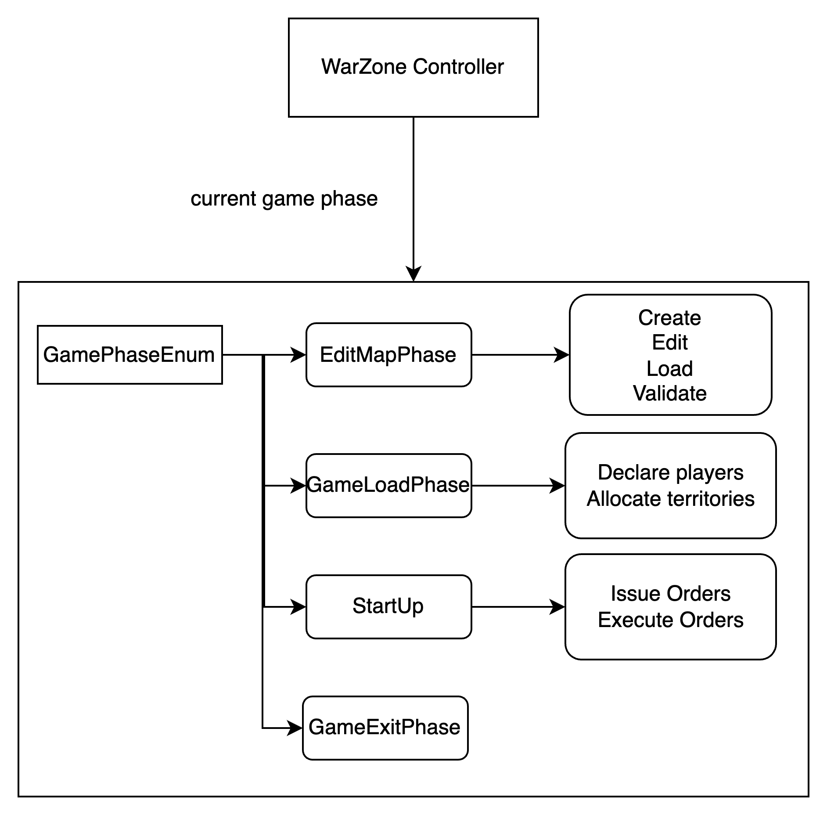
GamePhaseEnum

Slide 14
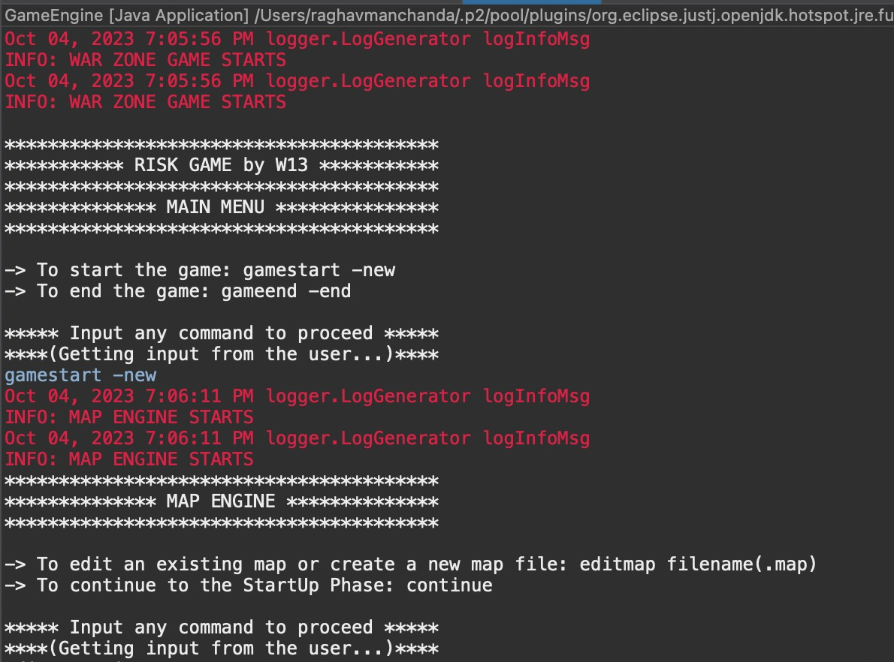
Game Snapshots

Slide 15
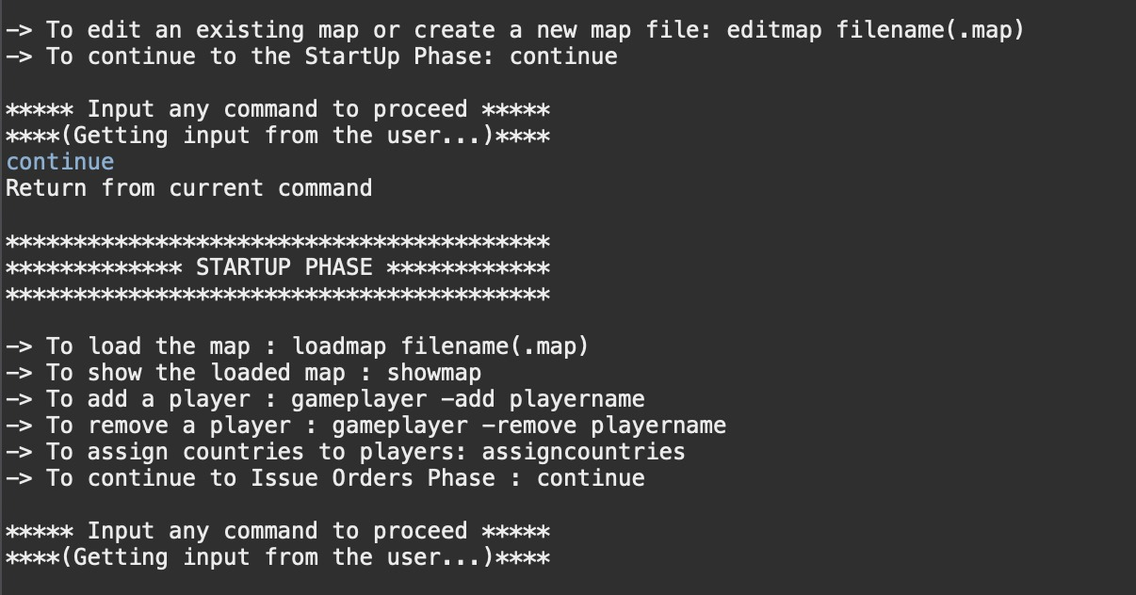

Slide 16
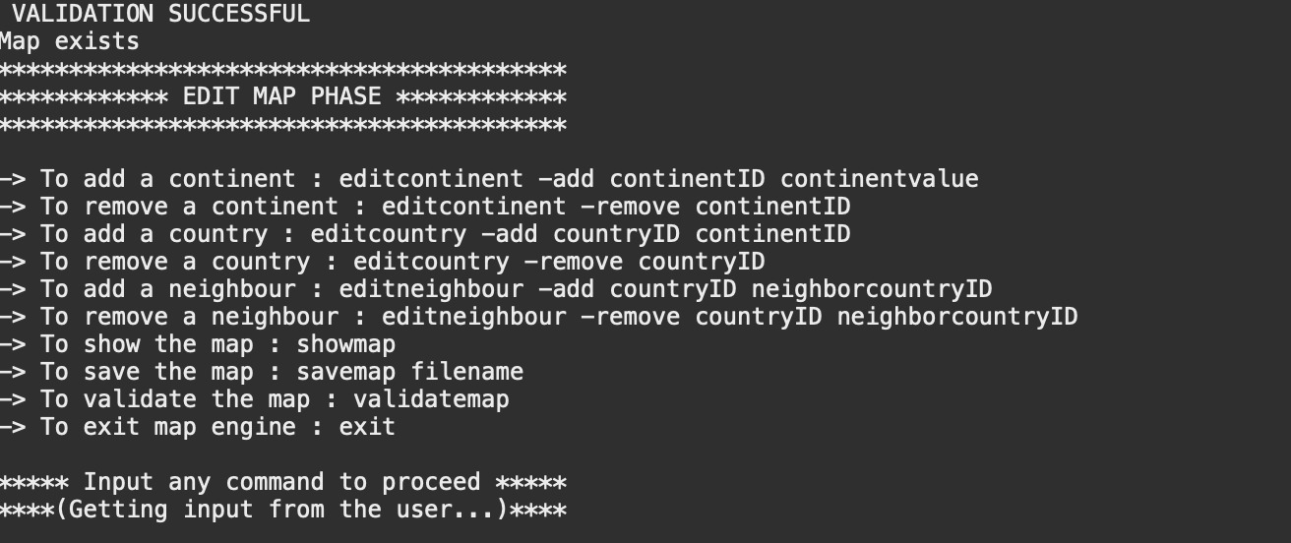

Slide 17
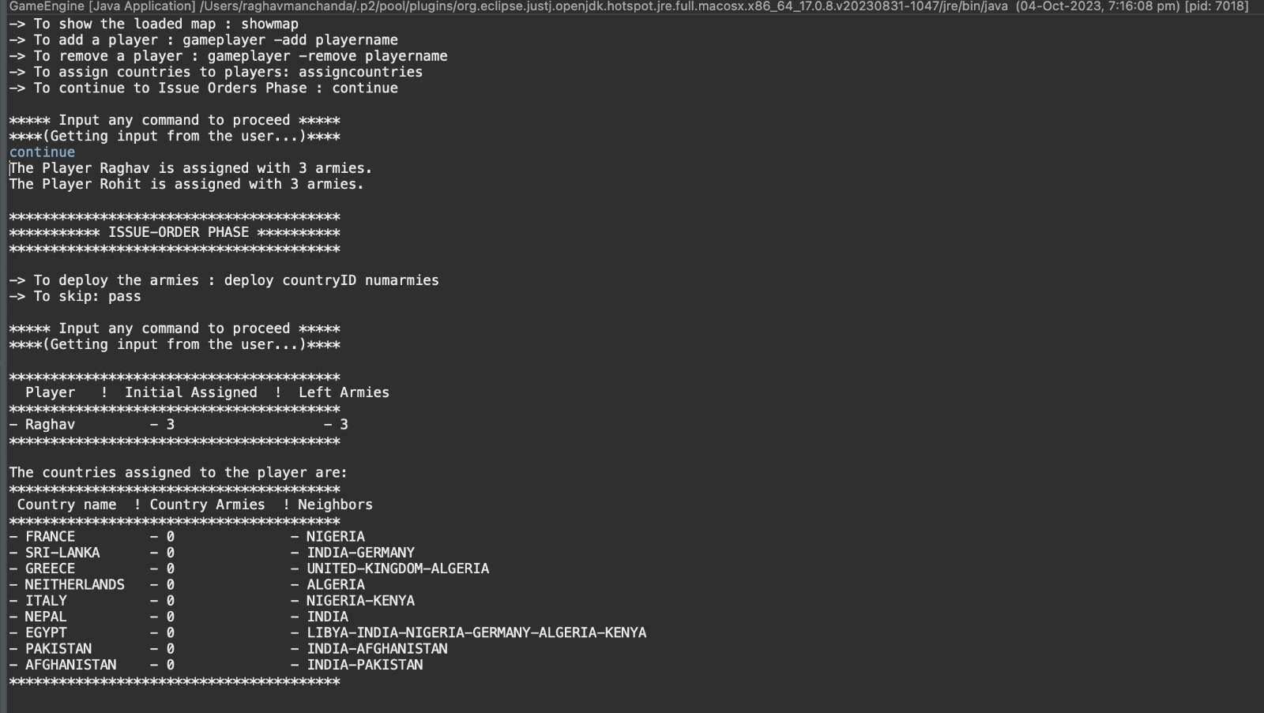

Slide 18
Tools used
GitHub
Version control and collaboration
Repository setup and cloning
Collaboration with team members
Git commands for branching, committing, and pushing
Eclipse IDE
Integrated Development Environment
Project setup and coding
Running JUnit tests
Debugging and Git integration
Javadoc
Code documentation with comments
Generating Javadoc in Eclipse
Clear code documentation for classes and methods
JUnit
Unit testing framework
Writing test classes with annotations
Running tests and using assertions

Slide 19
Coding conventions followed
Naming conventions
class names in CamelCase that starts with a capital letter
data members start with d_
method parameters start with p_
local variables start with l_
global variables in capital letters
static members start with a capital letter, non-static members start with a lower case letter
Code layout
consistent layout throughout code (use an IDE auto-formatter)
Commenting convention
javadoc comments for every class and method
long methods (more than 10 lines) are documented with comments for procedural steps
no commented-out code
Project Structure
one folder for every module in the high-level design
tests are in a separate folder that has the exact same structure as the code folder
1-1 relationship between tested classes and test classes

Slide 20
Thank you

