Slide 1
MapReduce

Slide 2
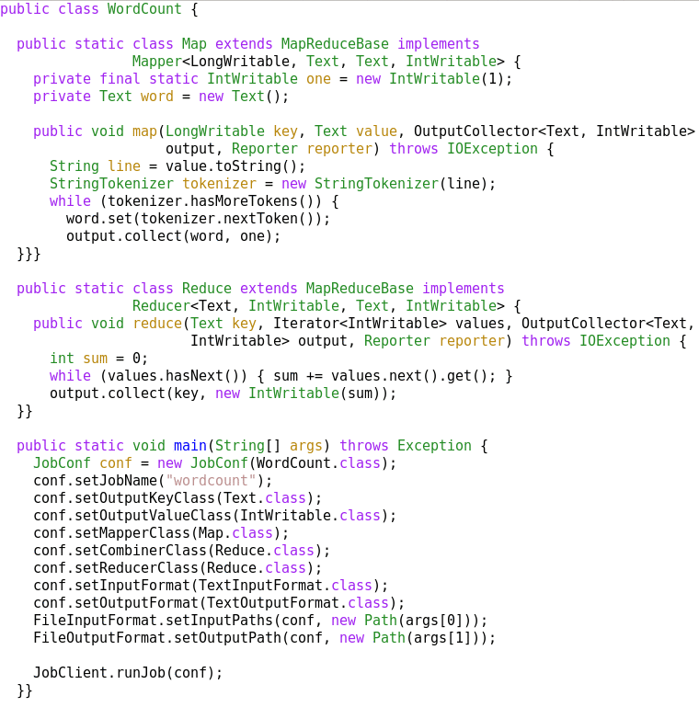
A MapReduce Job
Mapper
Reducer
Run this program as
a MapReduce job

Slide 3
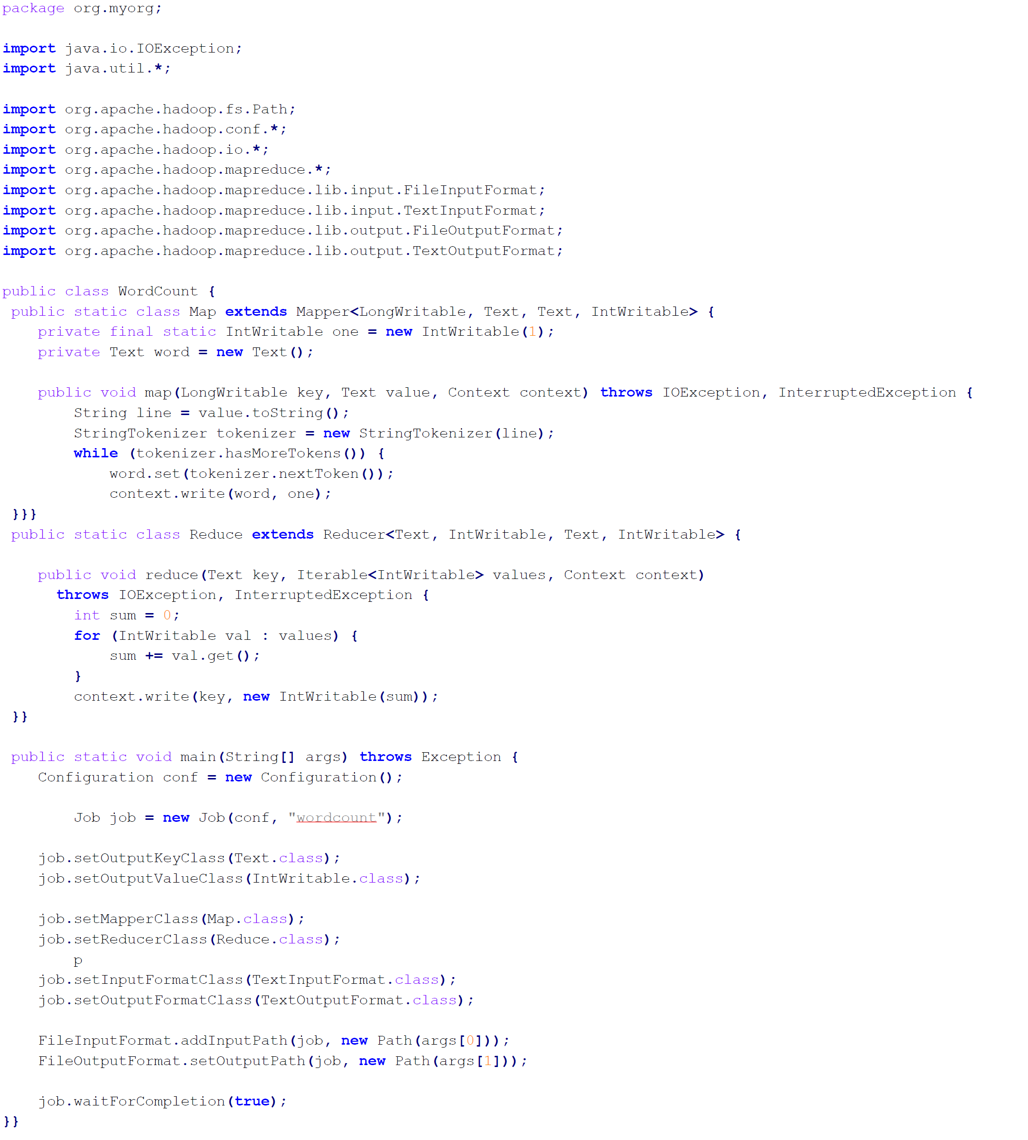
Mapper
Reducer
Run this program as
a MapReduce job

