Slide 1
Data Analytics 2 - Case Study Multi-Objective Optimization
Group 7
10.07.2019

Slide 2
How we approached the optimization problem
Agenda
Trained models of several algorithms to approximate the underlying functions
Conducted research to find especially a sampling approach fitting the problem
Implemented NSGA II using Python to generate Pareto-optimal set of points
Research
Surrogate Modeling
Sanity-checked the results and manually tuned algorithm parameters where necessary
Used adaptive sampling to request points from the API based on statistical uncertainty
Sampling
Optimization
Evaluation

Slide 3
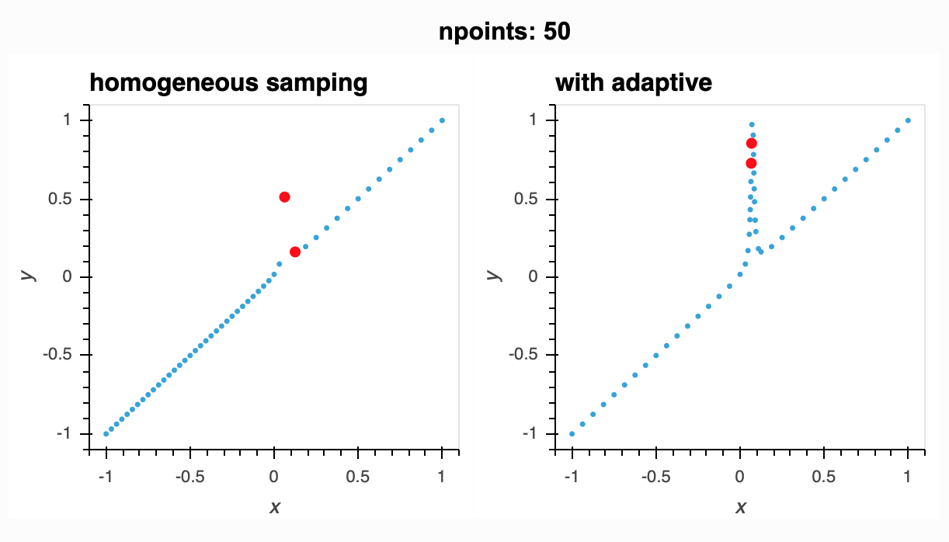
Using the budget to sample relevant points is key
Research
Research question: How to sample those points that are most relevant when fitting the model?
With homogenous sampling approaches, relevant areas might be underrepresented
Adaptive sampling is executed in iterations
Adaptive sampling incorporates a learner that applies a measure of relevance to every point in the feature space and samples most relevant points in the next iteration
Source: https://adaptive.readthedocs.io/en/latest/docs.html

Slide 4
We used confidence as measure of relevance in adaptive sampling
Sampling

Slide 5
Thank you for your attention!

