Slide 1
Data Analytics 2 - Case Study Multi-Objective Optimization
Group 7
10.07.2019

Slide 2
How we approached the optimization problem
Agenda
Trained models of several algorithms to approximate the underlying functions
Conducted research to find especially a sampling approach fitting the problem
Implemented NSGA II using Python to generate Pareto-optimal set of points
Research
Surrogate Modeling
Sanity-checked the results and manually tuned algorithm parameters where necessary
Used adaptive sampling to request points from the API based on statistical uncertainty
Sampling
Optimization
Evaluation

Slide 3
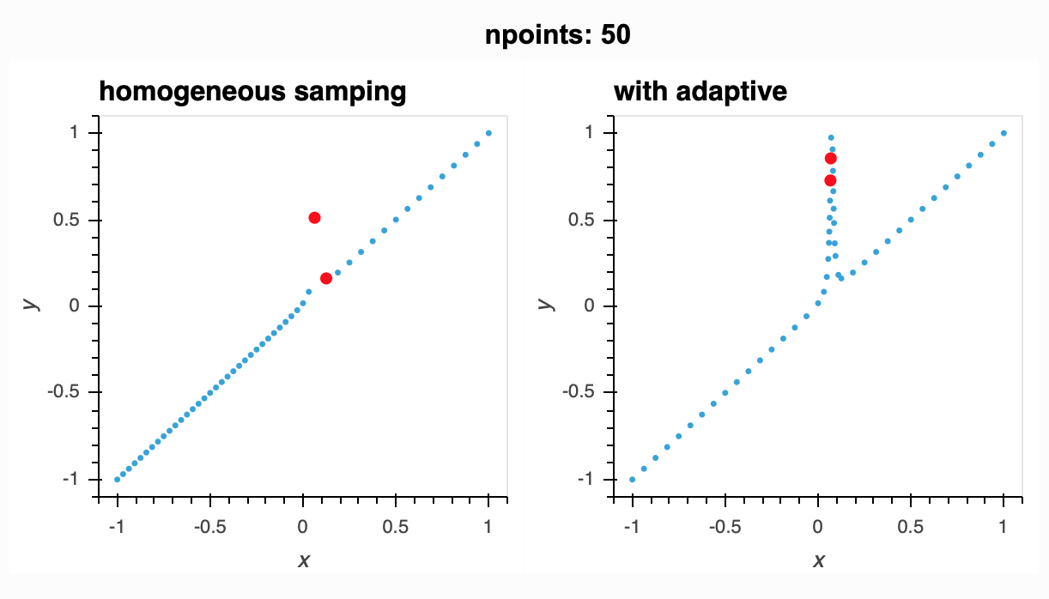
Using the budget to sample relevant points is key
Research
Research question: How to sample those points that are most relevant when fitting the model?
With homogenous sampling approaches, relevant areas might be underrepresented
Adaptive sampling is executed in iterations
Adaptive sampling incorporates a learner that applies a measure of relevance to every point in the feature space and samples most relevant points in the next iteration
Source: https://adaptive.readthedocs.io/en/latest/docs.html

Slide 4


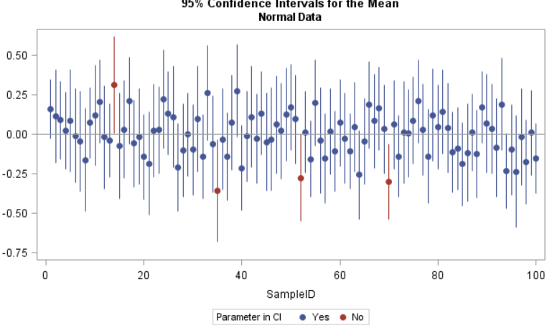
We used confidence as measure of relevance in adaptive sampling
Sampling
Generating 50 points randomly for each function
Requesting the response for these points from the API
Y1 | Y2
100 | 200
250 | 350
400 | 300
X1 | X2 | X2 | Seed
1 | 2 | 3 | 1234
2 | 3 | 1 | 1234
4 | 3 | 1 | 1234
Sample randomly
Request points
Applying noise to the selected observation and restart the sampling process (until a constraint is met)
Applying noise
Applying linear regression learner to receive confidence intervals for every point
Apply regression
Y1
Select observation
Y2
Analyze confidence
Randomly select one observation from the 25 with highest uncertainty
Receiving the indices of the 25 observations where the confidence interval is the largest (high uncertainty)

Slide 5
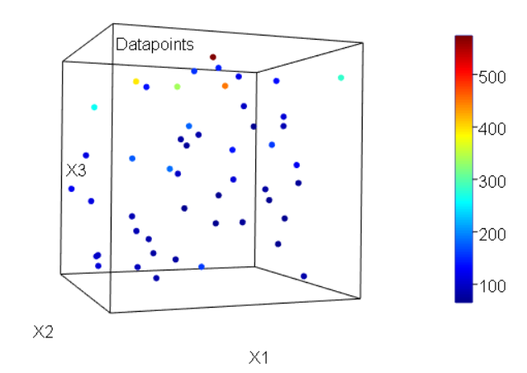
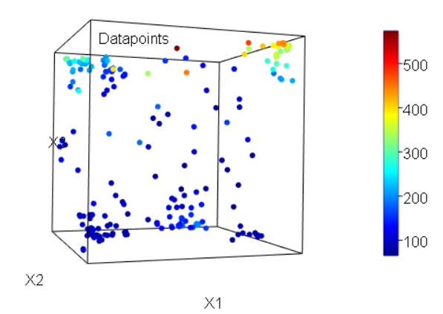
Adaptive sampling focuses on uncertain locations of the learner
Sampling
50 random samples
50 random samples + 370 adaptive samples

Slide 6
The ANN performs best on function 1 according to the MSE
Surrogate Modeling
R² value for all algorithms above 0.97
The best performing ANN-model was compiled using the following parameters:
Dropout rate
Learning epochs
Activation
7.46
ANN
191.18
XGBoost
241.72
Random Forest
140.83
Support Vector Machines
137.97
K-Nearest Neighbours

Slide 7
XGBoost was chosen for function 2 as the ANN overfitted
Surrogate Modeling
R² value for all algorithms above 0.97
Pareto-front of the ANN model was not plausible which indicated an overfitting of the model
XGBoost model was chosen with the following parameters:
nrounds (number of trees):
max_depth (number of splits in tree):
eta (preventing overfitting):
4950242
ANN
12540839
XGBoost
15188832
Random Forest
12886694
Support Vector Machines
39328421
K-Nearest Neighbours

Slide 8
The underlying functions differ in complexity
AUF DIESER FOLIE BEIDE VISUALISIERUNGEN NACH UNSEREN MODELS EINFÜGEN

Slide 9
Using NSGA-II, the pareto-optimal points are revealed
Optimization
Selection
Selecting 50 y1/y2 pairs using non-dominated sorting and crowding distance
Extraction
Extracting the underlying pareto-sets (x1, …, xN) from the subset of selected observations
The process is iterated until a stopping criterion is met or there is no further advancement in the evaluation of solutions
Using this process, the y1/y2 values are gradually moving towards their minimal values of the surrogate functions
Prediction
Piping offspring to fitted surrogate models to receive y1/y2 values for the new values
Mutation
Performing Gaussian mutation on the initial pareto-set to generate points that potentially increase crowding distance

Slide 10
(slide for showing the pareto-front we received)
Optimization

Slide 11
What to take away
Evaluation
Sampling more (3/4) observations of the more complex function 2 boosted the overall performance
Checking the presence of duplicates and out-of-bound observations is important during adaptive sampling and optimization
Integration of adaptive sampling and surrogate modelling is expensive as it requires retraining of all models after every additionally sampled observation but offers high potential for improvement
Using the actual target value as measure of relevance for sampling observations might improve the model predictions where local optima are located and thus the optimization results

Slide 12
Thank you for your attention!

Slide 13
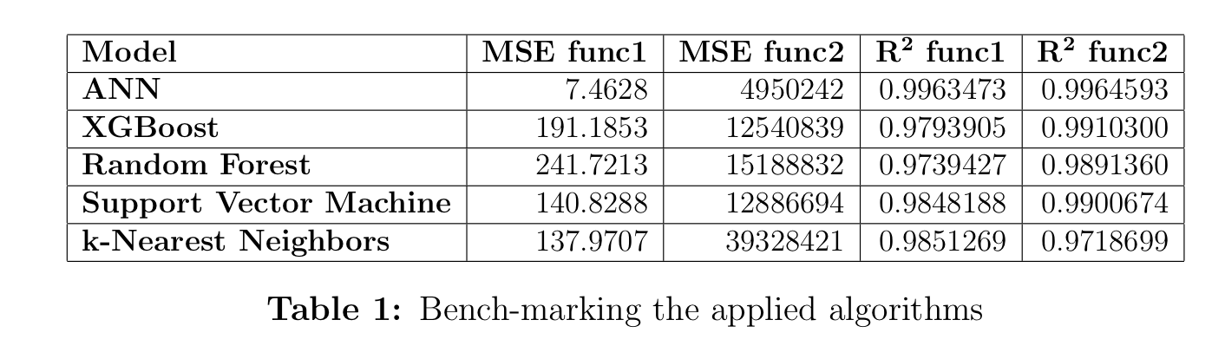

Slide 14
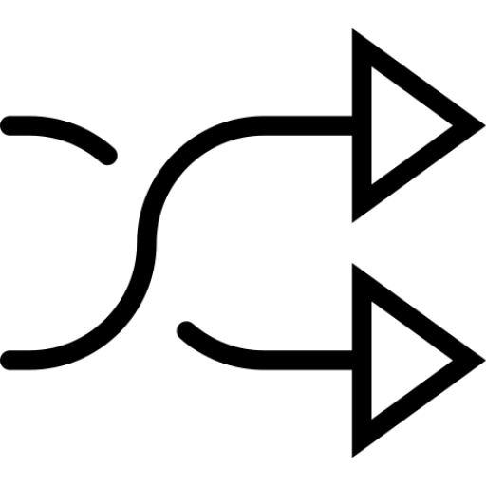
Sampling (Online)
Evolution (Offline)
For both targets we create models (surrogates) that are then optimised using random search
Y1
We first create a random sample
We add the first response values from the API
X1 | X2 | X2 | Seed
1 | 2 | 3 | 1234
2 | 3 | 1 | 1234
4 | 3 | 1 | 1234
Y2
Y1 | Y2
100 | 200
250 | 350
400 | 300
All target variables are evaluated according to the NSGA2 algorithm. This includes non-dominated sort and crowding distance.
A selection of 50 target1/target2 pairs is chosen based on their performance in the evaluation step
Y1
The subset of chosen observations is carried over to the next step where the underlying pareto sets (x1…xN) are extracted
On the pareto set mutation is performed in the form of gaussian mutation
For both targets we create models
Y2
We sample 10 observations from the observations that have the biggest measure of uncertainty.
We apply noise to the selected data and start the sampling again. This will happen until a constraint is met.
The mutated set of features (x1 …xN) is piped into the fitted models for target1 and target2 respectively
For each model we look at the confidence Intervals for the different observations
We will do this process until a stopping criterion is met or there is no further advancement in the evaluation of solutions.
Using this process, the target1/target2 values are gradually moving towards their minimal values of the surrogate functions.

