Slide 1
Comparative DSP Benchmark:
DFT, FFT, FIR and IIR
Digital Signal Processing Mini Project | MATLAB
Guide: Dr. Hrishikesh B. Vanjari
Submitted by: Raghav Bholeshwar Palange | PRN: 1022512013
TY B.Tech ECE (AI/ML), Division B, Semester I
School of Engineering and Technology, DES Pune University, Pune | 15 October 2026
Notes:
Introduce the topic: one reproducible benchmark of the core DSP algorithms.

Slide 2
Why this project?
Problem and need
Objectives
DFT, FFT, convolution, FIR and IIR are core DSP blocks
Normally compared by theory alone
No single test of accuracy and cost on common signals
Engineers need numbers to choose an algorithm
Implement the algorithms in MATLAB
Test on synthetic and real signals, one protocol
Measure runtime, RMSE, resolution, operations
Compare with MATLAB built-ins (existing method)
Deliver a reusable framework and tables
DSP Mini Project | Comparative DSP Benchmark: DFT, FFT, FIR and IIR
Notes:
Algorithms are usually compared by theory only. We measure them under one protocol.

Slide 3
Methodology and workflow
1 Signals
2 Algorithms
3 Metrics
4 Outputs
5 Analysis
Synthetic tones + noise; real handel audio
Naive DFT, own FFT, convolution, FIR, IIR
Runtime, RMSE, operations, resolution
4 tables (CSV), 7 figures (PNG)
Compare with theory and built-ins
Tools: MATLAB + Signal Processing Toolbox (fft, conv, fir1, butter, filter, filtfilt, timeit) | Reference: MATLAB built-in functions
DSP Mini Project | Comparative DSP Benchmark: DFT, FFT, FIR and IIR
Notes:
Fixed random seed rng(1) makes every table reproducible. Paste the workflow diagram from the report if you prefer.

Slide 4
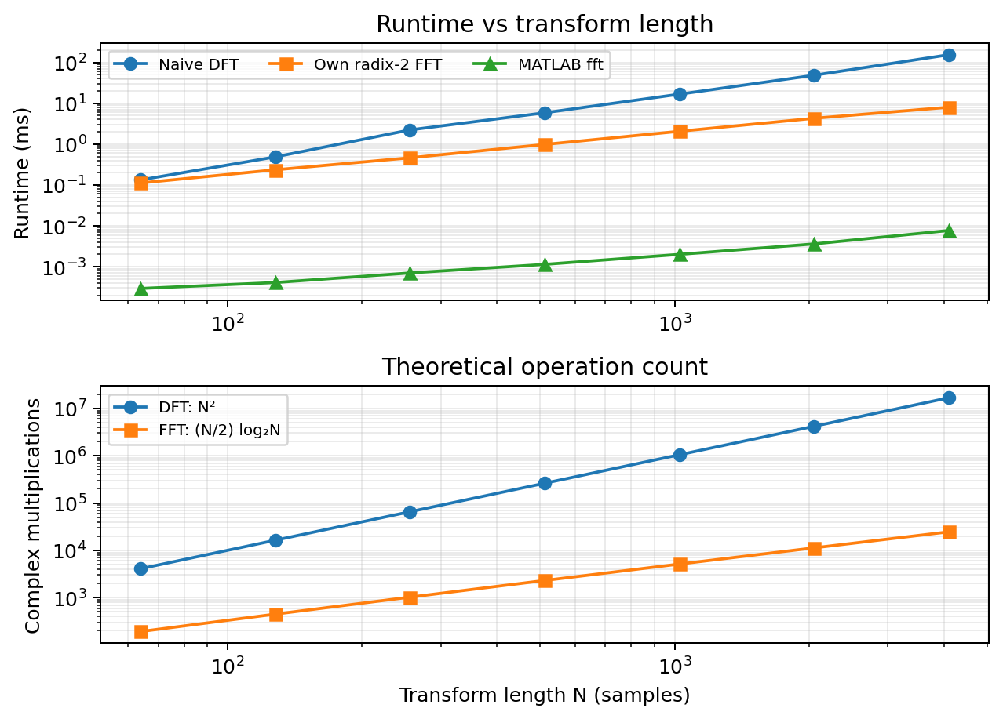
DFT vs FFT: same answer, far less work
19.2× faster
Own radix-2 FFT vs naive DFT at N = 4096.
Near machine precision
Own FFT agrees with MATLAB fft to about 10⁻¹⁴.
Complexity matters
FFT’s lower growth in operations is consistent with the increasing measured speedup.
DSP Mini Project | Comparative DSP Benchmark: DFT, FFT, FIR and IIR
Notes:
Paste fig1_runtime.png and fig2_ops.png here if you want your own figures. Built-in fft is faster because it is compiled code.

Slide 5
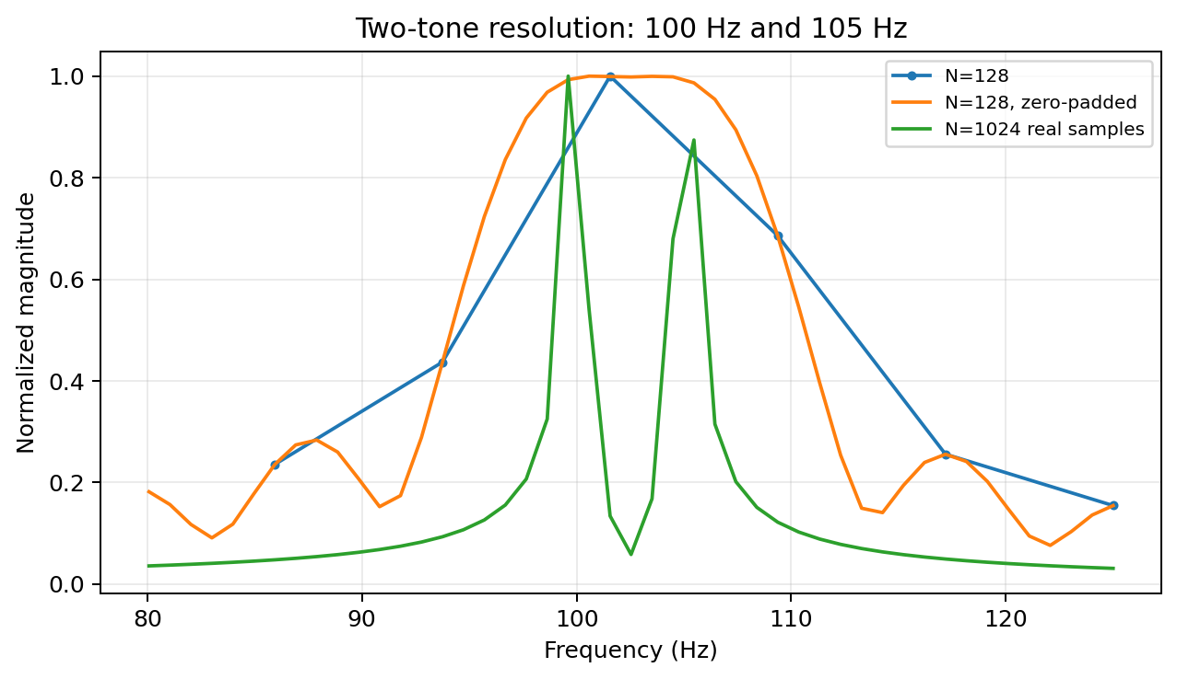
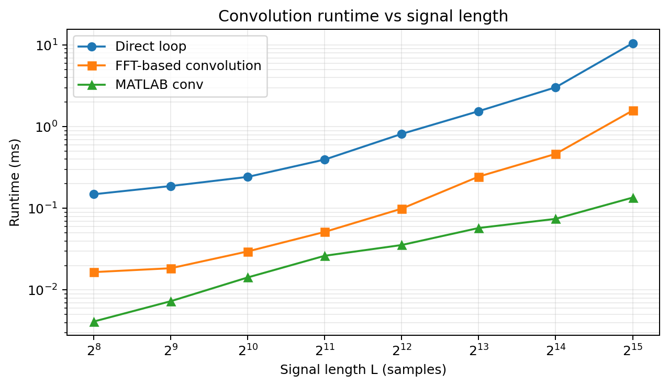
Frequency resolution and convolution
Resolution: Δf = fs/N. At N=128, the 5 Hz-separated tones merge; zero-padding smooths the spectrum but does not add information. N=1024 real samples resolve the two tones.
Convolution (255-tap filter): at L=32768, FFT-based convolution takes 1.58 ms vs 10.57 ms for the direct loop (6.7× faster). MATLAB conv is fastest in this benchmark.
DSP Mini Project | Comparative DSP Benchmark: DFT, FFT, FIR and IIR
Notes:
Use fig3_resolution.png and fig4_convolution.png from the results folder if asked for the plots.

Slide 6
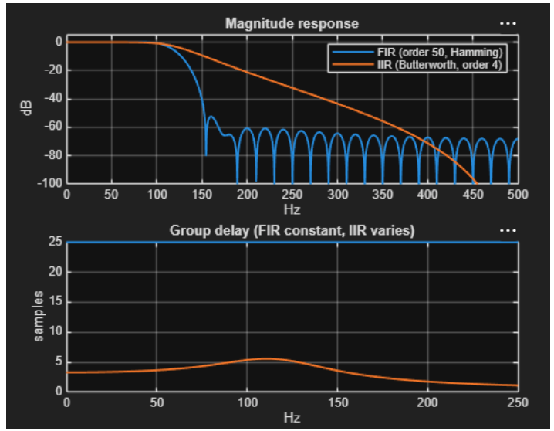
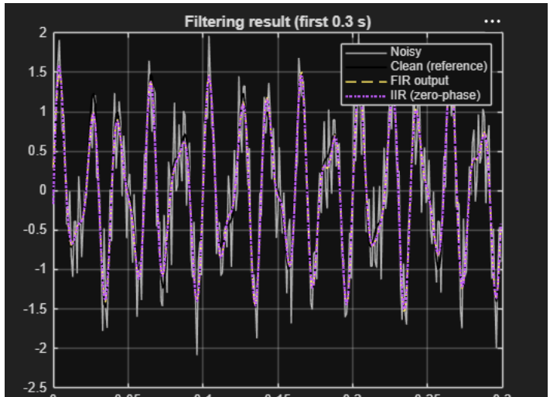
FIR vs IIR (synthetic signal, low-pass at 120 Hz)
Filter | RMSE | Ops / sample | Stopband (dB) | Linear phase
FIR, order 50, Hamming | 0.096 | 101 | -60.7 | Yes
IIR Butterworth 4, causal | 0.917 | 17 | -16.5 | No
IIR Butterworth 4, filtfilt | 0.094 | 34 | -16.5 | Yes (offline)
FIR: stronger stopband attenuation (−60.7 dB) and linear phase, at 101 operations/sample.
Causal IIR: lower cost (17 operations/sample), but RMSE rises to 0.917 in this waveform comparison.
Zero-phase IIR (offline filtfilt): RMSE ≈ 0.094, close to FIR’s 0.096, with 34 operations/sample.
DSP Mini Project | Comparative DSP Benchmark: DFT, FFT, FIR and IIR
Notes:
Real handel audio gives the same ordering: FIR 0.142, causal IIR 0.341, zero-phase IIR 0.129. Figures 5 and 6 show the response and the filtered signal.

Slide 7
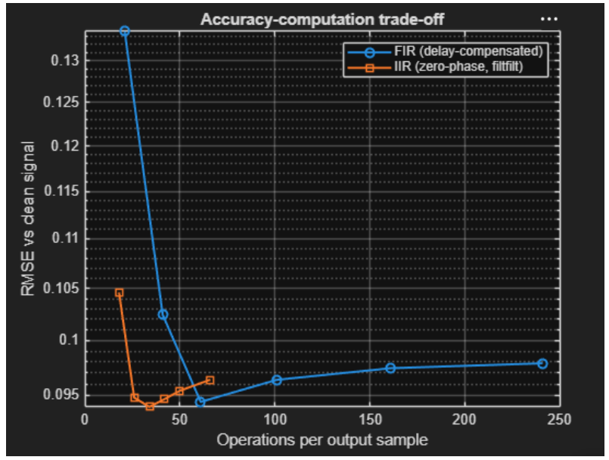
Accuracy vs computation
FIR sweep
RMSE falls from 0.134 at order 10 to about 0.094 at order 30 (61 operations/sample). Higher orders add cost without improving this test.
IIR sweep (zero-phase)
Zero-phase IIR reaches RMSE ≈ 0.094 at order 4 with 34 operations/sample, lower than FIR order 30 for similar error.
DSP Mini Project | Comparative DSP Benchmark: DFT, FFT, FIR and IIR
Notes:
Both filters plateau near RMSE 0.094, the in-band noise floor. Figure 7 shows the full sweep.

Slide 8
Comparison with the existing method (MATLAB built-ins)
Item | Our implementation | MATLAB built-in | Result
FFT, N = 4096 | myfft: 7.99 ms | fft: 0.0077 ms | RMSE about 1e-14; built-in about 1000x faster
Convolution, L = 32768 | conv_fft: 1.58 ms | conv: 0.136 ms | RMSE about 1e-16; built-in faster
Filtering | fir1 and butter designs | filter, filtfilt | Built-ins used for design and filtering
Contribution: a unified, reproducible framework for testing the algorithms on the same signals. The naive DFT, own FFT and convolution routines are compared with MATLAB references; FIR/IIR design and filtering also use MATLAB built-ins.
DSP Mini Project | Comparative DSP Benchmark: DFT, FFT, FIR and IIR
Notes:
Our own implementations are exact; the built-ins are faster because they are compiled and optimised.

Slide 9
Conclusion and future work
Conclusion
Future work
FFT: up to 19.2x faster than DFT, negligible numerical error
FFT convolution: 6.7x faster for long signals
FIR: better stopband, linear phase, higher cost
IIR: same RMSE at lower cost once phase is compensated
Two-channel QMF filter bank (Agrawal and Sahu, 2013)
More filter designs and FFT variants
Compare with Python / SciPy and ECG or speech data
Embedded and fixed-point implementation
DSP Mini Project | Comparative DSP Benchmark: DFT, FFT, FIR and IIR
Notes:
Recommendations: FFT for long transforms, FIR for linear phase, IIR when computation is limited.

Slide 10
References
1. S. Agrawal and R. Sahu, “Two-Channel Quadrature Mirror Filter Bank: An Overview,” ISRN Signal Processing, 2013. https://doi.org/10.1155/2013/815619
2. SciPy open-source signal-processing library, arXiv:2502.14224. https://arxiv.org/abs/2502.14224
3. J. W. Cooley and J. W. Tukey, “An algorithm for the machine calculation of complex Fourier series,” Mathematics of Computation, vol. 19, pp. 297–301, 1965.
4. A. V. Oppenheim and R. W. Schafer, Discrete-Time Signal Processing, 3rd ed., Pearson, 2010.
5. J. G. Proakis and D. G. Manolakis, Digital Signal Processing: Principles, Algorithms and Applications, 4th ed., Pearson, 2007.
6. MathWorks, Signal Processing Toolbox documentation. https://www.mathworks.com/help/signal/
7. GitHub repository: https://github.com/raghavpalange2/dsp-benchmark-dft-fft-fir-iir
DSP Mini Project | Comparative DSP Benchmark: DFT, FFT, FIR and IIR
Notes:
Add your GitHub link in the last line before presenting.

