Slide 1
Data Structures

Slide 2
Introduction
Data Structure is a way of collecting and organizing data in such a way that we can perform operations on these data in an effective way. Data Structures is about rendering data elements in terms of some relationship, for better organization and storage. For example, we have some data which has, player's name "Virat" and age 26. Here "Virat" is of String data type and 26 is of integer data type.
We can organize this data as a record like Player record, which will have both player's name and age in it. Now we can collect and store player's records in a file or database as a data structure. For example: "Dhoni" 30, "Gambhir" 31, "Sehwag" 33

Slide 3
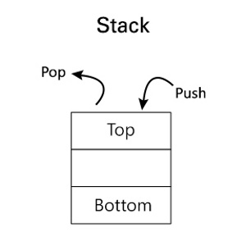
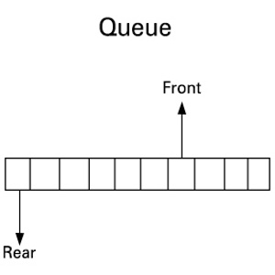
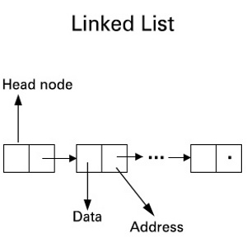
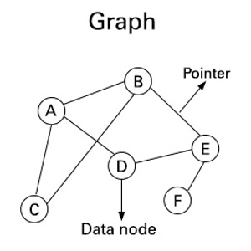
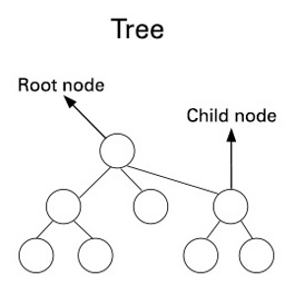
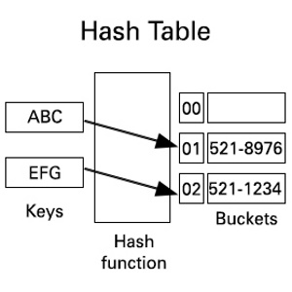
Applications Of Data Structures

Slide 4
Stack
Stack refers to an orderly arrangement of data. It consists of just one end. This end is used for both, data addition as well as removal. It is said to follow the LIFO pattern, which implies that the last data item to enter is the first one to be removed. It is also sometimes termed as the pushdown stack. 'Push' and 'Pop' are the two functions of this data structure. Push is a function defined for adding data, and Pop is for popping out or deleting the data.

Slide 5
Queue
A queue is a list with a linear pattern which has two ends: front and rear. The front end allows deletion of data items from the list. The rear end allows insertion of data items into the list. In case of a queue, the input data doesn't need to be processed immediately. In fact, the data is processed in a FIFO fashion. It is very efficient for scenarios wherein data is transferred between different processes.

Slide 6
Linked List
A linked list is a collection of objects which are linked to each other in a linear pattern. Each of these objects is called a node. The first object is called the front node or the head. Each of the nodes store some data in them. One important feature of this type of list is that the data is not stored in contiguous locations. Every object has two components - one is the data part and the other is the address of the node to which it is pointing. The nodes are not continuous, and can lie in any part of the memory.

Slide 7
Graph
A graph consists of a bounded set of nodes (also termed as vertices). A pair of two nodes is called an edge. Each node has some data associated with it. Whereas, the edges indicate the pointers between the nodes. For two nodes 'a' and 'b', its edge can be represented as (a,b). This type of structure represents the concept of graphs in mathematics.

Slide 8
Tree
A tree consists of a set of nodes which are linked via pointers. Each structure has a root node and branches containing the remaining data nodes. In case of an ordered tree, the nodes or objects are ordered in a sequence. In case of an un ordered tree, no ordering exists. A tree having no data or nodes is called an empty or null tree.

Slide 9
Hash Table
Hash table is a type of table whose main function, in addition to data storage, is mapping the keys to values. The table has some keys to be mapped, a hash function, and buckets. Each bucket is an array which stores data. The role of the hash function is to map the keys to the buckets. Each key is allotted to a unique bucket. This structure also accommodates the feature that multiple keys will be assigned to the same bucket by the hash function of the table

Slide 10
Complexities
Space Complexity
Its the amount of memory space required by the algorithm, during the course of its execution. Space complexity must be taken seriously for multi-user systems and in situations where limited memory is available.
An algorithm generally requires space for following components :
Instruction Space: Its the space required to store the executable version of the program. This space is fixed, but varies depending upon the number of lines of code in the program.
Data Space: Its the space required to store all the constants and variables(including temporary variables) value.
Environment Space: Its the space required to store the environment information needed to resume the suspended function.

Slide 11
Time Complexity
Time complexity of an algorithm signifies the total time required by the program to run till its completion.
The time complexity of algorithms is most commonly expressed using the big O notation. It's an asymptotic notation to represent the time complexity. We will study about it in detail in the next tutorial.
Time Complexity is most commonly estimated by counting the number of elementary steps performed by any algorithm to finish execution.

Slide 12
Advantages of Data Structures
Allows easier processing of data.
It allows information stored on disk very efficiently.
These are necessary for designing an efficient algorithm.
It provides management of databases like indexing with the help of hash tables and arrays.
We can access data anytime and anywhere.
It is secure way of storage of data.
Graphs models real life problems
It allows processing of data on software system

Slide 13
Tricky Questions on Data Structures
When is a binary search best applied?
What is a linked list?
How do you reference all the elements in a one-dimension array?
In what areas do data structures are applied?
What is LIFO?
What is Huffman’s algorithm?
What is Fibonacci search?
How do you search for a target key in a linked list?
What are doubly linked lists?

