Slide 1

Project Title: Healthcare Analytics for Doctor Visits: Understanding What Drives Patient Visits
Raghav Paroli

Slide 2

PROBLEM STATEMENT
Some people visit a doctor much more often than others, and in this dataset about 80% made no visit at all.
Healthcare providers need to know which health, financial and insurance factors are linked to doctor visits.
This project analyzes 5,190 patient records to find those patterns and to predict whether a person is likely to visit a doctor.

Slide 3
Project Description
Dataset: 5,190 records and 12 usable columns covering personal information (gender, age), income, health (illness, reduced activity days, health score, chronic conditions), healthcare support (private, free-poor, free-repatriation cover) and the number of doctor visits. There were no missing values; only the record-ID column was dropped.
Approach:
Explored visit patterns with charts and group averages.
Measured how strongly each factor relates to visits (correlation).
Built two models, Logistic Regression and Random Forest, to predict whether a person visits a doctor at least once.
Built a Streamlit web app that gives a live prediction from patient details.
Model | Accuracy | F1 | ROC-AUC
Logistic Regression (final) | 71.6% | 0.459 | 0.736
Random Forest | 72.5% | 0.436 | 0.732

Slide 4

WHO ARE THE END USERS?
Hospitals and clinics: plan staffing and appointment capacity.
Health insurers: identify groups that use care most and design plans.
Government and public health planners: target free-care programs at the people who need them.
Doctors and care coordinators: flag patients with many illnesses or long-term conditions for early follow-up.
Students and researchers: learn healthcare analytics on a real dataset.

Slide 5

Technology Used
Python 3
Pandas and NumPy: data handling
Matplotlib: charts
Scikit-learn: Logistic Regression and Random Forest
Joblib: saving the trained model
Streamlit: interactive prediction web app
VS Code

Slide 6
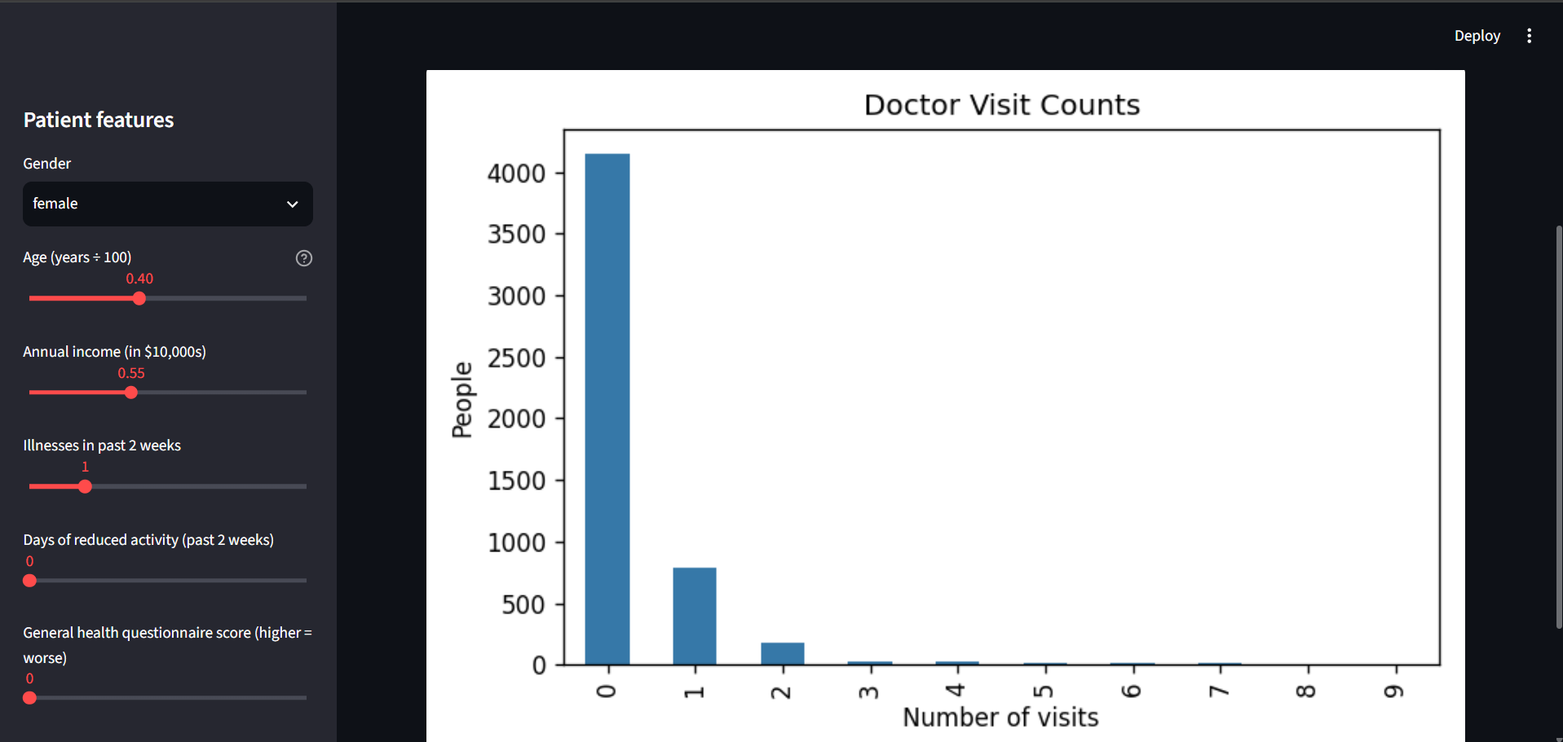
RESULTS
DEMO LINK - https://healthcare-doctor-visits-an-9uyyckgcoshudykg9qmjx7.streamlit.app/

Slide 7
Thank you
.
.

