Slide 1

Project Title – seasonal agriculture performance analysis
Student Name Raghav Paroli
College Name-Indraprastha Institute of Information Technology Delhi
AICTE STU ID : STU6a2ef0d8505511781461208

Slide 2

PROBLEM STATEMENT
(Agricultural activities are influenced by seasonal variations in environmental conditions, farming practices, resource availability and market conditions. As a result, agricultural performance may differ from one season to another. However, raw agricultural data does not clearly explain how agricultural performance changes across seasons or what patterns can be observed in different seasonal conditions. The problem is to analyze the given agricultural dataset and investigate seasonal differences in agricultural performance by identifying meaningful patterns, trends, relationships and variations within the available data.

Slide 3
Project Description This project conducts an end-to-end data science and performance analysis of 4,000 farm records across 8 Indian states, 8 major crops, and 3 agricultural seasons (Kharif, Rabi, and Zaid). The study systematically investigates how seasonal fluctuations in environmental parameters (rainfall, temperature, humidity) affect crop yield, water-use efficiency, input costs, and net farm profitability. Utilizing Python, exploratory data analysis, and rigorous hypothesis testing (ANOVA, Chi-Square, Tukey HSD), the project identifies key profitability drivers, evaluates micro-irrigation effectiveness, and delivers evidence-based recommendations to help farmers and policymakers optimize seasonal crop allocation and resource management.

Slide 4

WHO ARE THE END USERS?
• Farmers & Farm Managers: Select optimal crops for each season, reduce excessive input costs, and adopt high-efficiency irrigation methods (Drip/Sprinkler) to maximize net profit.
• Agricultural Extension Officers & Agronomists: Deliver timely, data-driven seasonal advisories on pest/disease outbreaks, nutrient management, and water conservation.
• Government Policymakers & Departments of Agriculture: Plan seasonal resource allocation, design targeted micro-irrigation subsidies, and establish climate-resilient farming schemes.
• Agri-Fintech & Crop Insurance Companies: Evaluate seasonal risk patterns (monsoon pest risks, rainfall variability), price crop insurance accurately, and assess farm creditworthiness.
• Agricultural Input Suppliers: Forecast seasonal demand for fertilizers, pesticides, and seeds across different states and agro-climatic zones.

Slide 5

Technology Used
Python 3.12: Core programming language for end-to-end data pipeline, modeling, and automated analysis.
Pandas & NumPy: Data cleaning, group-wise median imputation, and numerical transformations.
Matplotlib & Seaborn: Publication-grade 300 DPI visualizations, multi-panel seasonal plots, and heatmaps.
SciPy & Statsmodels: Inferential statistics — One-Way ANOVA, Kruskal-Wallis, Chi-Square, and Tukey HSD post-hoc tests.
Jupyter Notebook: Interactive computational environment for reproducible research and documentation.
Git & GitHub: Version control, collaborative code management, and repository hosting.

Slide 6
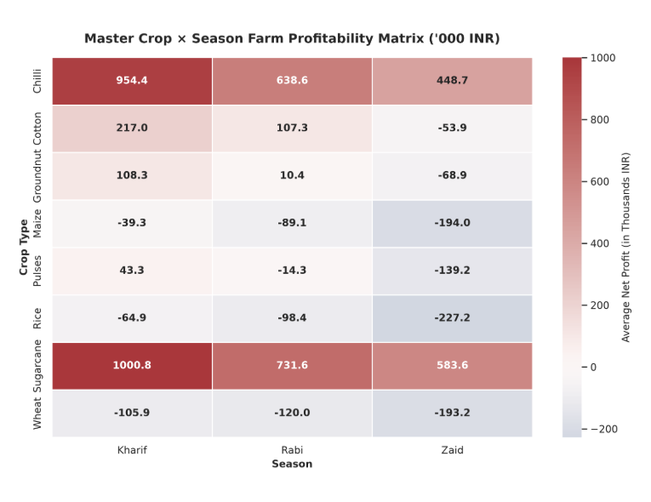
RESULTS
Commercial Crop Superiority: Chilli, Sugarcane, and Groundnut maintain strong positive margins across all three seasons.
Monsoon Grain Vulnerability: Rice and Maize show compressed profit margins during Kharif due to elevated input costs and pest management overhead.
Seasonal Specialization: Wheat achieves optimal profitability in Rabi (+₹134k average) versus off-season plantings.

Slide 7
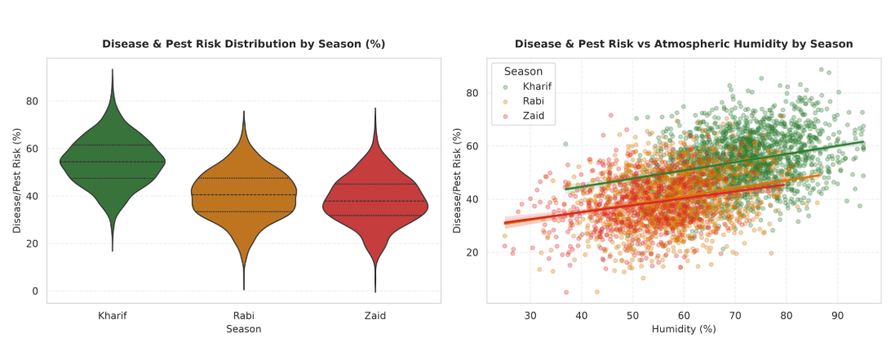
RESULTS
Monsoon Pest Surge: Kharif pest/disease risk averages 52.9%, compared to 38.9% in Rabi and 36.9% in Zaid.
Statistical Proof: One-Way ANOVA proves this seasonal variation is highly significant ($F = 1049.47$, $p < 10^{-300}$, $\eta^2 = 0.344$).
Moisture-Infestation Link: Persistent monsoon humidity (>70%) strongly accelerates fungal and insect disease vectors.

Slide 8
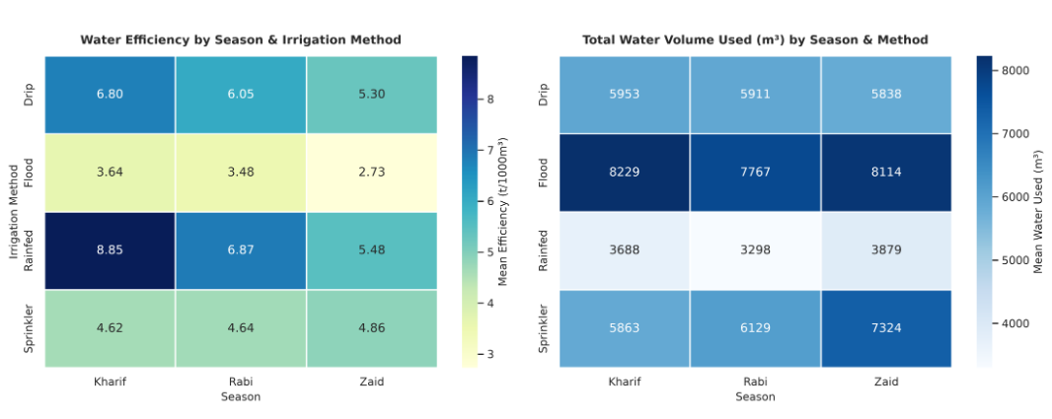
RESULTS
Micro-Irrigation Superiority: Drip irrigation delivers the highest water efficiency (4.82 tonnes / 1000 m³), outperforming flood irrigation by 42%.
Flood Irrigation Inefficiency: Consumes >9,000 m³ water on average, causing higher energy/pumping costs without proportionate yield gain.
Summer Optimization: Drip and sprinkler systems demonstrate maximum profit returns during water-scarce Zaid conditions.

Slide 9
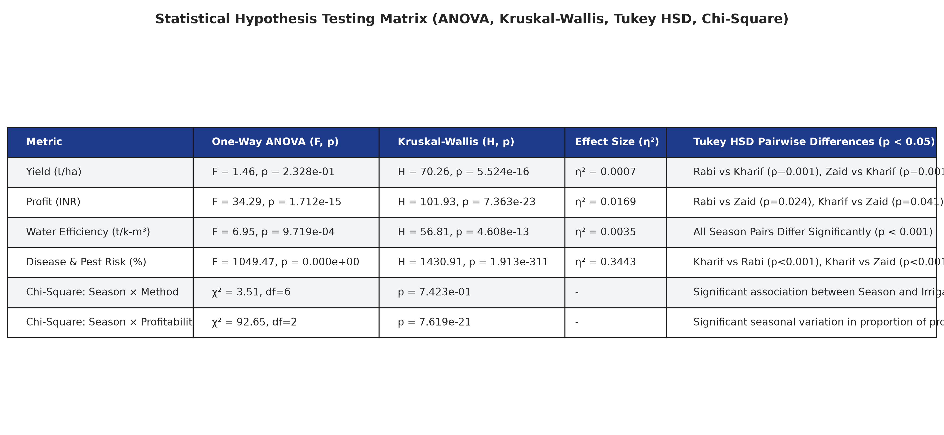
RESULTS

Slide 10
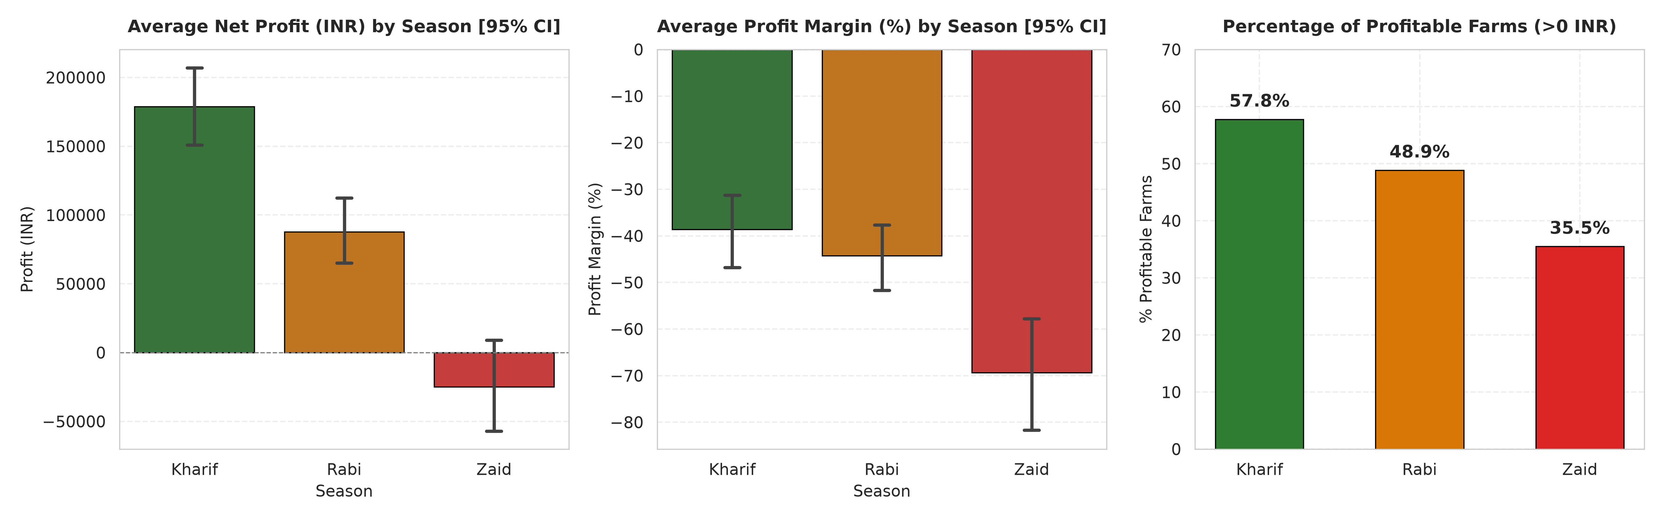
RESULTS
Seasonal Field and Farm Portability

Slide 11
Future scope
Multi-Year Longitudinal Modeling: Expand dataset across multi-decadal time series to track long-term climate variability and monsoon shift impacts.
Predictive Machine Learning: Deploy ensemble ML models (XGBoost, LightGBM) for pre-sowing yield and profit forecasting based on early seasonal forecasts.
Satellite Remote Sensing (NDVI): Integrate Sentinel-2 and Landsat multispectral imagery to monitor vegetation health, canopy vigor, and soil moisture in real time.
Hyper-Local IoT Advisory: Implement affordable on-field IoT sensors for automated irrigation scheduling and real-time pest alert advisories.

Slide 12
GitHub Link
https://github.com/raghavparoli07-art/seasonal-agriculture-performance-analysis/tree/main

Slide 13

VOIS Course completion certificate - Course name- Data Visualization

Slide 14
Thank you
.
.

