Slide 1














Gaming Peripherals
WebTech Project CS-2232
Made by-
Raghav Patodiya
209301599
Mentor:
Abadhan Saumya Sabyasachi

Slide 2

Gaming Peripherals is to be a one-stop website for all the basic needs for gaming, ranging from best-in-class headphones to controllers and keyboards.
The proposed plan for the website is to contain a ‘Sign-up to our newsletter’ which helps us to contain the user data in a database and provide them with latest updates on their mails.
The website will also contain links to different gaming accessories.

Slide 3

The languages used are HTML, CSS, JavaScript, Java.
The server-side framework is to be done using Flask and the database to be implemented is SQLite.
Some Code Snippets and Design, Themes are added in the next few slides.

Slide 4

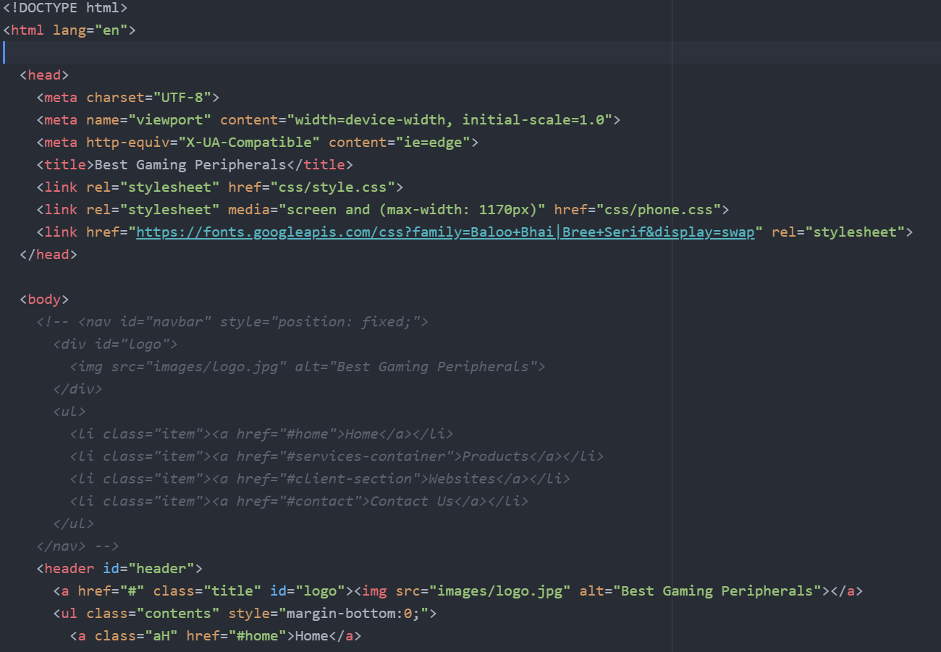
The ‘index.html’ provides a default constructor for all the .html files to help reduce repeated parts of the code structure.

Slide 5
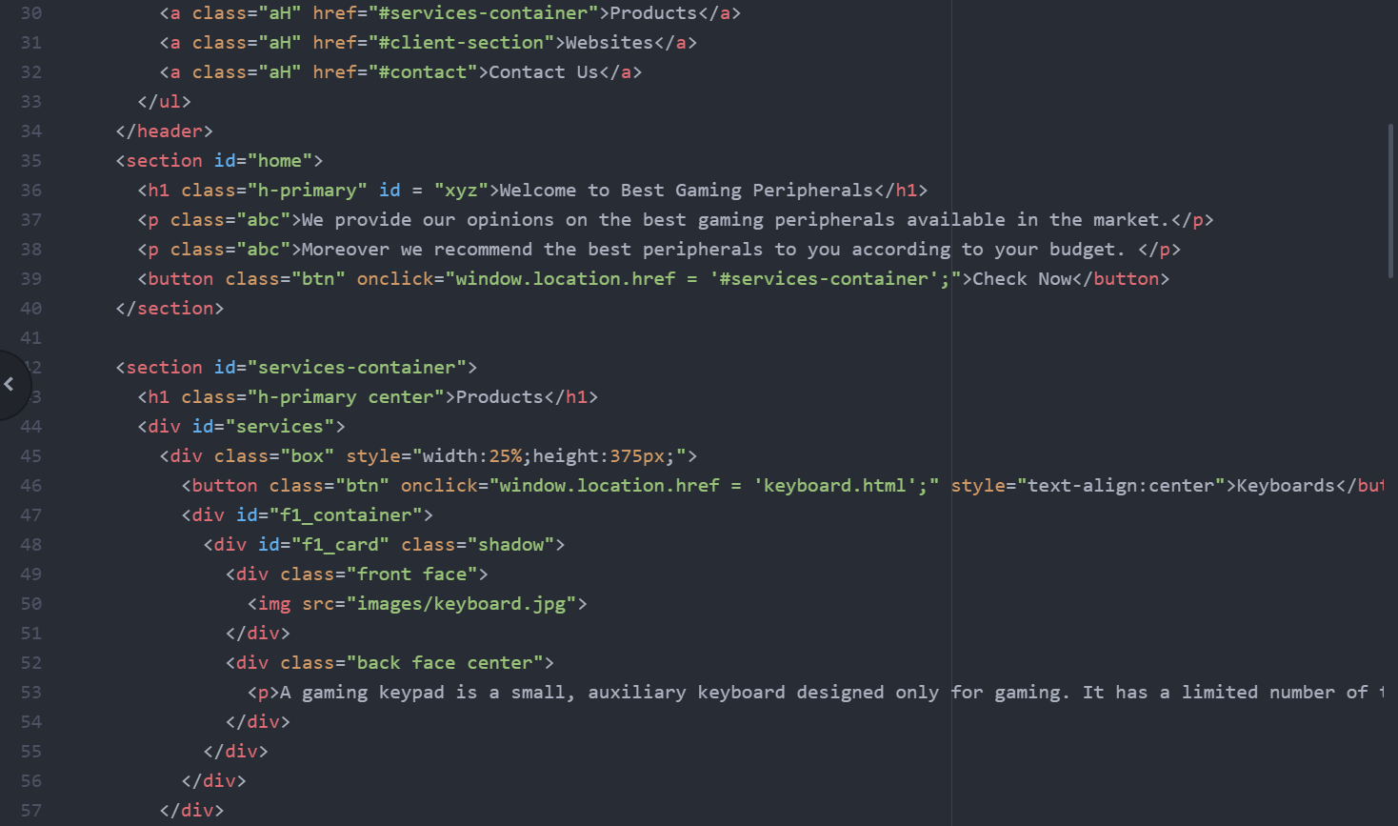

.

Slide 6
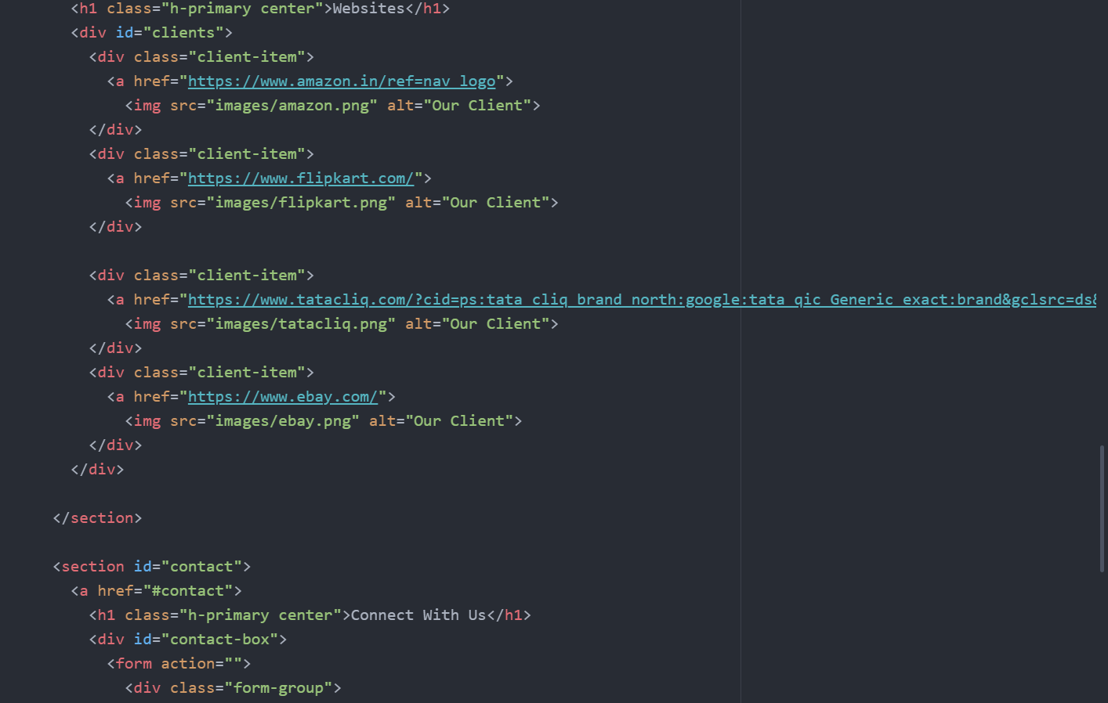

Slide 7
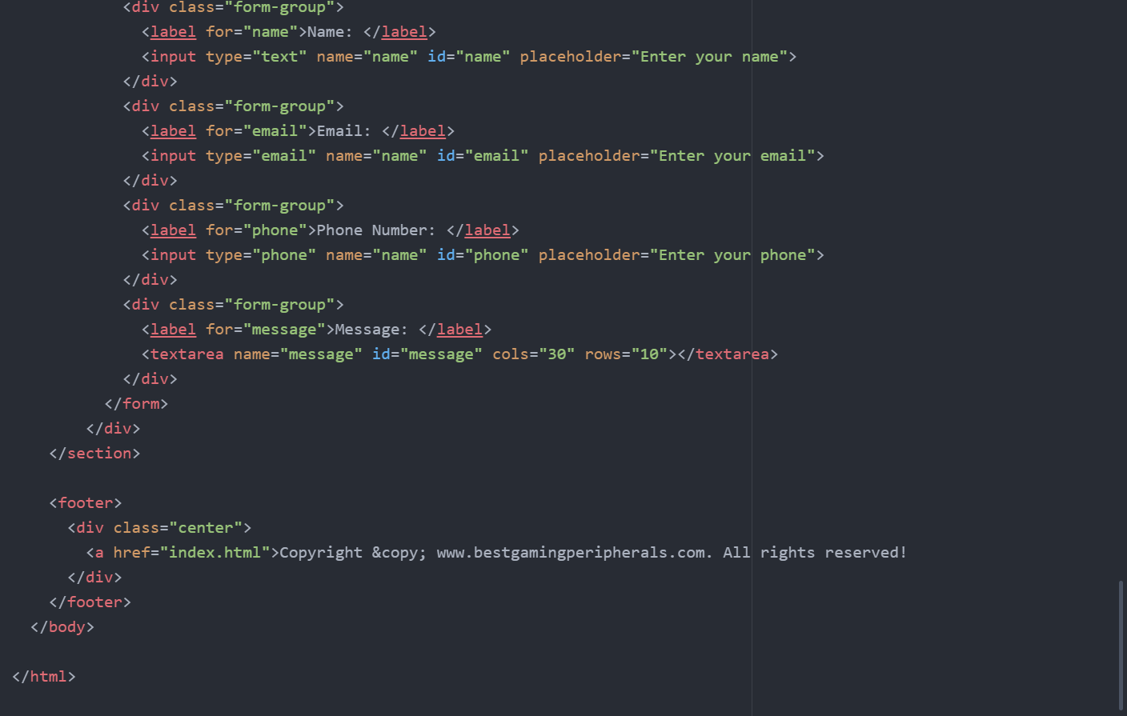
Thank you~!

