Slide 1


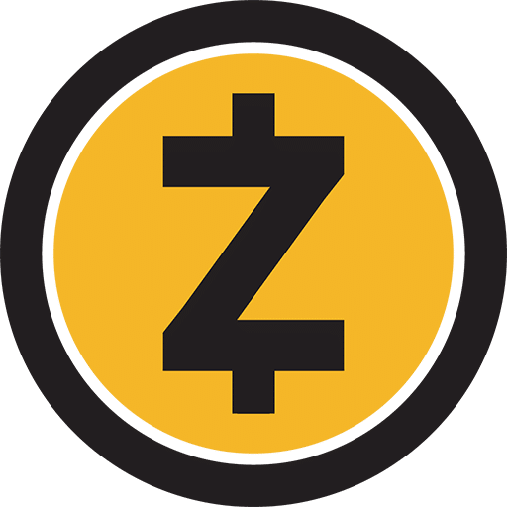
INSE 6120 Cryptographic Protocols and Network Security
Monero and Zcash
Submitted To:
Prof. Ivan Pustogarov
Presented By:
Student Name | Student ID
Raghavendran Raghunathan | 40220965
Arun Prasad Karunanithi | 40220964
Naveen Sesetti | 40206610
Meetsinh Parihar | 40217262
Gayatri Tangudu | 40221830
Priya Meghana Raavi | 40221227
Bhavya Panner Selvam | 40205936

Slide 2
Introduction
Two of the most well-known cryptocurrencies that use different cryptographic primitives to ensure anonymity are Monero and Zcash.
Both cryptocurrencies employ different cryptographic primitives with variable impacts on their effectiveness and usability in order to promote anonymity
In this study, the advantages and disadvantages of the Monero and Zcash protocols will be compared.
In light of the identified shortcomings, adjustments to the Monero protocol will be suggested and tested in addition to a direct comparison.

Slide 3
Monero
A decentralised cryptocurrency which puts an emphasis on user privacy and security.
It was developed in 2014 by a group of programmers who thought that Bitcoin's lack of anonymity left it open to abuse and spying.
Transaction data are obscured by Monero using the RingCT technology and the CryptoNote protocol, making it nearly hard to link a transaction to a specific user.
Transaction data are obscured by Monero using the RingCT technology and the CryptoNote protocol, making it nearly hard to link a transaction to a specific user.

Slide 4
Core features of Monero
Privacy
The sender, recipient, and amount of each transaction are kept secret from prying eyes by using ring signatures, stealth addresses, and confidential transactions.
All Monero transactions are by default private, in contrast to Bitcoin, where all transactions are openly available on the blockchain.
Security
To protect its network and stop double spending, it employs a proof-of-work consensus algorithm.
Also, it is challenging for attackers to detect and trace transactions using Monero due to its ring signatures and stealth addresses.
Untracability
Monero conceals the true sender of a transaction via ring signatures, making it challenging to determine who began the transaction.
The value of a specific transaction cannot be ascertained because confidential transactions conceal the amount of each transaction.

Slide 5
How Monero Works?
Monero works by using a combination of advanced cryptographic techniques, including the CryptoNote protocol and the RingCT technology.
A transaction is broadcast to the Monero network when a user sends Monero to another user, where it is verified and recorded on the blockchain.
Moreover, Monero employs stealth addresses to safeguard the recipient's privacy. Each transaction generates a unique stealth address, making it impossible to connect repeated transactions to the same receiver.
Finally, Monero conceals the amount of each transaction by using confidential transactions. Pedersen commitments, a method used in confidential transactions, encrypt the transaction amount, rendering it difficult for anyone to ascertain the value of a specific transaction.

Slide 6
Z-Cash
Zcash (ZEC) is a decentralized, open-source cryptocurrency that was launched in 2016.
Zcash is based on a public blockchain, but it uses a unique technology called zk-SNARKs to provide users with the option to make transactions completely private. .
Sender, receiver, and transaction amount can be hidden from the public blockchain, making it nearly impossible to trace.
Zcash is maintained by a community of developers and has no centralized authority or controlling entity.
The total supply of ZEC is limited to 21 million coins.

Slide 7
How Zcash Works?
Uses Advanced privacy feature achieved through the use of zk-SNARKS
The sender, receiver, and transaction amount can all be kept secret from the public blockchain while using Zcash, which is made possible by the usage of zk-SNARKs.
Zcash transactions can be divided into two types:
Transparent : Transparent transactions are similar to Bitcoin transactions in that they are publicly visible on the blockchain and do not use zk-SNARKs
Shielded: Shielded transactions, on the other hand, use zk-SNARKs to completely hide the transaction information from the public blockchain.

Slide 8
Zk-SNARKS
zk-SNARKS stands for Zero-Knowledge Succinct Non-Interactive Argument of Knowledge.
Verifies a transaction without revealing any of the details of that transaction to anyone other than the parties involved.
Creates a mathematical proof that verifies the authenticity of a transaction without revealing any of the transaction details.
The proof is then added to the blockchain, allowing anyone to verify the authenticity of the transaction without knowing any of the specific details.
Overall, Z-snarks are a powerful tool for enabling private and secure transactions on a public blockchain.

Slide 9
Zcash: Mining and Supply
Mining
Zcash is a Proof of Work (PoW) cryptocurrency, which means that it is mined using computing power to solve complex mathematical problems.
Mining Algorithm Used : Equihash(Designed to be resistant to ASIC minin
Zcash has a block reward that is given to miners who successfully add a block to the blockchain.
Supply
The total supply of ZEC is limited to 21 million coins.
This is achieved by gradually reducing the block reward over time until it reaches zero.
At that point, no new ZEC will be created, and the only way to obtain it will be through transactions on the blockchain.
Overall, the mining and supply of Zcash is designed to ensure that the cryptocurrency remains scarce, while also promoting decentralization and fair distribution among miners.

Slide 10

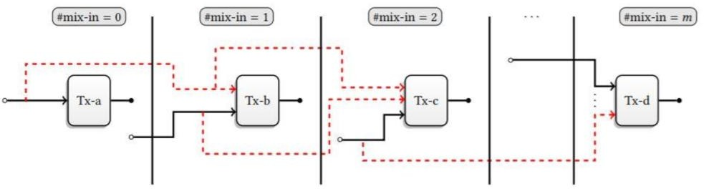
COMPARISION OF MONERO AND ZCASH
1.Anonymity set
Zcash and Monero are two of the most popular privacy-focused cryptocurrencies, and both aim to provide high levels of anonymity to their users.
Monero :
mixed with at least 7 other transactions to make it difficult to determine the true source of the transaction.
If a transaction is sent with zero mixins, it can be easily de-anonymized.
Zcash :
It has a much larger anonymity set because all shielded transactions are mixed together.
Considerably larger than Monero’s anonymity set.
Overall, Zcash has the potential to provide greater anonymity than Monero due to its larger anonymity set.

Slide 11
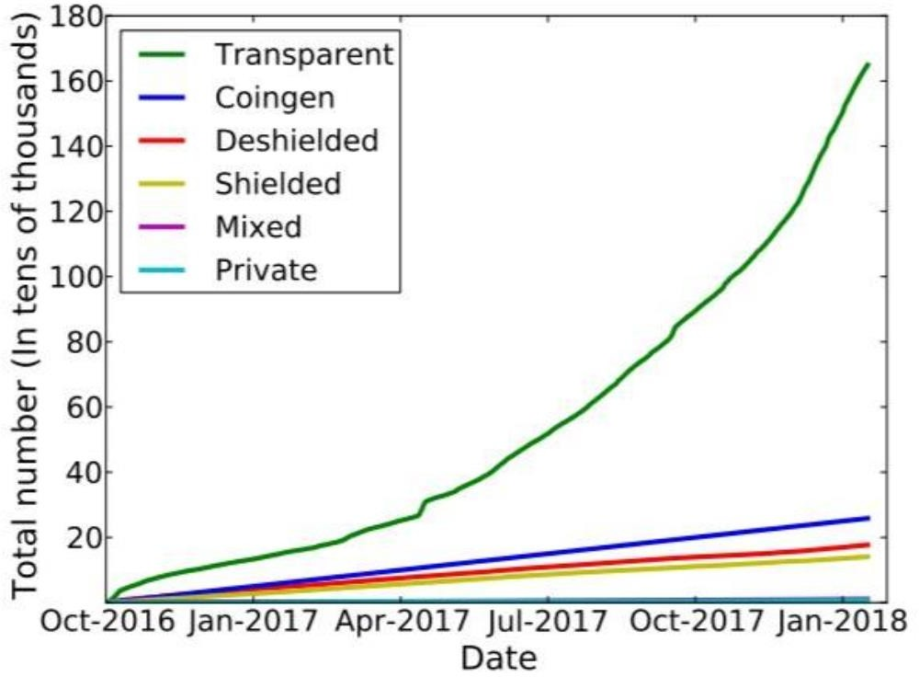
COMPARISION OF MONERO AND ZCASH(Contd)
2.Opt In Privacy
Overall, both Monero and Zcash provide privacy features that allow for anonymous transactions. However, there are some key differences between the two.
Monero :
mandates the use of RingCT
has a fixed minimum ring size
Zcash :
has a larger anonymity set.
but limited usage of its privacy features
In conclusion, both Monero and Zcash have their strengths and weaknesses when it comes to privacy features.

Slide 12
COMPARISION OF MONERO AND ZCASH(Contd)
3.Transaction Size
Another notable difference between Zcash and Monero is the cryptographic technology they use to achieve privacy
Monero :
uses Ring Confidential Transactions (RingCT), which obscures the transaction amount.
RingCT, does not require a trusted setup.
Zcash :
uses zk-SNARKs, which allows for the transaction amount to remain hidden.
zk- SNARKs can be computationally intensive, requiring more resources and time to verify transactions
Overall, both Zcash and Monero provide strong privacy features and are among the most private cryptocurrencies available. However, they differ in the size of the anonymity set, transaction size, and the cryptographic technology used to achieve privacy.

Slide 13
COMPARISION OF MONERO AND ZCASH(Contd)
4.Trusted Setup
Trusted setup process is done in a way that ensures that the generated parameters remain secret and cannot be tampered with.
Monero :
Generating a set of secret keys that are used to create ring signatures
Requires Mandatory RingCT usage
Zcash :
the trusted setup process involves generating a set of secret parameters that are used to create zk-SNARKs
different parties, each holding a part of the master secret, participated in the setup.
Ultimately, the choice between Zcash and Monero depends on a user's priorities and concerns regarding privacy, transaction fees, and trust in the system's setup.

Slide 14
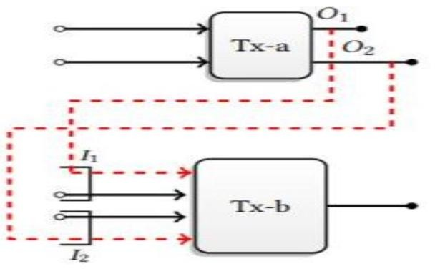
COMPARISION OF MONERO AND ZCASH(Contd)
they were able to identify transactions made by founders and miners and reduce the size of the overall anonymity set by 69.1%.
5.Traceability Analysis
It is a crucial aspect of blockchain technology as it helps ensure the security and transparency of transactions. Monero and Zcash are two privacy-focused cryptocurrencies that use different techniques to ensure transaction anonymity and prevent traceability analysis.
Monero :
none of the inputs that were de-anonymised by previous research.
able to correctly guess that the newest input is also the real input 81%
Zcash :
there are recognisable patterns in the transactions going into and coming out of the shielded pool.
they were able to identify transactions made by founders and miners and reduce the size of the overall anonymity set by 69.1%.
Both Monero and Zcash are designed to prevent traceability analysis and ensure user privacy. However, it is worth noting that no technology is completely foolproof, and it is always possible that new techniques could be developed to trace transactions on these networks.

Slide 15
Similarities between Monero and Zcash
they were able to identify transactions made by founders and miners and reduce the size of the overall anonymity set by 69.1%.
1.Privacy
Monero: Ring signatures, stealth addresses, and confidential transactions are all used by Monero to conceal transaction data and shield user identities.
Zcash: It uses a concept called zero-knowledge proofs to let users demonstrate their knowledge of a specific piece of information without actually disclosing it.
Ultimately, Monero and Zcash's privacy features aim to shield user identities and transaction data from prying eyes, making them appealing to users who value their security and privacy.
2.Decentralization
Monero: several volunteer nodes that operate the Monero software which makes the cryptocurrency more secure and trustworthy and makes it resistant to censorship and control.
Zcash: runs on a node-maintained decentralized peer-to-peer network. It uses a consensus algorithm called Equihash which makes it resistant to ASIC-based mining Similar to Monero
Ultimately, Monero and Zcash's decentralization makes cryptocurrencies more safe and more dependable than conventional financial systems and increases their resistance to censorship and control.

Slide 16
Similarities between Monero and Zcash(Contd)
they were able to identify transactions made by founders and miners and reduce the size of the overall anonymity set by 69.1%.
3.Open Source
Monero: Due to Monero's open-source design, third-party wallets and other programmes that can communicate with the coin are also possible. The code base of Monero is accessible on Github
Zcash: Zcash has an open-source codebase that is accessible on GitHub. The codebase must be maintained and improved by the developer community, and anyone can help with the creation of the coin.
Furthermore, because both Monero and Zcash are open-source, problems and vulnerabilities may be found and fixed right away..
4.Community Driven Development
Monero: With new features and enhancements being regularly introduced, Monero's community-driven approach to development has helped the cryptocurrency expand and change over time.
Zcash: Zcash has a robust community of users, developers. Anybody can participate in the development process because the community is welcoming and open to everyone.
Both cryptocurrencies have vibrant and committed user, developer, and contributor communities that collaborate to maintain and advance the coins while assuring their continued security, dependability, and adaptability to user demands.

Slide 17
Similarities between Monero and Zcash(Contd)
they were able to identify transactions made by founders and miners and reduce the size of the overall anonymity set by 69.1%.
5.Optional Privacy
Monero: Ring signatures and secret transactions can be enabled or disabled.
Zcash: shielded transactions can be enabled or disabled in Zcash.
Depending on the circumstance, this enables users to strike a compromise between their requirements for privacy and their desires for transparency and traceability. a significant resemblance between Zcash and Monero is their optional privacy features, both allow users to select their level of privacy.
6. High Security
Monero: Monero's dynamic block size limit aids in the prevention of spam assaults.
Zcash: A high level of security is offered by Zcash's zk-SNARKS technology, which enables transaction verification without disclosing any of the transaction data.
Ultimately, both Monero and Zcash are built with security in mind, leveraging a variety of cutting-edge tools that upholds the anonymity and privacy of their users. Users that appreciate the safety and security of their financial transactions find them appealing due to their emphasis on security.
.

Slide 18
ATTACKS ON ZCASH AND MONERO

Slide 19
Attacks on ZCASH: PING AND REJECT
they were able to identify transactions made by founders and miners and reduce the size of the overall anonymity set by 69.1%.
EXPLOIT:
Both PING AND REJECT attacks on a high level view demonstrates the differences in a way that Zcash client process the transactions to find out whether the victim is the payee of the transaction targeted.
ACCESS:
It can lead a remote attacker to identify the payee of a shielded transaction
Locate the Zcash node that holds the private incoming viewing key which can reveal shielded payment address “Zaddr”
Corrupt and crash a Zcash node that receives the transaction

Slide 20
Attacks on ZCASH: PING AND REJECT
they were able to identify transactions made by founders and miners and reduce the size of the overall anonymity set by 69.1%.
Who can be affected:
The PING attack could have affected any user of the official Zcash client who has received shielded funds in a Sapling transaction
The REJECT attack could have affected any user of the official Zcash client who has generated a Sapling shielded payment address and shared this address with one or more third parties(EG: posting it online where the user can receive money)
Difference between the ATTACKS:
PING applies to all shielded transactions, including those sent by trustworthy users, whereas REJECT only applies to shielded transactions that have been specifically crafted by the attacker.
The side-channel that the attacks target varies. PING exploits a timing sidechannel in which the payee of a transaction takes longer than usual to react to a ping, whereas REJECT forces the payee of a transaction to explicitly relay an error message to the attacker.

Slide 21
REJECT ATTACK:
they were able to identify transactions made by founders and miners and reduce the size of the overall anonymity set by 69.1%.
A new shielded transaction crafted by the attacker comes in to the Zcash client.
Upon the arrival Upon seeing a new shielded transaction, the Zcash client attempts to decrypt the associated Note ciphertext C.
If the decryption succeeds ,the client then attempts to parse the Note plaintext np . A valid plaintext is a 564-bit string, where the first byte indicates the encoding version (0x00 for Sprout and 0x01 for Sapling).
If the leading version byte takes on an incorrect value it throws an exception with error message “lead byte of SaplingNotePlaintext is not recognized”.

Slide 22
REJECT ATTACK:
they were able to identify transactions made by founders and miners and reduce the size of the overall anonymity set by 69.1%.
The use of this exception-type for errors in message encoding is inherited from the Bitcoin.
This provides the sender with an oracle indicating the successful decryption of a Note ciphertext with a specifically malformed plaintext (e.g., with a version byte of 0x02).
We note that Zcash has an in-built anti-DoS mechanism, inherited from Bitcoin, wherein peers that send malformed transactions get assigned penalty scores and are ultimately dropped from the P2P network. Surprisingly, encoding errors such as this one doesn’t trigger the anti-DoS mechanism.

Slide 23
PING ATTACK:
they were able to identify transactions made by founders and miners and reduce the size of the overall anonymity set by 69.1%.
A remote attacker can create a timing side-channel on the duration of the Decrypt callby relaying a shielded transaction immediately followed by a “ping” message to a Zcash node.
Zcash’s peer-to-peer interface processes incoming messages in a serial fashion. It will thus first process the transaction, including the Decrypt call, and then respond to the “ping” message.
The time elapsed before the receipt of the “ping” response leaks information about the success of the Note decryption, and therefore on whether the node was the payee of the relayed transaction.

Slide 24
SUMMARY OF THE ATTACK:
they were able to identify transactions made by founders and miners and reduce the size of the overall anonymity set by 69.1%.
The REJECT attack involves an attacker sending a message to a node on the Zcash network and measuring the response time to see if the node has received a particular transaction.
When a node receives a message, it sends a "reject" message back to the sender if the message is invalid.
The attacker can send a message with known spurious content to a node and measure the response time.
If the node responds quickly, it means that the node has not received the message before and therefore the message is likely to be true.
If the node responds slowly, it means that the node has received the message before and so the message is likely invalid.
The attacker can use this information to guess which nodes have received a particular incident.
By combining this information with the network map obtained through the PING attack, the attacker can identify the parties involved in the incident.

Slide 25
Analysis of transaction flooding attacks against Monero
they were able to identify transactions made by founders and miners and reduce the size of the overall anonymity set by 69.1%.
Analysis
an attacker can take advantage of the system’s current settings to conduct both a high-profile transaction flooding attack and a stealthier version.
Researchers proved that after flooding the network for 12 months, the attacker can identify the true spend of 46.24% of newly created transaction inputs by conducting the strongest attack and 14.47% by using the low-profile strategy.
EXPLOIT
a new attack based on flooding the network with transactions to trace the payment keys of real users in Monero’s blockchain.

Slide 26
Analysis of transaction flooding attacks against Monero
they were able to identify transactions made by founders and miners and reduce the size of the overall anonymity set by 69.1%.
Challenges:
The transaction fee is proportional to its size in bytes, which means that the attacker should carefully chose a cost-effective size.
Try to maximize the number of output keys per transaction. Ideally, the attacker should create cost-effective transactions with as many output keys as possible.
Explore chain reactions on the transaction tracing attack and how it can potentially increase the number of traced transaction inputs.
Model:
In order to accommodate changes in transaction volume, Monero supports dynamic block sizes.
If miners wish to increase the block size past the current limit, they will suffer a block reward penalty.
By keeping the block size within the limit, the attacker does not have to pay higher fees in order to accommodate his transactions.

Slide 27
Analysis of transaction flooding attacks against Monero
they were able to identify transactions made by founders and miners and reduce the size of the overall anonymity set by 69.1%.
ATTACKER MODEL :
Assume the attacker is willing to pay transaction fee in exchange for the ability to trace transaction inputs
Assume attacker possess 2 different monero addresses to use in the flooding network
One for covering up the fees paid for the attack transactions and one for receiving it and store output keys
Now he can create numerous amount of transactions at any given time t

Slide 28
Analysis of transaction flooding attacks against Monero
they were able to identify transactions made by founders and miners and reduce the size of the overall anonymity set by 69.1%.
Flooding Monero’s network:
To trace input key’s attacker must create a large number of output keys to trace the transaction inputs.
The strategy adopted by the attacker is to generate new output keys by sending payments to his own Monero wallet Addresses.
To maximize the efficiency of the attack, the output keys must be evenly distributed across the blockchain
After adding 20 user transactions to the transaction pool, researchers created attacker transactions to observe how many of those can be added in the remaining space inside the blocks.
Having obtained the number of attacker transactions that can be included in the free space inside each block, attackers need to execute the attack to evaluate its impact in the system.

Slide 29
Analysis of transaction flooding attacks against Monero
they were able to identify transactions made by founders and miners and reduce the size of the overall anonymity set by 69.1%.
TRACING ALGORITHM:
In order to trace transactions attacker can either
Target specific transactions and its transaction inputs
Run a tracing algorithm over all blockchain transaction data generated after the attack begins.
In both cases, the attacker must keep track of the keys generated by attack transactions during the network flooding phase.

Slide 30
Analysis of transaction flooding attacks against Monero
they were able to identify transactions made by founders and miners and reduce the size of the overall anonymity set by 69.1%.
TRACING ALGORITHM:
The procedure begins with two data inputs, namely the block data extracted from Monero’s blockchain and the set of keys owned by the attacker .
On each iteration of Algorithm ,the inputs of each transaction are extracted . For each input there’s the need to check the output keys contained in the ring and mark those which are in the attacker’s set of keys.
If the attacker knows all but one key of the transaction input , then the remaining key is the true spend (traced key) and should be added to the list of keys known by the attacker .
When the set of attacker’s keys increases , it means new true spend keys have become known. In that case the analysis will be run again on all blocks as more input keys can be potentially traced.
The algorithm will stop only when zero inputs were able to be traced in the last iteration, meaning that there no new keys and therefore new true spend keys cannot be identified.
Once ended, the algorithm returns the list of identified true spend keys

Slide 31
Attacking Zcash protocol for Fun and Profit
they were able to identify transactions made by founders and miners and reduce the size of the overall anonymity set by 69.1%.
The ITM Attack is a linkability attack against shielded transactions in the Zcash cryptocurrency network.
This attack is based on the principle that when two transactions share common input notes, the anonymity set of those notes is reduced, and their linkability is increased.
shielded transactions are designed to provide enhanced privacy by hiding the sender, receiver, and transaction amount from public view.
ITM attack can be used to link shielded transactions by analyzing the metadata associated with each transaction, such as the time it was sent, the amount transacted, and the transaction inputs and outputs.
The Sietch mitigation, developed by the Hush team, is designed to prevent the ITM attack by creating decoy transactions that introduce noise into the transaction graph, making it more difficult for attackers to link transactions together.
The ITM Attack can be described as a specific instance of a new class of metadata attacks against blockchains called Metaverse Metadata Attacks.

Slide 32
Attacking Zcash protocol for Fun and Profit
they were able to identify transactions made by founders and miners and reduce the size of the overall anonymity set by 69.1%.
Transaction Graphs: Directed graphs in cryptocoins representing finds being spent and unspent
The paper focuses on shielded transaction graphs, which leak metadata at the protocol level but do not reveal personal information.
The paper specifically addresses the Zcash Protocol and a new ITM Attack zaddr linkability attack, as well as mitigations against it.
The techniques described could also be used against transparent blockchains, but they would not serve a purpose since they already leak useful metadata.
The paper also notes that even coins with transaction graphs only at the network p2p level are not immune to attacks.

Slide 33
Attacking Zcash protocol for Fun and Profit
they were able to identify transactions made by founders and miners and reduce the size of the overall anonymity set by 69.1%.
ITM ATTACK:
The ITM Attack is a type of metadata leakage attack that specifically targets fully-shielded Zcash Protocol transactions, which have the highest level of privacy.
The attack aims to make sure of certain metadata such as the value of the zaddr sending funds, the value of any zaddrs receiving funds, the value of any ShieldedInputs spent in the transaction, and possible ranges of values being sent to any zaddr.
The ITM attack does not break the mathematics of zk-SNARKs, but rather takes advantage of how they are used in the Zcash Transaction Format Protocol and its associated consensus rules.
The attack is described as a "defeat" of zero-knowledge mathematics only in practice, not in theory.

Slide 34
Attacking Zcash protocol for Fun and Profit
they were able to identify transactions made by founders and miners and reduce the size of the overall anonymity set by 69.1%.
The consensus oracle is responsible for determining the validity of transactions and reaching consensus among the nodes in the network.
The consensus oracle is also used to determine the parameters of the zk-SNARKs used in the protocol, which are a key component in maintaining privacy and anonymity in Zcash transactions.
The ITM attack on the consensus oracle involves compromising the internal components of the Zcash node software in order to manipulate the consensus oracle and undermine the security and privacy of the Zcash network.
Once the attacker gains access to the consensus oracle, they can manipulate the zk-SNARK parameters to their advantage, allowing them to generate fake transactions and steal funds from other users.

Slide 35
Attacking Zcash protocol for Fun and Profit
they were able to identify transactions made by founders and miners and reduce the size of the overall anonymity set by 69.1%.
Metaverse Metadata attacks:
Metaverse attacks involve meticulously changing one piece of data at a time to use the consensus rules at that moment in blockchain history as an oracle.
In this sense, Metaverse attacks can be classified as consensus oracle attacks, similar to other side-channel attacks such as compression oracle attacks and padding oracle attacks against SSL/TLS.
Metaverse Metadata Attacks are a new technique that uses public chain data and consensus-level errors in simulations to extract metadata from privacy coin public data.
Sietch:
Sietch is a privacy-enhancing tool that makes every individual shielded transaction more complex, thus making the transaction graph harder to analyze.
This creates a "herd immunity" against deanonymization, even if some outputs of a transaction are completely de-anonymized.
The Hush community feels that the few extra seconds they have to wait for each transaction is well worth the enhanced privacy Sietch provides.

Slide 36
Attacking Zcash protocol for Fun and Profit
they were able to identify transactions made by founders and miners and reduce the size of the overall anonymity set by 69.1%.
Sietch:Non-Determinism
Sietch introduces non-determinism into the Zcash Protocol, which is a departure from the deterministic behavior inherited from Bitcoin.
3 kinds of Non-Determinism:
The order of automatically added zaddr outputs is random
The exact number of automatically added outputs is random
The zaddrs which are sent to are random
The Hush developers believe that this non-determinism is a powerful mitigation against Metaverse Attacks because it makes it impractical or impossible for attackers to simulate the blockchain and leak useful bits of metadata.

Slide 37
Attacking Zcash protocol for Fun and Profit
they were able to identify transactions made by founders and miners and reduce the size of the overall anonymity set by 69.1%.
Advice on Zcash protocols:
High number of Zaddr outputs for privacy with minimum 4 being recommended
Hush uses seven currently for security
The ITM attack can be made impractical with more outputs as there are more ways to swap in and out remaining inputs
It is important for users to keep their zaddr and transaction information private and avoid posting it publicly

Slide 38
References
Sun, S.F., Au, M.H., Liu, J.K. and Yuen, T.H., 2017. Ringct 2.0: A compact accumulator-based (linkable ring signature) protocol for blockchain cryptocurrency monero. In Computer Security–ESORICS 2017: 22nd European Symposium on Research in Computer Security, Oslo, Norway, September 11-15, 2017, Proceedings, Part II 22 (pp. 456-474). Springer International Publishing.
Li, Y., Yang, G., Susilo, W., Yu, Y., Au, M.H. and Liu, D., 2019. Traceable monero: Anonymous cryptocurrency with enhanced accountability. IEEE Transactions on Dependable and Secure Computing, 18(2), pp.679-691..
Banerjee, A., Clear, M. and Tewari, H., 2020, November. Demystifying the Role of zk-SNARKs in Zcash. In 2020 IEEE conference on application, information and network security (AINS) (pp. 12-19). IEEE.
Leto, D., 2020. Attacking Zcash For Fun And Profit. Cryptology ePrint Archive
Chervinski, J.O., Kreutz, D. and Yu, J., 2021, May. Analysis of transaction flooding attacks against Monero. In 2021 IEEE international conference on blockchain and cryptocurrency (ICBC) (pp. 1-8). IEEE.
Tramer, F., Boneh, D. and Paterson, K.G., 2019. PING and REJECT: The Impact of Side-Channels on Zcash Privacy.
Estensen, H.A., 2018. A Comparison of Monero and Zcash.

Slide 39

Thank You!

