Slide 1
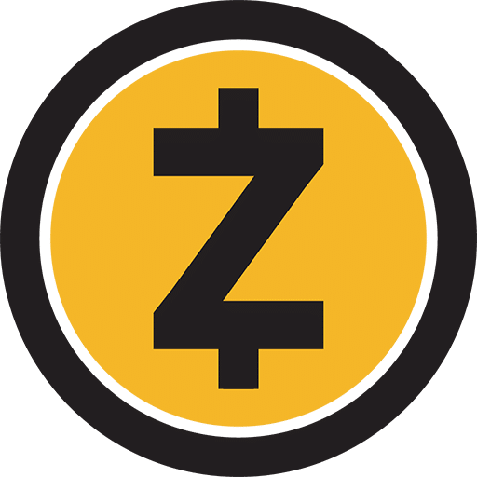
Z-Cash
Zcash (ZEC) is a decentralized, open-source cryptocurrency that was launched in 2016.
Zcash is based on a public blockchain, but it uses a unique technology called zk-SNARKs to provide users with the option to make transactions completely private. .
Sender, receiver, and transaction amount can be hidden from the public blockchain, making it nearly impossible to trace.
Zcash is maintained by a community of developers and has no centralized authority or controlling entity.
The total supply of ZEC is limited to 21 million coins.

Slide 2
How Zcash Works?
Uses Advanced privacy feature achieved through the use of zk-SNARKS
The sender, receiver, and transaction amount can all be kept secret from the public blockchain while using Zcash, which is made possible by the usage of zk-SNARKs.
Zcash transactions can be divided into two types:
Transparent : Transparent transactions are similar to Bitcoin transactions in that they are publicly visible on the blockchain and do not use zk-SNARKs
Shielded: Shielded transactions, on the other hand, use zk-SNARKs to completely hide the transaction information from the public blockchain.

Slide 3
Zk-SNARKS
zk-SNARKS stands for Zero-Knowledge Succinct Non-Interactive Argument of Knowledge.
Verifies a transaction without revealing any of the details of that transaction to anyone other than the parties involved.
Creates a mathematical proof that verifies the authenticity of a transaction without revealing any of the transaction details.
The proof is then added to the blockchain, allowing anyone to verify the authenticity of the transaction without knowing any of the specific details.
Overall, Z-snarks are a powerful tool for enabling private and secure transactions on a public blockchain.

Slide 4
Zcash: Mining and Supply
Mining
Zcash is a Proof of Work (PoW) cryptocurrency, which means that it is mined using computing power to solve complex mathematical problems.
Mining Algorithm Used : Equihash(Designed to be resistant to ASIC minin
Zcash has a block reward that is given to miners who successfully add a block to the blockchain.
Supply
The total supply of ZEC is limited to 21 million coins.
This is achieved by gradually reducing the block reward over time until it reaches zero.
At that point, no new ZEC will be created, and the only way to obtain it will be through transactions on the blockchain.
Overall, the mining and supply of Zcash is designed to ensure that the cryptocurrency remains scarce, while also promoting decentralization and fair distribution among miners.

