Slide 1
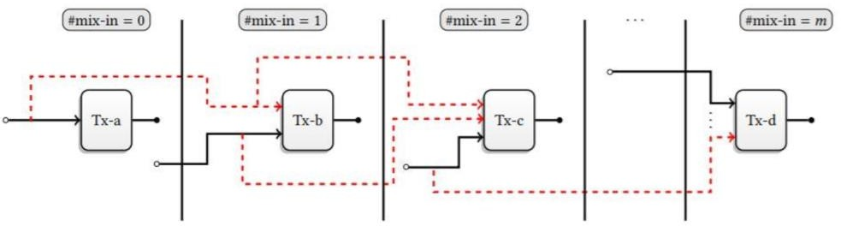
COMPARISION OF MONERO AND ZCASH
1.Anonymity set
Zcash and Monero are two of the most popular privacy-focused cryptocurrencies, and both aim to provide high levels of anonymity to their users.
Monero :
mixed with at least 7 other transactions to make it difficult to determine the true source of the transaction.
If a transaction is sent with zero mixins, it can be easily de-anonymized.
Zcash :
It has a much larger anonymity set because all shielded transactions are mixed together.
Considerably larger than Monero’s anonymity set.
Overall, Zcash has the potential to provide greater anonymity than Monero due to its larger anonymity set.

Slide 2
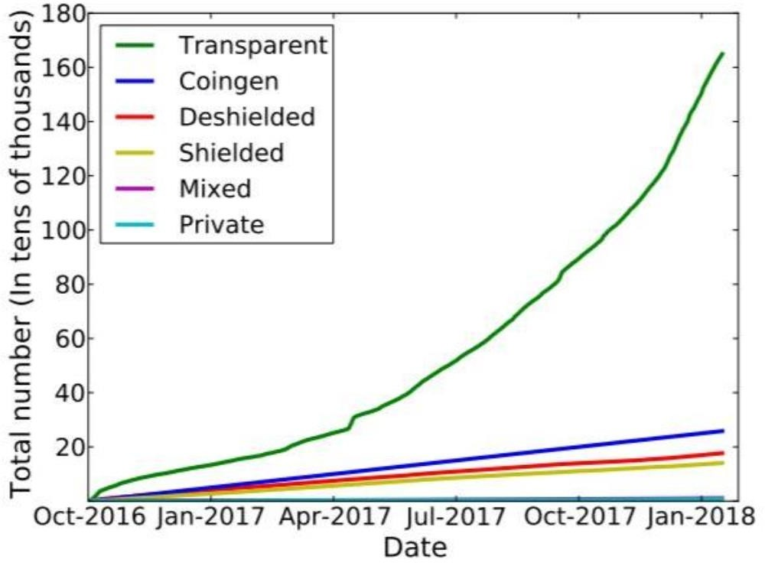
COMPARISION OF MONERO AND ZCASH(Contd)
2.Opt In Privacy
Overall, both Monero and Zcash provide privacy features that allow for anonymous transactions. However, there are some key differences between the two.
Monero :
mandates the use of RingCT
has a fixed minimum ring size
Zcash :
has a larger anonymity set.
but limited usage of its privacy features
In conclusion, both Monero and Zcash have their strengths and weaknesses when it comes to privacy features.

Slide 3
COMPARISION OF MONERO AND ZCASH(Contd)
3.Transaction Size
Another notable difference between Zcash and Monero is the cryptographic technology they use to achieve privacy
Monero :
uses Ring Confidential Transactions (RingCT), which obscures the transaction amount.
RingCT, does not require a trusted setup.
Zcash :
uses zk-SNARKs, which allows for the transaction amount to remain hidden.
zk- SNARKs can be computationally intensive, requiring more resources and time to verify transactions
Overall, both Zcash and Monero provide strong privacy features and are among the most private cryptocurrencies available. However, they differ in the size of the anonymity set, transaction size, and the cryptographic technology used to achieve privacy.

Slide 4
COMPARISION OF MONERO AND ZCASH(Contd)
4.Trusted Setup
Trusted setup process is done in a way that ensures that the generated parameters remain secret and cannot be tampered with.
Monero :
Generating a set of secret keys that are used to create ring signatures
Requires Mandatory RingCT usage
Zcash :
the trusted setup process involves generating a set of secret parameters that are used to create zk-SNARKs
different parties, each holding a part of the master secret, participated in the setup.
Ultimately, the choice between Zcash and Monero depends on a user's priorities and concerns regarding privacy, transaction fees, and trust in the system's setup.

Slide 5
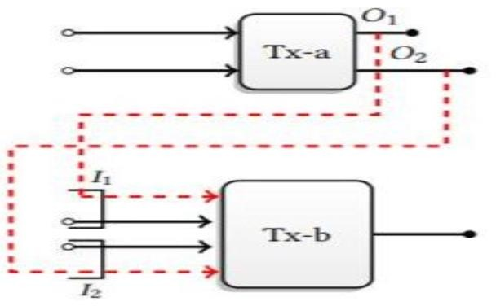
COMPARISION OF MONERO AND ZCASH(Contd)
they were able to identify transactions made by founders and miners and reduce the size of the overall anonymity set by 69.1%.
5.Traceability Analysis
It is a crucial aspect of blockchain technology as it helps ensure the security and transparency of transactions. Monero and Zcash are two privacy-focused cryptocurrencies that use different techniques to ensure transaction anonymity and prevent traceability analysis.
Monero :
none of the inputs that were de-anonymised by previous research.
able to correctly guess that the newest input is also the real input 81%
Zcash :
there are recognisable patterns in the transactions going into and coming out of the shielded pool.
they were able to identify transactions made by founders and miners and reduce the size of the overall anonymity set by 69.1%.
Both Monero and Zcash are designed to prevent traceability analysis and ensure user privacy. However, it is worth noting that no technology is completely foolproof, and it is always possible that new techniques could be developed to trace transactions on these networks.

