Slide 1

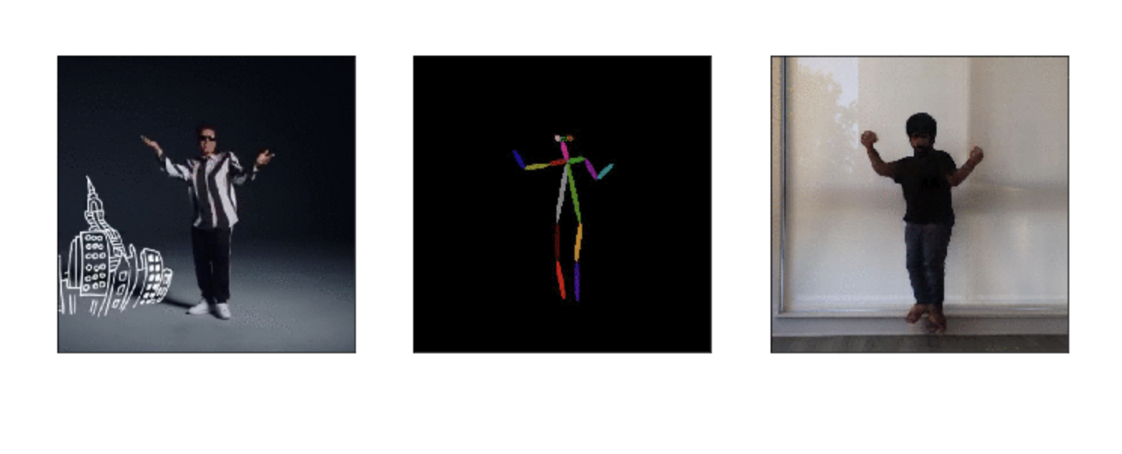
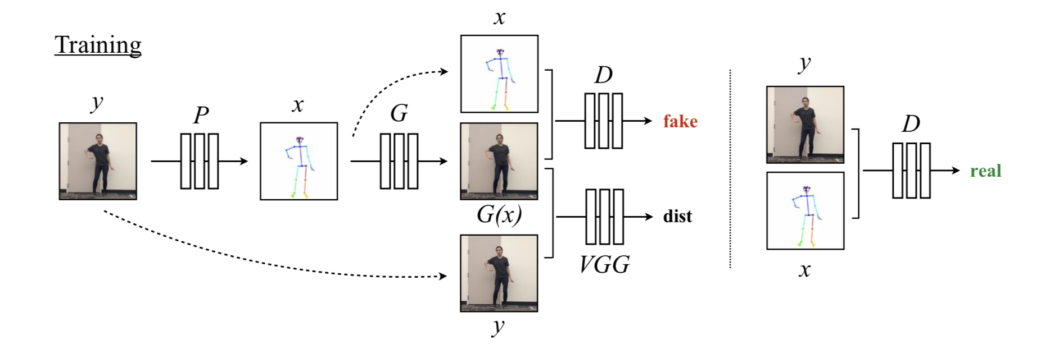
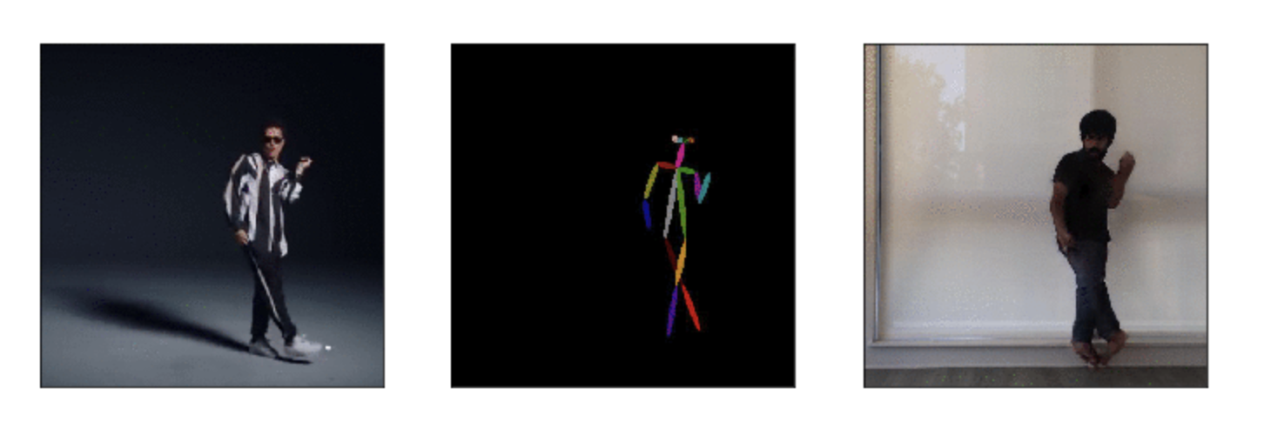
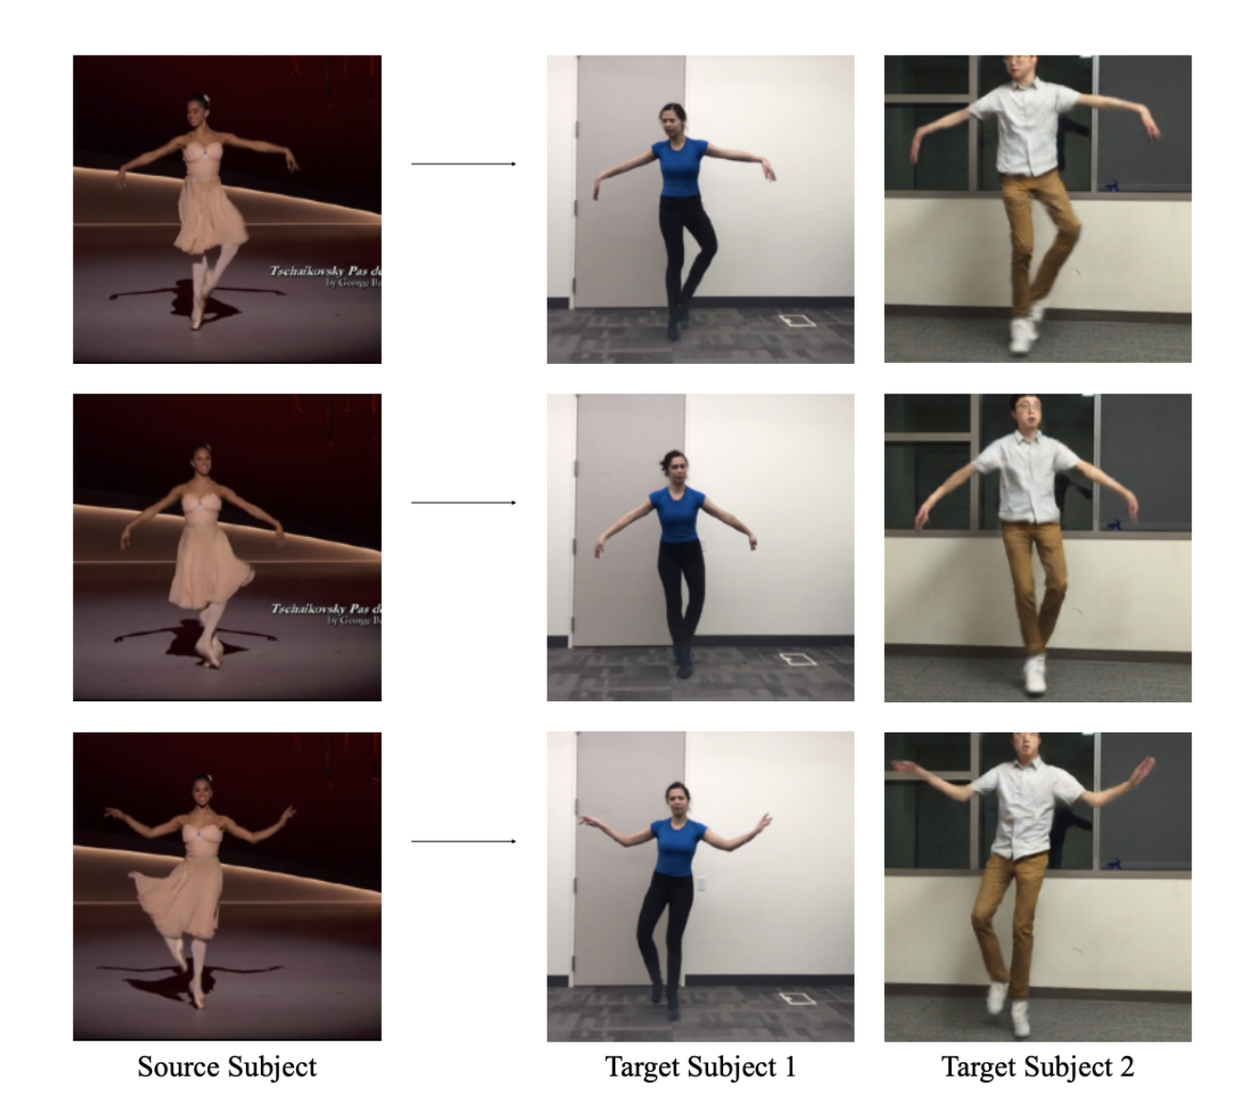
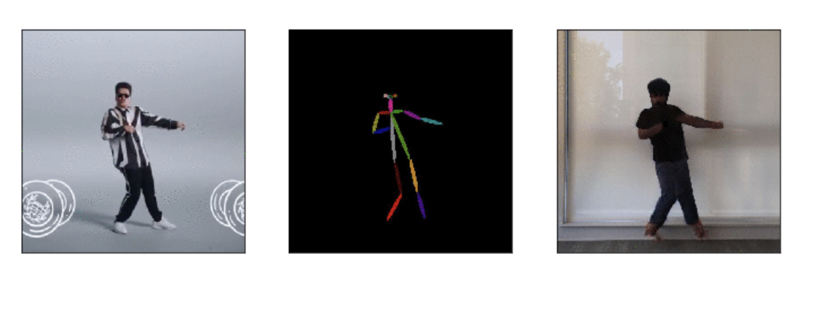
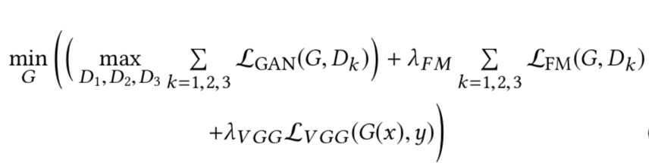
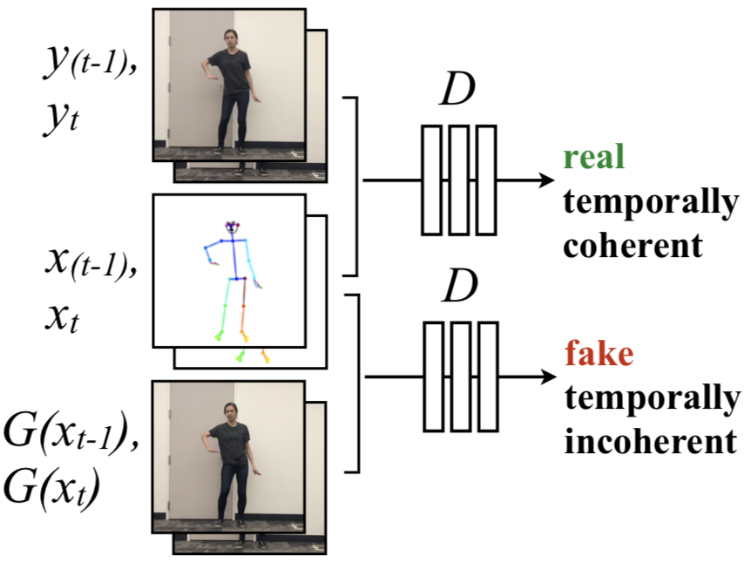
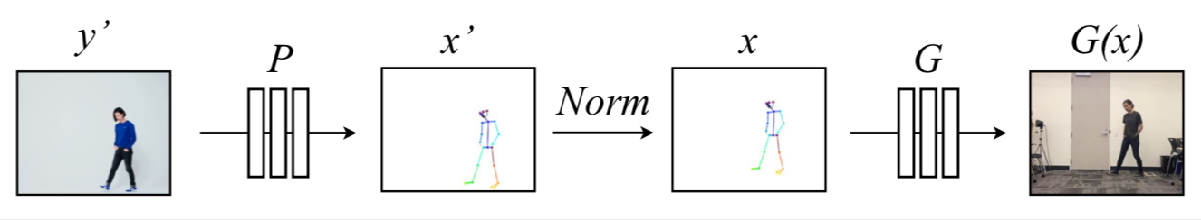
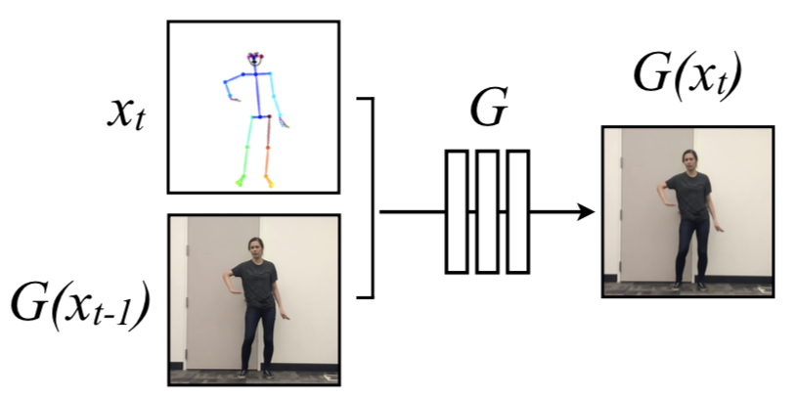
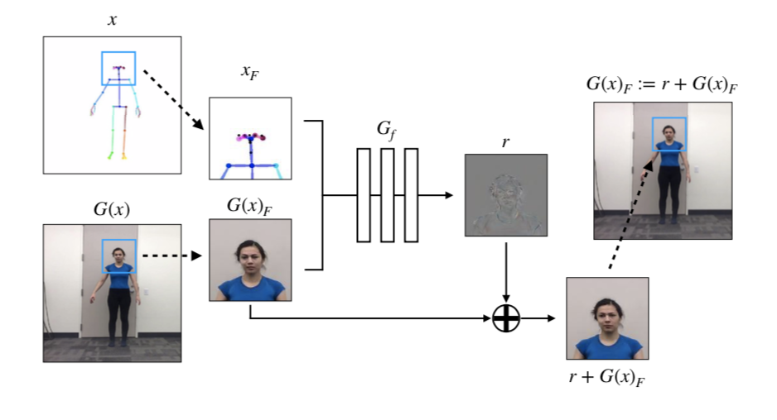
Motion Transfer from a source video to target subject
Vishvak Murahari, Raghav Raj Mittal, Taha Merghani
Introduction
In this project, we attempt to recreate the paper titled 'Everybody Dance Now' for 'do as I do' motion transfer. Given a source video of a person dancing, we wish to transfer the person's motions and performance to a target.
Training pipeline showing the loss terms
Optimize the L1-loss between the VGG fc7 embeddings of both G(x) and also the L1-loss of layer-wise representations of D obtained with G(x) and y.
Potential Improvements
G is modified to also take in the image at time t – 1, and two consecutive images are generated. D takes in the two images with their poses and decides whether the image at the time t is real or not. This forces temporal coherence between images and helps reduce jitter.
Global pose normalization –Analyzing the body positions of the source and mapping them to the target will help generate more realistic images and account for different body shapes.
Results from the original paper
FaceGAN – The face region is passed through a second generator to generate a residual which is added on to the existing face. This improves the quality and realism of the generated face.
Approach
Collect 20 minutes of video of the target subject dancing.
Run OpenPose, CMU’s open-sourced posed detector, to find the pose at each frame.
We now have a dataset mapping poses to actual images. Let us refer to this as (x,y) where x represents pose and y represents the image.
Figure illustrating temporal smoothing
During transfer time, we look at the source video and calculate a pose for each frame. For every frame in the source video, pass in the calculated pose along with the previously generated image to G to generate the next output image!
Train a generator G to generate images given a pose and train a discriminator D to identify generated images, by optimizing the adversarial GAN loss.
Current Results
Figure illustrating FaceGAN
References
The generated images are reasonable, but are jittery at certain times.
Chan, Caroline, et al. "Everybody dance now." arXiv preprint arXiv:1808.07371. 2018.

