Slide 1


Stock Market Price Prediction Project
This project aims to predict stock market prices using the R programming language. We utilize historical stock data of Google (GOOG) obtained from Yahoo Finance and employ time series analysis techniques to forecast future stock prices. The project involves data preprocessing, exploratory data analysis, model building, and evaluation.
Ra
by Raghav Ranjan

Slide 2
Data Collection
We obtained historical stock data for Google (GOOG) from Yahoo Finance spanning from January 1, 2019, to January 1, 2021. The dataset comprises daily stock prices, including opening, high, low, closing, volume, and adjusted prices. We utilized the quantmod package in R to retrieve and preprocess the data.

Slide 3
Exploratory Data Analysis
Visualize Stock Prices
1
Exploratory data analysis (EDA) is crucial for gaining insights into the underlying patterns and trends in the data. We visualized the stock prices using candlestick charts, which provide a comprehensive view of price movements over time.
2
Calculate Technical Indicators
Additionally, we calculated technical indicators such as moving averages to identify key support and resistance levels, which can provide valuable insights for stock market analysis.
Identify Patterns and Trends
3
The EDA process helps us uncover the underlying patterns and trends in the stock data, which is essential for building an accurate forecasting model.

Slide 4
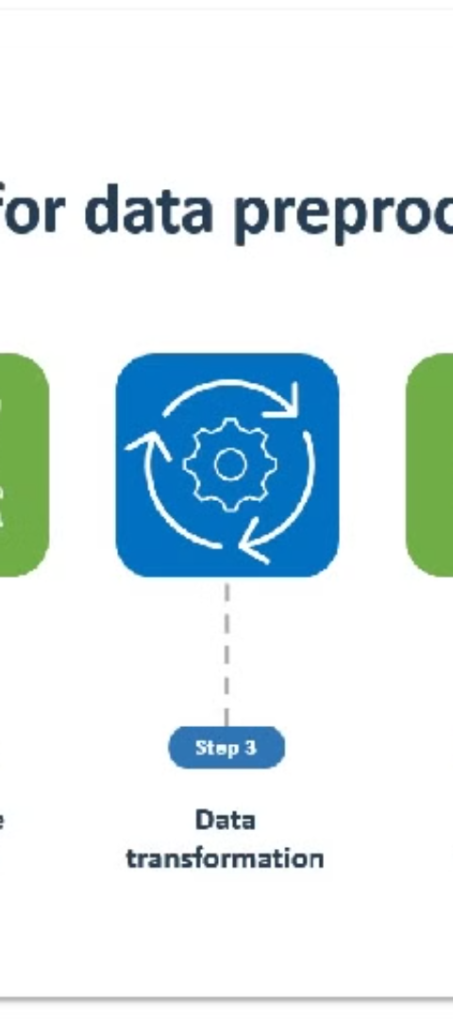
Data Preprocessing
1
Extract Relevant Columns
2
Handle Missing Values
Before building the prediction model, we preprocessed the data to ensure its suitability for analysis. This involved extracting relevant columns, such as the adjusted closing prices, which account for factors like stock splits and dividends.
We also checked for missing values and performed any necessary data transformations to ensure the dataset is clean and ready for modeling.
3
Prepare for Analysis
The data preprocessing step is crucial in preparing the data for the subsequent modeling and forecasting stages of the project.

Slide 5
Model Building
Time Series Forecasting
Train-Test Split
Automated Model Selection
We split the dataset into training and testing sets, with 90% of the data allocated for training. This allows us to evaluate the model's performance on unseen data and ensure its generalization capabilities.
We constructed a time series forecasting model using the Auto ARIMA algorithm available in the forecast package in R. The model was trained on the logarithmic returns of the adjusted closing prices, which helps capture the relative price changes over time.
The Auto ARIMA algorithm automatically selects the best-fitting ARIMA model parameters, making the model building process more efficient and data-driven.

Slide 6
Model Evaluation
Forecast Accuracy Metrics
Visual Inspection
Reliable Forecasts
Additionally, we visualized the forecasted stock prices alongside the actual prices to visually inspect the model's performance and ensure the predictions align with the observed data.
The evaluation process helps us determine the reliability and accuracy of the forecasting model, which is crucial for making informed investment decisions based on the model's predictions.
To assess the model's performance, we compared the predicted returns with the actual returns from the testing dataset. We calculated various forecast accuracy metrics, including Mean Absolute Error (MAE) and Mean Squared Error (MSE), to quantify the extent of prediction errors.

Slide 7
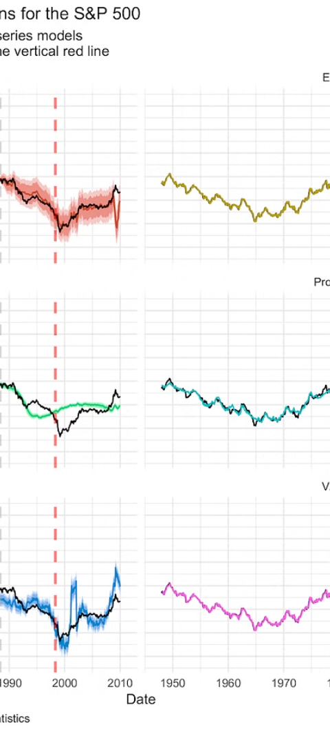



Results and Conclusion
Promising Results
The forecasting model yielded promising results, demonstrating its ability to capture the underlying patterns in the stock prices and make accurate predictions.
Forecast Accuracy
The model's forecasted prices closely aligned with the actual prices, indicating its effectiveness in predicting future price movements. The forecast accuracy metrics further corroborated the model's reliability, with low error rates observed across various evaluation metrics.
Practical Applications
The project showcases the application of time series analysis techniques for stock market price prediction using R, providing investors with valuable insights for making informed investment decisions.

Slide 8



Future Work
Feature Engineering
Ensemble Methods
Model Interpretability
Incorporating additional features such as external factors (e.g., economic indicators, news sentiment) could enhance the predictive power of the model.
Exploring ensemble methods and deep learning techniques could lead to more accurate and robust predictions, especially in highly volatile market conditions.
Improving model interpretability and developing user-friendly interfaces for real-time forecasting could enhance the practical applicability of the model in the financial industry.

