Slide 1

Linear Regression in R
Linear regression is a fundamental statistical method used for modeling the relationship between variables. In this project, we implement linear regression in R, a powerful statistical computing language widely used for data analysis and visualization.
Ra
Raghav Ranjan

Slide 2

Objective
1
Demonstration
Showcasing the implementation of linear regression in R to analyze the relationship between variables and make predictions.

Slide 3
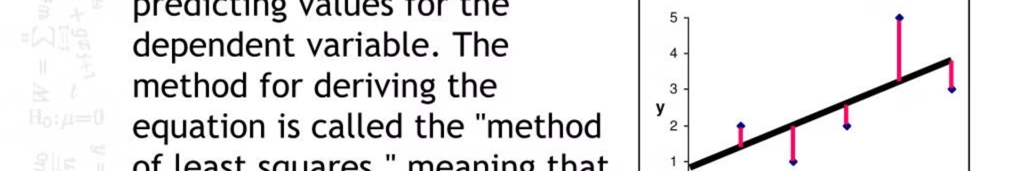
Methodology
1
Define Functions
linear_regression() to calculate coefficients and predict_linear() for making predictions.
2
Generate Data
Create sample data for performing linear regression.
3
Perform Regression
Analyze the data and visualize the regression line.

Slide 4
Implementation
Define a function linear_regression() {
// Calculate coefficients
}
Define a function predict_linear() {
// Make predictions
}
Generate sample data.
Perform linear regression.

Slide 5
Sample Data
Generated data includes an independent variable (X) and a dependent variable (Y) with a known relationship.

Slide 6
Results
Coefficients
Calculated using the linear regression algorithm.

Slide 7
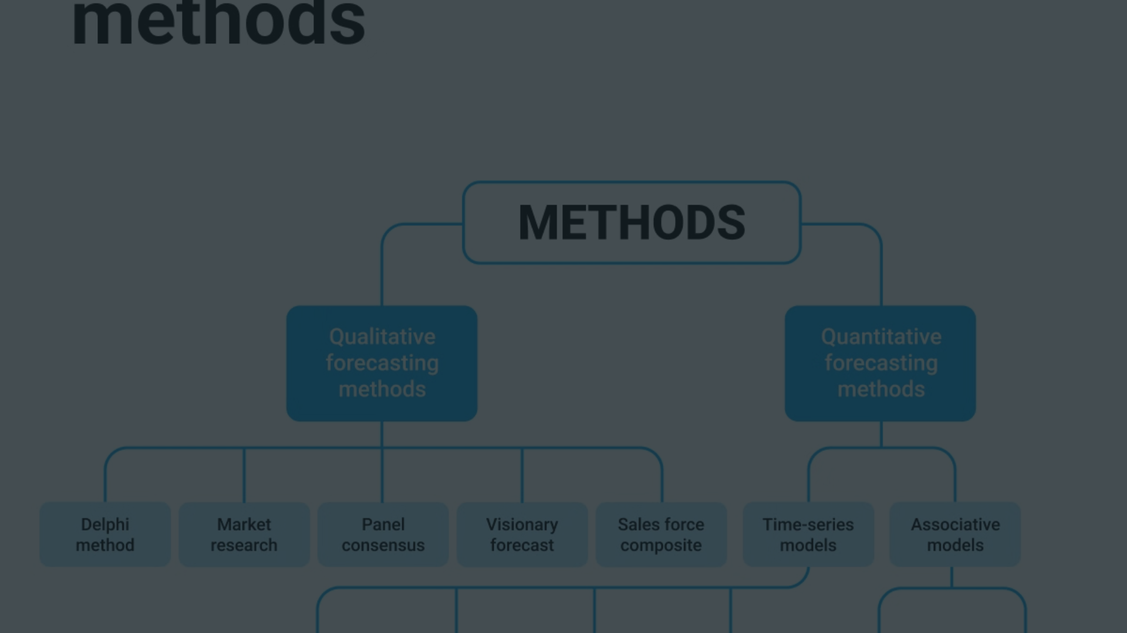
Predictions
1
Evaluation
Comparing predicted values with actual values to assess model accuracy.

Slide 8
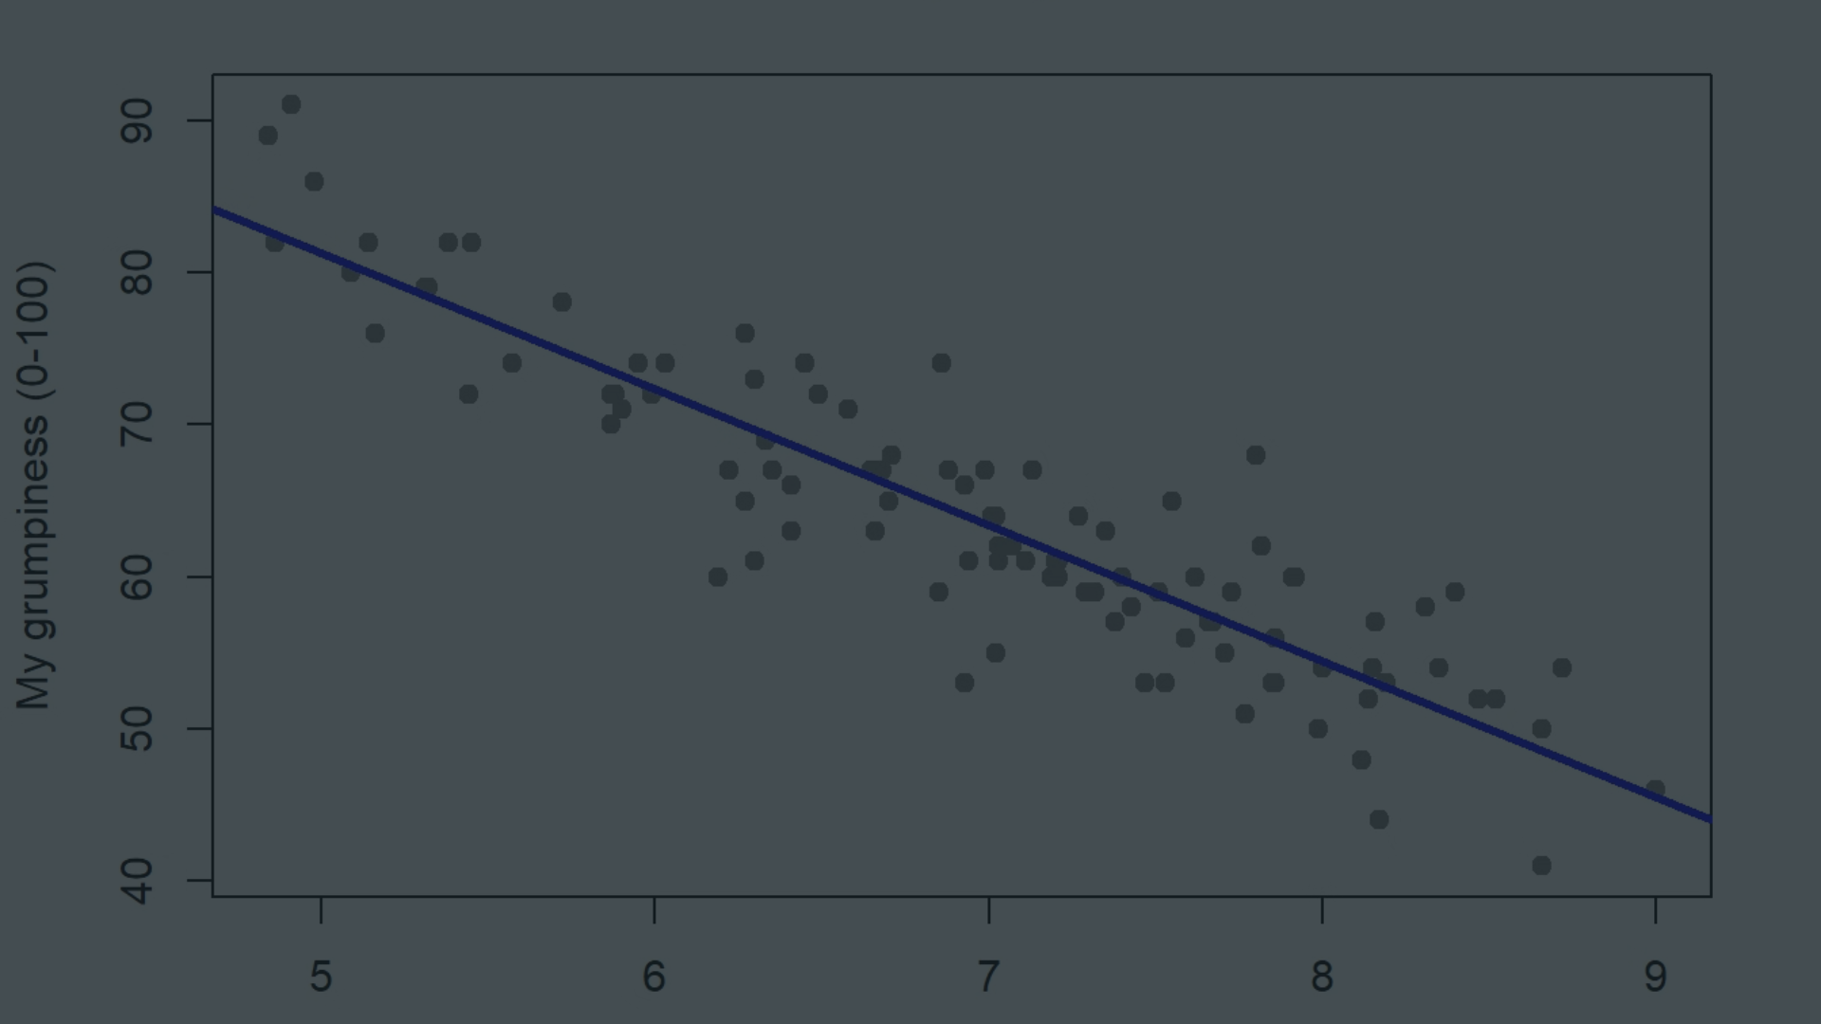


Visualization
Scatter Plot
Regression Line
Shows the relationship between independent and dependent variables.
Overlaid on the plot to visualize the model's fit to the data.

