Slide 1
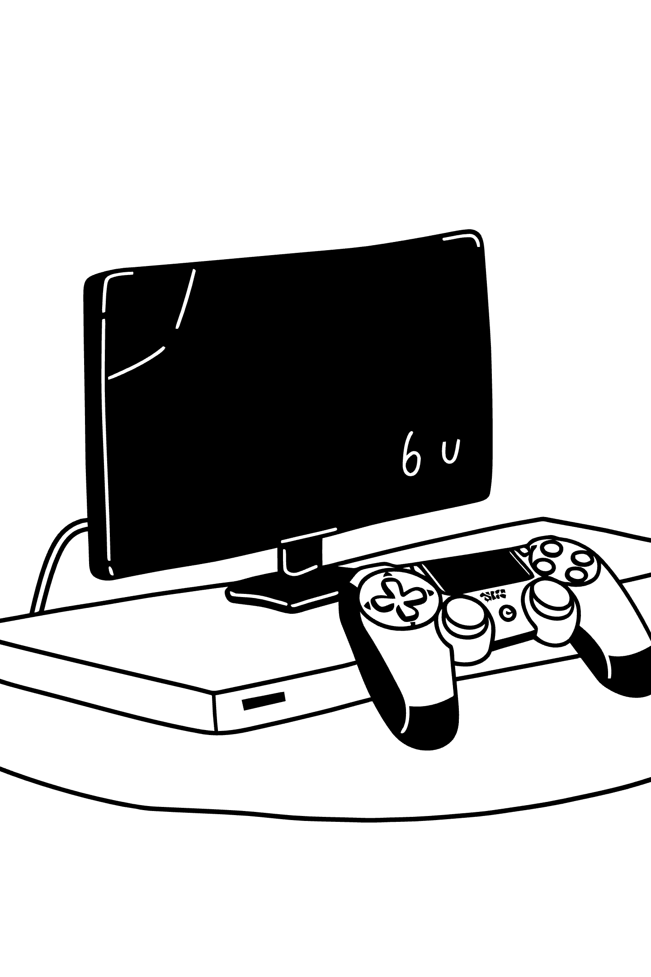
C++ Programming & Console Application Development
Industrial / Summer Internship Report · One-Month Remote Programme
IILM UNIVERSITY, GREATER NOIDA
SCHOOL OF COMPUTER SCIENCE & ENGINEERING

Slide 2
Internship at a Glance
30
4
Days
Projects
Remote internship duration
Console applications built
2
1
File-Based
GitHub
Projects with persistence
Version-controlled submissions
Student
Host Organisation
Raghav Rathi (25SCS1003003137) · Class 2CSE23 · 2nd Year, 3rd Semester · B.Tech CSE
VirtualWorks Lab (an educational initiative by Noivrn, MSME UDYAM-MH-26-1199183) · Ref: VWX-SEP26TOOCT26-773 · 09 Sep – 09 Oct 2026

Slide 3

About VirtualWorks Lab
VirtualWorks Lab is an educational internship initiative operated by Noivrn, registered under the Ministry of MSME. It runs short, remote, project-based programmes for early-stage engineering students — emphasising working code over passive lectures.
Structured Tasks
Performance Evaluation
Increasingly involved assignments tracked against a public code repository.
Each programme closes with a documented evaluation and certificate of completion.
Real Deliverables
Interns build applications a non-programmer could actually run and use.

Slide 4
Objectives & Scope
What Was the Goal?
Scope & Limitations
Reinforce C++ syntax — loops, conditionals, functions, arrays, strings — through complete programs.
Design menu-driven, console-based user interaction.
Use randomisation for an interactive, replayable game.
Model a 2D game board with win/draw detection.
Persist structured records using C++ file streams.
Build the habit of testing against normal, boundary, and invalid inputs.
Beginner-to-intermediate, single-user, console-based C++ applications for learning — not production deployment.
Persistence uses plain text files (no database)
No authentication or concurrency handling
No graphical interface

Slide 5
Tools & Working Method
Tools & Technologies
Working Method
Each task followed the same disciplined workflow:
Tool | Role
C++ Standard Library | Primary language for all four apps
iostream | Console menus, prompts, output
fstream | Reading/writing persistent records
rand() / srand() | Random number generation
Arrays & 2D arrays | Board & record buffers
Git & GitHub | Version control & submission
01
Task Brief
Note inputs, outputs, edge cases
02
Design Sketch
Map functions and flow on paper
03
Core Logic
Implement first, format later
04
Validation & Polish
Add input guarding and formatting
05
Test & Submit
Push tested code to GitHub

Slide 6
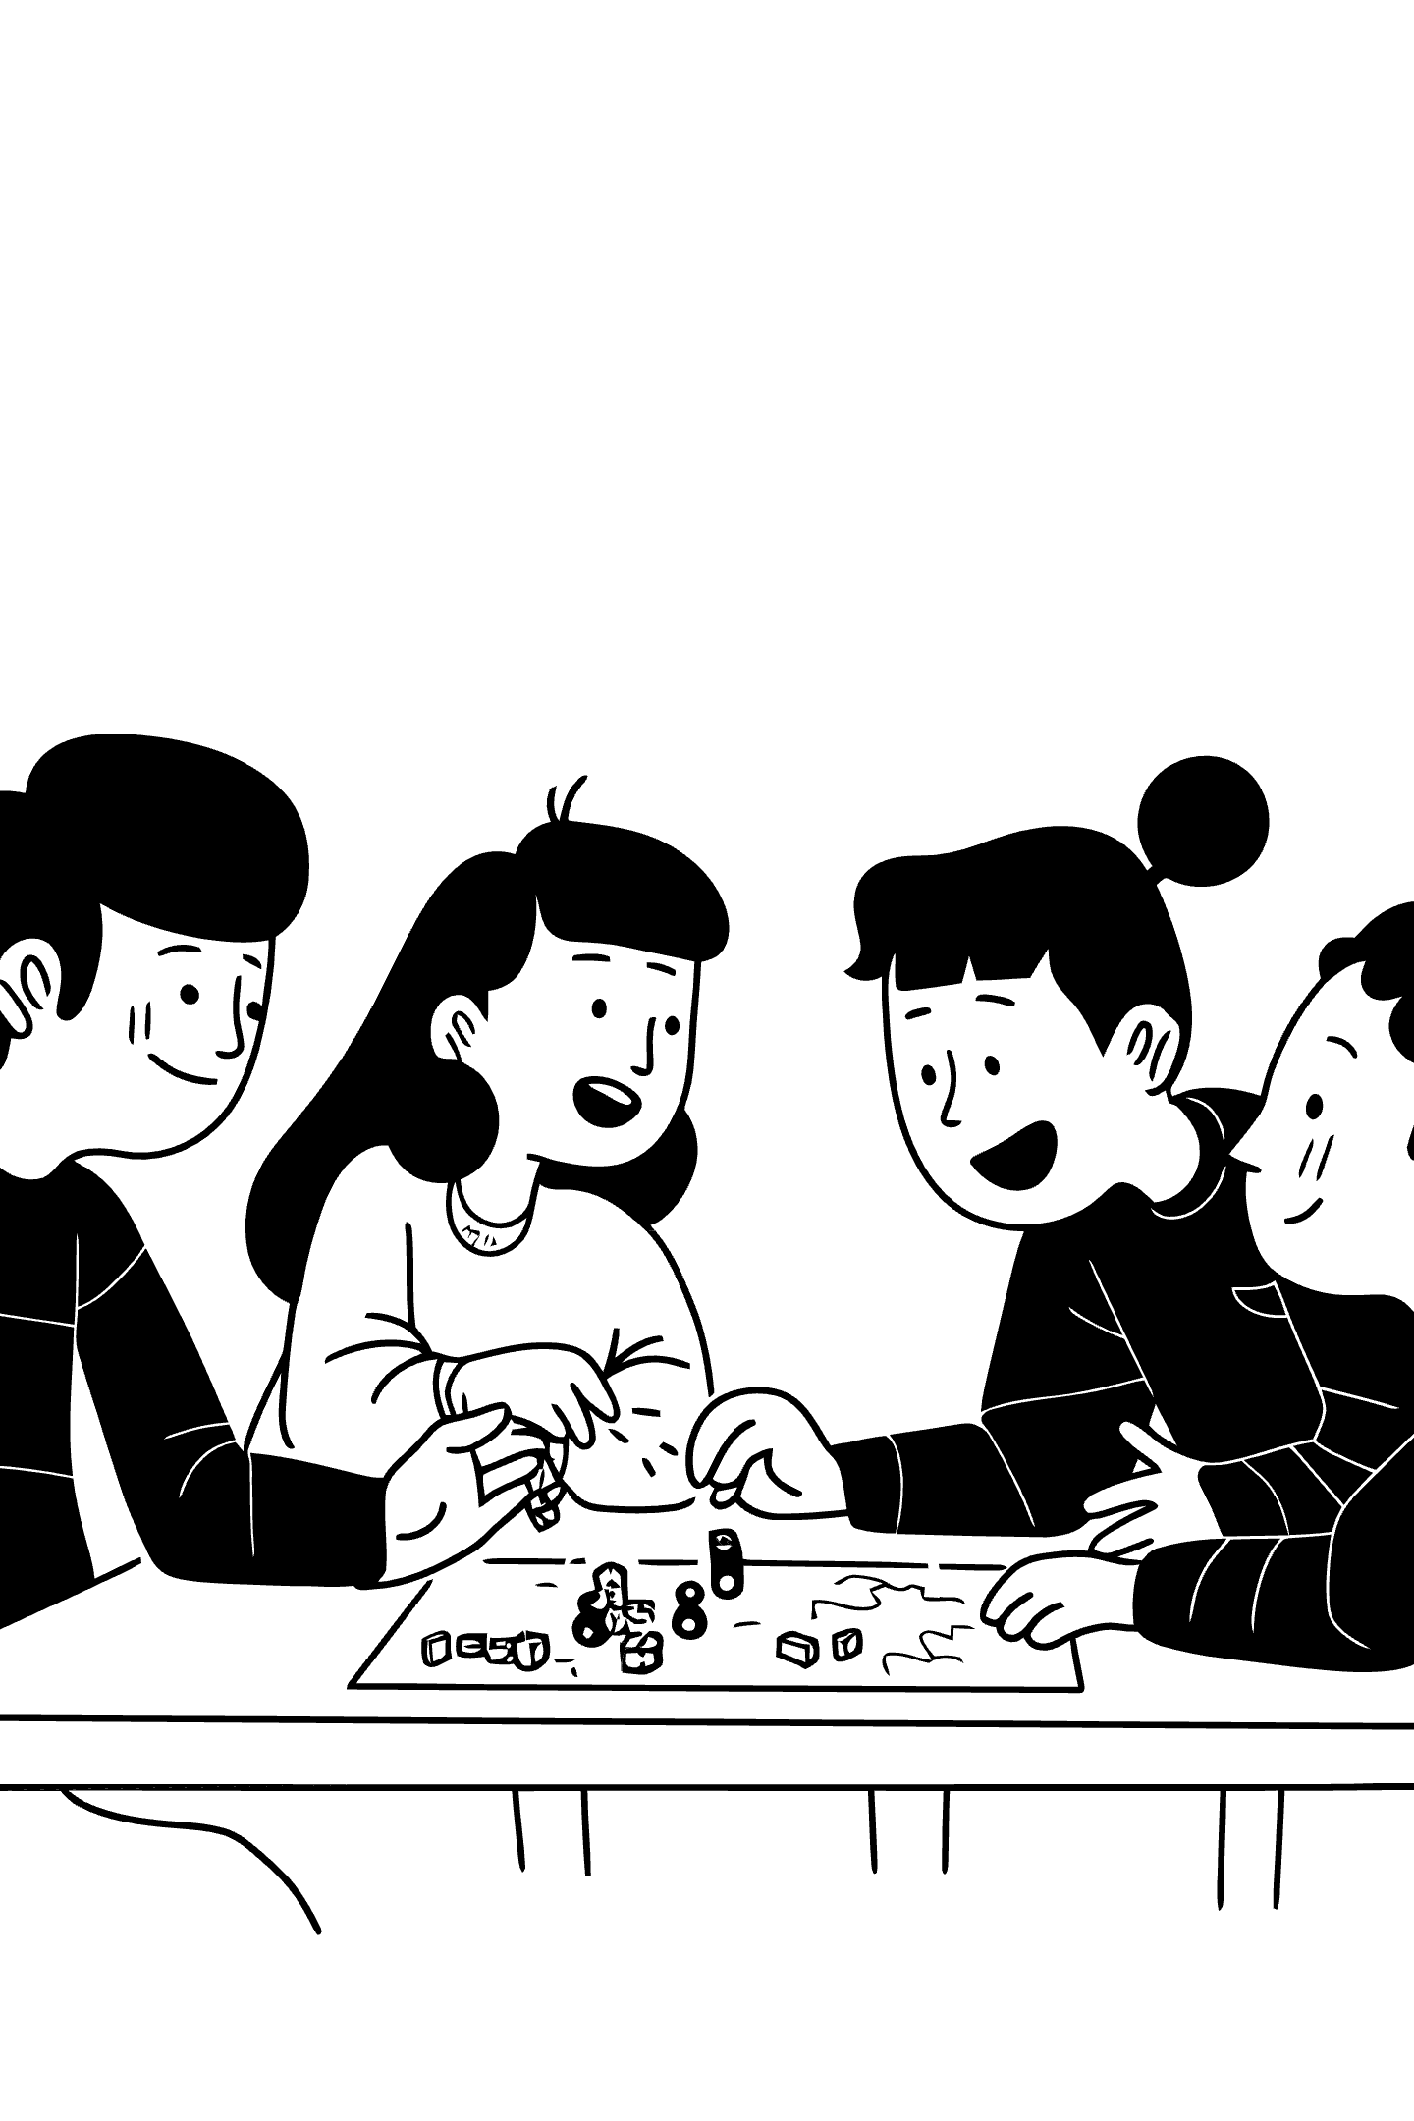

Project 1: Number Guessing Game
The simplest of the four tasks — an interactive game where the program generates a random target and the user guesses until correct.
Random Target
Feedback Loop
Generated via rand() seeded with srand(time(0)) within a configurable range.
"Too high" or "Too low" after every incorrect guess, with an attempt counter on win.
Input Guarding
Non-numeric entries are handled gracefully — the loop cannot be broken by bad input.
Reinforced clean read-compare-respond loops and graceful recovery from unexpected input.

Slide 7
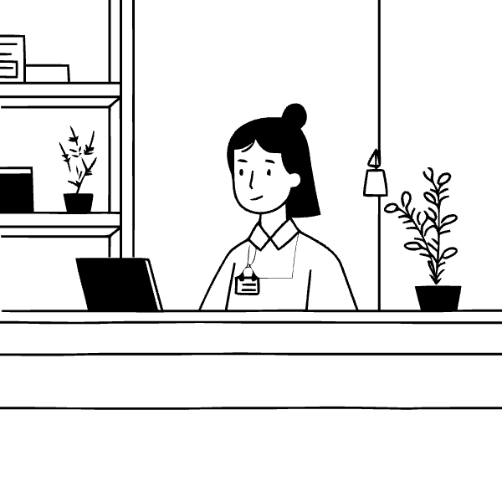
Project 2: Hotel Management System
The most structurally demanding task — manages rooms, bookings, billing, and checkout, all backed by a text file so data survives between runs.
Key Features
Room-status view: free or occupied
Booking flow: guest name, contact, stay duration → written to file
Billing routine: calculates total from room rate × nights
Checkout: frees the room and removes the record from file
File Handling Insight
C++ file streams have no built-in "delete this record" — checkout rewrites the entire file excluding the removed entry.

Slide 8
Projects 3 & 4: Tic-Tac-Toe & Contact Management
Tic-Tac-Toe Game
Contact Management System
Two-player game on a 3×3 grid stored as a 2D character array.
A dedicated contact book extending file-handling lessons from the Hotel System.
Board redrawn after every move
Move validation: rejects out-of-range or occupied cells
Win detection across 8 lines (3 rows, 3 columns, 2 diagonals)
Automatic turn-switching with clear end-of-game messages
Structured storage: name, phone, email in a delimited text file
Linear search by name or phone number
Rebuild-on-delete: read all, skip target, rewrite fresh file
Duplicate-entry and empty-field checks on add

Slide 9




Summary of Deliverables & Testing
Project | Core Concepts | Persistence
Number Guessing Game | Randomisation, loops, comparisons | None (in-memory)
Hotel Management System | Records, menus, billing logic | Text file (bookings)
Tic-Tac-Toe | 2D arrays, state checks, turn logic | None (in-memory)
Contact Management System | Search, add/view/delete, file rewrite | Text file (contacts)
Testing Approach
Normal-Case
Boundary
Typical, well-formed input
Smallest/largest valid values, edge cells
Invalid Input
Persistence
Out-of-range choices, non-numeric entries
Reopen program to confirm records intact

Slide 10
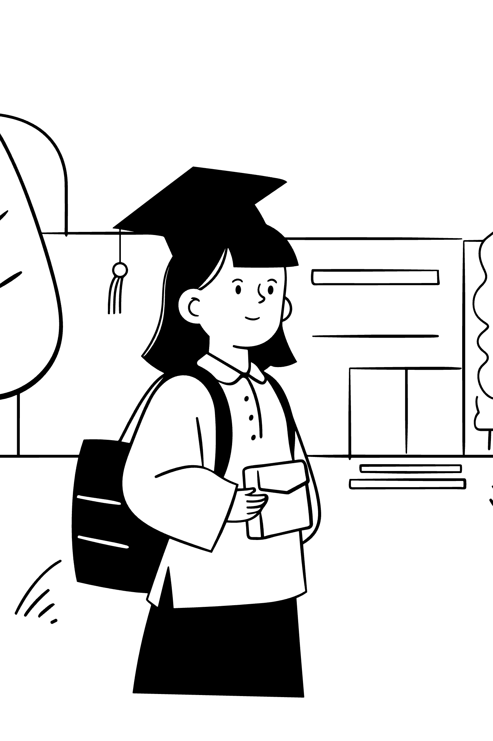
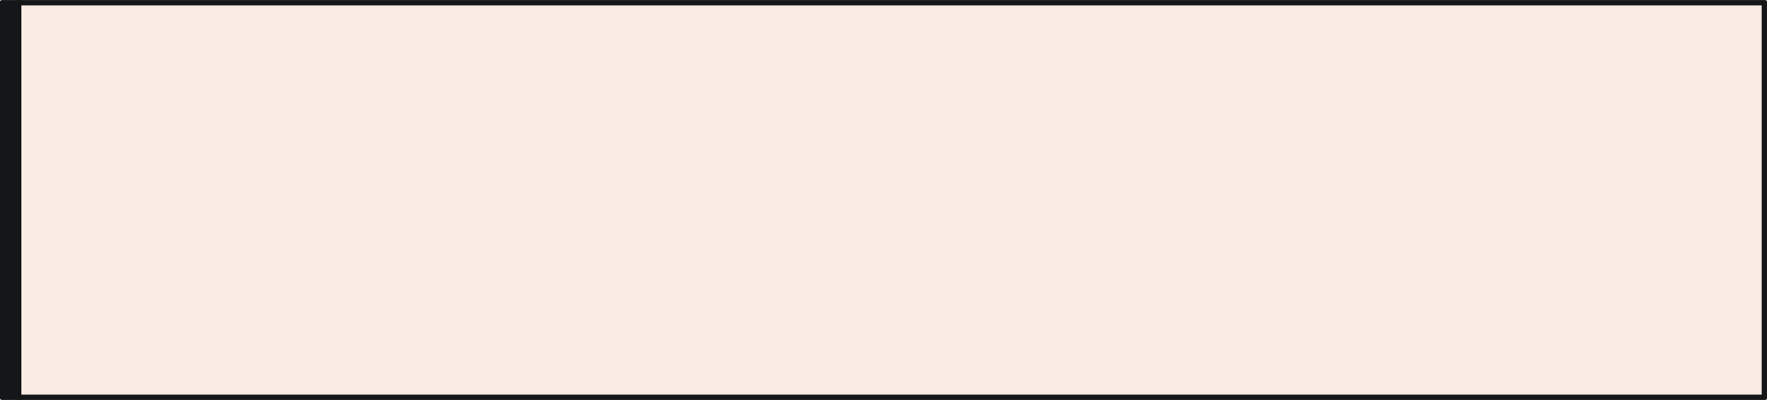
Outcomes, Extensions & References
Key Outcomes
Confidence with menu-driven programs, file streams for persistence, 2D array state management, edge-case testing habits, and Git-based submission workflow.
Possible Extensions
Difficulty levels for Guessing Game; room categories & date-range checks for Hotel System; AI opponent for Tic-Tac-Toe; edit option & lightweight database for Contacts.
References
cppreference.com · IILM University (iilm.edu/greater-noida/) · VirtualWorks Lab Offer Letter & Certificate, Ref. VWX-SEP26TOOCT26-773 · GitHub submission repositories

