Slide 1

Analysis of Teams and Players of NBA
Submitted by:-
Raghav sharma
Registration no:-11813297

Slide 2
Introduction to NBA
The National Basketball Association (NBA) is an American men's professional basketball league. The league was formulated in the year of 1949 with the merger of 2 major basketball leagues. So, the league is new with certain aspects kept in mind being only 74 years old. It was initially an 11-team league when it was formed, but today it has 30 teams in total. The United States is the home to 29 teams and 1 team is from Toronto, Canada. The NBA is known as the most lucrative and prestigious basketball league in the world, with the fame and fortune it offers attracting the best players from around the globe

Slide 3
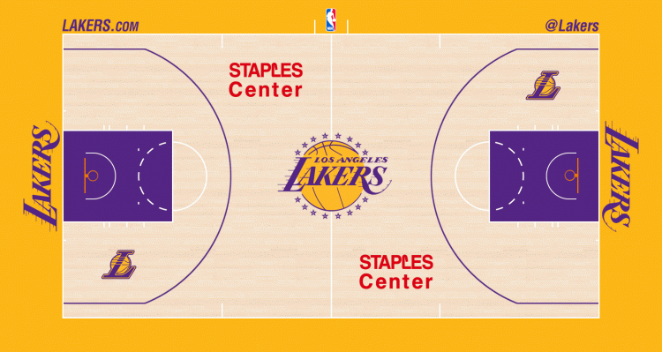
Rules and Terminology
The 3-Point line: The big arc beside the “STAPLES CENTER” watermark is the 3-pt line. If a player shoots the ball from or behind this line, is counted as a 3-point.
Any shot taken from inside the 3-pt line is mapped as 2-pts.
If a player is fouled while shooting, he is awarded Free Throws (number of three throws depend on the degree of foul). A Free Throw is taken from the line behind the purple box (called the Painted Area). A FT is 1-pt.

Slide 4
The Game
An NBA game is of a duration of 48 minutes, divided into 4 quarters, 12 minutes each. Although, if the score is tied at the end of a match, multiple overtimes can come into play until a winner is decided.
Both teams are given total of 7 timeouts for this duration of game which they can call to figure out the strategies between games or substitute a player from bench.
The game is of 5 vs 5 player during the game, but the team can have 6 players substitutes sitting on the bench who they can swap multiple times with the starters during course of the game.

Slide 5
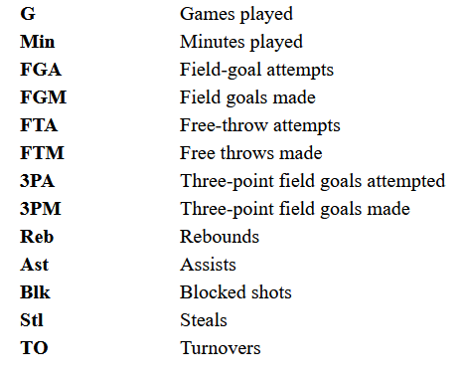
Terms used
FG% - Field Goal Percentage; the formula is FGM / FGA
FT% - Free Throw Percentage; the formula is FTM / FTA.
3P% - 3-Point Field Goal Percentage
PTS/GM- Points scored per game.
AST/GM- Assists per game.
REB/GM- Rebounds per game.
MIN/GM- Minutes played per game.

Slide 6
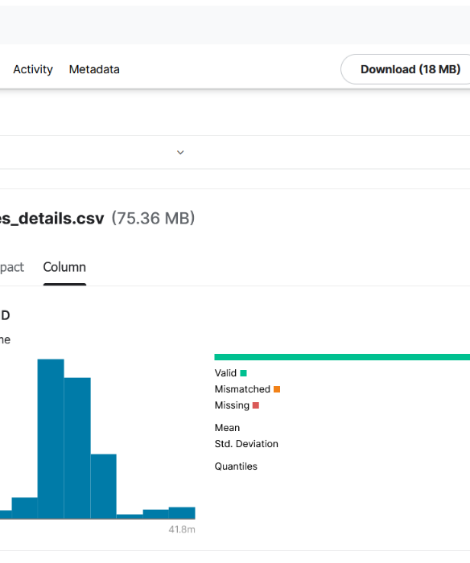
Data Used
I pulled the dataset from Kaggle . Kaggle is a very trusted website for looking at data, uploaded by community itself.
Last Updated 8 months ago, it provides 5 csv files which contains all the data about player and team stats in the past 17 years.
The data is of 860,000 rows and 92MB in size. Specifications of the data:
The 5 files are very raw and need to be connected to make sense to a viewer.
Certain columns will act as primary keys to join the data.
What is the content of dataset?
Every game since 2003-04 season till March,2020.
Every detail of player that has played in these 17 years.
Team details.

Slide 7
OBJECTIVES/ SCOPE OF ANALYSIS
Cleaning the data (Tableau Prep Builder)
Visualizing the data (Pivot charts and dashboards)
Pivoting the data and looking into the stats.
Comparing teams.
Players analysis and comparison
Predicting the future of players’ career.

Slide 8
ETL PROCESS
1. In the first step extraction, data is extracted from the source system into the staging area. In this we have extracted the data from the dataset downloaded from kaggle.com in the form of 5 csv files and used for further steps. Refer SOURCE OF DATASET for more information regarding this.
2. In the transformation step, the data extracted from source is cleansed and transformed with Tableau Prep, flow chart of which will be attached in this report. Cleaned data resulted in 4 xlsx files which are further loaded into Excel for analysis and visualization.
3. Loading data into the target tables is the last step of the ETL process. In this we create pivot tables based on the relations mentioned in the objectives to help us analyze the data hence getting the result and visualizing the results in form of charts and graphs.
4. The charts and graphs are then turned to into an interactive dashboard to display all the results to the user at the same time hence giving the eventual result of the analysis to the user.

Slide 9
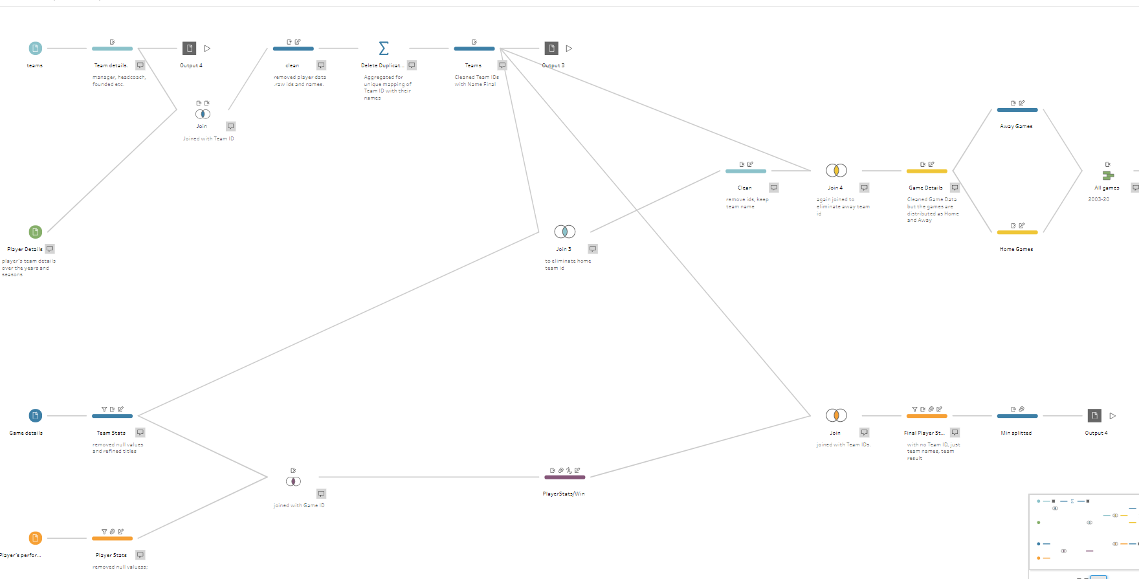
USE OF TABLEAU PREP BUILDER

Slide 10

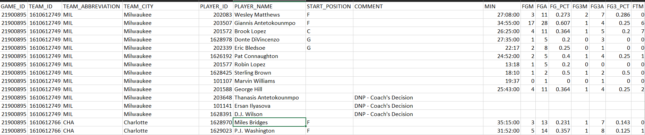
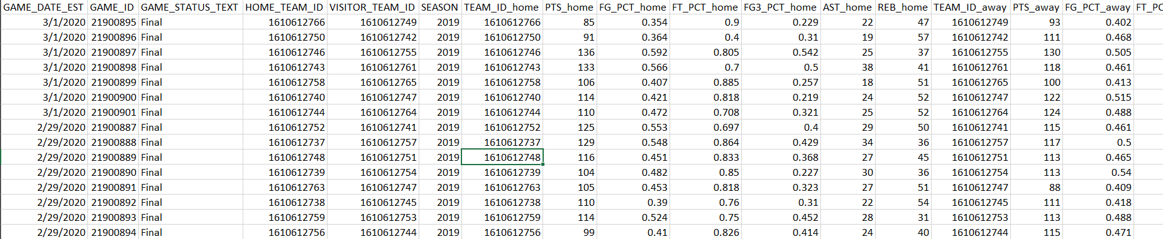

Slide 11
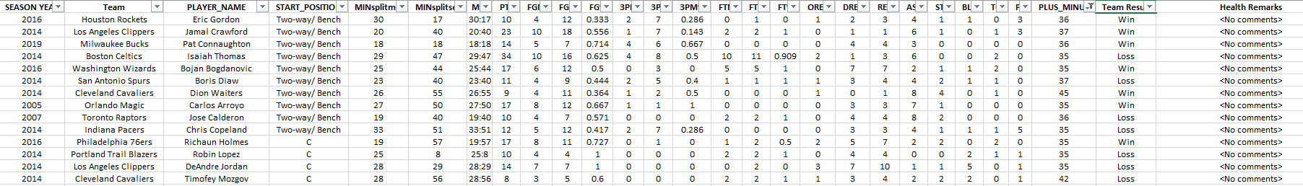
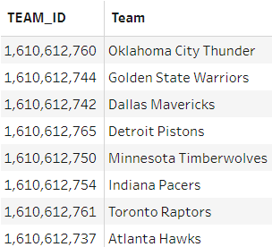
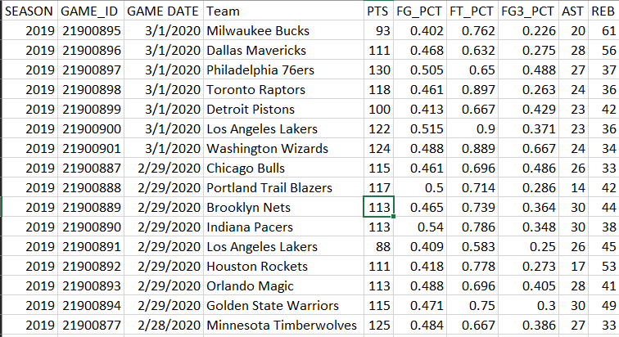
CLEANED DATA

Slide 12
Tools used
Tableau Prep Builder: For cleaning of data
PIVOT TABLE:-A pivot table is a table of statistics that summarizes the data of a more extensive table (such as from a database, spreadsheet, or business intelligence program). This summary might include sums, averages, or other statistics, which the pivot table groups together in a meaningful way.
Pivot tables are a technique in data processing. They arrange and rearrange (or "pivot") statistics in order to draw attention to useful information.
PIVOT CHART:-Visual representation of pivot table.

Slide 13
Tools used
SLICERS:-Slicers provide buttons that you can click to filter tables, or PivotTables. In addition to quick filtering, slicers also indicate the current filtering state, which makes it easy to understand what exactly is currently displayed.
ARITHMETIC OPERATORS-: Various arithmetic operators are being used like percentage, addition, division, ratio etc.
FILTERS-: The filters are used to the data in the table according to the requirements of the users.

Slide 14
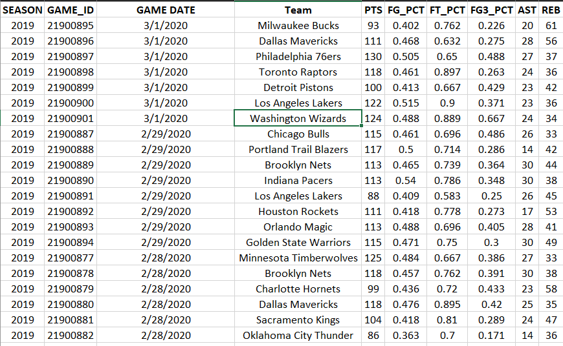
ANALYSIS
TEAM ANALYSIS

Slide 15
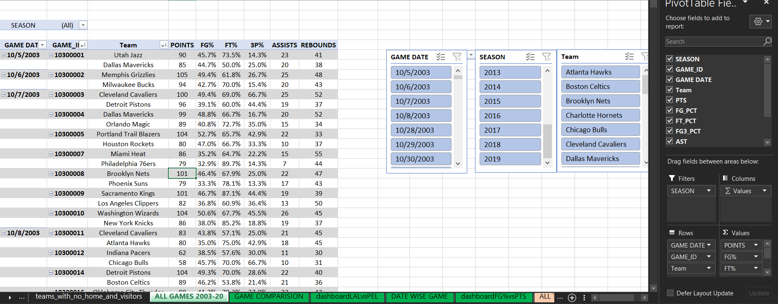
PIVOTING

Slide 16
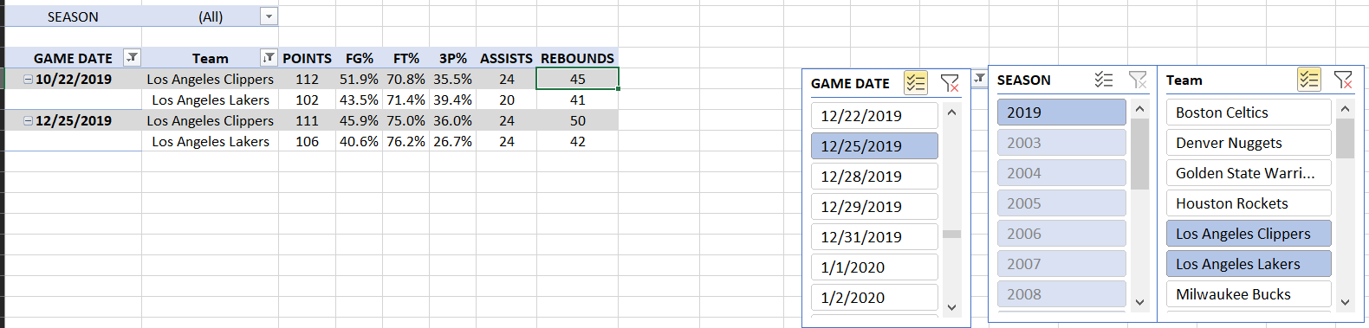
ANALYSIS 1: LAKERS VS CLIPPERS

Slide 17
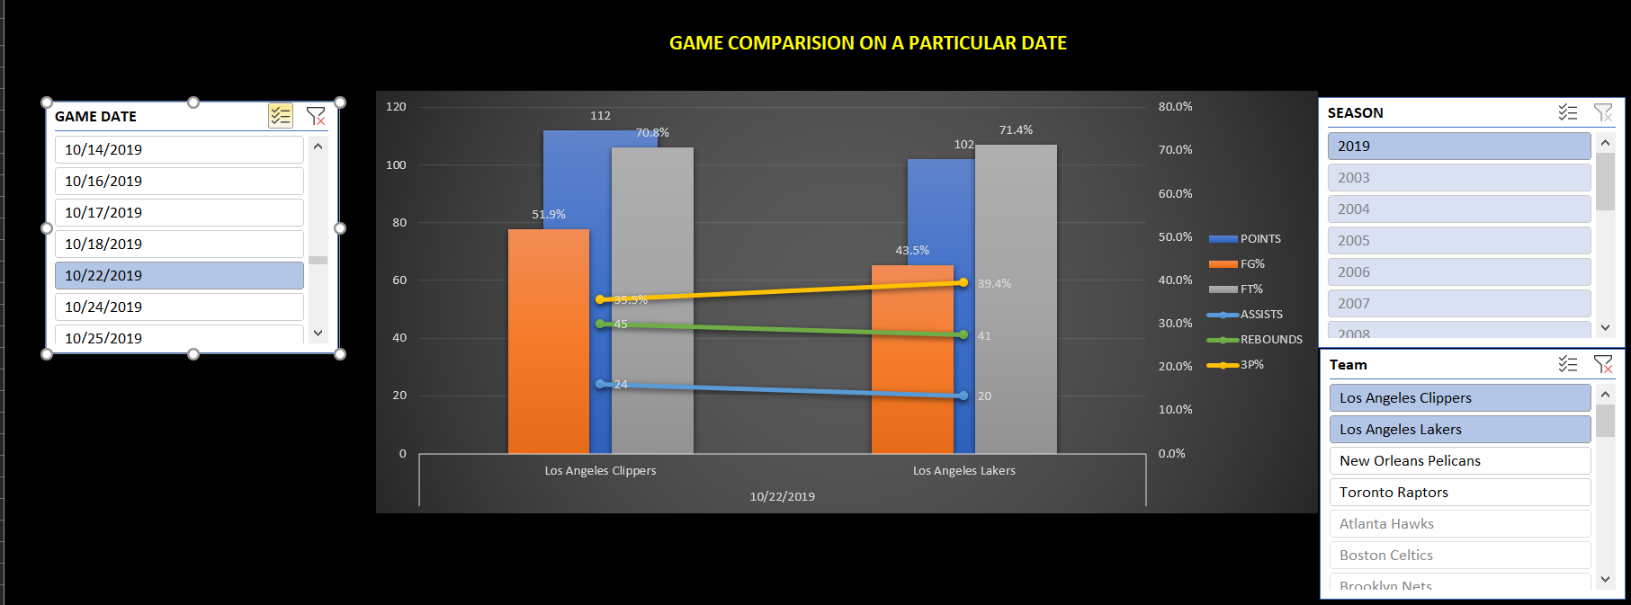
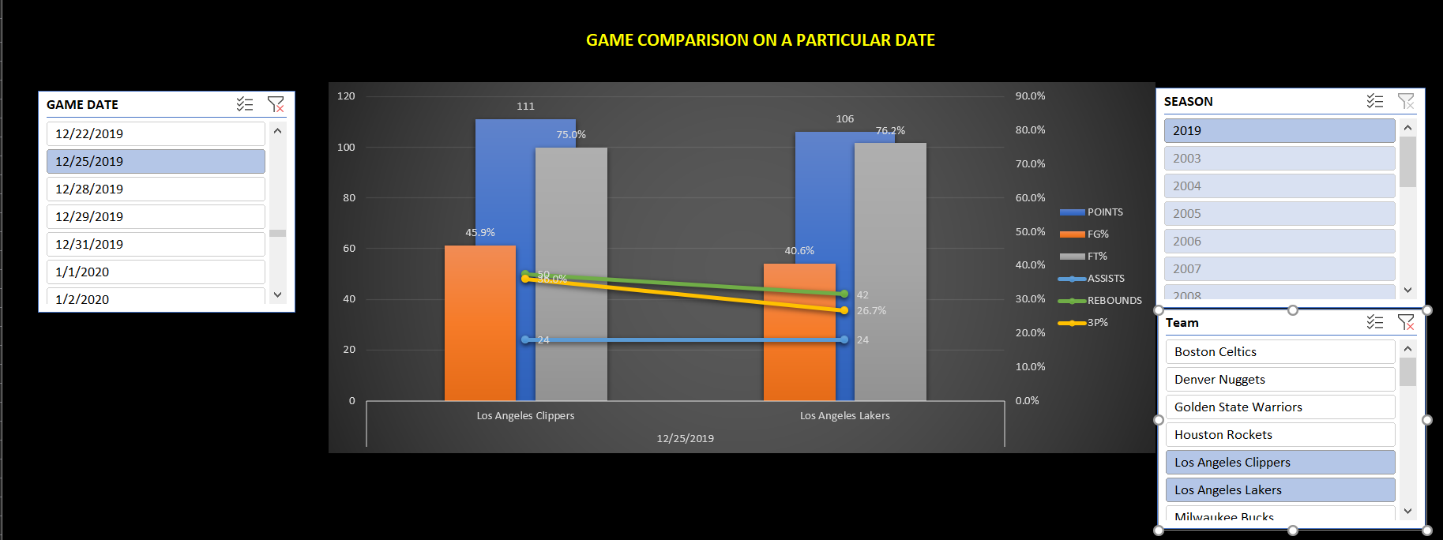
VISUALIZATION

Slide 18
RESULT
Although the Lakers have 17 championships in the past, it does not change the fact that the current Clippers team is not a match for Lakers.
PREDICTION: Clippers plays better in a single game match with the Lakers but in the playoff, they choke because they have to play 7 game series and every single year they get eliminated. So, to infer from this, if there happens to be a playoff series of Lakers Vs Clippers, chances are that Clippers are going to win, but as the history of the game suggests, the odds of that matchup happening is very unlikely because the Clippers never made out of the 1st round of playoffs.
In the second matchup on 25th Dec 2019, the Lakers shot the ball better than Clippers but still lost. That tells us they shot probably less number of shots than Clippers.
PREDICTION: If the Lakers want to defeat Clippers in their next matchup, they need to take more shots and look to score the 3pt more because Clippers are a faster team in comparison

Slide 19
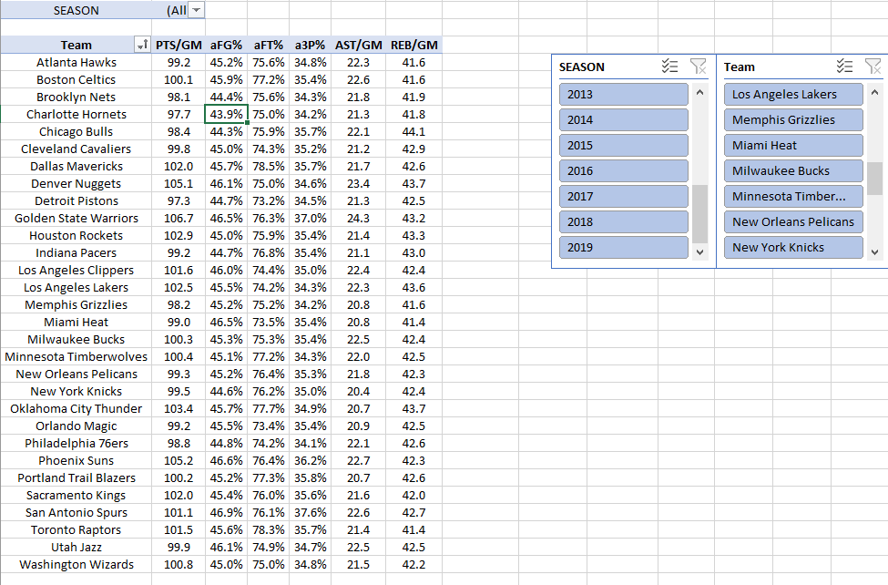
ANALYSIS 2: SUPERTEAMS

Slide 20
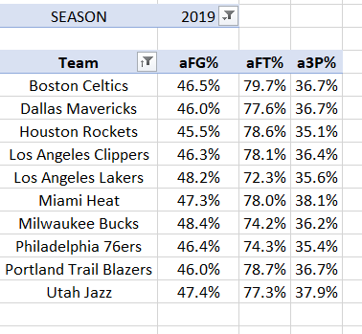
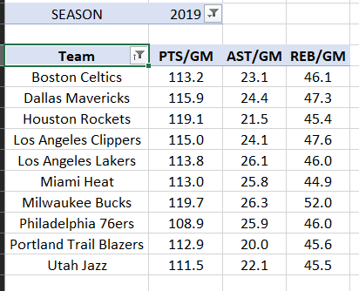

Slide 21
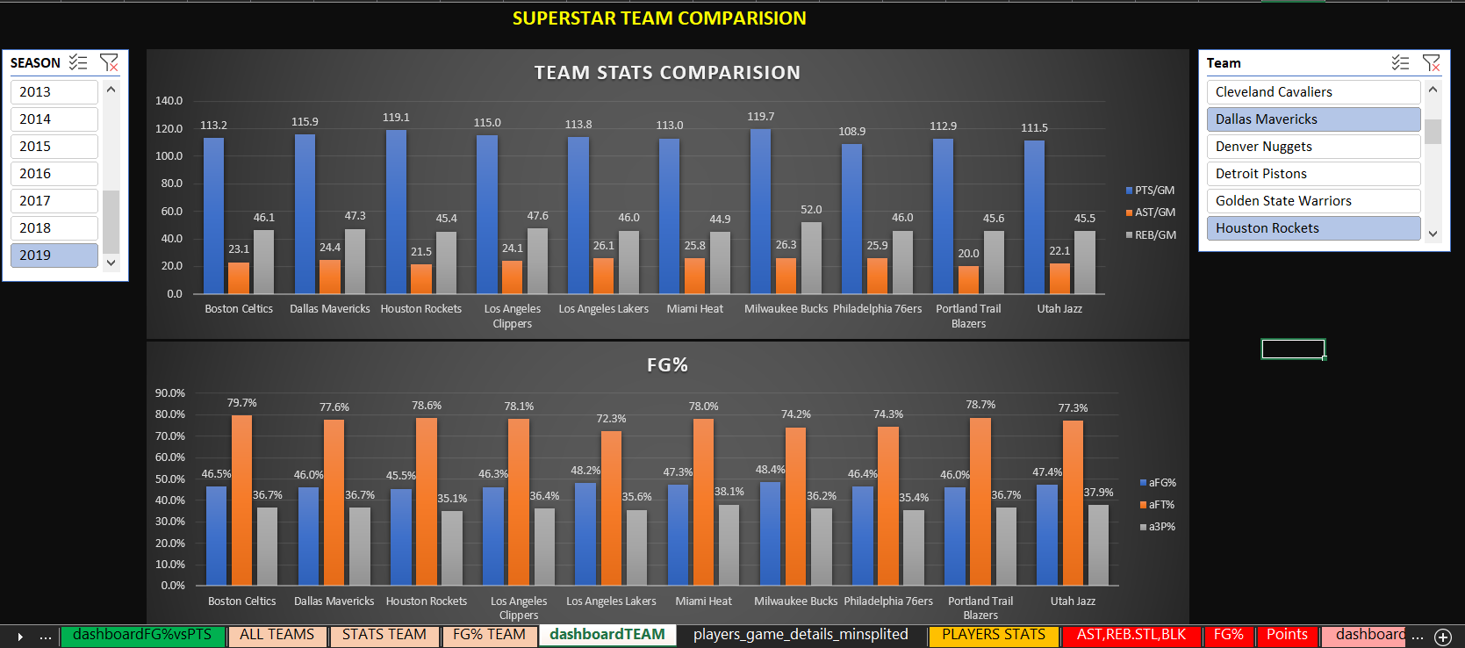

Slide 22
RESULTS
Milwaukee Bucks were the scoring leaders per game of the 2019-20 season.
Los Angeles Lakers led the league in Assists per game in 2019-20 season
Milwaukee Bucks won the Rebounds per game in 2019-20 season.
Bucks shot the best basketball with 48.4% in 2019-20.
Miami Heat of south beach shot best from the 3-point line in 2019-20. (38.1%)
Celtics shot the best Free Throw% in 2019-20. (79.7%)

Slide 23
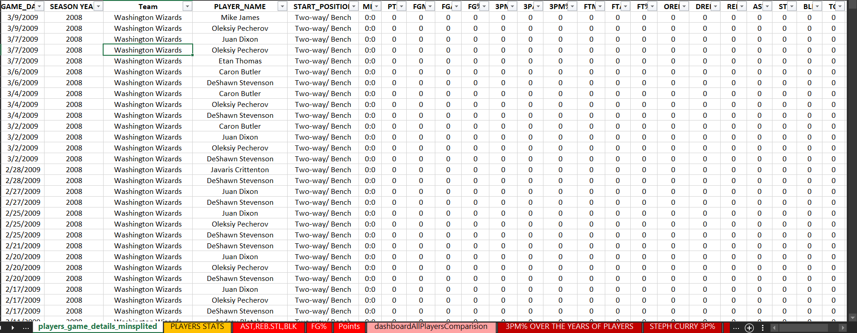
ANALYSIS
PLAYER ANALYSIS

Slide 24
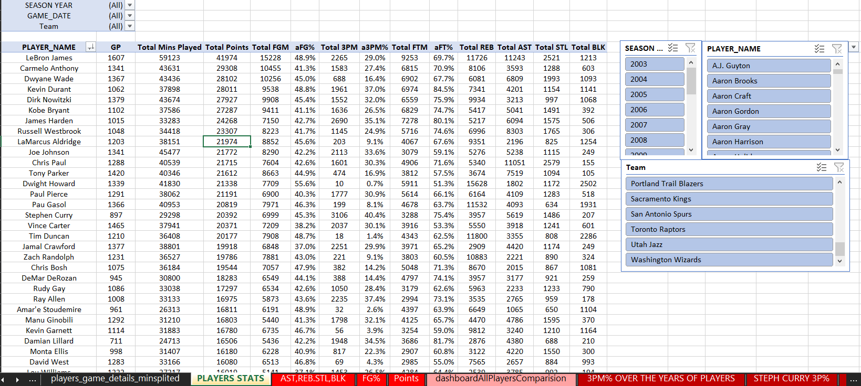
PIVOTING

Slide 25
ANALYSIS 3: SUPERSTARS
The pivot table created in the previous page is still of 2500 rows of DISTINCT PLAYERS. So, we need to create a similar table but for our 8 players according to our need
Damian Lillard
Giannis Antetokounmpo
James Harden
Kawhi Leonard
Kevin Durant
Kobe Bryant
LeBron James
Stephen Curry

Slide 26
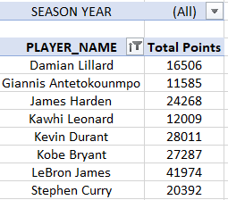
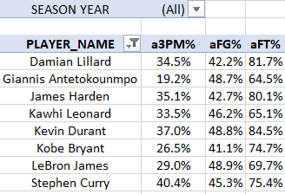
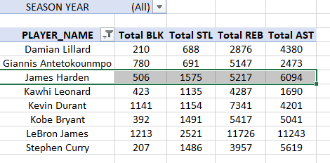

Slide 27
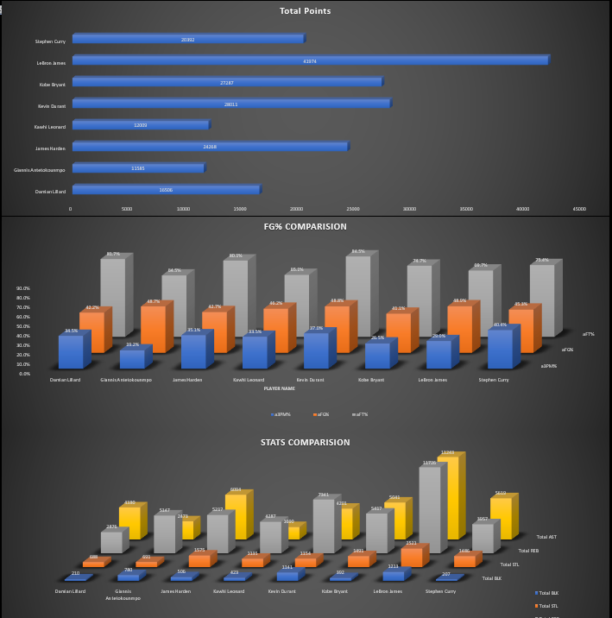

Slide 28
Giannis Antetokounmpo, who has just recently started showing his prime career, already in discussion with players like LeBron James and Kevin Durant in terms of total blocks, rebounds, steals, and total points scored.
PREDICTION: Giannis is a poor 3- pointer shooter and free throw shooter, maybe because is 7 feet tall, and his game mostly depend on playing close to the hoop and dunking the ball.
Obviously, Lebron is an elite in every category, but what is surprising is that he is 6’9 tall and leads the league in total assists, blocks, steals and STILL has the most POINTS EVER SCORED IN THE PAST 2 DECADES!
Lebron has almost 10x more assist than Kawhi, who plays the same position as him, so GM would want Lebron over Kawhi any day as he helps his teammates, while playing his top tier game!
Lebron James, no matter how great he is, is a below average Free throw shooter with just below 69%
Stephen Curry is the best 3-point shooter with almost 41% from the 3-pt line.
Kobe Bryant, who retired in 2016, had the best years of his career after 2003, clearly because he won 5 championships with the Lakers with just around 30000 points.

Slide 29
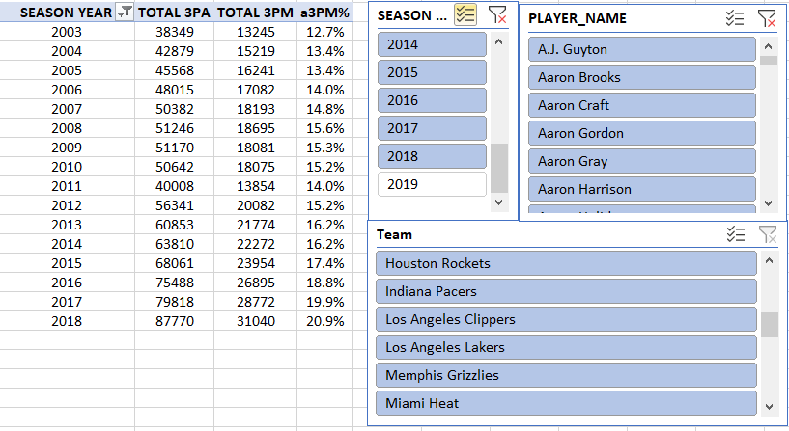
ANALYSIS 4: EVOLUTION OF 3 POINTER

Slide 30
WHAT HAPPENED
Back in the 1990s, the 3-point line was not used with the same frequency as it is now a days in the NBA, the game was more played around the hoop, with layups and dunking. But in the last 2 decades this has changed to a lot extent to the point that if a team in today’s NBA do not shoot 3s, they are probably going to lose the game.
One of biggest reason of this change has been players like STEPHEN CURRY.
Curry was drafted in 2009 and came into the league with a scorching 3 pointer that forced other player like DAMIAN LILLARD to shoot more 3s to balance out the winning of games and overall NBA.
In this analysis we will look at the fashion at which the 3 pointers have evolved since 2003.

Slide 31
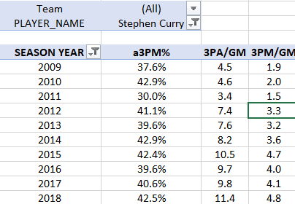
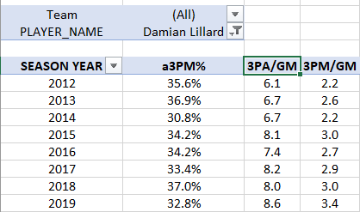
STEPH AND DAME

Slide 32
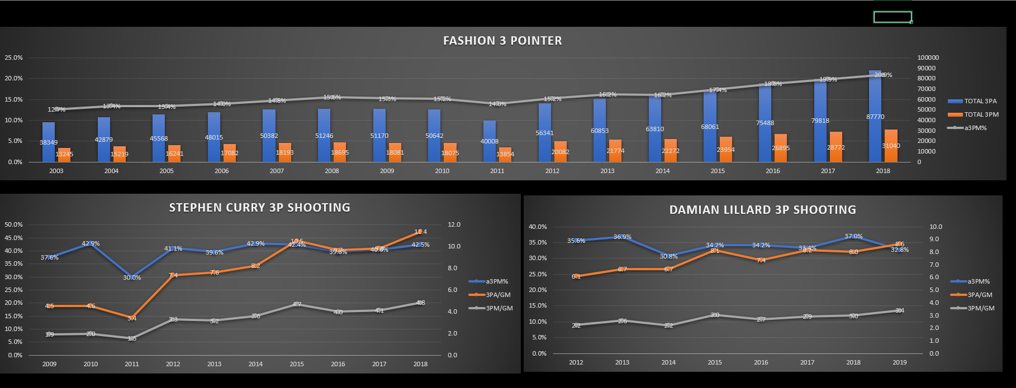

Slide 33
RESULTS
There is a gradual increase in % of 3 pointers since 2003 from 12% to nearly 25% around the league. This means that players finally understood that shooting 3s, no matter how difficult it is, gives more 3 points on the scoreboard with less game planning at a faster rate with less energy required.
There is a dip in 2011, because the season was halted due to the Depression.
After 2011, the pace of increase in 3P% increased dramatically, part of reason being Stephen Curry, who’s stats show that in 2012 he ATTEMPTED MORE 3S AND MADE MORE 3S PER GAME than in 2010, at almost the same shooting percentage of 41%. This forced players like Damian Lillard, who play the same position as Curry in his team, to shoot more 3s.
As we can see in 2015, Curry attempted 10.5 threes and almost made 5 of them per game, that is nearly half of those shots. This caused a rattle around the league that one player is DESTROYING THE LEAGUE WITH HIS UNIMAGINABLE TALENT. But he was doing nothing illegal, so Damian Lillard also started taking more threes as his past season, made more, at a higher clip than his previous seasons.
This provoked other star players like Lebron James and Kevin Durant to change their style of play to keep up with these Point “Gods”.

Slide 34
ANALYSIS 5: LeBron James G.O.A.T ?
LeBron James, 36 years old currently, in 18th year of his career, was drafted in 2003 and has dominated the NBA ever since. He is 6’9 of height and can play almost every position in basketball possible. That is very impressive given his height and weight, he moves like a point guard of height 6’ and defends like Centre of height 7’. He has won 4 championships, the recent one with the Lakers. The most talked about athlete in the past 2 decades, he is a centre of media attention has often been compared to the Great Michael Jordan. In this analysis we will compare him to his other colleagues because there is no way to compare him to someone who played in the NBA 30 years ago. Game has changed a lot.

Slide 35
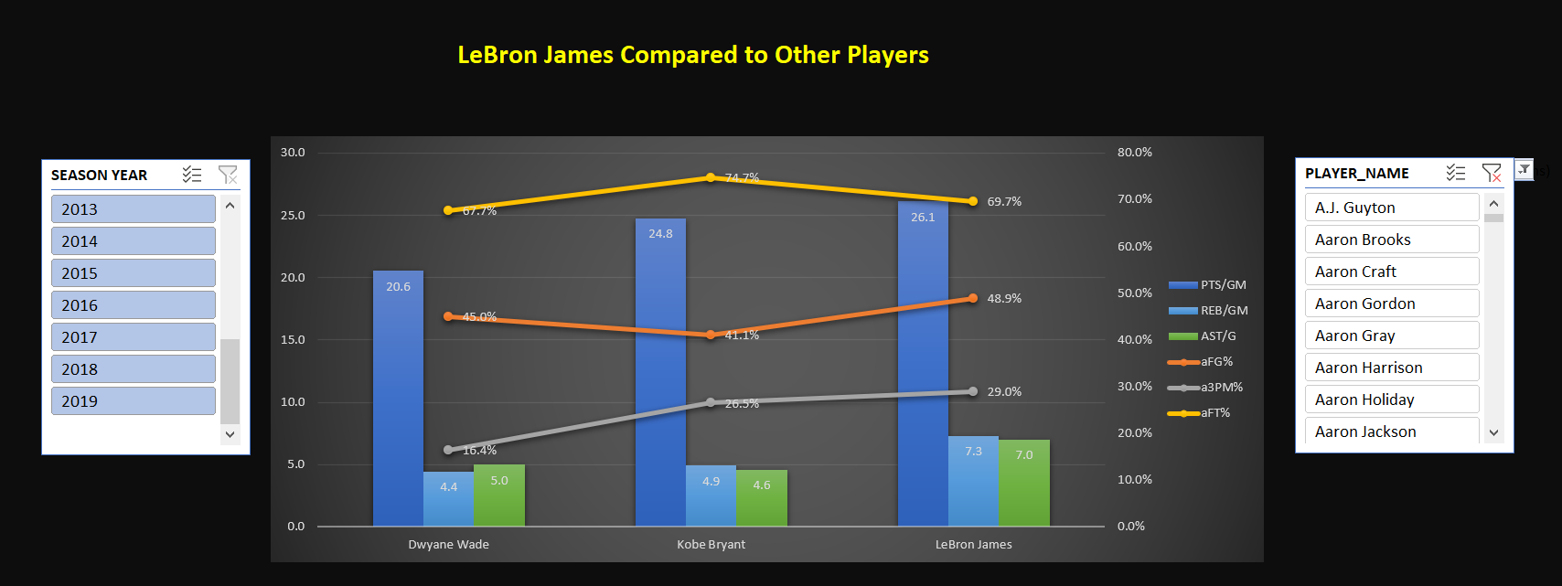

Slide 36
RESULT 1
Dwayne Wade, was drafted along side Lebron James in 2003, is a great player throughout his career, played the same position as him. Kobe Bryant (RIP legend) played in the league for 20 years retired in 2016, also compared to Jordan often. Both players, when compared to James, gets crushed in terms on number stats. The only thing Lebron is average at is free throw shooting at the line, and that too is pretty good for an average NBA player.
LeBron leads both these players in- POINTS/GM, AST/GM, AND REB/GM AND he is still playing whereas Dwayne and Kobe are retired!

Slide 37
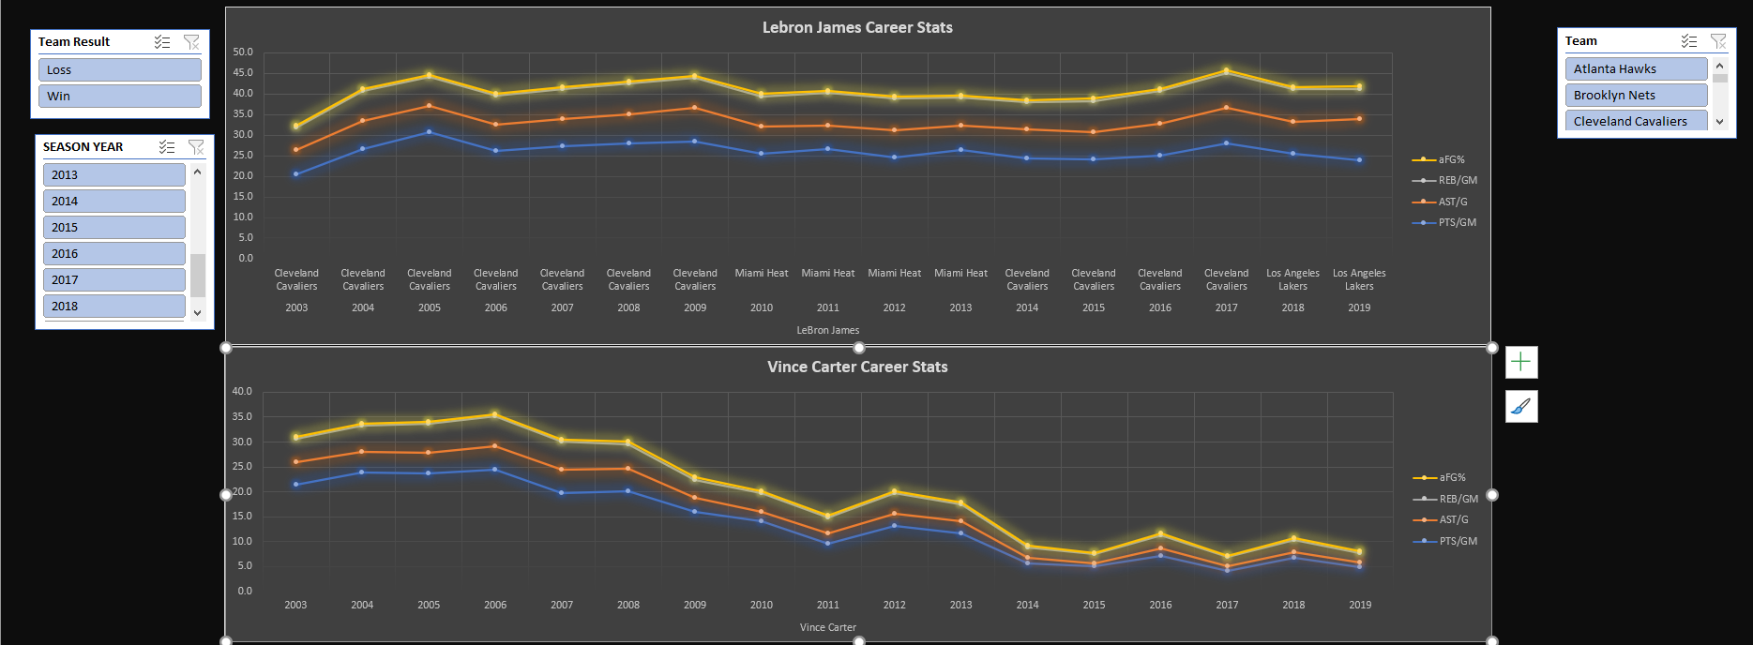

Slide 38
RESULT 2
The bottom graph shows the career stats for Vince Carter, a great player who played along side Lebron for 18 years. We can see that how a career of a great average player descends towards retirement.
The first graph shows the career stats for Lebron James. It is very self-explanatory. The man is showing no signs of slowing down going into his 18th season in 2020!

Slide 39
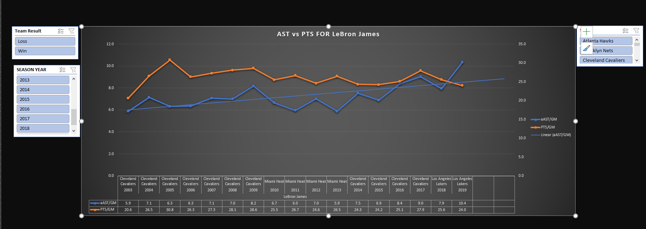

Slide 40
RESULT 3
This graph shows how Lebron James’ assist and point totals has transcended over the course of his career. Along with playing good basketball himself, he makes great plays for his teammates.
PREDICTION: In the recent season 2019-20, his Points/Game number showed a little decline, maybe because his team had a great player along side him in Anthony Davis, but his Assist/Game took a LEAP. This just indicates in how many ways he can impact the game even when he is not scoring the basketball. This also tells that, IF, he ever slows down, due to age factor, his assists number will grow and points will come down, making him unstoppable even in his late 30s.

Slide 41

FINAL DASHBOARD

Slide 42
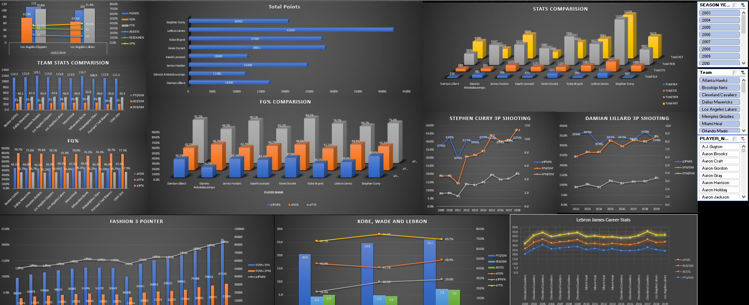

Slide 43

THANK YOU!

