Slide 1
Forecasting Air Quality in Beijing
What a short-range PM2.5 forecast is worth to the people who have to act on it
Group 04 | Time Series Analysis
Name | Roll Number
Nishkarsh Khandelwal | 27PGAI0051
Jagath Ponnanna P M | 27PGAI0072
Raghavendra Prasad Shetti | 27PGAI0052
Chirag Parida | 27PGAI0055
Notes:
Group 04. The project forecasts daily PM2.5 in Beijing and asks what the forecast is actually worth to a decision maker.

Slide 2
The client and the decision
Client: the Beijing municipal environmental authority
The decision: issue a health advisory, restrict traffic, or tell schools to cancel outdoor activity
The decision needs notice. A school told at 7 a.m. has already let children travel in
The two errors do not cost the same. A false alarm costs credibility; a missed episode costs health
Our objective: forecast daily mean PM2.5 one to seven days ahead, with an interval, and say how far ahead it stays useful
Notes:
The asymmetry between the two errors drives the metric choice and the final recommendation, so we state it at the start.

Slide 3
The data
Beijing PM2.5 dataset, UCI Machine Learning Repository (Chen 2015, CC BY 4.0)
43,824 hourly readings, 1 January 2010 to 31 December 2014, 13 columns
PM2.5 from the US Embassy station; weather from Beijing Capital Airport
2,067 readings missing (4.7%), in 214 separate gaps: median one hour, longest 155 hours
Gaps of six hours or less interpolated; longer gaps left missing
A day needs 18 valid hours to get an average. 79 of 1,825 days failed and were dropped
Filling a six day gap would be inventing data, so we did not.

Slide 4
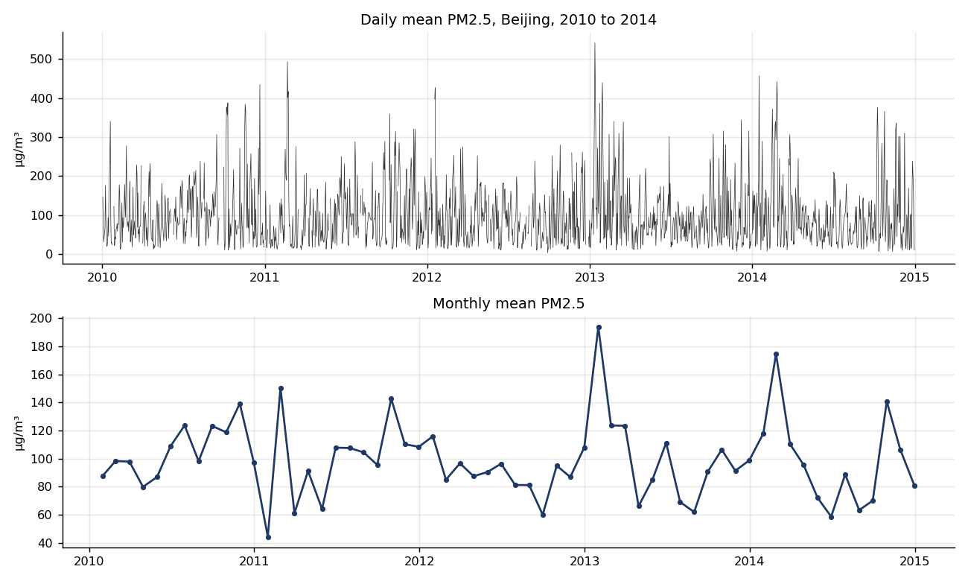
What the series looks like
Strong winter peaks, no visible long run trend. Mean 98.6, median 78.7, skew 1.62, maximum 542 µg/m³.

Slide 5
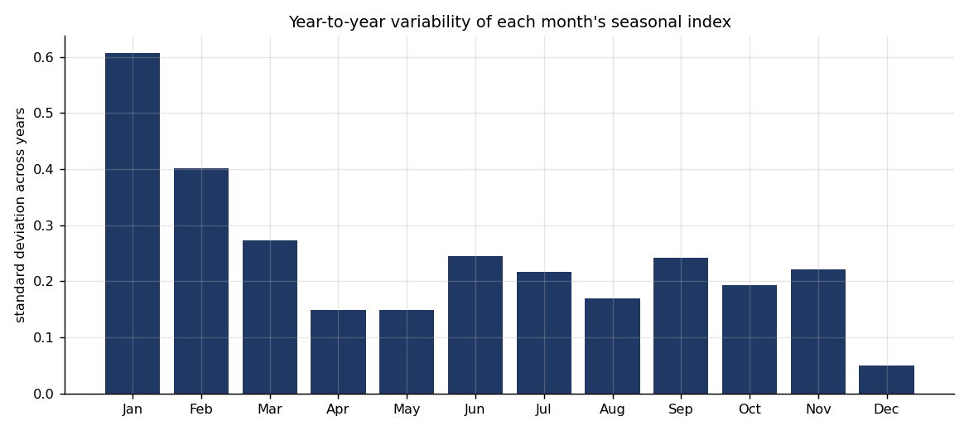
A diagnostic: are all months equally repeatable?
Seasonal indices computed separately for each year, not once for the whole series
January ranges from 0.44 (2011) to 1.92 (2013); December sits at a standard deviation of 0.049
Our hypothesis was the Spring Festival, which moves between late January and mid February
But January 2013 averaged 193.9 against January 2011 at 44.3 — the airpocalypse could explain it alone
The diagnostic flags the months; it cannot attribute the cause. That needed a proper test.

Slide 6
Models tested, in the order the course teaches them
Model | 1 day RMSE | 7 day RMSE
Seasonal ARMA (1,0,1) x (1,0,1,7) | 64.88 | 81.72
Naive | 74.61 | 111.02
Simple exponential smoothing | 74.62 | 105.29
Holt | 74.76 | 108.63
Winters (weekly) | 79.73 | 105.86
Calendar regression | 77.86 | 78.29
Overall mean | 81.34 | 81.40
Train 2010 to 2013, test on 2014. Parameters fixed on the training data only
One day ahead the seasonal ARMA beats the naive floor by about 13 per cent
Seven days ahead the ARMA model falls back to the long run average; the calendar regression edges ahead on RMSE but catches almost no episodes

Slide 7
Why we select on RMSE
All five course measures computed. They disagree, so the choice matters
MAPE and MPE break down here: dividing by a reading of 3 µg/m³ turns a small error into a huge percentage
Every model showed MPE between -43% and -108% while mean error in µg/m³ was near zero
So we added mean error as the bias check and selected on RMSE
RMSE punishes large misses hardest, which matches a client who only really cares about severe episodes
MAD would treat a 10 µg/m³ error on a clean day as equal to a 10 µg/m³ error during an emergency.

Slide 8
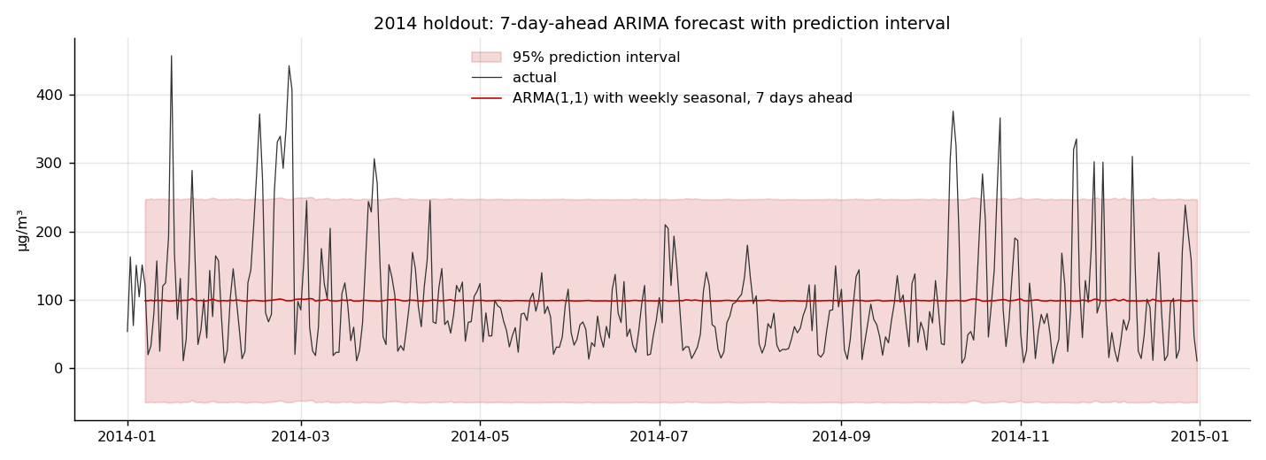
Prediction intervals, and whether they can be trusted
Horizon | Nominal 80% | Nominal 95% | Average 95% width
1 day | 80.8% | 92.6% | 240 µg/m³
7 days | 89.4% | 93.0% | 298 µg/m³
One day ahead the intervals are well calibrated, which is what lets the alert rule use them.

Slide 9
The lunar hypothesis: real effect, no forecasting gain
Variable | OLS | ARIMAX | ARIMAX p
New Year’s Eve | -33.81 | +99.18 | 0.0013
Week before festival | -29.52 | +61.12 | 0.0002
Lantern Festival | +76.72 | +41.85 | 0.0298
Festival day | +23.64 | +23.21 | 0.3316
Festival window | -22.95 | +13.00 | 0.4054
Durbin-Watson of 0.93 in the regression meant the OLS standard errors could not be trusted; ARIMAX fixes that
Three effects are clearly significant, and the largest is the Lantern Festival fireworks
Yet AIC rises from 16076.9 to 16088.5, and holdout RMSE gets slightly worse
Conclusion: real on the day, useless across a year. Five or six days out of 365

Slide 10
Combining forecasts: tested properly, then rejected
Step 1, bias check: both forecasts pass, so combining is legitimate
Step 2, squared error correlation: r = 0.726 at one day, r = 0.989 at seven days, both highly significant
The course example had r = -0.178, p = 0.374 — genuinely independent errors
Why ours fail: at seven days both models predict near the average, so they miss the same spikes by the same amount
Regression weights at seven days: -0.93 and +2.00. One is negative, which the method warns against
Out of sample, the combination is worse than the ARMA model alone at one day ahead
Combining pays only when models fail in different places. We have a clean demonstration of what happens when they do not.

Slide 11
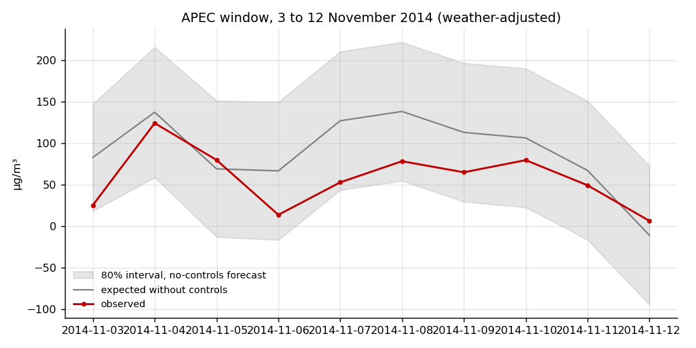
APEC, November 2014: what a shutdown buys
Controls ran 3 to 12 November: factories halted, construction stopped, number plate restrictions, heating delayed
Expected without controls 89.8, observed 57.5, a gap of 32.3 µg/m³ or 36 per cent
Weather adjusted, so a windy fortnight does not explain it
External check: Beijing’s monitoring centre reported about 30 per cent at the time. Our model never saw that figure
Caveat: no single day fell below the 80% lower bound. Strong in the average, not proof on any one date.

Slide 12
The Spring Festival: we were wrong, four years out of four
Festival | Expected | Observed | Difference
2011 | 94.5 | 113.9 | +19.4
2012 | 67.4 | 77.0 | +9.6
2013 | 100.6 | 123.2 | +22.7
2014 | 85.8 | 109.5 | +23.7
Average | 87.1 | 105.9 | +18.8
We expected the two week industrial shutdown to clean the air. It does the opposite, every year
Agrees with the ARIMAX coefficients: New Year’s Eve +99, Lantern Festival +42
Contrast with APEC: a controlled shutdown works; a shutdown plus two weeks of celebration does not

Slide 13
The finding that matters: accuracy is not value
Model | RMSE | Days | Hits | Misses | False alarms
Seasonal ARMA, 1 day | 64.9 | 365 | 27 | 36 | 15
Naive, 1 day | 74.6 | 365 | 33 | 30 | 30
Seasonal ARMA, 7 days | 81.7 | 359 | 0 | 60 | 0
Upper 80% rule, 1 day | 102.3 | 365 | 59 | 4 | 191
Upper 95% rule, 1 day | 137.0 | 365 | 63 | 0 | 299
Threshold 150 µg/m³. 63 of 365 days crossed it in 2014
Best RMSE model catches 27 episodes. The naive model, far worse on RMSE, catches 33
The 7 day model has a respectable RMSE and catches zero. It reverts to the mean, so it never warns
Cost at 10:1 — ARMA 375, naive 330, upper 80% rule 231
The 7 day model looks usable on the accuracy table and is worthless as a public health instrument.

Slide 14
Recommendation
Model: seasonal ARMA, SARIMAX(1,0,1) x (1,0,1,7) with a constant, published with its 80% interval
Do not include the festival variables operationally. Do not use a combined model
Alert rule: trigger when the upper bound of the 80% interval crosses 150, not the point forecast
That catches 59 of 63 episodes against 27, for 191 false alarms against 15
Strategy 1: stop promising week ahead forecasts. Publish an honest three day horizon
Strategy 2: invest in weather inputs. Adding meteorology raised adjusted R² from 0.016 to 0.481
Strategy 3: plan the Spring Festival as a pollution event. The lever is fireworks, not factories
The model choice is statistical. The interval level is a policy choice about tolerance for false alarms.

Slide 15
Limitations, and what we would do differently
Four Spring Festivals in training is too few to estimate five coefficients precisely
One monitoring station. Beijing is large and pollution is not uniform across it
The counterfactuals are suggestive comparisons, not controlled causal estimates
The cost ratios are assumptions. We showed the sensitivity rather than hiding it
We would chase weather forecasts from the start, and build the decision evaluation first rather than last
We set out to ask whether Beijing’s two calendars improve a forecast. The data gave a broader answer: dependence drives the short term, weather explains most of the variation, festival effects are real but too concentrated to help, and accuracy alone is not grounds for a public health decision.

