Slide 1
Fitting
Computer Vision
CS 543 / ECE 549
University of Illinois
Slides from Derek Hoiem, Svetlana Lazebnik

Slide 2
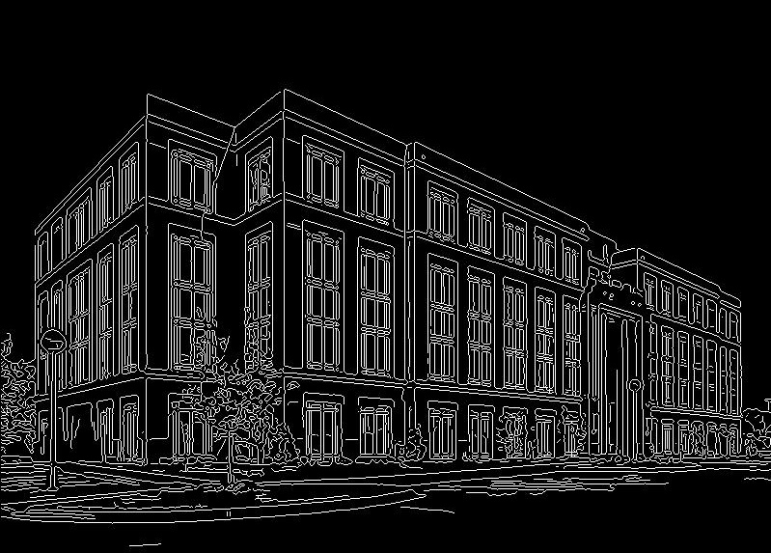
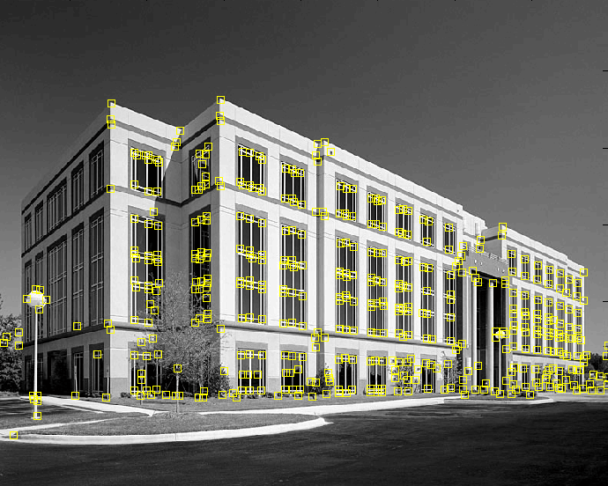
Fitting
We’ve learned how to detect edges, corners, blobs. Now what?
We would like to form a higher-level, more compact representation of the features in the image by grouping multiple features according to a simple model
Slide from L. Lazebnik

Slide 3
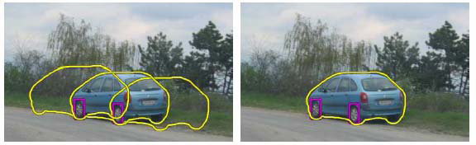
Fitting
Choose a parametric model to represent a set of features
simple model: lines
simple model: circles
complicated model: car
Source: K. Grauman

Slide 4
Fitting Methods
Global optimization / Search for parameters
Least squares fit
Robust least squares
Hypothesize and test
Generalized Hough transform
RANSAC
Slide from D. Hoiem

Slide 5
Simple example: Fitting a line
Slide from D. Hoiem

Slide 6
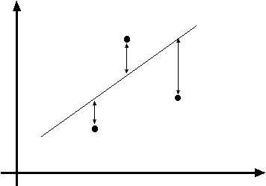
Least squares line fitting
Data: (x₁, y₁), …, (x_{n}, y_{n})
Line equation: y_{i} = m x_{i} + b
Find (m, b) to minimize
y=mx+b
(x_{i}, y_{i})
Matlab: p = A \ y;
Modified from S. Lazebnik

Slide 7
Problem with “vertical” least squares
Not rotation-invariant
Fails completely for vertical lines
Slide from S. Lazebnik

Slide 8
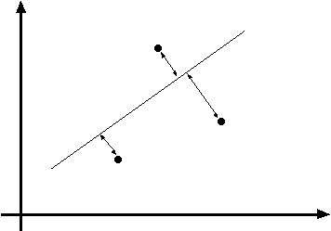
Total least squares
Slide modified from S. Lazebnik
If (a²+b²=1) then
Distance between point (x_{i}, y_{i}) and line ax+by+c=0 is |ax_{i} + by_{i} + c|
ax+by+c=0
Unit normal: N=(a, b)
(x_{i}, y_{i})
proof: http://mathworld.wolfram.com/Point-LineDistance2-Dimensional.html

Slide 9
Total least squares
Slide modified from S. Lazebnik
If (a²+b²=1) then
Distance between point (x_{i}, y_{i}) and line ax+by+c=0 is |ax_{i} + by_{i} + c|
Find (a, b, c) to minimize the sum of squared perpendicular distances
ax+by+c=0
Unit normal: N=(a, b)
(x_{i}, y_{i})

Slide 10
Total least squares
Slide modified from S. Lazebnik
Find (a, b, c) to minimize the sum of squared perpendicular distances
ax+by+c=0
Unit normal: N=(a, b)
(x_{i}, y_{i})
Solution is eigenvector corresponding to smallest eigenvalue of A^{T}A
See details on Raleigh Quotient: http://en.wikipedia.org/wiki/Rayleigh_quotient

Slide 11
Recap: Two Common Optimization Problems
Problem statement
Solution
(matlab)
Problem statement
Solution
Slide from D. Hoiem

Slide 12
Least squares (global) optimization
Good
Clearly specified objective
Optimization is easy
Bad
May not be what you want to optimize
Sensitive to outliers
Bad matches, extra points
Doesn’t allow you to get multiple good fits
Detecting multiple objects, lines, etc.
Slide from D. Hoiem

Slide 13
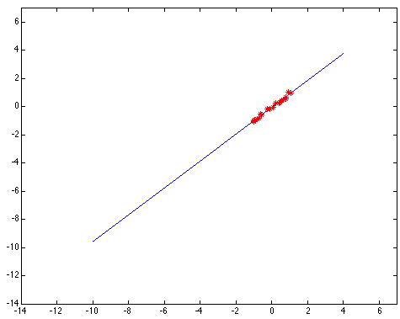
Least squares: Robustness to noise
Least squares fit to the red points:
Slide from L. Lazebnik

Slide 14
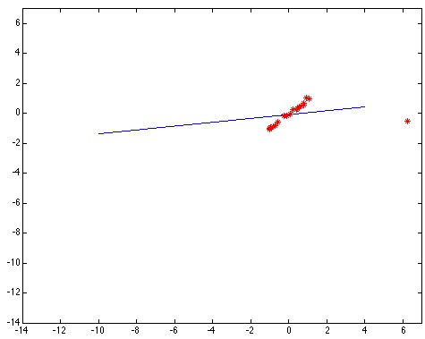
Least squares: Robustness to noise
Least squares fit with an outlier:
Problem: squared error heavily penalizes outliers
Slide from L. Lazebnik

Slide 15

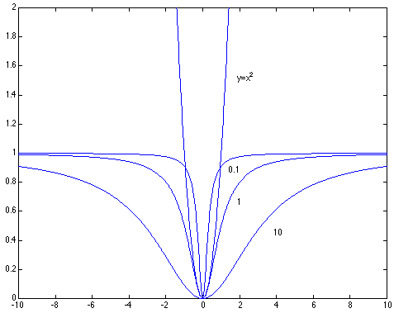
Robust least squares (to deal with outliers)
General approach:
minimize
u_{i} (x_{i}, θ) – residual of i^{th} point w.r.t. model parameters θ ρ – robust function with scale parameter σ
The robust function ρ
Favors a configuration
with small residuals
Constant penalty for large residuals
Slide from S. Savarese

Slide 16
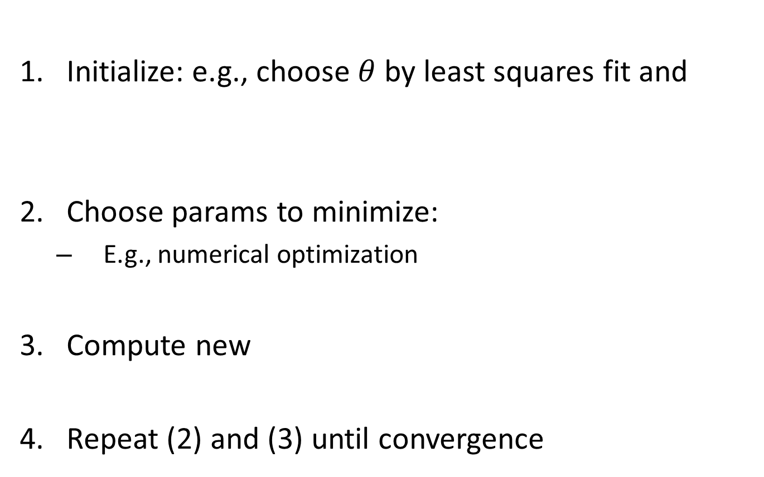
Robust Estimator
Initialize: e.g., choose $θ$ by least squares fit and
Choose params to minimize:
E.g., numerical optimization
Compute new
Repeat (2) and (3) until convergence
Slide from D. Hoiem

Slide 17

Choosing the scale: Just right
The effect of the outlier is minimized
Slide from L. Lazebnik
Notes:
Fit to earlier data with an appropriate choice of s

Slide 18
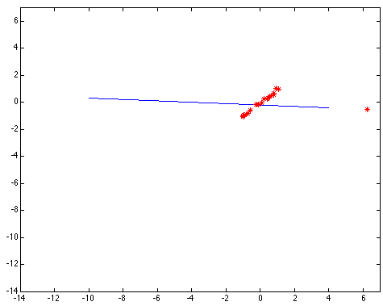
Choosing the scale: Too small
The error value is almost the same for every point and the fit is very poor
Slide from L. Lazebnik

Slide 19

Choosing the scale: Too large
Behaves much the same as least squares
Slide from L. Lazebnik

Slide 20
Other ways to search for parameters (for when no closed form solution exists)
Line search
For each parameter, step through values and choose value that gives best fit
Repeat (1) until no parameter changes
Grid search
Propose several sets of parameters, evenly sampled in the joint set
Choose best (or top few) and sample joint parameters around the current best; repeat
Gradient descent
Provide initial position (e.g., random)
Locally search for better parameters by following gradient
Slide from D. Hoiem

Slide 21
Hypothesize and test
Propose parameters
Try all possible
Each point votes for all consistent parameters
Repeatedly sample enough points to solve for parameters
Score the given parameters
Number of consistent points, possibly weighted by distance
Choose from among the set of parameters
Global or local maximum of scores
Possibly refine parameters using inliers
Slide from D. Hoiem

Slide 22
Hough Transform: Outline
Create a grid of parameter values
Each point votes for a set of parameters, incrementing those values in grid
Find maximum or local maxima in grid
Slide from D. Hoiem

Slide 23
Hough transform
P.V.C. Hough, Machine Analysis of Bubble Chamber Pictures, Proc. Int. Conf. High Energy Accelerators and Instrumentation, 1959
Given a set of points, find the curve or line that explains the data points best
y
m
x
b
Hough space
y = m x + b
Slide from S. Savarese
Notes:
􀁑 Basic ideas
• A line is represented as . Every line in the image corresponds
to a point in the parameter space
• Every point in the image domain corresponds to a line in the parameter
space (why ? Fix (x,y), (m,n) can change on the line . In other
words, for all the lines passing through (x,y) in the image space, their
parameters form a line in the parameter space)
• Points along a line in the space correspond to lines passing through the
same point in the parameter space (why ?)

Slide 24
Hough transform
y
m
x
b
y
m
3
5
3
3
2
2
3
7
11
10
4
3
2
3
1
4
5
2
2
1
0
1
3
3
x
b
Slide from S. Savarese
Notes:
􀁑 Basic ideas
• A line is represented as . Every line in the image corresponds
to a point in the parameter space
• Every point in the image domain corresponds to a line in the parameter
space (why ? Fix (x,y), (m,n) can change on the line . In other
words, for all the lines passing through (x,y) in the image space, their
parameters form a line in the parameter space)
• Points along a line in the space correspond to lines passing through the
same point in the parameter space (why ?)

Slide 25
Hough transform
P.V.C. Hough, Machine Analysis of Bubble Chamber Pictures, Proc. Int. Conf. High Energy Accelerators and Instrumentation, 1959
Issue : parameter space [m,b] is unbounded…
Use a polar representation for the parameter space
y
x
Hough space
Slide from S. Savarese
Notes:
􀁑 Basic ideas
• A line is represented as . Every line in the image corresponds
to a point in the parameter space
• Every point in the image domain corresponds to a line in the parameter
space (why ? Fix (x,y), (m,n) can change on the line . In other
words, for all the lines passing through (x,y) in the image space, their
parameters form a line in the parameter space)
• Points along a line in the space correspond to lines passing through the
same point in the parameter space (why ?)

Slide 26
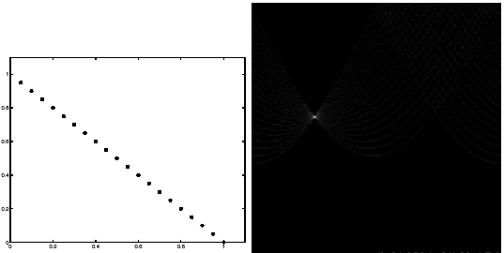
Hough transform - experiments
features
votes
Slide from S. Savarese
Notes:
Figure 15.1, top half. Note that most points in the vote array are very dark, because they
get only one vote.

Slide 27
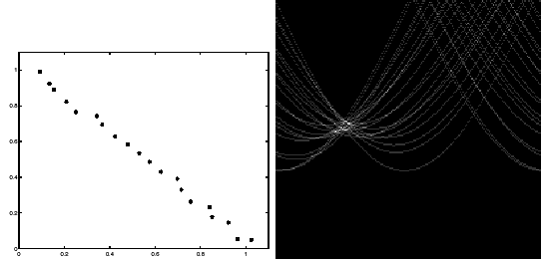
Hough transform - experiments
Noisy data
features
votes
Need to adjust grid size or smooth
Slide from S. Savarese
Notes:
This is 15.1 lower half

Slide 28
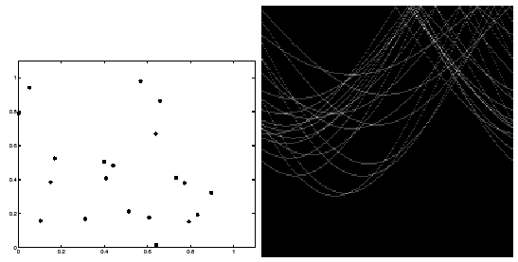
Hough transform - experiments
features
votes
Issue: spurious peaks due to uniform noise
Slide from S. Savarese
Notes:
15.2; main point is that lots of noise can lead to large peaks in the array

Slide 29
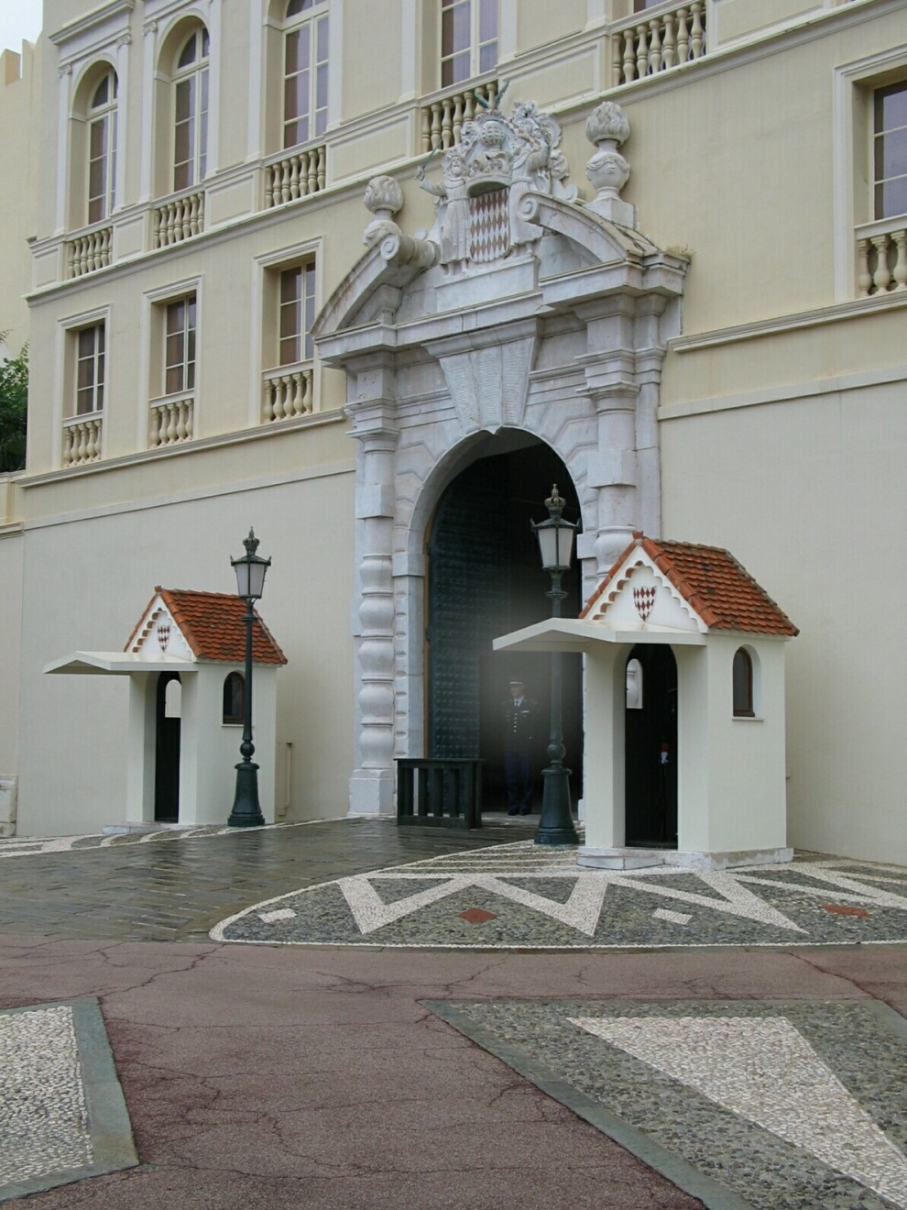
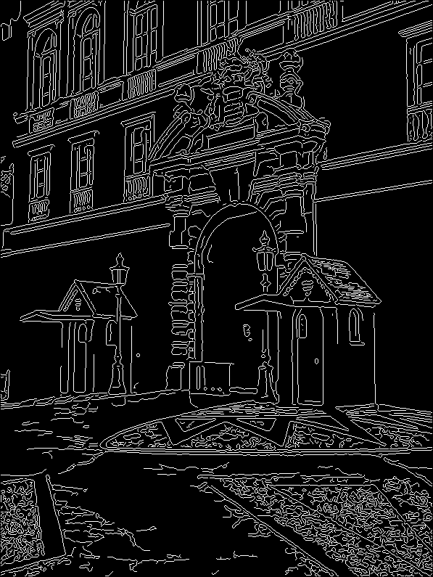
1. Image → Canny
Slide from D. Hoiem

Slide 30
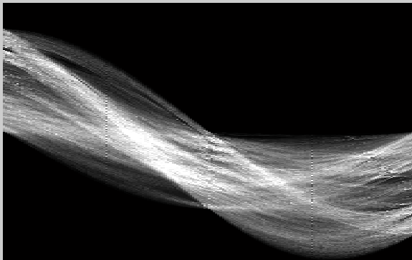
2. Canny → Hough votes
Slide from D. Hoiem

Slide 31
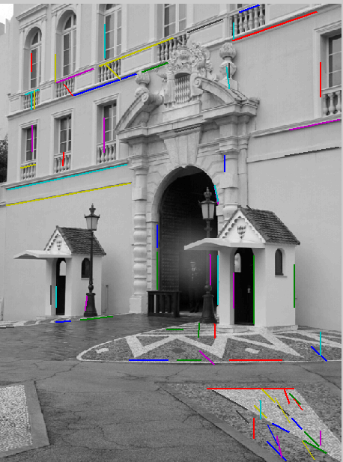
3. Hough votes → Edges
Find peaks and post-process
Slide from D. Hoiem

Slide 32
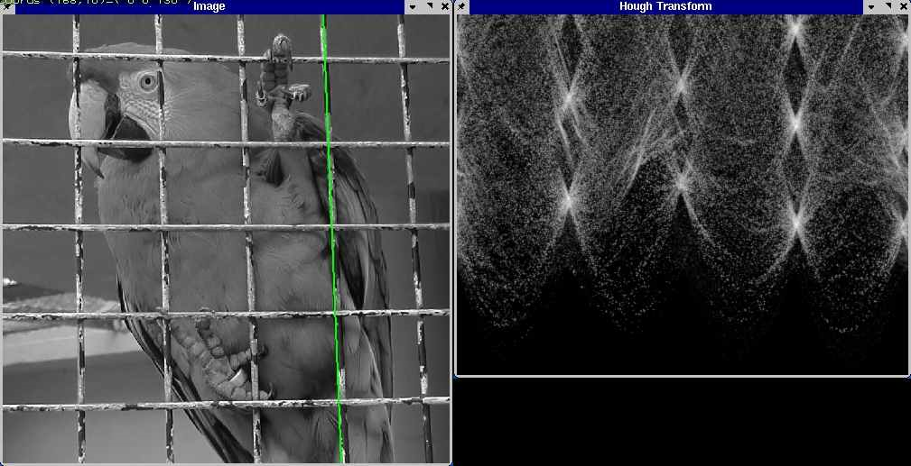
Hough transform example
Slide from D. Hoiem
http://ostatic.com/files/images/ss_hough.jpg

Slide 33
Finding circles (x₀, y₀, r) using Hough transform
Fixed r
Variable r
Slide from D. Hoiem

Slide 34
Hough transform for circles
image space
Hough parameter space
r
y
(x,y)
x
x
y
Slide from L. Lazebnik

Slide 35
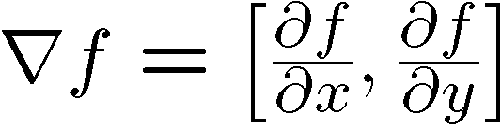

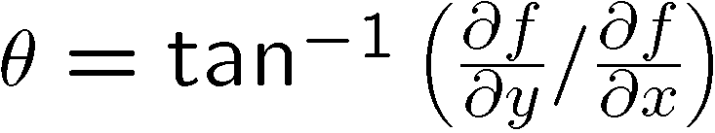
Incorporating image gradients
When we detect an edge point, we also know its gradient orientation
How does this constrain possible lines passing through the point?
Modified Hough transform:
For each edge point (x,y) θ = gradient orientation at (x,y) ρ = x cos θ + y sin θ H(θ, ρ) = H(θ, ρ) + 1 end
Slide from L. Lazebnik

Slide 36
Hough transform conclusions
Good
Robust to outliers: each point votes separately
Fairly efficient (much faster than trying all sets of parameters)
Provides multiple good fits
Bad
Some sensitivity to noise
Bin size trades off between noise tolerance, precision, and speed/memory
Can be hard to find sweet spot
Not suitable for more than a few parameters
grid size grows exponentially
Common applications
Line fitting (also circles, ellipses, etc.)
Object instance recognition (parameters are position/scale/orientation)
Object category recognition (parameters are position/scale)
Slide from D. Hoiem

Slide 37
RANSAC
_{(RANdom SAmple Consensus) :}
Fischler & Bolles in ‘81.
Algorithm:
Sample (randomly) the number of points required to fit the model
Solve for model parameters using samples
Score by the fraction of inliers within a preset threshold of the model
Repeat 1-3 until the best model is found with high confidence
Slide from D. Hoiem

Slide 38
RANSAC
Line fitting example
Algorithm:
Sample (randomly) the number of points required to fit the model (#=2)
Solve for model parameters using samples
Score by the fraction of inliers within a preset threshold of the model
Repeat 1-3 until the best model is found with high confidence
Slide from D. Hoiem
Illustration by Savarese

Slide 39
RANSAC
Line fitting example
Algorithm:
Sample (randomly) the number of points required to fit the model (#=2)
Solve for model parameters using samples
Score by the fraction of inliers within a preset threshold of the model
Repeat 1-3 until the best model is found with high confidence
Slide from D. Hoiem

Slide 40
RANSAC
Line fitting example
Algorithm:
Sample (randomly) the number of points required to fit the model (#=2)
Solve for model parameters using samples
Score by the fraction of inliers within a preset threshold of the model
Repeat 1-3 until the best model is found with high confidence
Slide from D. Hoiem

Slide 41
RANSAC
Algorithm:
Sample (randomly) the number of points required to fit the model (#=2)
Solve for model parameters using samples
Score by the fraction of inliers within a preset threshold of the model
Repeat 1-3 until the best model is found with high confidence
Slide from D. Hoiem

Slide 42
How to choose parameters?
Number of samples N
Choose N so that, with probability p, at least one random sample is free from outliers (e.g. p=0.99) (outlier ratio: e )
Number of sampled points s
Minimum number needed to fit the model
Distance threshold δ
Choose δ so that a good point with noise is likely (e.g., prob=0.95) within threshold
Zero-mean Gaussian noise with std. dev. σ: t²=3.84σ²
 | proportion of outliers e
s | 5% | 10% | 20% | 25% | 30% | 40% | 50%
2 | 2 | 3 | 5 | 6 | 7 | 11 | 17
3 | 3 | 4 | 7 | 9 | 11 | 19 | 35
4 | 3 | 5 | 9 | 13 | 17 | 34 | 72
5 | 4 | 6 | 12 | 17 | 26 | 57 | 146
6 | 4 | 7 | 16 | 24 | 37 | 97 | 293
7 | 4 | 8 | 20 | 33 | 54 | 163 | 588
8 | 5 | 9 | 26 | 44 | 78 | 272 | 1177
Slide from D. Hoiem
modified from M. Pollefeys

Slide 43
RANSAC conclusions
Good
Robust to outliers
Applicable for larger number of objective function parameters than Hough transform
Optimization parameters are easier to choose than Hough transform
Bad
Computational time grows quickly with fraction of outliers and number of parameters
Not as good for getting multiple fits (though one solution is to remove inliers after each fit and repeat)
Common applications
Computing a homography (e.g., image stitching)
Estimating fundamental matrix (relating two views)
Slide from D. Hoiem

Slide 44
Fitting Summary
Least Squares Fit
closed form solution
robust to noise
not robust to outliers
Robust Least Squares
improves robustness to noise
requires iterative optimization
Hough transform
robust to noise and outliers
can fit multiple models
only works for a few parameters (1-4 typically)
RANSAC
robust to noise and outliers
works with a moderate number of parameters (e.g, 1-8)
Slide from D. Hoiem

