Slide 1
A Gentle Introduction to Bilateral Filtering and its Applications
Naïve Image Smoothing:
Gaussian Blur
Sylvain Paris – MIT CSAIL

Slide 2
Notation and Definitions
Image = 2D array of pixels
Pixel = intensity (scalar) or color (3D vector)
I_{p} = value of image I at position: p = ( p_{x} , p_{y} )
F [ I ] = output of filter F applied to image I
y
x

Slide 3
Strategy for Smoothing Images
Images are not smooth because
adjacent pixels are different.
Smoothing = making adjacent pixels
look more similar.
Smoothing strategy
pixel → average of its neighbors

Slide 4
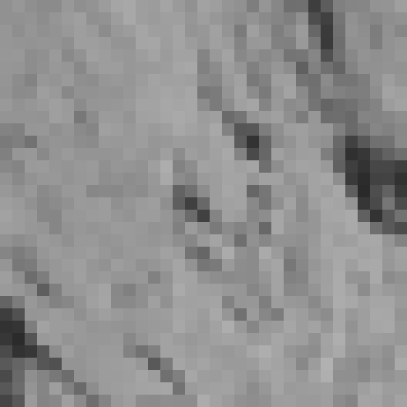

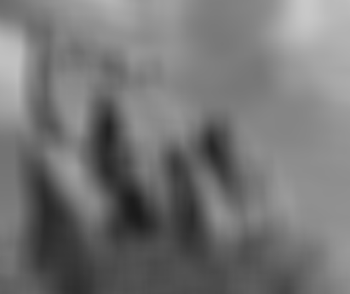

Box Average
square neighborhood
input
output
average

Slide 5
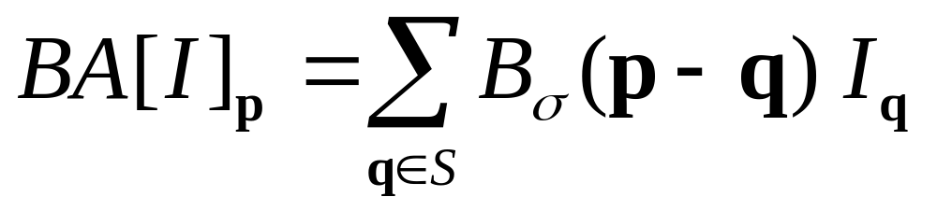
Equation of Box Average
result at
pixel p
intensity at
pixel q
sum over
all pixels q
normalized
box function
0

Slide 6
Square Box Generates Defects
Axis-aligned streaks
Blocky results
output
input

Slide 7

Box Profile
pixel
weight
pixel
position
unrelated
pixels
related
pixels
unrelated
pixels

Slide 8

Strategy to Solve these Problems
Use an isotropic (i.e. circular) window.
Use a window with a smooth falloff.
box window
Gaussian window

Slide 9
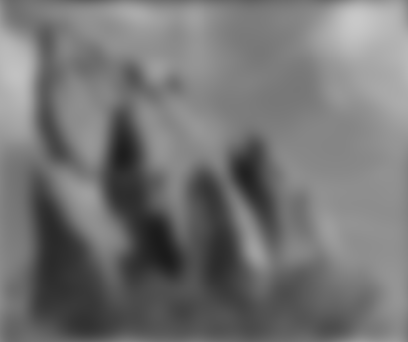
Gaussian Blur
per-pixel multiplication
*
input
output
average

Slide 10
input

Slide 11
box average

Slide 12
Gaussian blur

Slide 13
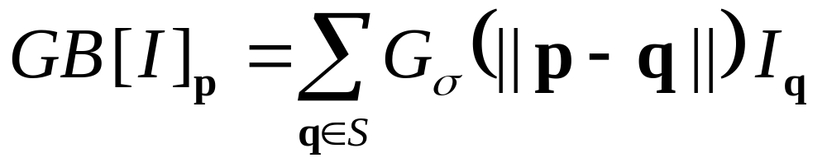
Equation of Gaussian Blur
Same idea: weighted average of pixels.
normalized
Gaussian function
1
0

Slide 14
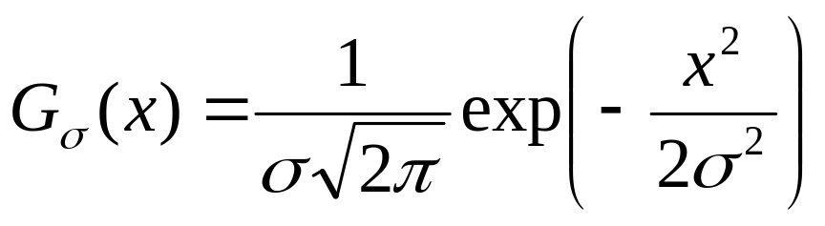
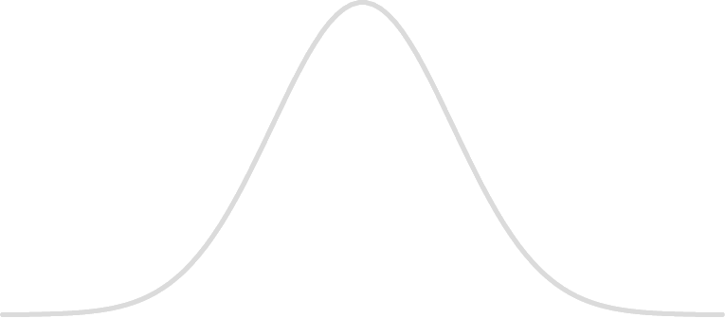
Gaussian Profile
pixel
weight
pixel
position
unrelated
pixels
uncertain
pixels
related
pixels
uncertain
pixels
unrelated
pixels

Slide 15


Spatial Parameter
input
size of the window
small σ
large σ
limited smoothing
strong smoothing

Slide 16
How to set σ
Depends on the application.
Common strategy: proportional to image size
  e.g. 2% of the image diagonal
  property: independent of image resolution

Slide 17
Properties of Gaussian Blur
Weights independent of spatial location
  linear convolution
  well-known operation
  efficient computation (recursive algorithm, FFT…)

Slide 18
Properties of Gaussian Blur
input
Does smooth images
But smoothes too much:
edges are blurred.
  Only spatial distance matters
  No edge term
output
space

