Slide 1

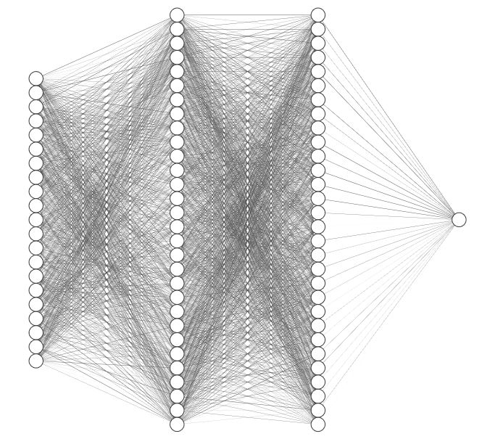
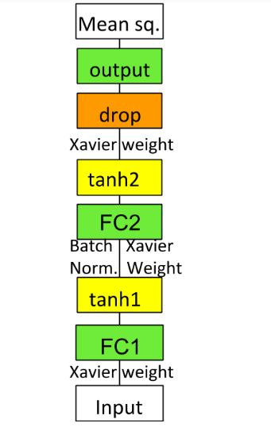
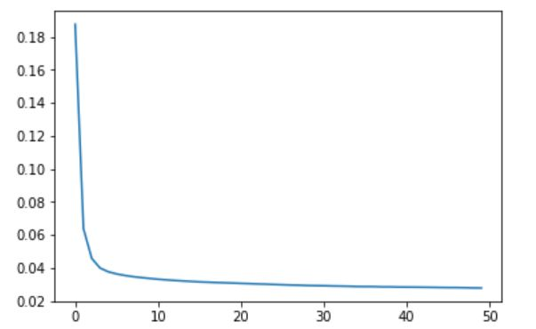
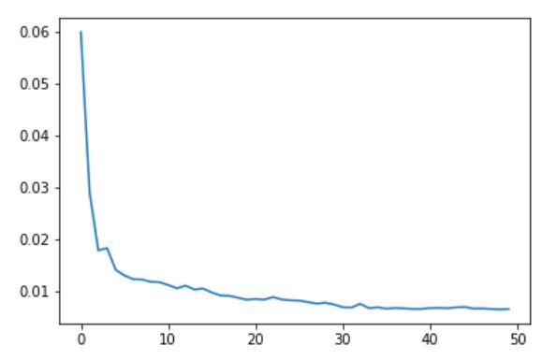
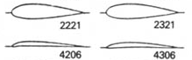
Prediction of Airfoil Performance Parameters using Neural Network
Siddharth Ghiya, Raghav Sood and Rahul Sharma
Abstract
Conventional CFD softwares take large amount of time to solve for the flow around an airfoil. For reducing that time taken To calculate lift coefficient, we have employed a Fully-connected Neural Network. CFD solvers have high-dimensional non-linearity, therefore if our network can learn those nonlinearities, that would
Network Description
Parameter estimation is a regression problem, and thus our model, the Fully-Connected uses Mean Squared Error as the loss measure. The output is a single value i.e. lift coefficient. Also, tanh is used considering the range limits of the lift coefficient (-1 to +1).
(Left):
Network
Architecture
be really useful.
Problem Formulation
Our objective is: lift coefficient estimation using NACA digits. We have taken the NACA 4-digit series to estimate the lift coefficient data from JavaFoil.
(Above): FC used : 42 × 60 × 60 × 1
Results
Above are the plot of losses of the network over the training data(left) and testing data(right) versus the number of epochs. Here, the number of epochs used = 50, learning rate used = 0.005 and batch size = 50. From the above plots, we can see that:
minimum train loss = 0.035 and minimum test loss = 0.009
Dataset Generation
We are using UIUC Airfoil Database from where lift coefficient data for each NACA 4-digit profile is generated, by using JavaFoil. The database has about 1600 profiles from where 28 NACA airfoils were selected.
Data was preprocessed by resizing the NACA digits to a 42×1 one-hot tensor(10 for each digit and one for Re and α, after normalizing). After data augmentation using multiple α(±20°) & Re(30,000-6,430,000), the dataset has 15,000 training &
(Left): NACA Airfoils
Conclusions & Future Work
We can conclude that the present network could be used over any NACA 4-digit series, and so, the final model should incorporate NACA 5-digit, as well as 6-digit series so that it could generalize for any airfoil profile. Additionally, we must further finetune our hyper-parameters based upon loss trends and more training/validation data. Further, creating data from a better source like experimental or a high-end CFD solver will enable us to better train our model.
5,000 testing data.

