Slide 1

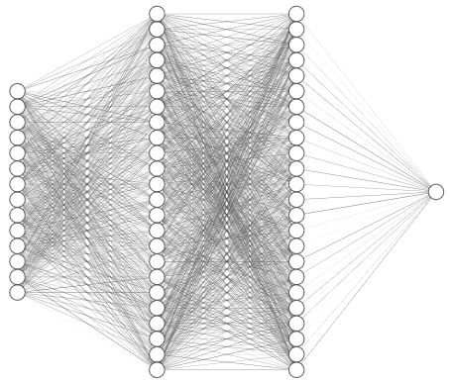
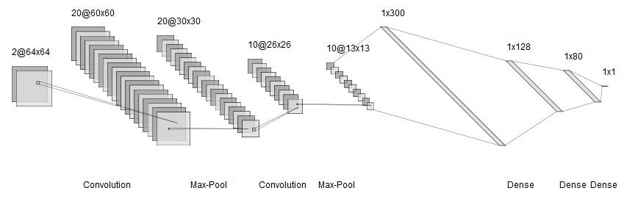
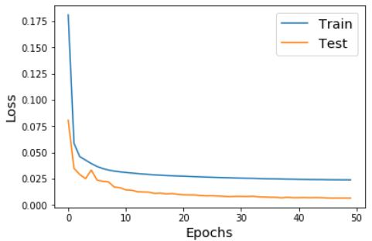
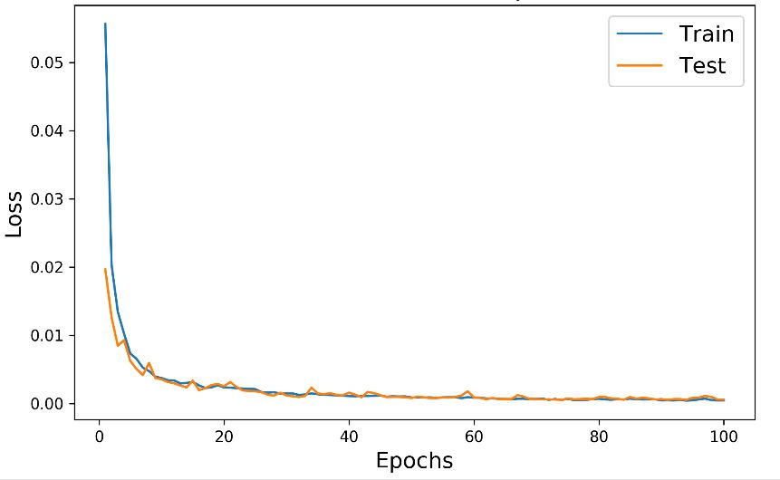
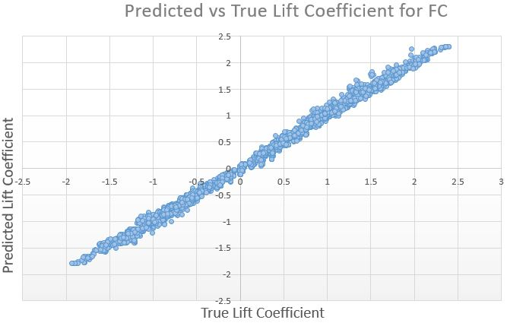
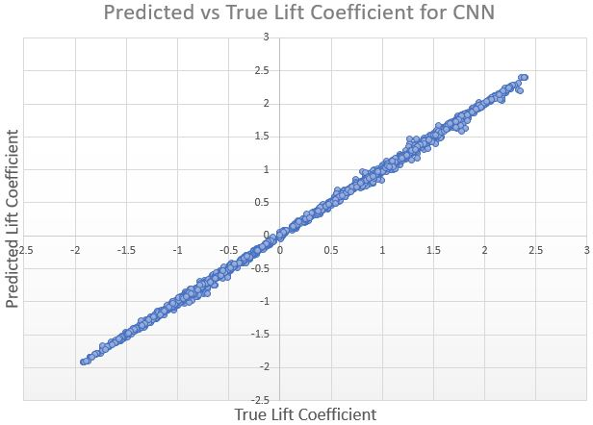
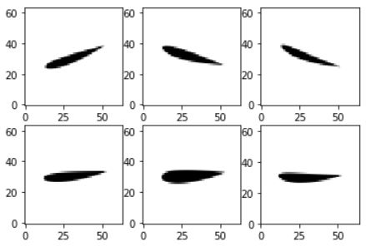
Prediction of Airfoil Performance Parameters using Neural Network
Siddharth Ghiya, Raghav Sood and Rahul Sharma
ABSTRACT
NETWORK DESCRIPTION
Conventional CFD software take huge time to solve for airfoil flow. For reducing that time to calculate lift coefficient, we have employed a Convolutional Neural Network as well as a Fully-connected Neural Network. CFD solvers have high-dimensional non-linearity, therefore if our network can learn those nonlinearities, it can produce great results in numerous applications.
Parameter estimation is a regression problem, and thus our model, the Fully-Connected uses Mean Squared Error as the loss measure. The output is a single value i.e. lift coefficient. Also, tanh is used in FC layers whereas ReLU is used in CNN.
(Left): FC used : 42 × 60 × 60 × 1
(Above): Fully-Connected network Architecture
(Below): CNN Architecture Used
1690
500
100
PROBLEM FORMULATION
Our objective is two-fold: lift coefficient estimation using first, NACA digits and second, airfoil images. For both goals, NACA 4-digit series was then used to estimate lift coefficient data from Java Foil.
RESULTS
The above graphs indicate the train and test losses for FC(left) and CNN(right), and the below indicate predicted vs true lift Coefficient.
DATASET GENERATION
UIUC Airfoil Database is used for Airfoil geometries, whereas lift coefficient data for each NACA 4-digit profile is generated, by using JavaFoil. The database has about 1600 profiles; selected NACA are 28. Data was pre-processed by resizing NACA digits to 42×1 one-hot tensor(10 for each and one for Re, α, after normalizing). After data augmentation using multiple α(±20°) & Re(30,000-6,430,000), the dataset has 15,000 training & 5,000 testing data.
CONCLUSIONS AND FUTURE SCOPE
Hence, both networks(preferably CNN) could be used over NACA 4-digit series. In Future, other Airfoils apart from NACA can be trained on the CNN network and also the lift coefficient data can be generated from high-end CFD solver.

