Slide 1
HIRR.IN
Design and Structure of a Job Portal based in MERN stack

Slide 2
agenda
INTRODUCTION
PRIMARY GOALS
ARCHITECTURE OVERVIEW
DATABASE
USER FACING FEATURES

Slide 3

Introduction
JOB PORTALS :
The job market today is highly competitive and rapidly evolving. Job portals have become indispensable tools for both job seekers and employers, providing a streamlined and efficient way to connect talent with opportunities.
MERN STACK :
The MERN stack is a powerful combination of technologies that enables the development of robust and scalable web applications. MongoDB, a flexible and scalable NoSQL database, serves as the foundation for storing and retrieving data. Express.js, a lightweight web application framework, handles the server-side logic and routing. React.js, a popular JavaScript library, provides a dynamic and responsive user interface on the client-side. And lastly, Node.js, a server-side JavaScript runtime, brings it all together by facilitating seamless communication between the front-end and back-end components.

Slide 4
Primary Goals
Connecting Job Seekers and Employers: Our job portal aims to provide a seamless platform for job seekers and employers to connect, facilitating the hiring process and fostering meaningful career opportunities.
User-Friendly Interface: We have prioritized creating a user-friendly interface that offers a smooth and intuitive experience for all users. This ensures ease of navigation and efficient interaction with the job portal's features.
Advanced Search and Filtering Options: We understand the importance of tailored job searches. By implementing advanced search and filtering options, users can refine their search based on specific criteria such as location, industry, experience level, and more.

Slide 5
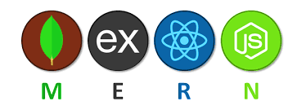
Architecture Overview
MongoDB: MongoDB is the database component of the MERN stack. It is used for storing and retrieving data, it is flexible and scalable for handling large amounts of job-related information.
Express.js: Express.js is the web application framework used for server-side development. It is used for handling routing, middleware, and managing HTTP requests and responses.
React.js: React.js is the JavaScript library responsible for building the user interface of the job portal. It has component-based architecture, virtual DOM, and efficient rendering capabilities.
Node.js: Node.js is the server-side JavaScript runtime environment that enables the execution of server-side code. It is crucial in facilitating seamless communication between the front-end and back-end components of the job portal.

Slide 6
Database Design
Our database will be based around 3 core models :
User Model or Candidate Model
Company Model or Employer Model
Job Post Model or Application Model
All these model are available in JSON format for you to download.

Slide 7
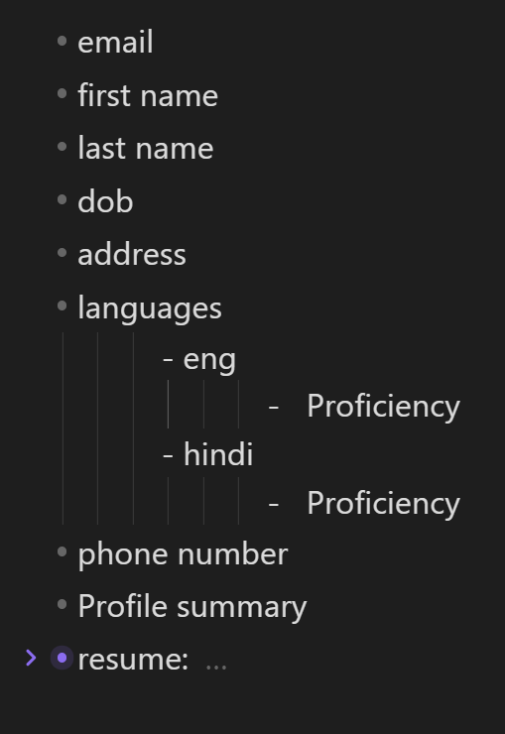
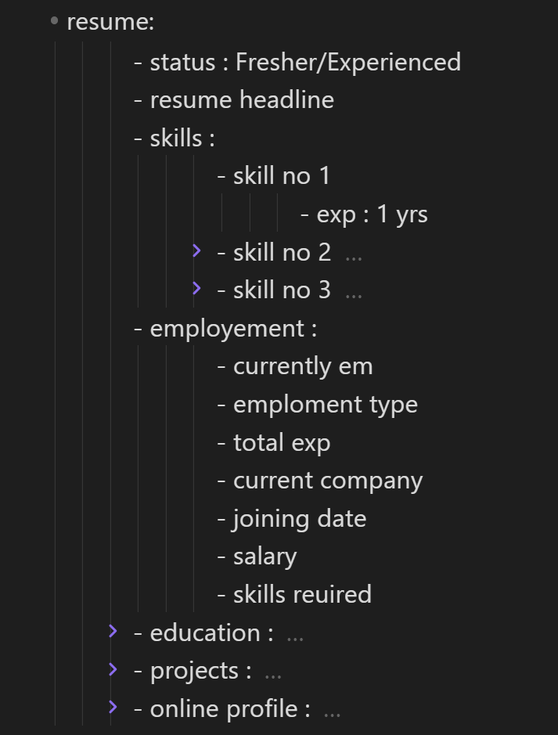
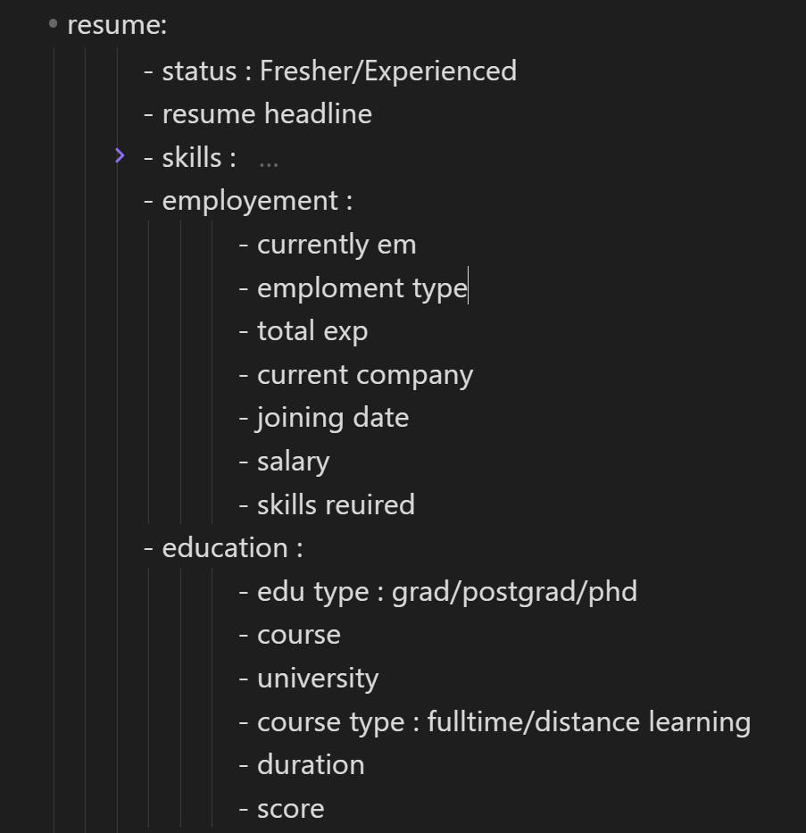
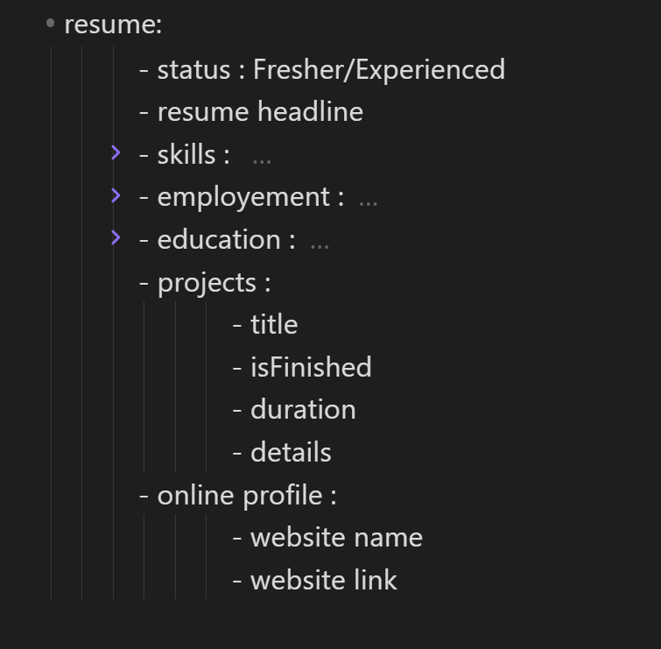
User Model
These are all the details a user can provide it is JSON tree like structure which as multiple sub-section.

Slide 8
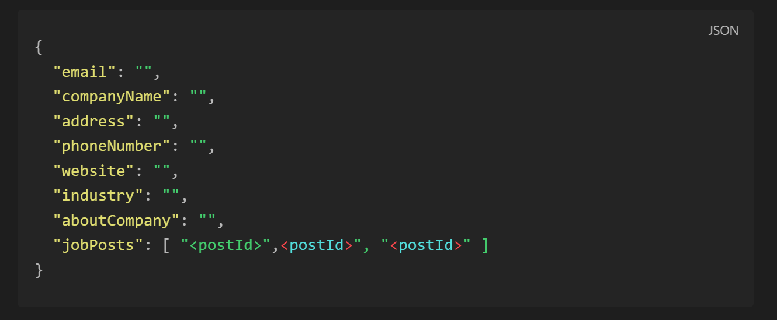
Employer Model

Slide 9
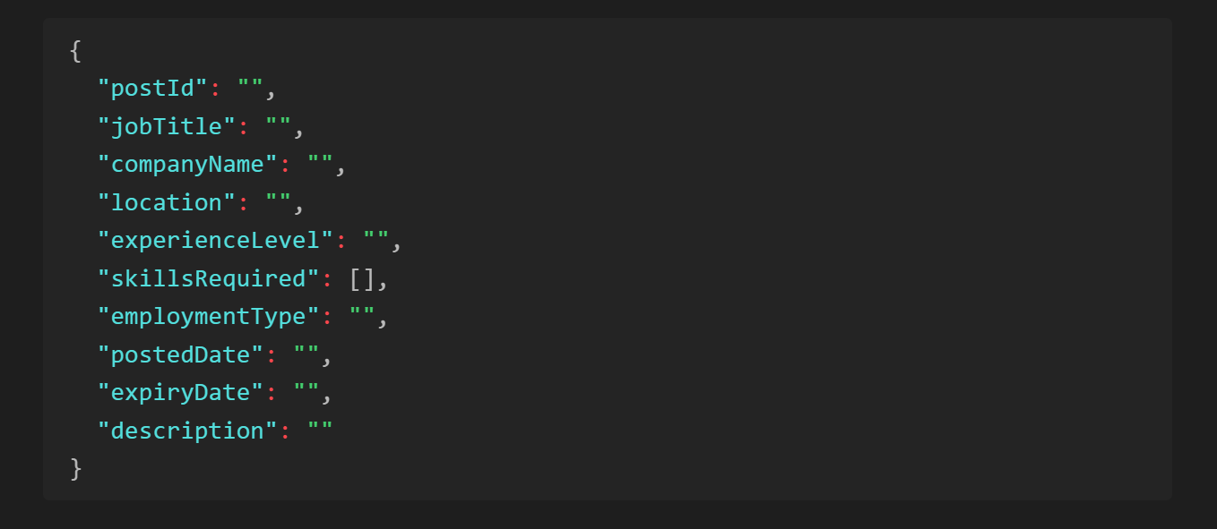
Post Model

Slide 10
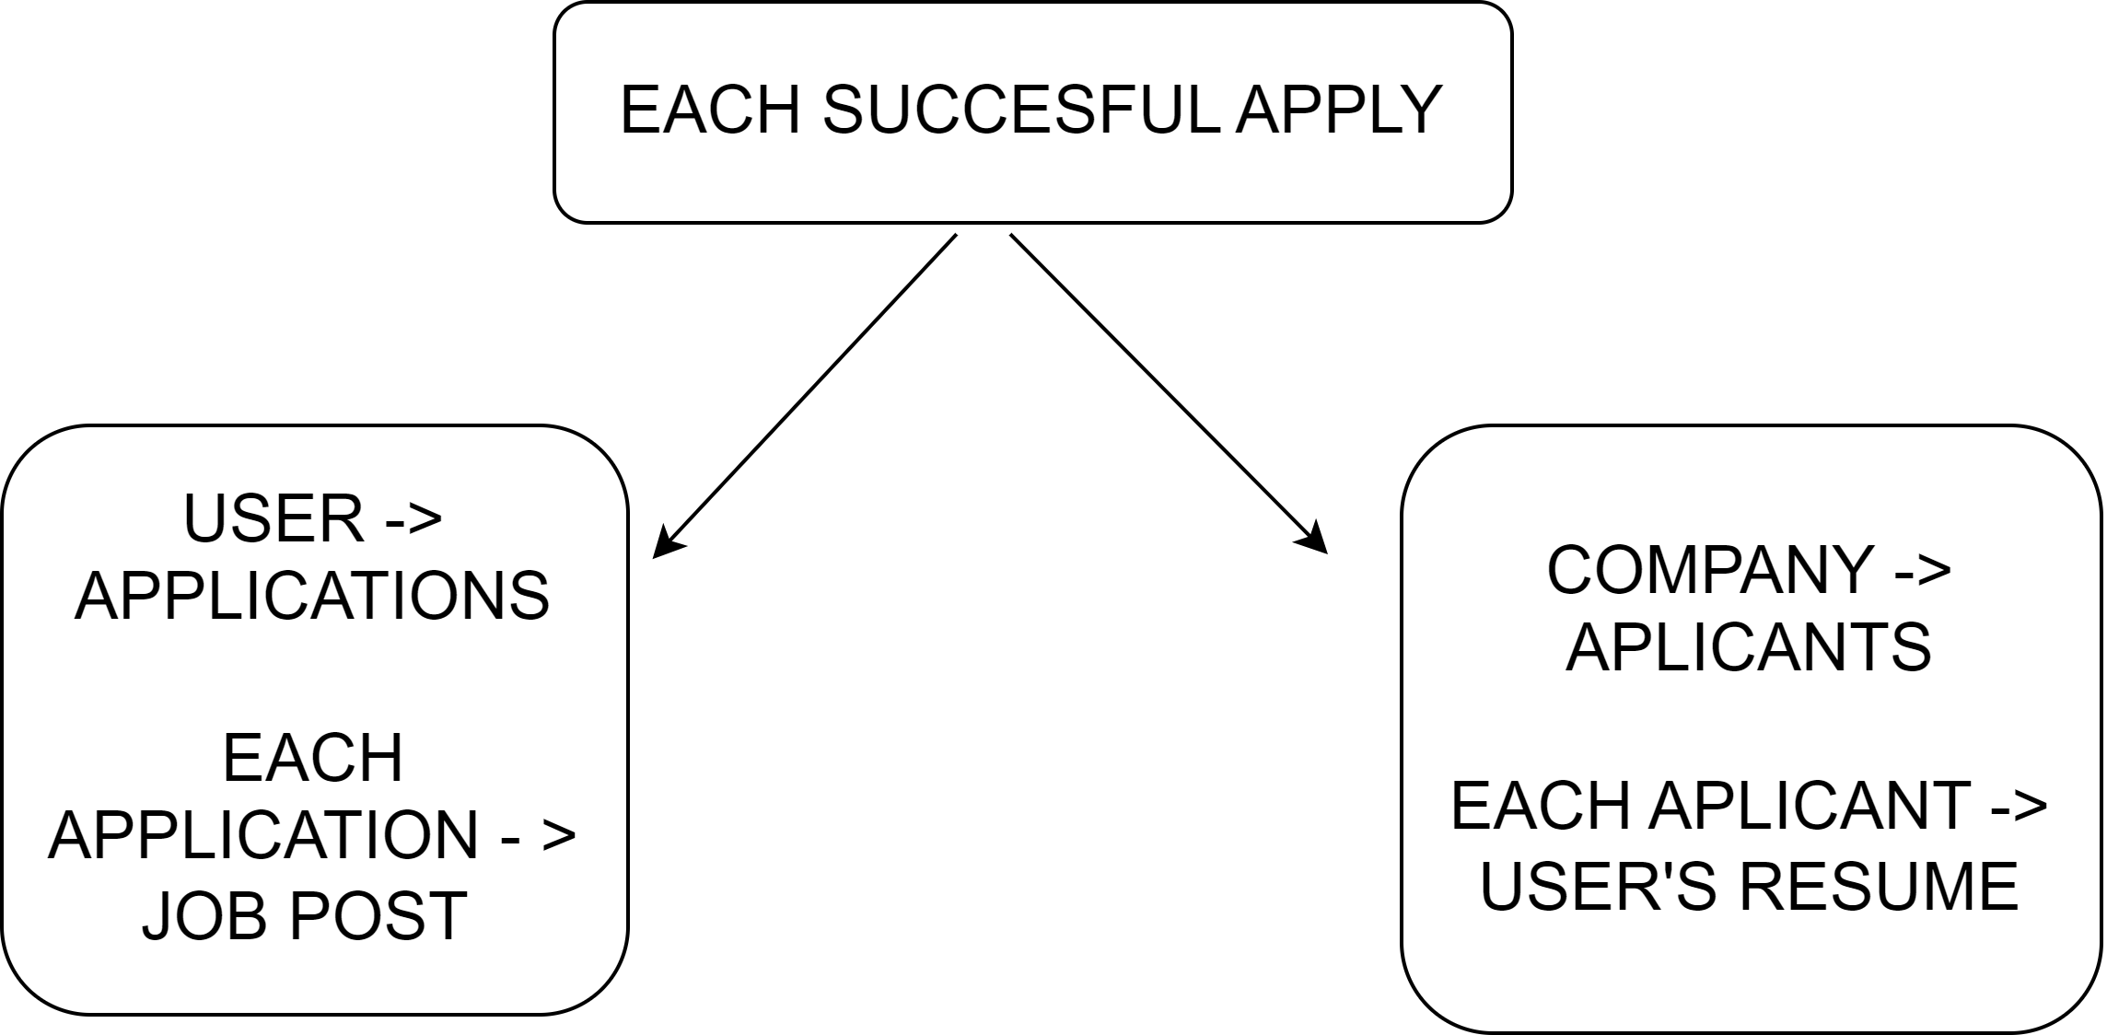
Connections
Each successful apply will add a new entry with post details in user’s application array.
Also each successful apply will add that user to company’s post’s applicants array.

Slide 11
Searching and Filtering
Searching of jobs can be done user by inputting required text in the search box. Search results will be based on the data companies have added in their Posts.
Examples
– user can search for “JavaScript” and all the posts containing “JavaScript” in their skills required section will be shown to the user.
– user can search for “frontend developer” and all the posts containing “frontend developer” in their job title section will be shown to the user.

Slide 12
Filtering and Sorting
Users when searching for jobs can select filters and apply sorting.
Example –
User applying for “Senior DevOps Engineer” can select experience level in ascending order to get job posts that require the least experience
User can filter through the jobs my simply selecting “Delhi” in location and will only be shown job posts in which job location is “Delhi”

Slide 13
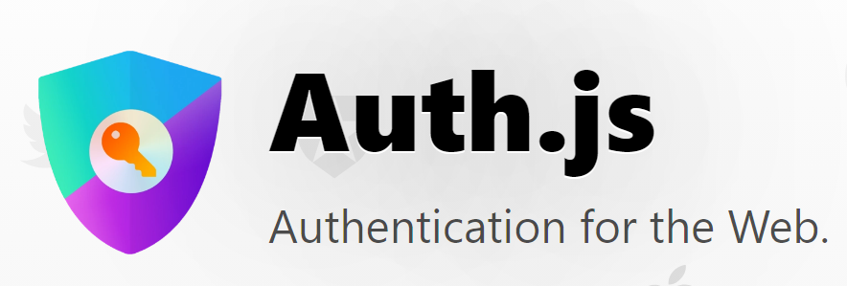
Authentication
auth.js is a commonly used JavaScript file or module that handles authentication and user authorization within web applications. It typically contains functions, classes, or methods that facilitate the authentication process and enforce access controls based on user roles and permissions.
Capabilities –
User Registration
User Login
Token-based Authentication
Access Control and Authorization

Slide 14


Frontend & APIs
The frontend and APIs of a project play a crucial role in delivering a seamless and interactive user experience while facilitating communication between the user interface and the backend services. Here's an overview of the frontend and APIs of your project:
Frontend:
User Interface Design – Modern design language, responsive for every screen size and accessible for people with impaired vision.
Frontend Framework/Library - Based on ReactJS, Material UI and many other industry standard JS frameworks.
State Management - Redux is used for state management of the whole website which takes care of all the elements and their arguments of the frontend.
API Integration - The frontend interacts with the backend APIs to fetch and send data. It utilizes techniques like RESTful API calls to communicate with the backend to update the UI accordingly.

Slide 15
thank you
Raghav Tandon

