Slide 1

Customer Shipping Behavior & Satisfaction
A data-driven analysis of 3,900 transactions uncovering the drivers of customer lifetime value, fulfillment preferences, and subscription adoption.
ANALYTICS REPORT
PYTHON · SQL · POWER BI

Slide 2

ETL Pipeline & Data Architecture
Ingest
Transform
Standardize
Load
Median imputation preserved statistical accuracy. Engineered features: age_group and purchase_frequency_days for behavioral segmentation.

Slide 3
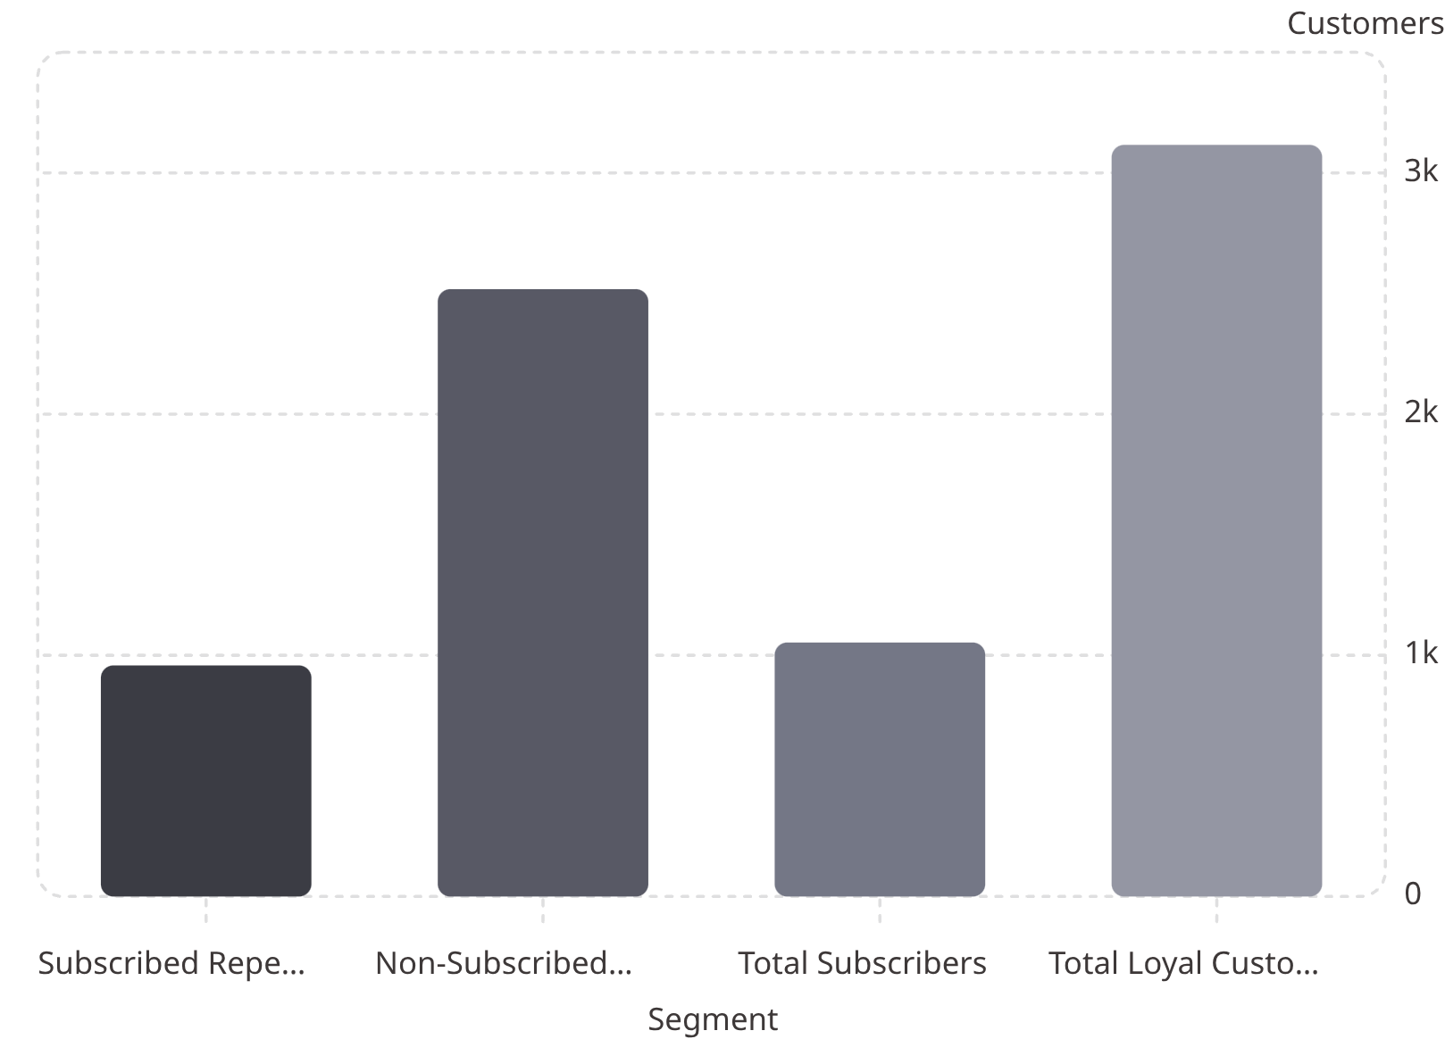
The Subscription Paradox
The Conversion Gap
2,518 repeat buyers (5+ purchases) are not subscribed — yet they drive the majority of revenue.
$170,436
$62,645
Revenue from non-subscribers
Revenue from subscribers

Slide 4

AOV Inversion: A Critical Signal
Non-Subscribers
$59.87 Average Order Value
Subscribers
$59.49 Average Order Value
Non-subscribers outspend subscribers — the subscription value proposition is not compelling enough to justify conversion.

Slide 5
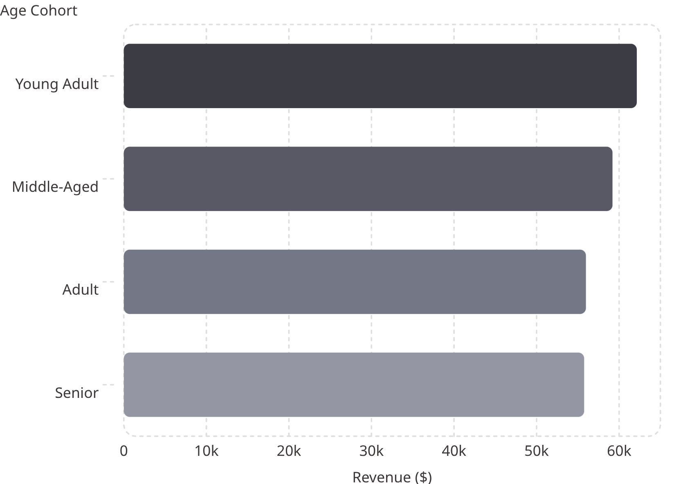
Demographic Revenue Drivers
Gender Revenue Split
Male customers generate 2.1× more revenue than female customers. Young Adults lead all age cohorts.
Male
Female
$157,890 — Primary driver
$75,191 — Underpenetrated

Slide 6
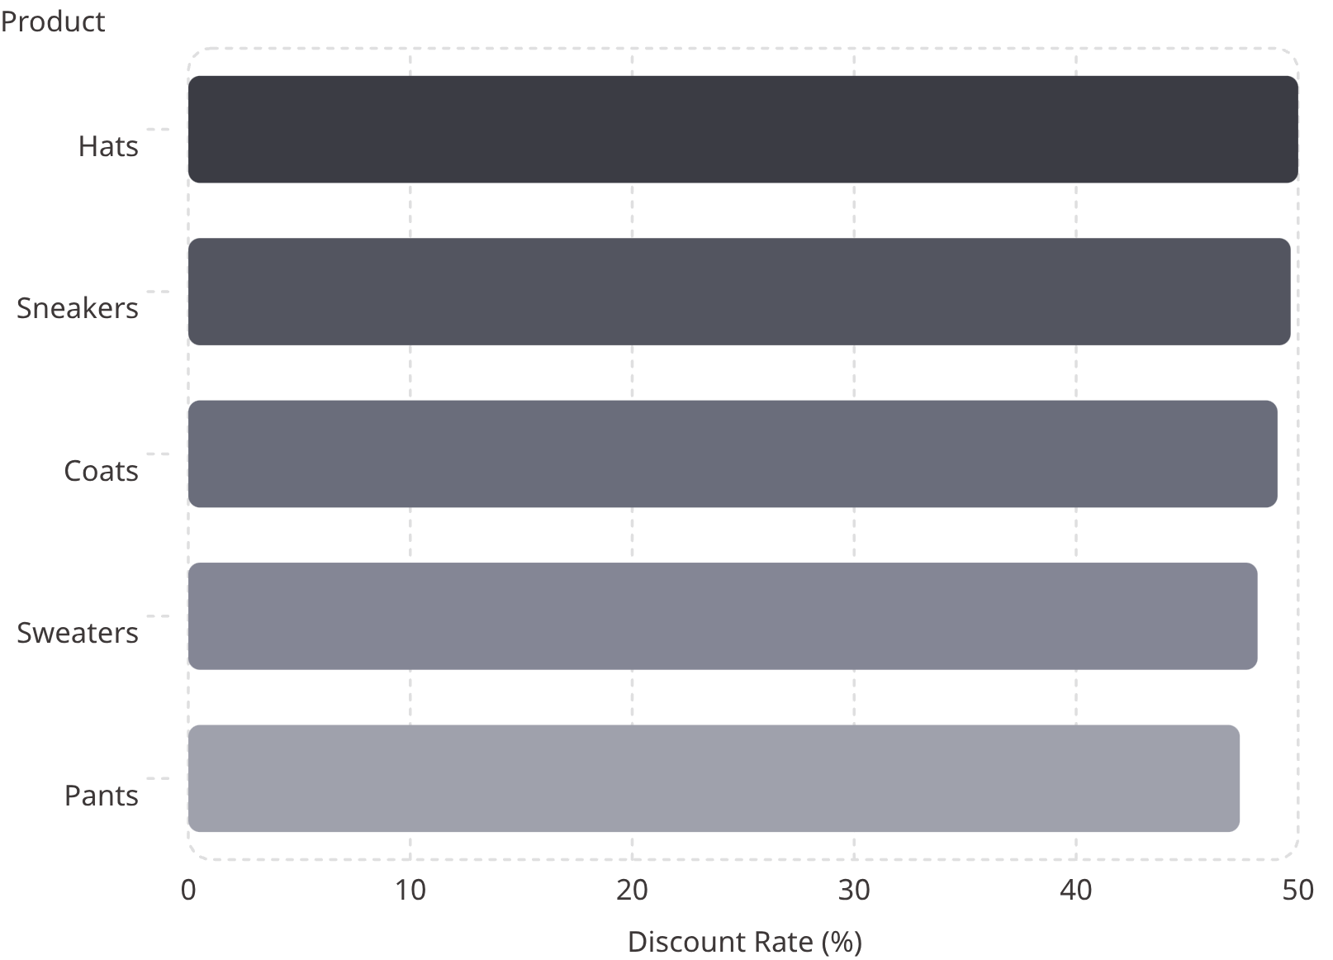

Discount Sensitivity & Margin Risk
839 High-Value Bargain Hunters
Customers who used discounts yet still exceeded the global average purchase amount — discounts drive upsells, not just margin erosion.
Top 5 SKUs rely on ~50% discounts to move inventory. Base pricing or bundling review is urgent.

Slide 7
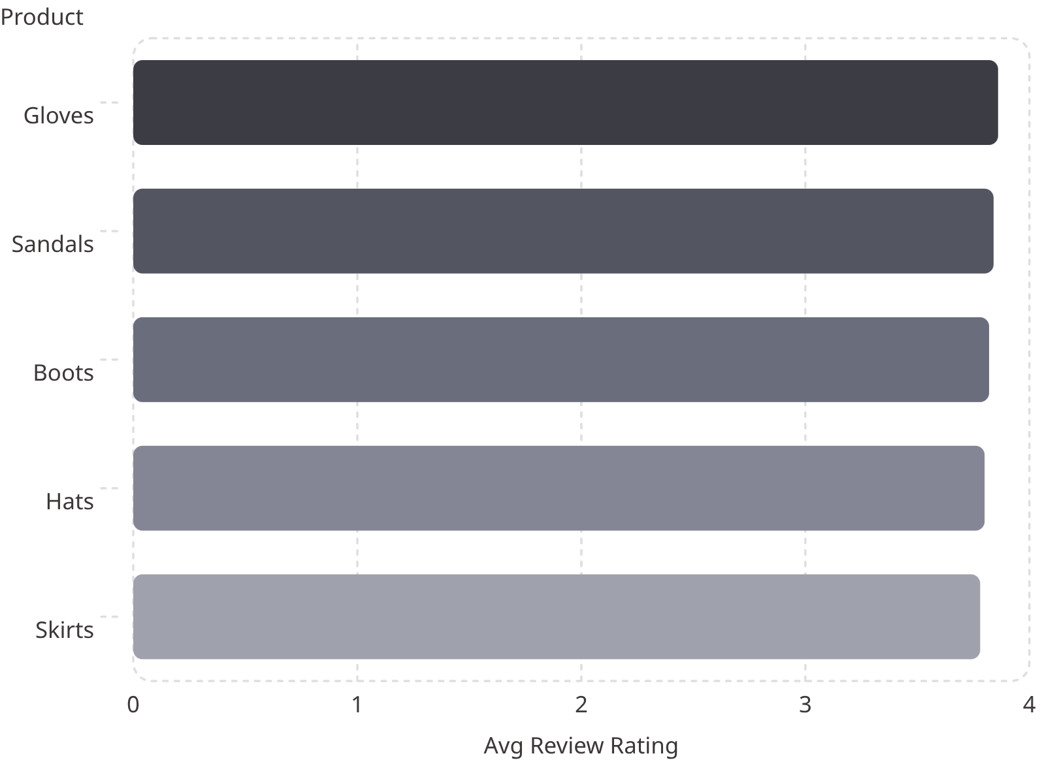
Category Performance & Fulfillment
Fulfillment Preference Impact
Express customers spend $2.02 more on average — a natural upsell opportunity.
Express Shipping
Standard Shipping
AOV: $60.48
AOV: $58.46

Slide 8
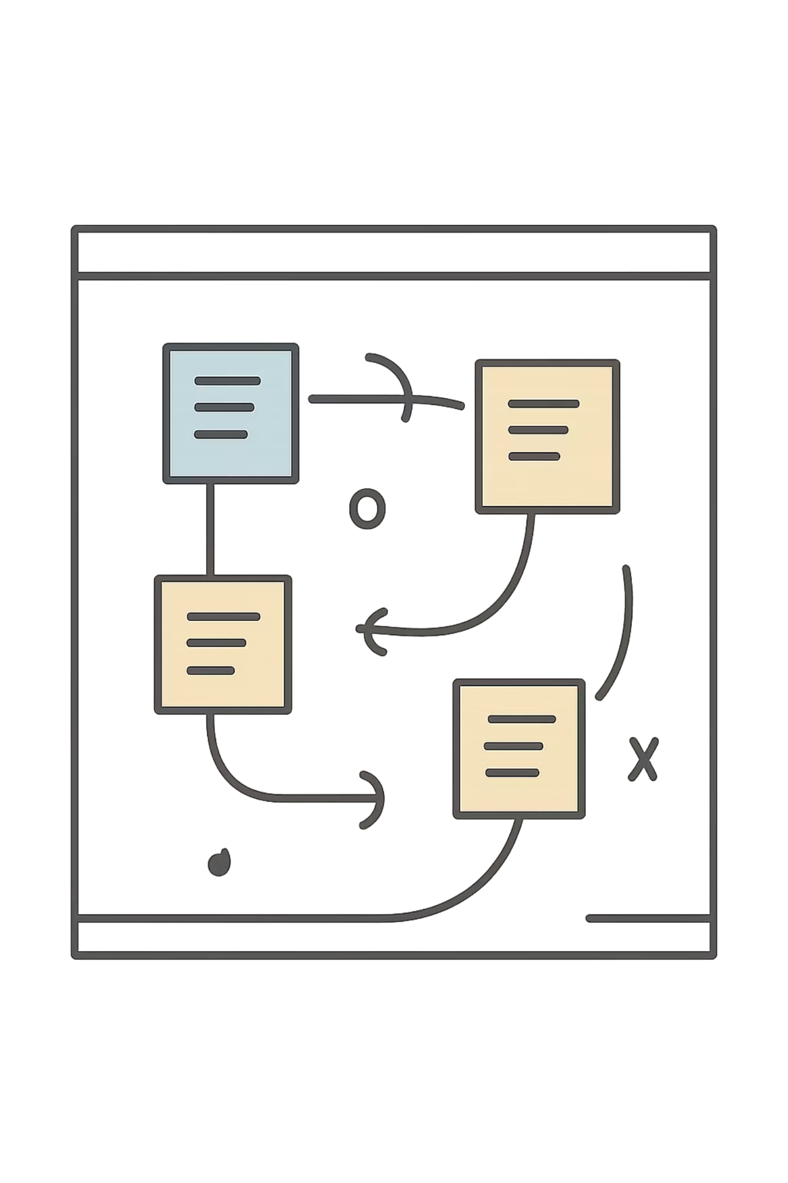
Strategic Recommendations
01
Overhaul Subscription Value
A/B test perks — gate Express shipping or exclusive discounts to convert 2,518 repeat buyers.
02
Optimize Discount Strategy
Review pricing for top 5 discount-dependent SKUs. Bundle with high-margin items.
03
Reallocate Ad Spend
Target Male Young Adults — highest CLV and revenue cohort.
04
Leverage Top-Rated SKUs
Feature Gloves & Sandals in front-page campaigns to boost brand perception.

Slide 9
Key Metrics at a Glance
3,900
2,518
Transactions Analyzed
Unconverted Repeat Buyers
Across all product lines
5+ purchases, not subscribed
$233K
839
Total Revenue Tracked
High-Value Discount Users
$170K non-subscribers · $63K subscribers
Exceeded global avg purchase amount

Slide 10

From Insight to Action
This analysis transforms raw transactional data into a clear growth roadmap — closing the subscription gap, protecting margins, and targeting the highest-value customer segments.
🔁 Convert
🎯 Target
2,518 loyal buyers → subscribers
Male Young Adults for maximum ROI
🛡️ Protect
Margin via smarter discount strategy

