Slide 1
Object Oriented Programing
Spring 2026
Lecture-1
Introduction

Slide 2
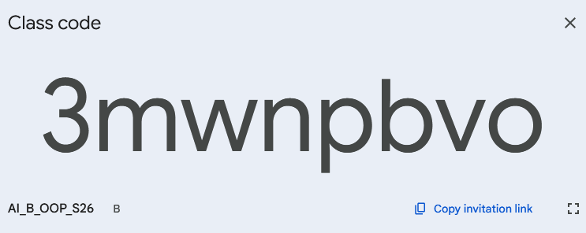
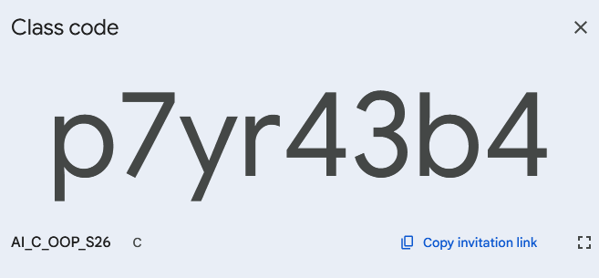
Object Oriented Programing
Spring 2026
Instructions
Please join Google Classroom to get updates.
Attendance will be marked on Google Forms.
In case of any query, contact me on my email. (ishabansatti@gmail.com)
Please be punctual in class.

Slide 3
Object Oriented Programing
Spring 2026
Marks Breakup
Quizzes (25 = 5 X 5)
Assignments (5 = 1 X 5)
Mid Exam (30)
Final Exam (40)
Instructions
MCQs based quizzes on google forms.
You should have a GitHub account to upload your assignment codes.
All assignments will be followed by a relevant viva.

Slide 4



Object Oriented Programing
Spring 2026
Tools Required for this course
CLion(code editor)
GCC C++ compiler and GDB debugger from mingw-w64
Safe exam browser
CMake
https://www.jetbrains.com/clion/
https://code.visualstudio.com/docs/cpp/config-mingw
https://safeexambrowser.org/download_en.html
https://cmake.org/download/

Slide 5
Object Oriented Programing
Spring 2026
01.
Why we need OOP?
02.
Characteristics of OOP
03.
A Basic C++ Program
04.
Variables
05.
Input & Output
06.
Type Conversion
Agenda
07.
Arithmetic Operations

Slide 6
Object Oriented Programing
Spring 2026
Why do we need OOP?
01.

Slide 7
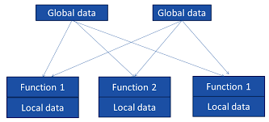

Object Oriented Programing
Spring 2026
Procedural Programming
Structures code as a sequence of instructions.
Organized into reusable blocks called functions, which are called in a specific order to perform tasks.
Key languages include C.
Issues with Procedural Paradigm
1. Unrestricted access
2. Poor real-world mapping
3. Inextensibility

Slide 8
Object Oriented Programing
Spring 2026
Object Oriented Programming
Combines data (data items) and relevant functions (member functions) in a single unit (object).
Issues with Procedural Paradigm
1. Unrestricted access
2. Poor real-world mapping
3. Inextensibility

Slide 9
Object Oriented Programing
Spring 2026
Characteristics of OOP
02.

Slide 10
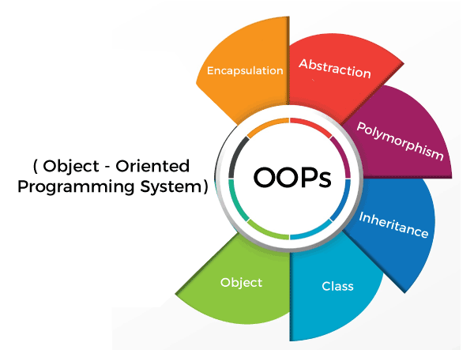
Object Oriented Programing
Spring 2026

Slide 11
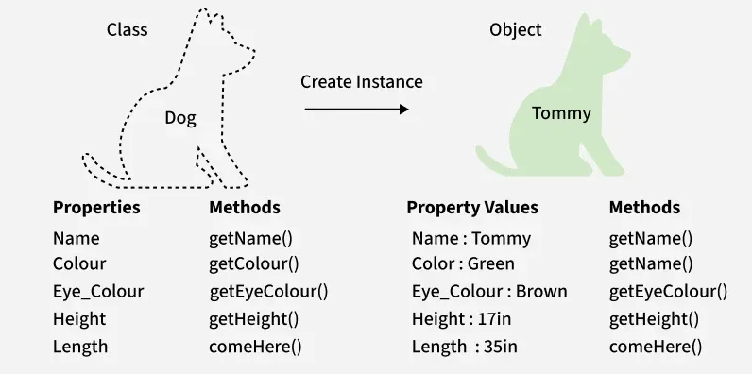
Object Oriented Programing
Spring 2026
Class and Object

Slide 12
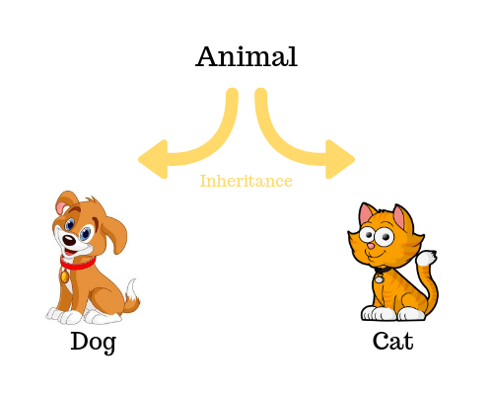
Object Oriented Programing
Spring 2026
Inheritance and Reusability

Slide 13
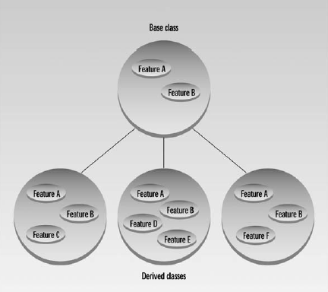
Object Oriented Programing
Spring 2026
Inheritance and Reusability

Slide 14
Object Oriented Programing
Spring 2026
A Basic C++ Program
03.

Slide 15
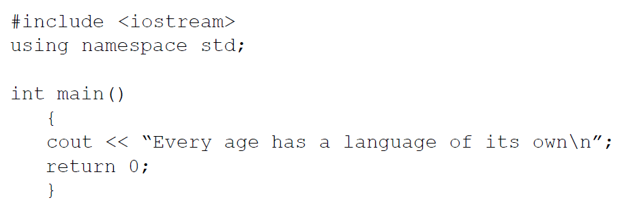
Object Oriented Programing
Spring 2026
A Basic C++ Program
Preprocessor Directive
Using Directive
main function
statements

Slide 16
Object Oriented Programing
Spring 2026
Preprocessor Directive
A preprocessor directive is an instruction to the compiler.
The preprocessor directive #include tells the compiler to insert another file into your source file.
The type file usually included by #include is called a header file.

Slide 17
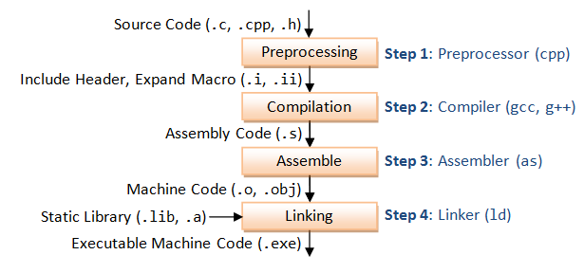
Object Oriented Programing
Spring 2026
C++ Application Build Process

Slide 18
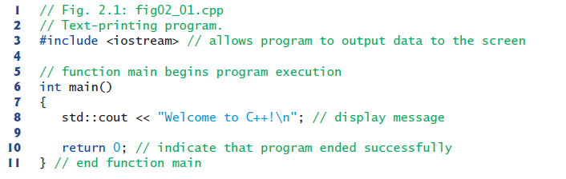
Object Oriented Programing
Spring 2026
A Basic C++ Program
comments
Without Using Directive

Slide 19

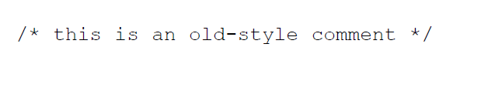
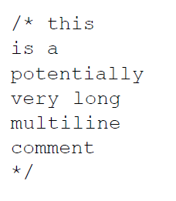
Object Oriented Programing
Spring 2026
Comments

Slide 20
Object Oriented Programing
Spring 2026
Whitespaces
Whitespace is defined as spaces, returns, and tabs.
These characters are invisible to the compiler.
The first line of the program, starting with #include, is a preprocessor directive, which must be written on one line.
Also, string constants, such as “Every age has a language of its own”, cannot be broken into separate lines. (If you need a long string constant, you can insert a backslash (\) at the line break or divide the string into two separate strings, each surrounded by quotes.)

Slide 21
Object Oriented Programing
Spring 2026
04.
Variables

Slide 22
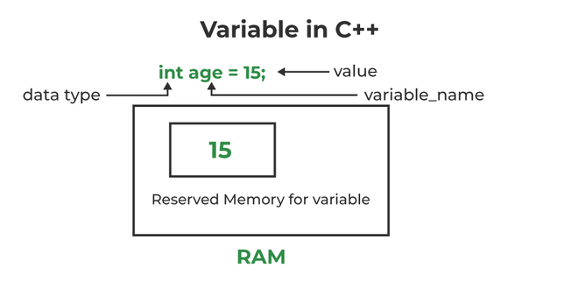
Object Oriented Programing
Spring 2026
Variables
Variable Name/Identifier
Numbers, alphabets, and _ allowed
First character should be letter or underscore
Case sensitive
Do not use keywords

Slide 23
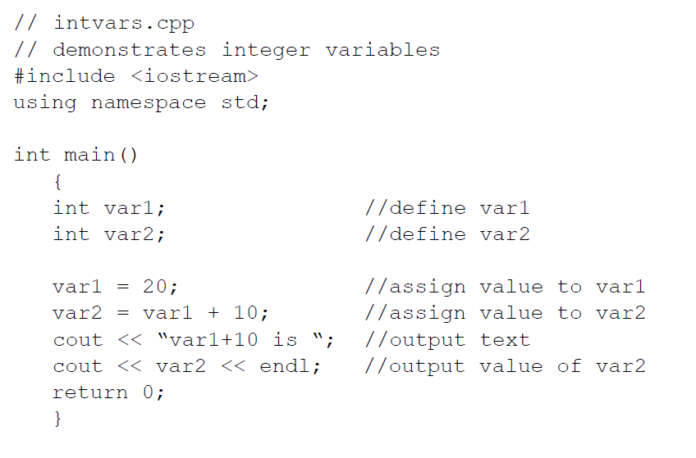
Object Oriented Programing
Spring 2026
Example Code
Variable declaration
Variable definition

Slide 24
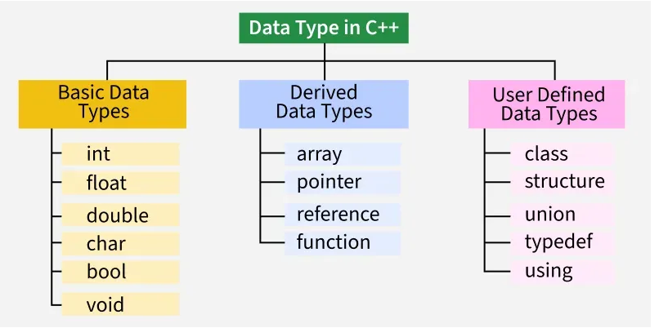
Object Oriented Programing
Spring 2026
Data Types

Slide 25
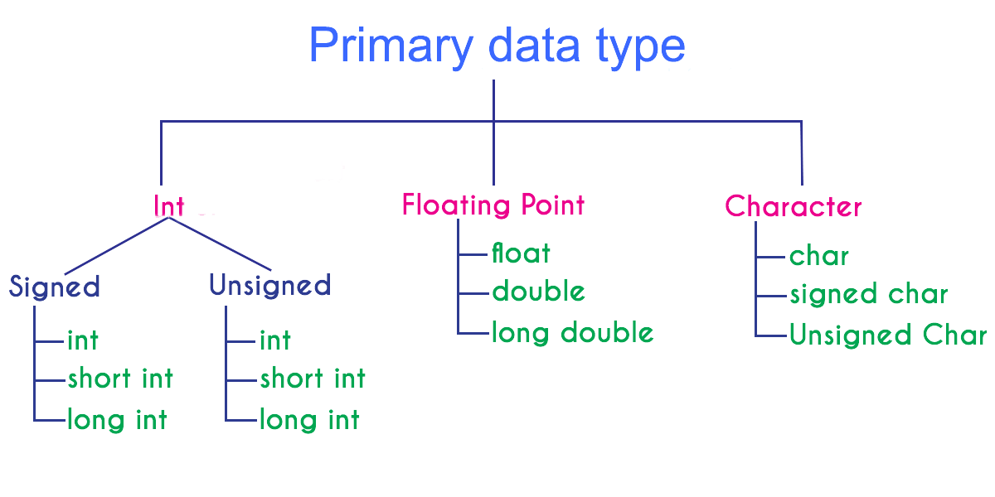
Object Oriented Programing
Spring 2026
Data Types

Slide 26
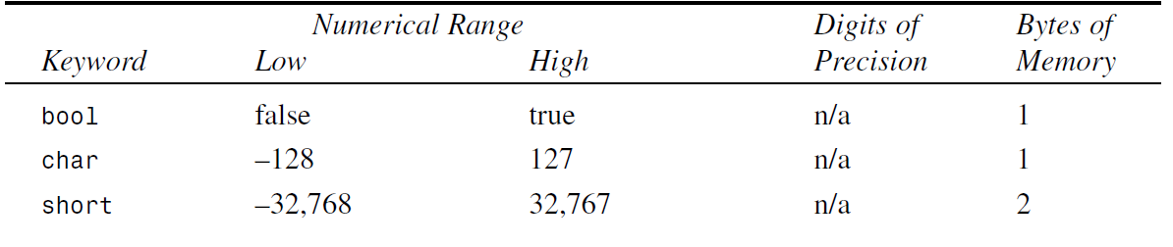
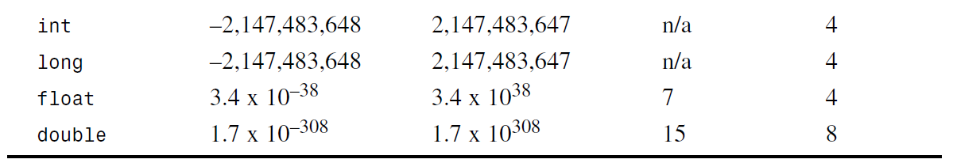
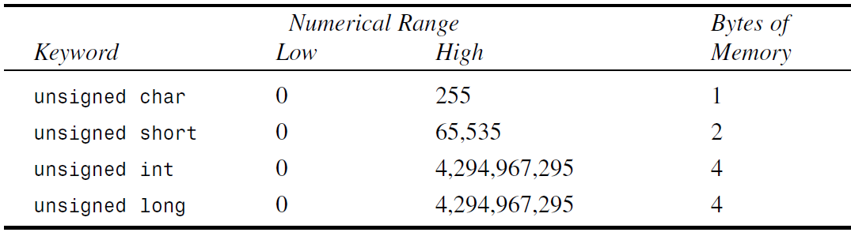
Object Oriented Programing
Spring 2026
Data Types

Slide 27
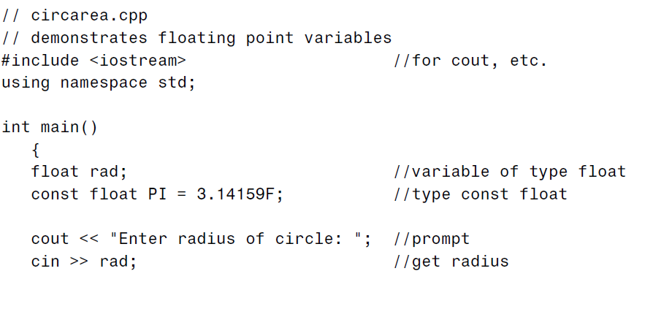
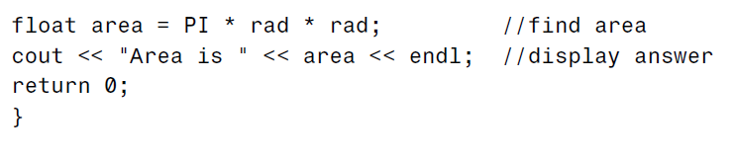
Object Oriented Programing
Spring 2026
Example Code

Slide 28
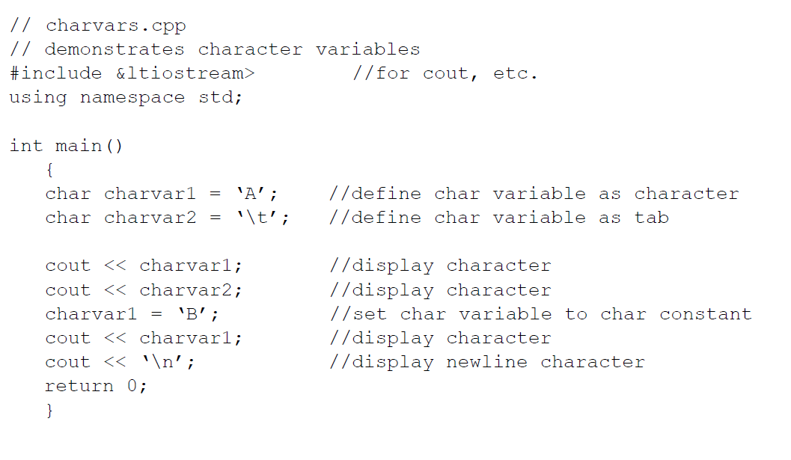
Object Oriented Programing
Spring 2026
Example Code

Slide 29
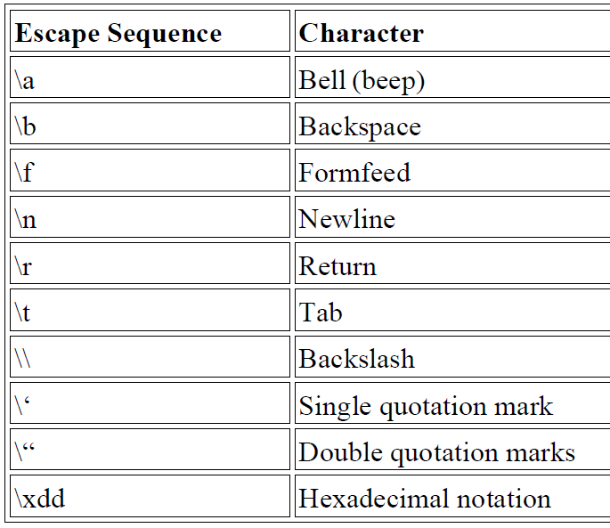
Object Oriented Programing
Spring 2026
Escape Sequences
Special way to write characters that can't be typed directly and have special meaning.
It starts with a backslash (\).
They are used inside strings or characters.

Slide 30
Object Oriented Programing
Spring 2026
05.
Input & Output

Slide 31

Object Oriented Programing
Spring 2026
Output using cout
cout
<<
variable
Insertion/ put to operator

Slide 32
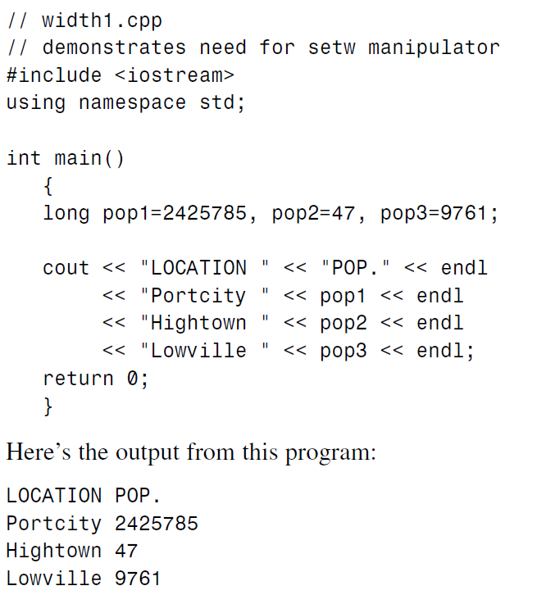
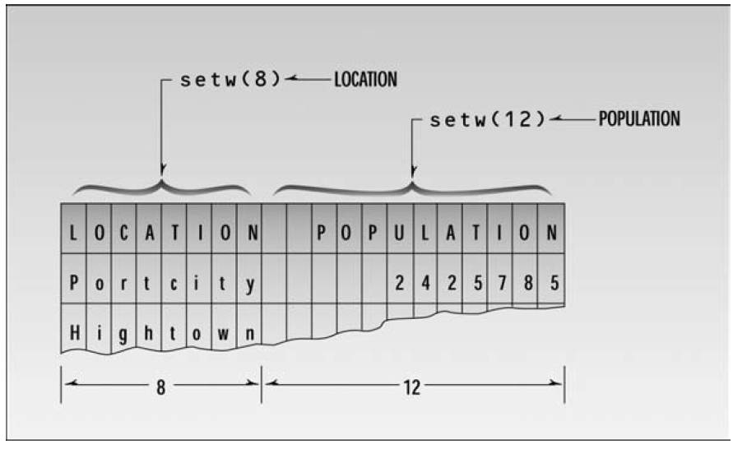
Object Oriented Programing
Spring 2026
Setw manipulator

Slide 33
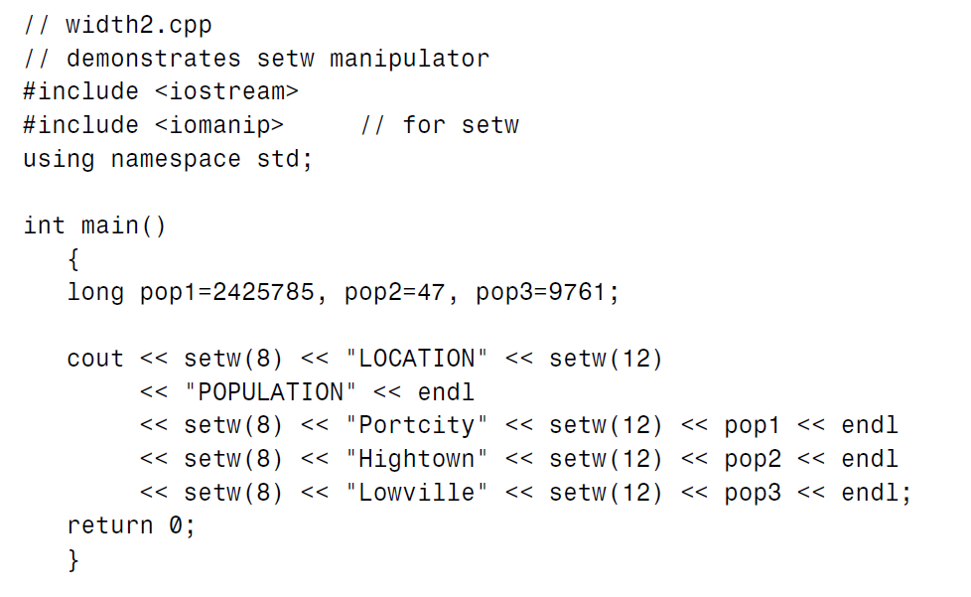
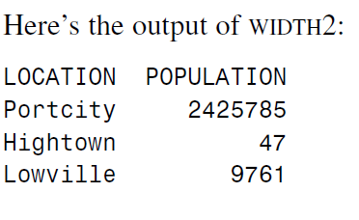
Object Oriented Programing
Spring 2026
Setw manipulator

Slide 34
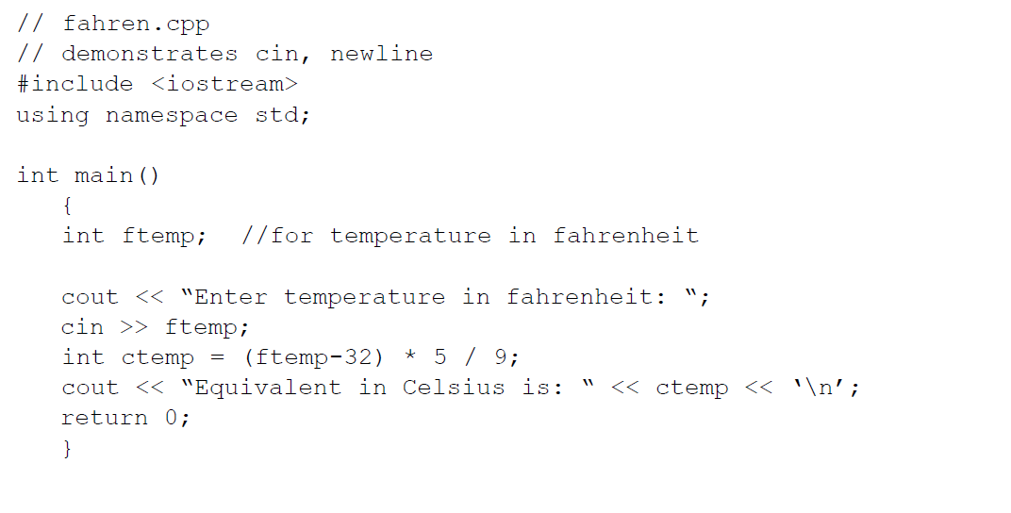
Object Oriented Programing
Spring 2026
Input using cin
input

Slide 35

Object Oriented Programing
Spring 2026
cin
>>
variable
Input using cin
extraction/ get from operator

Slide 36
Object Oriented Programing
Spring 2026
06.
Type Conversion

Slide 37
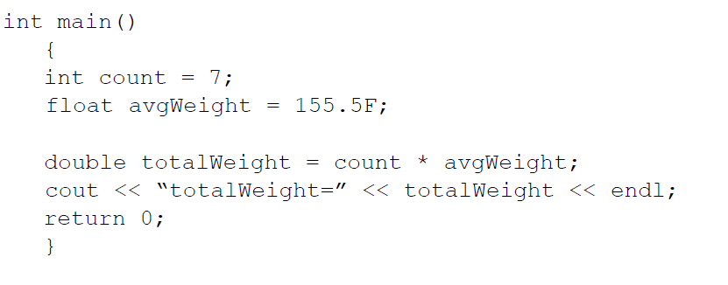
Object Oriented Programing
Spring 2026
Automatic Type Conversion

Slide 38
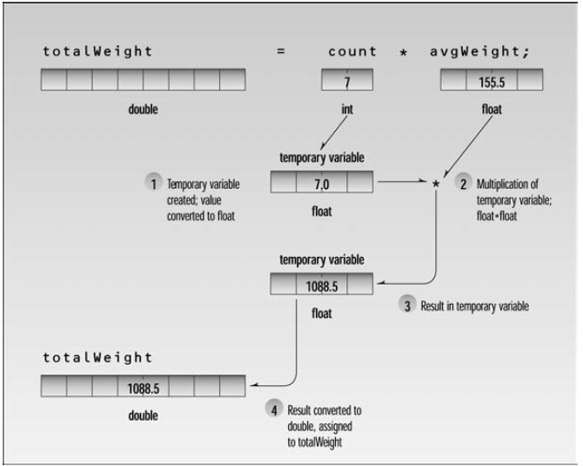
Object Oriented Programing
Spring 2026
Automatic Type Conversion

Slide 39
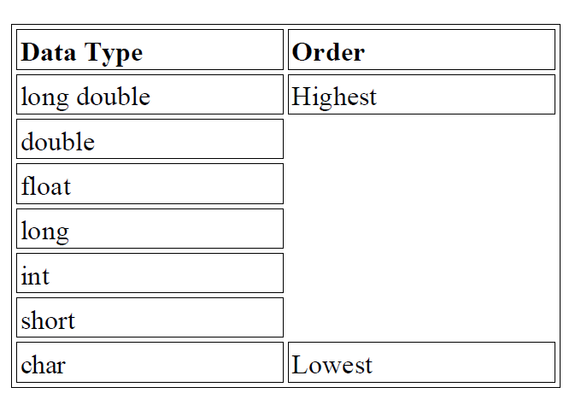
Object Oriented Programing
Spring 2026
Automatic Type Conversion
The arithmetic operators such as + and * like to operate on two operands of the same type.
When two operands of different types are encountered in the same expression, the lower-type variable is converted to the type of the higher-type variable.

Slide 40
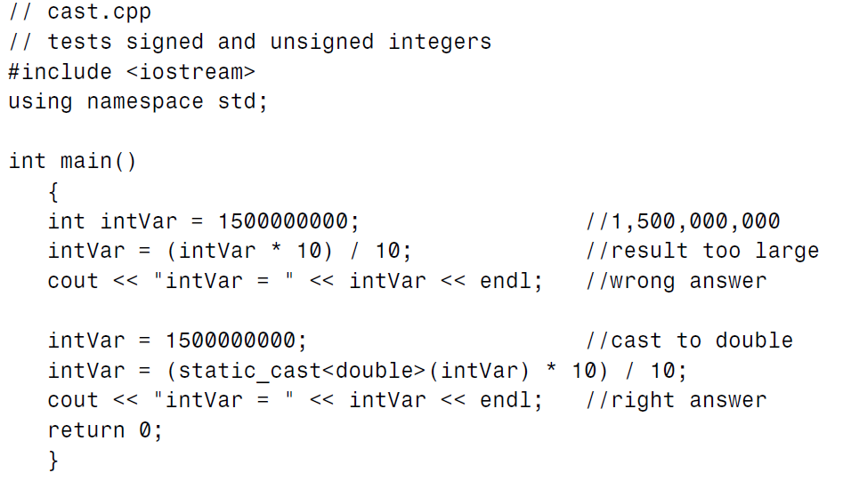
Object Oriented Programing
Spring 2026
Type Casting

Slide 41
Object Oriented Programing
Spring 2026
07.
Arithmetic Oper.

Slide 42
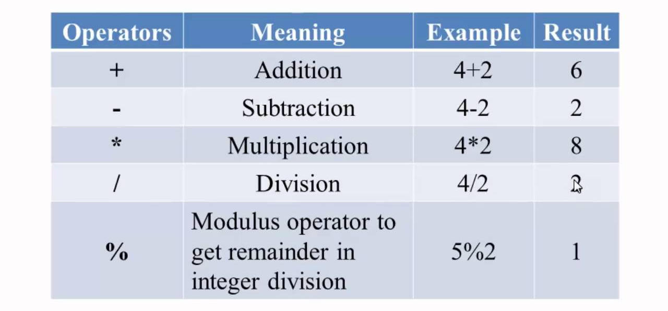
Object Oriented Programing
Spring 2026
Arithmetic Operations

Slide 43
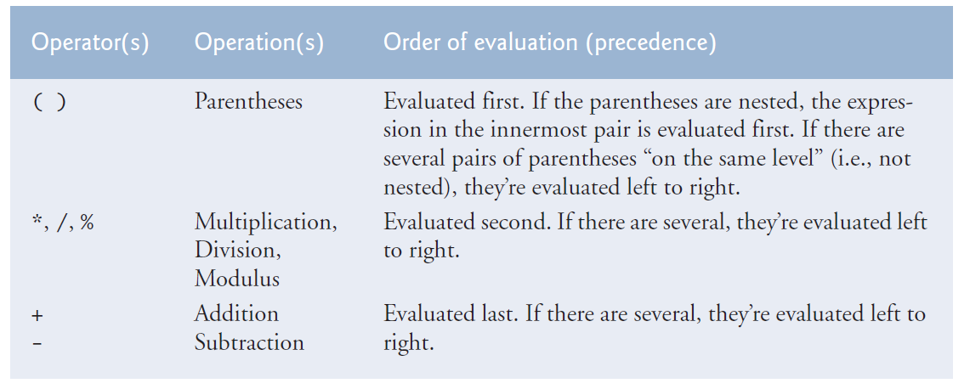
Object Oriented Programing
Spring 2026
Arithmetic Operations Precedence

Slide 44
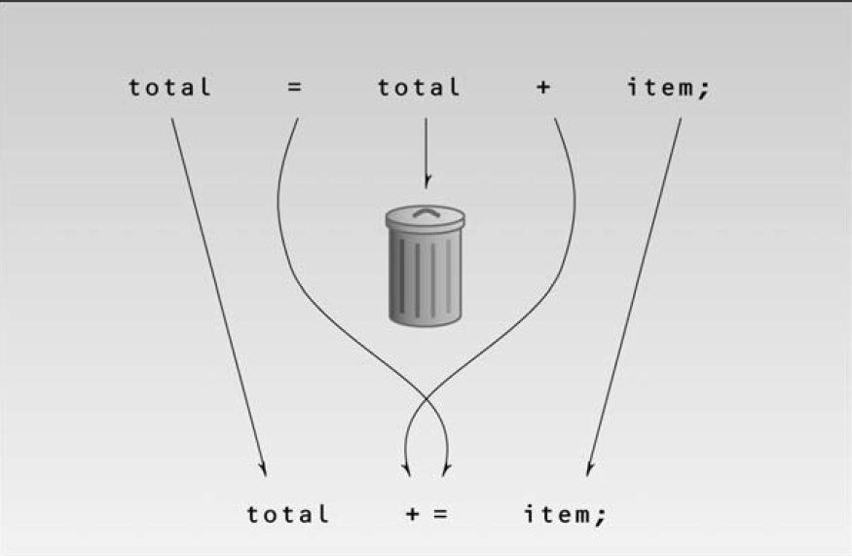
Object Oriented Programing
Spring 2026
Arithmetic Assignment Operations

Slide 45
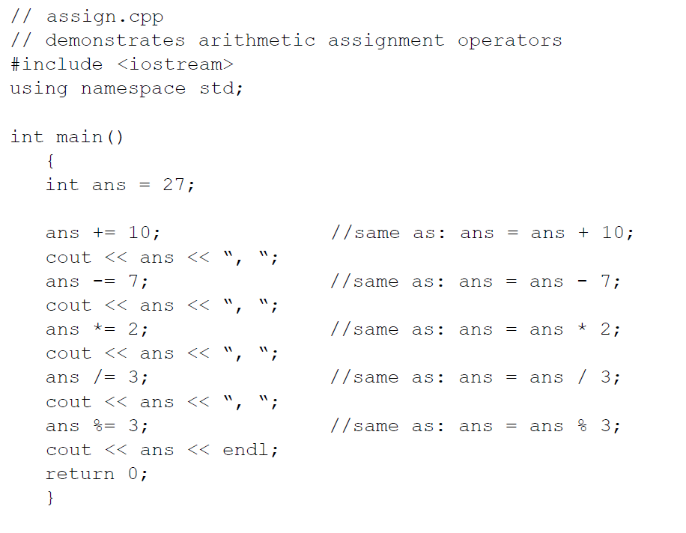
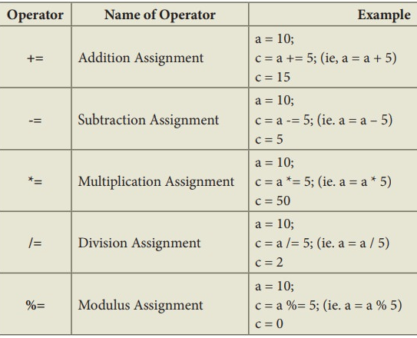
Object Oriented Programing
Spring 2026
Arithmetic Assignment Operations

Slide 46
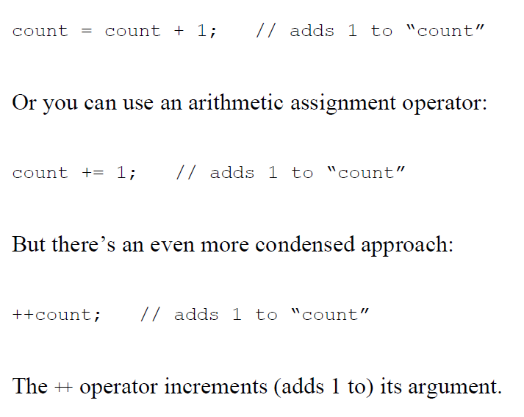
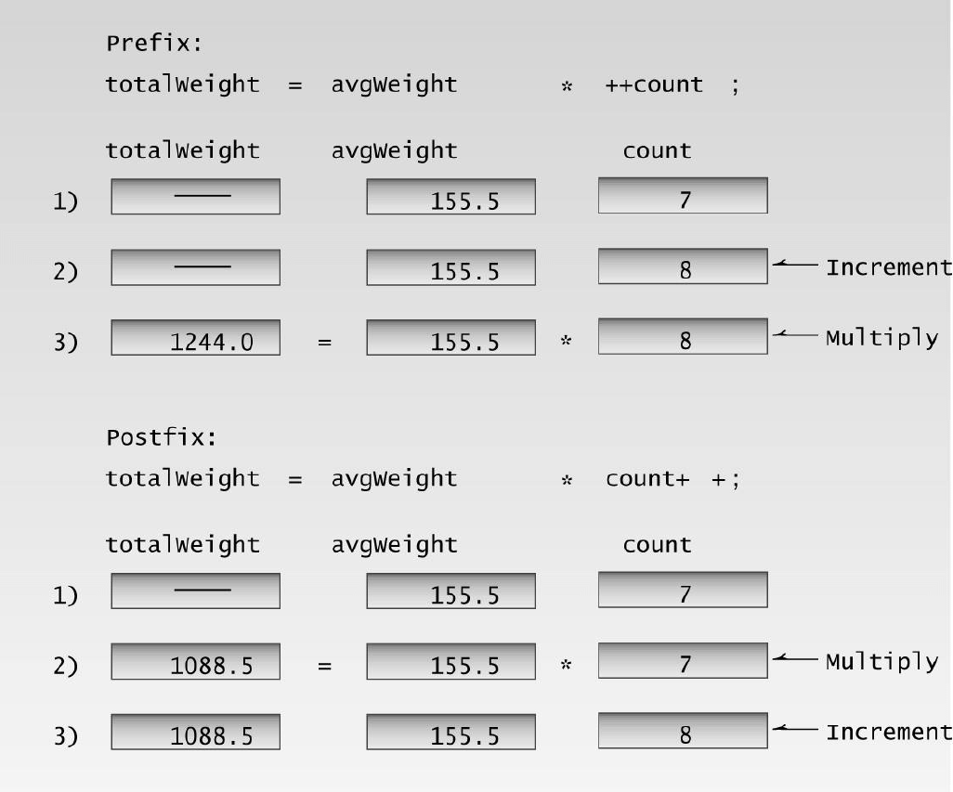
Object Oriented Programing
Spring 2026
Increment Operator
Postfix and Prefix

Slide 47
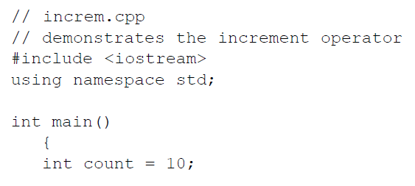
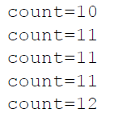
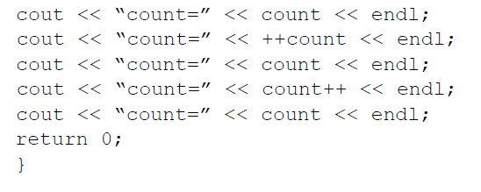
Object Oriented Programing
Spring 2026
Increment Operator

Slide 48
Object Oriented Programing
Spring 2026
08.
Tasks

Slide 49
Object Oriented Programing
Spring 2026
Task-1
You can convert temperature from degrees Celsius to degrees Fahrenheit by multiplying by 9/5 and adding 32.
Write a program that allows the user to enter a floating-point number representing degrees Celsius, and then displays the corresponding degrees Fahrenheit.

Slide 50
Object Oriented Programing
Spring 2026
Task-2
Write a program that generates the following output:
10
20
19
Use an integer constant for the 10, an arithmetic assignment operator to generate the 20, and a decrement operator to generate the 19.

Slide 51
Object Oriented Programing
Spring 2026
Thank
You!

