Slide 1
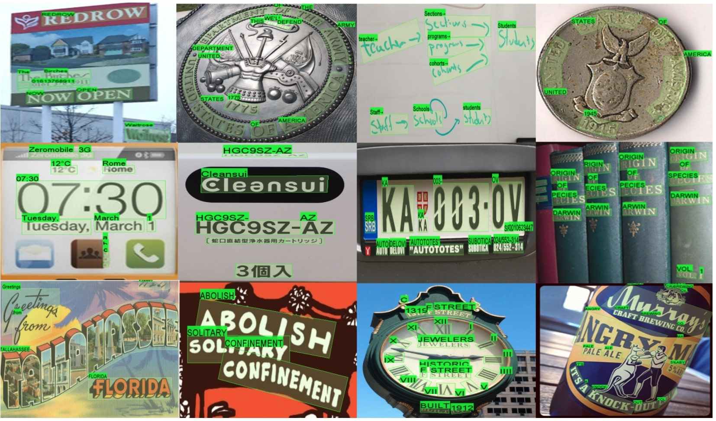
SVTR: Scene Text Recognition with a Single Visual Model
(Presentation)
Publish date:
[v1] Sat, 30 Apr 2022
[v2] Mon, 23 May 2022
Published at:
https://doi.org/10.48550/arXiv.2205.00159
Presented by: Mohammad Raghib Noor

Slide 2

SVTR Details
Scene to Text Recognition System
Cleansui
Paper Summary:
  Dominant scene to text recognition models usually contain two building blocks, this makes the models more complex and less efficient. This study proposes a Single Visual model for Scene Text Recognition within patchwise image tokenization framework.
Contributions:
    Proposed model achieved record SOTA accuracy in Chinese scene to text recognition and competitive accuracy in English scene to text recognition.
    Helped deprecate use of two stage architectures for scene text recognition.
    Provides inter character and intra character representations directly from text image to recognizer network.
    Granular stroke features from images directly inputted into recognizer model.

Slide 3
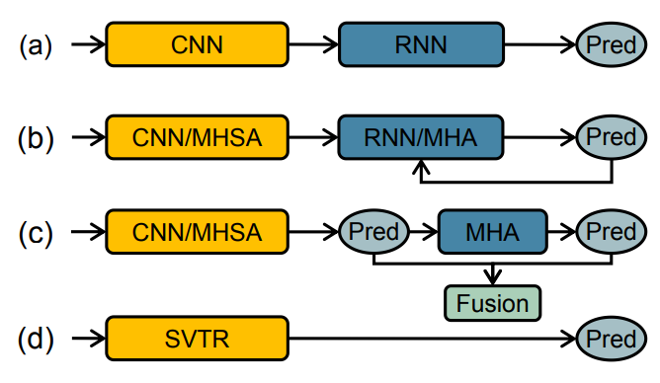
Deep Learning models used in the
Scene-Text Recognition Domain
CRNN
ENCODER DECODER BASED MODELS WITH MULTI HEADED SELF ATTENTION MODULES
VISION-LANGUAGE MODELS
SVTR

Slide 4
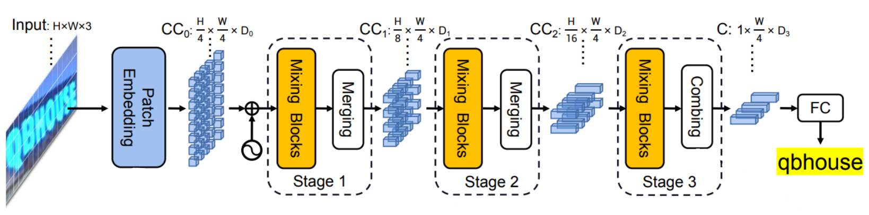
Model Architecture Overview
Global Mixing Blocks: Builds inter character relationship within input image
Local Mixing Blocks: Builds intra character relationship within input image
The height dimension of the input is progressively compressed with every merging operation with the help of a 3x3 convolution with stride of (2,1)

Slide 5
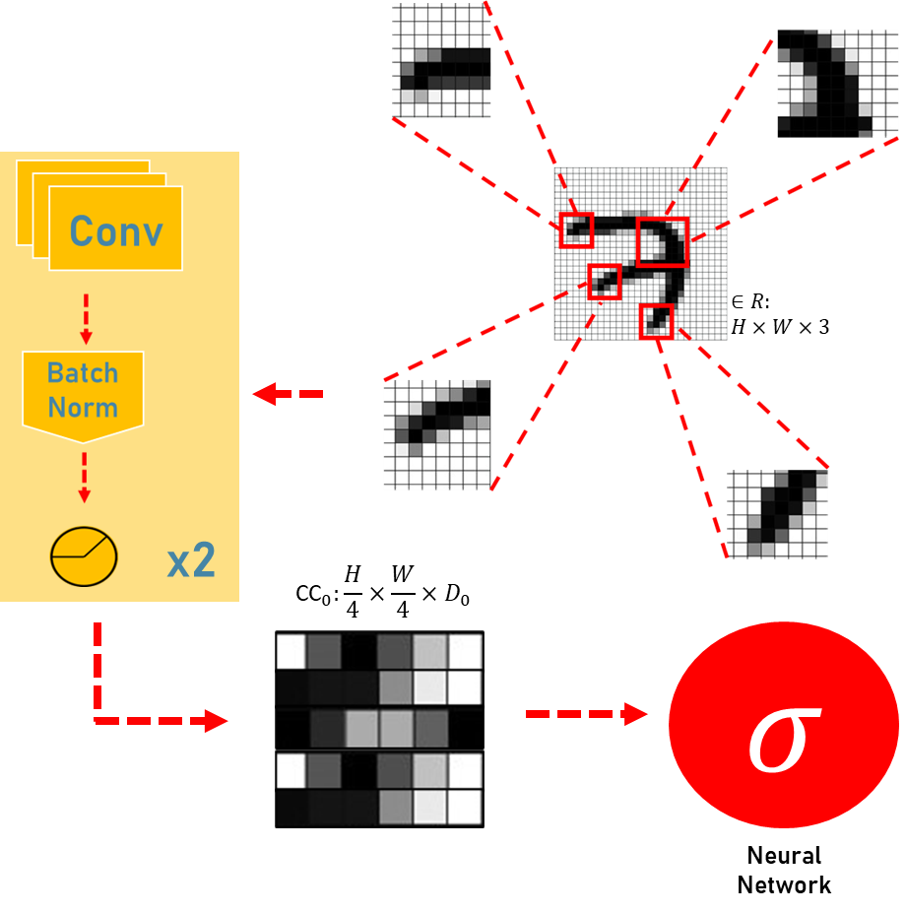
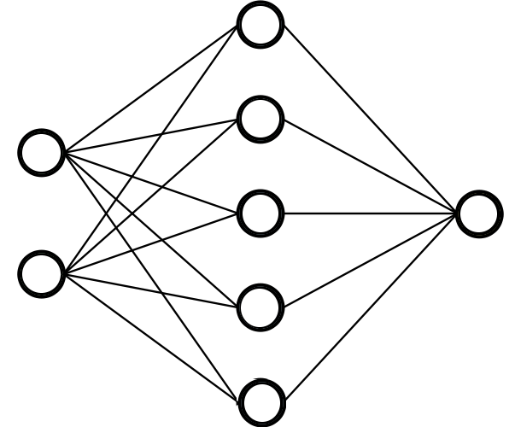

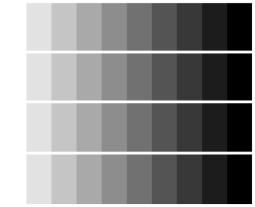
Progressive Patch Embedding
Two Stage Scene Text
Recognition model inputs
SVTR
inputs
Encoder
Input
Input
Loss of information from encoder’s transformation of image to feature embedded vector
Feature encoded embedding
Decoder
Embedding from raw patches of input image with two cycles of one 3x3 convolution with a stride of 2 along with batch normalization and activation function

Slide 6
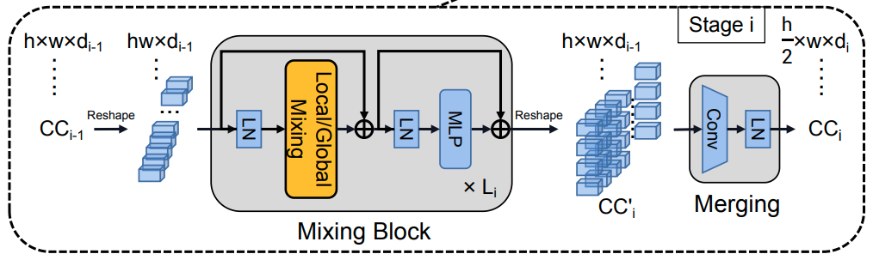
Mixing Stage Overview

Slide 7

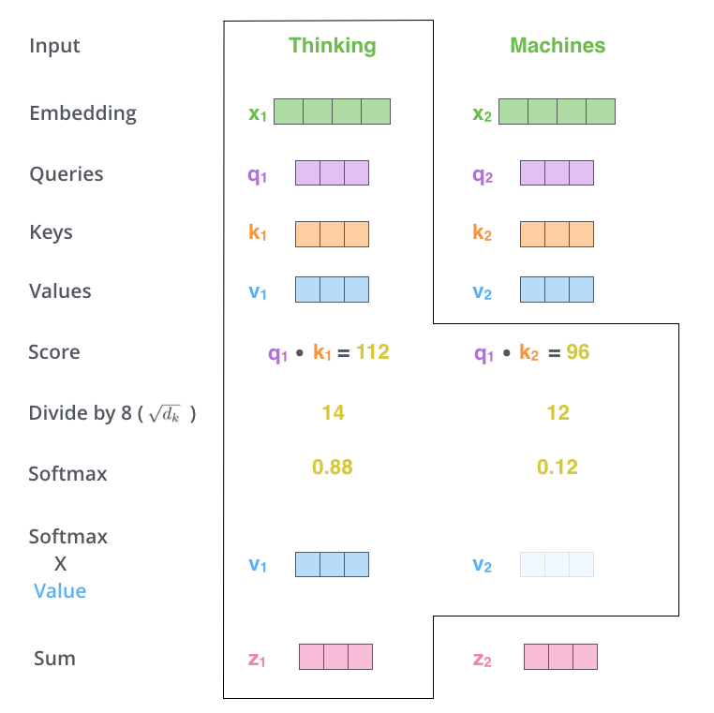
11
7
7 x 11 convolution used on flattened patch matrix to mix intra character components for relationship building
In self attention head, each of the flattened patches of the input image is mapped to each other, thus mapping co-linearity between a character component’s intra granular stroke features
`

Slide 8
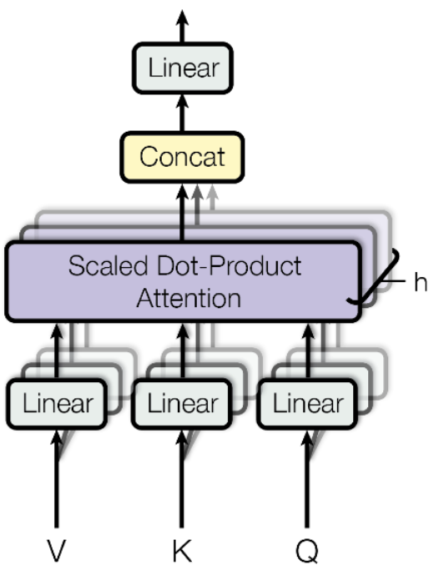
Global Mixing
x
The layer normalized input is passed
through a multi headed self attention block in order to establish various relationships in between inter character components
`

Slide 9
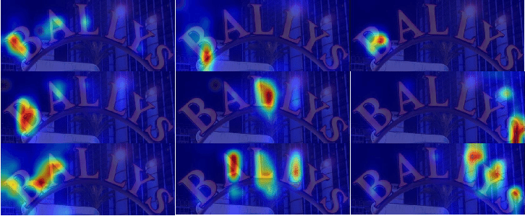
Attention Map of Mixing Blocks
Sub character level
Character level
Cross Character Level
The visualized attention maps, as provided in the paper, shows that stronger values of dependencies can be seen across sub characters, characters and cross characters

Slide 10
Mixing Stage Overview

Slide 11
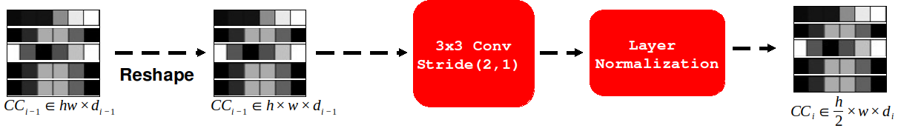
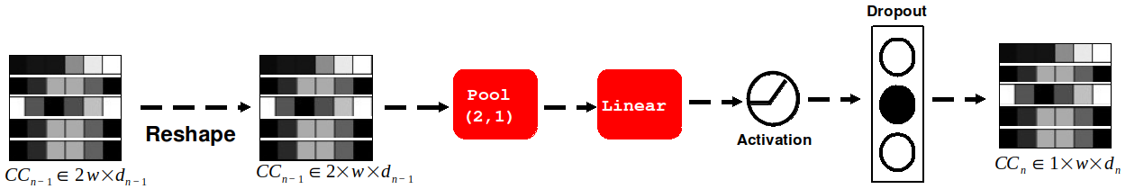
Merging and Combining Blocks
Merge
Combine

Slide 12
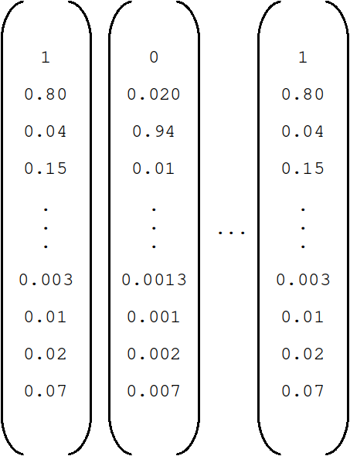

SVTR Output Matrix
(for English)
Nodes:
1 for character component boolean
26 for alphabets
10 for numbers
1 | 0
a
b
c
.
.
.
7
8
9
0
Fully Connected
Layer with N nodes

Slide 13
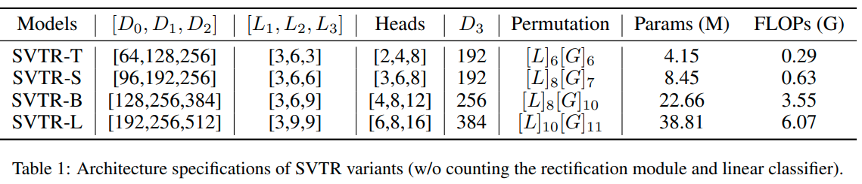
SVTR Variants
Table: Architecture specifications of SVTR variants (w/o counting the rectification module and linear classifier).

Slide 14
Datasets used in training and testing the SVTR
Trained on:
  Mj Synth: This dataset consists of 9 million images covering 90k English words, and includes the training, validation and test splits.
  Synthtext: A dataset with approximately 800000 synthetic scene-text images.
  Chinese Scene Dataset: This is a public dataset containing 509,164, 63,645 and 63,646 training, validation, and test images.
Tested on:
  ICDAR 2013 (IC13): This dataset contains 1095 testing images.
  Street View Text (SVT): This dataset has 647 testing images cropped form Google Street View.
  IIIT5K-Words (IIIT) : The dataset contains 3000 testing images.
  ICDAR 2015: This dataset has two versions, one with 1,811 images and the other with 2,077 images.
  Street View Text-Perspective (SVTP): This dataset has 639 test this set and many of them are perspectively distorted.
  CUTE80 (CUTE): This dataset used for curved text recognition. 288 testing images are cropped from full images by using annotated words.
  Chinese Scene Dataset: This is a public dataset containing 509,164, 63,645 and 63,646 training, validation, and test images. The validation set is utilized to determine the best model, which is then assessed using the test set.

Slide 15
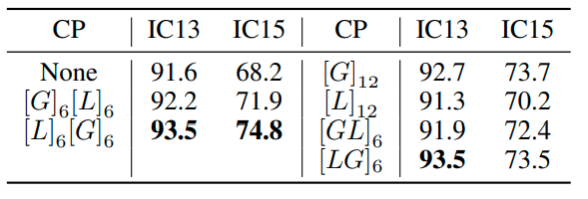
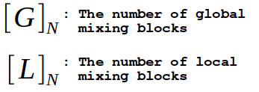
Accuracy Improvements from existence and permutation of Mixing Blocks
Table : Performance of SVTR with different combinations of mixing blocks against current benchmark in IC13 and IC15

Slide 16
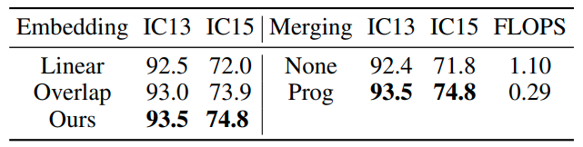
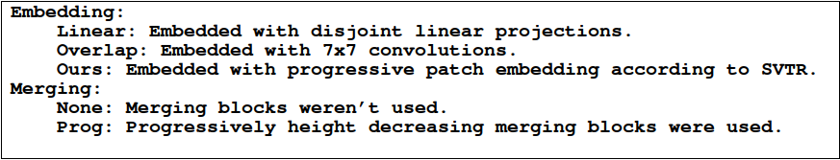
Accuracy Improvements due to Merging and Patch Embedding
Table : Changes in accuracy due to patch embedding (left half) and merging (right half)

Slide 17
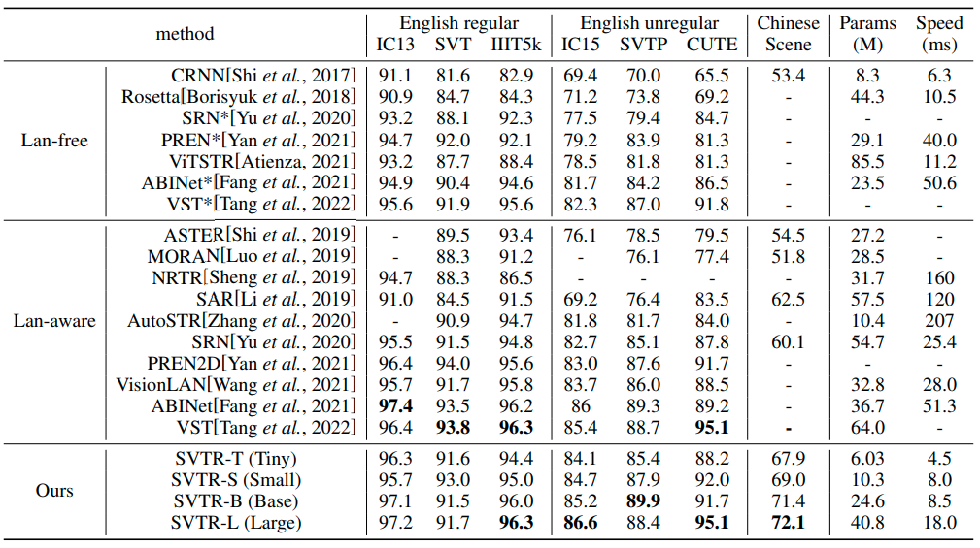
SVTR Performance Against Scene To Text Recognition Benchmarks
Table: Models classified according to awareness of languange information are pitted against SVTR varients in 7 datasets, parameter space and Inference Speed

Slide 18
Thank you

