Slide 1
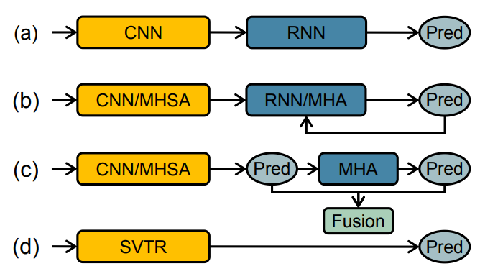
Deep Learning models used in the
Scene-Text Recognition Domain
CRNN
ENCODER DECODER BASED MODELS WITH MULTI HEADED SELF ATTENTION MODULES
VISION-LANGUAGE MODELS
SVTR

Slide 2
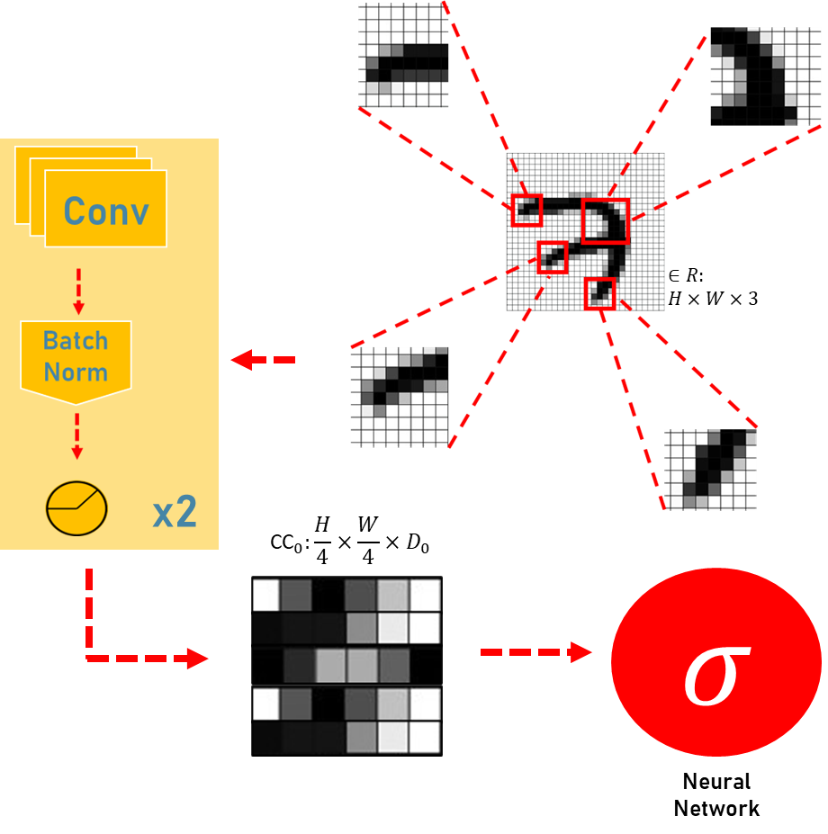
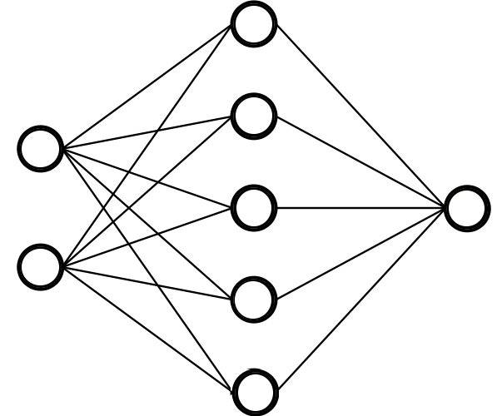

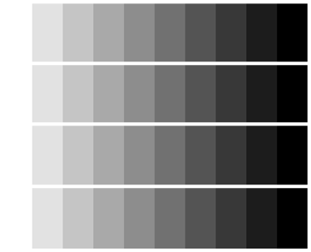
Progressive Patch Embedding
SVTR inputs
Two Stage Scene Text
Recognition model inputs
Encoder
Input
Input
Loss of information from encoder’s transformation of image to feature embedded vector
𝜎
Feature encoded embedding
Decoder
Embedding from raw patches of input image with two cycles of one 3x3 convolution along with batch normalization and activation function

