Slide 1
Knowledge Sharing Session: AI in Legal Contracts
Presented by:
Mohammad Raghib Noor

Slide 2







Legal Contracts and AI
Agreement
Enforced By Law
NLP
Archiving, knowledge graphs & semantic searches
Insights on components of paper

Slide 3
Papers Listed
BERT Goes to Law School: Quantifying the Competitive Advantage of Access to Large Legal Corpora in Contract Understanding
Lawformer: A Pre-trained Language Model for Chinese Legal Long Documents
LeSICiN: A Heterogeneous Graph-based Approach for Automatic Legal Statute Identification from Indian Legal Documents
Unsupervised Simplification of Legal Texts
Iteratively Questioning and Answering for Interpretable Legal Judgment Prediction
CUAD: An Expert-Annotated NLP Dataset for Legal Contract Review

Slide 4
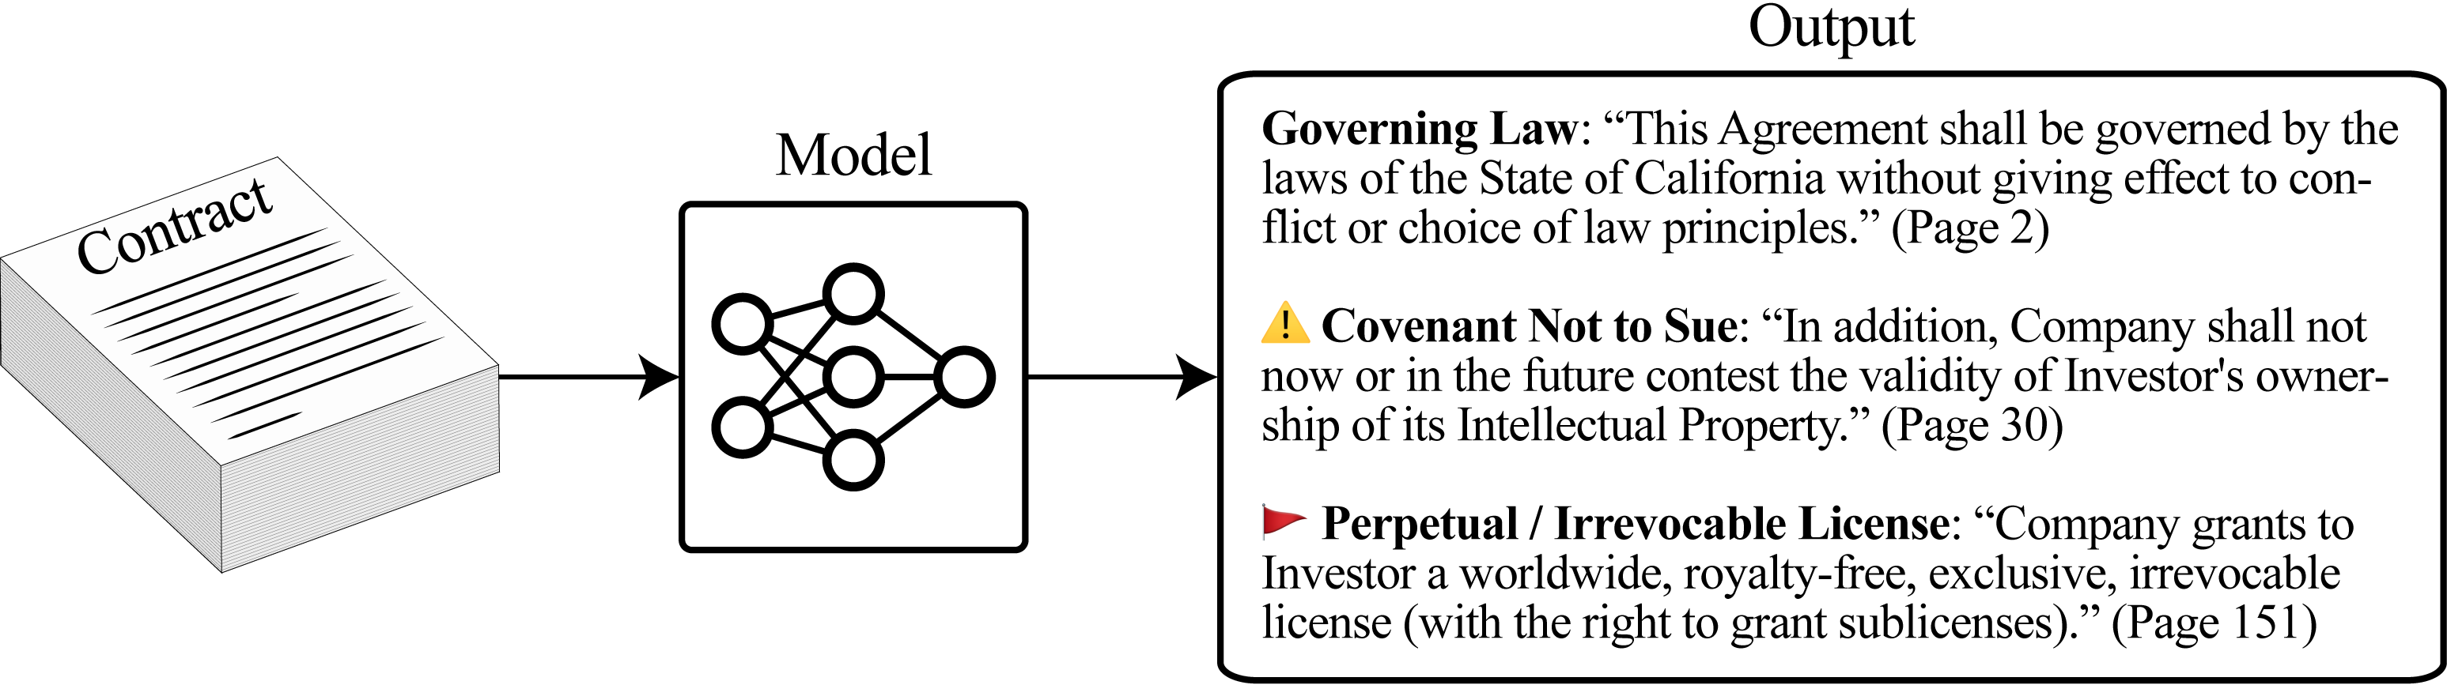
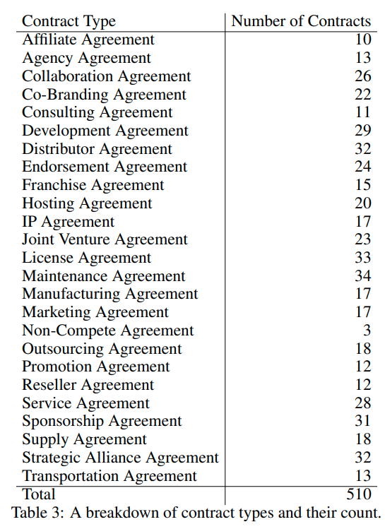
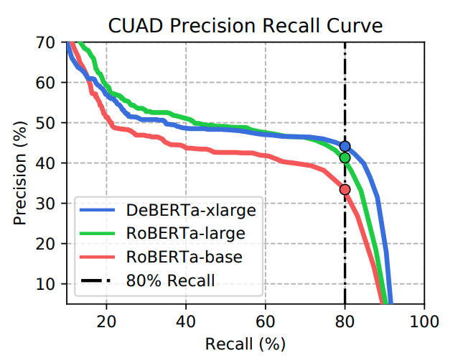
CUAD: An Expert-Annotated NLP Dataset for Legal Contract Review
Models evaluated with:
BERT
RoBERTa
ALBERT
DeBERTa

Slide 5
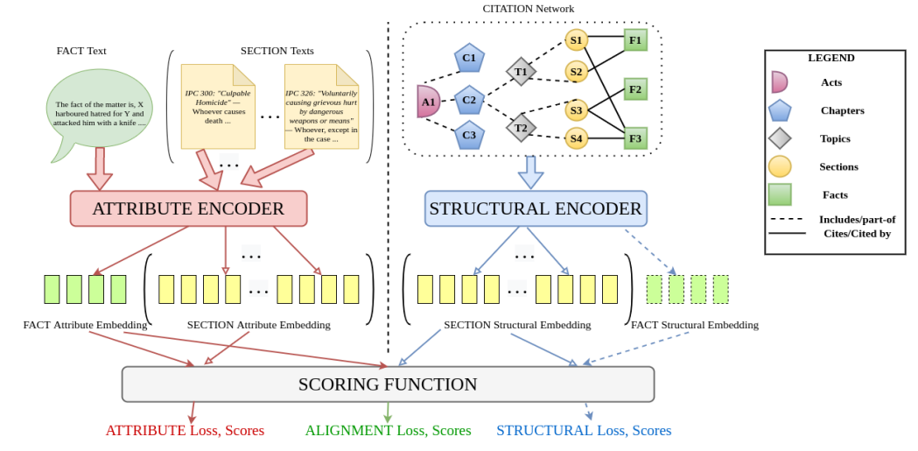
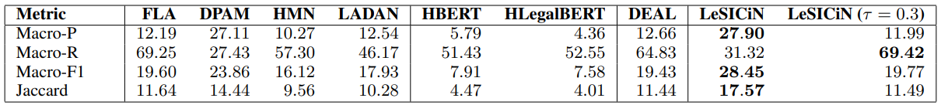
LeSICiN: A Heterogeneous Graph-based Approach for Automatic Legal Statute Identification from Indian Legal Documents
Contribution:
Provides large-scale LSI dataset from Indian court case documents, where the task is to identify Sections of the Indian Penal Code.
First of its kind in using the statute citation network in conjunction with textual descriptions for the task of Legal Statute Identification.
Reached SOTA accuracies for many benchmarks on LSI prediction tasks.

Slide 6
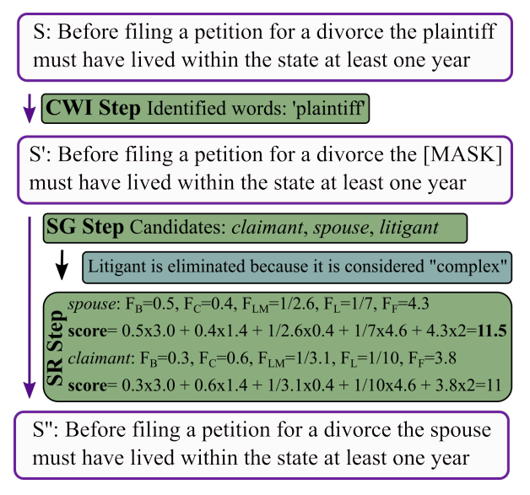
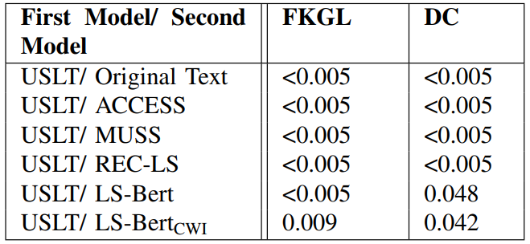
Unsupervised Simplification of Legal Texts
Datasets:
Case-Law Project: A repository of legal cases by the Harvard Law School. This paper produced two datasets from data based on this repository:
A legal corpus of 27,000 US Supreme Court cases
A legal corpus of 1,000 sentences from diverse case categories within the Case-Law Project.
SUBTLEX-UK: A corpus containing English subtitles for movies in foreign languages, representing regular English in daily use.
Contribution:
Provides unsupervised method for lexicion simplification
Increases readability of legal text for people who are not from the domain.

Slide 7
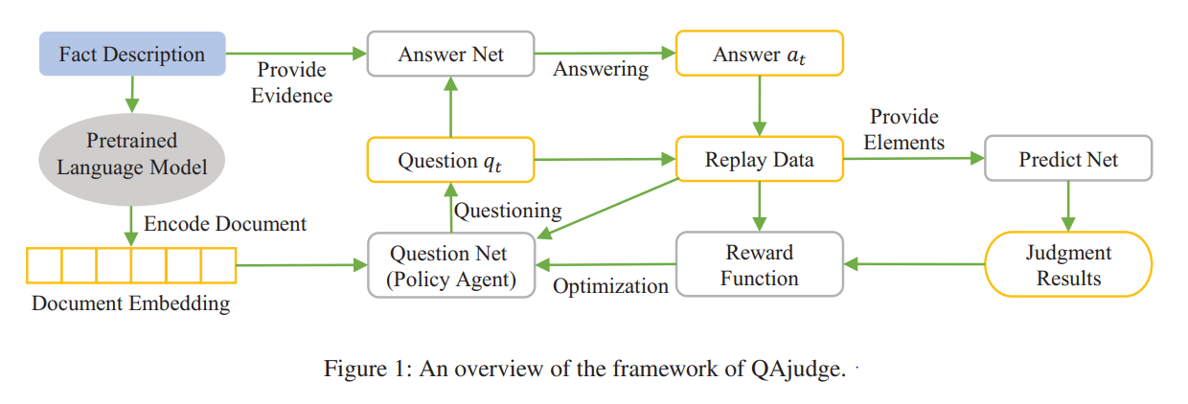
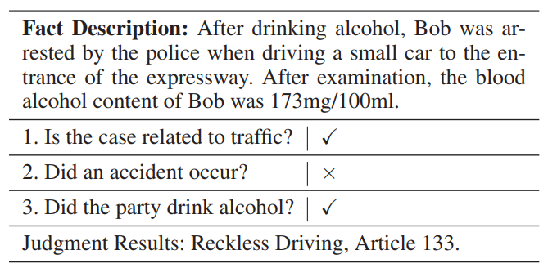
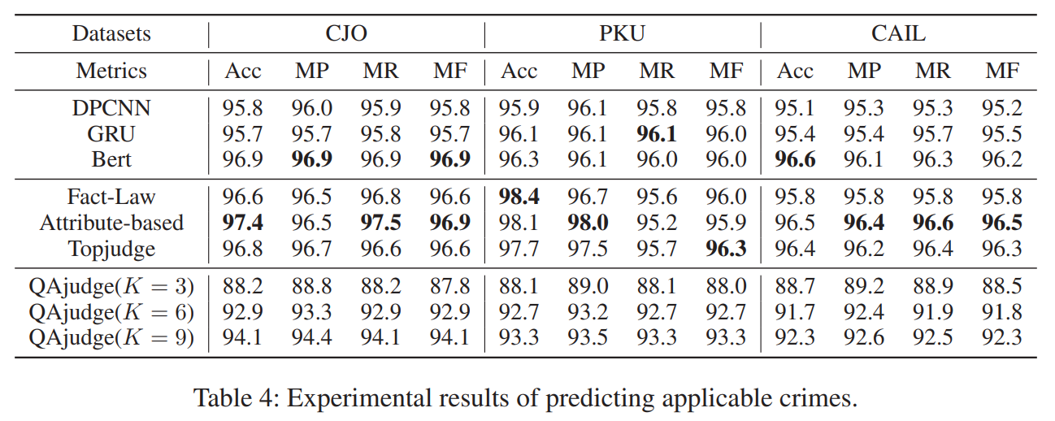
Iteratively Questioning and Answering for Interpretable Legal Judgment Prediction
Iteratively Questioning and Answering for Interpretable Legal Judgment Prediction

Slide 8
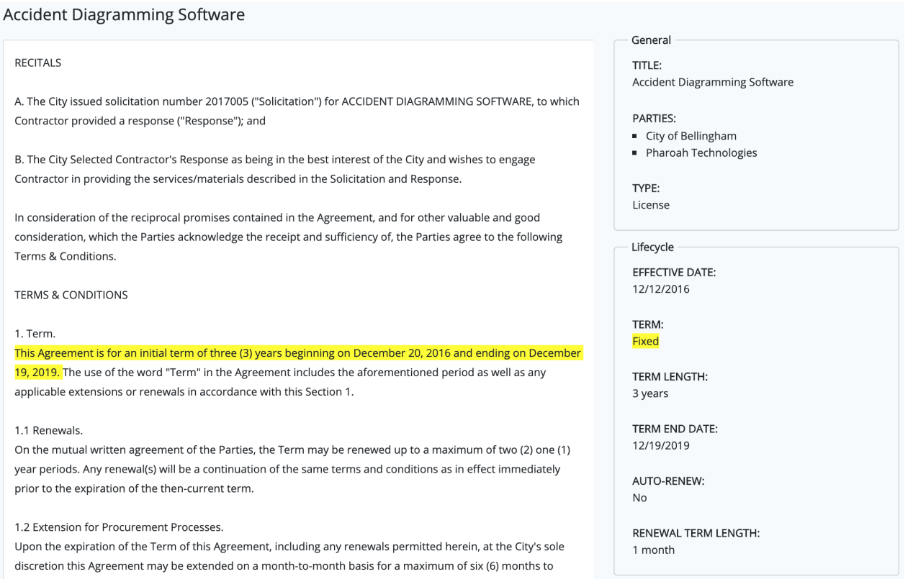
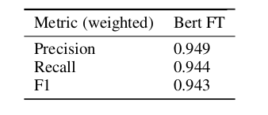
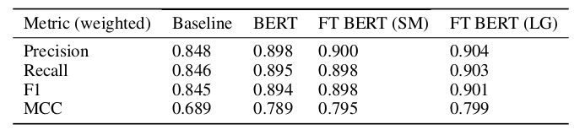
BERT Goes to Law School

Slide 9
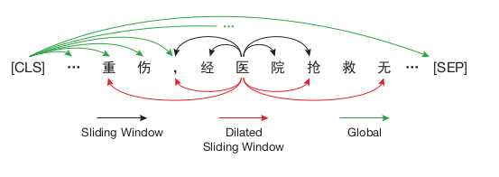
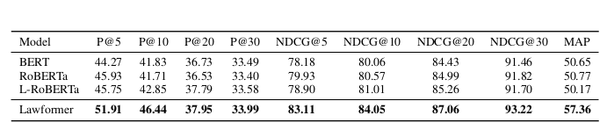
Lawformer: A Pre-trained Language Model for Chinese Legal Long Documents
Contribution:
Lawformer is the first pre-trained language model for legal long documents which is trained on Chinese legal documents.
Lawformer is evaluated on legal document understanding with a high degree of convergence on existing typical LegalAI tasks. In this benchmark, a new legal judgment prediction dataset for both criminal and civil cases is proposed.
Lawformer can achieve strong performance on various LegalAI tasks that require the models to process long documents. Lawformer has achieved comparable results with RoBERTa in the legal corpora.
Task specific datasets used to train Lawformer
Legal Judgement Prediction: CAIL-Long
Legal Case Retrieval: Legal Case Retrieval Dataset (LeCaRD)
Legal Reading Comprehension: Chinese judicial reading comprehension (CJRC)
Legal Question Answering: JEC-QA dataset

Slide 10
Thank You

