Slide 1
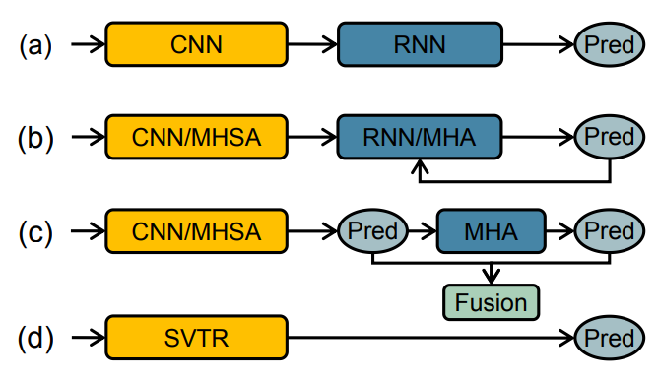
Deep Learning models used in the
Scene-Text Recognition Domain
CRNN
ENCODER DECODER BASED MODELS WITH MULTI HEADED SELF ATTENTION MODULES
VISION-LANGUAGE MODELS
SVTR

Slide 2
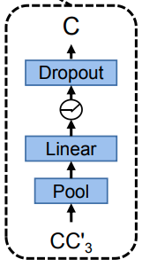
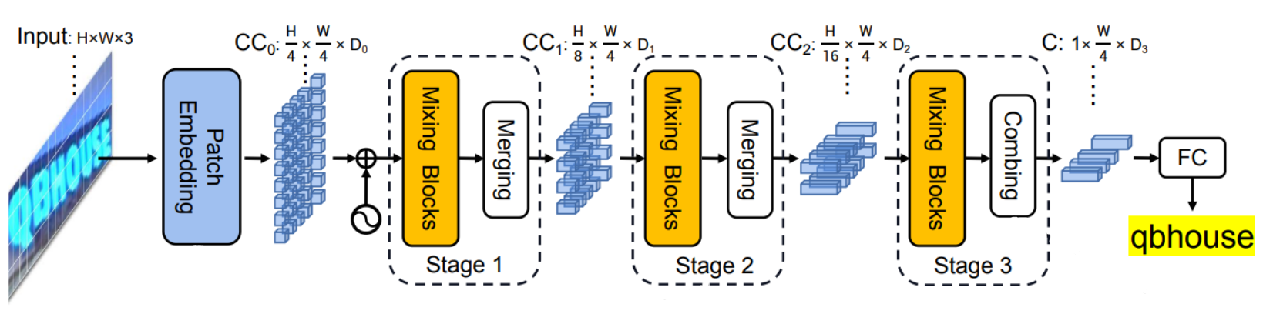
Model Architecture Overview
Global Mixing Blocks: Builds inter character relationship within input image
Local Mixing Blocks: Builds intra character relationship within input image
The height dimension of the input is progressively compressed with every merging operation with the help of a 3x3 convolution with stride of (2,1)
$H↓$

Slide 3
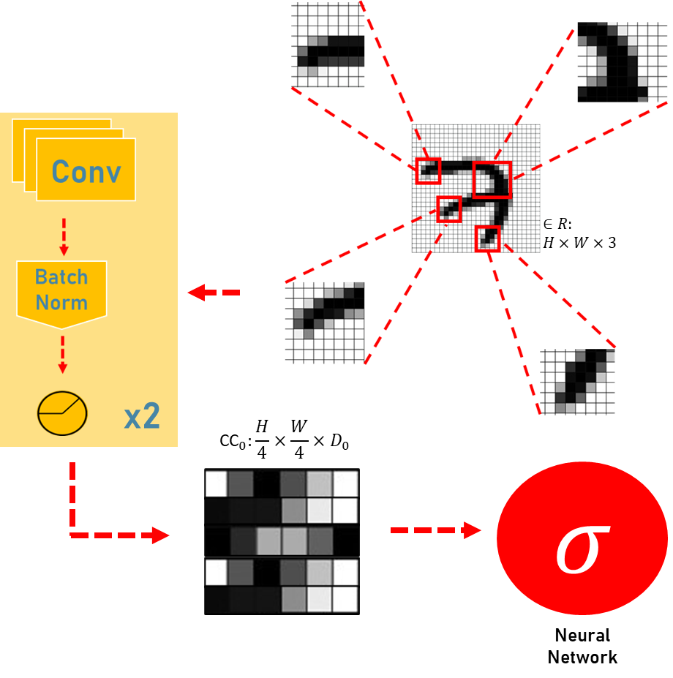
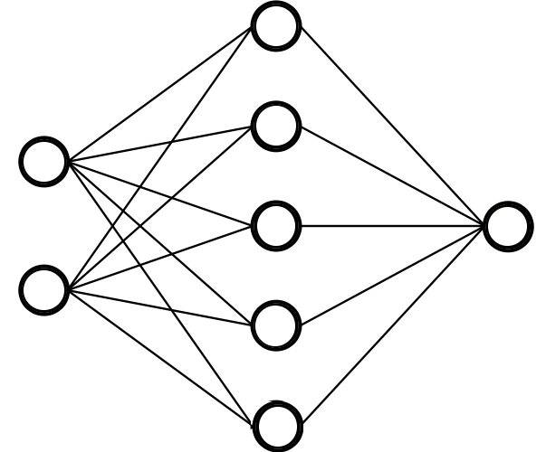
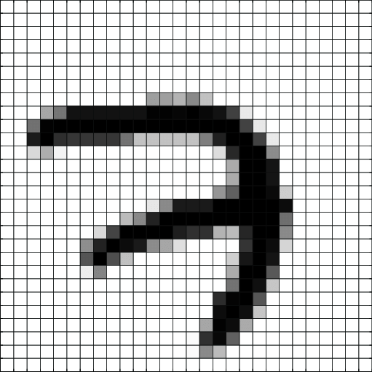
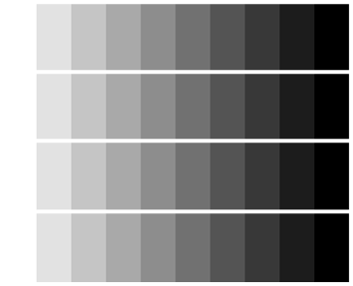
Progressive Patch Embedding
Two Stage Scene Text
Recognition model inputs
SVTR inputs
Encoder
Input
Input
Loss of information from encoder’s transformation of image to feature embedded vector
Feature encoded embedding
Decoder
Embedding from raw patches of input image with two cycles of one 3x3 convolution with a stride of 2 along with batch normalization and activation function

Slide 4
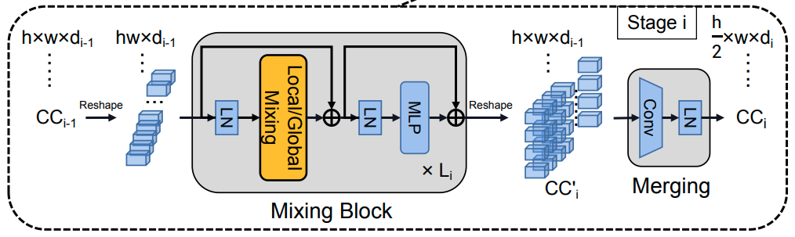
Mixing Stage Overview

Slide 5

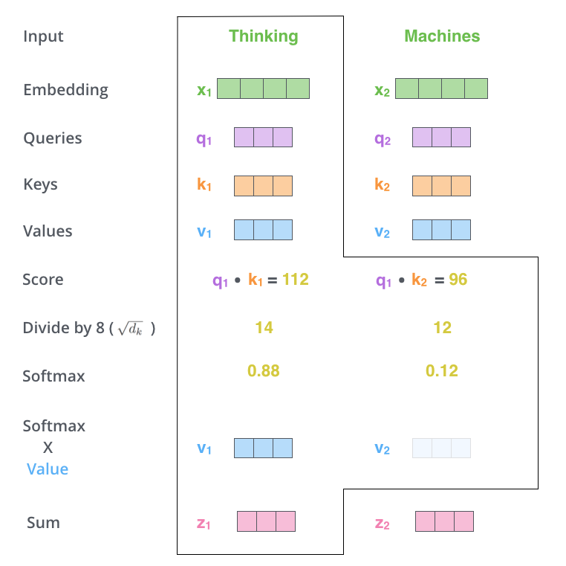
11
7
$Input∈hw×d_{i−1}$
7 x 11 convolution used on flattened patch matrix to mix intra character components for relationship building
In self attention head, each of the flattened patches of the input image is mapped to each other, thus mapping co-linearity between a character component’s intra granular stroke features
`
$Output∈hw×d_{i−1}$

Slide 6
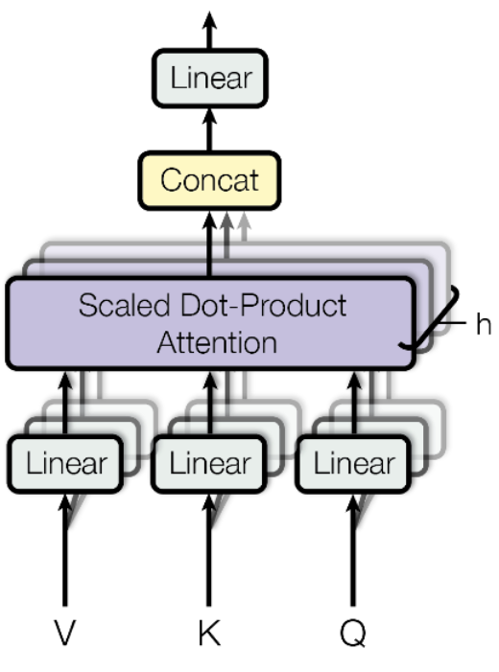
Global Mixing
$Input∈hw×d_{i−1}$
The layer normalized input is passed
through a multi headed self attention block in order to establish various relationships in between inter character components
`
$Output∈hw×d_{i−1}$

Slide 7
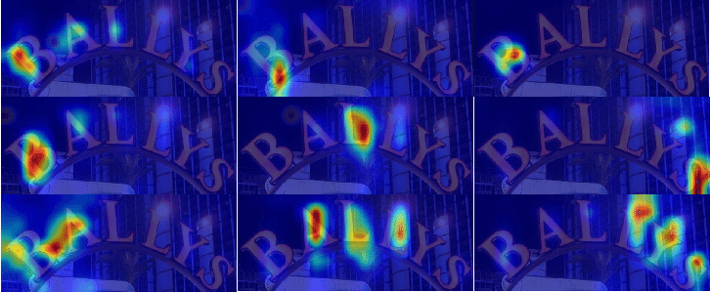
Attention Map of Mixing Blocks
The visualized attention maps, as provided in the paper, shows that stronger correlation can be seen between characters (inter relationships and perspectives) and just the characters themselves (intra relationships and perspectives)

Slide 8
Merging and Combining Blocks
3x3 Conv
Stride(2,1)
Layer
Normalization
Reshape
${CC}_{i−1}∈hw×d_{i−1}$
${CC}_{i−1}∈h×w×d_{i−1}$
${CC}_{i}∈\frac{h}{2}×w×d_{i}$
Pool (2,1)
Reshape
${CC}_{n−1}∈2w×d_{n−1}$
${CC}_{n−1}∈2×w×d_{n−1}$
${CC}_{n}∈\frac{h}{2}×w×d_{n}$

