Slide 1
Diabetes Prediction Using Machine Learning

Slide 2
Contents
Introduction
Proposed System
Block Diagram
Machine Learning Workflow
Algorithms
Results
Conclusion and future scope

Slide 3
Introduction
Diabetes is a common chronic disease that can be dangerous.
Diabetes can be identified when blood glucose is higher than normal level, which is caused by high secretion of insulin or biological effects.
Diabetes can cause various damage to our body and can disfunction tissues, kidneys, eyes and blood vessels.
Diabetes can be divided into two categories, type 1 diabetes and type 2 diabetes.
Patients with type 1 diabetes are normally younger with an age less then 30 years old. The clinical symptoms are increase thirst and frequent urination this type of diabetes cannot be cleared by medications as it requires therapy.
Type 2 diabetes occurs more commonly on middle-aged and old people, which can show hypertension, obesity and other diseases. with our living standards diabetes has increased commonly in people’s daily life.
So how to analyze diabetes is worth studying.

Slide 4
Proposed System
Our proposed system aims at Predicting the number of Diabetes patients and eliminating the risk of False Negatives Drastically.
In proposed System, we use Random forest, Decision tree, Logistic Regression and Gradient Boosting Classifier to classify the Patients who are affected with Diabetes or not.
Random Forest and Decision Tree are the algorithms which can be used for both classification and regression.
The dataset is classified into trained and test dataset where the data can be trained individually, these algorithms are very easy to implement as well as very efficient in producing better results and can able to process large amount of data.
Even for large dataset these algorithms are extremely fast and can able to give accuracy of about over 90%.

Slide 5
Introduction to Machine Learning

Slide 6
Block Diagram
Prediction
Testing Dataset
Model
Data
Algorithm
Evaluation
Training Dataset
Production data

Slide 7
Machine Learning Workflow
We can define the machine learning workflow in 5 stages.
Gathering data
Data pre-processing
Researching the model that will be best for the type of data
Training and testing the model
Evaluation

Slide 8
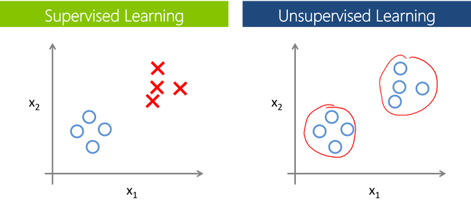
The machine learning model is nothing but a piece of code which an engineer or data scientist models by training it with the data according to the need of the project
Making the model learn through the data and allowing it to predict or give the solution that we want whenever we ask it to give.
So, whenever we give our model the new data which we want it to predict, we will get the predicted value according to the model training.
The trained model might or might not perform well on the test data that we want it to predict, due to various reasons,
So before trying to train any model we need to make sure that the algorithm that is going to use is appropriate for the desired class that we want to predict and based on the data that we are using.

Slide 9
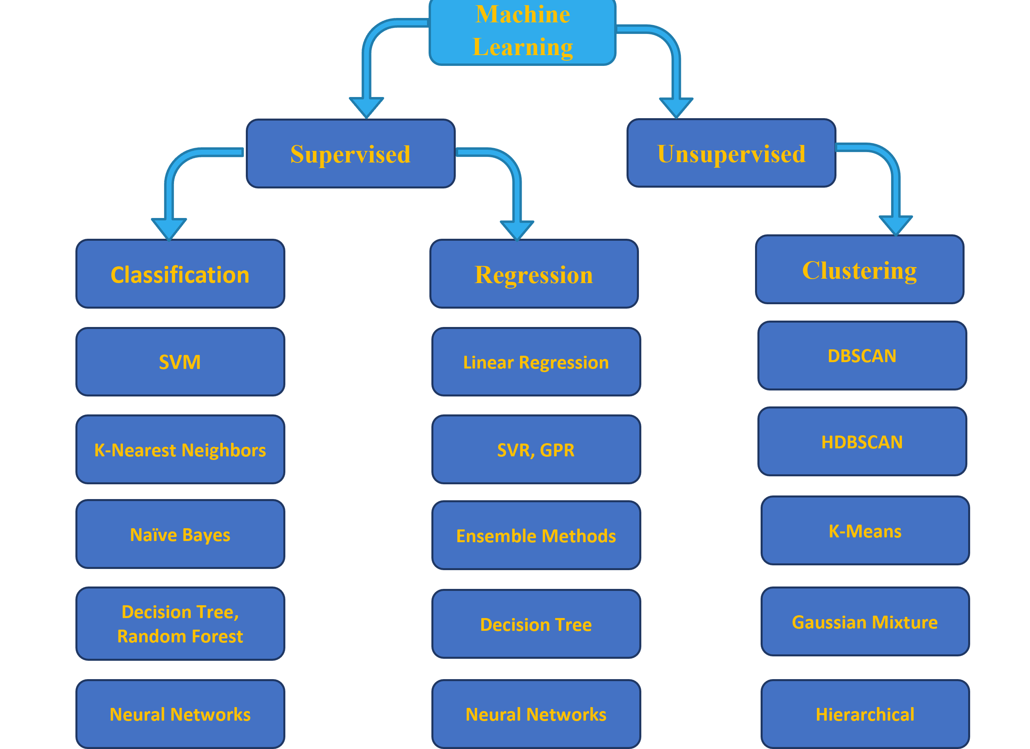
Overview of the Machine Learning Models

Slide 10
Training and Testing the model.
Training is the most important part, where we train our model using the data available and make the machine learn and understand the data.
When the model has learned from the data, we provide the model with another dataset to evaluate how good our model is performing, if it is performing well, we then test the model using test data, where we get to know the final performance of our model, which can be measure using various metrics, such as Accuracy, recall, precision, and through classification report.
This whole process of building and deploying a model is done using 3 different datasets which are split using train_test_split(), which are ‘Training data’, ‘Validation data’, and ‘Testing data’.

Slide 11
Algorithms Used

Slide 12
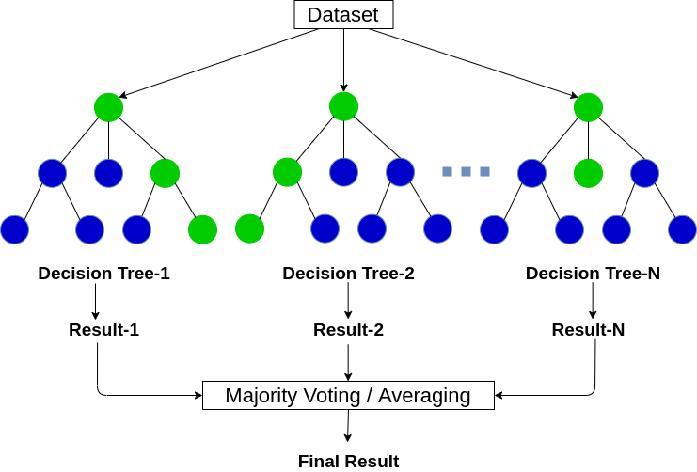
Algorithms(1/3)
The Random Forest Classifier
Random Forest is a popular machine learning algorithm that belongs to the supervised learning technique. It is one of the widely used algorithms, which perform well with any kind of dataset, be it classification or regression.
It is based on the concept of ensemble learning, which is a process of combining multiple classifiers to solve a complex problem, and at the end, the results are either made an average of all the classifiers or mode of all the classifiers.
The greater number of trees in the forest leads to higher accuracy and prevents the problem of overfitting.

Slide 13
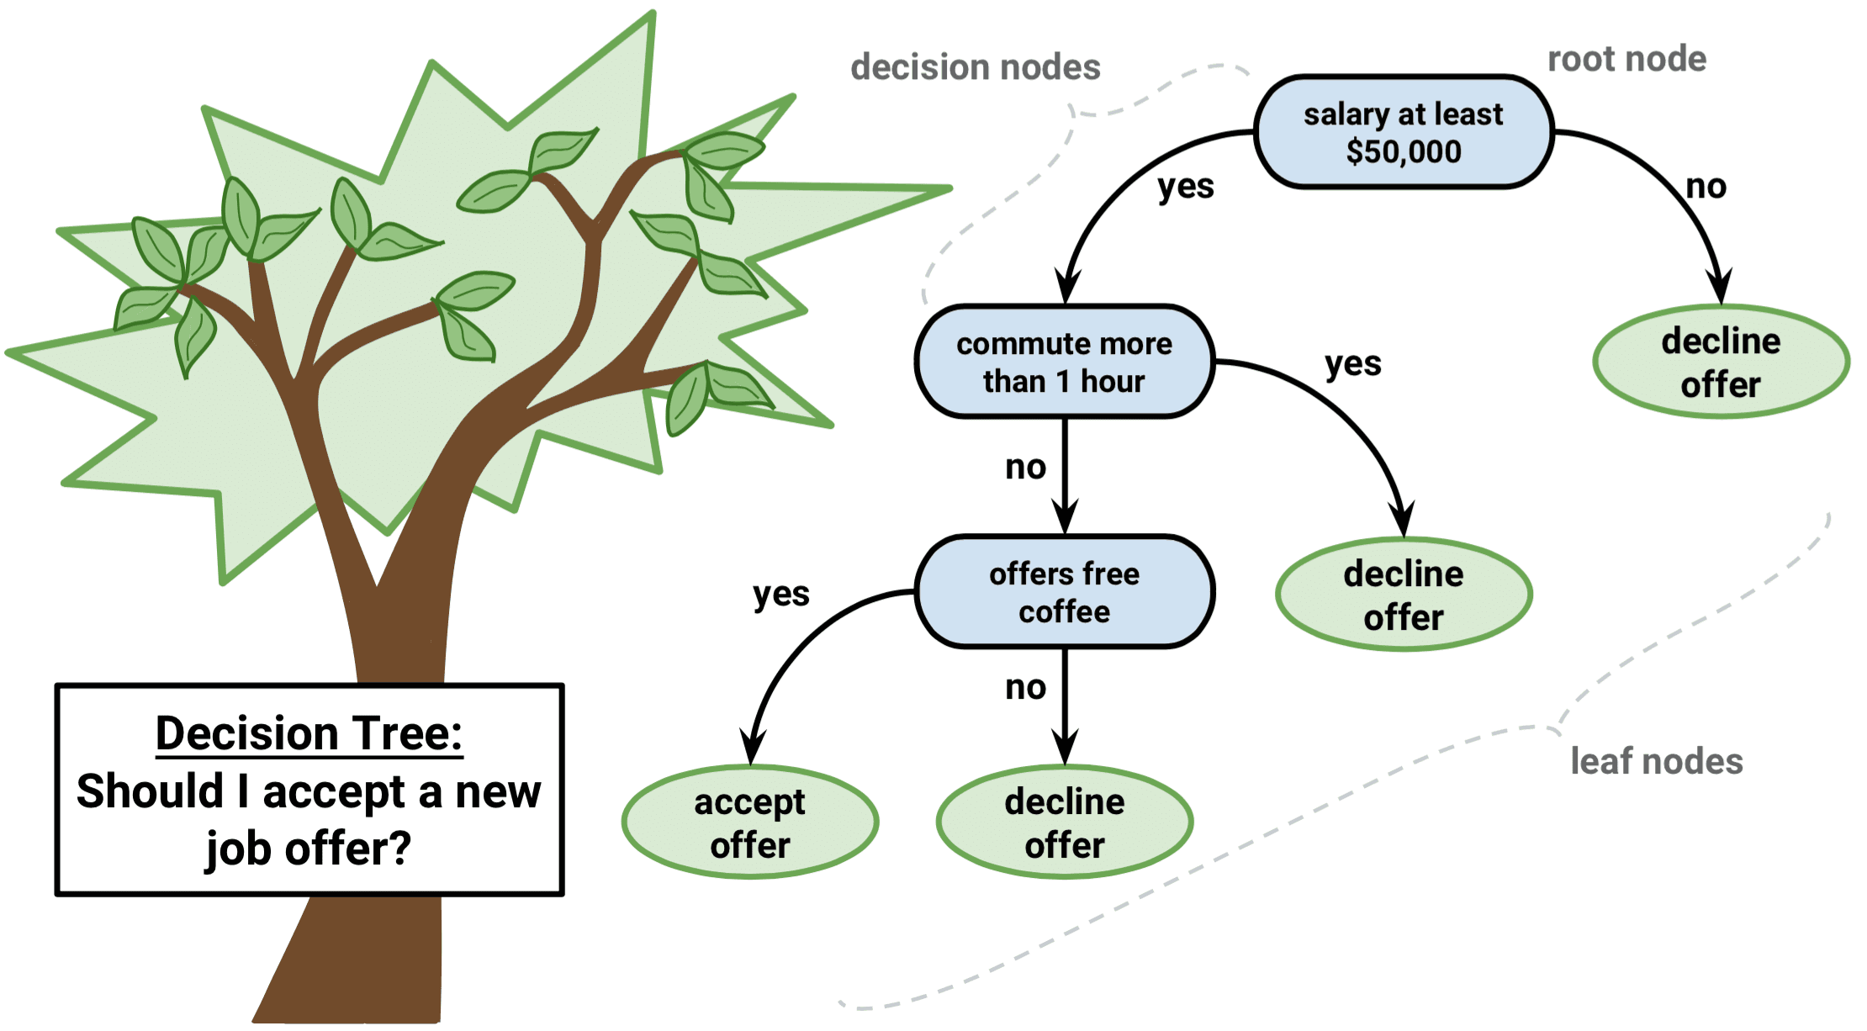
Algorithms(2/3)
Decision Tree
Decision tree, as the name suggests, creates a branch of nodes
Where each internal node denotes a test on an attribute, each branch represents an outcome of the test, and the last nodes are termed as the leaf nodes
Leaf node means there cannot be any nodes attached to them, and each leaf node (terminal node) holds a class label.
The decision tree is one of the most popular algorithms in machine learning, it can be sued for both classification and regression.
There are some exceptions to decision tree also, in terms of data scaling and data transformation, since decision tree works like a flowchart in the form of branches doing data transformation and scaling might be optional.

Slide 14
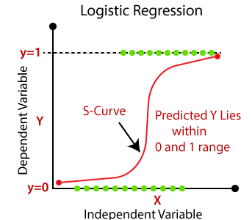
Algorithms(3/3)
Logistic Regression
Logistic regression models a relationship between predictor variables and a categorical response variable.
Logistic regression helps us estimate a probability of falling into a certain level of the categorical response given a set of predictors.
We can choose from three types of logistic regression, depending on the nature of the categorical response variable.
Binary Logistic Regression:
Used when the response is binary (i.e., it has two possible outcomes).
Nominal Logistic Regression:
Used when there are three or more categories with no natural ordering to the levels.
Ordinal Logistic Regression:
Used when there are three or more categories with a natural ordering to the levels, but the ranking of the levels do not necessarily mean the intervals between them are equal.

Slide 15
Algorithm(4/4)
Gradient Boosting Classifier
Gradient boosting is a powerful ensemble machine learning algorithm.
It’s popular for structured predictive modeling problems, such as classification and regression on tabular data, and is often the main algorithm or one of the main algorithms used in winning solutions to machine learning competitions, like those on Kaggle.
There are many implementations of gradient boosting available, including standard implementations in SciPy and efficient third-party libraries. Each uses a different interface and even different names for the algorithm.

Slide 16
Results

Slide 17
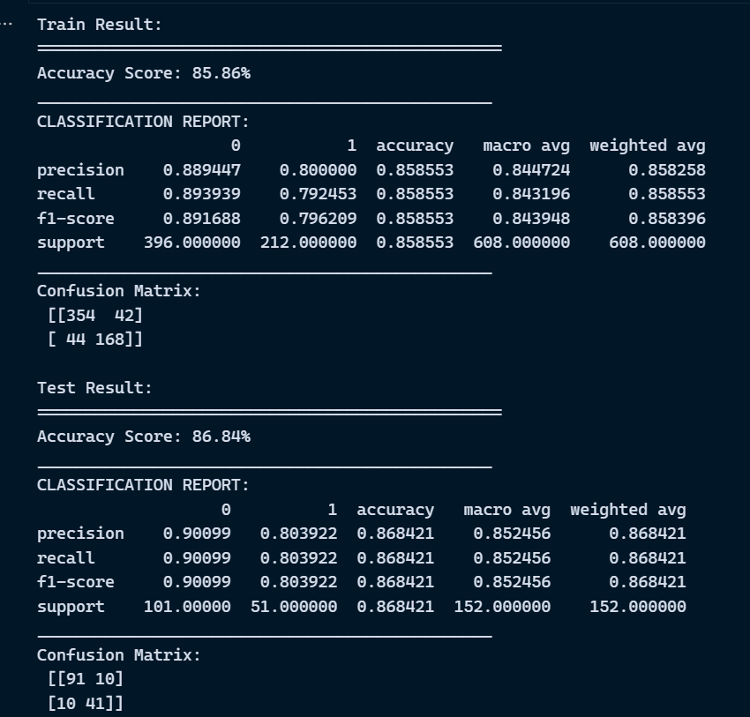
Logistic Regression

Slide 18
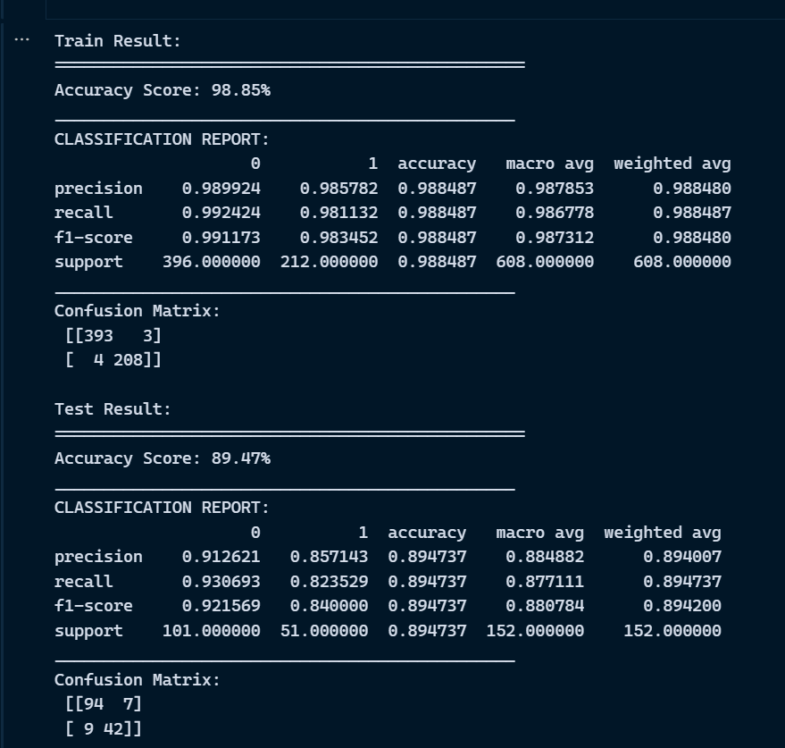
Decision Tree

Slide 19
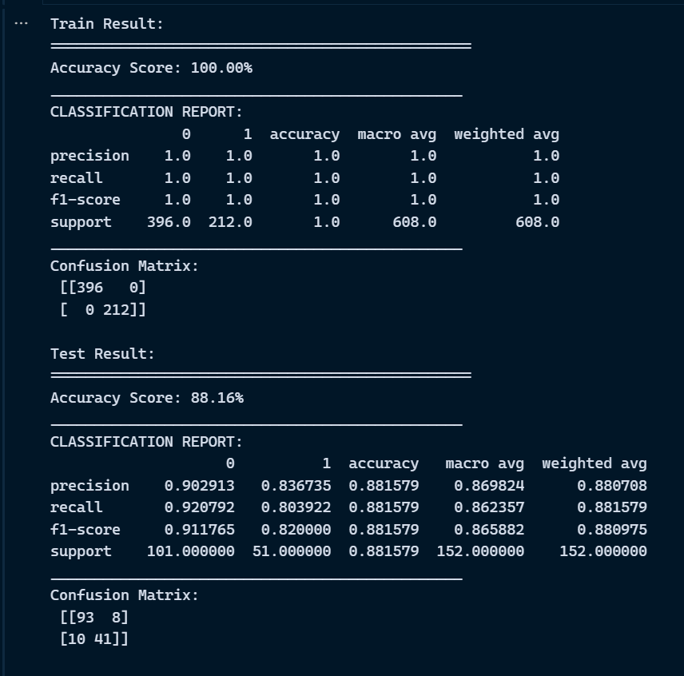
Random Forest

Slide 20
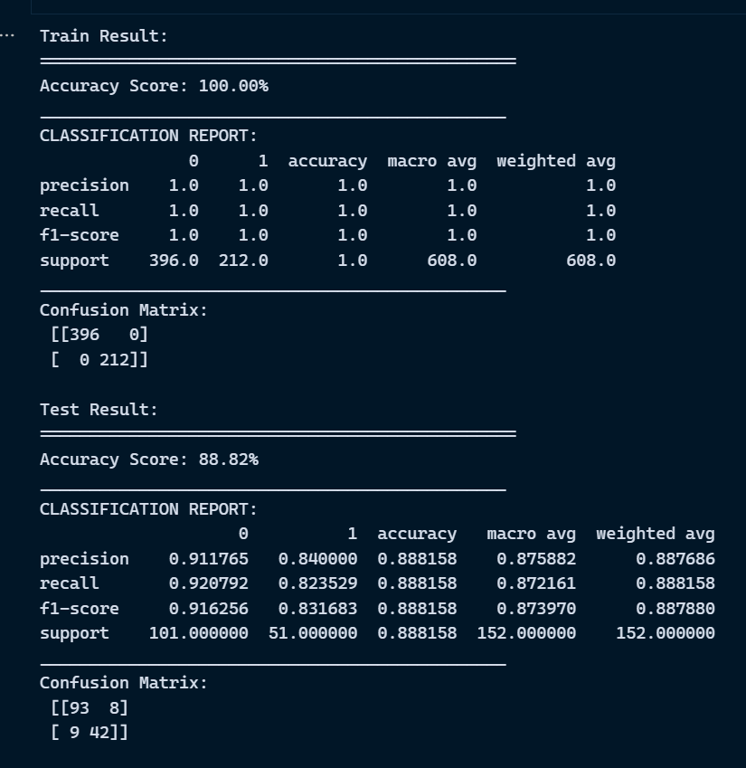
Gradient Boosting Classifier

Slide 21
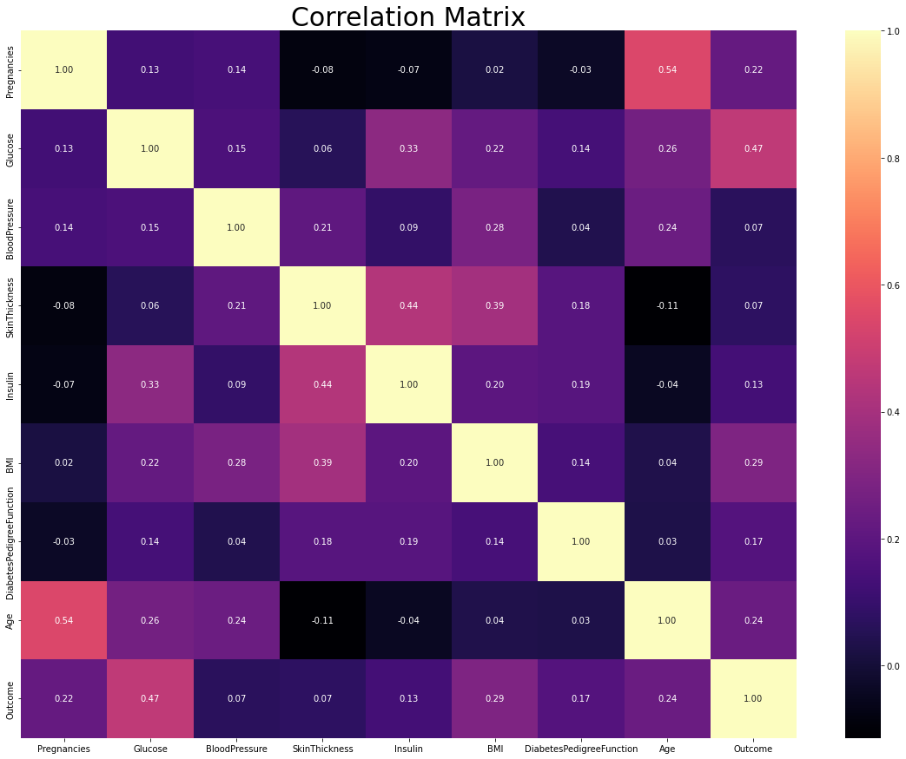
Correlation Diagram

Slide 22
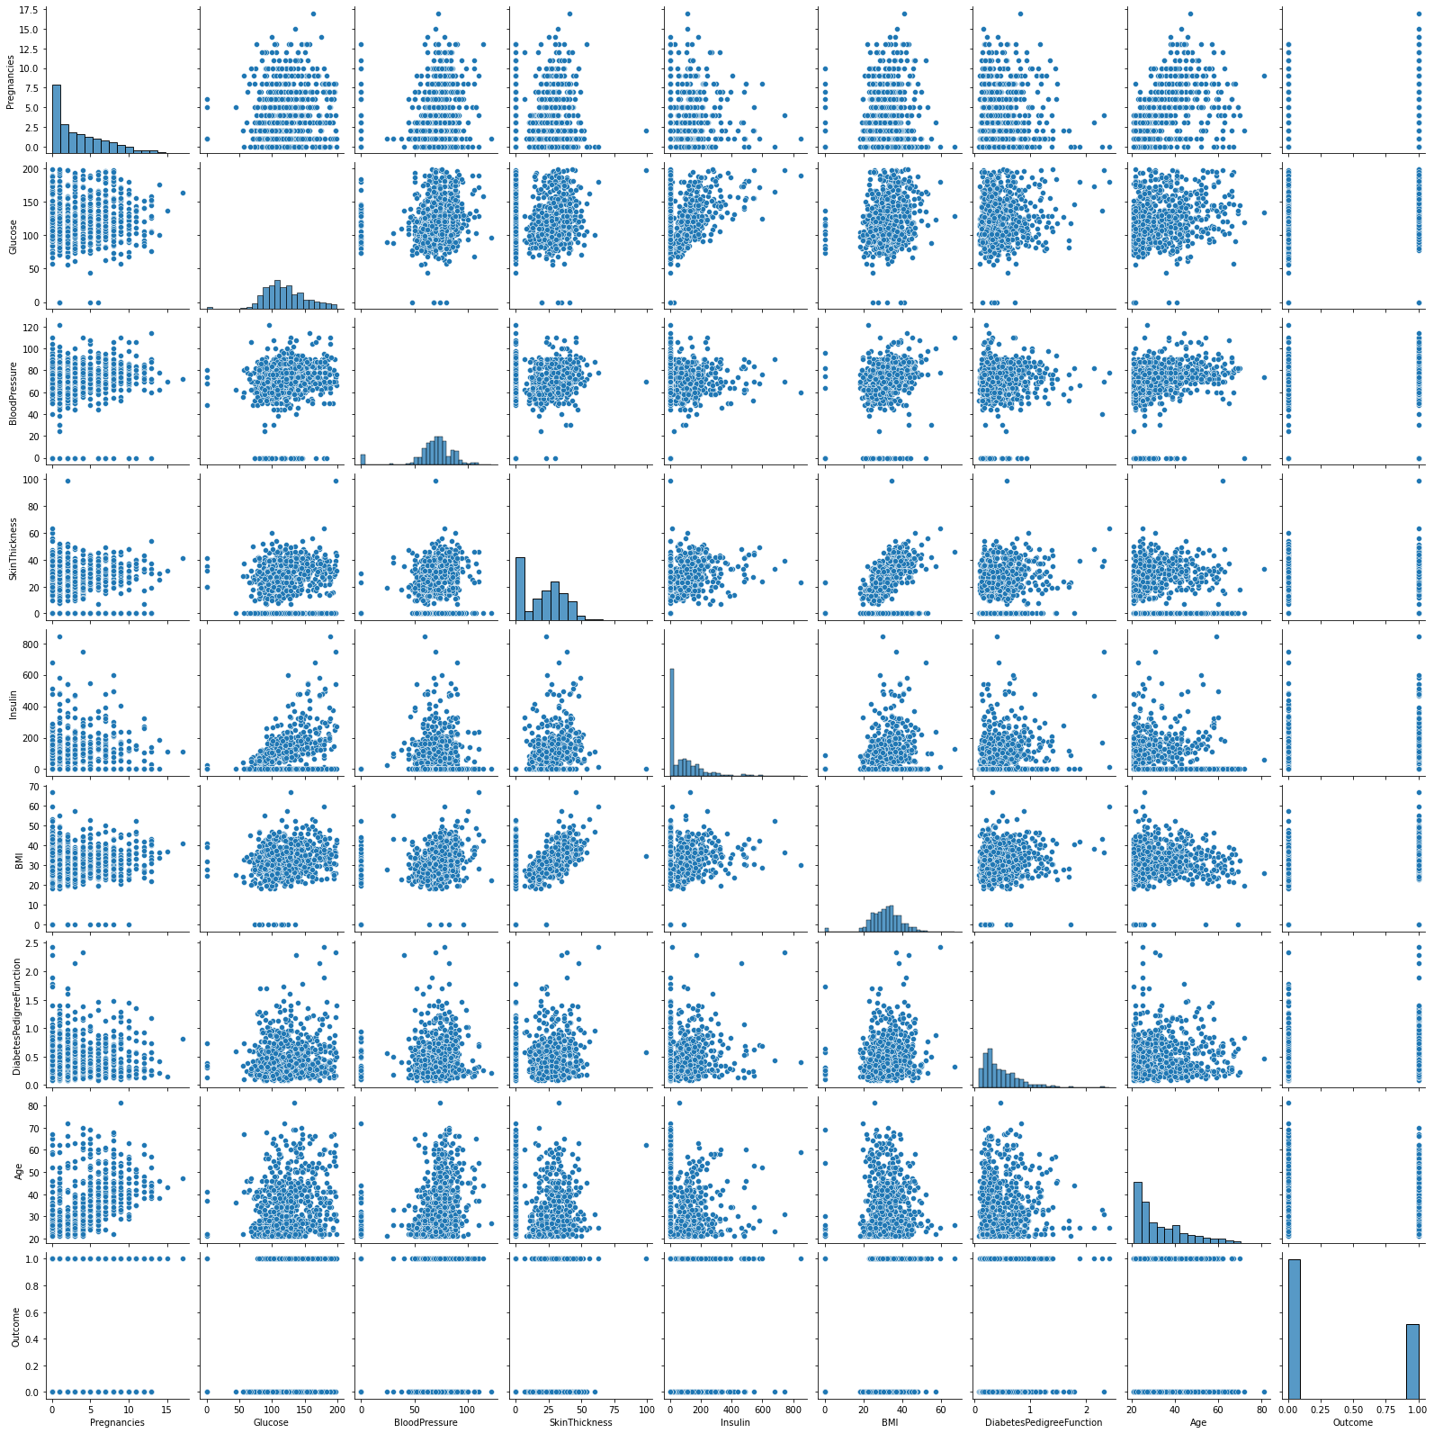
Pair Plot

Slide 23
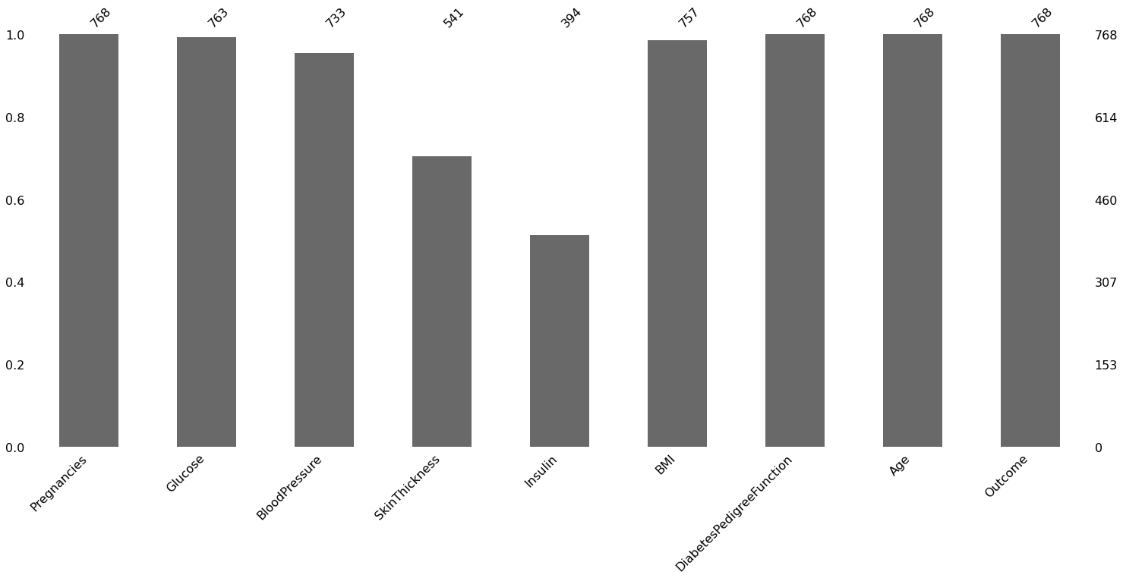
Missing Values

Slide 24
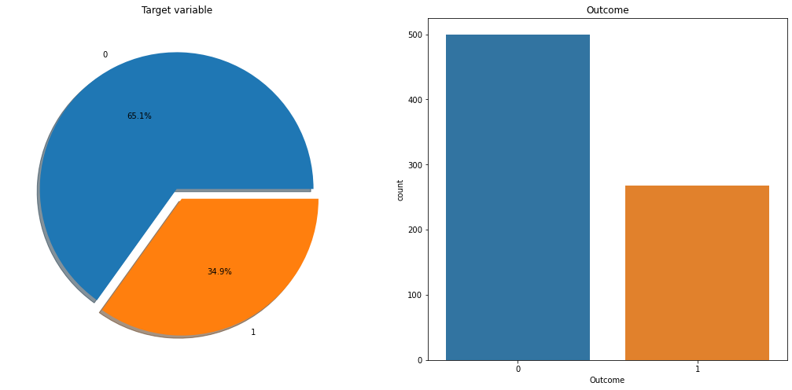
Outcome Variable

Slide 25
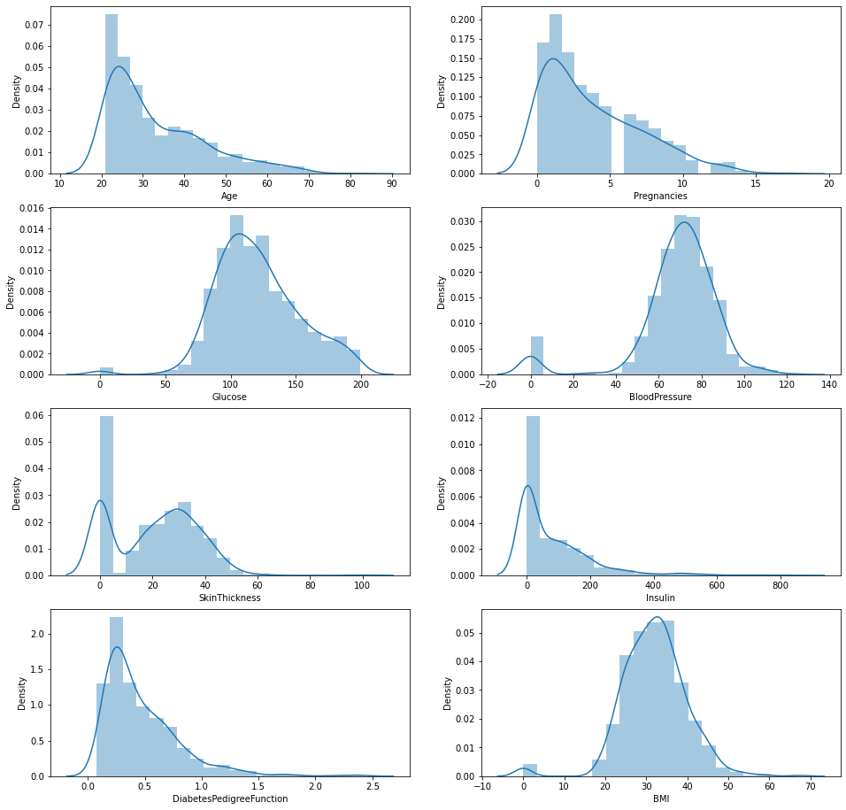
Density Plot

Slide 26
Conclusion
As per the main objective of the project is to classify and identify Diabetes Patients Using ML algorithms is being discussed throughout the project.
we build the model using some machine learning algorithms such as logistic regression, decision tree, Random Forest and Gradient Boosting, these all are supervised machine learning algorithm in machine learning.
As part of the future scope, we hope to try out different algorithms to optimize the feature output process, increase the feature similarity of data to improve the model's representation capability.

Slide 27
Thank You

