Slide 1
BALL CORPORATION · PROPOSAL
Establishing AI Practice and Agentic AI Framework at
Ball Corp
An enterprise-wide agentic AI operating model spanning ERP, JD Edwards, SAP, Databricks, open-source engineering, QA and the business functions.
Data & AI Foundation
Context Engineering
Agentic Mesh
FDE Delivery Model
Prepared for the Ball Corporation technology leadership team · Internal working draft
Notes:
Framing: Ball is not short of AI ideas — it is short of a shared foundation, an operating model and a delivery discipline that lets those ideas reach production across every system. This deck proposes a dedicated AI Division to own all three. No cost or schedule estimates are included by design; sequencing is expressed as phases.

Slide 2
CONTENTS
What we will cover
01
Where we stand
02
The foundation
03
The disciplines
Industry advancements in AI
Ball current status & gaps
The case for an AI Division
AI & Data roadmap
AI data assessment → GenAI framework
Databricks as the data foundation
AI tech stack & ADLC
Context engineering & the CE team
Harness engineering
Forward Deployed Engineer (FDE) model
04
The architecture
05
The integrations
06
The plan
Multi Agent orchestration/Agentic mesh
Six MCP servers
AI gateway & AI observability
DE.AI IDE ↔ Databricks
JD Edwards API ↔ Claude ↔ MCP
SAP IDE integration (in progress)
Agentic program task plan
Governance, security & risk
Success measures and the ask
Ball Corporation | AI Division Proposal | Confidential — Internal Draft
2
Notes:
Six sections. Sections 1–2 are the exec narrative; 3–6 carry the technical detail leadership will delegate.

Slide 3
TOPIC 1
Where the industry actually is in 2026
Published market signals — the shift from experimentation to governed production is already underway.
A
Protocol convergence
MCP has become the default way agents reach enterprise systems, removing bespoke glue between every model and every application.
B
Orchestration matured
Stateful multi-agent frameworks are now production patterns, with supervision, retries and hand-off semantics.
C
Governance caught up
Runtime control planes now govern models, agents and tools with the same catalogue, lineage and audit used for data.
Sources: industry surveys and vendor disclosures, 2026. Figures are market-level, not Ball-specific.
Ball Corporation | AI Division Proposal | Confidential — Internal Draft
4
Notes:
The 78% / 8% tension is the story: most teams have agents somewhere, very few have them governed in production. Ball's opportunity is to skip the ungoverned middle.

Slide 4
TOPIC 1
What changed: assistants → agentic systems
Yesterday — the assistant era
Today — the agentic era
Human types a prompt, reads an answer
Knowledge lives in the prompt
Integration by copy-paste
One model, one vendor
Value measured in time saved per person
Risk managed by user training
Success = a good demo
Agent receives a goal and executes a plan
Knowledge assembled by a context pipeline
Integration by MCP tools with typed schemas
Model routing by task, cost and data residency
Value measured in process cycle time and defect rate
Risk managed by policy, guardrails and audit trail
Success = a governed system running unattended
The implication for Ball: the investment shifts from licences and training toward data readiness, tool surfaces, policy and delivery engineering.
Ball Corporation | AI Division Proposal | Confidential — Internal Draft
5
Notes:
This slide is the pivot: every architecture decision later in the deck follows from the right-hand column.

Slide 5
TOPIC 2
Current status across the Ball estate
Illustrative baseline — every item marked [CONFIRM] must be validated with the system owner before this deck is presented.
Domain | Where we are today [CONFIRM] | AI readiness signal
ERP — JD Edwards EnterpriseOne | Core transactional backbone; AIS/Orchestrator available but used mainly for point integrations. Role-based security well established. | Provided couple of approaches how to Integrate AI Agents with JDE.
ERP — SAP | Coexists with JDE in parts of the estate; integration work under way. IDE-level AI integration is in progress, not yet standardised. | In progress
Data platform — Databricks | Lakehouse in place; Unity Catalog adopted for data governance. AI-specific governance (models, agents, tools) not yet extended. | Strong foundation, extension needed
Open source / engineering | Fragmented adoption of AI coding assistants across teams; no shared standards, evaluation or telemetry. | Establish ADLC process, build workflows to get more context on code repositories
Quality assurance | Largely manual and script-based regression; test data provisioning is a bottleneck. | High-value early agent target
Business functions | Departmental experimentation (finance, supply chain, commercial) using SaaS-embedded AI features. | Shadow adoption — needs a front door
Manufacturing & plant systems | Rich operational telemetry; limited exposure to the analytics/AI layer. | Untapped
Ball Corporation | AI Division Proposal | Confidential — Internal Draft
6
Notes:
Deliberately honest. The point is not that Ball is behind — it is that adoption is happening without a foundation, which is the expensive failure mode.

Slide 6
THE PROPOSAL
The Ball AI Division — charter and mandate
Mandate
Own the enterprise AI platform: gateway, mesh, MCP estate, observability and evaluation
Own the context layer: semantics, retrieval, memory and knowledge curation for all agents
Own the AI development lifecycle and the definition of production-ready
Embed engineers into business and system domains to deliver outcomes, not tickets
Set policy with Legal, Security, Privacy and Internal Audit — and make it enforceable in the runtime
Run enablement so every function can build safely inside the guardrails
Ball Corporation | AI Division Proposal | Confidential — Internal Draft
8
Notes:
The anti-mandate column matters more than the mandate column in the room. It is what stops the division being read as a land grab by system owners.

Slide 7
THE PROPOSAL
Operating model: a hub with embedded spokes
ERP & JDE
SAP
Databricks & Data
Embedded FDE pod · domain context owner
Embedded FDE pod · domain context owner
Embedded FDE pod · domain context owner
AI DIVISION — HUB
Platform · Context · Lifecycle · Policy
Engineering & OSS
Quality Assurance
Business Functions
Embedded FDE pod · domain context owner
Embedded FDE pod · domain context owner
Embedded FDE pod · domain context owner
Hub supplies: gateway, MCP estate, evaluation harness, observability, reference architecture, standards, enablement. Spokes supply: domain semantics, process ownership, adoption, and the business case.
Ball Corporation | AI Division Proposal | Confidential — Internal Draft
9
Notes:
Federated, not centralised. The hub is small and infrastructural; the mass of headcount sits in the spokes, reporting into the domain with a dotted line to the hub for standards.

Slide 8
TOPIC 3
AI & data roadmap — four horizons
Sequenced by dependency, not by calendar. Each horizon has an explicit exit condition before the next begins.
H1
Establish
H2
Enable
H3
Scale
H4
Compound
Stand up the AI Division and governance forum
Complete the AI data readiness assessment
Extend Unity Catalog to models, agents and tools
Deploy the AI gateway in front of all model traffic
Publish the AI acceptable-use and data-classification policy
Provision the first MCP servers over JDE, Databricks and the knowledge estate
Stand up the context engineering function and semantic layer
Introduce the ADLC and evaluation harness
Launch two lighthouse agents (QA regression, ERP master-data)
Complete the six-server MCP estate incl. SAP
Deploy the agentic mesh control plane
Embed FDE pods in every spoke domain
Roll out harness engineering across the SDLC
Open self-service agent building to the business
Multi-agent workflows spanning ERP, plant and commercial
Agent-to-agent delegation under mesh policy
Continuous evaluation and automatic regression gating
Cross-domain memory and institutional knowledge reuse
Exit: every model call at Ball is attributable, capped and logged.
Exit: a governed agent runs unattended in production with an owner and an SLA.
Exit: business teams ship agents without hub engineering in the critical path.
Exit: AI capability is a standing platform capability, not a programme.
Ball Corporation | AI Division Proposal | Confidential — Internal Draft
10
Notes:
Deliberately no durations. If pressed for timing, answer with the exit conditions — they are the honest gate.

Slide 9
TOPIC 3
Roadmap by workstream
Workstream | H1 · Establish | H2 · Enable | H3 · Scale | H4 · Compound
Data foundation | Readiness assessment; UC coverage of AI assets | Semantic layer; curated domain marts; vector indexes | Real-time and plant telemetry onboarded | Cross-domain knowledge graph
Platform | AI gateway; model routing; spend caps | First MCP servers; evaluation harness | Full MCP estate; agentic mesh control plane | Agent-to-agent policy; autoscaling runtime
Context engineering | Charter; ownership of definitions | CE team formed; retrieval and memory patterns | Domain context packs for every spoke | Continuous context quality scoring
Delivery (FDE) | Model defined; first two engineers | Pods in JDE and QA | Pods in every spoke; enablement programme | Business self-service with FDE coaching
Engineering / SDLC | Assistant usage telemetry and standards | Harness pipelines for AI-generated change | Agent DLC: build, test, deploy agents as code | Autonomous worker agents in delivery flow
ERP integration | JDE orchestration inventory and security review | JDE MCP server (read); Claude integration | JDE write-path with approvals; SAP MCP server | Cross-ERP process agents
Governance & risk | Policy, classification, forum, register | Guardrails at the gateway; audit trail | Model risk reviews; third-party agent policy | Continuous assurance and automated evidence
Ball Corporation | AI Division Proposal | Confidential — Internal Draft
11
Notes:
Read down a column for what a horizon looks like across the estate; read across a row for how a discipline matures.

Slide 10
ASSESSMENT
AI data assessment → a GenAI framework for Ball
Six connected deliverables. Each one is the input to the next; together they are the framework.
a
Data discovery & readiness assessment
b
Future-state architecture & recommendation
c
Building blocks: data ready for AI
Inventory the sources, score them for AI use, and expose the gaps that would otherwise surface as agent failures.
The target lakehouse, serving and retrieval architecture, with an explicit path from where Ball is today.
The reusable components — contracts, semantics, indexes, evaluation sets — that make data consumable by agents.
d
AI agentic hybrid approach
e
Agentic AI ecosystem
f
AI agentic action flow
Where Ball uses deterministic automation, where it uses agents, and how the two hand off to each other.
The full runtime: models, tools, memory, policy, humans-in-the-loop and the systems of record they touch.
The step-by-step path a single business request takes, from intent to audited action in a system of record.
Ball Corporation | AI Division Proposal | Confidential — Internal Draft
12
Notes:
The next six slides expand a–f in order.

Slide 11
ASSESSMENT · A
Data discovery and readiness assessment
What we inventory
How each source is scored
Systems of record: JDE, SAP, MES/plant historians, WMS, CRM, HR
Analytical estate: lakehouse tables, marts, semantic models, reports in active use
Unstructured estate: SOPs, work instructions, specifications, quality records, contracts, tickets, engineering docs
Metadata: lineage coverage, ownership, classification, retention and residency constraints
Access: who can see what today, and how that maps to what an agent may retrieve on their behalf
Findable
Catalogued, owned, described
Trusted
Quality rules, freshness, reconciliation
Semantic
Business meaning defined once, not per report
Governed
Classified, access-controlled, lineage complete
Retrievable
Chunked, embedded, filterable by permission
Evaluable
A gold-standard question set exists for it
Output: a scored source register, a prioritised remediation backlog, and the shortlist of domains ready to carry a lighthouse agent.
Ball Corporation | AI Division Proposal | Confidential — Internal Draft
13
Notes:
Six-dimension scoring keeps the assessment objective and lets us defend why a domain is or is not ready.

Slide 12
ASSESSMENT · B
Future-state architecture and recommendation
Experience
Genie-style conversational surfaces · agents in Teams/Slack · embedded assistants in JDE, SAP and QA tooling · IDE agents
Agent runtime
Agentic mesh: registry, orchestration, delegation, memory, human-in-the-loop checkpoints
Tool & context layer
MCP servers over ERP, lakehouse, documents and DevOps · retrieval and semantic services · prompt/context assembly
Model & policy layer
AI gateway: routing, spend caps, PII and prompt-injection guardrails, residency enforcement, full request capture
Data foundation
Databricks lakehouse · Unity Catalog governing data, models, agents, MCP services and skills · vector and search indexes
Systems of record
JD Edwards EnterpriseOne · SAP · MES and plant historians · WMS · CRM · document repositories
Recommendation: extend what Ball already governs rather than building a parallel AI stack. Unity Catalog becomes the single registry for data and AI assets; the gateway becomes the single egress for model traffic.
Ball Corporation | AI Division Proposal | Confidential — Internal Draft
14
Notes:
Six layers, bottom-up dependency. If someone asks 'why not just buy an agent platform', the answer is layer 5 — we would fork governance.

Slide 13
ASSESSMENT · C
Building blocks: making Ball data ready for AI
01
Contracts & quality
02
Semantics
03
Retrieval
04
Evaluation
Data contracts on every source feeding an agent
Freshness and completeness SLOs
Reconciliation back to the system of record
Break-glass alerts when a contract fails
One definition per business concept, owned by a named steward
Metric and dimension layer agents query instead of raw tables
Synonyms and plant-local vocabulary mapped to canonical terms
Chunking tuned per document class (SOP vs. spec vs. ticket)
Embeddings refreshed on change, not on schedule
Permission-filtered search — retrieval respects source ACLs
Hybrid keyword + vector for part numbers and codes
Gold question/answer sets per domain
Regression suite run on every context or model change
Human review queue for low-confidence responses
Traceable score history per agent version
None of these are AI projects. They are data engineering projects that AI finally makes non-optional.
Ball Corporation | AI Division Proposal | Confidential — Internal Draft
15
Notes:
Useful line for a sceptical CFO: most of this backlog has business value with or without agents.

Slide 14
ASSESSMENT · D
The AI agentic hybrid approach
D
Deterministic
A
Assisted
G
Agentic
Rules, orchestrations and pipelines
Used for: financial postings, regulated quality records, inventory movements
Guarantee: same input, same output, every time
Ball example: a JDE orchestration that creates a purchase order
Model proposes, human disposes
Used for: master-data changes, engineering change proposals, supplier correspondence
Guarantee: no state changes without an approval event
Ball example: agent drafts a supplier quality notification for QA sign-off
Model plans and executes within a bounded tool set
Used for: research, triage, test generation, document synthesis, analysis
Guarantee: reversible actions only, full trace, policy-bounded
Ball example: agent builds and runs a regression suite against a release candidate
The hand-off rule: an agent may plan freely, but any action that writes to a system of record must execute through a deterministic, permissioned, logged path — an orchestration or an API with its own controls. The agent never becomes the control.
Ball Corporation | AI Division Proposal | Confidential — Internal Draft
16
Notes:
This is the slide that satisfies Internal Audit and the plant leadership. The agent is never the system of control.

Slide 15






























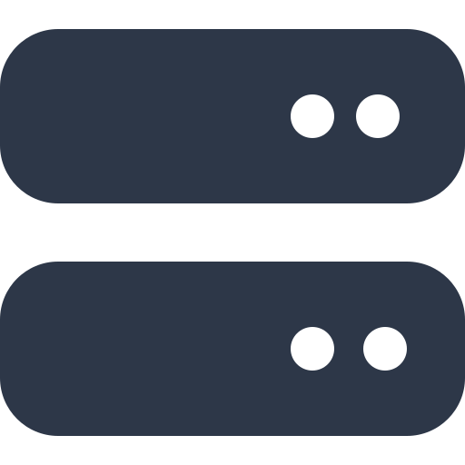



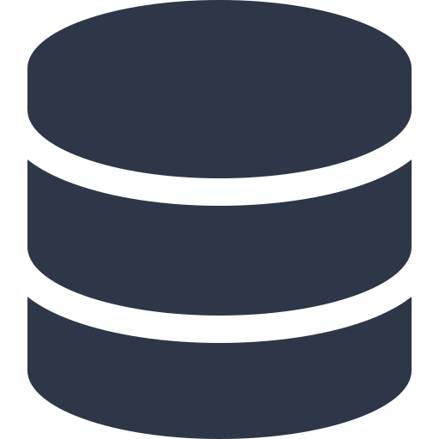


























BALL CORPORATION — ENTERPRISE AGENTIC AI ARCHITECTURE ON AZURE (2026)
Production-Ready • Modular • Secure • Observable • Azure-Native • Foundry-First • Cost Governed • Plant to Cloud
1. CLIENT LAYER
2. API GATEWAY
3. AUTHENTICATION & AUTHORIZATION
4. ADMIN & OPERATIONS PANEL
5. AI GATEWAY (MODEL ROUTER)
22. SECURITY &
GOVERNANCE
Plant Ops Web App
Route Management
OAuth2 / OIDC
User & Role Management
Knowledge Bases
Unified API • Model Routing • Fallbacks • Cost Optimization • A/B Testing
Key Vault /
(React / Next.js)
Rate Limiting
Token Validation (JWT)
Azure OpenAI
Foundry
Foundry
Foundry
Foundry
Foundry
Managed HSM
Mobile Apps
AI Providers & Models
System Settings
(GPT-4.1 / 4o)
(Llama 3.x)
(Mistral)
(DeepSeek)
(Phi-4)
(Grok)
(iOS, Android — line ops)
Load Balancing
RBAC / ABAC
Encryption
Teams App / Copilot
Agent Registry
Logs & Monitoring
Anthropic Claude
Google Gemini
Self-Hosted
(CMK, TDE, TLS)
(Microsoft 365)
API Versioning
Conditional Access
(via APIM)
(via APIM)
(AKS + vLLM)
CLI / Terminal
Request Validation
Multi-Factor Auth / PIM
Workflows & Templates
Billing & Usage
PII Protection
(Engineering power users)
Logging & Monitoring
Azure API Management AI Gateway / Foundry Model Router
& Masking (Purview)
Partner APIs
Fine-Grained Permissions
Prompt Management
Security & Policies
(Suppliers, co-packers)
Azure Front Door + API Management
Microsoft Entra ID
Token limits, quotas and fallbacks enforced per plant & business unit
Prompt Shields
(Injection defence)
Workflow Orchestration
State Management
Checkpoints
Retries & Timeouts
Human-in-the-Loop
Parallel Execution
Event Driven
6. AGENT ORCHESTRATOR & WORKFLOW ENGINE
7. MEMORY LAYER
Content Safety
Foundry Agent
Service
Semantic
Kernel
AutoGen
LangGraph
Durable
Functions
Logic Apps
Working Memory
Conversation Memory
Long-Term Memory
& Guardrails
Agent Types (Examples)
(Short-term)
(Session)
(Persistent)
Rate Limiting
Planner
Agent
Quality
Agent
Maintenance
Agent
Supply
Agent
Spec
Agent
Sustainability
Agent
Analyst
Agent
…More
Agents
Semantic Memory
Episodic Memory
& Abuse Prevention
(Embeddings — AI Search)
(Events & experiences)
Audit Logs
Cosmos DB · Azure Cache for Redis · Azure AI Search
& Compliance
Data Lineage
8. RAG PIPELINE
9. EMBEDDING LAYER
10. VECTOR & SEARCH LAYER
11. KNOWLEDGE GRAPH
12. TOOL & MCP LAYER
13. CACHE LAYER
14. QUEUE & EVENT BUS
(Purview governance)
Document Ingestion
OCR / Parsing
Chunking
Metadata Extraction
Embedding Generation
Quality Validation
Indexing
text-embedding-3-large
Azure AI Search (Vector)
Cosmos DB Gremlin
MCP Servers (Examples)
Azure Cache for Redis
Azure Service Bus
Azure Policy
text-embedding-3-small
pgvector (Azure PostgreSQL)
GraphRAG (Azure)
SAP S/4HANA
SharePoint / Files
Semantic Cache (APIM)
Event Hubs (Kafka)
& Defender for Cloud
Cohere Embed v3 (Foundry)
Cosmos DB (DiskANN)
Entity Extraction (AI Language)
AVEVA PI
Graph / Webhooks
Event Grid
NV-Embed (Foundry)
FactoryTalk MES
Coupa / Ariba
Embedding Cache
Storage Queues
Compliance
BGE / E5 (AKS self-host)
Hybrid Search
(Vector + BM25 + Semantic Ranker)
Relationships & Linking
Azure SQL / Cosmos
…More
Durable Functions
(GDPR, SOC 2, ISO)
…More Models
Gremlin / Cypher queries
Tool Registry & Permissions
Response Cache
Logic Apps (Workflows)
15. DATA LAYER
16. OBJECT STORAGE
17. PROMPT MANAGEMENT
18. EVALUATION LAYER
19. HUMAN-IN-THE-LOOP
20. COST & USAGE MONITORING
21. OBSERVABILITY & MONITORING
Azure SQL (Primary DB)
Blob Storage (Hot / Cool)
Prompt flow templates
Azure AI Evaluation SDK
Review & Approve (QA Mgr)
Token Usage Tracking (APIM)
TRACING & EVALUATION
LOGS & METRICS
ALERTING
PostgreSQL + pgvector
ADLS Gen2
Versioning
Foundry Evaluations
Edit & Feedback
Cost Estimation
Azure Monitor (Traces)
Log Analytics Workspace
Azure Monitor Alerts
Operational Data
User & Role Data
Metadata
Fabric Analytics
Azure Files
Variables & Key Vault secrets
RAGAS (OSS)
App Insights (APM)
Azure Managed Grafana
Action Groups
Documents & Specs
Hallucination Detection
Context Relevance
Answer Correctness
Groundedness
Escalation Rules
Budget Alerts (Cost Mgmt)
Images (defect photos)
Prompt Library
Audit Decisions
Usage Reports by plant
Foundry Tracing
Metrics & KQL queries
PagerDuty / Teams
Audio / Video
A/B Testing
Expert Validation
Model Cost Comparison
OpenTelemetry
Workbooks
SLO & error budgets
Backups
23. DEVOPS &
DEPLOYMENT
CONTAINERIZATION
ORCHESTRATION
CI / CD PIPELINE
INFRA AS CODE
CONFIG & SECRETS
DEPLOYMENT TARGETS
24. BACKUP & DISASTER RECOVERY
• Docker / ACR
• AKS / Container Apps
• Azure DevOps
• Bicep
• Helm
• AKS / Container Apps
Database Backups
Search Index Backups
Object Storage Backups
Configuration Backups
Point-in-Time Recovery
• GitHub Actions
• Terraform
• App Configuration
• Azure Functions
(Azure Backup, automated)
(AI Search / pgvector)
(Blob versioning, GRS)
(Prompts, models, policies)
(Geo-replication & versioning)
• Ansible
• Key Vault
• Azure Local (plant edge)
• On-Prem MES gateway
ARCHITECTURE PRINCIPLES
LEGEND (DATA FLOW)
NOTES
• Modular & Decoupled
• Observable & Measurable
• Open Standards (MCP, OTel)
Synchronous Flow
Azure-first reference architecture for Ball Corporation beverage packaging operations — plant floor to cloud.
Non-Azure models are reached through API Management as external backends; plant-edge workloads run on Azure Local.
Costs vary by region, reserved capacity and PTU commitments; validate residency and CMK requirements per plant.
• Scalable & Elastic
• Cost Governed
• Azure-Native
Asynchronous Flow
• Secure by Design
• AI-Native
Management / Control Flow
Notes:
Editable Azure-native enterprise agentic AI reference architecture (24 sections) contextualised for Ball Corporation beverage packaging manufacturing and supply chain. Custom 13.333x9in canvas matching the source proportions; all boxes, arrows and text are native PowerPoint objects.

Slide 16














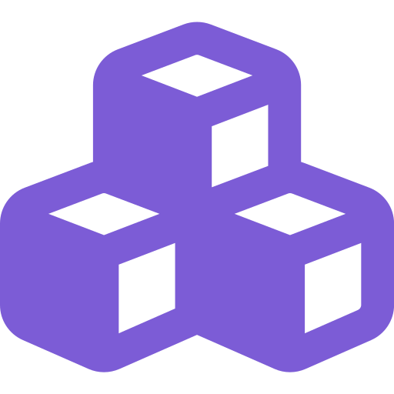









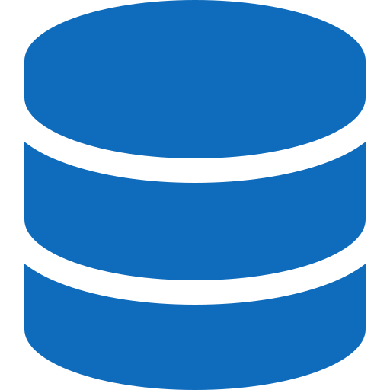









Enterprise AI Governance Architecture
Ball Corporation — A Unified Platform: AI Gateway + Microsoft Foundry + Microsoft Fabric
BUSINESS OUTCOMES
AI
CONSUMERS
Copilots
Teams Agents
Plant & Quality
Agents
Customer Service
Agents
Plant Ops Apps
Partner APIs
Governed AI
(Microsoft 365)
(Shift handover)
(Web & mobile)
/ SDKs
One policy set and guardrails across every plant
AI Gateway
PUBLIC PREVIEW
Enterprise Scale
ENTERPRISE AI CONTROL PLANE · Azure API Management
Consistent, secure access for all AI workloads
Security
Governance
Observability
Cost Control
Content Safety
MCP Governance
Traffic Management
Audit Ready
Authentication
& Authorization
Policy Enforcement
& Compliance
Monitoring, Tracing
& Audit Logs
Token Quotas, Rate
Limits & Cost Visibility
Filtering &
Risk Controls
MCP Servers &
Tool Governance
Routing, Load
Balancing & Failover
Complete traceability for customer and regulatory audits
Unified access, security, policy enforcement and observability for every AI workload and tool — across all Ball plants, regions and business units
Cost Visibility
Token spend tracked by plant and business unit
“
Microsoft Foundry
The future challenge
isn't building AI.
BUILD, ORCHESTRATE & OPERATIONALISE AI · formerly Azure AI Foundry
Models
Agent Service
Prompt Flows
Evaluations
RAG
Vector Stores
MCP Servers
Security by Default
It's governing
AI at scale.
(GPT-4.1 + Ball
fine-tuned)
(Plant agents)
(Orchestration)
(Quality & Safety)
(Specs, SOPs, NCRs)
(Azure AI Search)
(SAP, PI, MES)
Entra identity, content safety and compliance built in
Microsoft Fabric
Faster Innovation
TRUSTED ENTERPRISE DATA FOUNDATION · PLANT FLOOR TO CLOUD
Plants self-serve within enterprise guardrails
OneLake
Lakehouse
Warehouse
Real-Time
Intelligence
Power BI
Data Factory
(Unified plant data)
(SAP + MES + PI)
(Analytics)
(Line telemetry)
(OEE & quality)
(Pipelines)
Request / Response
Telemetry / Logs
Policies / Governance
Adapted for Ball Corporation manufacturing & supply chain · AI Gateway tier in Azure API Management is in public preview
Notes:
Editable enterprise AI governance architecture for Ball Corporation: AI Gateway (Azure API Management, public preview) over Microsoft Foundry over Microsoft Fabric. Custom 13.333x8.9in canvas matching the source proportions; all bands, cells, arrows and text are native PowerPoint objects.

Slide 17

























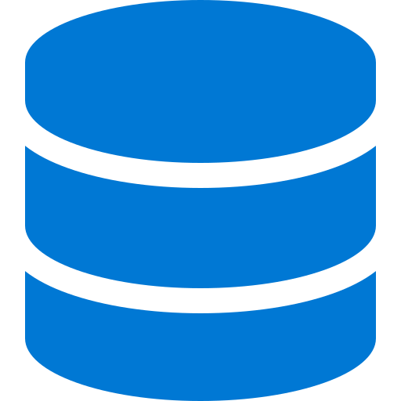













THE $0 AZURE AI ARCHITECTURE STACK
2026 EDITION · BALL CORPORATION
Free-tier Azure services + open-weight models running on plant hardware — built for beverage packaging operations
2
Frontend Layer
3
Agent Orchestrator
Captures input and
streams responses
Plans tasks and routes to
tools, RAG or local LLM
Azure Static Web Apps
Azure Functions
Free plan
Consumption free grant
App Service F1
Semantic Kernel
1
User Input
Free tier (shared)
Open source
Plant Ops Web · Mobile · Teams · CLI
Microsoft Entra ID
LangGraph
Free tier
Open source
4
Need plant
knowledge?
5
RAG Pipeline
Yes
NO
6
LLM Layer
Context from specs,
SOPs, COAs and NCRs
Open-weight models on
plant hardware — $0 tokens
Ingest & OCR
Foundry Local (Windows / edge PC)
11
Document Intelligence F0 — 500 pages/mo
Phi-4
Embed (BGE-M3)
Llama 3.x
Observability
Runs locally — $0 tokens
Context
Mistral Small
Monitor, trace and
evaluate the system
Store & Search
Qwen3 / Gemma 3
Azure AI Search Free — 50 MB, 3 indexes
DeepSeek-R1
Rerank
Application
State
SAP
Application Insights
BGE-Reranker-v2 (local)
free ingestion grant
AVEVA PI
Azure Monitor
7
Tool Use via MCP
free platform metrics
Read-only connectors to Ball systems
and plant data at $0
OpenTelemetry
FactoryTalk
open source
9
Memory, Data & Cache
Store state, memory and speed up responses
SharePoint
Cosmos DB
Blob / Table Storage
8
Code Agent
Free tier: 1000 RU/s + 25 GB
free grant
Writes, edits and
tests code
Azure SQL
SQLite / DuckDB
free offer (serverless)
on-device
Azure DevOps (free 5 users)
In-process cache
Durable Functions
GitHub Actions (free minutes)
no Redis at $0
state & checkpoints
VS Code + Foundry Local
10
Guardrails & Evals
Ensure quality, safety and evaluate outputs
Azure AI Content Safety F0
Promptfoo
Ragas
12
Deployment
Azure Container Apps
Static Web Apps
Azure Functions
Azure Free Account
Ship for $0
(free monthly grant)
(Free plan)
(Consumption)
($200 / 30 days + always-free)
VERIFIED FREE TIERS (Microsoft docs)
CHECK BEFORE YOU COMMIT
Cosmos DB free tier — first 1000 RU/s + 25 GB, lifetime of account, one per subscription, opt in at creation
AI Search Free tier — 50 MB, 3 indexes, one service per subscription, never expires
Functions Consumption — 1M requests + 400,000 GB-s free grant per month per subscription
Content Safety F0 — 5,000 text + 5,000 image analyses/month; Doc Intelligence F0 — 500 pages/month
App Service Free (F1) — shared CPU, no scale-out; Functions needs Consumption, not Free/Shared plans
GitHub Models is retired — $0 inference here comes from Foundry Local on plant hardware
Ball Corporation · $0 Azure reference stack · adapted from a concept by Vaibhav Aggarwal
Notes:
Editable $0 Azure AI reference stack for Ball Corporation. Free-tier limits shown were checked against Microsoft documentation in August 2026; verify current allowances before committing. Portrait 10x12.8in; all boxes, arrows and text are native PowerPoint objects. Layout adapted from a concept by Vaibhav Aggarwal.

Slide 18
ASSESSMENT · E
The agentic AI ecosystem at Ball
Intelligence
Capability
Memory
Frontier and open-weight models via the gateway
Task-based routing and fallback
Fine-tuned and distilled models for narrow, high-volume tasks
Embedding and reranking models
MCP tool servers over every system of record
Skills: reusable, versioned units of know-how
Retrieval, search and semantic services
Deterministic orchestrations as callable tools
Short-term working context per task
Long-term entity memory: plants, SKUs, customers, suppliers
Institutional memory: decisions, precedents, resolutions
Evaluation memory: what has failed before
Control
Experience
Assurance
Unity Catalog registry for data, models, agents, tools and skills
Gateway policy: spend, residency, PII, injection defence
Human-in-the-loop checkpoints and approval routing
Immutable audit trail per agent action
Conversational surfaces in Teams and the browser
Agents embedded in JDE, SAP and QA tooling
IDE agents for engineering
Scheduled and event-triggered agents
Continuous evaluation against gold sets
Drift and regression detection
Incident response for agent failures
Model and third-party agent risk review
Ball Corporation | AI Division Proposal | Confidential — Internal Draft
17
Notes:
Six subsystems. A useful check on any vendor proposal: which of these six does it actually cover, and which does it assume we already have?

Slide 19
ASSESSMENT · F
AI agentic action flow — one request, end to end
1
Intent
2
Identity & policy
3
Context assembly
4
Plan
A planner in QA asks: 'which open defects block the release of line 4's new lid spec?'
Gateway resolves the user, their entitlements, the data classification in scope and the applicable policy.
Context service retrieves the spec, linked defects, prior change records and the canonical definition of 'blocking'.
Agent decomposes the request into tool calls and declares which are read-only and which would write.
5
Tool execution
6
Synthesis & check
7
Action
8
Trace & learn
MCP servers query JDE, the lakehouse and the document estate — each call permission-filtered and logged.
Answer assembled with citations; confidence scored; low-confidence output routed to human review.
Any write executes through a deterministic orchestration with approval — never as a free-form agent call.
Full trace persisted: context, tools, model version, cost, outcome. Feeds evaluation and memory.
Steps 2, 5, 7 and 8 are where governance is enforced. They are infrastructure, not per-use-case work — which is precisely why they belong to a division rather than a project.
Ball Corporation | AI Division Proposal | Confidential — Internal Draft
18
Notes:
Walk this slide slowly — it is the most concrete thing in the deck and it answers 'what does an agent actually do here'.

Slide 20
























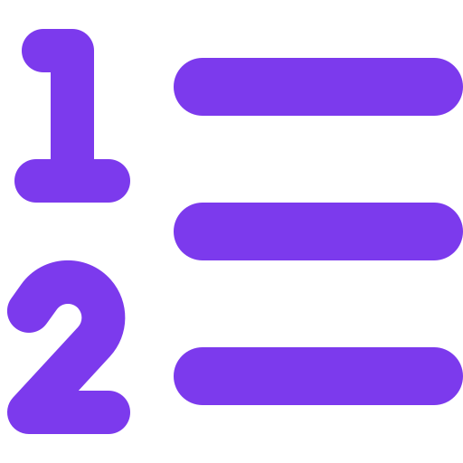










Prompt vs Context vs Harness vs Loop
vs Graph Engineering
Ball Corporation
Manufacturing & Supply Chain AI
Five layers that expand one model call into a governed AI system
Inputs
Goal
Role
Prompt
Builder
LLM
(Azure OpenAI)
Draft
Response
Prompt
Engineering
Rules
Examples
Shape the
instruction
Evaluate and refine prompt
e.g. draft a seam-defect NCR summary from spec + shift log
Unit of work: one instruction
Signals
Context
Router
Retrieve
Rank +
Compress
Query
Specs &
SOPs
Context
Engineering
Memory
PI / MES
Results
Curate what the
model sees
Grounded
Answer
LLM
Context
Pack
e.g. right spec revision, SPC window and prior NCRs — nothing else
Store useful outcomes, discard noise
Unit of work: one context package
Request +
Context
Orchestrator
Planner
Search
Evidence
Merge
SAP / PI API
Harness
Engineering
Code / SPC
Connect reasoning
to action
Failed verification → revise plan and rerun
Sub-agent
Trusted
Output
Verify
Policy Gate
e.g. query PI, recompute Cpk, write back an SAP inspection lot — gated
Unit of work: one assisted task
Objective
Plan
Act
Observe
Budget
Loop
Engineering
Final Output
Yes
Max Steps
Manage progress
and retries
Revise +
Retry
Success?
Evaluate
Stop Rules
e.g. keep hunting root cause until Cpk explained or step budget hit
No
Unit of work: the complete run
State +
Topology
Router
Quality Analyst
Merge
State
Reviewer
Final
Report
SAP / PI Node
Graph
Engineering
QA Manager Approval
Coordinate nodes
and routes
Review failure → update state and choose a new route
e.g. route across quality, planning and sustainability agents with a human gate
Unit of work: the operating graph
Ball Corporation · adapted from a concept by Prashant Rathi (@prashantrathi1)
Notes:
Editable five-layer AI engineering comparison (Prompt / Context / Harness / Loop / Graph) contextualised for Ball Corporation manufacturing and supply chain. Portrait 10x12.7in; all boxes, arrows and text are native PowerPoint objects. Layout adapted from a concept by Prashant Rathi.

Slide 21
TOPIC 4
Context engineering: why agents succeed or fail
Definition
What a context engineer actually owns
The practice of designing systems that dynamically assemble the right information, tools and institutional knowledge into an agent's working context — treating that context window as a scarce, engineered resource rather than a prompt.
System instructions
Role, constraints, refusal behaviour, escalation rules
Retrieval strategy
What is fetched, from where, ranked how, filtered by whose permissions
Knowledge curation
Which SOPs, specs and precedents are canonical — and which are deprecated
Tool surface
Which MCP tools an agent may see, and how their schemas are described
Why it matters more than model choice
Most enterprise AI failures trace to context — missing, stale, conflicting or irrelevant — not to model capability
Prompt engineering does not scale past a handful of use cases; the majority of data leaders now say so explicitly
Context is where Ball's proprietary advantage lives; the model is a commodity anyone can rent
Memory policy
What persists between sessions, what expires, what must never persist
Token budget
Compression, summarisation and eviction under a fixed context window
Evaluation
The gold sets that prove a context change improved rather than regressed behaviour
Ball Corporation | AI Division Proposal | Confidential — Internal Draft
19
Notes:
If leadership takes one technical idea away, make it this one. It reframes the investment away from tools and toward knowledge assets.

Slide 22
TOPIC 4
Onboarding context engineering at Ball
Phase | What happens | Who is involved | Done when
Phase 1 — Establish the practice | Publish the context engineering standard: how prompts, retrieval, memory and tools are specified and versioned. Choose the repository and review process. Define the evaluation format. | AI Division · Enterprise Architecture | Any team can find, read and follow one written standard
Phase 2 — Build the semantic spine | Agree canonical definitions for the top business entities — plant, line, SKU, customer, order, defect, spec. Register them in Unity Catalog with named stewards. | Data governance · domain SMEs · AI Division | Entity definitions exist once, are owned, and are queryable by agents
Phase 3 — Package domain context | For each spoke, build a context pack: curated documents, retrieval configuration, entity mappings, refusal rules and a gold question set. | FDE pods · domain SMEs · CE team | Two domains have production context packs with passing evaluations
Phase 4 — Instrument and iterate | Capture retrieval traces from live agents. Score context relevance. Feed failures back into the packs on a fixed review cadence. | CE team · AI observability | Context changes are made from evidence, not intuition
Phase 5 — Federate | Domain teams maintain their own packs against the standard; the CE team reviews, tools and audits rather than authors. | All spokes · CE team as reviewer | Context throughput no longer depends on the central team
Ball Corporation | AI Division Proposal | Confidential — Internal Draft
20
Notes:
Phase 5 is the goal state — the central team must become a reviewer, not an author, or it becomes the bottleneck it was created to remove.

Slide 23
TOPIC 6
Building the context engineering team
Context Engineering Lead
Context Engineer
Knowledge Steward (domain)
Evaluation Engineer
Owns the standard, the review process and the quality bar. Accountable for context as a product.
Builds and tunes context packs for a domain: retrieval, memory, instructions, tool descriptions.
The SME who decides what is canonical. Part-time, drawn from the business — not an IT role.
Proves that a change helped. Owns the harness, the regression suites and the scoring.
Sets the specification format
Chairs context review
Owns the evaluation policy
Retrieval and reranking design
Prompt and instruction authoring
Gold-set construction
Approves source documents
Deprecates stale knowledge
Adjudicates disputed definitions
Automated eval pipelines
Drift and regression alerts
Human review triage
1
Source it from inside first
2
Attach, don't centralise
3
Treat context as code
The scarce skill is Ball knowledge, not model knowledge. Analytics engineers, senior BAs, technical writers and QA leads retrain into this faster than external hires ramp on Ball.
Context engineers sit with the FDE pod in the domain. A central team writing context for a plant it has never visited produces confident, wrong answers.
Version-controlled, peer-reviewed, tested in CI and released through the ADLC. No context change reaches production by editing a live prompt.
Ball Corporation | AI Division Proposal | Confidential — Internal Draft
21
Notes:
The 'source it from inside' point usually resolves the headcount objection — this is largely a retraining story, not a hiring story.

Slide 24
TOPIC 5
Harness engineering — shipping AI-made change
The problem it solves
Without it vs. with it
Coding agents and worker agents produce non-deterministic output at a volume human review cannot absorb. Harness engineering builds the pipelines, gates and evidence that let that output ship safely — treating the delivery system, not the reviewer, as the control.
Dimension
Today
With harness engineering
Review load
Humans read every AI diff
Gates screen; humans read exceptions
Provenance
Unknown what was AI-authored
Every change tagged and attributable
What it covers at Ball
Agent releases
Prompts edited in production
Agents versioned, tested, rolled back
CI/CD pipelines that treat AI-authored change as a first-class, traceable change type
Automated gates: tests, security scanning, policy checks, deployment verification
The agent development lifecycle — building, testing, releasing and rolling back agents
Autonomous worker agents for the work between writing code and shipping it
DORA and quality telemetry to prove whether AI-assisted delivery is improving
Security
Scanning after the fact
Policy enforced in the pipeline
Measurement
Anecdotes about productivity
DORA and defect data per change type
Ball Corporation | AI Division Proposal | Confidential — Internal Draft
22
Notes:
Harness engineering is the answer to 'what happens when 40% of our code is agent-written'. Ball already has CI/CD; this extends it rather than replacing it.

Slide 25
TOPIC 5
Onboarding harness engineering at Ball
Phase | Task-level activities | Exit criteria
Phase 1 — Baseline | Inventory current pipelines across JDE CNC, SAP, integration and application teams · capture DORA baseline · survey which teams already use coding assistants and on what code · classify repositories by risk tier | A single, current picture of how change reaches production today
Phase 2 — Standardise the pipeline | Define the golden pipeline template · mandate build, unit, SAST, dependency, IaC and policy stages · introduce provenance tagging so AI-assisted change is identifiable · enforce branch protection | Every tier-1 repository builds through the golden template
Phase 3 — Admit agents to the SDLC | Approve the assistant and coding-agent tool set · route agent model traffic through the AI gateway · define what an agent may and may not do unattended · require human approval on merge to protected branches | Agent-authored change is governed identically to human change
Phase 4 — Agent DLC | Treat each agent as a deployable artefact: versioned prompt, context pack, tool manifest and eval suite · promote agents through dev, test and production · automated rollback on evaluation regression | An agent can be released and rolled back without a human editing production
Phase 5 — Autonomous workers | Introduce worker agents for the gap between commit and production: test generation and repair, dependency upgrades, release notes, deployment verification, incident triage | Measurable reduction in delivery toil with no regression in change-failure rate
Ball Corporation | AI Division Proposal | Confidential — Internal Draft
23
Notes:
Phase 3 is where most organisations skip a step and later discover ungoverned agent traffic. Do not let it be skipped.

Slide 26
TOPIC 7
The Forward Deployed Engineer model
What an FDE is
The FDE skill profile
A senior engineer who embeds inside a business or system domain for the life of a solution and is accountable for the outcome — not for the code. The model was proven at Palantir and has since been adopted at scale across the enterprise AI industry.
✓
Systems fluency
Reads a JDE orchestration, a Spark job and a Terraform plan with equal comfort
✓
Agent craft
Tool design, context assembly, evaluation, failure analysis
✓
Domain immersion
Spends time on the floor and in the process, not only in the backlog
Why Ball needs the role
The distance between a working demo and a governed production system is an integration problem, and nobody owns it
Ball's value is locked in domain specifics — plant practice, quality regimes, ERP configuration — that no requirements document captures
A central request queue turns every AI idea into a prioritisation argument; an embedded engineer turns it into a shipped system
FDEs carry standards outward: they are how the hub's platform actually gets adopted
✓
Production discipline
Access control, audit trails, logging, privacy, rollback — from day one, not day ninety
✓
Facilitation
Runs workshops, elicits requirements, translates business language into technical delivery
✓
Ownership
Accountable for the outcome after go-live, including the pager
Ball Corporation | AI Division Proposal | Confidential — Internal Draft
24
Notes:
Note the last one — accountability after go-live is what distinguishes an FDE from a consultant. It is also the hardest part to sell internally.

Slide 27
TOPIC 7
Bringing FDE roles into Ball
The role is scarce in the market — so build it internally and hire selectively at the senior end.
1
Define the role formally
2
Seed with two senior hires
Job family, levelling, compensation band and career path agreed with HR before anyone is recruited. Without a defined path the role decays into 'senior developer on loan'.
Hire externally only at the top of the range, for people who have shipped agentic systems in a regulated or industrial setting. They set the bar and mentor.
3
Convert from within
4
Deploy as pods, not individuals
Identify internal engineers with deep JDE, Databricks, MES or QA knowledge and put them through a structured FDE enablement track. Ball knowledge is the harder half of the job.
Two FDEs plus a context engineer, embedded with a domain product owner. Never a single engineer alone in a business unit.
Indeed postings, US. A ~729% year-on-year increase — competing for this talent on the open market is the slowest available path.
5
Rotate deliberately
6
Measure outcomes, not activity
Time-boxed placements with a hand-back to a named domain owner. Rotation prevents dependency and spreads platform standards.
Pods are assessed on process metrics moved and systems in production — never on tickets closed or models deployed.
Ball Corporation | AI Division Proposal | Confidential — Internal Draft
25
Notes:
The 'convert from within' step is the crux — Ball domain knowledge takes years to acquire and agent craft takes months.

Slide 28
TOPIC 8
Building the agentic mesh
A unified runtime, control plane and trust framework for agents — the equivalent of what a service mesh did for microservices.
Business workflows
Order-to-cash · plan-to-produce · quality management · maintenance · procurement · financial close
Agent registry & discovery
Every agent declared with an owner, purpose, tool manifest, data scope, evaluation record and lifecycle state
Orchestration & delegation
Supervisor patterns, task decomposition, agent-to-agent hand-off, retries, timeouts, escalation to humans
Trust & policy plane
Identity propagation · entitlement checks · spend and rate limits · residency · guardrails · immutable audit
Tool plane (MCP)
The six MCP servers, versioned and permission-scoped · deterministic orchestrations exposed as callable tools
Runtime & observability
Execution environment · OpenTelemetry tracing across multi-agent runs · cost, token and latency attribution
Why a mesh and not microservices: microservices assume deterministic A-to-B calls. Agents negotiate goals probabilistically, so the runtime has to supply discovery, policy, supervision and trace as first-class services rather than leaving them to each caller.
Ball Corporation | AI Division Proposal | Confidential — Internal Draft
26
Notes:
If asked 'buy or build': buy the runtime and registry, build the Ball-specific policy and tool plane. Do not build a mesh from scratch.

Slide 29


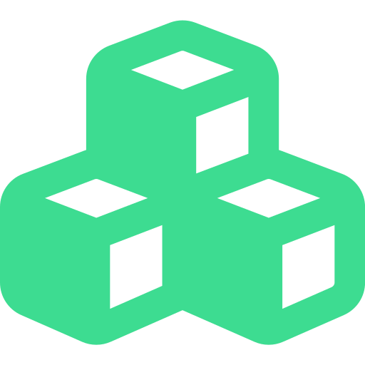
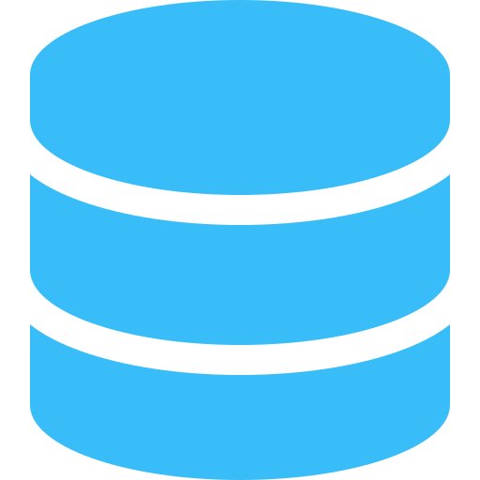













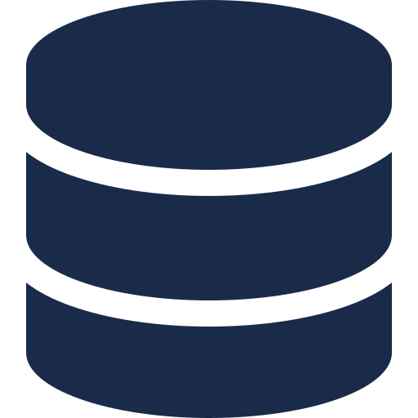










FROM AGENTIC RAG
AGENT MESH
Specialist agents. Shared context. Governed handoffs.
TO AGENT MESH
GOVERNED
HANDOFFS
TRUST AT
EVERY HOP
SAP AGENT
Negotiate. Verify.
Pass context.
Core ERP and finance.
Postings, master data.
Verify at each
interaction.
BEYOND ONE AGENT. TOWARD COOPERATING INTELLIGENCE.
From retrieval to orchestrated action.
From one agent to a network of specialists,
governed at every hop.
AGENTIC RAG
JDE AGENT
DATABRICKS AGENT
Manufacturing and supply.
Inventory, work orders.
SHARED CONTEXT
& MEMORY
Lakehouse analytics.
Features, models, history.
One agent. One context window. One chain.
VERIFIED AT
EVERY HOP
OBSERVABILITY
Query
Retrieve
Reason
Act
Least privilege.
Audit every handoff.
FACTORYTALK AGENT
One system trace across
agents. Across hops.
Shop-floor telemetry.
Machine state and OEE.
Breaks the moment a workflow needs more than one specialist.
AGENT MESH — REFERENCE ARCHITECTURE
01
02
03
04
05
CROSS-CUTTING GOVERNANCE
Identity & Trust
Policy & Authorization
INTERACTION LAYER
ORCHESTRATION &
PROTOCOL LAYER
AGENT MESH
SHARED CONTEXT
& MEMORY
GOVERNED TOOL
& ACTION LAYER
Audit & Compliance
Users, enterprise systems,
and channels initiate a request.
Capability negotiation and
handoff routing — MCP /
A2A-style contracts.
Specialist agents collaborate,
negotiate, and hand off work
within governed boundaries.
Episodic and semantic memory,
read and written under
access control.
Least-privilege execution
against systems of record
and external tools.
Observability & Tracing
Safety & Guardrails
Cost & Efficiency
Specialized expertise
for every domain
Collaborative outcomes
through negotiation
Trust boundaries
at every hop
End-to-end observability
and system trace
Scalable, governable
intelligence at enterprise scale
Notes:
Editable recreation of the 'From Agentic RAG to Agent Mesh' infographic. All elements are native PowerPoint shapes and text boxes; icons are transparent PNGs in the icons/ folder.

Slide 30
TOPIC 8
Agentic mesh — build sequence
01
Registry first
02
Identity propagation
03
Policy plane
Stand up the agent registry inside Unity Catalog
Mandate registration: no unregistered agent may obtain a gateway credential
Capture owner, purpose, data scope, tools, eval record
End-user identity flows through the agent to every tool call
No service accounts with standing broad access
Entitlements resolved at call time, not at build time
Central policy: what data classes an agent may touch
Spend caps and rate limits per agent and per domain
PII redaction and prompt-injection defence at the boundary
04
Tool plane
05
Orchestration
06
Trace everything
Register MCP servers as governed assets with versioned schemas
Scope tool visibility per agent — least privilege by default
Deterministic orchestrations exposed as tools for all write paths
Supervisor agents for multi-step, cross-domain work
Explicit hand-off contracts and failure semantics
Human checkpoints at defined risk thresholds
OpenTelemetry spans across agents, tools and model calls
Cost, token, latency and outcome attribution per run
Replay capability for any past agent decision
Ball Corporation | AI Division Proposal | Confidential — Internal Draft
27
Notes:
Order matters. Registry before policy, policy before tools, tools before orchestration. Reversing this creates agents that cannot be governed retroactively.

Slide 31








































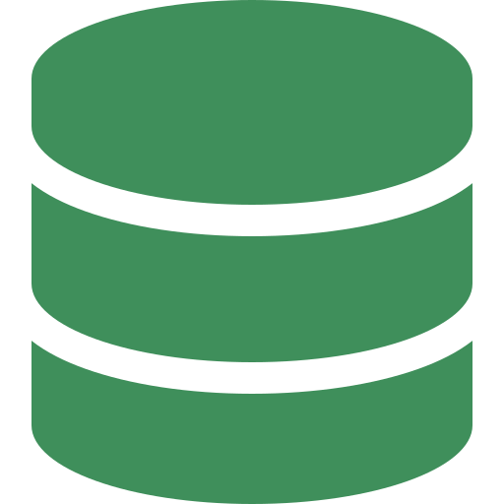


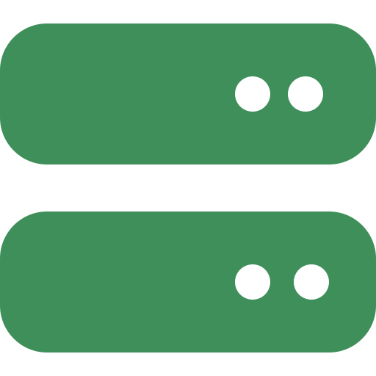








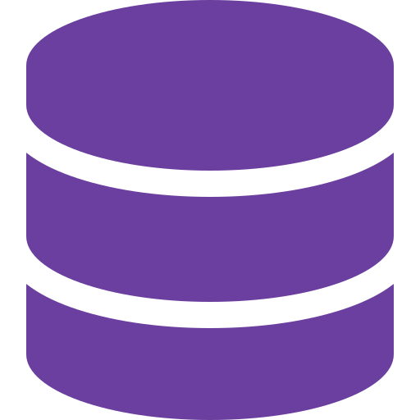



















MULTI-MODEL AI AGENT PLATFORM ARCHITECTURE ON AZURE
USERS
AUTHENTICATION
AI AGENT INTERFACE
BACKEND LLM MODELS
Microsoft Foundry Agent Service · Copilot Studio · Teams / Web / API channels
TEXT / GENERAL MODELS
Web App
Microsoft Entra ID
SSO / OAuth 2.0 · OIDC / SAML
Chat
File / Document
Image
Video
Research
Voice
GPT-4o /
4.1
Claude
Gemini
Llama 3.1
…
Mobile App
Entra ID (P1 / P2)
RESEARCH MODELS
Entra External ID
AI ORCHESTRATION LAYER
AI GATEWAY
Microsoft
Teams
Conditional Access
Foundry Agent Service · Prompt flow · Semantic Kernel orchestration
Azure API Management
Perplexity
API
Grounding
w/ Bing
AI Search
RAG
…
1. PROMPT
CLASSIFICATION
2. POLICY & RBAC
ENGINE
3. QUOTA & LIMIT
ENGINE
4. MODEL
ROUTER
Slack
Managed Identity
IMAGE MODELS
Request Routing
Detect intent
& category
Check Entra access
and policies
Check usage limits
(APIM policies)
Select best
available model
Model Abstraction
DALL·E 3
Stable
Diffusion
Midjourney
API
…
API / SDK
Text
Research
Code
Image
Video
Data / SQL
Sensitive / Other
Model access
Data access
Content policy
Compliance
Safety rules
Requests / day
Tokens / month
Cost / budget
Concurrency
Rate limits
Best capability
Cost optimized
Latency aware
Allowed by policy
Fallback model
Key Vault Auth
Retry / Failover
USER CONTEXT & RBAC
Load Balancing
VIDEO MODELS
Logging & Metrics
User Profile
Entra Groups / Roles
Permissions
Entitlements
Data Access Scope
Cost Tracking
Sora
Runway
Pika
…
KNOWLEDGE & DATA LAYER
TOOLS & ACTION LAYER
DOMAIN / FINE-TUNED MODELS
Azure AI
Search
Enterprise
Search
SharePoint /
OneDrive
Azure SQL /
Cosmos DB
Fabric /
Synapse
Graph /
Dataverse
Bing
Grounding
Fabric SQL
Query
Code
Interpreter
Calculator
Logic Apps /
Functions
MCP / 3rd
Party APIs
Finance
Model
Legal
Model
HR
Model
…
RESPONSE AGGREGATION & STREAMING
RESPONSE GOVERNANCE
Format · Citations · Guardrails · Source Attribution · Multi-modal Support
Azure AI Content Safety filters
PII / sensitive data (Purview)
AUDIT, LOGGING & MONITORING
Prompt Shields (injection)
Citations / grounding checks
Safety & compliance evaluations
Entra Sign-in Logs
Model Usage
Tokens & Cost
App Insights Metrics
Quality & Feedback
Azure Monitor Alerts
Purview Audit Trail
ADMIN PORTAL
INFRASTRUCTURE & SECURITY
LEGEND
Manage Users & Groups
Manage Models
Set Policies & Guardrails
Configure Limits & Quotas
View Analytics & Reports
Request Flow
Private Link /
VNet
Encryption
(CMK, TDE)
Key Vault /
Managed HSM
Compliance
(GDPR, SOC2, ISO)
Backup &
Site Recovery
Availability Zones
& Autoscale
Data / Context Flow
Response Flow
Governance / Control
Notes:
Editable Azure-mapped recreation of the multi-model AI agent platform architecture. All boxes, arrows and text are native PowerPoint objects; icons are transparent PNGs.

Slide 32
















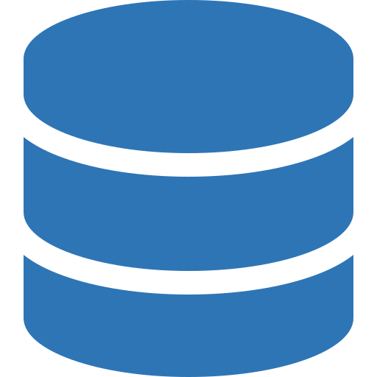






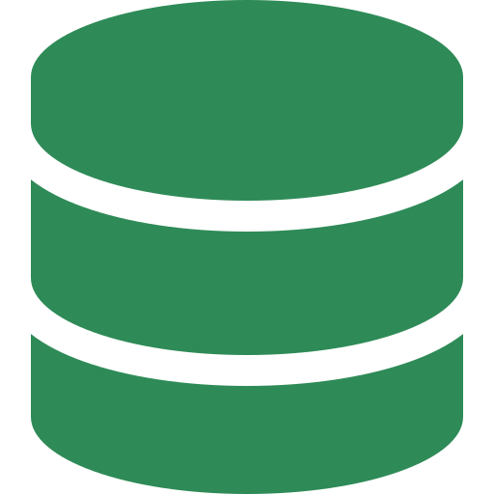



















































PRODUCTION-GRADE ENTERPRISE AGENTIC RAG ON AZURE
INGEST • ROUTE • REACT (ITERATIVE) • GOVERN • OBSERVE
Ball Corporation — Beverage Packaging Manufacturing & Supply Chain
1. USER & CHANNELS
Plant Ops
Portal
Mobile
(Line Ops)
Chat / Bot
Microsoft
Teams
APIs / SDKs
Email
Power Apps
Azure
Front Door
Azure WAF
Azure API
Management
Microsoft Entra ID
(AuthN / AuthZ)
2. AGENT ORCHESTRATION
(CONTROL PLANE)
AZURE AI FOUNDRY
AGENT SERVICE
INTENT UNDERSTANDING
& GOAL PARSING
REACT LOOP (ITERATIVE UNTIL GOAL ACHIEVED)
Agent Threads
1
RETRIEVE
2
REASON & PLAN
3
ACT
4
OBSERVE
(Session Management)
Hybrid Search
(Vector + BM25)
Filters · Reranking
Decide next action
(Thought / Plan)
SAP / MES / PI
Tool execution
Capture result &
update context
Prompt Flow
(Prompt Management)
Tool Registry
Azure OpenAI (GPT-4.1)
or Ball fine-tuned model
(SAP · MES · PI tools)
Guardrails
NO
5
EVALUATE
(Content Safety)
Goal achieved?
Validate & Score
Memory Management
(Threads & state)
YES
Agent Observability
(Traces & metrics)
FINAL ANSWER
Planner & Multi-Agent
Respond to plant / planner
(Collaboration)
Model Invocation (Via Dynamic Model Router)
3. ENTERPRISE TOOL & INTEGRATION LAYER
4. MODEL ROUTING LAYER (TASK → MODEL)
5. AGENT MEMORY LAYER
Azure Services
Azure AI Foundry / Azure OpenAI Service
Conversation Memory
Reasoning / Planning / Multi-step
(Short-term context)
Azure
Functions
Logic
Apps
Power
Automate
Azure
SQL
Cosmos
DB
GPT-4.1 / o3 / o4-mini
Extraction / Classification / JSON
Semantic Memory
Ball Enterprise Systems
GPT-4o / o4-mini
(Specs, SOPs, defect history)
Summarization / Long Documents
User Profile Memory
SAP
S/4HANA
AVEVA PI
Historian
FactoryTalk
MES
Salesforce
CRM
Coupa /
Ariba
GPT-4.1 / o4-mini / Phi-4
(Role, plant, line, shift)
Embeddings / Retrieval
Task / Workflow Memory
APIs & Connectivity
text-embedding-3-large / ada-002
(State, checkpoints, steps)
Vision / Multimodal (can & label defects)
REST
APIs
Microsoft
Graph
Share-
Point
Teams
Email /
SMTP
GPT-4o / GPT-4.1 (Vision)
Session Cache
Open Source Models (Optional)
(Fast access to session data)
Other Connectors
Phi-4 / Mistral / Llama / DeepSeek
Storage Options
Dynamic Model Router
Cosmos DB
(NoSQL)
Azure Cache
for Redis
Azure AI Search
(Vector Store)
Blob Storage
(Archive)
S3 / Third
Party
Plant
Databases
Web /
APIs
Legacy
DCS / PLC
Selects best model by task, cost, latency, context length & quality
6. KNOWLEDGE & DATA LAYER
Data Sources
Ingestion & Processing
Enrichment & Understanding
Storage & Indexing
Catalog & Governance
Blob Storage / ADLS
Azure Document Intelligence
Azure AI Content Understanding
Azure AI Search
Microsoft Purview
SharePoint / OneDrive
(OCR, layout, forms)
(Entities, key phrases, PII)
(Hybrid Search)
(Data catalog, lineage)
Plant Wiki / SOPs
Azure Data Factory
Azure OpenAI
Vector search
BM25 search
Semantic ranker
Filters & facets
Metadata index
Azure Data Catalog
SAP & MES databases
(Orchestration)
(Summarization, tagging)
(Business glossary)
Azure Functions
AVEVA PI historian
(Transform, chunk)
Custom skills / models
Policies & classification
Logic Apps
(Defect taxonomy, spec codes)
Blob Storage / ADLS
(Data owners, retention)
Specs, COAs, deviation
reports (PDF, Excel, images)
(Connectors, ETL)
(Raw & processed)
7. SECURITY, GOVERNANCE & GUARDRAILS (PARALLEL, NOT SERIAL)
Microsoft Entra ID
Azure Key Vault
Managed Identity
Private Link
RBAC
Azure Policy
Microsoft Purview
Azure Content Safety
Defender for Cloud
(Identity & access)
(Secrets & keys)
(Workload identity)
(Network isolation)
(Least privilege)
(Compliance)
(Data governance)
(Content filters)
(Threat protection)
REJECT
Guardrails Gate (Allow / Reject)
ALLOW
All checks run in parallel (single exit gate)
8. OBSERVABILITY & EVALUATION
Azure Monitor
(Metrics, logs, alerts)
Application Insights
(Tracing, performance)
Log Analytics
(Centralized logs)
Azure Data Explorer
(Advanced analytics)
Prompt Flow
(Evaluation, tracing)
AI Evaluation SDK
(Ground truth, metrics)
Dashboards
(Grafana / Workbooks)
Human Feedback
(Thumbs, ratings)
Metrics: Latency • Token Usage • Cost • Retrieval Quality • Hallucination Rate • Success Rate • Agent Actions • Tool Usage • Errors
9. FOUNDATION & DEPLOYMENT
Scalable & Resilient (AKS)
High Retrieval Quality
Agentic & Iterative
Enterprise Ready
Observable & Measurable
Cost Optimized
Extensible
Built on Azure PaaS & managed services
Hybrid search, reranking & metadata filters
REACT loop for goal achievement
Security, governance & compliance built-in
End-to-end visibility
Dynamic model routing & caching
Easy to add plants, tools & models
Notes:
Editable Azure agentic-RAG reference architecture contextualised for Ball Corporation beverage packaging manufacturing and supply chain. Portrait 10x15in canvas; all boxes, arrows and text are native PowerPoint objects.

Slide 33





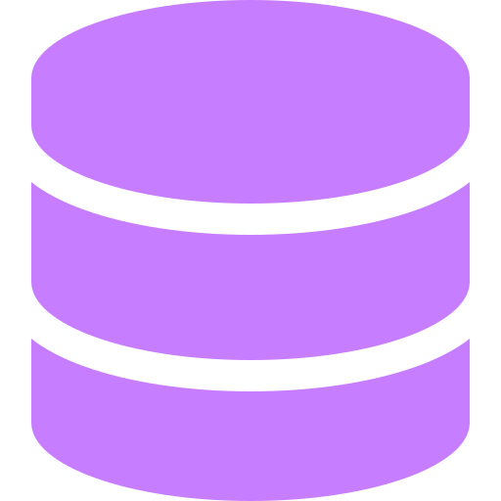


























Understanding Agent Skills
Skills · MCP · Subagents · Hooks · Tools — The Complete Agentic Architecture
Ball Corporation — Beverage Packaging Manufacturing & Supply Chain
SECTION 1 — What are Skills?
SECTION 2 — Core Agent Loop
SECTION 3 — MCP Servers
Reusable instruction modules
Loaded ON-DEMAND by the agent
Contains: instructions, scripts, resources, templates
Progressive Disclosure — agent reads metadata first, loads full content only when needed
Like SOPs / WORK INSTRUCTIONS for AI
Skills teach expertise → MCP provides the instruments → Subagents do the work
“ One agent, one loop: perceive → reason → act → observe,
repeating until the goal is met. ”
PERCEIVE
SAP
AVEVA PI
FactoryTalk
SharePoint
request, context,
line & spec data
.claude/skills/
├── spec-review/
│ └── SKILL.md
├── deviation-triage/
│ ├── SKILL.md
│ └── scripts/
└── plant-report/
└── SKILL.md
REPEAT
REASON
Coupa
Azure SQL
Fabric
Teams
loop back
Agent Core
LLM plans
next step
MCP = ABILITY (connects to plant systems)
LLM ↔ Tools
MCP Server 1 (e.g., SAP S/4HANA)
MCP Server 2 (e.g., AVEVA PI)
Skills = KNOWLEDGE (what to do)
Runs on Azure AI
Foundry Agent Service
MCP Server 3 (e.g., FactoryTalk MES)
Example Ball skills
One protocol reaches ERP, historian,
MES and quality systems alike
spec-review
OBSERVE
ACT
checks drawings vs. customer spec
evaluate
results
tool call,
SAP / PI / MES
No bespoke integration per tool —
add a server, every skill gains it
deviation-triage
classifies and routes NCRs
plant-report
Credentials stay in Key Vault;
access scoped by Entra ID
builds shift & OEE summaries
Instructions &
Domain Knowledge
External Tools
& Plant Data
supplier-scorecard
scores coil and ink suppliers
SECTION 4 — Knowledge Sources
Plugins bundle Skills + Hooks + Subagents + MCP into one installable unit —
ship a validated Ball playbook to every plant at once
SECTION 8 — How They Stack
CLAUDE.md
Always-on context
PLUGINS
spec-review
package layer · bundles everything
SKILLS
deviation-triage
SECTION 5 — Subagents
knowledge & workflows
The
Agent
Extension
Stack
Subagents = DELEGATION (independent workers)
MCP
TOOLS
plant-report
Isolated context — own model, own permissions, own tool allow-list
external connections
built-in capabilities
Reference docs / specs
SUBAGENTS
Subagent 1:
Subagent 2:
Subagent 3:
isolated execution
Quality Analyst
Supply Planner
Sustainability
HOOKS
Skills = WHAT to know
Tools:
Tools:
Tools:
deterministic automation
MCP = HOW to connect
Read, PI Query,
SPC charts
SAP, Coupa,
Fabric SQL
Fabric, Docs,
Purview
CLAUDE.md
Hooks = WHEN to automate
>_
>_
>_
always-on context
SECTION 6 — Hooks
SECTION 7 — When to Use What?
SECTION 9 — Real-World Example
Fire outside the loop
Component
Purpose
Analogy
“Investigate the seam-defect spike on Line 3 and write the deviation report”
Skills
Teach expertise & workflows
SOP binder
1. CLAUDE.md loads
PRE-TOOL
MCP
Connect to external services
USB-C port
plant context, line & product data
runs BEFORE tool execution — blocks unsafe SAP writes
2. Skill activates
Subagents
Delegate isolated tasks
Shift team members
'deviation-triage' framework
POST-TOOL
3. MCP fires →
runs AFTER tool execution — logs, formats, files records
Hooks
Automate deterministic events
Line interlocks
queries AVEVA PI for seam telemetry
ON-EDIT
4. Subagent spawns →
fires when spec or SOP files change
CLAUDE.md
Always-on project context
Whiteboard at the line
quality-analyst pulls SPC charts
ON-NOTIFICATION
5. Subagent spawns →
deviation alerts & audit logging
Plugins
Bundle & distribute all above
Toolkit crate
supply-planner checks coil lots
Deterministic — NOT controlled by the LLM
6. Hook triggers →
Hooks = AUTOMATION (outside agent loop)
formats report, files the NCR
Ball Corporation · Manufacturing & Supply Chain AI Platform · adapted from a concept by Brij Kishore Pandey (@brijpandeyji)
Notes:
Editable dark-theme agent architecture poster (Skills / MCP / Subagents / Hooks / Tools) contextualised for Ball Corporation manufacturing and supply chain. Portrait 10x13.333in; all boxes, arrows and text are native PowerPoint objects. Layout adapted from a concept by Brij Kishore Pandey.

Slide 34
DATABRICKS
Databricks as the AI foundation for Ball
Extend the governance spine Ball already has rather than standing up a second control plane.
Unity Catalog
Unity AI Gateway
Managed MCP servers
Now governs models, agents, MCP services and skills alongside data
One set of access controls, discovery, lineage and audit for every AI asset
Registration becomes the front door to the mesh
Runtime governance for agents: spend caps, smart routing, service policies
PII guardrails applied at the boundary rather than per application
Every request captured by default — no instrumentation sprawl
Ready-to-use servers over Unity Catalog data, search indexes, Genie agents and custom functions
Removes bespoke glue between agents and the lakehouse
Governed and versioned like any other catalogue asset
Genie
Lakehouse & serving
ML & evaluation
Conversational surface over governed data for business users
Reasons over unstructured content and calls external tools via MCP
Available where people already work — browser, mobile, Teams, Slack
Single copy of data for BI, ML and agent retrieval
Vector and search indexes co-located with governed tables
Streaming path for plant and operational telemetry
Model serving, fine-tuning and batch inference under the same governance
Experiment tracking and evaluation runs as first-class artefacts
Lineage from an agent answer back to the source table
Ball Corporation | AI Division Proposal | Confidential — Internal Draft
28
Notes:
Framing for the room: this is not a new platform purchase, it is switching on governance capability alongside a platform Ball already runs.

Slide 35
INTEGRATION
DE.AI IDE ↔ Databricks integration
Provisioning tasks
What the integration delivers
1
Approve the IDE and agent extension set; publish a standard developer image
Data engineers work in their own IDE with an AI agent that can see the governed catalogue — schemas, lineage, ownership and quality signals
The agent authors and refactors pipeline code with real table context instead of guessing at column names
Test data and validation queries generated against actual profiles, not synthetic assumptions
Jobs, notebooks and workflows deployed through the same CI/CD path as application code
Every agent action attributable to the engineer's identity and their existing Unity Catalog entitlements
Model traffic from the IDE routed through the AI gateway like any other workload
2
Register the Databricks MCP server (Unity Catalog + search + functions) in the tool registry
3
Configure OAuth so the IDE agent acts as the signed-in engineer, never as a shared service principal
4
Scope entitlements: development catalogues by default; production read requires explicit grant
5
Route the IDE's model traffic through the AI gateway; tag spend to the engineering cost centre
6
Add provenance tagging so AI-assisted commits are identifiable in the repository
7
Enable trace export to the observability stack — prompts, tool calls and cost per session
8
Publish golden-path examples: an ingestion job, a DQ check and a semantic model built with the agent
Ball Corporation | AI Division Proposal | Confidential — Internal Draft
29
Notes:
Key control point is task 3 — shared service principals destroy the audit trail and are the most common shortcut taken here.

Slide 36
INTEGRATION
JD Edwards + Claude via an MCP server
User / Agent
AI Gateway
Claude
JDE MCP Server
JD Edwards E1
Business user or supervising agent issues an intent
→
Identity, policy, guardrails, routing, spend control, full capture
→
Plans the task, selects tools, synthesises the response with citations
→
Discovery · introspection · execution over AIS and Orchestrator
→
AIS Server · Orchestrator Studio · role-based security unchanged
What the MCP server exposes
Controls that stay in place
Provisioning sequence
Discovery — list the orchestrations an agent is permitted to see
Introspection — fetch input schemas and output shapes so calls are typed
Execution — run an orchestration with a structured, validated payload
Query — read business data through AIS with the user's own entitlements
JDE role-based security is authoritative: if the user cannot see payroll, the agent cannot retrieve it
Write operations run only through approved orchestrations, never ad-hoc
Every call logged with user, orchestration, payload and result
Rate limits protect the AIS server from agent retry storms
Inventory orchestrations; classify each read/write and by risk
Stand up the MCP server in a non-production environment against a test E1 instance
Publish read-only tools first; validate against a gold question set
Introduce write tools one process at a time, each with an approval checkpoint
Ball Corporation | AI Division Proposal | Confidential — Internal Draft
30
Notes:
The security story is the strongest part: MCP does not create a new permission model, it inherits JDE's. That is what makes it approvable.

Slide 37
INTEGRATION
SAP IDE integration — work in progress
Open decisions to close
Where this stands today [CONFIRM]
Tool surface
OData/RFC services, BAPIs, or an integration-layer abstraction as the agent-facing contract?
Integration work is under way; no standardised, governed pattern is agreed yet
Development tooling and AI assistance in the SAP stack are being evaluated in parallel with the JDE work
Decision pending on whether SAP agent access goes through the same MCP and gateway pattern as JDE
Identity
How does end-user identity propagate from the agent through to SAP authorisation objects?
Data residency
Which SAP data classes may leave the estate for inference, and which must be processed in region?
The recommendation
Landscape scope
Which systems and clients are in scope, and how are non-production landscapes used for agent testing?
Hold SAP to the same architectural contract as JD Edwards: one MCP tool surface, identity propagated from the end user, writes only through approved, deterministic services, and all model traffic through the AI gateway. Divergence here is how Ball would end up with two AI estates to govern.
Vendor overlap
Where do SAP-native AI capabilities and the Ball platform overlap, and which wins for which use case?
Sequencing
Does SAP follow the JDE pattern once proven, or run in parallel with its own pod?
Ball Corporation | AI Division Proposal | Confidential — Internal Draft
31
Notes:
Present this as an open item with a recommendation, not as a gap. The ask is a decision on the architectural contract, not on tooling.

Slide 38
TOPIC 4 · STACK
The Ball AI technology stack
Experience
Genie · Teams and browser agents · agents embedded in JDE, SAP and QA tooling · IDE agents · scheduled and event-driven agents
Agents & orchestration
Agentic mesh runtime · agent registry · supervisor and delegation patterns · human-in-the-loop approval routing
Context
Context packs · retrieval and reranking services · semantic and metric layer · short-term, entity and institutional memory
Tools (MCP)
Six governed MCP servers · deterministic orchestrations exposed as tools · versioned, permission-scoped schemas
Gateway & policy
Model routing and fallback · spend caps and rate limits · PII redaction · prompt-injection defence · residency enforcement · request capture
Models
Frontier models incl. Claude · open-weight models for narrow tasks · embedding and reranking models · task-based routing
Data & governance
Databricks lakehouse · Unity Catalog over data, models, agents, MCP services and skills · vector and search indexes · lineage
Delivery & assurance
Harness pipelines and Agent DLC · evaluation harness · OpenTelemetry tracing · cost attribution · drift and regression detection
Systems of record
JD Edwards EnterpriseOne · SAP · MES and plant historians · WMS · CRM · document and quality repositories
Principle: one gateway, one catalogue, one tool protocol. Everything else is replaceable.
Ball Corporation | AI Division Proposal | Confidential — Internal Draft
32
Notes:
Deliberately vendor-light above the data layer — the stack should survive a model or framework change without re-architecture.

Slide 39
TOPIC 5 · ADLC
ADLC — the AI development lifecycle
How an idea becomes a governed agent in production, and how it gets safely retired.
01
Frame
02
Build
03
Evaluate
04
Release
Business outcome and owner named
Deterministic, assisted or agentic decided
Data classification and residency assessed
Success measure and gold set defined up front
Context pack authored and versioned
Tool manifest scoped to least privilege
Agent defined as code — prompt, context, tools, policy
Peer review as with application code
Run against the gold set; score accuracy, groundedness, refusal behaviour
Adversarial and prompt-injection testing
Cost and latency profiling
Sign-off by the domain steward
Promote through dev, test and production
Canary to a limited user group first
Rollback plan and kill switch tested, not assumed
Registered in the catalogue with an owner and SLA
05
Operate
06
Improve
07
Retire
Applies to every agent
Trace every run: context, tools, model version, cost, outcome
Human review queue for low-confidence output
Incident process for agent failures
Spend and usage reported to the domain
Regression suite on every context or model change
Drift detection against the gold set
Feedback loop from review queue into the context pack
Periodic re-certification
Deprecation notice with a migration path
Tool credentials revoked
Traces retained per the retention policy
Catalogue entry archived, not deleted
No exceptions for pilots, proofs of concept or vendor-supplied agents
A third-party agent that touches Ball data enters at Evaluate
The ADLC is enforced by the pipeline, not by a review board
Ball Corporation | AI Division Proposal | Confidential — Internal Draft
33
Notes:
The last card is the enforcement statement — it is what prevents vendor agents becoming an ungoverned back door.

Slide 40
TOPIC 6 · MCP
The six MCP servers to provision
# | Server | Exposes | Primary consumers | Write path
1 | JD Edwards E1 | Orchestration discovery, introspection and execution; AIS data queries; application sessions | Supply chain, finance, plant operations, master data | Approved orchestrations only, with approval checkpoint
2 | Databricks / Unity Catalog | Governed tables, search and vector indexes, Genie agents, registered functions | Analytics, data engineering, every retrieval-based agent | Read-only; writes via governed jobs
3 | Enterprise knowledge | SOPs, work instructions, specifications, quality records, policies — permission-filtered | QA, engineering, manufacturing, compliance, HR | Read-only
4 | DevOps & engineering | Repositories, pipelines, issues, build and deployment status, incident records | Engineering, harness engineering, worker agents | Guarded: branch protection and approvals enforced
5 | Collaboration & workflow | Email, calendar, chat, ticketing and approval workflows | Every business-facing agent needing human hand-off | Sending and task creation, scoped per agent
6 | SAP | Business objects and services under the same contract as JDE — subject to the open decisions | Finance, procurement, and shared processes | Deferred until the architectural contract is agreed
Each server is a governed asset: registered in the catalogue, versioned, permission-scoped, rate-limited and traced. None of them is a shared credential.
Ball Corporation | AI Division Proposal | Confidential — Internal Draft
34
Notes:
Server 6 is deliberately last — sequencing SAP behind a proven JDE pattern reduces risk and rework.

Slide 41
TOPIC 6 · MCP
Provisioning an MCP server — the repeatable task sequence
01
Scope & classify
05
Evaluate
Name the source system, the owning team and the data classes in scope. Record residency and retention constraints. Produce the tool inventory: every capability the server will expose, marked read or write.
Run the gold question set through an agent using only this server. Score accuracy, correct tool selection and refusal behaviour. Adversarial test: attempt privilege escalation and prompt injection through tool output.
02
Security design
06
Register & publish
Choose the authentication pattern — OAuth with end-user identity propagation, never a shared service principal. Map source-system roles to tool visibility. Agree the audit record format with Internal Audit.
Register in Unity Catalog with owner, version, schema and data scope. Publish tool documentation. Define which agents may see which tools — least privilege as the default, not the exception.
03
Build in non-production
07
Release to production
Deploy the server against a non-production instance of the source. Implement discovery, introspection and execution. Write typed schemas and worked examples for every tool description.
Deploy read-only tools first. Canary with a named pilot group. Enable full tracing to the observability stack. Confirm the kill switch works before, not after, go-live.
04
Harden
08
Operate & extend
Rate limits and circuit breakers to protect the source system. Input validation and output size caps. Redaction of sensitive fields. Deterministic error handling that an agent can reason about.
Monitor usage, cost, latency and error rates. Review traces on a fixed cadence. Introduce write tools one process at a time, each with its own approval checkpoint and its own evaluation.
Run once per server. Steps 01–04 are per-system engineering; steps 05–08 are identical every time and become platform capability.
Ball Corporation | AI Division Proposal | Confidential — Internal Draft
35
Notes:
The repeatability is the point: by server three, only steps 1–4 involve real design work.

Slide 42
TOPIC 6 · GATEWAY
AI gateway — provisioning tasks
Step | Task | Detail | Control it establishes
1 | Inventory model traffic | Find every path by which Ball currently reaches a model — SaaS features, developer keys, vendor tools, notebooks | Visibility: we learn what is actually running
2 | Select and deploy | Stand up the gateway; decide managed vs. self-hosted per data residency requirement; deploy in each region in scope | A single, monitored egress point
3 | Configure routing | Register approved models; define routing by task type, cost and residency; set fallback chains and timeouts | Model choice becomes a policy decision, not a per-app decision
4 | Identity & attribution | Integrate with corporate identity; require every call to carry a user, an agent and a cost centre | Every request attributable to a person and a budget
5 | Budgets & limits | Hard spend caps and rate limits per agent, team and environment; alerting before the cap, not after | Runaway agent spend becomes structurally impossible
6 | Guardrails | PII detection and redaction; prompt-injection defence; content safety; blocked-topic policy; jailbreak detection | Policy enforced at the boundary, once, for every application
7 | Capture & export | Log every request and response; export OpenTelemetry traces and Prometheus metrics to the enterprise observability stack | Complete evidence trail with no per-app instrumentation
8 | Migrate and close doors | Move all discovered traffic behind the gateway; revoke direct keys; block direct egress at the network layer | No ungoverned path to a model remains
Step 8 is the one organisations skip. Without it the gateway is a recommendation rather than a control.
Ball Corporation | AI Division Proposal | Confidential — Internal Draft
36
Notes:
This is the highest-leverage single item in the whole programme and the fastest to demonstrate value to Security and Finance.

Slide 43
TOPIC 6 · OBSERVABILITY
AI observability — provisioning tasks
Step | Task | Detail | Answers the question
1 | Define the trace schema | Standardise the span model: agent, session, tool call, retrieval, model call, human checkpoint — with token, cost and latency on every span | What exactly happened during this run?
2 | Instrument at the gateway | Capture every model request by default at the boundary rather than through per-application SDKs | Are we seeing all of it?
3 | Instrument the mesh | OpenTelemetry tracing across multi-agent runs; propagate the trace context through delegation and hand-off | Which agent in the chain went wrong?
4 | Capture context | Record the assembled context: which documents were retrieved, their scores, and what was evicted under the token budget | Why did it answer that way?
5 | Cost attribution | Token-level spend attributed by agent, team, environment and business process | Who is spending what, and is it worth it?
6 | Quality signals | Automated groundedness and relevance scoring; user thumbs and escalation events; low-confidence review queue | Is it actually any good?
7 | Alerting | Alert on cost anomalies, latency regression, evaluation score drops, guardrail trips and error-rate spikes | Do we find out before the business does?
8 | Dashboards & review | Per-domain dashboards for the FDE pods; a platform view for the AI Division; a fixed trace-review cadence | Are we improving, run over run?
Observability is what converts an agent incident from an argument into a root cause. It is not optional infrastructure.
Ball Corporation | AI Division Proposal | Confidential — Internal Draft
37
Notes:
Step 4 — context capture — is the differentiator. Most teams trace model calls and cannot reconstruct why the model saw what it saw.

Slide 44
TOPIC 7 · PLAN
AI agentic programme — task-level plan
Track | Establish | Enable | Scale | Owner
Governance | Charter signed · AI forum stood up · acceptable-use and data-classification policy published · risk register opened | Guardrail policy live at the gateway · audit record format agreed · third-party agent policy | Model risk reviews · automated evidence collection · continuous assurance | AI Division + Legal, Security, Privacy, Internal Audit
Platform | AI gateway deployed · traffic inventoried · direct keys revoked | MCP servers 1–3 live · evaluation harness · observability stack | MCP servers 4–6 · agentic mesh registry, policy and orchestration planes | AI Division platform team
Data | Readiness assessment complete · scored source register · remediation backlog | Semantic layer for top entities · curated indexes · gold question sets | Plant and streaming telemetry onboarded · cross-domain knowledge | Data engineering + Unity Catalog stewards
Context engineering | Standard published · repository and review process live | CE team formed · context packs for two lighthouse domains | Context packs per spoke · federated authoring with central review | Context Engineering Lead
Delivery (FDE) | Role defined with HR · first two senior hires · internal conversion track designed | Pods embedded in JDE and QA · lighthouse agents to production | Pods in every spoke · business self-service with coaching | AI Division delivery lead
Engineering / harness | Pipeline baseline · DORA baseline · assistant usage telemetry | Golden pipeline template · provenance tagging · agent traffic through the gateway | Agent DLC · autonomous worker agents · rollback on eval regression | Platform engineering + AI Division
Adoption | Front door for AI requests · shadow-usage amnesty · exec communications | Enablement curriculum · office hours · pattern library | Domain-led communities of practice · certification for builders | AI Division enablement
Columns are dependency-ordered phases, not calendar periods. A track advances when its exit condition is met, independently of the others.
Ball Corporation | AI Division Proposal | Confidential — Internal Draft
38
Notes:
If asked for dates: offer to return with a schedule once the readiness assessment is complete — that is the honest input to any timeline.

Slide 45
ASSURANCE
Governance, security and risk
01
Data protection
02
Access & identity
03
Adversarial risk
Classification decides what may leave the estate
PII redaction at the gateway, not per application
Residency-aware routing for regulated regions
Retention policy for prompts, traces and outputs
End-user identity propagated to every tool call
No standing service accounts with broad access
Source-system permissions remain authoritative
Least-privilege tool visibility per agent
Prompt-injection defence on all untrusted content
Tool output treated as untrusted input
Agents cannot escalate their own privileges
Red-team exercises before high-risk release
04
Operational risk
05
Third parties
06
Assurance & audit
Kill switch per agent, tested pre-release
Reversible actions only, outside approved write paths
Rollback to a prior agent version on regression
Incident runbook for agent failures
Vendor agents enter at the ADLC Evaluate stage
Data-sharing terms reviewed before connection
No vendor agent reaches a system of record directly
Exit plan documented per vendor
Immutable trace per agent action
Evidence generated automatically, not at audit time
Periodic re-certification of production agents
Register of agents with owner, scope and risk tier
Ball Corporation | AI Division Proposal | Confidential — Internal Draft
39
Notes:
Bring Legal, Security, Privacy and Internal Audit into the forum from the first meeting. Retrofitting their requirements is the most expensive way to do this.

Slide 46
ASSURANCE
How we will know it is working
Leading indicators for the platform; lagging indicators for the business. No vanity metrics.
Platform health — leading
Business outcome — lagging
Share of model traffic flowing through the gateway — target: all of it
Share of production agents registered with a named owner and an SLA
Evaluation pass rate and its trend, per agent version
Mean time to reconstruct the root cause of an agent failure
Number of reusable tools and context packs consumed by more than one domain
Proportion of agent releases that reach production without hub engineering involvement
Cycle time for the specific processes each lighthouse agent touches
Defect escape rate and regression coverage in QA
Master-data error rate and rework in the ERP estate
Time from a business question to a defensible, sourced answer
Engineering change-failure rate and lead time, split by AI-assisted and human-authored change
Adoption depth: repeat use by the same team, not first-time trials
Explicitly not measured: number of use cases launched, licences deployed, or people trained. Those measure activity, not value.
Ball Corporation | AI Division Proposal | Confidential — Internal Draft
40
Notes:
Offer to bring a baseline for each lagging indicator once the readiness assessment identifies the lighthouse domains.

Slide 47
NEXT STEPS
The ask
01
Approve the division
02
Approve the gateway
03
Commission the assessment
Endorse the charter, the mandate and — importantly — the anti-mandate. Name an executive sponsor and confirm the reporting line.
Authorise deployment of the AI gateway and the subsequent revocation of direct model access. This is the single fastest risk reduction available.
Approve the AI data readiness assessment across the priority domains. Its output is the honest input to any schedule or investment case.
04
Name the spoke owners
05
Stand up the forum
06
Pick two lighthouses
Each domain — JDE, SAP, Databricks, engineering, QA, business, plant — nominates a context owner and a product owner.
Convene the AI governance forum with Legal, Security, Privacy and Internal Audit represented from the first meeting.
Agree the first two production agents. Recommendation: QA regression generation and ERP master-data quality — both bounded, measurable and low-risk.
No cost or schedule estimates are presented here by design. Both follow the readiness assessment — committing to them before it would be a guess dressed as a plan.
Ball Corporation | AI Division Proposal | Confidential — Internal Draft
41
Notes:
Close on this slide. Six decisions, none of which requires a budget number today.

Slide 48
APPENDIX
References and further reading
All external figures in this deck are market-level published data. Items marked [CONFIRM] are placeholders requiring validation with Ball system owners before presentation.
1
Market signals — agentic AI and MCP
4
Databricks
MCP enterprise adoption analyses and 2026 state-of-AI-agents surveys covering production deployment rates, server counts and integration challenges.
Data + AI Summit 2026 announcements: Unity AI Gateway, Unity Catalog governance of models, agents, MCP services and skills, Genie, and managed MCP servers (Databricks documentation).
2
Agentic mesh
5
JD Edwards
Sean Falconer, 'Agentic Mesh: the future of enterprise agent ecosystems' (InfoWorld); McKinsey QuantumBlack on enabling agents at scale with an agentic AI mesh.
Oracle documentation: REST API for the EnterpriseOne AIS Server, Orchestrator service endpoints, and EnterpriseOne architecture for Orchestrator. Community reporting on JDE–MCP integration.
3
Context engineering
6
FDE model & harness engineering
2026 practitioner guides on context engineering and agent memory; the 2026 State of Context Management report on the limits of prompt engineering.
TechCrunch and practitioner analyses on forward deployed engineering; Harness platform materials on the AI agent development lifecycle and autonomous worker agents.
Ball Corporation | AI Division Proposal | Confidential — Internal Draft
42
Notes:
Keep this slide — leadership will ask where the numbers came from.

